Slide 1

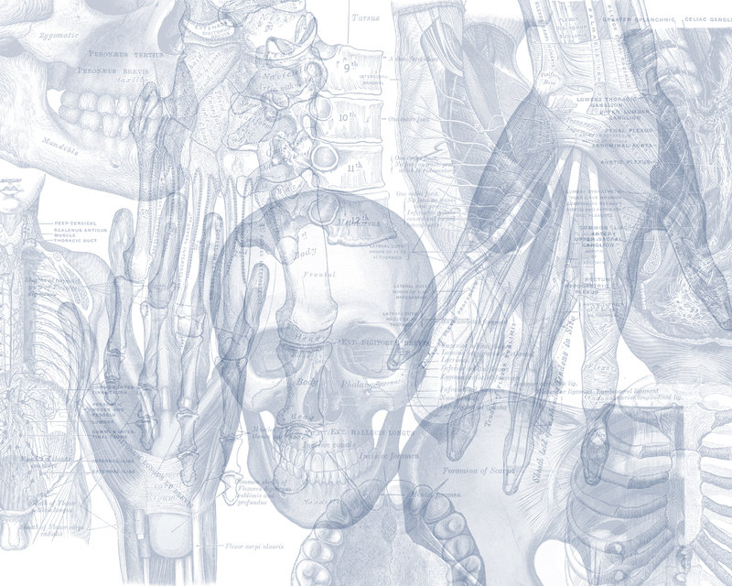


OSPE
MUSCULOSKELETAL BLOCK
Color Code
Nerves
Arteries
Veins
Muscles

Slide 2
A 23-year-oldsoldier presents with shrapnel wound in the lateral wall of his chest. Few months later, his physical therapist observed his scapula moves away from the chest.
Which nerve is likely damaged?
Long thoracic nerve or nerve to serratus anterior or nerve of bell.
What is the root value of this nerve?
-C5,C6 and C7 (root of brachial plexus)
Which muscle is probably affected?
Serratus anterior
Action: which called the boxer muscle because it rotate scapula forward, and it rotate scapula outward (when raising the arm above 90 degree)
Origin: Upper eight ribs.
Insertion: Medial border of scapula
Q1

Slide 3
A 17-years old student examined by his family physician as he has sever pain in the root of his left thumb, after a basket ball game. The physician exacerbates his pain as he applied pressure on the anatomical snuff box as shown in the next photo.
Which bones the physician suspect injury?
Styloid process of radius. (proximal)
Scaphoid.(distal)
Which artery runs in the floor of this area?
Radial artery.
There are two tendons in the snuff box:
Medial: extensor pollicis longus,
Lateral: extensor pollicis brives, abductor pollicis longus.
Q2

Slide 4
On evaluation of the hand function the physician holds 3 fingers in extended position and asked the patient to flex the proximal interphalangeal joint of the middle finger.
Which muscle is the doctor testing?
Flexor digitorum superficialis.
Which nerve is supplying this muscle?
Median nerve.( c5,6,7,8 ,T1 )
All the Flexor muscle are supplied by Median nerve , Except: Flexor carpi ulnaris and medial 1 and ½ of flexor digitorum profundus .
Q3

Slide 5
A 33-year-old male had a fracture of his left humerus at the level of the spiral groove. 2 months later he cannot extends his left wrist or the left fingers.
Which nerve is most likely injured?
Radial nerve (posterior cord)
Describe the area of cutaneous loss?
Lateral 2/3 of dorsal aspect of the hand and lateral 3 and 1/2 fingers up to the middle phalanges.
Q4

Slide 6
A physician performs a tendon reflex.
Which tendon reflex he is testing?
Biceps reflex.
What is the nerve supply of the tested muscle?
Musculocutaneous nerve.
Which cord gives this nerve?
Lateral cord. (C5, C6 and C7)
Q5

Slide 7
On evaluation of the hand function, the physician asked the patient to flex the terminal phalanx of the right index finger.
Which muscle the physician is testing?
Flexor digitorum profundus.
What is the nerve supply he is testing?
Median nerve.
FDP inserted into the base of the distal medial four fingers -> the medial one and half finger is supplied by Ulnar nerve , the rest by median nerve
Q7

Slide 8
On evaluation of the peripheral circulation of diabetic patient, the physician put his fingers as shown in the next photo.
Which artery he is trying to feel?
Dorsalis pedis artery.
(main blood supply for the toes)
Which tendons descends on both sides of the artery in this area?
Extensor hallucis longus. (medial)
Extensor digitorum longus.(lateral)
Q8

Slide 9
On evaluation of the foot function, the physician asked the patient to raise his heel from the ground as shown in the next photo.
Enumerate 2 muscles perform this action?
1-Gastrocnemus .
2-Soleus.
3-Plantaris.
4-tibialis posterior.
5-flexor digiturm longus.
What is the nerve supply of each?
Tibial nerve. (for gastrocnemus and Soleus)
Q9

Slide 10
Identify each of the following muscles and its nerve supply:
1- latissimus dorsi.
Its nerve: Thoracodorsal nerve or nerve to latissimus dorsi.
2- Subscapularis.
Its nerve: upper and lower subscapular nerves.
3- teres major.
Its nerve: lower subscapular.
Station “1”
2
3
1

Slide 11
Identify each of the following muscles and its nerve supply:
1- Deltoid.
Its nerve: Axillary. (it also supplies teres minor)
2- Pectoralis major.
Its nerve: Lateral and medial pectoral nerves.
Station “2”
1
2

Slide 12
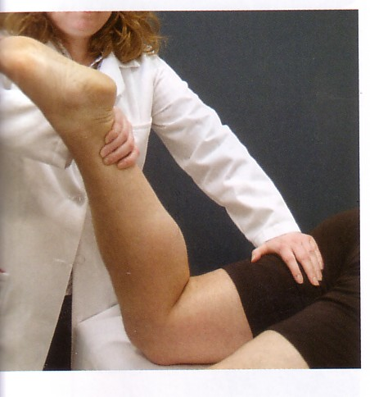
On evaluation of the knee function, the physician asked the patient to flex the knee against resistance as shown in the next photo.
Which group of muscles produces this function?
Hamstring muscles.
What is the nerve supply of this group?
Sciatic nerve.

Slide 13
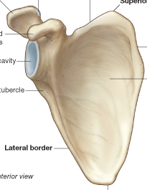
Station “3”
Identify the muscle attached to the marked area “1”
Subscapularis
What is its nerve supply?
Upper and lower subscapular nerves.
Where it is inserted?
Lesser tuberosity of humerus.
What is its function?
Medial rotation
1

Slide 14
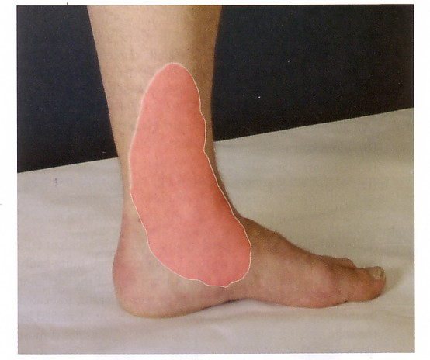
A 67 –year- old man recently underwent a coronary bypass operation. After he recovered he experienced burning sensation in the marked area in the next photo.
Which nerve supply this area?
Saphenous nerve.
From which nerve this nerve originates?
Femoral nerve.
Which vein is used in the bypass Operation ?
Great saphenous vein.

Slide 15
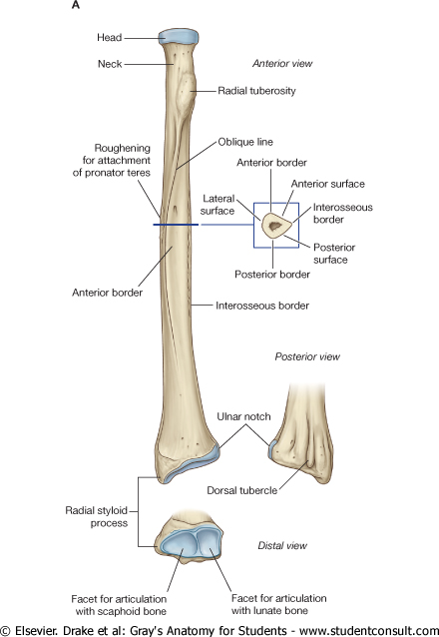
Station “4”
1
Identify the muscles attached to the marked area and what is its nerve supply:
1- Biceps brachii.
Its nerve: Musculocutaneous nerve.
2- Pronator quadratus.
Its nerve: anterior interosseous nerve from Median nerve.
2

Slide 16
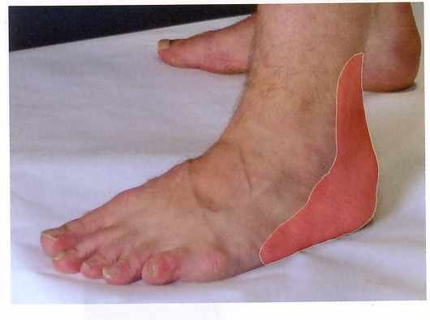
A 75-year- old man recently has coronary bypass. After recovery he noticed numbness and paraesthesia in the marked area in the given photo.
Which vein is used in the bypass operation?
Small saphenous vein.
Which nerve supply the skin in the marked area?
Sural nerve.

Slide 17
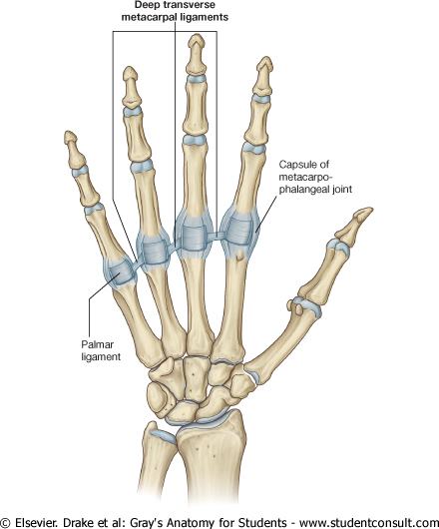
Station “5”
Identify the muscles attached to the marked areas ”1 & 2”, And its nerve supply.
1
2
1- Flexor digitorum profundus.
Its nerve: Medial 2 fingers Ulnar nerve.
Lateral 2 fingers median nerve.
2- Flexor digitorum superficialis.
Its nerve: Median nerve.

Slide 18
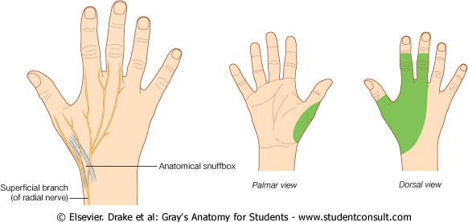
Station “6”
Q1- What is the nerve supply of the green area?
Radial nerve.
Root value: (c5,6,7,8,T1)

Slide 19
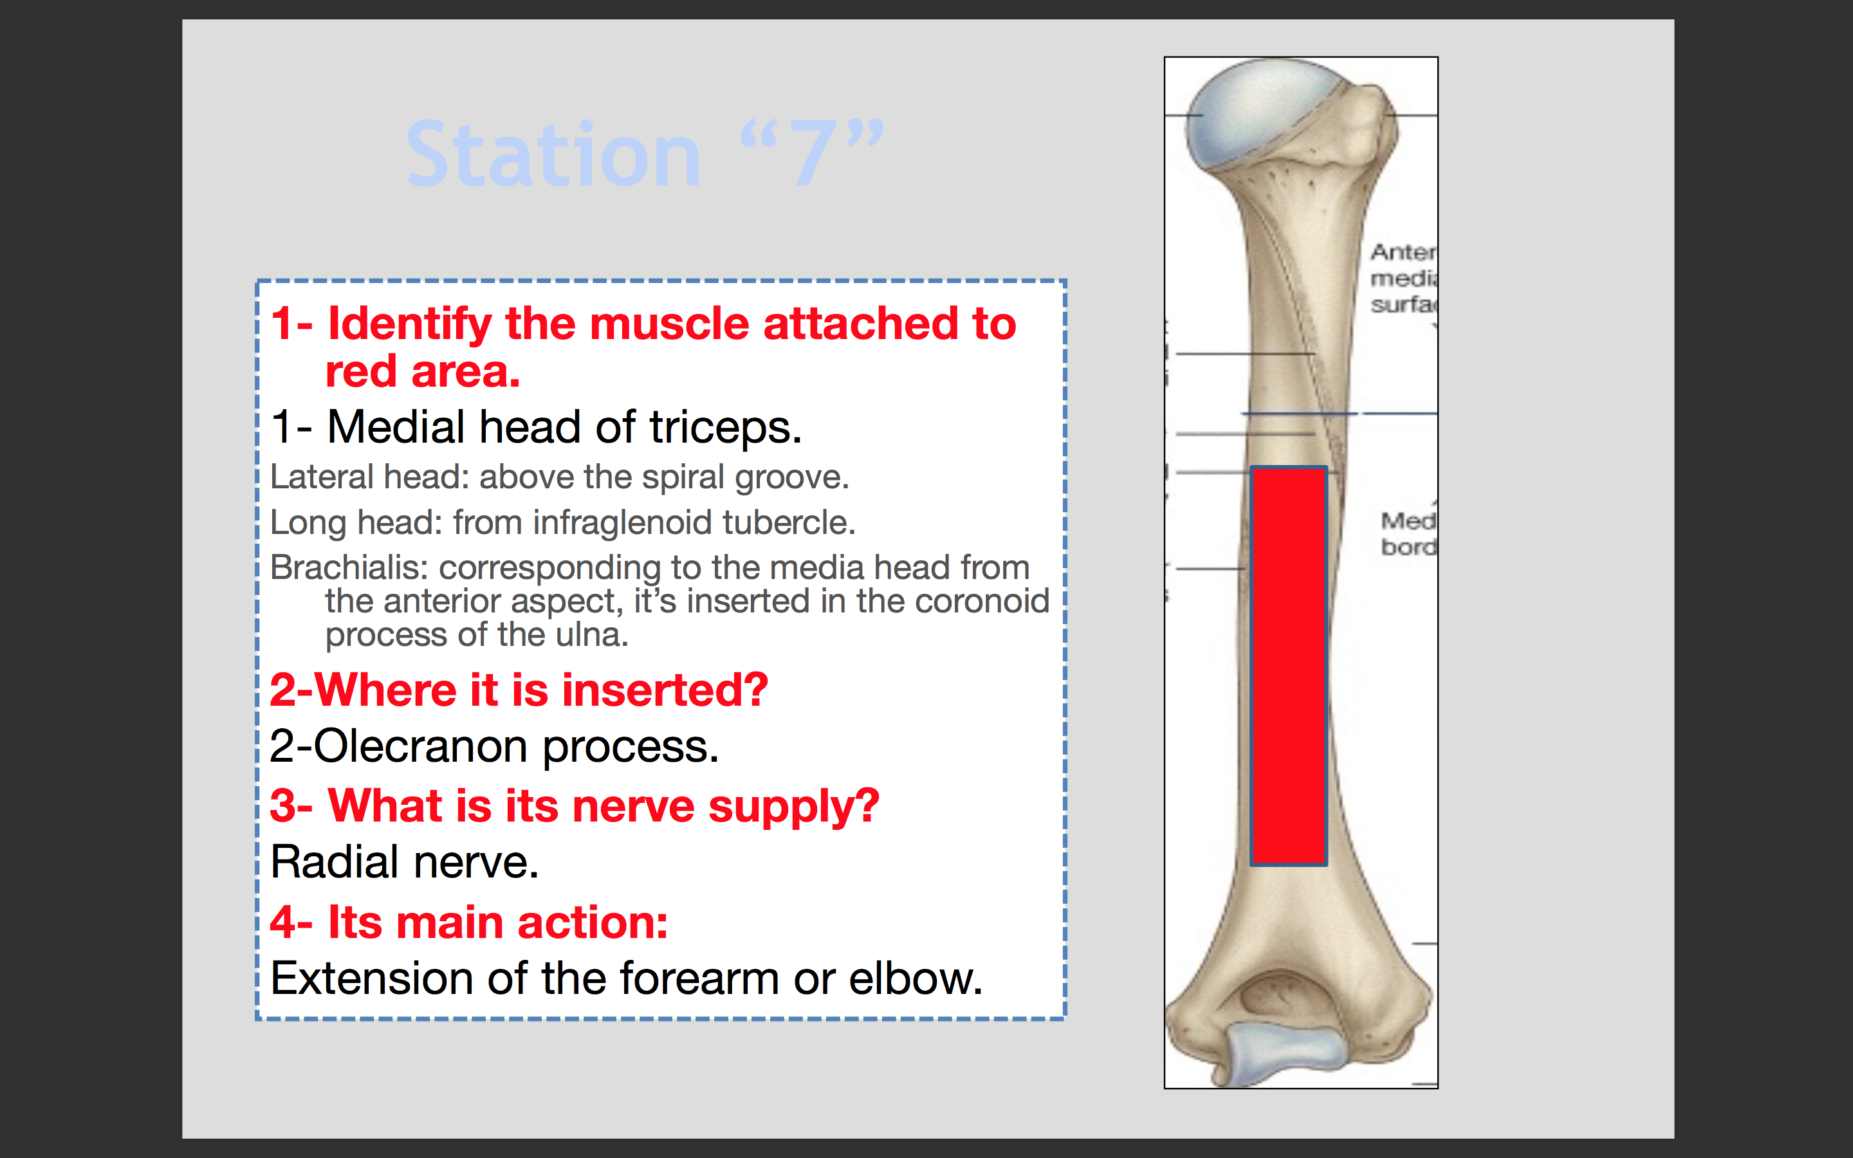
Station “7”
Q1- Identify the muscle attached to red area.
Medial head of triceps.
Lateral head: above the spiral groove.
Long head: from infraglenoid tubercle.
Brachialis: corresponding to the media head from the anterior aspect, it’s inserted in the coronoid process of the ulna.
Q2-Where it is inserted?
Olecranon process.
Q3- What is its nerve supply?
Radial nerve.
Q4- Its main action:
Extension of the forearm or elbow.

Slide 20
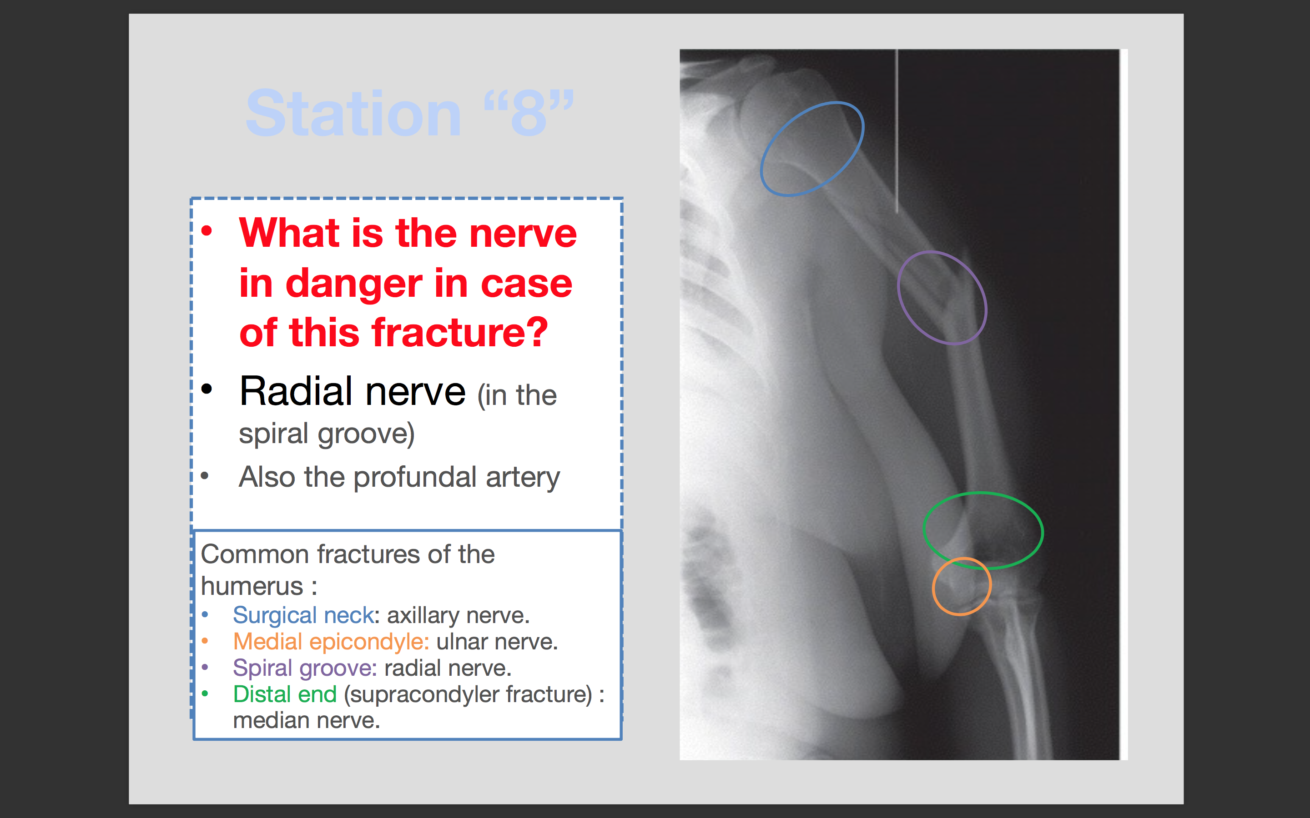
Station “8”
Q1- What is the nerve in danger in case of this fracture?
Radial nerve (in the spiral groove)
Also the profundal artery
Common fractures of the humerus :
Surgical neck: axillary nerve.
Medial epicondyle: ulnar nerve.
Spiral groove: radial nerve.
Distal end (supracondyler fracture) : median nerve.

Slide 21
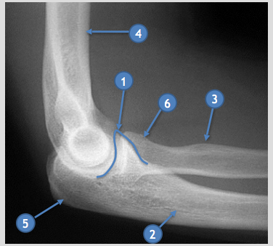
Lateral elbow joint x-ray
Identify:
1- Coronoid process.
2- Ulna.
3- Radial (bicipital) tuberosity.
4- Humerus.
5- Olecranon
6- Radial head.

Slide 22
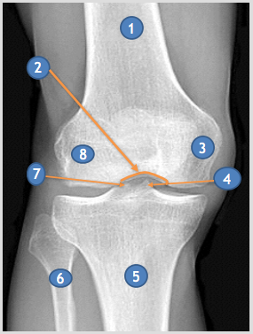
Frontal knee x-ray
Identify:
1- Femur.
2- Interchondylar notch.
3- Medial condyle
4- Medial tibial spine ( medial tibial eminence)
5- Tibia
6- Fibula
7- Lateral tibial spine ( lateral tibial eminence )
8- Lateral condyle.

Slide 23
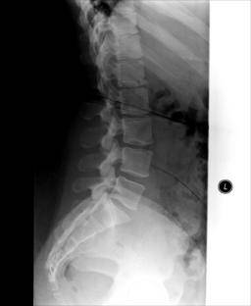
Identify:
1- Vertebral body L3
2- Intervertebral disk
3- Spinous process
4- Neural foramen
5- Sacrum
3
1
4
2
5

Slide 24
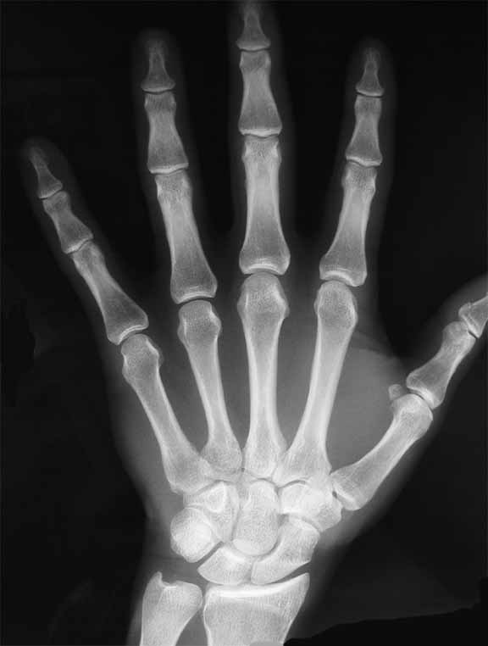
1
4
2
Identify:
1- Distal phalanx
2- Middle phalanx
3- Proximal phalanx
4- Distal interphalanx joint
5- Proximal interphalanx joint
6- Metacarpophalangeal joint
3
5
6

Slide 25
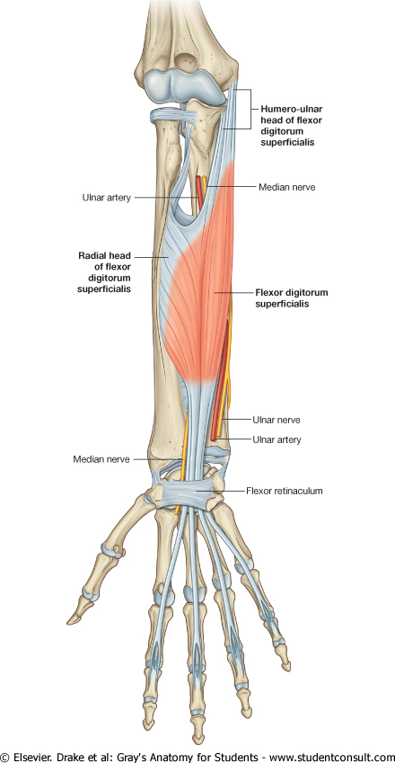
Station “9”
Q1- Identify the structure “A”
Flexor retinaculum .
Q2-Enumerate 2 nerves passing superficial & 2 tendon deep to it.
Superficial:
1- Ulnar nerve.(also the ulnar artery)
2- Palmar cutaneous branch of ulnar and median nerves.
(also the tendon of palmaris longus)
Deep:
1- Flexor digitorum superficialis and profundus.
2- Flexor pollicis longus.
(also median nerve)
A
Flexor carpi ulnaris : is not superficial to flexor retinaculum.

Slide 26
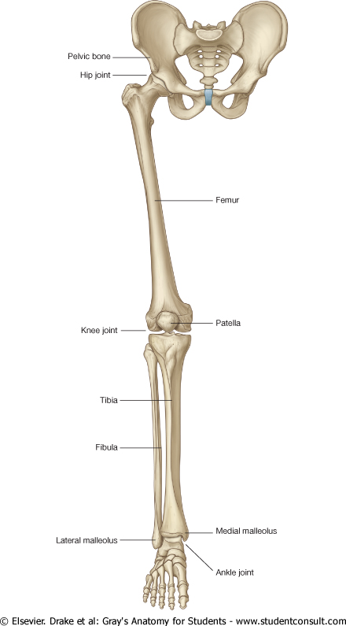
Station “10”
Q1- Identify the marked areas.
Q2- Identify one structure attached to each area.
1- Shaft of femur:
Muscle attached: vastus intermedius
Nerve supply: femoral nerve
2- Greater trochanter :
Muscles attached:
Anterior surface: gluteus minimus.
Lateral surface: gluteus medius.
Both supplied by: superior gluteal nerve.
Medial surface: Obturator internus.
Supplied by: nerve to obturator internus.
3-upper part of medial surface of Tibia: (SGS )
Surtorries: femoral nerve
Gracillis: obturator nerve
Semitendinosus: tibial portion of sciatic nerve.
2
1
3

Slide 27
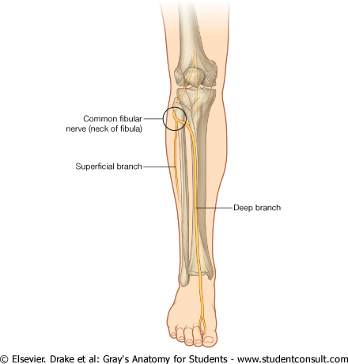
Station “11”
Q1-Identify these nerves:
1- Common peroneal nerve.
2- Musculocutaenous, or superficial peroneal. (lateral)
3- Deep peroneal or anterior tibial. (medial)
Q2-What is the nerve supply to the lateral side of the foot:
Sural nerve.
1
2
3

Slide 28
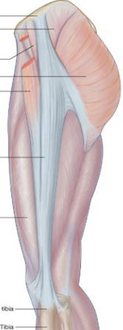
Station “12”
Q1- Identify these structures:
1- Glutes maximus.
2- Tensor fascia lata.
3- Iliotibial tract.
Q2- What is the nerve supply for 1 &2.
1. Inferior gluteal nerve.
2. Superior gluteal nerve.
1
2
3

Slide 29
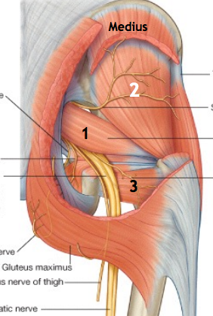
Station “13”
Identify the marked muscles and the nerve supply of each:
1- Piriformis muscle.
Nerve: S1 &2.
2- Gluteus minims.
Nerve: superior Gluteal nerve.
3- Quadratus femoris.
Nerve: Nerve to quadratus femoris.

Slide 30
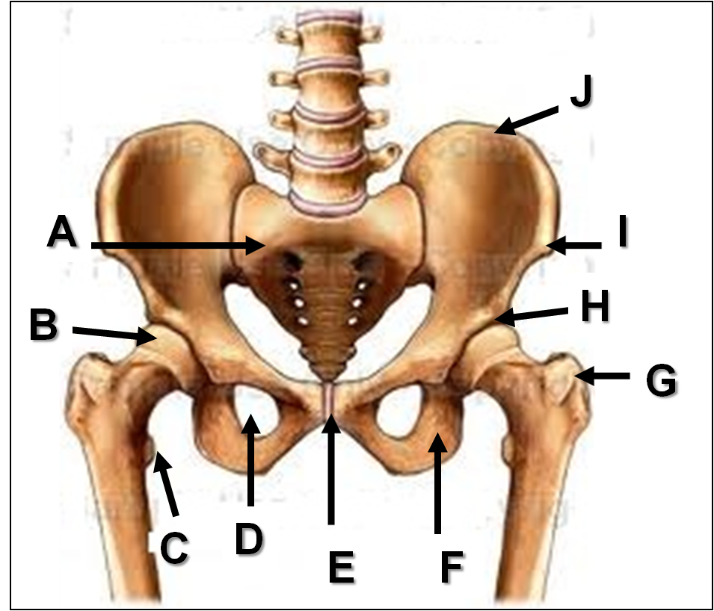
Identify:
A: Sacrum
B: Head of femur
C: Lesser trochanter
D: Obturator foramen
E: Pubic symphysis
F: Ischial tuberosity
G: Greater trochanter
H: Acetabulum
I: Anterior superior iliac spine
J: Iliac crest

Slide 31
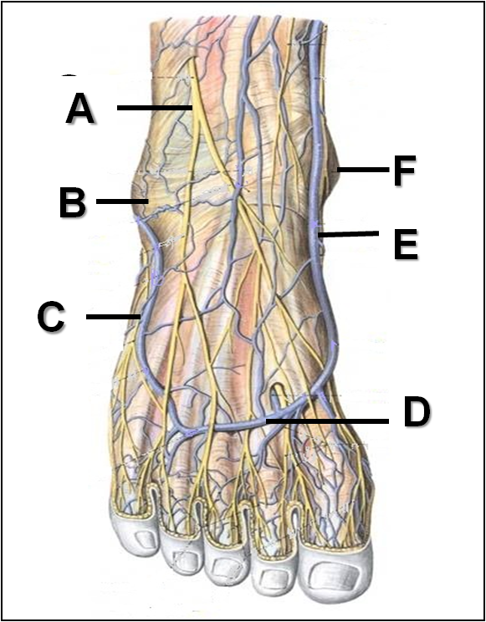
Identify:
A: Superficial peroneal nerve
B: Lateral malleolus
C: Lesser saphenous vein
D: Dorsal venous arch
E: Great saphenous vein
F: Medial malleolus

Slide 32
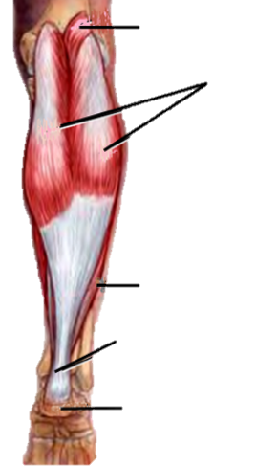
A
B
Identify:
A: Plantaris
B: Gastrocnemius
C: Soleus
D: Achilles tendon
E: Calcaneum
C
D
E

Slide 33
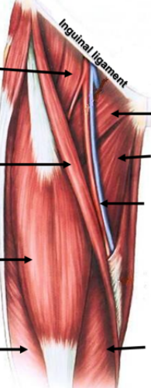
B
Identify:
A: Pectineus
B: Psoas major
C: Sartorius
D: Rectus femoris
E: Vastus lateralis
F: Vastus Medialis
G: Femoral vessels
H: Adductor longus
A
C
H
G
D
E
F

Slide 34
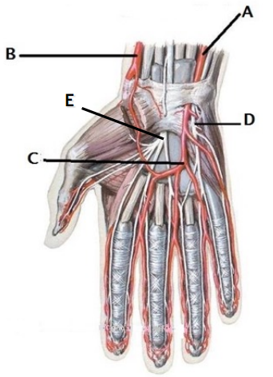
Identify:
A: Ulnar artery
B: Radial artery
C: Superficial palmer arch
D: Ulnar nerve
E: Median nerve

Slide 35
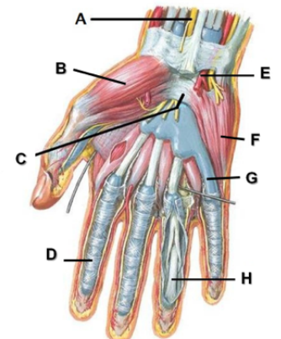
Identify:
A: Median nerve
B: Thenar muscles
C: Flexor retinaculum
D: Fibrous flexor sheath
E: Ulnar artery
F: Hypothenar eminence
G: Flexor synovial sheath
H: Tendon of flexor digitorum profundus

Slide 36
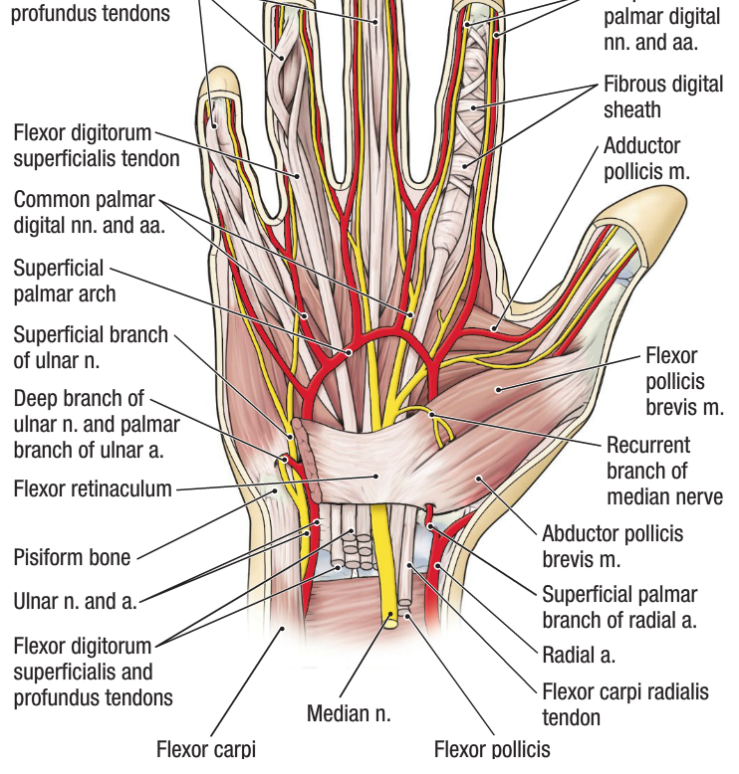
The structure of superficial Flexor retinaculum from Medial to Lateral:
1- Tendon of Flexor carpi ulnaris.
2- Ulnar nerve.
3- Ulnar artery.
4- Palmar cutaneous branch of ulnar nerve.
5- Palmaris longus tendon.
6- Palmar cutaneous branch of median nerve.

Slide 37
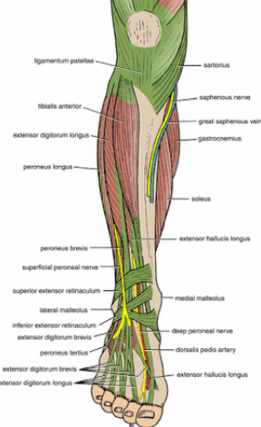
Structure of Extensor retinaculum From medial to lateral:
1. Tibialis posterior
2. Extensor hallucis longus
3. Dorsalis pedis artery (vessels)
4. Deep peroneal nerve
5. Extensor digitorum longus
6. Peroneos tertius
To memorize: Tom Has a Very Nice Dog and Pigeon

Slide 38


Leaders:
Mohammed Ghandour
Jawaher Abanumy
Members:
Mohammed Alyousef
Khalid Aleedan
Shatha Alghaihb
Rana Barasain
Jumana Alghtani
anatomyteam436@gmail.com
@anatomy436
Special Thanks to TEAM 435

