Slide 1
Histology Practical
Musculoskeletal Block

Slide 2
Things you need to know before the exam :
The pictures in the exam will be the same as the ones included in the slides.
Don’t try to take short cuts during the exam so avoid using abbreviations so you don’t lose marks.
Please keep in mind that this work is done by students , so if there are any mistakes please inform us .
This work is not by any means a reference.
Please study hard and don’t worry the exam will be easy!!

Slide 3
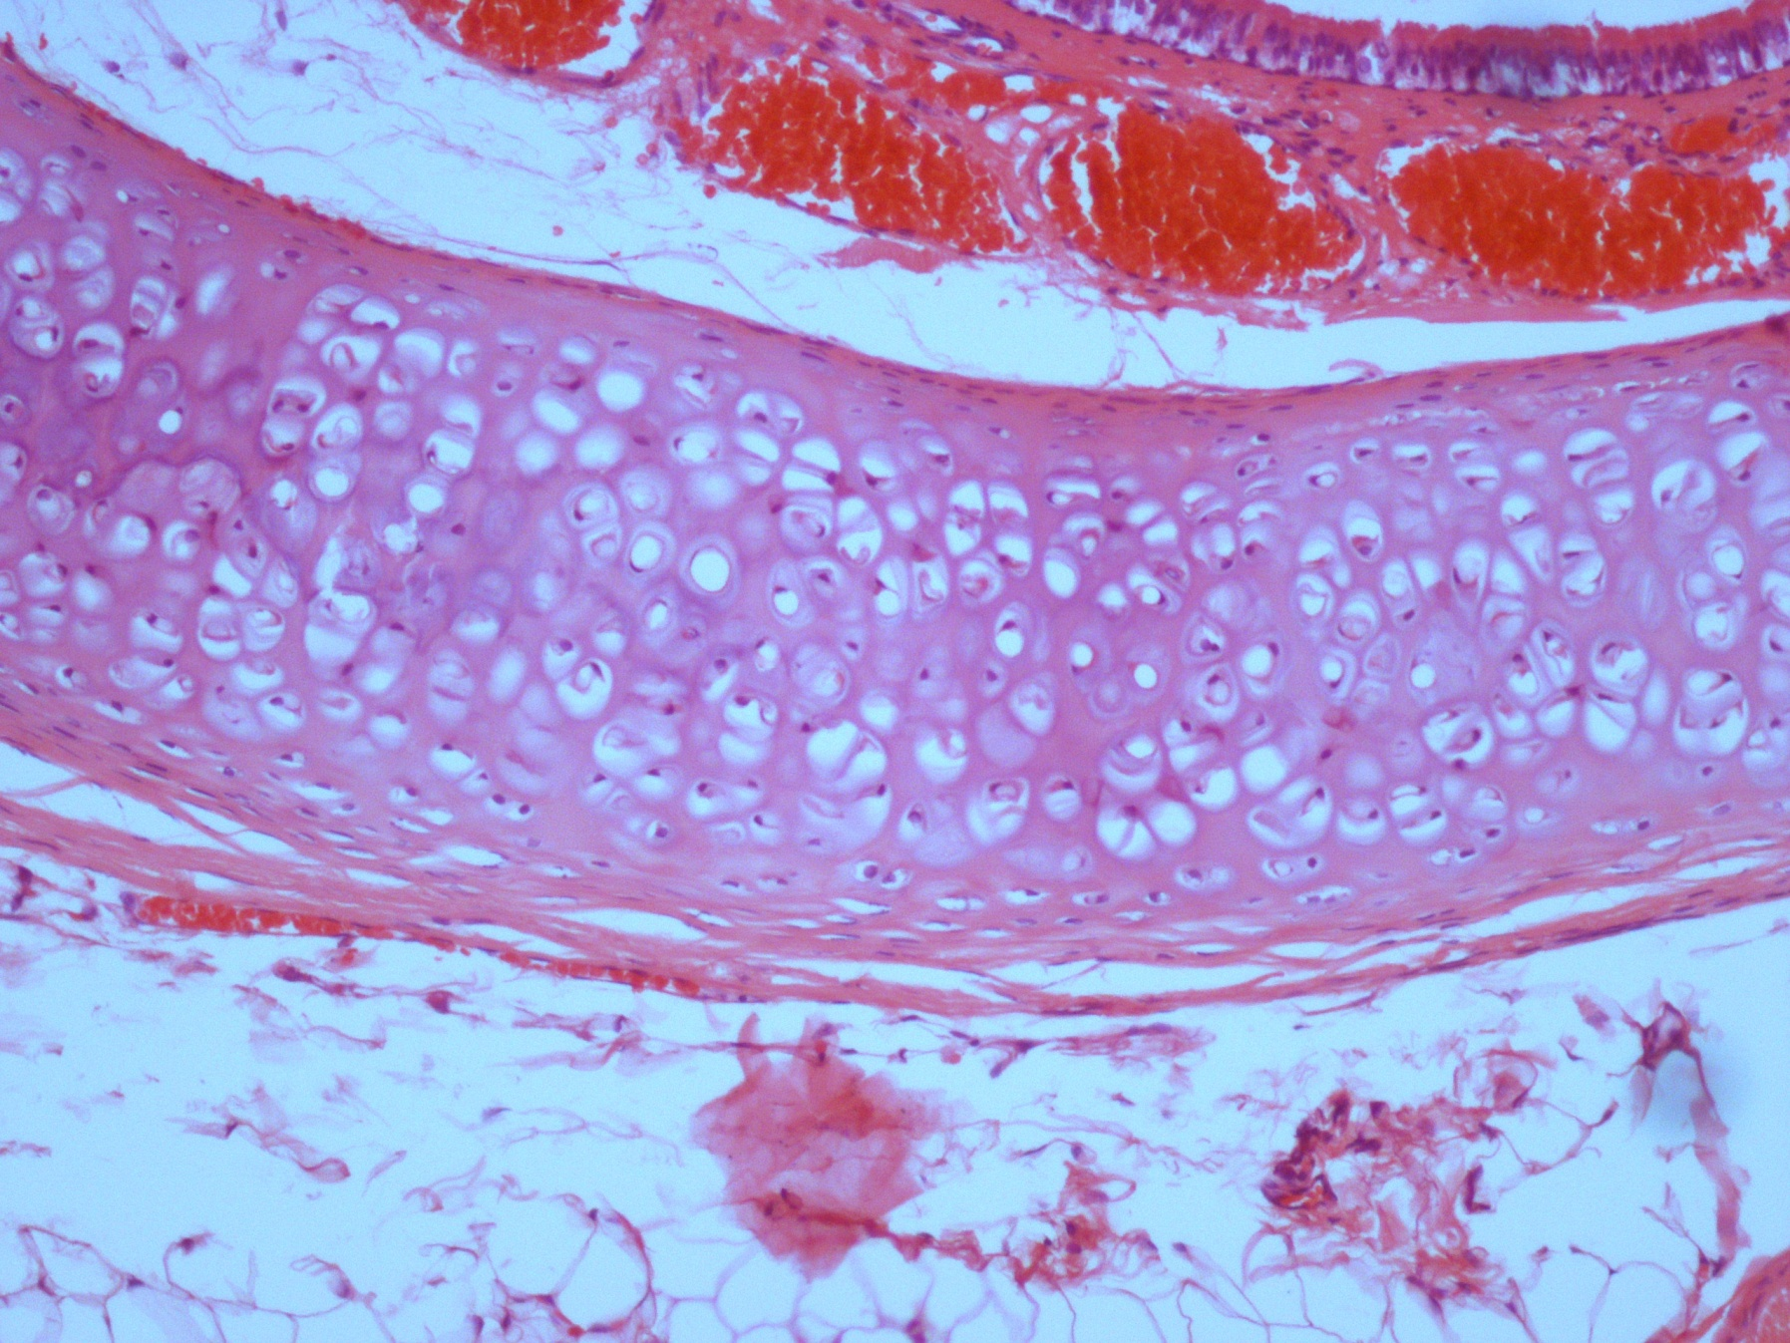
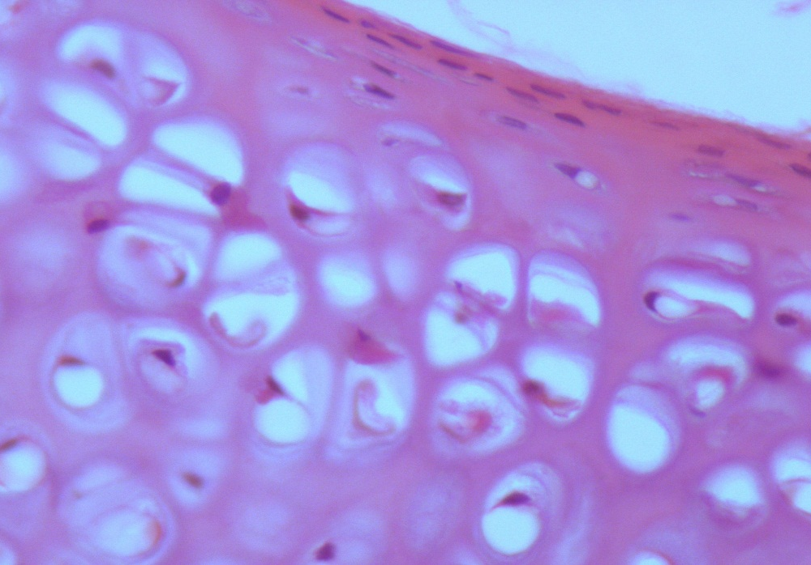
Hyaline Cartilage
Features :
Perichondrium.
chondrocytes (found in lacunae ) .
chondroblasts
Matrix :
Homogeneous and Basophilic .
collage fibers type II.
Sites :
Articular surfaces of bones.
Foetal (fetal) skeleton.
Costal cartilage.
Nose , Trachea & Bronchi.
chondroblasts
Perichondrium
( the outer fiber layer )
Chondrocytes

Slide 4
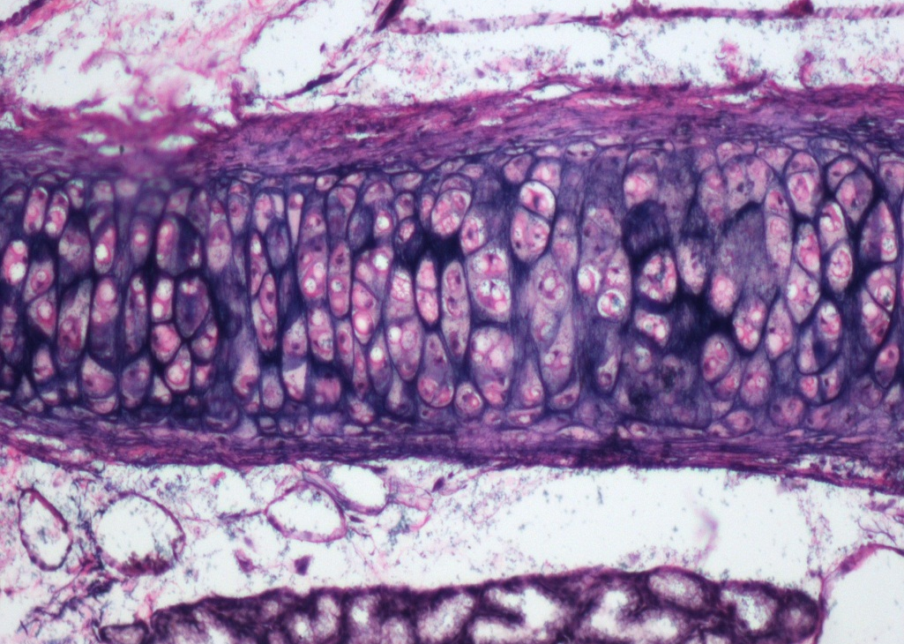
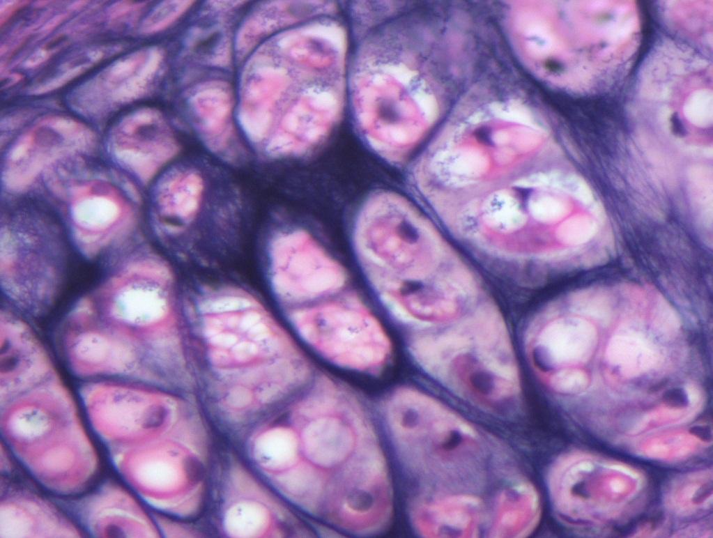
Elastic Cartilage
Features :
Perichondrium
Chondrocytes
Matrix :
Contains elastic fibers
Sites :
External ear
Epiglottis
Perichondrium
( the outer fiber layer )
Elastic fibers
Chondrocytes

Slide 5
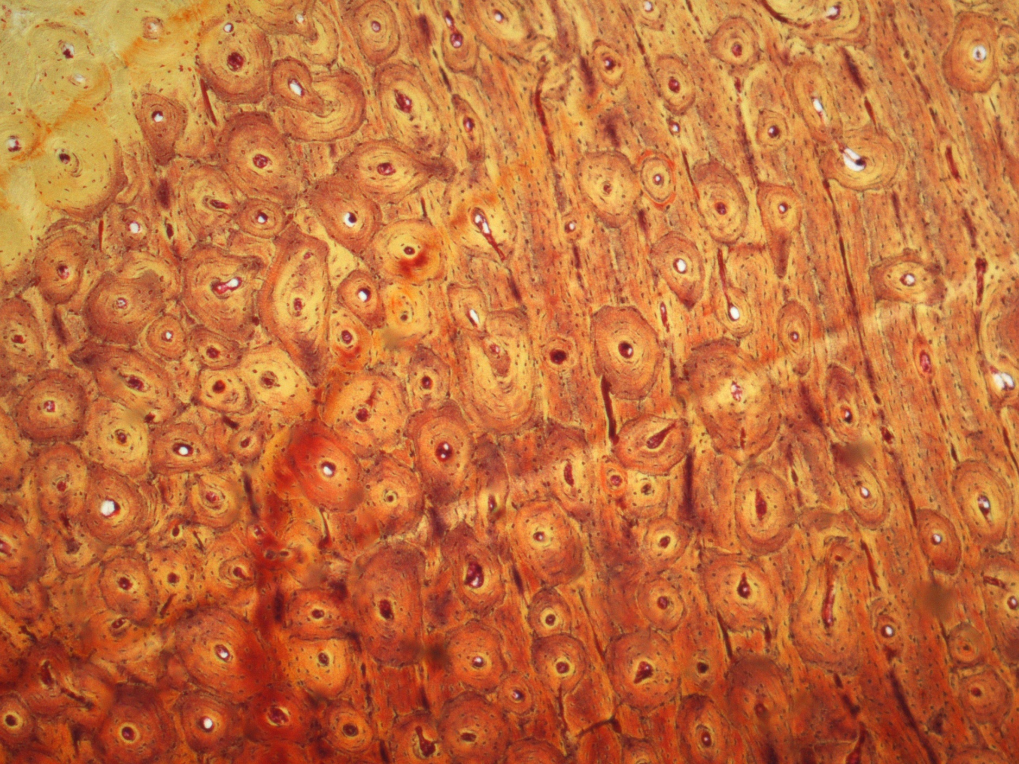
Compact bone (cortical)
Features:
Bone Lamellae.
Haversian systems.
Osteocyte inside lacunae that have canaliculi.
Site:
Diaphysis of long bones.
Volkmann’s canal
Haversian system

Slide 6
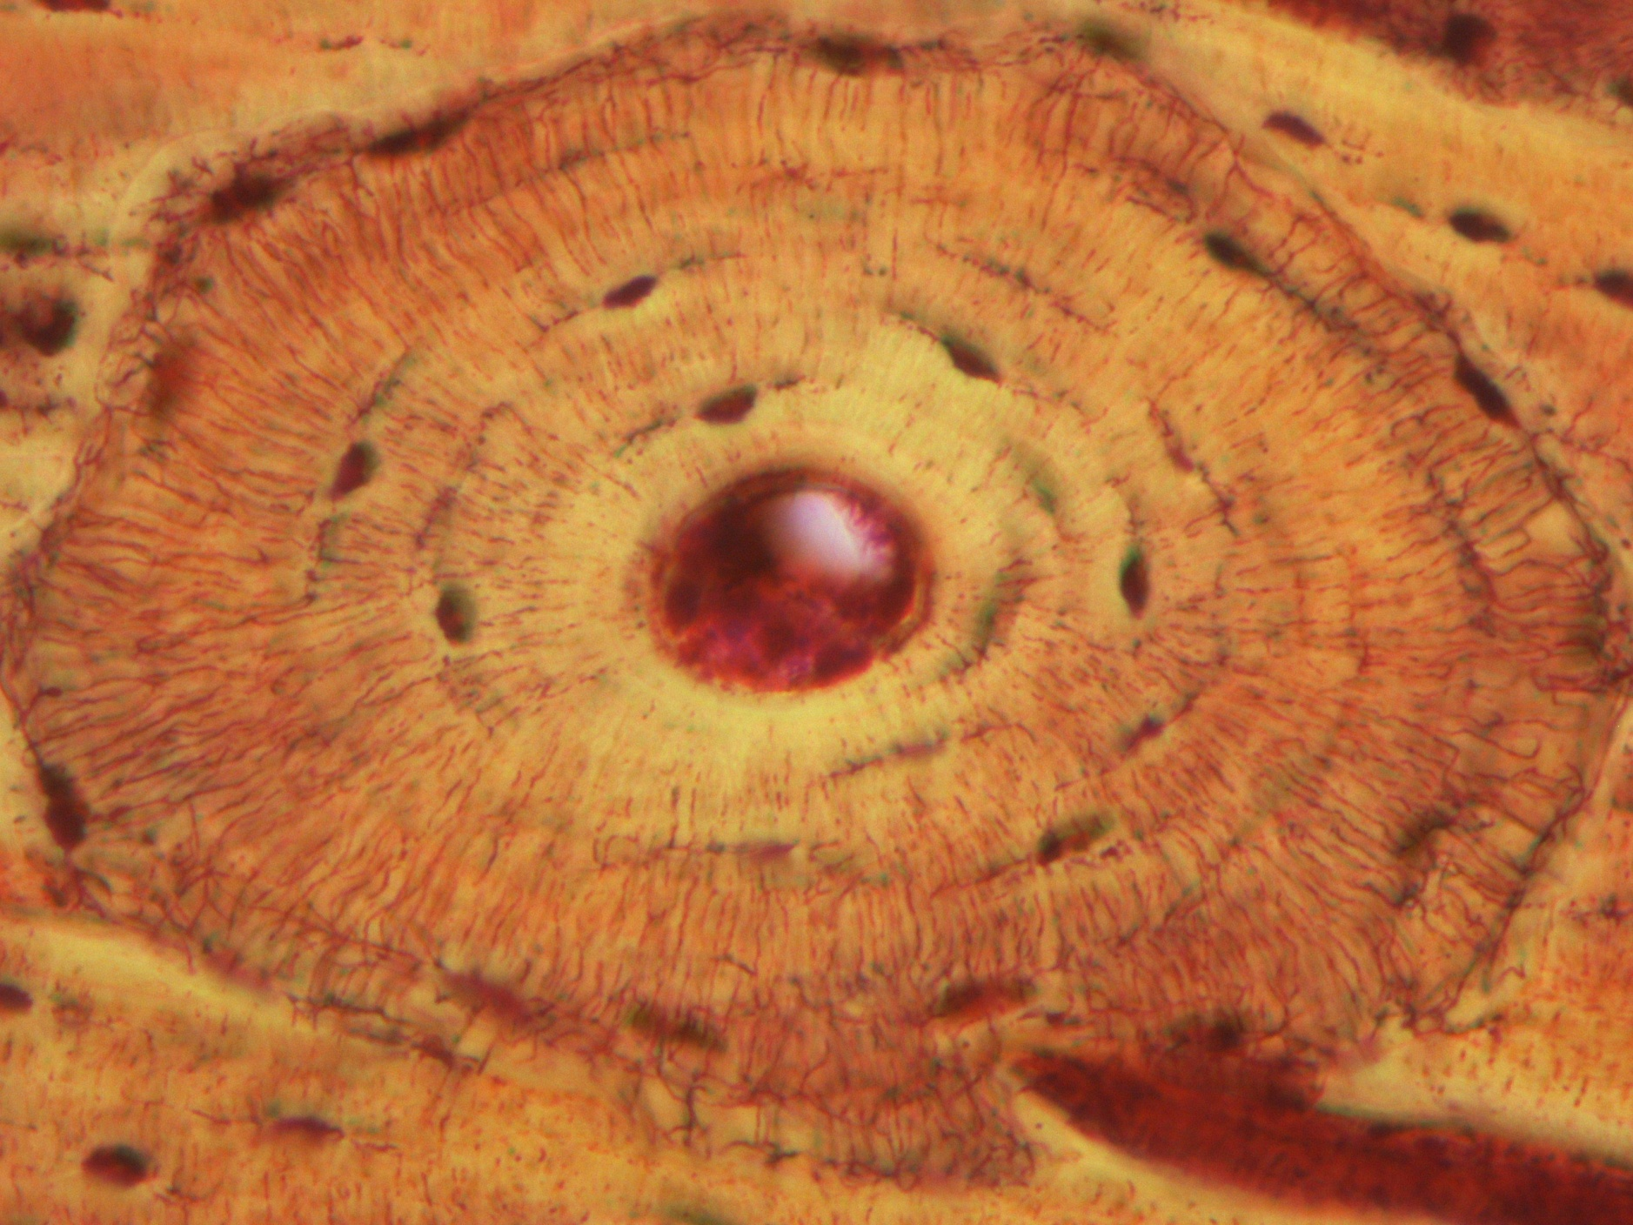
Haversian Systems (Osteons)
Features:
Concentric bone lamellae.
Haversian canal.
Osteocyte inside lacunae.
Canaliculi (fine lines)
Site:
Inside the compact bone in diyaphysis of long bone.

Slide 7
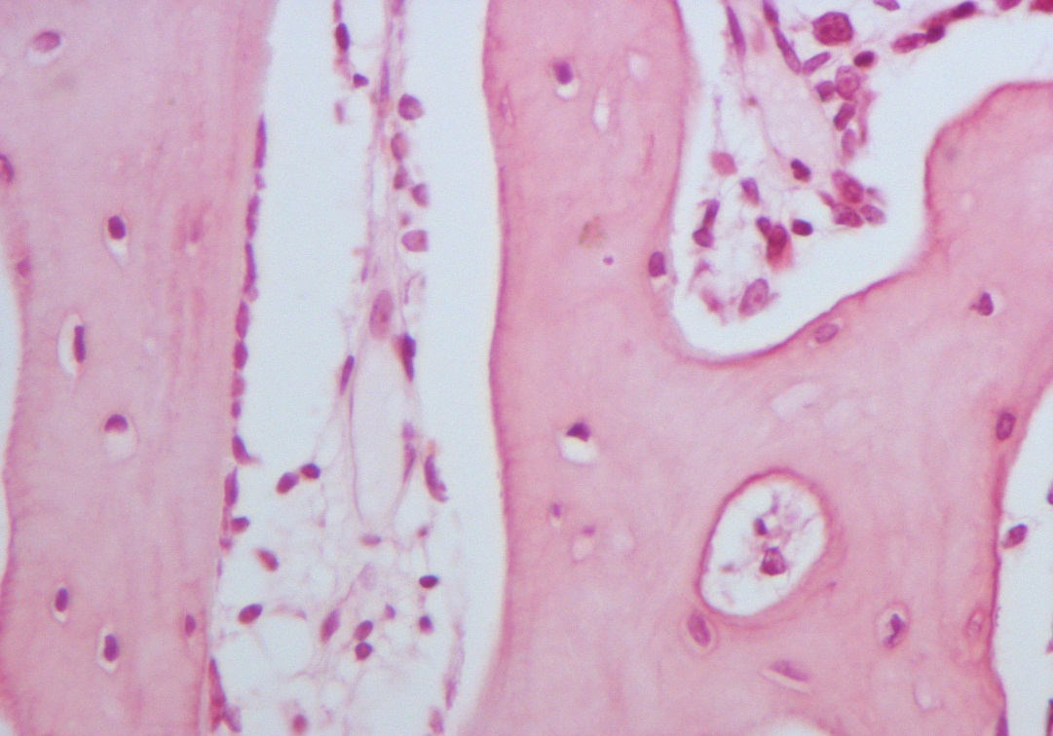
Spongy (Cancellous) Bone
Osteoclasts
Features :
Irregular bone trabeculae ( matrix ).
Irregular bone marrow spaces contains bone marrow .
NO Haversian systems .
Osteoclasts ( multinucleated )
Sites:
Flat bones.
Epiphysis of long bone.

Slide 8
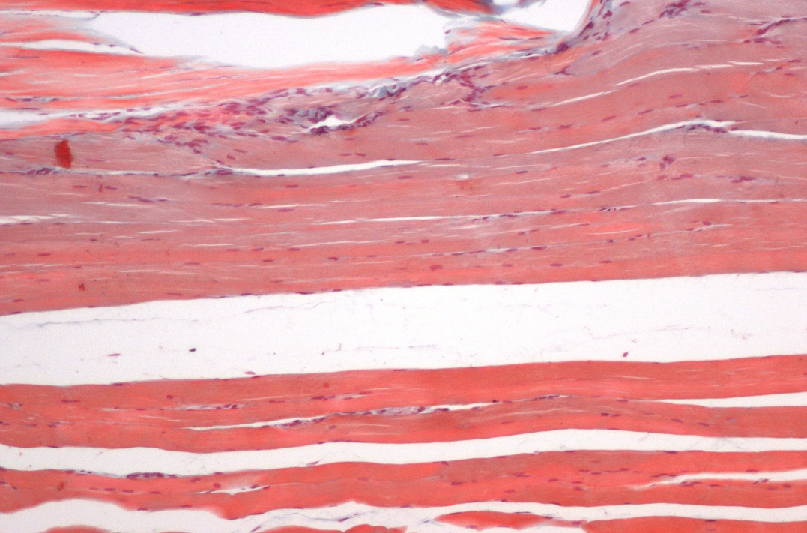
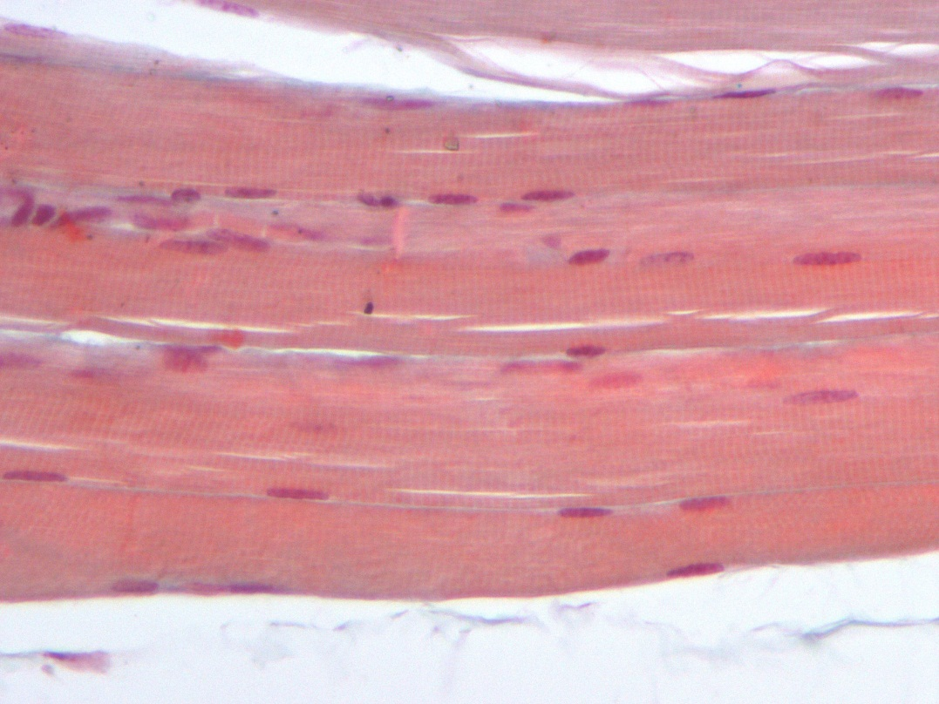
Skeletal muscle ( L.S.)*Longitudinal section
Features :
Multinucleated, nuclei on periphery.
Cylindrical in shape.
Non-branched .
Cytoplasm (sarcoplasm) is acidophilic and
shows clear transverse striations.
Sites :
Skeletal system ( all voluntary muscles ).

Slide 9
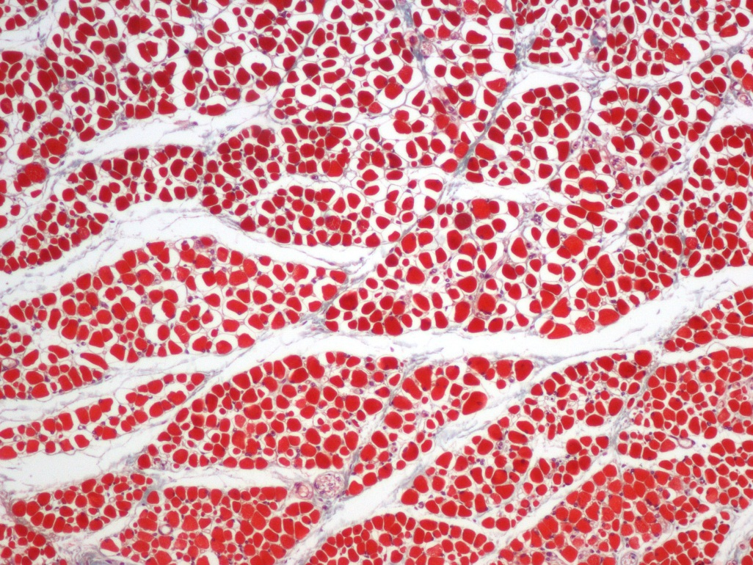
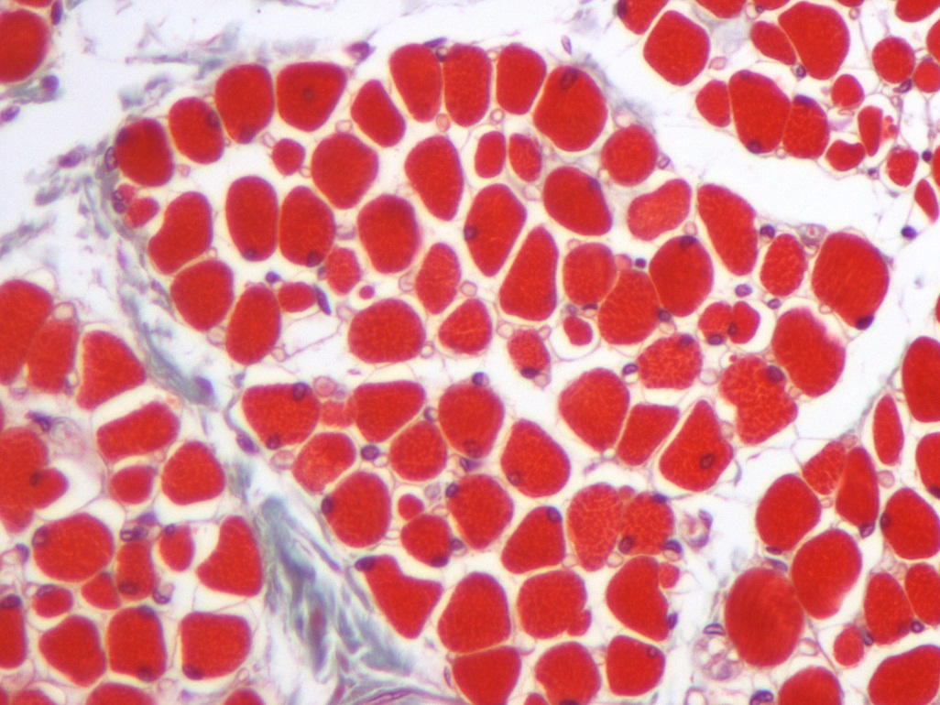
Skeletal muscle (T.S.) Transverse section
Features:
Endomysium: Loose C.T. separates the individual fibres.
Perimysium: Separates the parallel bundles of muscle fibres.
Epimysium: Thick CT covering the whole muscle.
Perimysium
T.S of muscle fibre
Nucleus of muscle
Endomysium

Slide 10
EXTRA slide for understanding the skeletal muscle connective tissues

Slide 11
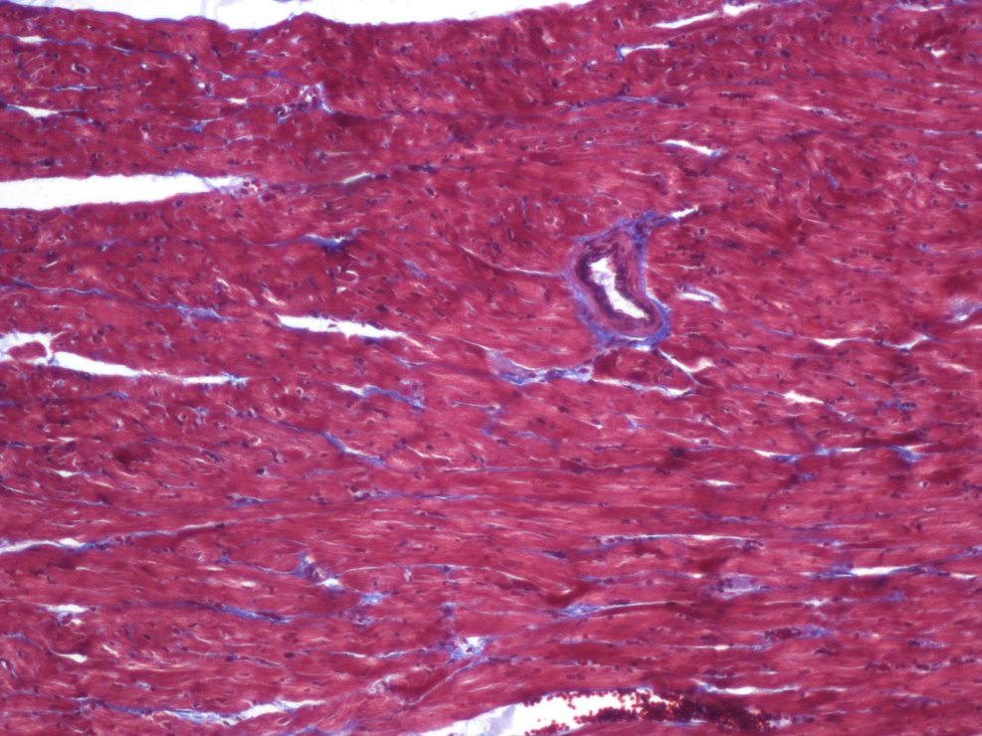
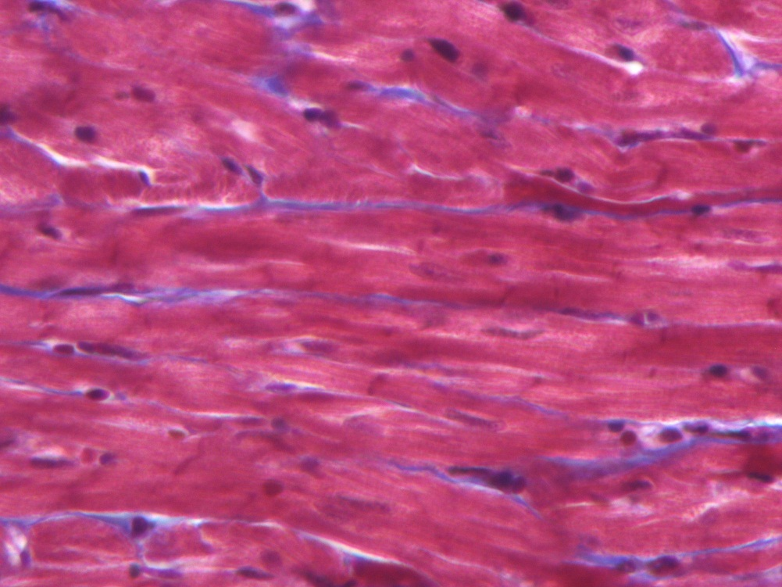
Cardiac muscle
Features:
Mononucleated.
Oval and central nuclei.
Branched and anastomose.
Striated (not clear)
Cylindrical in shape.
Intermediate in diameter (in comparison to other muscles)
Gap junctions are present .
Intercalated discs.
Site:
Myocardium.
Intercalated discs.

Slide 12
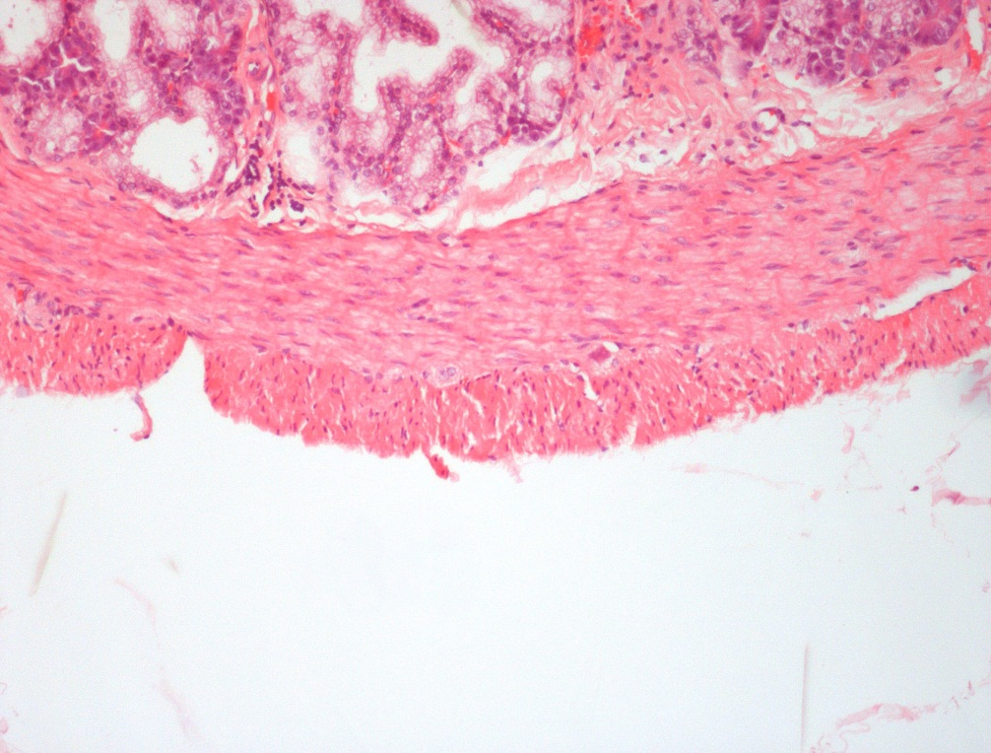
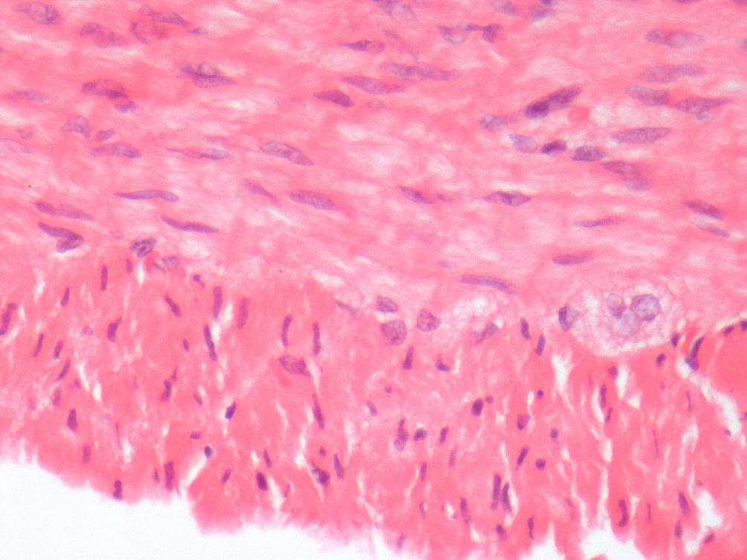
Smooth muscle ( T.S & L.S )
Features:
Mononucleated; oval and central nuclei.
Non striated.
Non branched.
Fusiform (spindle shaped).
Small in diameter .
Gap junctions are present.
Site :
Walls of blood vessels.
Viscera.

Slide 13
Best of luck -histology team

Slide 14
THANK YOU !
Done by:
Team Leaders :
Team Leaders
Reema AlOtaibi
Faisal AlRabaii
Contact us on HistologyTeam436@gmail.com

