Slide 1
Bones of the Lower Limb
Color Code
Important
Doctors Notes
Notes/Extra explanation
Editing File

Slide 2
Objectives
Classify the bones of the three regions of the lower limb (thigh, leg and foot).
Memorize the main features of the
– Bones of the thigh (femur & patella)
– Bones of the leg (tibia & Fibula)
– Bones of the foot (tarsals, metatarsals and phalanges)
Recognize the side of the bone.
لا تنصدمون من عدد الشرائح نصها شرح زائد وملخصات واسئلة
Some pictures in the original slides have been replaced with other pictures which are more clear BUT they have the same information and labels.

Slide 3
Terminology (Team 434)
Eminence | a small projection or bump/ شيء مرتفع

Slide 4
Terminology (Team 434)

Slide 5
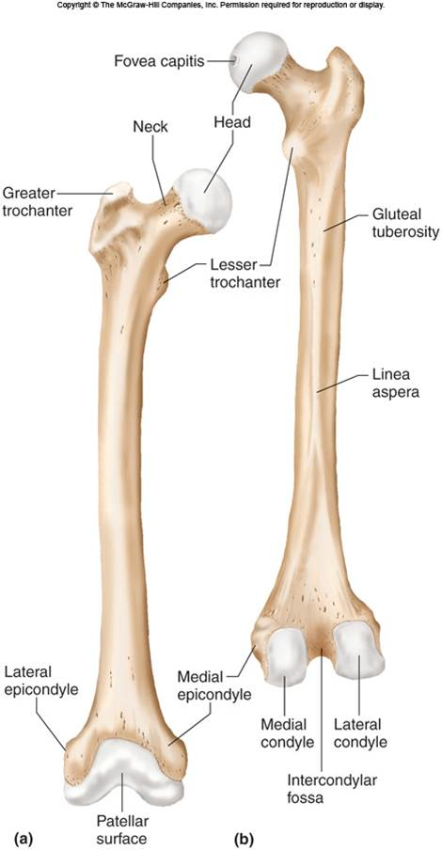
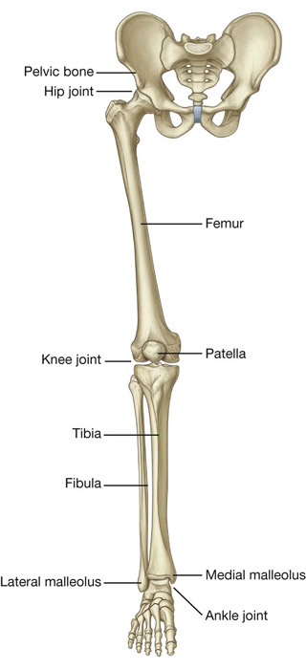
Bones of thigh (Femur and Patella)
Femur
Articulates (joins):
(1) above with Acetabulum of hip bone to form the hip joint,
(2) below with tibia and patella to form the knee joint.
Femur consists of:
Upper end.
Shaft.
Lower end.
Body of femur
(shaft)
Note:
All long bones consist of three things:
1- upper/proximal end
2- shaft
3- lower/distal end
posterior
anterior

Slide 6
Upper End of Femur
The upper end contains:
Head
Neck
Greater trochanter &
Lesser trochanter
Head:
Articulates (joins) with acetabulum of hip bone to form the hip joint.
Has a depression in the center called Fovea Capitis.
The fovea capitis is for the attachment of ligament of the head of Femur.
An artery called Obturator Artery passes along this ligament to supply head of Femur.
B. Neck:
Connects head to the shaft.
Extra picture for understanding

Slide 7
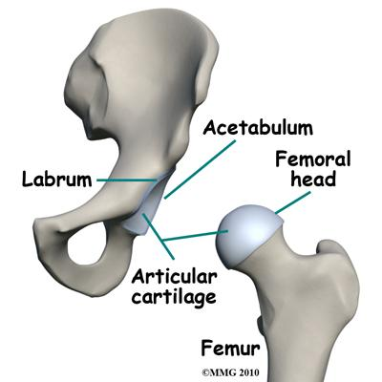
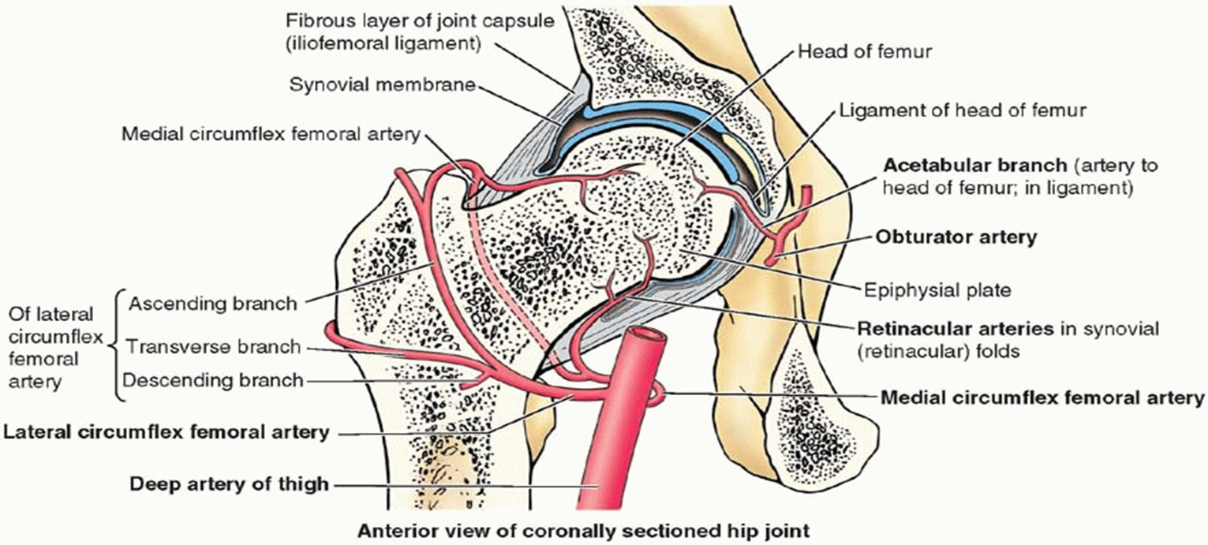
Extra pictures for understanding
المهم هنا فقط الأجزاء المحاطة بالأحمر

Slide 8
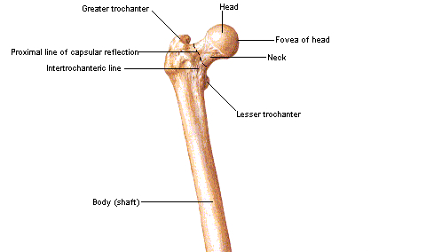
Upper End of Femur
C. Greater trochanter & D. Lesser trochanter
Anteriorly
the 2 trochanters are connected by the inter-trochanteric line, where the iliofemoral ligament is attached.
The iliofemoral ligament (ilium + Femur)
Posteriorly
the inter-trochanteric crest on which is the quadrate tubercle (Quadratus Femoris Muscle).

Slide 9
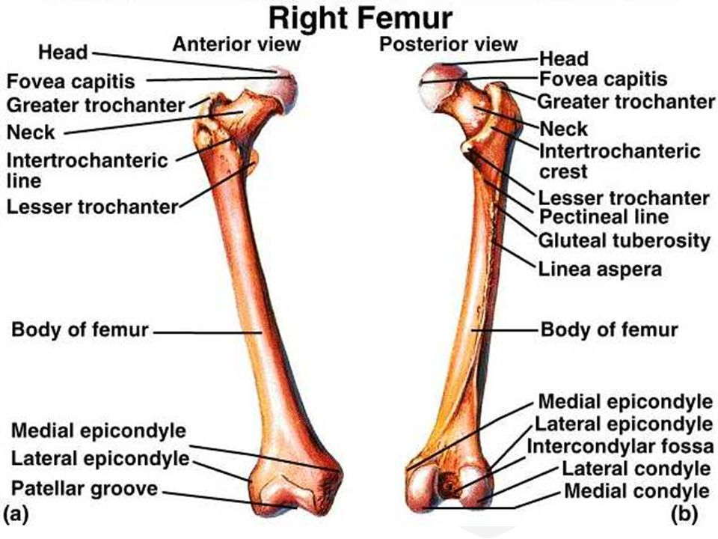
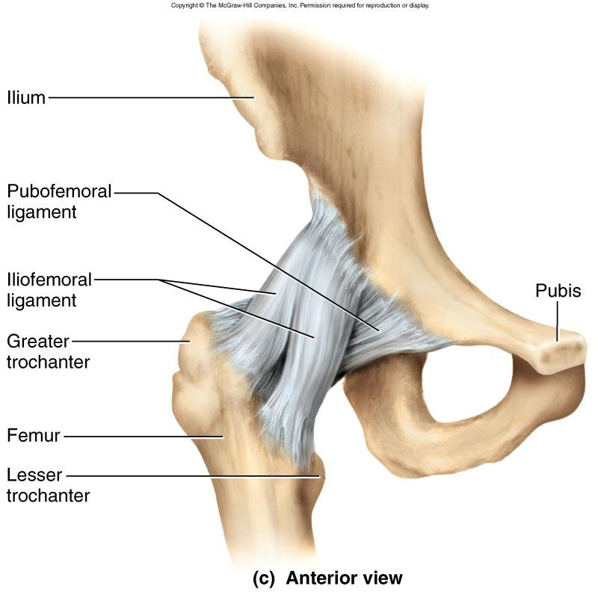
Extra pictures for understanding
This picture is on the doctor’s slides

Slide 10
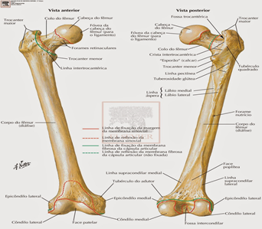
Shaft of femur
It has 3 surfaces
Anterior
Medial
Lateral
It has 3 borders:
Two rounded:
medial
lateral
One thick posterior border or ridge called linea aspera
Explanation:
border
(الحدود)
Surface
(السطح)
Between 2 borders is a surface.
Anteriorly
Posteriorly

Slide 11
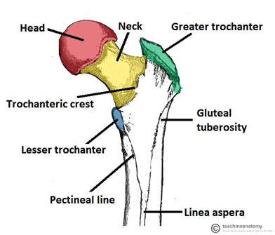
Shaft of femur
Anteriorly :
is smooth and rounded.
Posteriorly :
has a ridge, the linea aspera.
below the greater trochanter is the gluteal tuberosity for attachment of gluteus maximus muscle.
The medial margin of linea aspera continues below as medial supracondylar ridge.
The lateral margin continues below with the lateral supracondylar ridge.
A Triangular area, the popliteal surface lies at the lower end of shaft.
Gluteal tuberosity
Linea aspera
medial margin
Lateral margin
medial supracondylar ridge
lateral supracondylar ridge
Popliteal surface

Slide 12
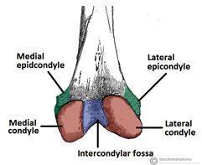
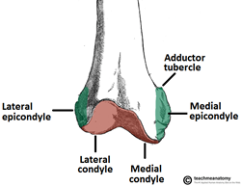
Lower end of femur
Has lateral and medial condyles, separated
anteriorly by articular patellar surface.
posteriorly by intercondylar notch or fossa.
The 2 condyles take part in the knee joint.
Above the condyles are the medial & lateral epicondyles.
Anteriorly
Posteriorly
articular patellar surface.

Slide 13
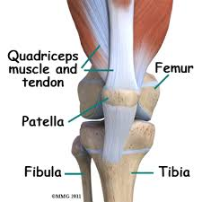
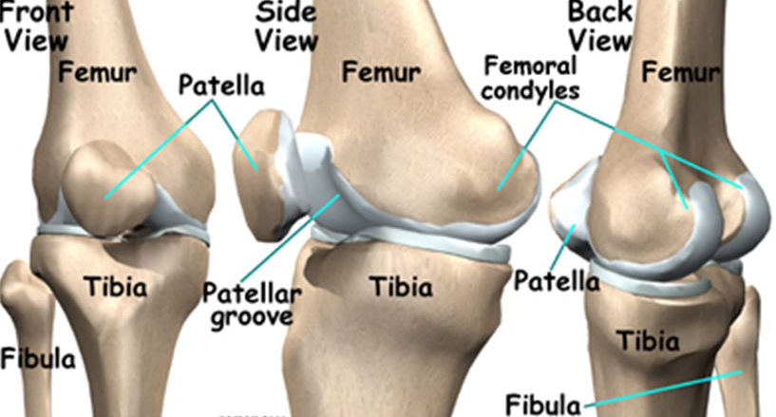
PATELLA
It is a largest sesamoid bone.
It lies inside the Quadriceps tendon (in front of knee joint).
Its anterior surface is rough and subcutaneous.
Its posterior surface articulates with the condyles of the femur to form knee joint.
Anterior surface
sesamoid bone: is a small independent bone or bony nodule developed in a tendon where it passes over an angular structure

Slide 14
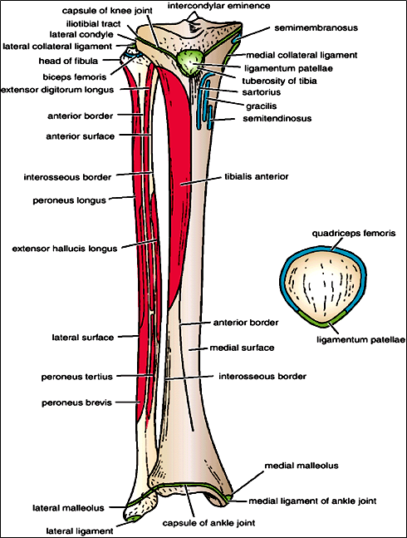
PATELLA
Upper margin
Lateral margin
Medial margin
Its upper, lateral, and medial margins give attachment to Quadriceps femoris muscles.
Its apex lies inferiorly and is connected to tuberosity of tibia by ligamentum patellae.
Note: A ligament is between two bones while a tendon is between a bone and a muscle.

Slide 15
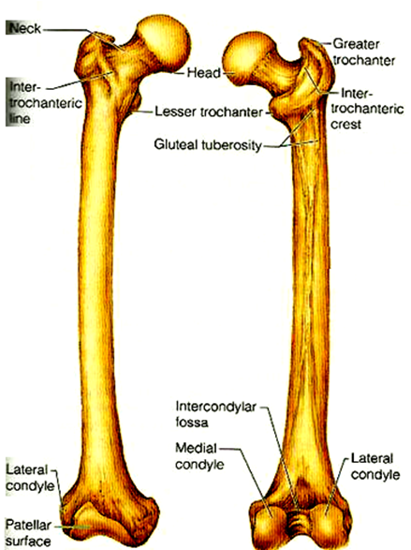
Position of Femur (Right or Left)
Head is directed upward & medially.
Shaft is smooth and convex anteriorly.
Shaft is rough and concave posteriorly.
Explanation:
To determine if the femur bone is in the left or right thigh:
Make sure that the head is facing upward and is directed medially (towards the center of the body).
Rotate the bone until the smooth convex side of the shaft is facing anteriorly, and the rough concave side is facing posteriorly.

Slide 16
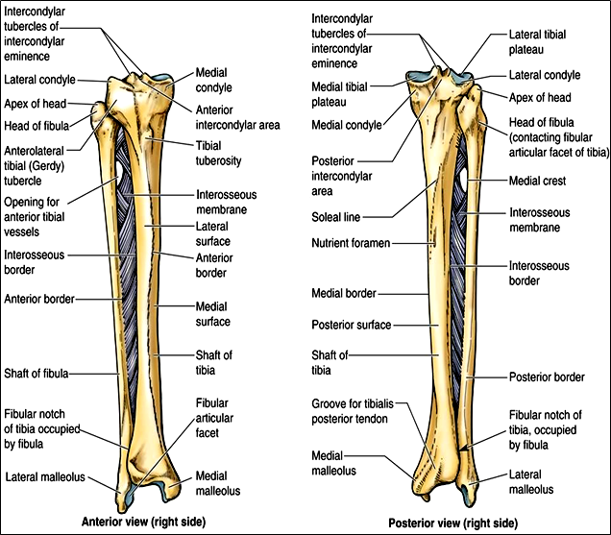
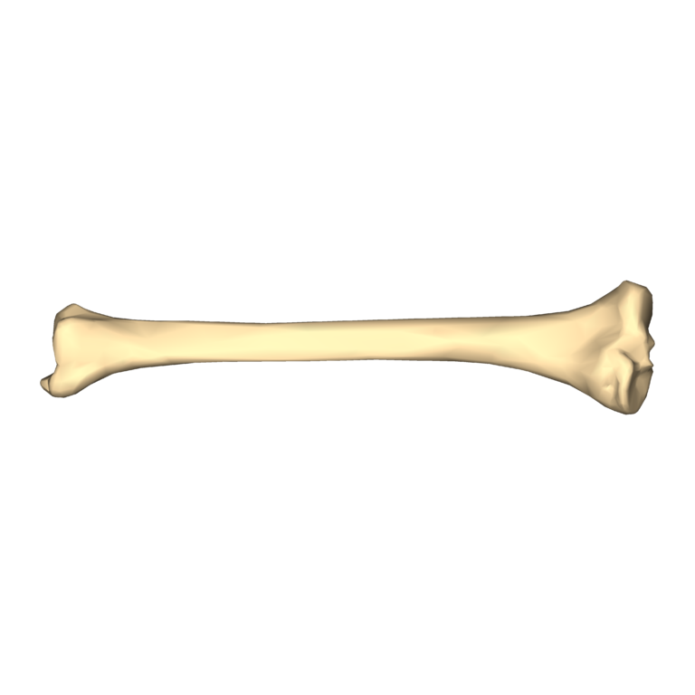
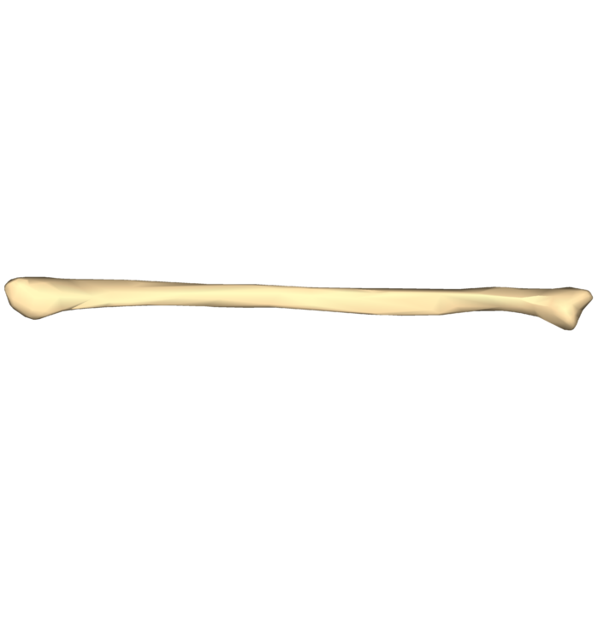
Bones of the Leg (Tibia and Fibula)
To remember:
TIBIA -> MEDIAL
FIBULA -> LATERAL
Tibia | Fibula
•It is the medial bone of leg. | •It is the lateral bone of leg.
•Each of them has: upper end shaft lower end

Slide 17
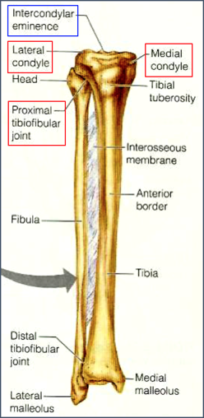
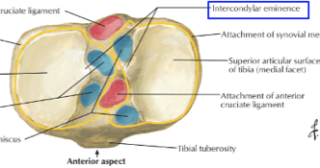
TIBIA
Upper end of Tibia
The upper end contains:
A. Two tibial condyles
B. Intercondylar area
A- Two tibial condyles:
Condyle | Size | Articulates with | Other
Medial condyle | Larger | Medial condyle of femur | has a groove on its posterior surface for semimembranosus muscle
Lateral condyle | Smaller | Lateral condyle of femur | has facet on its lateral side for articulation with head of fibula to form proximal tibio-fibular joint.
B- Intercondylar area:
• Rough.
• Has intercondylar eminence.
Extra picture

Slide 18
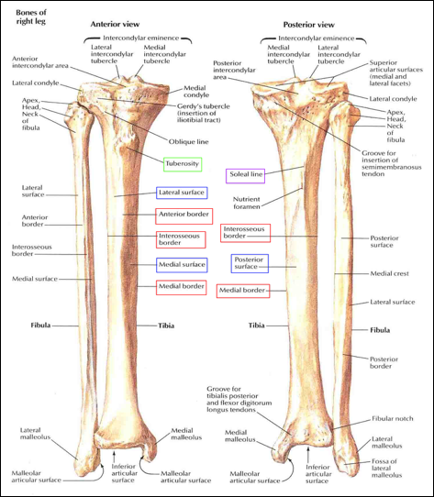
Shaft of Tibia
The shaft contains:
A. Tibial tuberosity
B. 3 borders
C. 3 surfaces
A. Tibial tuberosity
Upper smooth part: gives attachment to ligamentum patellae.
Lower rough part: subcutaneous .
B. 3 borders
Anterior border : sharp and subcutaneous.
Medial border.
Lateral border or interosseous border.
C. 3 surfaces
Medial: subcutaneous.
Lateral.
Posterior: has an oblique line, soleal line for attachment of soleus muscle.

Slide 19
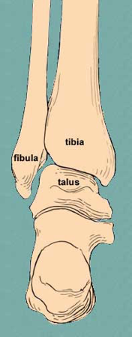
Lower end of Tibia
Articulates with talus for formation of ankle joint.
The lower end contains:
A. Medial malleolus
B. Fibular notch
A- Medial malleolus:
Medial surface is subcutaneous.
Lateral surface articulate with talus.
B- Fibular notch:
Lies on its lateral surface of lower end to form distal tibiofibular joint.
Medial surface
Lateral surface

Slide 20
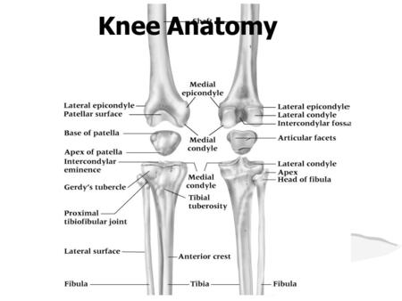
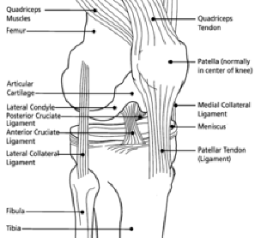
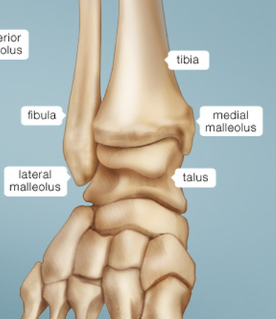
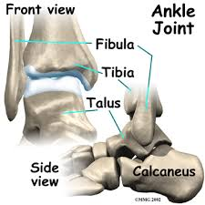
Overview of the joints
Knee joint:
Femur (medial and lateral condyles)
Patella (posterior surface)
Tibia (medial and lateral condyles)
Ankle joint:
Tibia (lower end/lateral surface of medial malleolus)
Fibula (medial surface of lower end)
Talus
These pictures are extra
These pictures are extra

Slide 21
Position of Tibia (Right or Left)
Upper end is larger than lower end.
Medial malleolus is directed downward and medially.
Shaft has sharp anterior border.
Explanation:
To determine if the tibia is in the right or left leg:
1- Turn the bone so that the larger part is at superior/upper, and the medial malleolus is inferior/downward.
2- Rotate the bone so that the sharp anterior border is facing anteriorly.

Slide 22
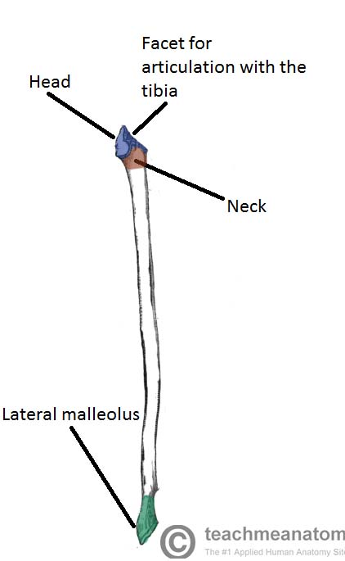
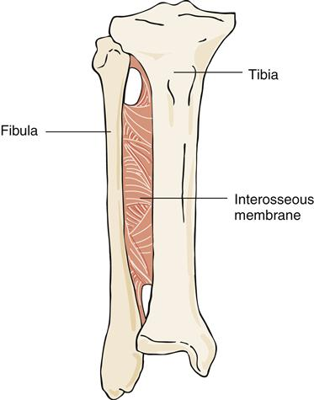
FIBULA
It is the slender (thin) lateral bone of the leg. It takes no part in articulation of knee joint
Styloid process
Bones involved in the knee joint are the femur, tibia and patella.
Upper end of Fibula
The upper end contains:
Head : articulates with lateral condyle of tibia.
Styloid process
Neck
Shaft of Fibula:
4 surfaces
4 borders: the medial border (interosseous border) gives attachment to interosseous membrane
*note: Femur and tibia each have 3 surfaces and 3 borders BUT fibula has 4 surfaces and 4 borders

Slide 23
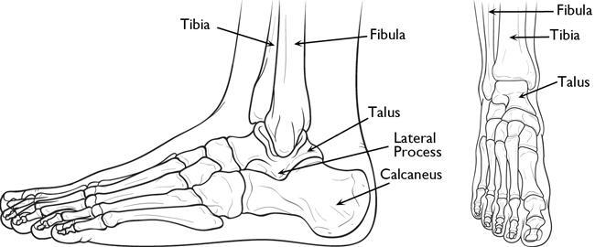
Lower end of Fibula A. Lateral malleolus (subcutaneous) Its medial surface is smooth for articulation with talus to form ankle joint.
*note: for each leg we have 2 malleolus : 1st the medial one comes from the tibia 2nd the lateral one comes from fibula
Extra Picture

Slide 24
Comparing the long bones
 | Femur | Tibia | Fibula
Articulates | 1- with acetabulum to form hip joint. 2- with tibia to form knee joint. | 1- with femur to form knee joint. 2- with fibula to form proximal and distal tibiofibular joint 3- with talus to form ankle joint | 1- with tibia to form proximal and distal tibiofibular joint. 2- with talus to form ankle joint.
Surfaces | 3 (medial, lateral, anterior) | 3 (medial, lateral, posterior) | 4
Borders | 3 (medial, lateral, posterior) | 3 (medial, lateral, anterior) | 4 (interosseous)

Slide 25
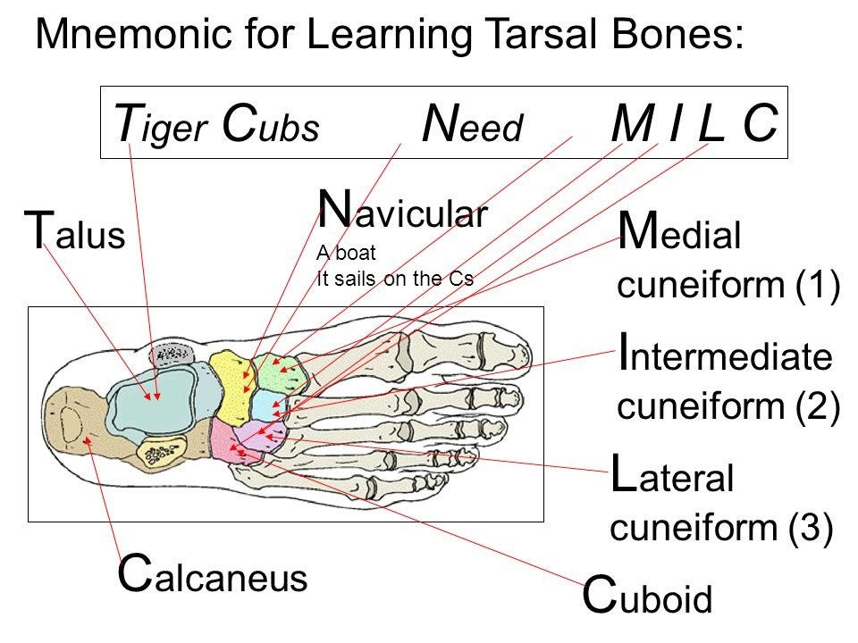
Bones of foot (26 bones in each foot)
7 tarsal bones
They start to ossify before birth and end ossification by 5th year in all tarsal bones.
(The process of ossification allows bones to form while a fetus is still in the womb. The process converts various types of connective tissue into bone)
They are:
Calcaneus
Talus
Navicular
Cuboid
3 Cuneiform bones
Note that:
Calcaneum is the largest bone of foot forming the “heel”.
ONLY TALUS articulate with tibia and fibula at the ankle joint.
Mnemonics for the Tarsal Bones (Team 432)
The Circus Needs More Interesting Little Clowns.
T: Talus
C: Calcaneus
N: Navicular
M: Medial cuneiform
I: Intermediate cuneiform
L: Lateral cuneiform
C: Cuboid
تهاني كلت كباب ونيفا وثلاث كتاكيت

Slide 26
Bones of foot (26 bones in each foot)
14 phalanges:
Only 2 phalanges for big two (proximal and distal only) while the rest 4 toes have 3 phalanges for each (proximal, middle, and distal)
Each phalanx has base, shaft, and head.
5 metatarsal bones:
Numbered from medial (big finger) to lateral.
First metatarsal is large and lies medially
Each metatarsal has a base (proximal), a shaft, and a head (distal).

Slide 27
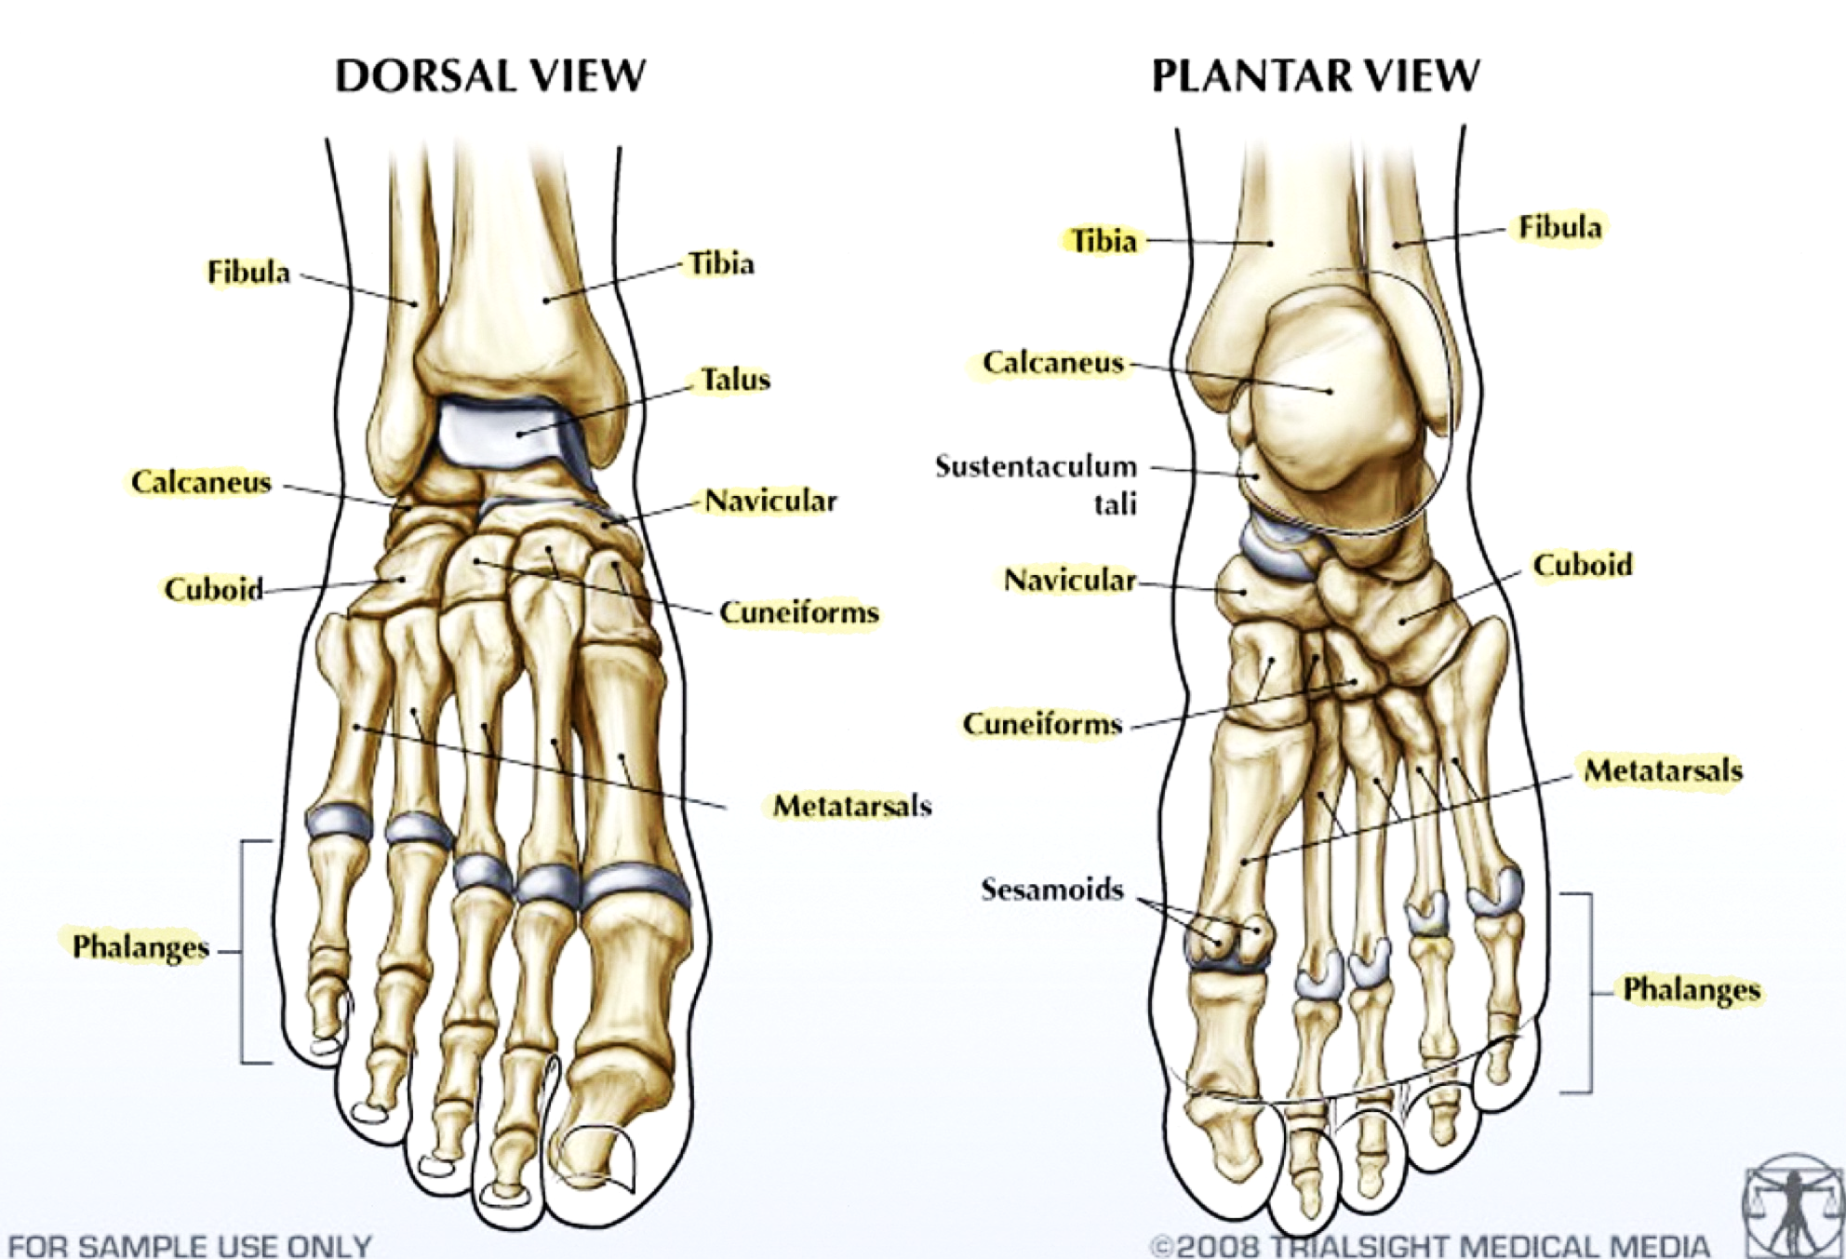
Notes about the bones of foot:
The foot is a complex structure,
There are 26 bones in each foot alone.
The foot is also well muscled and is supported by ligaments and tissue known as fascia.
Support is of prime importance in the foot, as it bears the weight of the body and must adopt different configurations to permit locomotion.
بطن القدم
Additional picture for understanding

Slide 28
Summary
Skeleton of lower limb consists of:
Femur: is the bone of thigh
Tibia: the medial bone of the leg
Fibula: the lateral bone of the leg
Skeleton of foot:
Tarsal bones (7 in number) and one of them is the calcaneum (the largest bone in foot forming the heel)
Metatarsal bones (5 in number)
Phalanges (14 in number)
The subcutaneous parts of bones in the lower limb are: (IMPORTANT)
Patella
Anterior border of the tibia
Tibial tuberosity
Medial surface of shaft of tibia
Medial malleolus of tibia
Lateral malleolus of fibula.

Slide 29
Don’t Forget!
Character | Name
depression in the center of Head in femur | Fovea capitis
passes along this ligament to supply head of femur. | Obturator artery
where the iliofemoral ligament is attached. | Inter-trochanteric line
posterior border OF FEMUR | Linea aspera
below the greater trochanter, for attachment of gluteus maximus muscle. | Gluteal tuberosity
Triangular area, lies at the lower end of shaft, OF FEMUR | Popliteal surface
largest sesamoid bone | Patella
Intercondylar area in the Upper end of tibia (rough) | Intercondylar eminence
Surface of TIBIA, for attachment of soleus muscle Posterior | Soleal line
the largest bone of foot, forming the heel. | Calcaneus
Process in the upper end of fibula | Styloid process

Slide 30
line

Slide 31
*We HIGHLY recommend you visit these websites*
http://teachmeanatomy.info/
http://www.med.umich.edu/lrc/coursepages/m1/anatomy2010/html/courseinfo/mich_quiz_index.html
To download Essential Anatomy 5
https://twitter.com/Med_436/status/807971055524515841

Slide 32
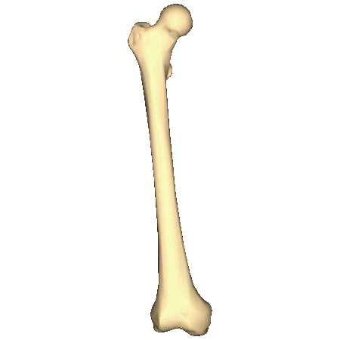
Questions
1. A thick border found posteriorly in the femur:
a) Axillary border
b) Medial border
c) Linea aspera
2. What is below the greater trochanter?
a) Articular patellar surface.
b) Gluteal tuberosity
c) Intercondylar notch or fossa.
3. The medial margin of linea aspera continues below as medial supracondylar ridge.
T
F
4. A Triangular area, lies at the lower end of the shaft.
a) popliteal surface.
b) lateral epicondyles.
c) intercondylar notch or fossa
5. What do lateral and medial condyles form?
a) intercondylar notch or fossa.
b) knee joint
c) linea aspera
6. The largest sesamoid bone in our body is:
Petalle
Tibia
Patella
Fibula
7. Apex of the patella lies inferiorly and is connected to:
Quadriceps femoris muscles.
Fibula
Condyles of the femur
Tuberosity of tibia
8. This is the :
Right humerus
Left humerus
Right femur
Left femur
Answers :
c
b
a
a
b
c
d
c

Slide 33
Questions
9. The lateral bone of leg is :
Patella
Fibula
Humerus
Tibia
10. The patella:
Lies on the back of the knee joint.
Has apex lying superiorly.
Has smooth articulating anterior surface.
Gives attachment to quadriceps femoris tendon.
11. The tarsal bones of foot consists of:
7 bones
8 bones
9 bones
10 bones
12. Which one of the foot bones contributes in the ankle joint?
Calcaneum
Talus
Cuboid
Navicular
13. Which one of the following bones forms the heel of foot?
a) Talus
b) Calcaneum
c) Cuboid
d) Navicular
14. Which one of the following bones is the largest bone in the foot?
Cuboid
Cuneiform
Navicular
Calcaneum
Answers :
9. b
10. d
11. a
12. b
13. b
14. d

Slide 34
Questions
15. The medial bone of the leg is:
Femur
Humerus
Tibia
Fibula
16. The cuboid bone of the foot is considered:
Metatarsal and is located on the medial side of the foot
Tarsal and is located on the medial side of the foot
Metatarsal and is located on the lateral side of the foot
Tarsal and is located on the lateral side of the foot
17. Tibia’s Shaft has three surfaces: Medial, Lateral and
a) Anterior.
b) Posterior.
c) Interosseous.
18. The lower end of the ….. articulates with the talus for formation of ankle joint.
a) Tibia
b) Femur
c) Humerus
19. The fifth toe of the foot doesn’t have a middle phalanx
True
False
20. The tarsal, metatarsal, and phalanges bones in the foot are respectively:
8, 5, 14
7, 5, 15
7, 5, 14
7, 4, 14
Answers:
15. c
16. d
17. b
18. a
19. b
20. c

Slide 35
Questions
21. List all the bones in the three regions of the lower limb.
22. Lateral condyle has facet on its lateral side for articulation with head of fibula to form ……? 23. An oblique line that attaches soleus muscle?
24. What are the parts of upper end of fibula?
25. How many surfaces and borders do the tibia and fibula have?
26. Fibular notch of the tibia forms?
Answers:
21. Bones of the thigh (femur & patella)
Bones of the leg (tibia & Fibula).
Bones of the foot (tarsals, metatarsals and phalanges)
22. Proximal tibio-fibular joint.
23. Soleal line.
24. Head, styloid process and neck.
25. The tibia has 3 surfaces and 3 borders and the fibula has 4 surfaces and 4 borders.
26. Distal tibiofibular joint.

Slide 36
Leaders:
Nawaf AlKhudairy
Jawaher Abanumy
Ghada Almazrou
Members:
Dania Alkelabi
Deena AlNowiser
Jawaher Alkhayyal
Nourah Al Hogail
Rawan Alharbi
Razan AlQahtani
Safa Al-Osaimi
anatomyteam436@gmail.com
@anatomy436

