Slide 1
Radial and Ulnar Nerves
Color Code
Important
Doctors Notes
Notes/Extra explanation
Editing File

Slide 2
Objectives
Describe the anatomy of the radial & ulnar nerves regarding: origin, course & distribution.
List the branches of the nerves.
Describe the causes and manifestations of nerve injury.

Slide 3
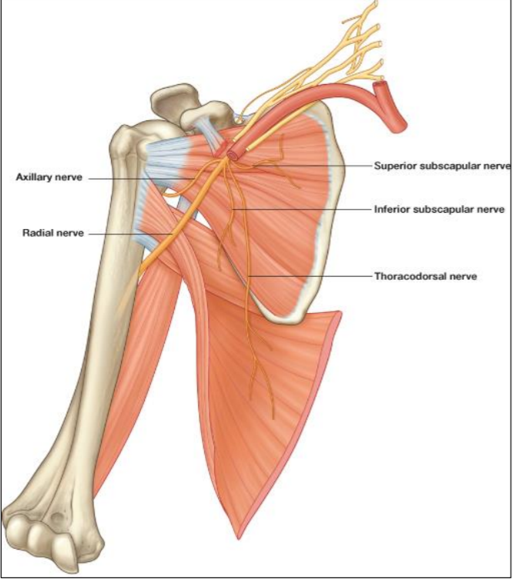
Radial Nerve
Origin: Posterior cord of the brachial plexus in the axilla
(the largest branch of nerves in the upper limb)
Supplies: All muscles of the posterior compartment of the arm (triceps) & forearm (3 groups)

Slide 4
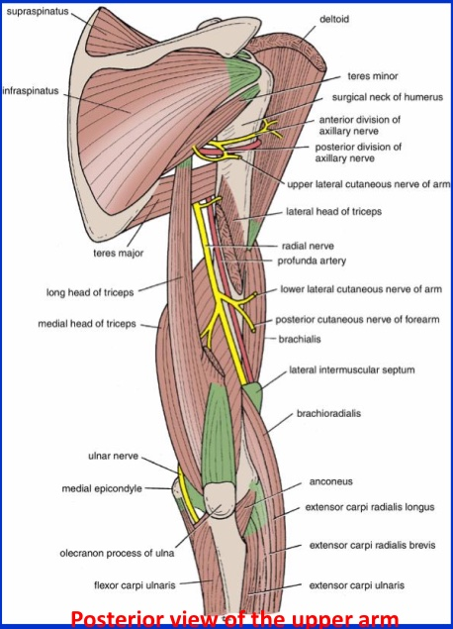
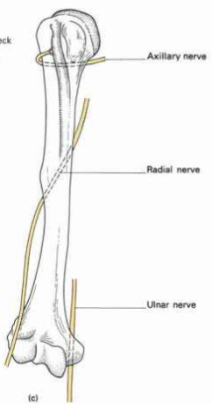
Radial Nerve Course & Distribution In the Arm
It winds(تلف) around the back of the arm in the Spiral Groove(radial groove) on the back of the humerus between the heads of the triceps. In the spiral groove, the nerve is accompanied by(with) the Profunda Vessels, and it lies directly in contact with the shaft of the humerus (Dangerous Position).
Any fracture of humerus specifically the spiral groove leads to injury of the radial nerve
Extra
Posterior view of upper arm

Slide 5
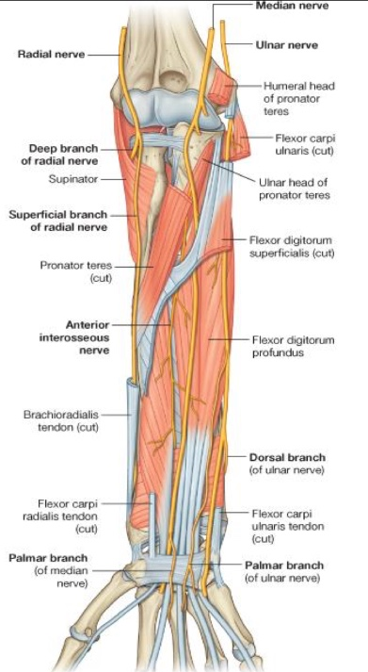
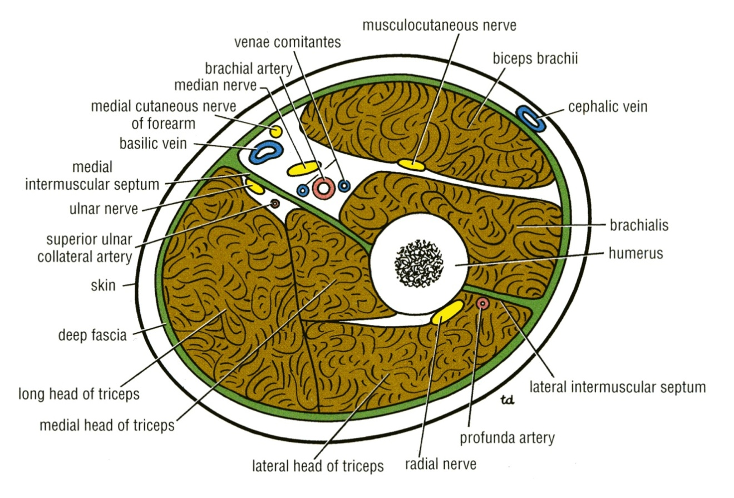
Radial Nerve Course In the Forearm
It pierces the Lateral Intermuscular septum.
(the nerve is behind the humerus، عشان يجي قدام يخترقthe intermuscular septum ) Descends in front of the Lateral Epicondyle. Passes forward into the Cubital Fossa Divides into Superficial & Deep branches.
Extra
Cubital Fossa
Extra

Slide 6
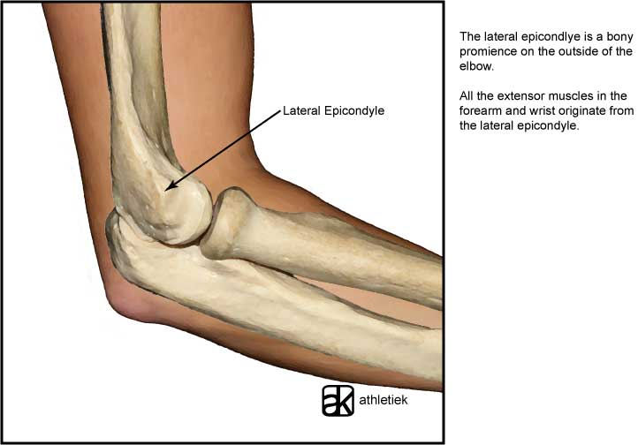
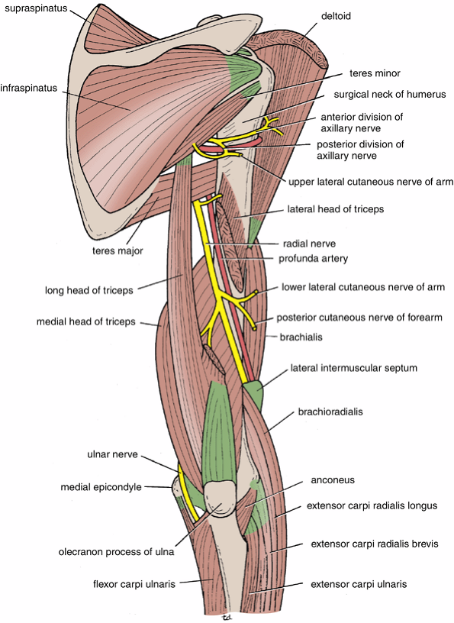
Radial Nerve Branches
Arising in the Axilla
Cutaneous to:
1. Posterior cutaneous nerve of arm
Muscular to:
1. Long & Medial heads of Triceps
Arising in the Spiral Groove
Cutaneous to:
Lower lateral cutaneous nerve of arm
Posterior cutaneous nerve of forearm
Muscular to:
Lateral & Medial heads of Triceps
Anconeus
Arising close to lateral epicondyle:
Muscular to:
1.Brachioradialis
2.Extensor carpi radialis longus
3.Brachialis
Articular to:
1. Elbow joint
Note the medial head of triceps is innervated twice
Extra

Slide 7
Radial Nerve Superficial Branch
1- It descends تنحدرunder cover of (covered by) Brachioradialis
2- Lateral to radial artery
3- It emerges beneath the Brachioradialis tendon.
Termination Of Superficial Branch
It reaches the posterior surface of the wrist ,where it divides into terminal branches that supply the skin on the lateral two thirds of the posterior surface of the hand and the posterior surface over the proximal phalanges of the lateral three and half fingers. Anatomical position كل الاتجاهات بنسبه لل
The area of skin supplied by the nerve on the dorsumظهر of the hand is variable.
(Don’t confuse between the cutaneous/sensory supply and the motor supply)

Slide 8
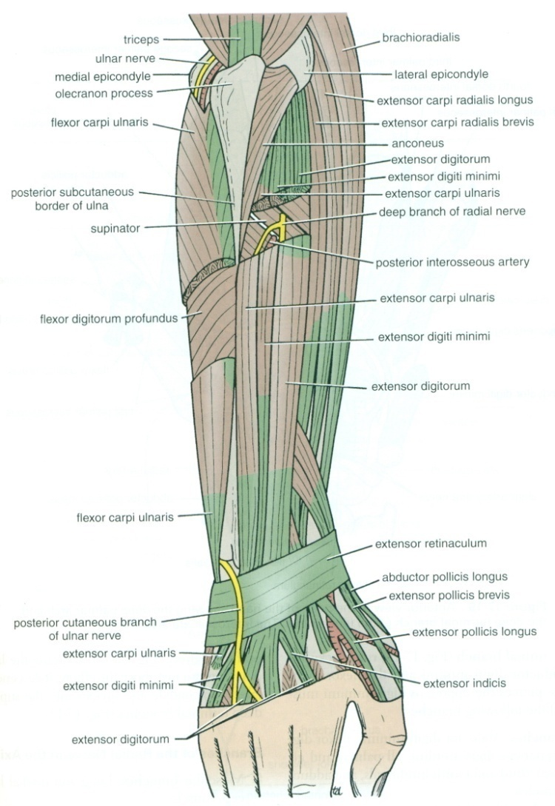
Radial Nerve Deep Branch
The superficial branch is sensory whereas the deep branch is motor
It winds around the neck of the radius, within the supinator muscle, and enters the posterior compartment of the forearm.
It supplies :
Extensor carpi radialis brevis.
Extensor carpi ulnaris.
Supinator.
Abductor pollicis longus.
Extensor pollicis brevis.
Extensor pollicis longus.
Extensor indicis.
Extensor digitorum.
Extensor digiti minimi.
Note: All muscles of the posterior/extensor compartment except ABE

Slide 9
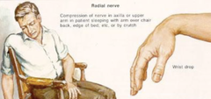
Injuries to Radial Nerve
In the Axilla
In the Spiral Groove (in the arm)
In the forearm
*Amazing video
https://www.youtube.com/watch?v=_Cu6ttAhe8Y
Injury or fracture of the spiral groove of the humerus, the patient is unable to extend the wrist and the fingers (Wrist Drop).
*the next slide
The nerve can be injured by a drunkard falling asleep with one arm over the back of a chair (they call it saturday night paralysis), also by fractures and dislocations of the proximal end of the humerus.
The triceps, the anconeus, and the long extensors of the wrist are paralyzed.
The patient is unable to extend the elbow & the wrist joints, and the fingers flexed always (Wrist Drop)
أو مثلاً واحد تعرض لطلق ناري أوإصابة بسكينة
All the branches from this point will be affected, while the branches from axilla (posterior of the forearm, long and medial head of triceps) are intact. The 2 heads of triceps are working therefor patient can extend the elbow joint .
Keep in mind!
The difference between injury to the radial nerve in the axilla and spiral groove is that in the spiral groove injury the patient can extend the elbow joint.
*Important note :
When the radial nerve injured at the axilla for any reason all the muscles and skin supplied by it will be affected.

Slide 10
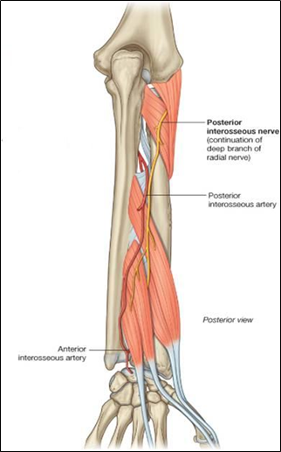
Injuries to Radial Nerve
In the Axilla
In the Spiral Groove (in the arm)
In the forearm
Injuries to the Deep Branch of the Radial Nerve
Injuries to the Superficial Branch of the Radial Nerve
•The deep branch of the radial nerve is PURELY Motor (It supplies the extensor muscles in the posterior compartment of the forearm ex. Extensor carpi ulnaris).
•It can be damaged in fractures of the proximal end of the radius or during dislocation of the radial head.
•The nerve that supply the supinator and the extensor carpi radialis longus will be undamaged (they are supplied by radial nerve itself before it got branched), and because the latter muscle is powerful, it will keep the wrist joint extended with lateral deviation because the extensor carpi ulnaris cannot work (supplied by deep branch)
•since patient can extend the wrist (No wrist Drop)
Superficial radial nerve is Sensory nerve.
Injury like a stab wound, results in a variable small area of anesthesia over the dorsum of the hand and lateral three and half fingers up to the base of their distal phalanges. (or distal interphalangeal joint)
Patient can do extension for elbow joint, skin that is supplied by radial nerve arising from the spiral groove region is intact ( No loss of sensation).

Slide 11
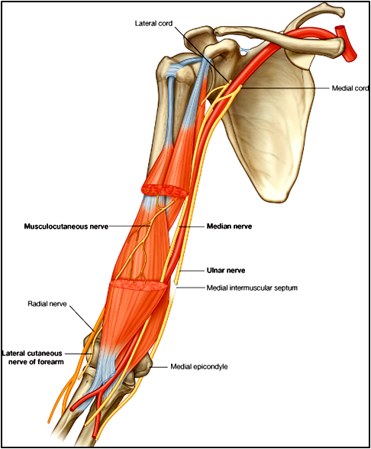
Ulnar Nerve
Origin : Medial cord of brachial plexus
Course :
In the axilla & arm
• Descends along the medial side of the following arteries: Axillary & Brachial
(Axillary artery continues as the brachial artery)
• Pierces the medial intramuscular septum .
• Passes behind the medial epicondyle of humerus.
(that’s why when you hit the medial back of your elbow you feel كهربه)

Slide 12
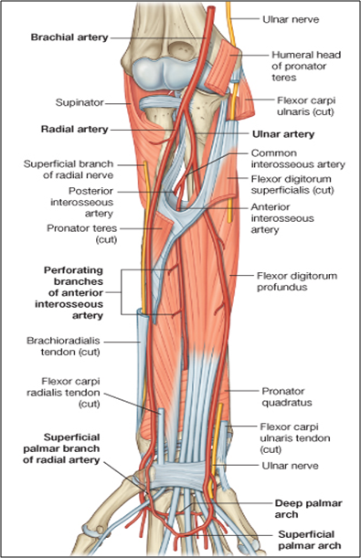
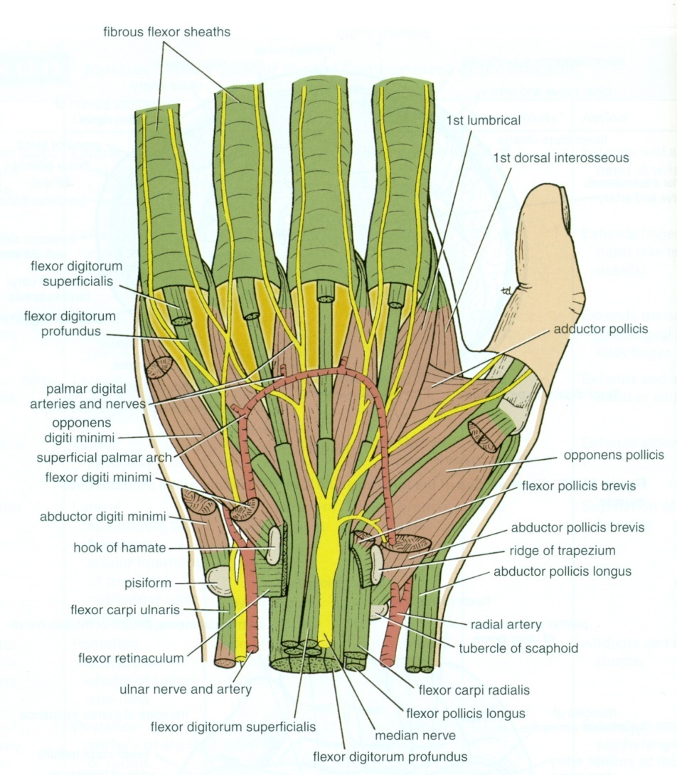
Ulnar Nerve
Course (cont)
In forearm :
• Enters the anterior compartment of forearm through
the flexor carpi ulnaris.
Ulnar nerve pasess between 2 heads of flexor carpi ulnaris and supplies them .
• Descends behind the flexor carpi ulnaris.
• medial to ulnar artery .
At the wrist :
• Passes anterior (superficial) to flexor retinaculum
• Lateral to pisiform bone.
• Medial to ulnar artery.
• Divides into : superficial and deep branches .

Slide 13
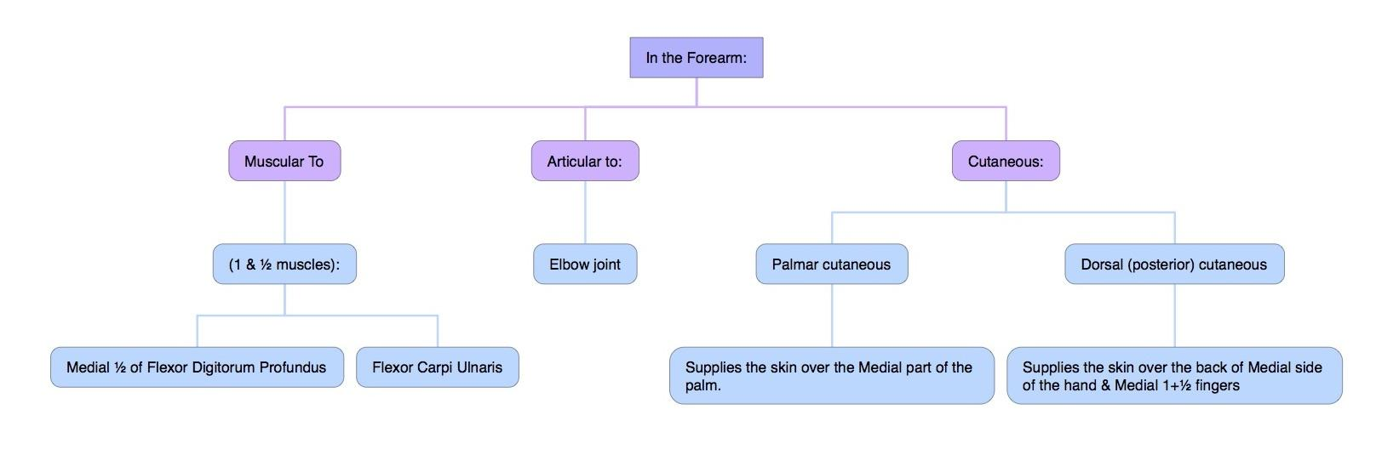
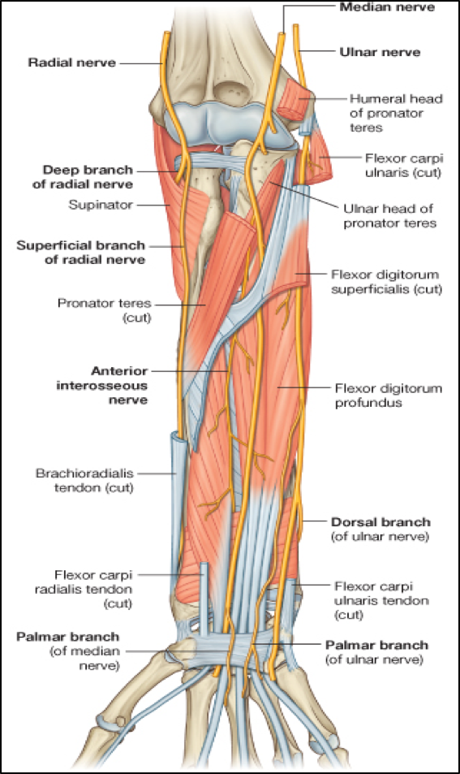
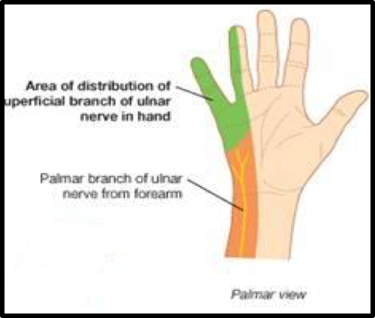
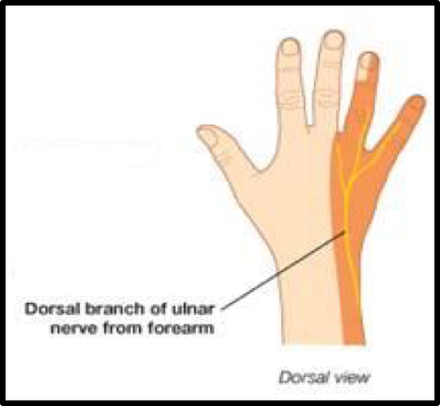
Ulnar Nerve
Branches
It has no branches in the arm or axilla

Slide 14
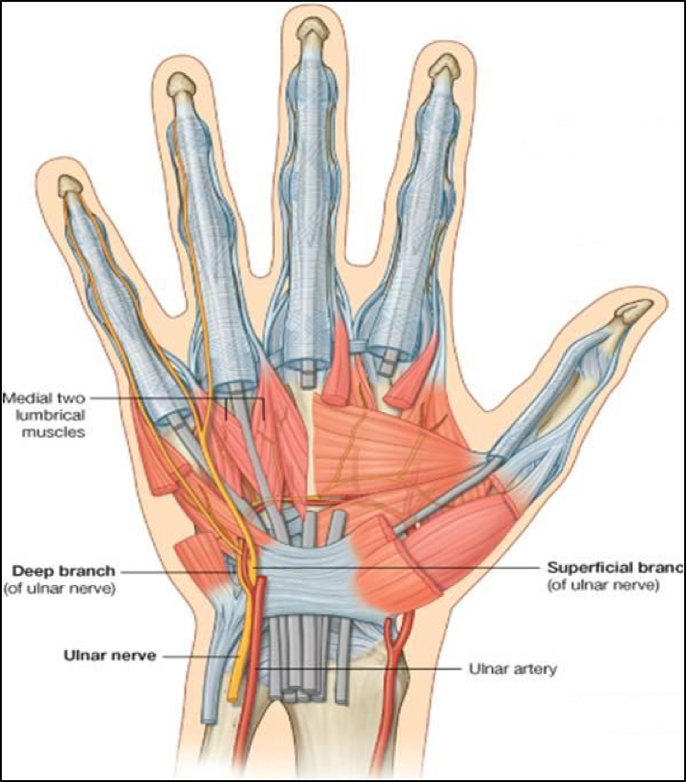
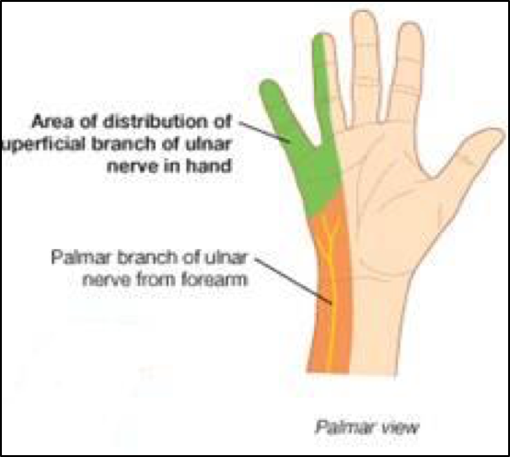
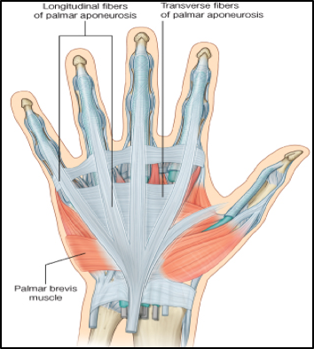
Branches of Superficial Terminal Branch:
Branches of Deep Terminal Branch:
Ulnar Nerve
Branches
1. Muscular:
Palmaris Brevis.
2. Cutaneous:
Skin over the Palmar aspect of the medial 1+ ½ fingers (including nail beds).
Muscular:
Hypothenar Eminence.
All Interossei (Palmar & Dorsal).
3rd & 4th Lumbricals.
Adductor pollicis.
2. Articular:
Carpal joints.

Slide 15
Ulnar Nerve
Injury
At the Elbow:
Atrophy of Ulnar (medial) side of forearm.
Flexion of the wrist with Abduction*.
Claw hand.
Wasting of Hypothenar Eminence.
At the Wrist:
Claw Hand.
Wasting of Hypothenar Eminence.
*There will be flexion with radial deviation since the flexor carpi radialis is working while the flexor carpi ulnaris is not

Slide 16
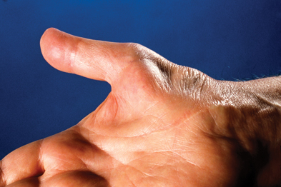
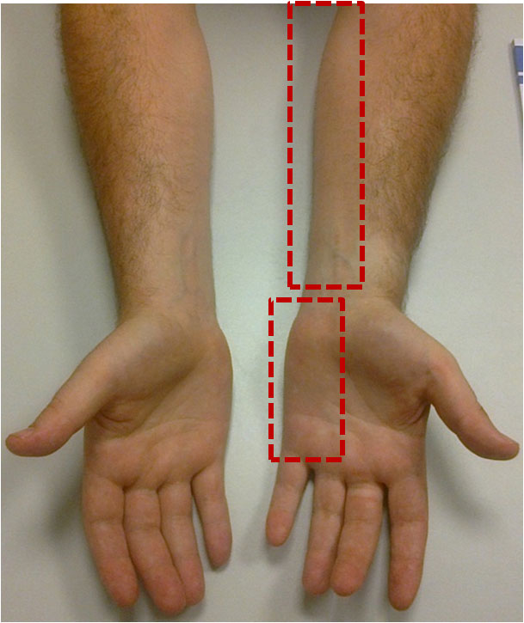
Ulnar Nerve
Injury
These pictures are extra
Atrophy of the Forearm (Ulnar side) and Hypothenar muscles
Wasting of Hypothenar Eminance
Claw hand

Slide 17
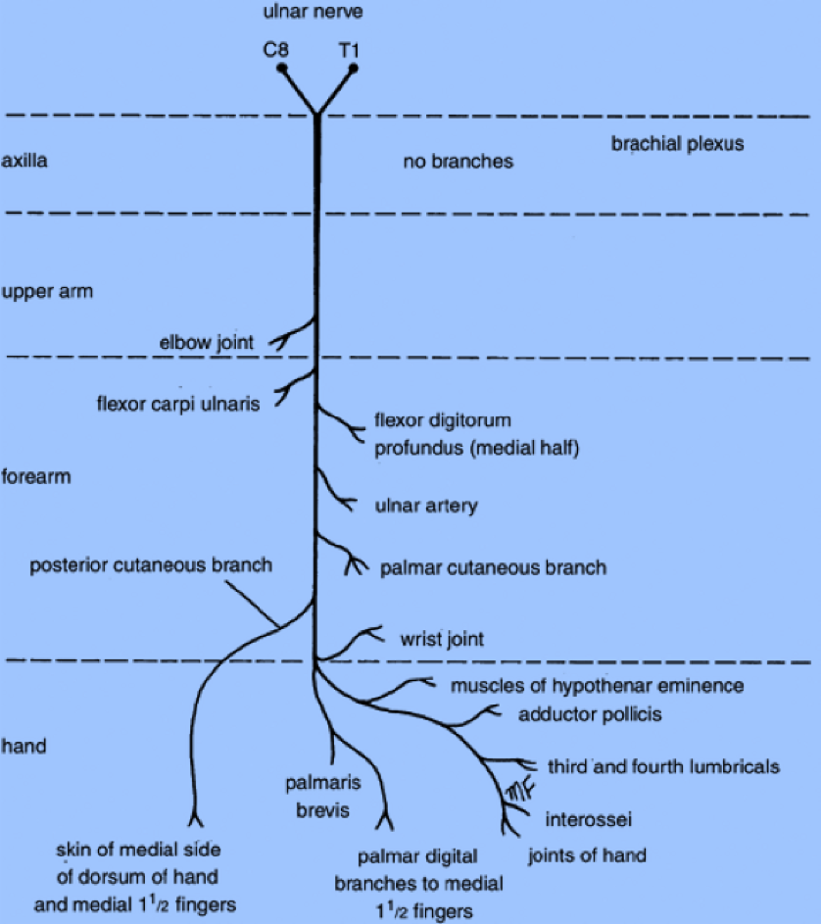
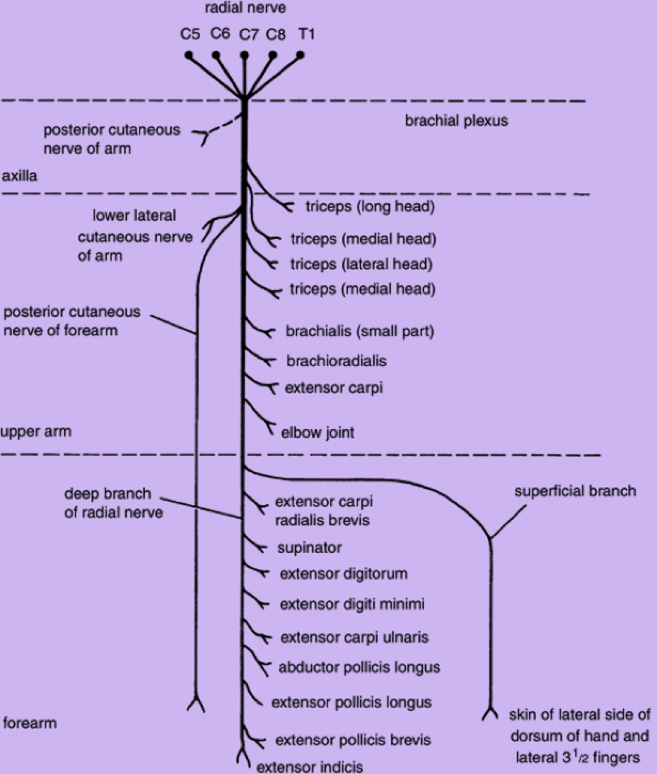
Summary of branches of Ulnar Nerve:
Summary of branches of Radial Nerve:

Slide 18
Only on the boys’ slides

Slide 19
Its important to know the different deformities and the nerves related
To remember: DR CUMAB
DR = Wrist Drop > Radial Nerve
CU = Claw Hand > Ulnar Nerve
MAB = Median Nerve > Ape Hand > Hand of Benediction

Slide 20
Questions
6- Injury to the radial nerve at which area causes wrist drop?
Axilla
Arm
Forearm
A & B
7- Which branch of the radial nerve supplies the following area?
Superficial
Deep
Medial
Lateral
8- The ulnar descends ______ along the brachial and axillary artery.
Anteriorly
Posteriorly
Medially
Laterally
9- A patient presented with injury to the superficial branch of the ulnar nerve. Which muscle is affected?
Palmaris Brevis
Palmrais Longus
Palmaris Superficialis
Palmaris Profundus
1- Which one is the largest nerve in the upper limb:
A) ulnar B) radial C) axillary D) medial
2- Where does the radial nerve divide:
A)spiral groove
B)lateral epicndyle
C)cubital fossa
D)wrist
3- Superficial branch of radial nerve descends under cover of?
A) Brachioradialis
B) Brachialis
C) Corachobrachialis
4- What are the roots of the radial nerve?
C5, C6
C5, C6, C7
C5, C6, C7, C8
C5, C6, C7, C8, T1
5- The radial nerve supplies all muscles of the anterior compartment of the arm.
True
False
Answers:
1- B
2- C
3- A
4- D
5- B
6- D
7- A
8- C
9- A

Slide 21
Questions
Mohammed, A 28-year-old man, was horseback riding with his partner when the horse he was riding stumbled, throwing him from the saddle. In order to break his fall, Mohammed stretched out his right hand, he felt severe pain in his arm. At the emergency room, the doctor examined the arm,patient is unable to extend the wrist. The doctor ordered X-Ray for the arm. The radiologist ,who examined the X-rays, found fracture in the upper part of humerus.
According to this case, please answer the following questions:
10- List 4 muscles supplied by the deep branch of radial nerve.
11- A little girl injured her wrist while playing. Upon clinical examination it was determined that the ulnar nerve was injured. List 3 characteristics the physician could have seen while examining the patient.
1) Which of the following is LEAST likely to happen in this case:
Loss of sensation in the lateral side of dorsum of the hand.
Extension of the medial fingers.
Loss of ability of abduction of the pollicis.
Extension of the elbow joint.
Answers:
10- 1. Extensor carpi radialis brevis.
Extensor carpi ulnaris.
Supinator.
Abductor pollicis longus.
Extensor pollicis brevis.
11- 1. Flexion of the wrist with Abduction.
2. Claw hand.
3. Wasting of Hypothenar Eminence.
2) The name of injured region of the humerus :
Intertubercular groove
Bicipital groove
Spiral groove
Surgical neck
3) this deformity of mandatory flexion of the wrist is known as :
Ape hand.
Claw hand.
Wrist drop.
Answers:
1- B
2- C
3- C

Slide 22
Leaders:
Nawaf AlKhudairy
Jawaher Abanumy
Ghada Almazrou
Members:
Alanoud Alsaikhan
Danyah Saja
Deena AlNowiser
Maha Alissa
Minyal Bawazier
Lara Alsaleem
anatomyteam436@gmail.com
@anatomy436

