Slide 1
ARM AND ELBOW
Color Code
Important
Doctors Notes
Notes/Extra explanation
Editing file

Slide 2
Objectives
Describe the attachments, actions and innervations of:
Biceps brachii
Coracobrachialis
Brachialis
Triceps brachii
Demonstrate the following features of the elbow joint:
Articulating bones
Capsule
Lateral & medial collateral ligaments
Synovial membrane
Demonstrate the movements; flexion and extension of the elbow.
List the main muscles producing the above movements.
Define the boundaries of the cubital fossa and enumerate its contents.

Slide 3
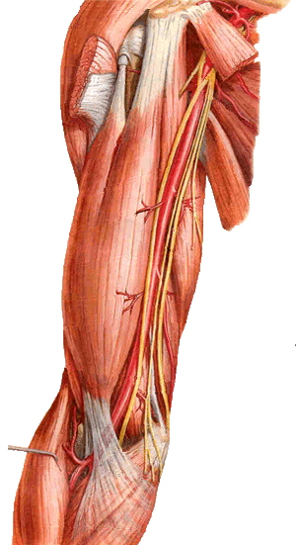
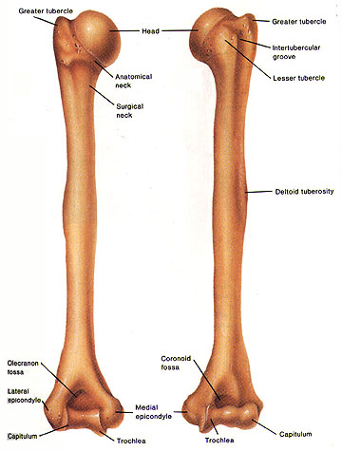
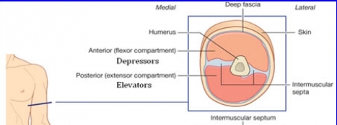
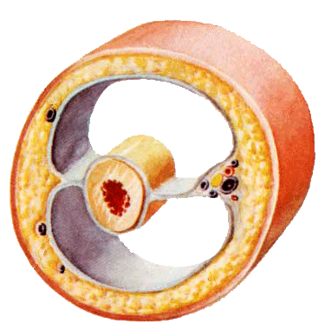
- An aponeurotic sheet separating various muscles of the upper limbs, including lateral and medial humeral septa. - The lateral and medial intermuscular septa divide the distal part of the arm into two compartments:
Shoulder
THE ARM:
A R M
Posterior
view
Anterior
view
Elbow
Arm
Humerus
Lateral intermuscular septum
Medial intermuscular septum
Anterior (flexor compartment)
Posterior (extensor compartment)
Neurovascular bundle
skin
Fascia
Humerus

Slide 4
Note: the radial and ulnar nerves begin in the anterior compartment then pierce the intermuscular septum and enter the posterior compartment
Anterior Fascial Compartment:
muscles
coracobrachiallis
Blood vessels
Nerves
Median
Brachial artery
Basilic vein
Biceps brachii
Brachialis
Radial
Ulnar
Musculocutaneous

Slide 5
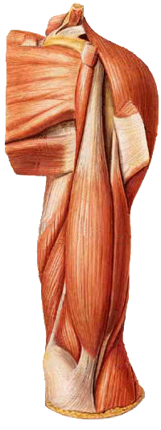
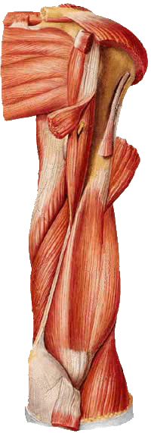
Muscles Of Anterior Compartment:
Coracobrachialis
Biceps
Brachii
Brachialis
Note: Brachi- means arm so any muscle with brachi in it’s name is related to the arm

Slide 6
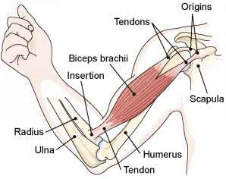
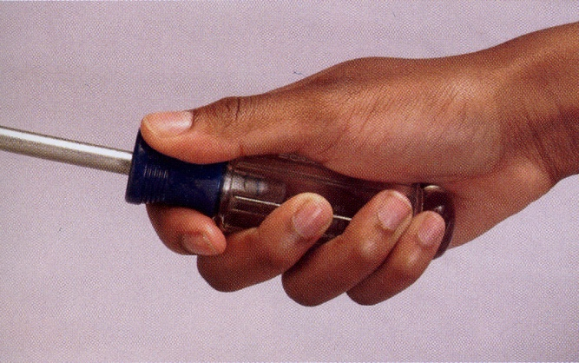
BICEPS BRACHII:
Coracoid Process
Origin | Long Head from supraglenoid tubercle of scapula (intracapsular) Short Head from the tip of coracoid process of scapula The two heads join in the middle of the arm
Insertion | In the posterior part of the radial tuberosity. Into the deep fascia of the medial aspect of the forearm through bicipital aponeurosis.
Nerve Supply | Musculocutaneous
Action | Strong supinator of the forearm used in screwing. Powerful flexor of elbow Weak flexor of shoulder

Slide 7
CORACOBRACHIALIS:
Origin | Tip of the coracoid process of scapula (with short head of biceps brachii)
Insertion | Middle of the medial side of the shaft of the humerus
Nerve Supply | Musculocutaneous
Action | Flexor & Weak adductor of the arm

Slide 8
BRACHIALIS:
Origin | Front of the lower half of humerus
Insertion | Anterior surface of coronoid process of ulna
Nerve Supply | Musculocutaneous (medial) Radial (lateral)
Action | Strong flexor of the forearm
The brachialis is innervated by 2 NERVES

Slide 9
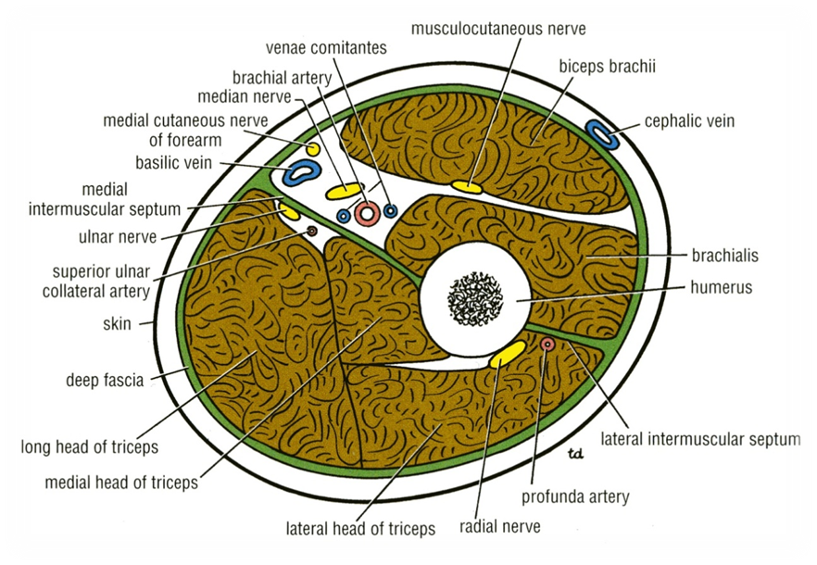
Posterior Fascial Compartment:
Nerves:
Radial & ulnar nerves
Vessels :
Profunda brachii (branch from brachial artery) & ulnar collateral arteries
Muscles :
Triceps brachii

Slide 10
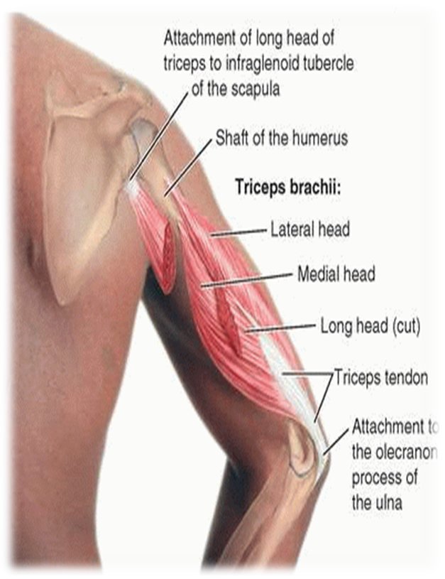
TRICEPS BRICHII:
Origin : three heads
* Long Head: from infraglenoid tubercle of the scapula.
* Lateral Head: from the upper half of the posterior surface of the shaft of humerus above the spiral groove
Insertion :
Common tendon inserted into the upper surface of the olecranon process of ulna
Action :
Strong extensor of the elbow joint
* Medial Head: from the lower half of the posterior surface of the shaft of humerus below the spiral groove
Nerve supply :
Radial nerve

Slide 11
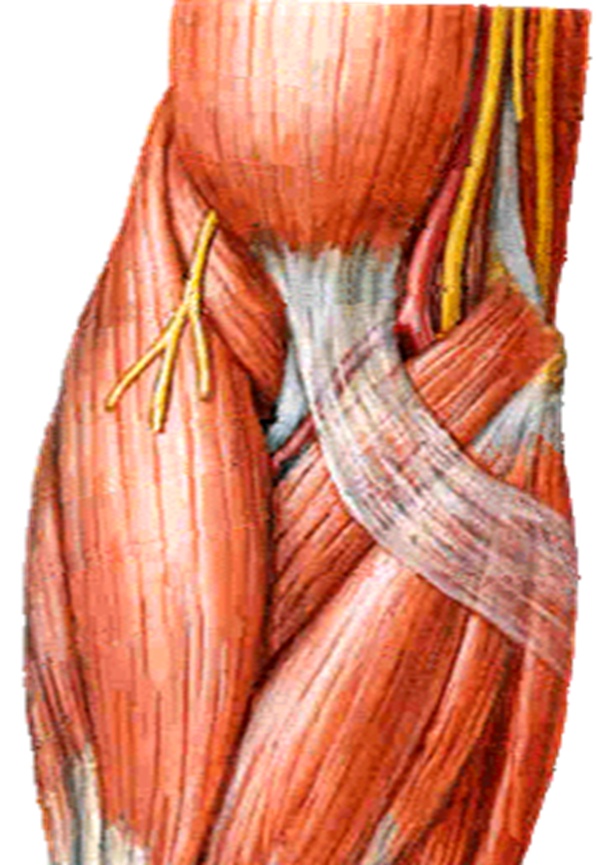
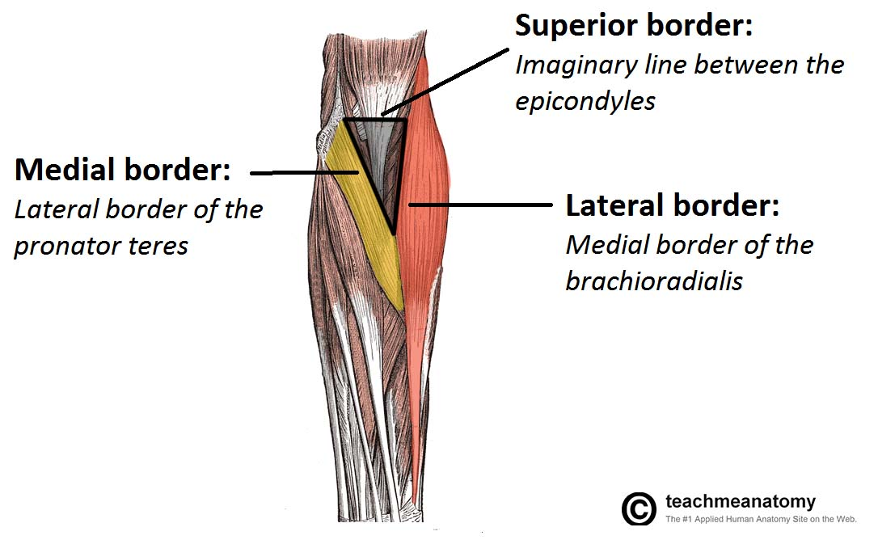
Cubital Fossa:
The cubital fossa is a triangular depression that lies in front of the elbow.
BOUNDARIES OF CUBITAL FOSSA
Base:
Line drawn through the two epicondyles of humerus
Floor:
Brachialis medially and supinator laterally.
Roof:
Skin, superficial & deep fascia and bicipital aponeurosis
Laterally:
Brachioradialis
Medially: Pronator teres
Extra

Slide 12
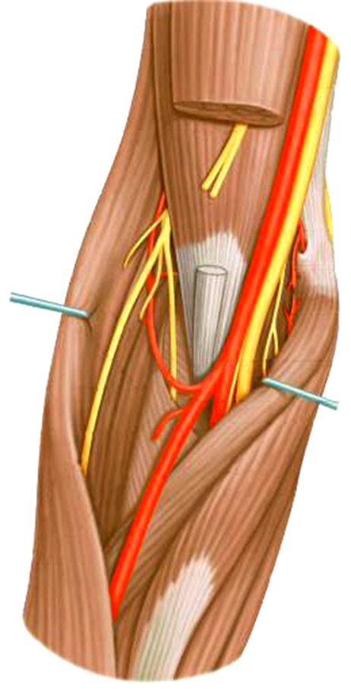
Content Of Cubital Fossa:
*From medial to lateral*
CONTENT OF CUBITAL FOSSA :
MEDIAN NERVE
BRACHIAL ARTERY
DEEP BRANCH OF RADIAL NERVE
BICEPS BRACHII TENDON
Biceps Brachii Tendon
Median Nerve
Deep Branch Of Radial Nerve
Ulnar Artery
Brachial Artery
Radial Artery
Ulnar Artery
Radial Artery
Starts with a Nerve (median nerve) and ends with one (deep branch of radial nerve)

Slide 13
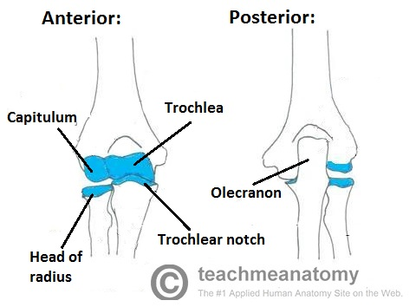
Elbow Joint:
ARTICULATION
ABOVE
Trochlea of humerus
BELOW
Trochlear notch of ulna
head of radius
Capitulum of humerus
Elbow joint is sorted as Uniaxial, Synovial Hinge Joint
The articular surfaces are covered with
articular (hyaline) cartilage.

Slide 14
Elbow Joint
Capsule:
-ANTERIORLY: Attached
Above: | To the humerus along the upper margins of the coronoid and radial fossa and to the front of the medial and lateral epicondyles.
Below: | To the margin of the coronoid process of the ulna and to the anular ligament, which surrounds the head of the radius.
-POSTERIORLY: Attached
Above | To the margins of the olecranon fossa of the humerus.
Below | To the upper margin and sides of the olecranon process of the ulna and to the anular ligament.

Slide 15
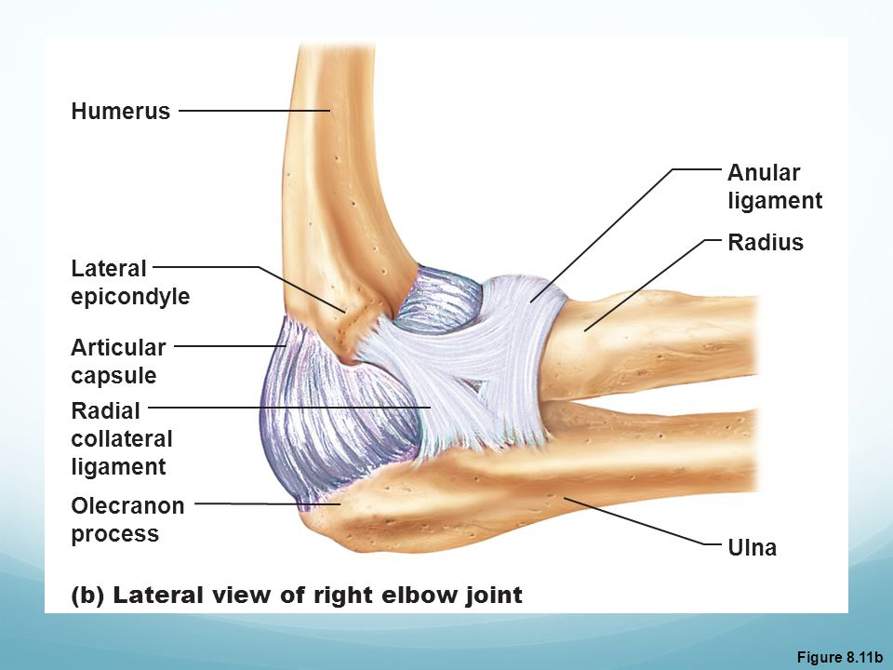
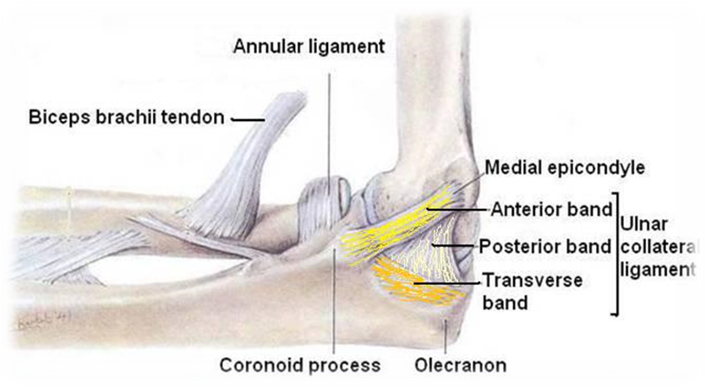
Elbow Joint
Ligaments
Lateral ligament (radial collateral ligament)
Shape: triangular.
Apex: attached to the lateral epicondyle of humerus.
Base: attached to the upper part of the annular ligament.
Medial ligament (ulnar collateral ligament)
Divided into three bands:
Anterior strong cord-like band:
Between medial epicondyle and the coronoid process of ulna.
Posterior weaker fan-like band:
Between medial epicondyle and the olecranon process of ulna.
Transverse band:
Passes between the anterior and posterior bands.

Slide 16
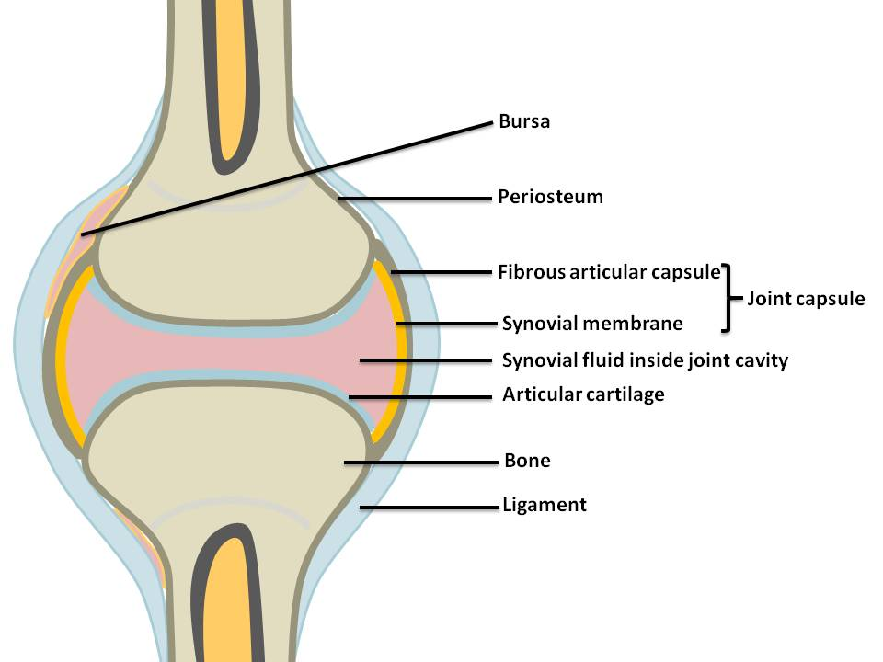
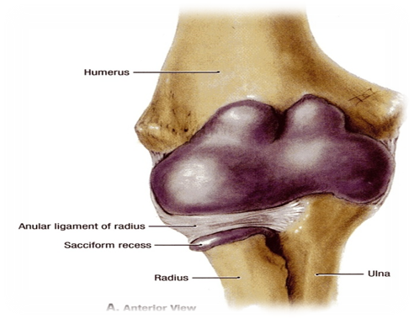
Elbow Joint
Synovial Membrane:
This lines the capsule and covers fatty pads in the floors of the coronoid, radial, and olecranon fossae.
Is continuous below with synovial membrane of the superior (proximal) radio-ulnar joint.
Contains the synovial fluid.

Slide 17
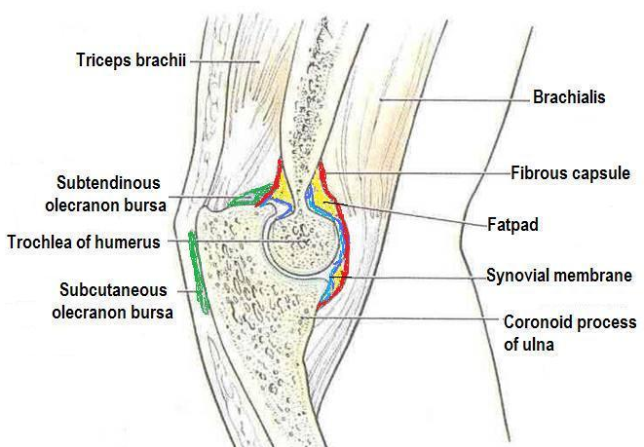
TEAM 435
This slide is NOT extra

Slide 18
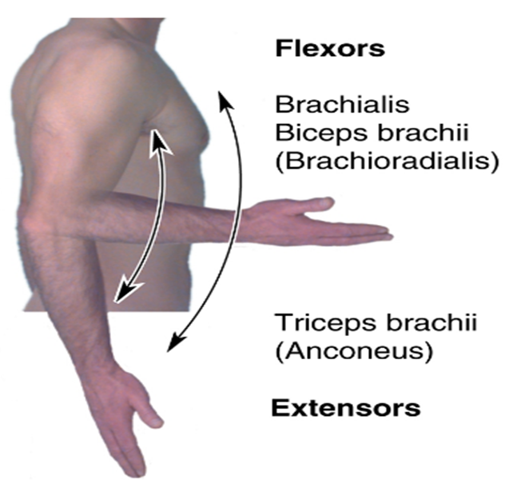
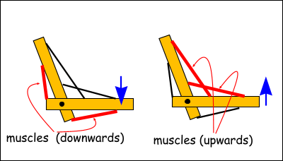
Elbow Joint
Movement:
Flexion | Extension
is limited by the anterior surfaces of the forearm and arm coming into contact. | is limited by the tension of the anterior ligament (medially) and brachialis muscle.
The joint is supplied by branches from:
Median Nerve
Radial Nerves
Musculocutaneous Nerve
Ulnar Nerve

Slide 19
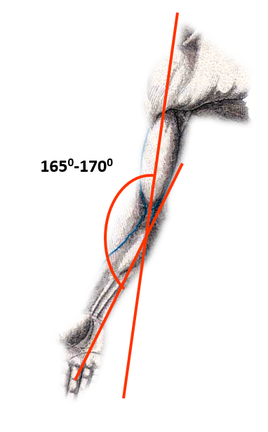
Carrying Angle:
Is the angle between the long axis of the extended forearm and the long axis of the arm.
It opens laterally.
It is 170 degrees in male and 167 degrees in females.
It disappears when the elbow joint is flexed.
It allows The forearms to clear the hips in swinging movements during walking and is important when carrying objects.

Slide 20
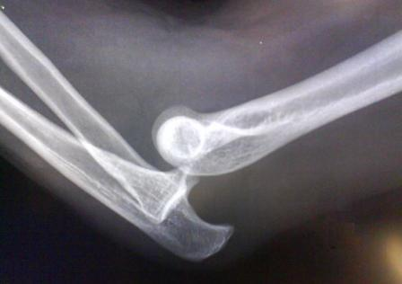
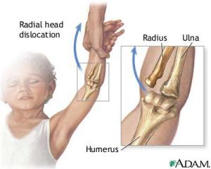
Elbow Joint
Articulations
The elbow joint is stable because of the:
Wrench-shaped articular surface of the olecranon and the pulley-shaped* trochlea of the humerus.
Strong medial and lateral ligaments.
Elbow dislocations are common & most are posterior**.
Posterior dislocation usually follows falling on the outstretched hand.
Posterior dislocations of the joint are common in children because the parts of the bones that stabilize the joint are incompletely developed.
شكل البَكرة = Pulley-shaped *
**The radius/ulna is dislocated posteriorly NOT the humerus

Slide 21
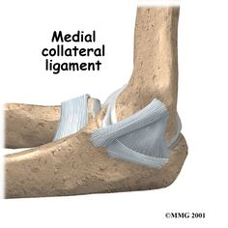
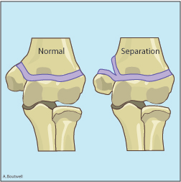
Elbow Joint:
Avulsion of the epiphysis of the medial epicondyle is also common in childhood because then the medial ligament is much stronger than the bond of union between the epiphysis and the diaphysis.
They are usually a result from an avulsion (pull off) injury caused by a valgus* stress at the elbow and contraction of the flexor muscles as in :
falling on an outstretched hand with the elbow in full extension
direct blow
posterior elbow dislocation
*Only on girls slides
Humerus
*valgus : a deformity involving oblique displacement of part of a limb away from the midline.

Slide 22
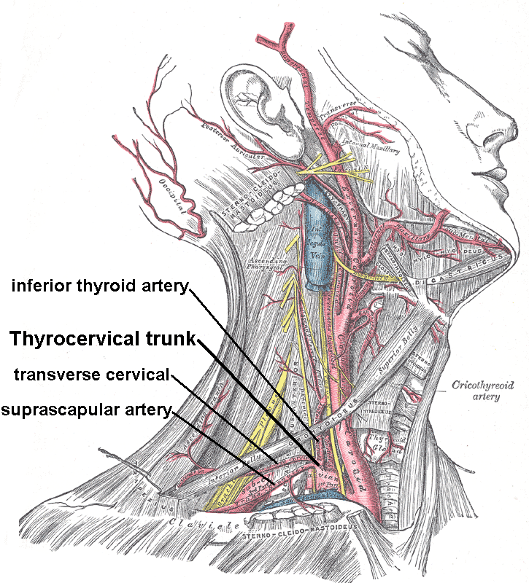
Blood Circulation:
Only in the boys’ slides
The upper limb (upper extremity) is the region extending from deltoid to the hand, including :
shoulder
Axilla
Arm
Wrist joint
Elbow joint
Forearm
ARTERIES OF UPPER LIMB :
Axillary
Brachial
Ulnar
Radial
Palmar arches
SUBCLAVIAN ARTERY :
Left subclavian arises from aortic arch
Right subclavian arises from brachiocephalic trunk
Main Branches :
Vertebral artery
to supply CNS
Internal thoracic artery
to supply mammary gland & the thoracic wall.
Thyrocervical trunk
to supply thyroid gland and scapula.
At lateral border of the 1st rib, it continuous in the axilla as the Axillary artery
It is the source of the arterial supply of the upper limb.

Slide 23
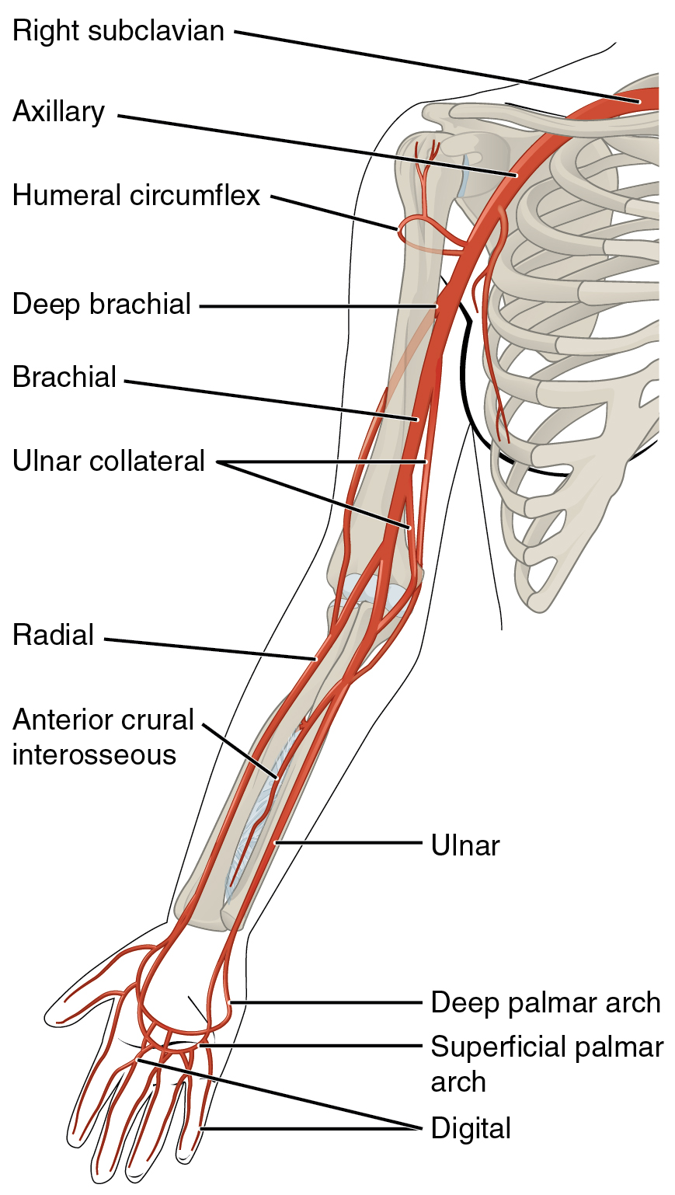
ARTERIES OF UPPER LIMB
Right Subclavian
Subclavian artery
continues as:
Axillary
Axillary artery
becomes:
Brachial
Radial
Brachial artery
Divides into:
Ulnar
Radial artery
Forms the:
Ulnar artery
Forms the:
Deep Palmar arch
Superficial Palmar arch
Palmar Arches
Only in the boys’ slides

Slide 24
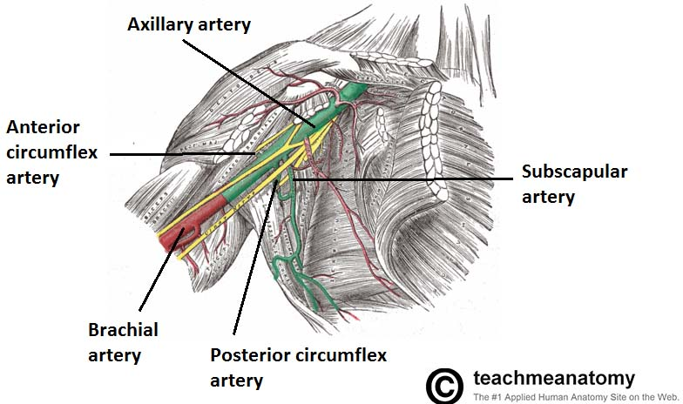
Axillary Artery
Only in the boys’ slides
This artery arises from the subclavian artery , it passes through the axilla, just underneath the pectoralis minor muscle, enclosed in axillary sheath .
At the level of the humeral surgical neck, the posterior and anterior circumflex humeral arteries arise .
They circle posteriorly around the humerus to supply the shoulder region.
The largest branch of the axillary artery is called Subscapular artery.
The axillary artery becomes the Brachial artery at the level of the Teres major muscle.

Slide 25
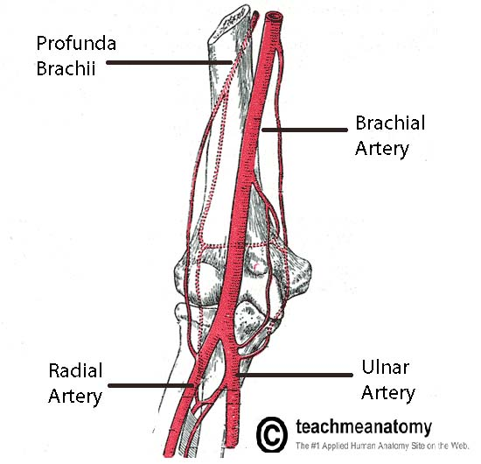
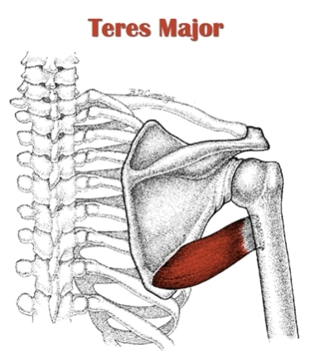
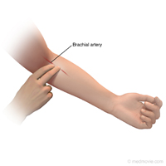
Brachial Artery
Only in the boys’ slides
The main source of blood for the arm.
Distal to the teres major, the brachial artery gives rise to the profunda brachii (the deep artery of the arm).
It travels along the posterior surface of the humerus, running in the radial groove to supply structures in the posterior aspect of the arm like triceps brachii.
Terminates by contributing to a network of vessels at the elbow joint.
The pulse of the brachial artery is palpable (محسوس) on the anterior aspect of the elbow, medial to the tendon of the biceps.
The brachial artery descends down the arm immediately posterior to the median nerve.
As it crosses the cubital fossa, underneath the brachialis muscle, the brachial artery bifurcating into the radial and ulnar arteries.
Other branches:
Superior ulnar collateral artery ulnar collateral artery
Inferior ulnar collateral artery ulnar collateral artery

Slide 26
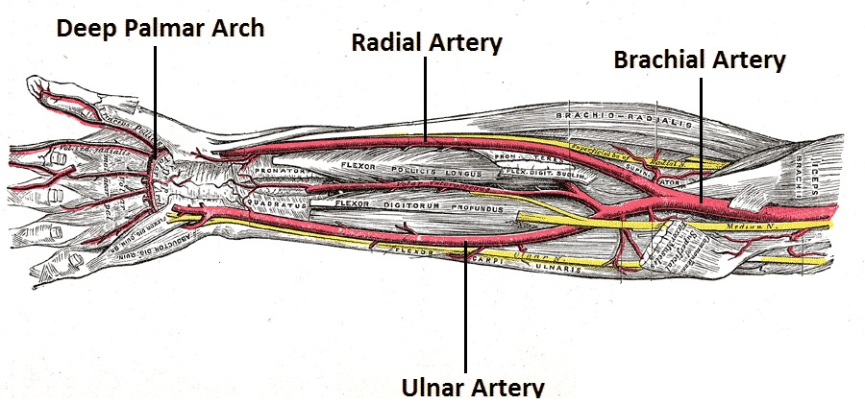
Ulnar & Radial Arteries
Only in the boys’ slides
The main source of blood for the forearm.
The ulnar artery supplies the anterior aspect.
The radial artery supplies the posterior aspect of the forearm.
The two arteries anastomose(تتشعب) in the hand, by forming two arches, the superficial palmar arch, and the deep palmar arch.

Slide 27
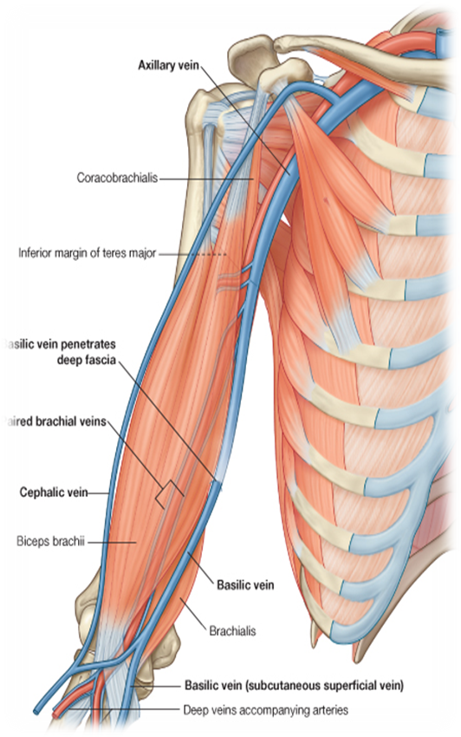
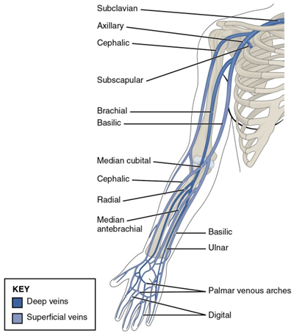
Only in the boys’ slides
Superficial Veins:
The major superficial veins of the upper limb are the cephalic and basilic veins.
At the elbow, the cephalic and basilic veins are connected by the median cubital vein.
Basilic vein
Originates from the dorsal venous network of the hand.
It ascends the medial aspect of the upper limb.
At the border of the teres major, the vein moves deep into the arm.
It then combines with the brachial veins to form the axillary vein..
Cephalic vein
Arises from the dorsal venous network of the hand.
It ascends the antero-lateral aspect of the upper limb, passing anteriorly at the elbow.
At the shoulder, the cephalic vein travels between the deltoid and pectoralis major
muscles to enter the axilla region via the clavipectoral triangle.
Within the axilla, the cephalic vein terminates by joining the axillary vein .

Slide 28
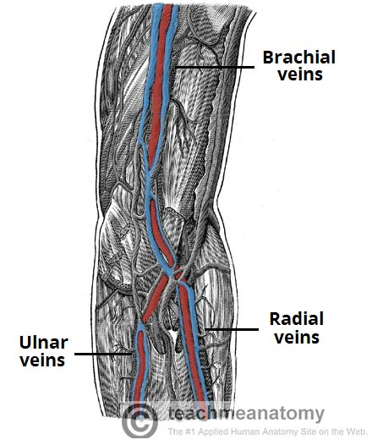
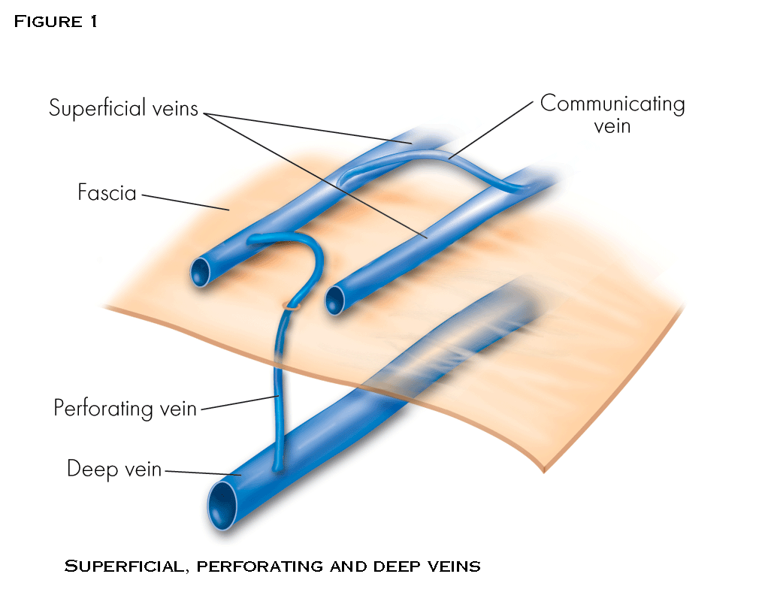
Deep Veins:
Only in the boys’ slides
They are underneath the deep fascia.
They are known as venae comitantis: a pair of veins that accompany one artery.
The brachial veins (venae comitantis of the brachial artery) on both sides of brachial artery (largest in size).
Ulnar veins ( known as venae comitantis of ulnar artery) on both side of ulnar artery.
Radial veins (known as venae comitantis of radial artery) on both side of radial artery.
Pulsation* from the brachial artery helps in venous return. (*pulsation: expansion of the artery because of blood flow)
Perforating veins run between the deep and superficial veins of the upper limb, connecting the two systems together.(they help in maintaining correct blood draining).

Slide 29
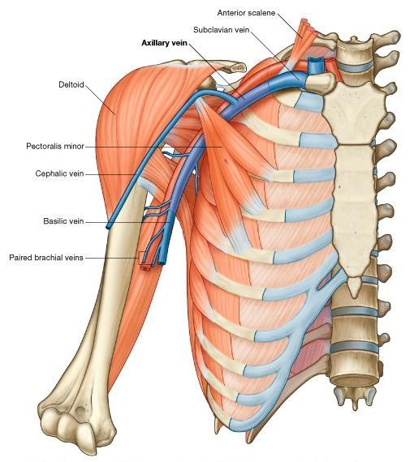
Axillary Vein:
Only in the boys’ slides
From lower border of Teres major muscle to the outer border of the first rib (between red lines shown on the picture).
Formed by the union of basilic vein and brachial veins.(the brachial veins are known as venae comitantes of the brachial artery)

Slide 30
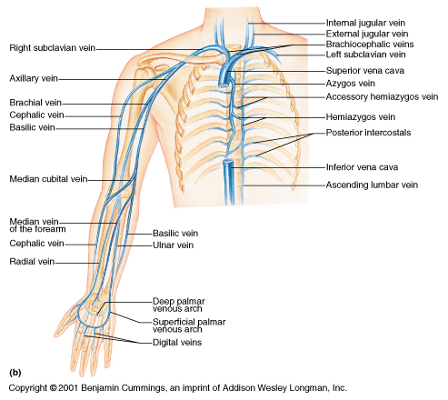
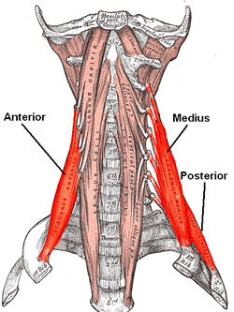
Subclavian Vein:
Only in the boys’ slides
Continuation of axillary vein
From outer border of first rib to medial border of anterior scalene muscle (or the sternal end of the clavicle).
The subclavian vein follows the subclavian artery
Joins internal jugular vein to form brachiocephalic vein.
Right and left brachiocephalic veins join forming the superior vena cava that enters the right atrium anterior to middle scalene.
Anterior scalene
Middle scalene

Slide 31
MCQs
1- Which of the following is not a part of the flexor compartment ?
A- Biceps
B-median nerve
C-brachial artery
D-triceps
2- What is the muscle that is responsible in “screwing” ?
A- coracobrachialis
B- biceps brachii
C- brachialis
D- triceps
3- The capsule attached to the margins of the of the coronoid process of the ulna from: A- Anteriorly above. B- Posteriorly above. C- Anteriorly below. D- Posteriorly below
4- Why do children have posterior dislocation more often than adults ? A- Weak bones B- Incomplete developed bones C- Osteoporosis
5- At which site the basilic vein moves deep into the arm ?
A-At the shoulder
B-At the border of teres minor
C-At the border of teres major
D-between the head of bicepes muscle
6- The subclavian vein is a continuation of which vein?
A-Axillary
B-Cephalic
C-Basilic
D-Vena comitantis of brachial artery
7- Which is not one of contents Cubital fossa :
A.Median Nerve
B. Brachial Atrtery
C. Deep Branch Of Radial Nerve
D. Triceps Brachii Tendon
Answers:
1-D
2-B
3-C
4-B
5-C
6-A
7-D

Slide 32
MCQs
SAQ
8- Which one of these is not a branch of the brachial artery :
A.Profunda brachii
B. Radial artery
C. Superior ulnar collateral artery
D. Subscapular artery
9- The axillary artery arises from :
A. Brachial artery
B. Vertebral artery
C. Subclavian artery
D. Suprascabular artery
10- Which of the following is bi-innervated?
Biceps brachii
Brachialis
Coracobrachialis
1.What articulates the elbow joint from above?
2.What covers the articular surfaces of elbow joint?
3.What are the superficial veins ?
4.What are the boundaries of the axillary vein?
.
1ST Answer: Trochlea of humerus & Capitulum of humerus
2ND Answer: Hyaline cartilage
3rd Answer:1-Basilic vein
2-Cephalic vein
4th Answer: It starts from the lower border of Teres major muscle to the outer border of the first rib
Answers:
8- D
9- C
10- B

Slide 33
Leaders:
Nawaf AlKhudairy
Jawaher Abanumy
Ghada Almazrou
Members:
Yazeed AlSuhaibani
Abdulmalik alhadlaq
Mohammed nasr
Majed alzain
Talal alhuqayl
Hamad Alkhudhairy
Mohammed Habib
Abdulhakim Alonaiq
Abdullah Jammah
Mohammed alkahil
Abdulaziz alsalman
anatomyteam436@gmail.com
@anatomy436

