Slide 1
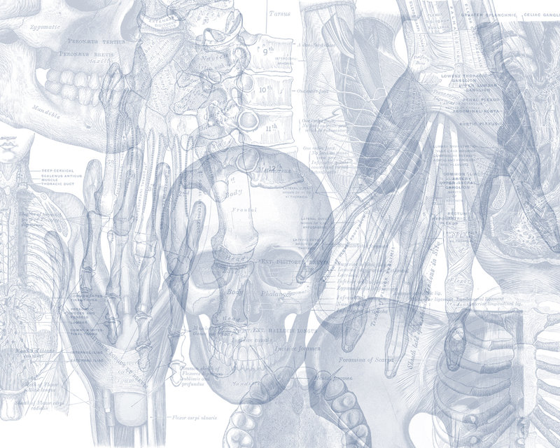
Hand and Wrist
Color Code
Important
Doctors Notes
Notes/Extra explanation
Editing file

Slide 2
Objectives
Describe the anatomy of the deep fascia of the wrist & hand (flexor & extensor retinacula & palmar aponeurosis).
List the structures passing superficial & deep to flexor retinaculum.
Describe the anatomy of the insertion of long flexor & extensor tendons.
Describe the anatomy of the small muscles of the hand (origin, insertion, action & nerve supply)

Slide 3
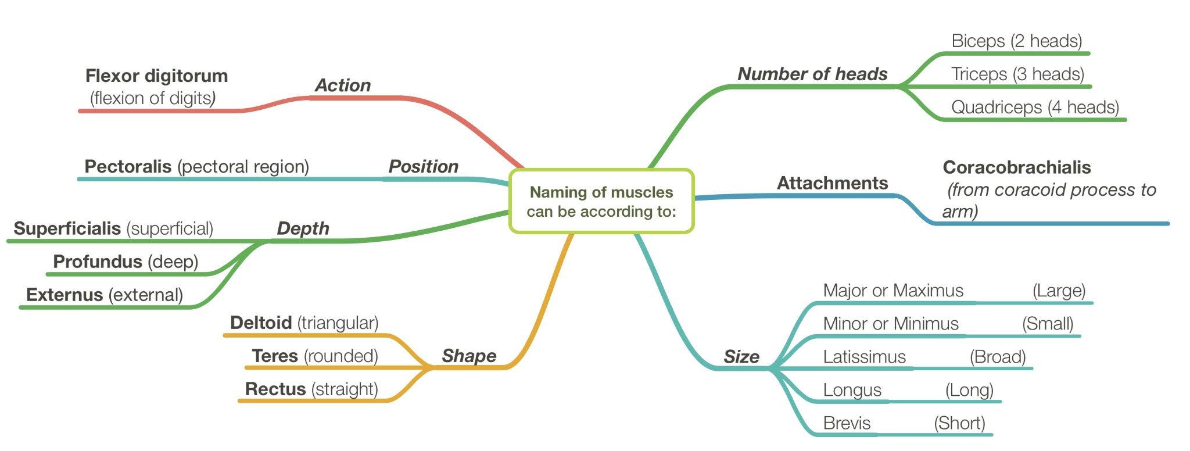
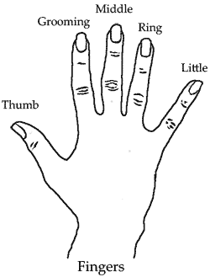
Recall what we took in foundation:
The following pairs always come together (they counter each other so if one is present so is the other)
Flexor & Extensor (flexor carpi ulnaris & extensor carpi ulnaris)
Longus & Brevis (extensor carpi radialis longus & extensor carpi radialis brevis)
Superficialis & Profundus (flexor digitorum superficialis & flexor digitorum profundus)
Major & Minor (pectoralis major & pectoralis minor)
The fingers:
Digitorum = has 4 tendons each attached to a finger
Pollicis = the thumb
Indices = index finger السبابه
Digiti minimi = pinkie
Index

Slide 4
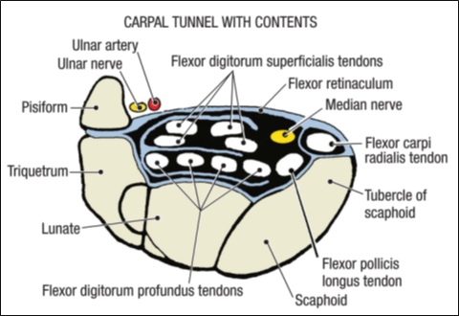
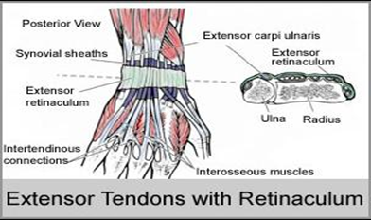
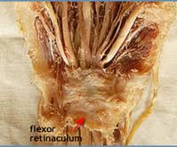
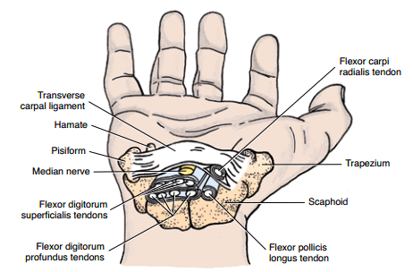
Retinacula
Flexor & Extensor Retinacula:
Bands of Deep Fascia at the Wrist
Function:
Hold the long flexor and extensor tendons at the wrist in position.
Attachments:
 | Medially | Laterally
Flexor retinaculum | Pisiform & Hook of hamate | Tubercle of scaphoid & Trapezium
Extensor retinaculum | Pisiform & Hook of hamate | Distal end of radius
Extra

Slide 5
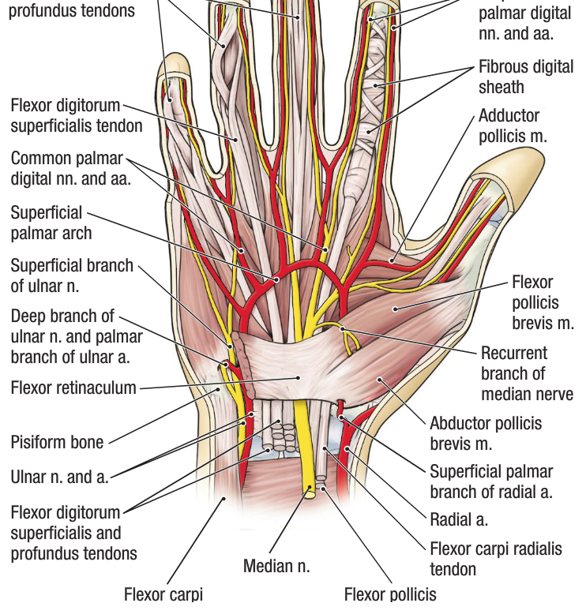
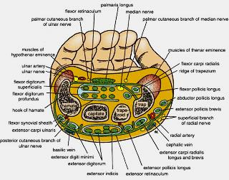
Structures Superficial to
Flexor Retinaculum
From Medial to Lateral
Tendon of Flexor carpi ulnaris.
Ulnar nerve.
Ulnar artery.
Palmar cutaneous branch of ulnar nerve.
Palmaris longus tendon.
Palmar cutaneous branch of median nerve.

Slide 6
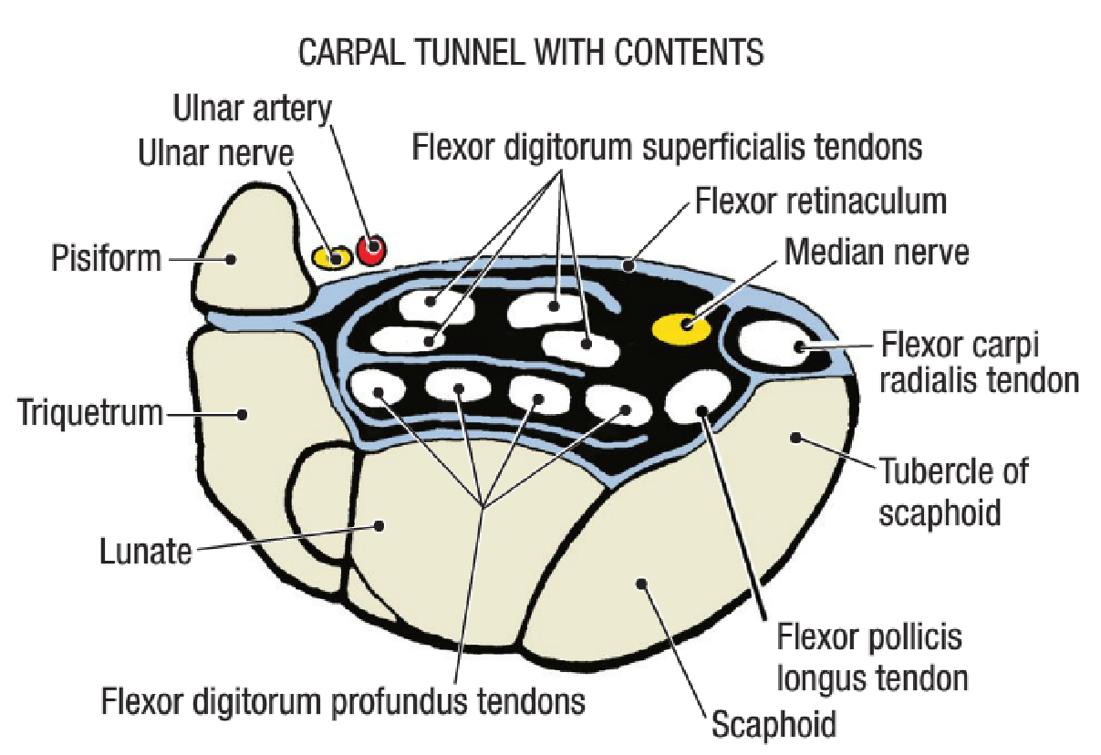
Carpal Tunnel
Formed from
Concave anterior surface of the Carpus (carpal bones) covered by Flexor Retinaculum.
Contents
From Medial to Lateral
Tendons of flexor digitorum superficialis & profundus
Median nerve
Flexor Pollicis Longus
(Flexor carpi radialis)
* Note the flexor carpi radialis is in between brackets because it has a special compartment in the fascia

Slide 7
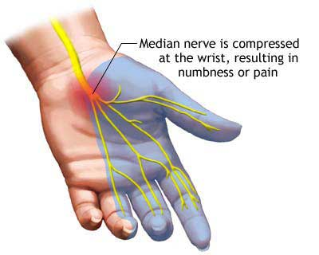
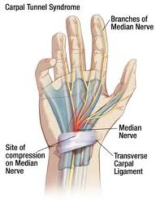
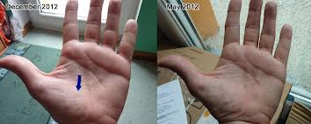
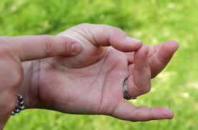
Carpal Tunnel Syndrome
Causes :
Compression of the median nerve within the carpal tunnel.
Manifestations:
1.Burning pain (pins and needles) in the lateral three and half fingers.
No paresthesia* over the thenar eminence (because it is supplied by the plamer cutaenous branch of the median which is superficial to the flexor retinaculum)
2. Weakness or atrophy of the thenar muscles (Ape Hand).
3. Inability to Oppose the thumb.
*Paresthesia: a sensation of pricking, tingling, or creeping on the skin usually associated with injury or irritation of a sensory nerve or nerve root

Slide 8
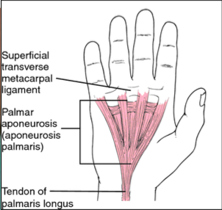
Palmar Aponeurosis:
The thickened deep fascia of the palm.
It is triangular in shape, occupies the central area of the palm.
It has:
Apex: attached to the distal border of flexor retinaculum and receives the insertion of palmaris longus tendon.
Base: divides at the bases of the fingers into four slips that pass into the fingers.
Function:
Firmly attached to the overlying skin and improves the grip (it’s deeply concave and not superficial in order to hold stuff easily)
Protects the underlying tendons, vessels & nerves.
Gives origin to palmaris brevis muscle.

Slide 9
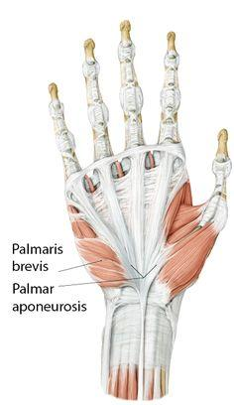
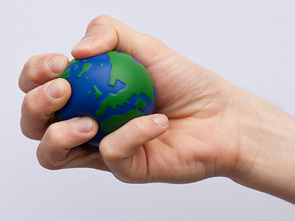
Palmaris Brevis:
Origin | Insertion | Nerve supply | Action
Flexor retinaculum (FR) & Palmar aponeurosis (PA) | Skin of the palm | Ulnar nerve (superficial branch) | Corrugation* of skin to improve grip.
(the contractions appear on the skin since it’s a superficial muscle)
corrugation*:shaped into alternate ridges and groove

Slide 10
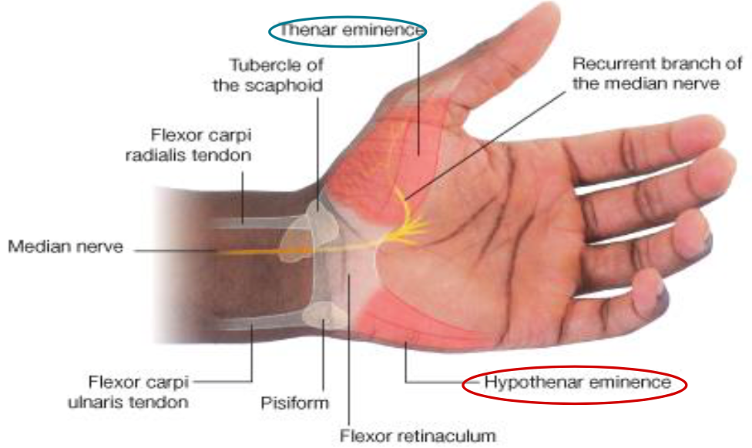
Short Muscles of Thumb & Little Finger: (explained in the next slide)
It includes the Thenar eminence and Hypothenar eminence. Each one is further divided into 3 types of muscles.
Can be remembered using the mnemonic,
"A OF A OF A" for:
(thenar muscles)
Abductor pollicis brevis
Opponens pollicis
Flexor pollicis brevis
Adductor pollicis
(Hypothenar muscles)
Opponens digiti minimi
Flexor digiti minimi
Abductor digiti minimi

Slide 11
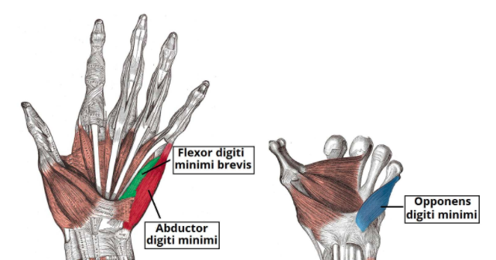
Short Muscles of Thumb & Little Finger:
Hypothenar Eminence
Muscle | Origin | Insertion | Nerve supply | Action
Abductor digiti minimi | Pisiform | Base of proximal phalanx | All by deep branch of ulnar nerve | Abduction
Flexor digiti minimi | Flexor retinaculum |  |  | Flexion
Opponens digiti minimi | Flexor retinaculum | Palmer surface of 5th meta-carpal |  | Pulls the 5th metacarpal forward

Slide 12
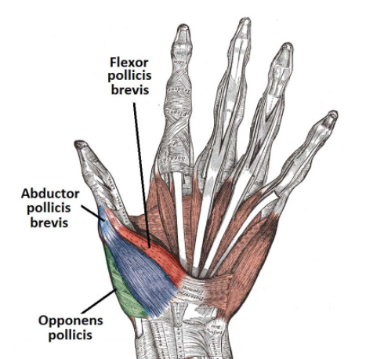
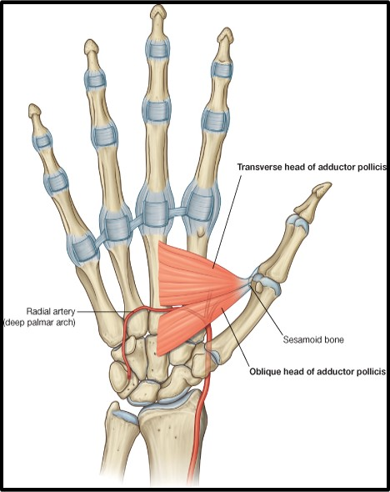
Short Muscles of Thumb & Little Finger:
Thenar Eminence
Muscle | Origin | Insertion | Nerve supply | Action
Abductor pollicis brevis | Flexor retinaculum, Scaphoid and trapezium | Base of proximal phalanx | All supplied by median nerve | Abduction
Flexor pollicis brevis | Flexor retinaculum |  |  | Flexion
Opponens pollicis | Flexor retinaculum | Lateral part of 1st metacarpal |  | Opposition
Adductor Pollicis (also on the thumb but not part of the thenar) | Origin | Insertion | Nerve supply | Action
 | Oblique head: Anterior bases of 2nd &3rd metacarpal. Transverse head : 3rd metacarpal. | Medial side of base of proximal phalanx of thumb. | Deep branch of Ulnar nerve. | Adduction.

Slide 13
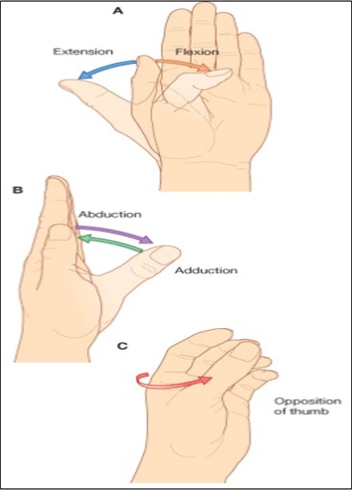
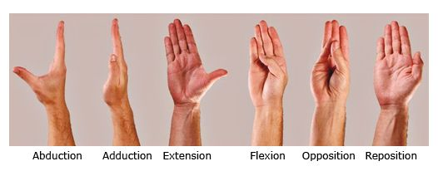
Movements of the Thumb

Slide 14
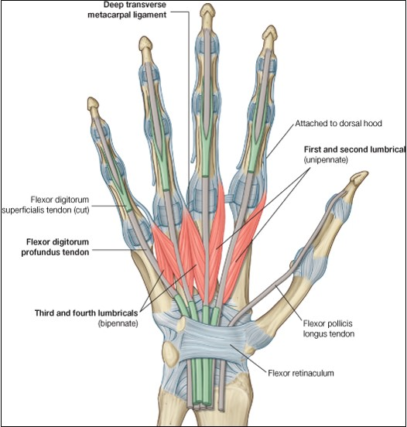
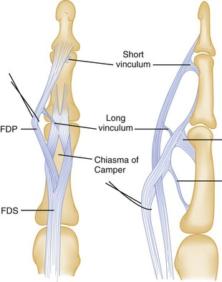
Insertion of
Flexor Digitorum Superficialis & Profundus
Extra
Flexor Digitorum Superficialis
1- Each tendon Divides into two halves & pass around the Profundus Tendon.
2- The two halves Meet on the posterior aspect of Profundus tendon (partial decussation of fibres).
3- Reunion (اتحاد من جديد) of the two halves.
4- Further Division into two slips attached to the Borders of Middle Phalanx.
4
2 & 3
1
Extra picture for understanding
Flexor digitorum Profundus :
Inserted into the Base of the Distal Phalanx.

Slide 15
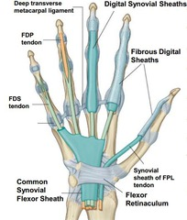
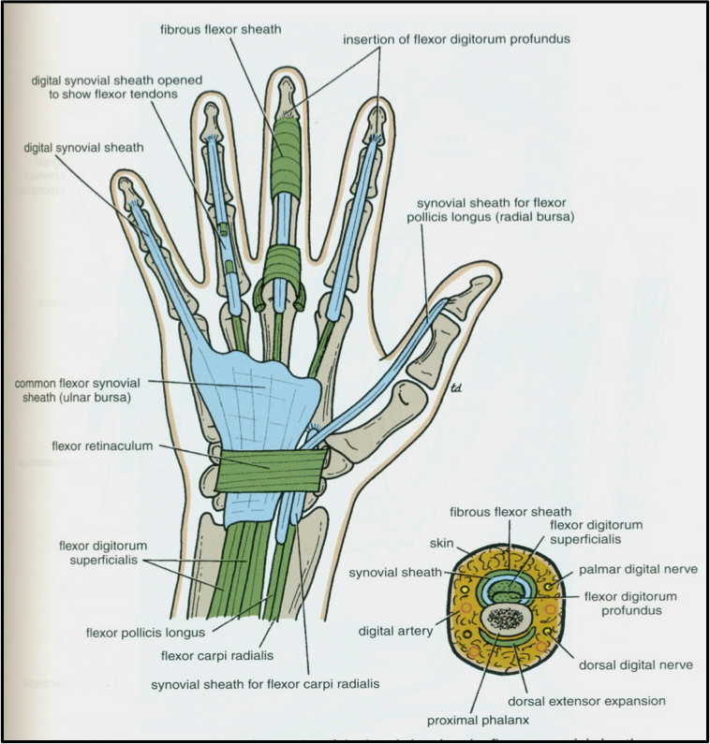
Fibrous Flexor (Digital) & Synovial Flexor Sheaths:
Synovial flexor sheaths:
Fibrous flexor sheaths:
A - Common synovial sheath (ulnar bursa).
Cover tendons of flexor digitorum superficialis and profundus.
The medial part of it extends distally (without intteruption) on tendons of the little finger. (covers the whole finger)
The lateral part stops on the middle of the palm. (doesn’t cover the 3 middle fingers)
The distal ends of the long flexor tendons to (index, middle and ring) fingers is digital synovial sheaths. (not the ulnar bursa).
Fibrous flexor is a strong fibrous sheath which covers ¹ the anterior surface of the fingers and attached to the sides of the phalanges.
Its proximal end is opened.
Its distal end is closed.
The sheath with the anterior surface of the phalanges & the interphalangeal joints form an osteofibrous blind tunnel ² for the long flexor tendons of fingers.
B - Flexor pollicis longus tendon of the thumb has its own synovial sheath (radial bursa).
Function of synovial sheaths:
They allow the long tendons to move smoothly with a minimum of friction beneath the flexor retinaculum and the fibrous flexor sheaths.
¹ Both kinds of sheath covers the tendon to protect it.
² like a cave ( opened from one side and closed from another )
Each finger has a tendon covered by (fibrous flexor sheath) to protect it and between the tendon and the fibrous sheath there are synovial sheaths to reduce friction.

Slide 16
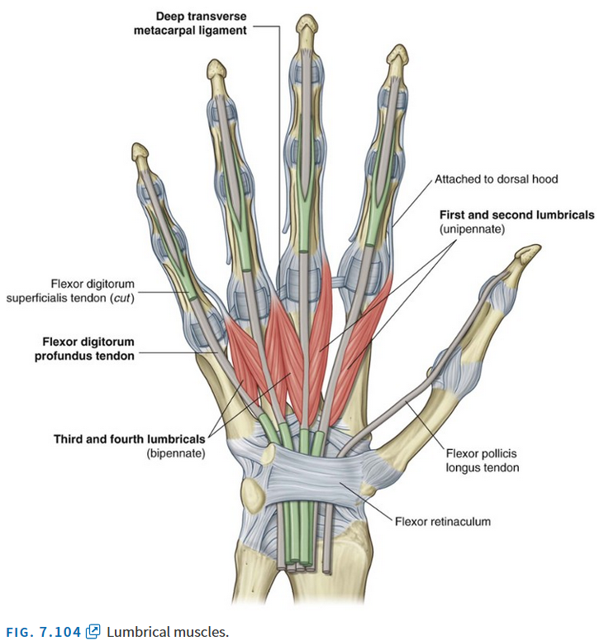
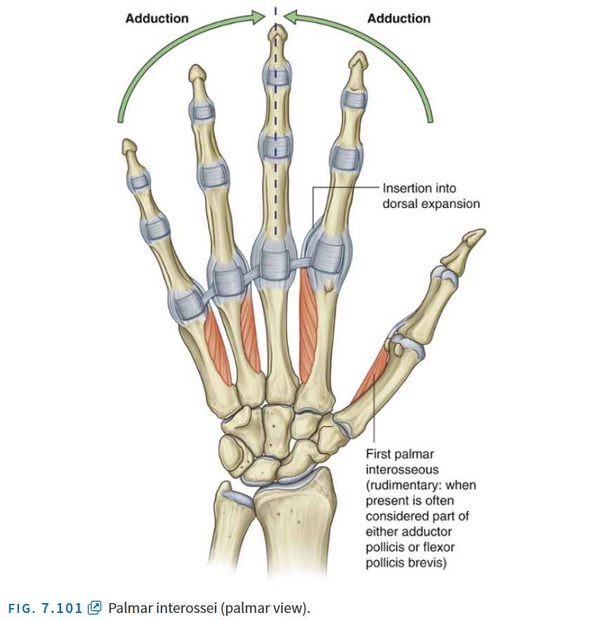
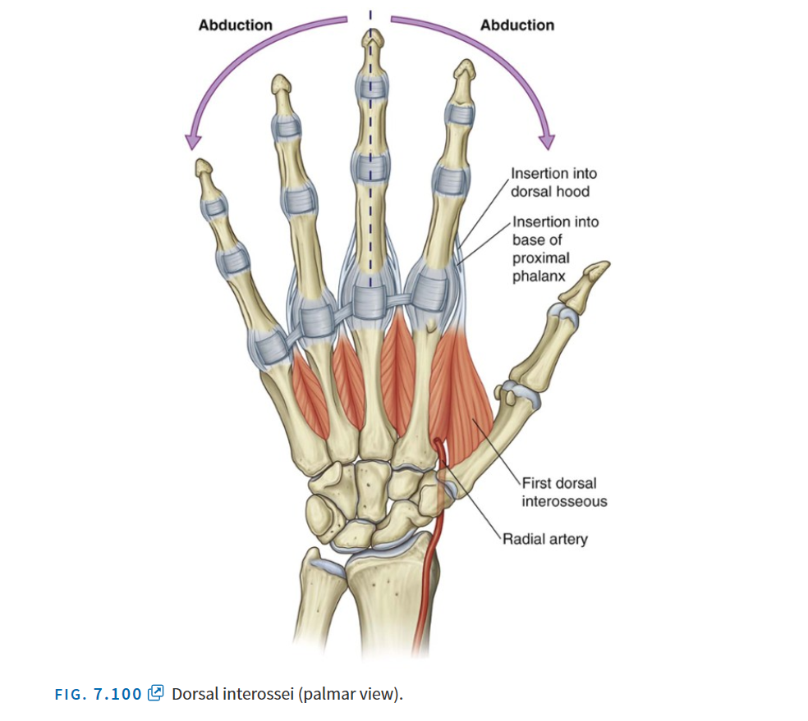
Muscles of the hand
Lumbricals (4 muscles)
Palmar interossei (4 muscles)
Dorsal interossei (4 muscles)
3
2
1
3
2
3\
2
4
4
4
1
1
Note: you have to differentiate between numbering according to the metacarpals and numbering the digits
Index
Index
2
3
4
1
2
3
1
5
4

Slide 17
Muscles of the hand
Muscle | Origin | Insertion | Nerve supply | Action
Lumbricals (4 muscles) | Tendons of flexor digitorum profundus | Extensor expansion of medial four fingers. | Lateral two 1st & 2nd by recurrent/digital branch of the median nerve Medial two 3rd &4th by the deep branch of the ulnar nerve. | Flex metacarpophalangeal joints and extend interphalangeal joints of fingers Except thumb
Palmar interossei (4 muscles) | 1st : Base of 1st metacarpal. Other three: Ant. Surface of Shafts of 2nd, 4rd & 5th metacarpals.* | Proximal phalanges of thumb ,index, ring, & little fingers and Extensor expansion | Deep branch of ulnar nerve | Adduction of fingers toward center of the 3rd one.
Dorsal interossei (4 muscles) | Contiguous sides of shafts of Metacarpals Contiguous: adjacent, sharing a common border | Proximal Phalanges of index, ring ,middle finger & Extensors | Deep branch of ulnar nerve | Abduction of fingers away from the 3rd one.
* The 3rd metacarpal doesn’t have palmer interossei because it is the axis (does not adduct)

Slide 18
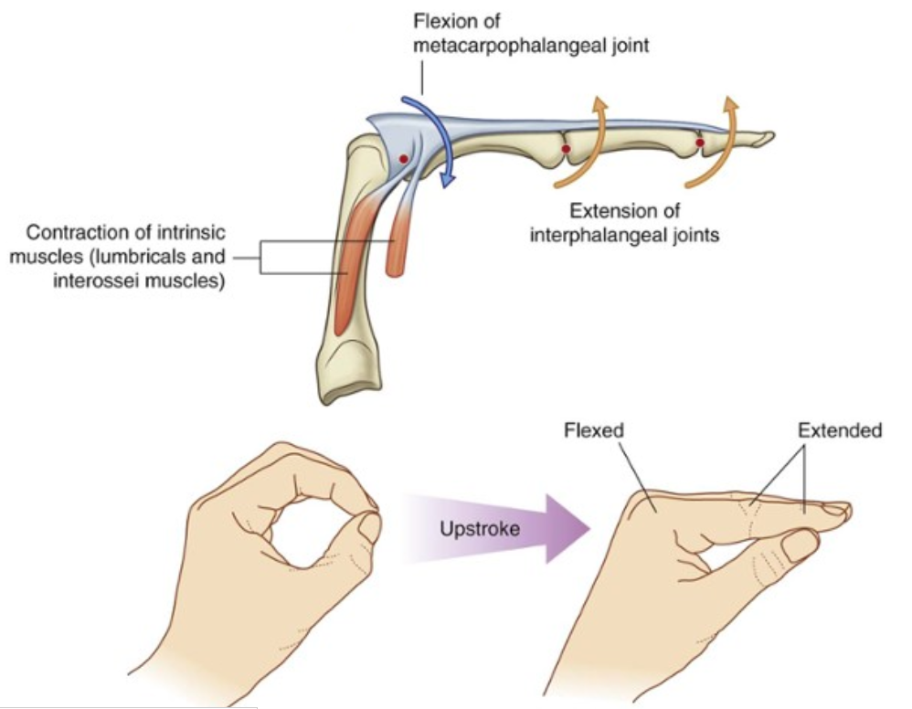
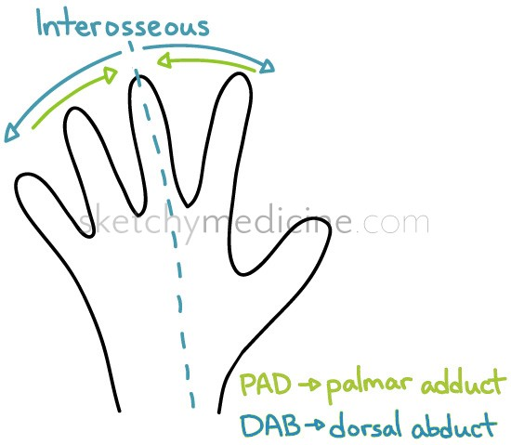
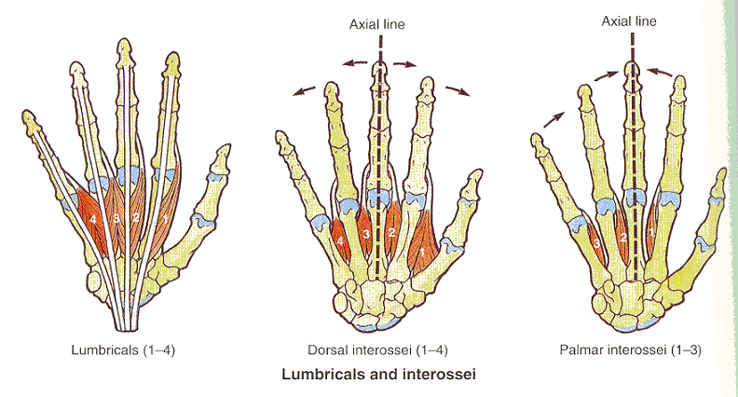
Action of Lumbricals & Interossei
Extra
Note: the main function of the interossei muscles is abd/adduction but they also assist the lumbricals
Extra
Note: Reverse the writing position and you get the claw hand
(extension of metacarpophalangeal & flexion of interphalangeal)

Slide 19
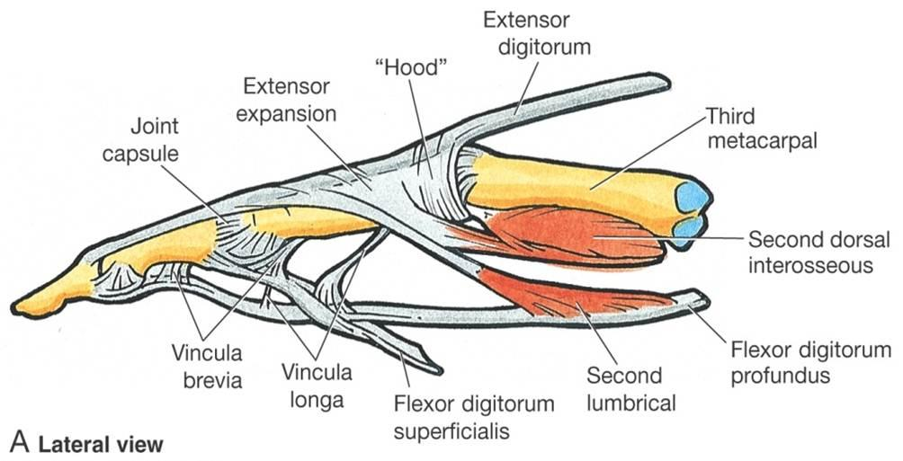
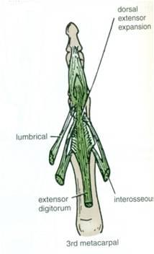
Extensor Expansion
Formed from the expansion of the tendon of the extensor digitorum at the PIJ (proximal interphalangeal joint).
The tendon split into three parts:
- One Central: inserted into the base of Middle phalanx.
- Two laterals: inserted into the base of the Distal phalanx.
The Expansion Receives the insertions of:
Corresponding Interosseous muscle (on each side).
Lumbrical muscle (on the lateral side).

Slide 20
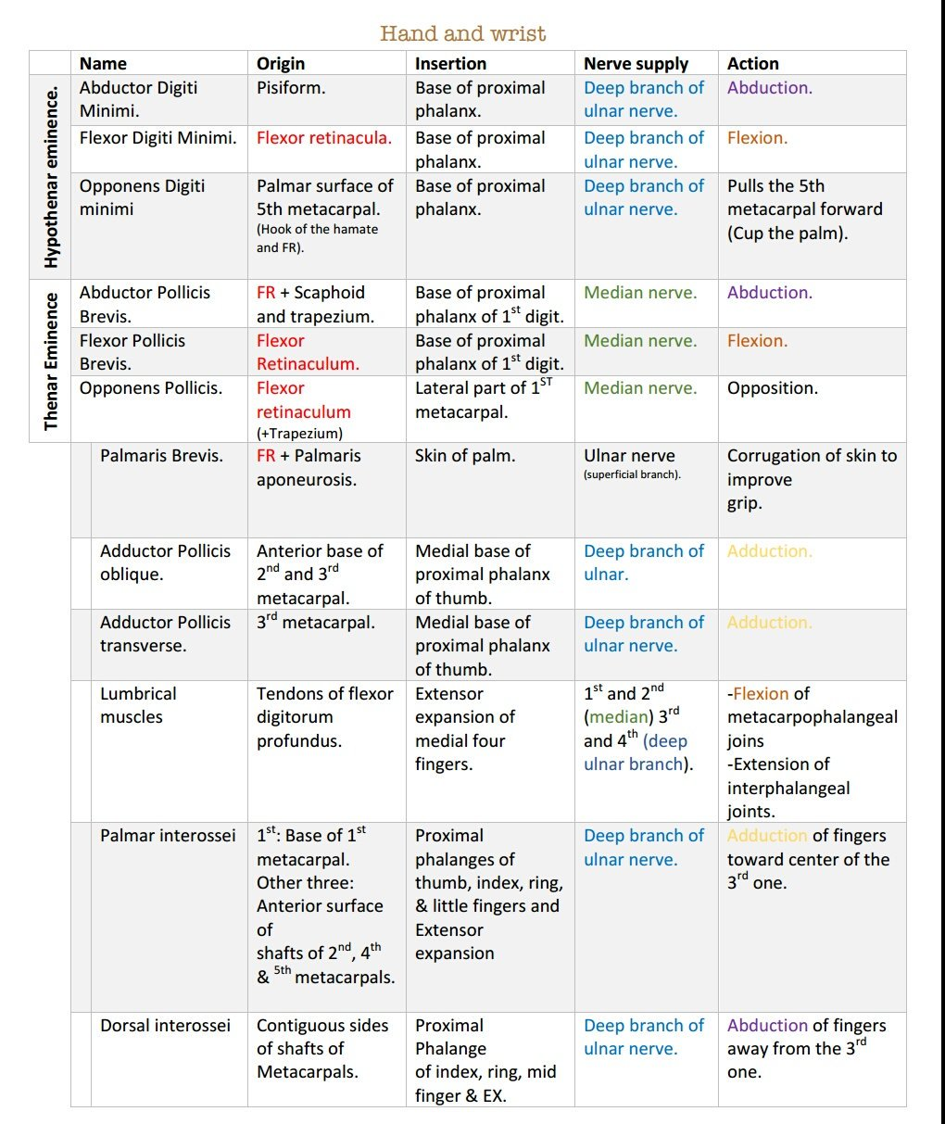
Summary
Flexor retinaculum
Palmer surface of 5th metacarpal

Slide 21
Questions
1- The hypothenar muscles are supplied by:
A- Median nerve
B- Superficial branch of the ulnar nerve
C- Musculocutaneous nerve
D- Deep branch of the ulnar nerve
2- The palmar aponeurosis gives origin to the palmaris longus muscle
A- True
B- False
3-There are two other muscles in the palm that are not lumbricals or interossei and do not fit in the hypothenar or thenar compartments:
A- Abductor pollicis & Opponens pollicis
B- Opponens digiti minimi & flexor digiti minimi
C-Adductor Pollicis & Palmaris Brevis
4- which end of fibrous flexor sheath is opened ?
A- proximal end
B- distal end
C- none of them
D- both of them
5- the function of synovial sheaths is:
A- to protect the bone
B- Hold the long flexor and extensor tendons at the wrist in position.
C- minimum friction
D- flexion of the wrist
6- The lateral two lumbrical muscles are supplied by :
A-Deep branch of ulnar nerve
B-digital branches of the median nerve
C-Superficial branch of the ulnar nerve
D-axillary nerve
7- The insertion of Dorsal interossei is in :
A-Proximal Phalanges of index, ring ,middle finger & Extensors
B- distal phalanges of index, ring, middle finger & Extensors
C-Base of proximal phalanx
D- Lateral part of 1sr metacarpal
8- What is the origin of Adductor Pollicis ?
A- Flexor retinaculum.
B- Pisiform.
C- Flexor retinaculum Scaphoid and trapezium.
D- Anterior base of 2nd and 3rd metacarpals.
9- The 2 halves of tendon of Flexor digiti superficialis will meet on :
A- Anterior aspect of Profundus tendon.
B- Posterior aspect of Profundus tendon.
C- Anterior aspect of superficialis tendon.
D- Posterior aspect of superficialis tendon.
1-D
2-B
3-C
4- A
5- C
6- B
7- A
8- D
9- B

Slide 22
Questions
10- A boy injured his median nerve and as a result there was a wasting in the thenar muscles. List the muscles affected and the action of each one.
11- A patient presented with burning pain in the lateral three and half fingers and inability to oppose the thumb. What is the most likely diagnosis? Which nerve is affected?
12- List 4 structures superficial to the flexor retinaculum.
Answers:
10- 1) abductor pollicis brevis (abduction)
2) flexor pollicis brevis (flexion)
3) opponins pollicis (opposition)
11- Carpel tunnel syndrome. The median nerve is compressed.
12- 1) ulnar nerve
2) ulnar artery
3) palmer cutaneous branch of ulnar nerve

Slide 23
Leaders:
Nawaf AlKhudairy
Jawaher Abanumy
Ghada Almazrou
Members:
Deena AlNowiser
Lama AlTamimi
Norah Alshabib
Razan AlQahtani
Thikrayat Omar
Wejdan Alzaid
anatomyteam436@gmail.com
@anatomy436

