Slide 1
Vascular Anatomy Of The Upper Limb
Color Code
Important
Doctors Notes
Notes/Extra explanation
Editing File

Slide 2
Objectives
At the end of the lecture, the students should be able to:
Identify the origin of the vascular supply for the upper limb.
Describe the main arteries and their branches of the arm, forearm & hand.
Describe the vascular arches for the hand.
Describe the superficial and deep veins of the upper limb

Slide 3
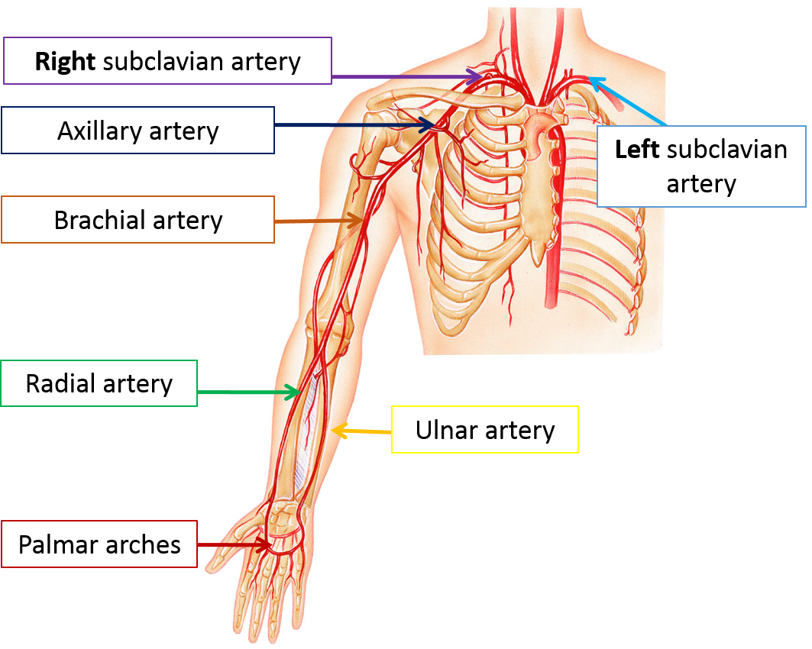
First: Arteries Of The Upper Limb :
Please take note that the left and right is mirrored so Your Right is His left and so on..

Slide 4
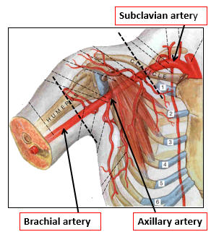
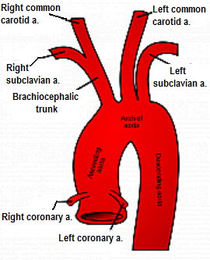
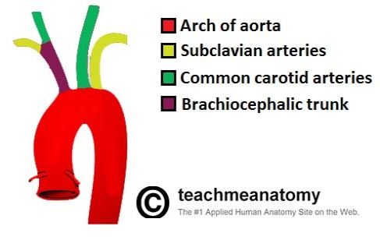
Arteries Of The Upper Limb
1) The Subclavian Artery:
*The right subclavian artery originates from the brachiocephalic artery.
*The left subclavian artery originates from the arch of the aorta.
*both Continue as Axillary artery at the lateral(outer) border of the 1st rib

Slide 5
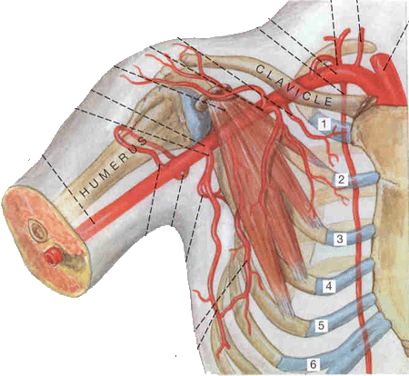
Arteries Of The Upper Limb
Subclavian artery
2) The Axillary Artery :
Axillary artery
Brachial artery
*Begins at the lateral border of the 1st rib as continuation of the subclavian artery.
*It’s closely related: to the cords of brachial plexus and their branches
* It’s enclosed (with axillary vein) within the axillary sheath.
*It’s crossed anteriorly by the pectoralis minor muscle, and is divided into three parts; 1st, 2nd & 3rd.
*Continues as brachial artery at lower border of teres major muscle.
1st rib
1st part
2nd part
The 1st part of the axillary artery
Highest thoracic artery
3rd part
*Extends from the lateral border of 1st rib to upper border of the pectoralis minor muscle.
*Related:
Anteriorly: to the pectoralis major muscle
Laterally: to the cords of the brachial plexus.
*It gives; ONE branch: Highest thoracic artery
Pectoralis minor muscle
Highest thoracic artery
Teres major muscle

Slide 6
axillary sheath contain:
This slide is extra

Slide 7
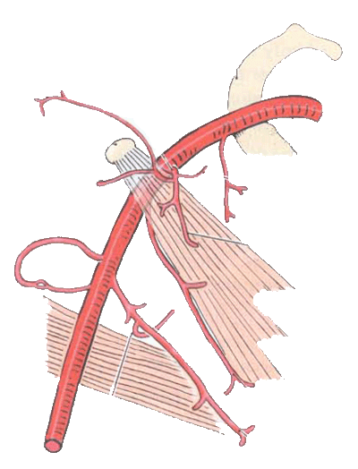
The 3rd part of the axillary artery
The 2nd part of the axillary artery
*Lies: behind the pectoralis minor muscle.تكون تغطيه
*It is related:
medially, laterally, and posteriorly to the corresponding cord of the brachial plexus.يعني ميديل له يكون الميديل كورد ولترل له يكون اللترل كورد...
*It gives; TWO branches:
1st rib
1st part
Lateral Thoracic artery .
In females it is bigger because it supplies the mammary glands
2nd part
Thoracoacromial artery.
Highest thoracic artery a.
3rd part
Thoracoacromial a.
*Extends from the lower border of pectoralis minor muscle to the lower border of teres major muscle.
*Related:
medially, laterally, and posteriorly, to the branches of the cords
of the brachial plexus
*It gives; THREE Branches:
Pectoralis minor muscle
Lateral Thoracic a.
Teres major muscle
1- Anterior circumflex humeral artery
2- Posterior circumflex humeral artery
3- Subscapular artery

Slide 8
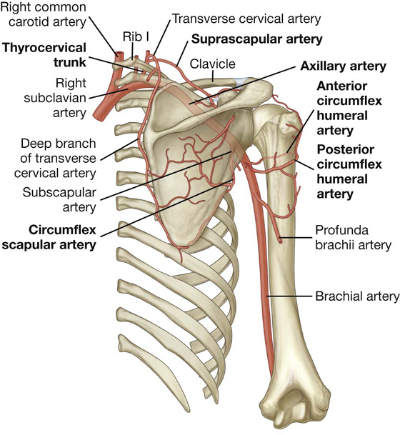
Anastomosis
Anastomosis occurs between branches of Subclavian and Axillary arteries:
Anastomosis: is a connection or opening between two things (especially cavities or passages) that are normally diverging or branching, such as between blood vessels.
وتعني مفاغرة وممكن تكون طبيعية مثل هنا. أو مرضية ...
around Shoulder joint (SCAPULA) (the first three)
Suprascapular artery
Branches from Subclavian Artery
Transverse cervical artery
Subscapular artery
Branches from Axillary Artery
The 3rd part
Anterior circumflex humeral artery
Anterior circumflex humeral artery
Posterior circumflex humeral artery
Anastomosis around the surgical neck of humeurs

Slide 9
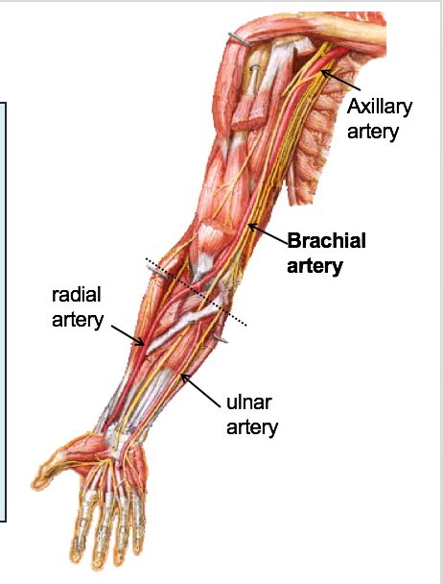
Arteries Of The Upper Limb
3)The Brachial Artery
coracobrachialis
Biceps
Provides main arterial supply to the arm.
Is a continuation of the axillary artery at the lower border of teres major muscle.
Terminates opposite Neck of Radius by dividing into Radial & Ulnar arteries.
Brachialis
Median N.
Anteriorly: crossed from above downward by medial cutanous nerve of the forearm(يكون انتيرير له في البروكسميل بارت له), median nerve (يكون انتيرير له في الميدين بارت له), and bicipital aponeurosis (يكون انتيرير له في الدستل بارت له).
Posterioly: triceps, coraco-brachialis and brachialis.
Medially: basilic vein, ulnar and median nerves(في اللور بارت له).
Laterally: coracobrachialis and biceps muscles.
Ulnar N.
Relations of brachial artery

Slide 10
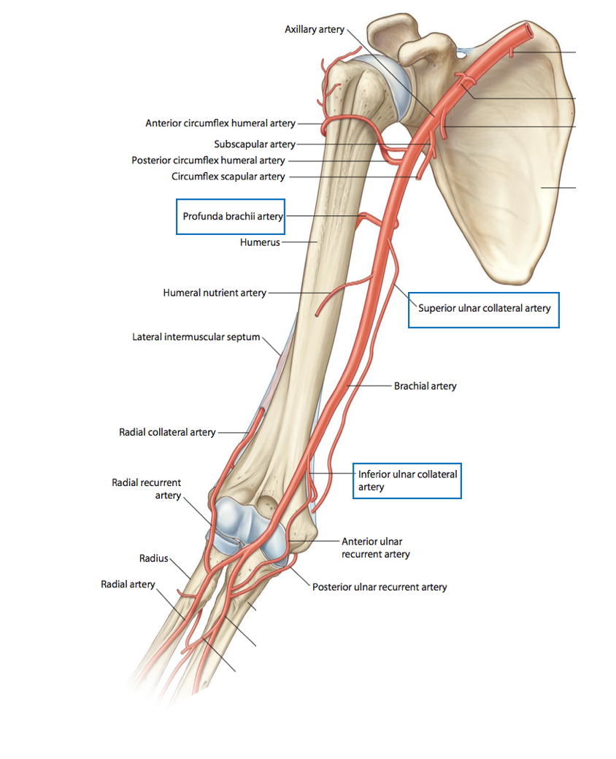
Branches of Brachial Artery
Muscular.
Nutrient to humerus.
They are three:
Profunda brachii along with the radial nerve in the spiral groove
Superior ulnar collateral.
Inferior ulnar collateral.
All share in anastomosis in elbow joint

Slide 11
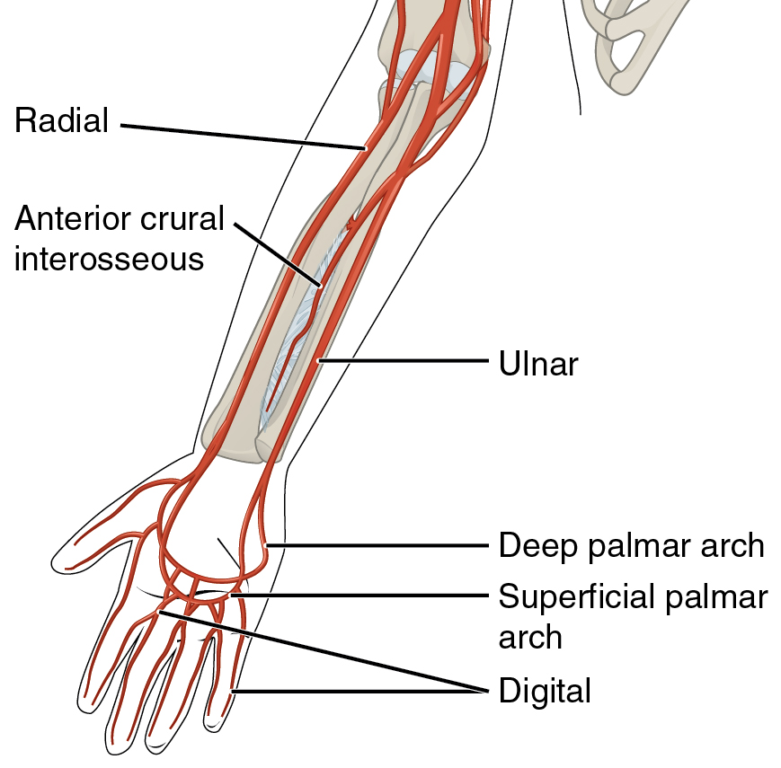
Arteries Of The Upper Limb
4) The Ulnar Artery
The larger of the two terminal branches of the brachial artery.
The radial artery is small but superficial so we can feel its pulse, while the ulnar artery is big but deep so we can’t feel its pulse.
Begins in the cubital fossa at the level of neck of radius.
Descends through the anterior compartment of the forearm.
Enters the palm, in front of the flexor retinaculum, with the ulnar nerve.
Ends by forming the superficial palmer arch, by anastomosing with superficial palmer branch of radial artery.
Recall:

Slide 12
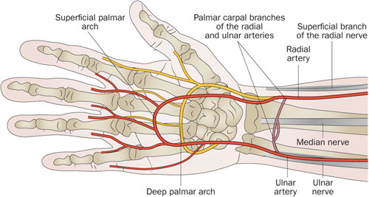
Branches of Ulnar Artery
Muscular.
1- Recurrent branch (for anastomosis around the elbow joint). Around the medial epicondyle, to anastomose with the inferior and superior ulnar collateral arteries
2- Common Interosseous artery, which gives:
Anterior Interosseous arteries
Posterior Interosseous arteries.
3- Branch to anastomoses around the wrist joint.
Recurrent branch
Ulnar Recurrent : branch of Ulnar Artery
ulnar collateral : branch of brachial Artery

Slide 13
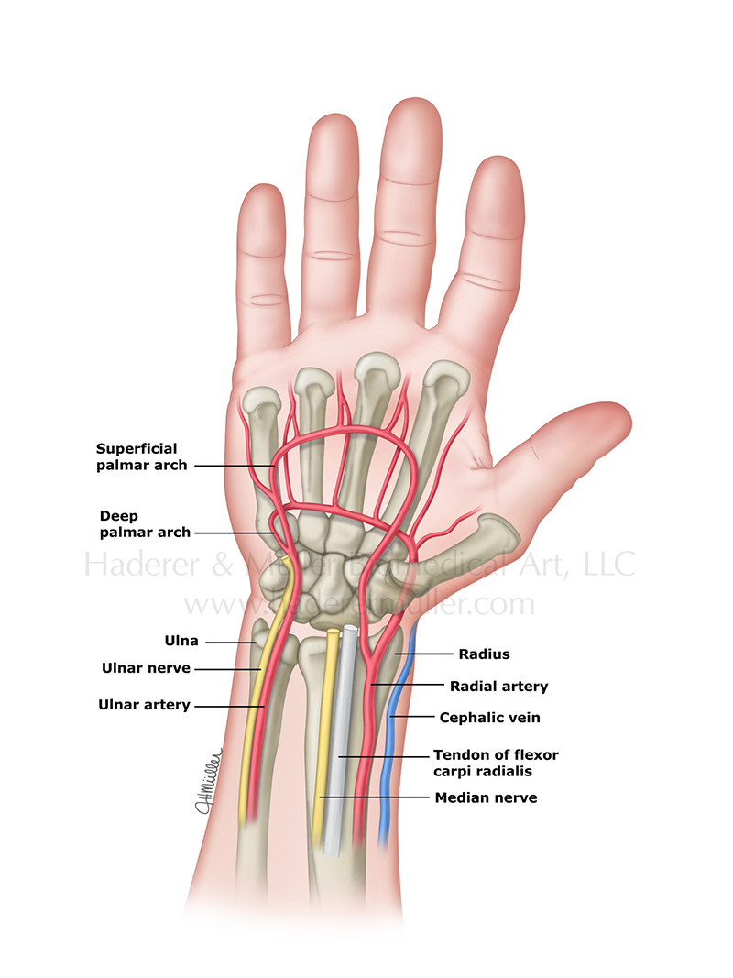
Arteries Of The Upper Limb
5) The Radial Artery
The smaller of the two terminal branches of the brachial artery.
Begins in the cubital fossa at the level of neck of radius.
Descends downward and laterally.
Leaves the forearm by winding around the lateral aspect of the wrist to reach the dorsum of the hand.

Slide 14
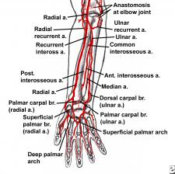
Branches of Radial Artery
Muscular
1- Recurrent branch (for anastomosis around the elbow joint).
2- Superficial palmar branch , joins the ulnar artery to form the superficial palmar arch.

Slide 15
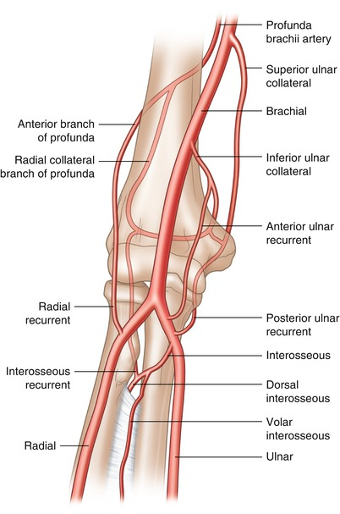
Anastomosis
around Elbow Joint
Anastomosis occurs between branches of Brachial, Radial and Ulnar arteries
Around the epicondyle of humerus (medial & lateral) :
Branches from Brachial Artery:
Profunda Brachii artery
Superior ulnar collateral artery
Inferior ulnar collateral artery
Branches from Ulnar and Radial Arteries:
Radial & ulnar recurrent arteries
Interosseous recurrent artery (from ulnar)
Around the lateral epicondyle The profunda brachii branches anastomose with the radial recurrent artery and the interosseous recurrent artery.
Around the medial epicondyle, the superior ulnar collateral artery anastomoses with the posterior ulnar recurrent. The inferior ulnar collateral artery anastomoses with the anterior ulnar recurrent
^هذا كله شرحته الدكتورة
Lateral
Medial

Slide 16
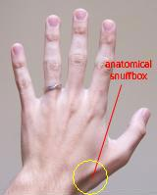
Arteries of the palm
Ulnar artery :
Enters the hand:
- anterior to the flexor retinaculum,
- on the lateral side of the ulnar nerve and pisiform bone.
Continue as the superficial palmar arch.
▪ Gives a deep branch.
Radial artery:
Leaves dorsum of the hand by turning forward between the proximal ends of the 1st and 2nd metacarpal bones, and between two heads of the 1st dorsal interosseous muscle. This place called anatomical snuff box.
▪ On entering the palm it continues as deep palmar arch.
▪ gives; arteria radialis indices and arteria princeps polices.
Policis = thumb
Indecis = index (السبابة)

Slide 17
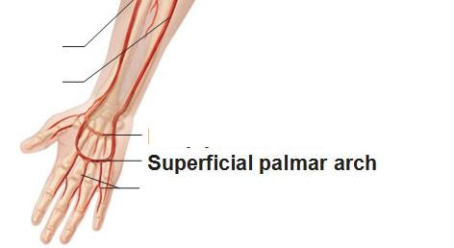
Arteries of the palm
The Superficial Palmar Arch
90% ulnar 10% radial
Is the direct continuation of the ulnar artery,
as it curves laterally behind the palmar aponeurosis.
➢Is completed by branch from the radial artery (only 10%).
➢Lies approximately at the level of the Distal Border of the Extended Thumb.
➢Gives: digital arteries from its convexity to supply the fingers.
^only the later 3 and half of the index because the thumb and other half are supplied by the radial artery
*The superficial palmar arch is more distal than the deep palmar arch.
The Superficial Palmar Arch

Slide 18
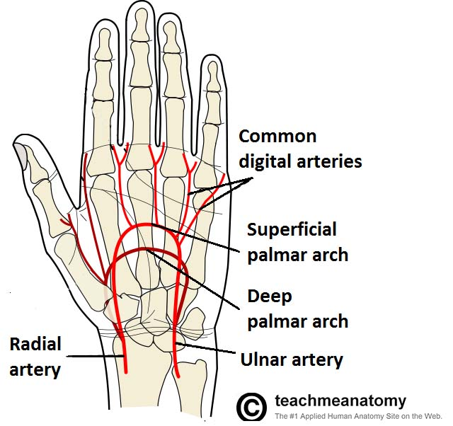
Arteries of the palm
The deep Palmar Arch
90% ulnar 10% radial
The deep palmar arch
Is a continuation of the radial artery as it curves medially beneath long flexor tendons , in front of the metacarpal bones and interosseous muscles.
➢Is completed on the medial side by deep branch of ulnar artery (only 10%).
➢Lies at a level of the Proximal Border of Extended thumb.
When the thumb is extended and I draw a line from the proximal border I get the deep arch and when I draw a line from the distal border I get the superficial arch.
➢It sends branches:
1- superiorly to share in anastomosis around the wrist joint
2- inferiorly to join branches of the superficial palmar arch.
The superficial palmer arch is more distal than the deep palmer arch
Notes:
1-
2-

Slide 19
Arterial Innervation And Raynaud’s Disease
Raynaud’s disease is a vasospastic disease involves digital arteries.
It may require Cervicodorsal رقبي ظهري preganglionic sympathectomy , to prevent necrosis of the fingers.
The artery gets its nerve supply from the sympathetic. If it is over stimulated they will be vasoconstriction if too little vasodilatation.
People who have over sympathetic supply in the digital artery they become vasoconstricted so there is a decrease in the arterial supply so the ends of their fingers become cold and blue. If the prescribed drugs cannot produce vasodilatation they will have to surgically remove sympathetic fibers/ganglion because if the problem is not resolved it can lead to dry gangrene due to ischemia. Symptoms: cold and blue fingers all the time (whether the temperature is cold or hot).
A sympathectomy is an irreversible procedure during which at least one sympathetic ganglion is removed.

Slide 20
second: Veins Of The Upper Limb :
Veins of the UL
Deep
Axillary
Subclavian
Superficial
Cephalic
Basilic
Median Cubital
venæ comitantes of the radial and ulnar arteries.
brachial veins

Slide 21
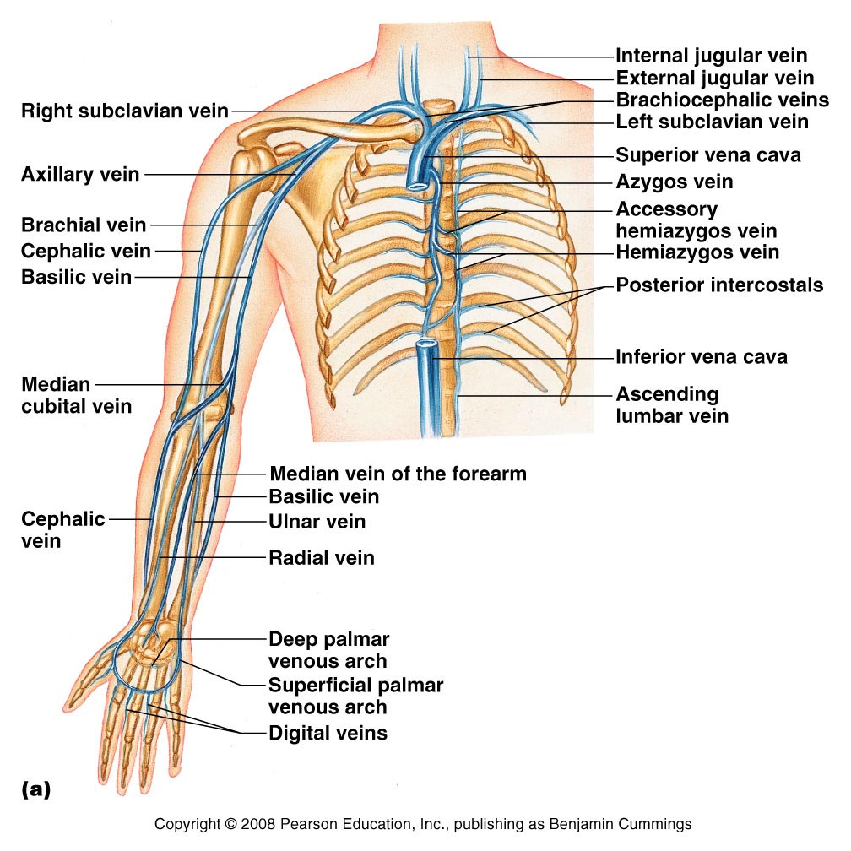
Veins of the Upper Limb
The veins of the upper limb are divided into two sets*: Superficial and Deep
1- The superficial veins: are placed immediately beneath the skin**, in the superficial fascia.
2- The deep veins:
a. accompany the arteries^. b. constitute the venæ comitantes of those vessels.
(The two sets anastomose frequently with each other)
*according to there position. **in the subcutaneous tissue.
^accompanying large or medium size arteries.
عادةً الديب فينز اللي مالها أسماء وتكون مرتبطة بكلا الجانبين للآرتري الكبير (venae comitantes)تسمى الأوردة المُصاحِبة
مثل البراكيال آرتري معاه بكل الجهتين أوردة مُصاحِبة.
فمثلاً في براكيال آرتري بس مافيه براكيال فين

Slide 22
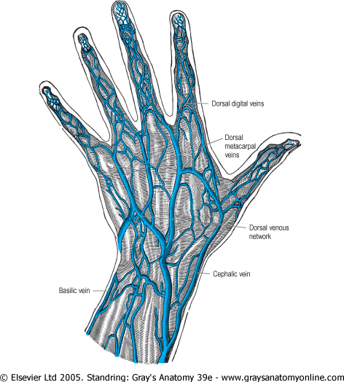
Veins of the Upper Limb
1- Superficial Veins
Dorsal Venous Arch (network)
The dorsal digital veins drain into dorsal
metacarpal veins, which unite to form
a dorsal venous arch or network.
Dorsal venous network lies on the dorsum of the hand, in the subcutaneous tissue, proximal to the metacarpophalangeal joints.
Drains into the Cephalic vein laterally, and Basilic vein medially.
Note: we study the veins from distal to proximal because they return the blood back to the heart from the peripheries and collect at the trunk. (they pour into/join each other so they don’t have branches)

Slide 23
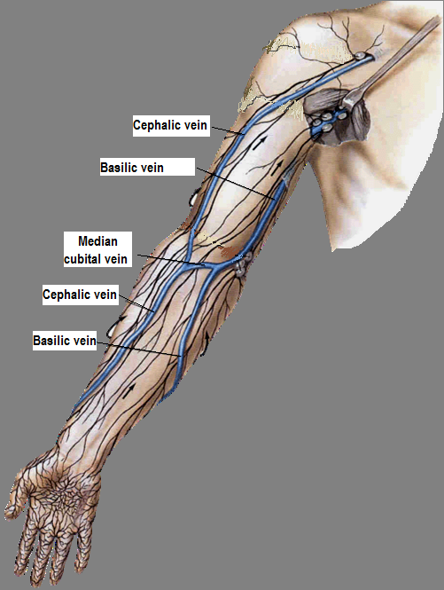
Cephalic Vein
Basilic Vein
Arises from the lateral end of the dorsal venous arch of hand.
Ascends on radial side of the forearm to the elbow and continues up to the arm in the deltopectoral groove.*
It pierces clavipectoral fascia** to drain into the axillary vein.
Arises from the medial side of the dorsal venous arch of hand.
Ascends on the ulnar side of forearm to the elbow.
In the middle of the arm it pierces the deep fascia and joins the brachial vein or axillary vein.^
Median Cubital Vein: 1- Links cephalic vein and basilic vein in the cubital fossa. ^^
2- Is a frequent site for venipuncture. (سحب الدم) + for IV injection
*space between Deltoid and Pectoralis major muscles.
**thick connective tissue filling the space between Clavicle and Pectoralis minor (in deltopectoral groove)
ف الفين يبغى يصير من سوبرفيشيال لديب لذلك يخترق هذي الفيشيا ويصب بالديب فين دائماً الأوردة السطحية تصب في أوردة عميقة
^ and it continues to the outer border of the first rib and it will called Subclavian vein.
^^most of the blood found in Cephalic vein will drain in Basilic vein by Median Cubital vein. The blood that did not drain in the Basilic vein by the Median Cubital vein will continue to the Axillary vein.

Slide 24
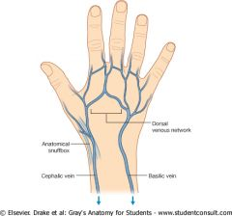
Veins of the Upper Limb
2- deep Veins
They accompany the arteries of the same region and bear similar names.*
Venae commitantes: They are generally arranged in pairs.
A- situated one on either side of the corresponding artery.
B- connected at intervals by short transverse branches. (بينهم مثل ال channels)
1- The superficial and deep palmar arterial arches are each accompanied by a pair of venæ comitantes which:
A- constitute the superficial and deep palmar venous arches.
B- receive the veins corresponding to the branches of the arterial arches.
Venae commitantes
2- The deep veins of the forearm are the venæ comitantes of the radial and ulnar arteries.
3- The brachial venae commitantes are placed one on either side of the brachial artery.
*For example:
Axillary and Subclavian veins

Slide 25
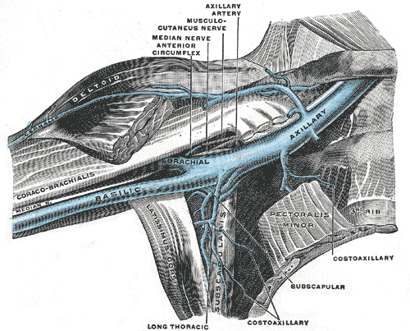
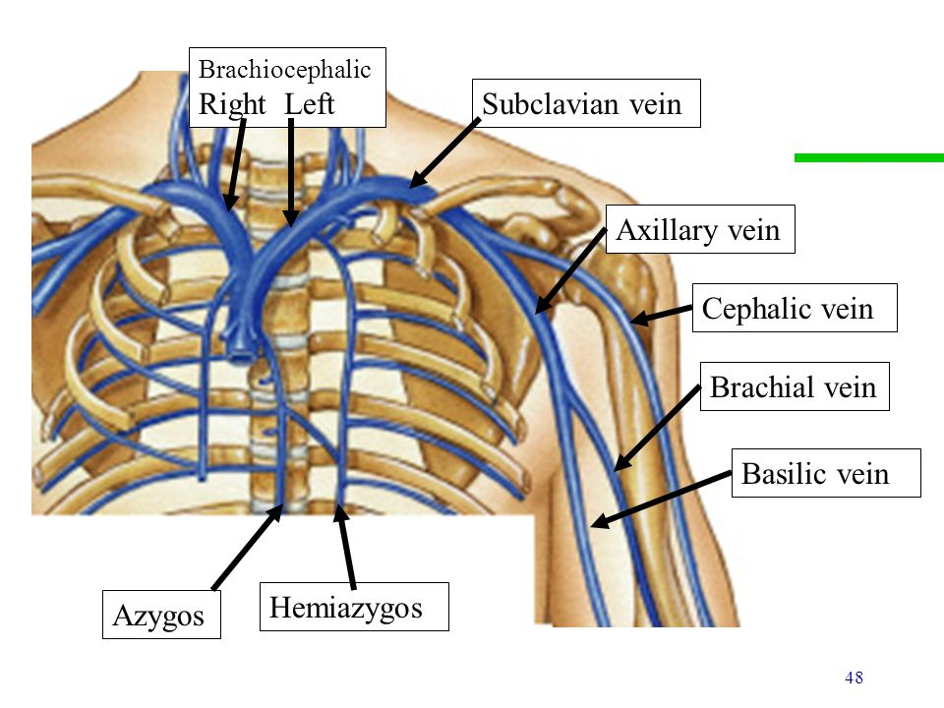
4- The Axillary vein:
5- The Subclavian vein:
Begins at the lower border of the Teres major, as the continuation of the basilic vein.
Ends at the outer border of the first rib as the subclavian vein.
Receives: 1- The brachial veins.
2- The cephalic vein (close l to its termination).
Is the continuation of the axillary vein.
Extends from the outer border of the first rib to the sternal end of the clavicle, where it unites with the internal jugular vein* to form the Brachiocephalic (Innominate) vein.
Rو L فيه منه يتحدون ويصبون في القلب
*بداية ونهاية الفين تكون عكس بداية ونهاية الآرتري مثل:
Axillary artery extends from the lateral border of 1st rib to lower border of the Teres major muscle. The axillary vein Begins at the lower border of the Teres major Ends at the outer border of the first rib.
*from the skull

Slide 26
Vein Catheterization
The Basilic vein is the vein of choice for central venous catheterization.
Because: from the cubital fossa until reaching the axillary vein:
1- It increases in diameter.*
2- lies in direct line with the axillary vein.
While The Cephalic vein:
1- dose not increase in size as it ascends in the arm.
2- frequently divides into small branches.(يتفرع = يصغر قطره)
3- it joins (opens) the axillary vein at right angle. So it is difficult to maneuver** the catheter around this angle.
* لأن كل ما يطلع لفوق الداياميتر يتوسع.
** to move in a careful and skillful way.

Slide 27
Summary
Subclavian Artery
Brachial
Continuation of Axillary at lower border of teres major
Ulnar and Radial
Begins at Cubital Fossa
originates from
right> brachiocephalic artery
left> arch of aorta
Axillary Artery
Begins at lateral border of first rib
crossed anteriorly by the pectoralis minor
three parts; 1st, 2nd & 3rd
Terminates opposite Neck of Radius by dividing into Radial & Ulnar
Provides main arterial supply to the arm
Ulnar is larger than radial

Slide 28
Summary (branches)
Axillary Artery
First part
Highest Thoracic Artery
Second part
Third part
Subscapular
Thoracoacromial
Lateral Thoracic
Anterior Circumflex Humeral
Posterior Circumflex Humeral

Slide 29
Summary : Anastomosis
around the surgical neck of humers
Anterior circumflex humeral artery
Posterior circumflex humeral artery
Suprascapular artery
Transverse Cervical artery
around shoulder joint (scapula)
around Elbow Joint
Profunda Brachii artery
Superior ulnar collateral artery
Inferior ulnar collateral artery
Radial & ulnar recurrent arteries
Interosseous recurrent artery( from ulner)
Subscapular artery
Branches from Axillary Artery
Branches from Brachial Artery
Branches from Subclavian Artery
Branches from Ulnar and Radial Arteries

Slide 30
Questions:
1)The first part of axillary nerve is related anteriorly to:
A-pectoralis major
B-pectoralis minor
C-cords of brachial plexus
D-Branches of cords of brachial plexus
2)the left subclavian artery originates from:
A-brachial artery
B-brachiocephalic trunk
C-common carotid artery
D-Arch of aorta
3)name the branch pointed on the picture:
…………………………………..
1st rib
1)A
2)D
3) Lateral Thoracic a.

Slide 31
3)The anastomosis in the scapula occurs between branches of … and ...?
4) Which of the following is a branch of subclavian artery?
A)Subscapular artery.
B)Anterior circumflex humeral artery.
C)Suprascapular artery.
5) Which of the following does not have a posterior relation with the brachial artery ?
A)Triceps.
B)coraco-brachialis.
C)biceps.
D)brachialis.
6) Which of the following is not a branch of brachial artery ?
A)Ulnar artery .
B)Profunda brachii .
C)Superior ulnar collateral.
D)Inferior ulnar collateral.
7) Name two arteries of the palm?
8) What arteries are effected by Raynaud's disease ?
3) Subclavian and Axillary arteries
4) C
5) C
6) A
7) Ulnar and radial
8) Digital arteries

Slide 32
9) which one of the following links cephalic vein and basilic vein in the cubital fossa:
Median vein
Brachial vein
Median cubital vein
Radial vein
10) when …………. drains into ……… which unite to form the Dorsal venous network which lies on the …:
a. dorsal digital veins, dorsal metacarpal veins, dorsum of the foot
b. dorsal metacarpal veins, dorsal digital veins, dorsum of the foot
c. dorsal metacarpal veins, dorsal digital veins, dorsum of the hand
d. dorsal digital veins, dorsal metacarpal veins, dorsum of the hand
11) Cephalic vein pierces:
clavipectoral fascia
deep fascia
Deltopectoral groove
venæ comitantes
12) it begins at the lower border of the Teres major, as the continuation of the basilic vein:
Subclavian vein
Axillary vein
Subclavian artery
Axillary artery
13) The Basilic vein is the vein of choice for central venous catheterization. Why?
9) C
10) D
11) A
12) B
13) Because: from the cubital fossa until reaching the axillary vein: 1- It increases in diameter. 2- lies in direct line with the axillary vein.

Slide 33
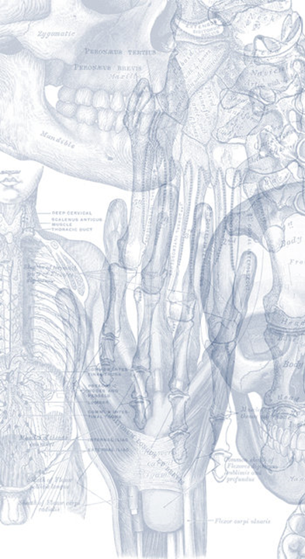
Leaders:
نواف الخضيري
جواهر ابانمي
غادة المزروع
members:
نجد الذيب
نورة السهلي
سمية الغامدي
آمال الشيبي
رنا باراسين
ريما العتيبي
بدرية الصباغ

