Slide 1
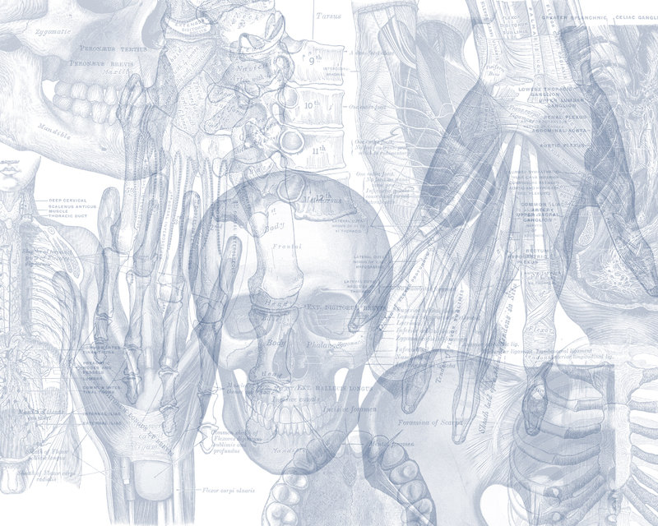
Anterior and Medial Thigh
Color Code
Important
Doctors Notes
Notes/Extra explanation
Editing file

Slide 2
Objectives
List the name of muscles of anterior compartment of thigh.
Describe the anatomy of muscles of anterior compartment of thigh regarding: origin, insertion, nerve supply and actions.
List the name of muscles of medial compartment of thigh.
Describe the anatomy of muscles of medial compartment of thigh regarding: origin, insertion, nerve supply and actions.
Describe the anatomy of femoral triangle & adductor canal regarding: site, boundaries and contents.

Slide 3
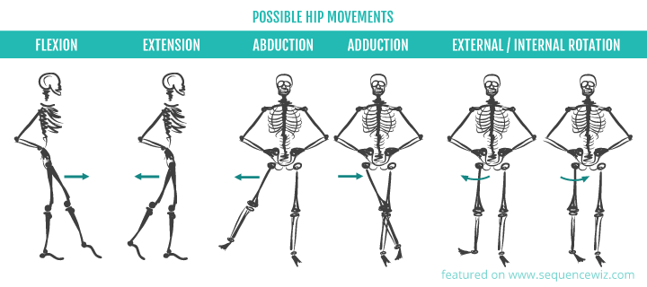
Or lateral
Or medial

Slide 4
The thigh is divided into 3 compartments
By 3 intermuscular septa (extending from deep fascia into femur)
Note: In the book the pectineus muscle is listed under the medial group but since it has similar innervation and action as the anterior group it is mentioned as a part of it here.
(Anterior compartment)
1. Quadriceps femoris
2. Sartorius
3. Pectineus
4. psoas major
5. Iliacus
Nerve supply:
Femoral nerve
(Posterior Compartment)
1. Hamstrings (next lecture)
Nerve supply:
Sciatic nerve
(Medial Compartment)
1. Adductor longus
2. Adductor brevis
3. Adductor magnus
(adductor part)
4. Gracilis
Nerve supply:
Obturator nerve

Slide 5
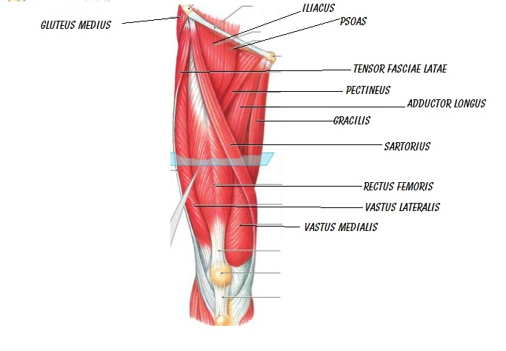
Anterior Compartment
MUSCLES:
Quadriceps femoris
Sartorius
Pectineus
psoas major
Iliacus
ACTION:
Extensor of the knee: Quadriceps femoris
Flexors of the hip: Sartorius , Pectineus , psoas major , Iliacus
Nerve supply:
Femoral nerve.
Vastus intermedius (deep to the rectus femoris)
flexors
extensors

Slide 6
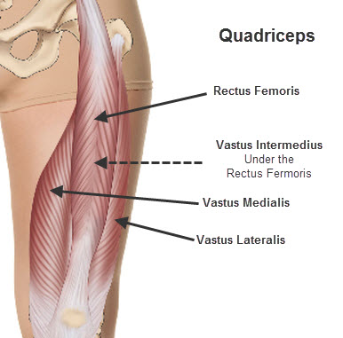
Anterior compartment
1- Quadriceps femoris
ORIGIN:
1- Rectus femoris: Anterior inferior iliac spine (Hip bone)
2- Vastus intermedius: Front of shaft of femur
3- Vastus medialis: Posterior border of femur
4- Vastus lateralis: Posterior border of femur
INSERTION:
Into PATELLA
(Patella is the largest sesamoid bone)
*From patella into TUBEROSITY OF TIBIA through ligamentum patellae (patellar ligament)
إذا سأل عن الانسيرشن لها الجواب هو آخر شيء اللي هو التيبيا تيوبرستي
ACTION: Extension of knee joint
Notes:
اتظليل الصورة

Slide 7
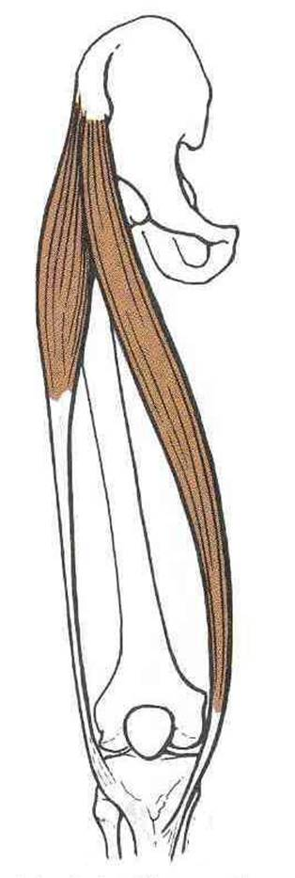
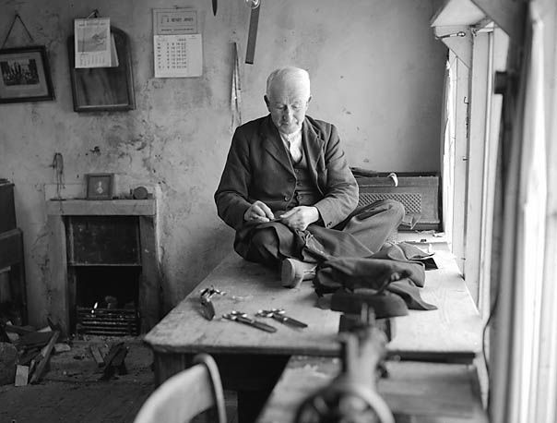
Anterior compartment
2- Sartorius
Origin:
Anterior superior iliac spine.
Insertion:
Upper part of medical surface of tibia.
SGS: same insertion(Upper part of medical surface of tibia)
= same action (flexes knee joint )
S: Sartorius (Anterior compartment)
G: Gracilis (Medial Compartment)
S: semitendinosus (part of Hamstrings) (Posterior Compartment)
Action:
(Tailor’s position)
Hip joint:
Flexion.
Abduction.
Lateral rotation.
Knee joint:
Flexion.
Tailor = خياط !

Slide 8
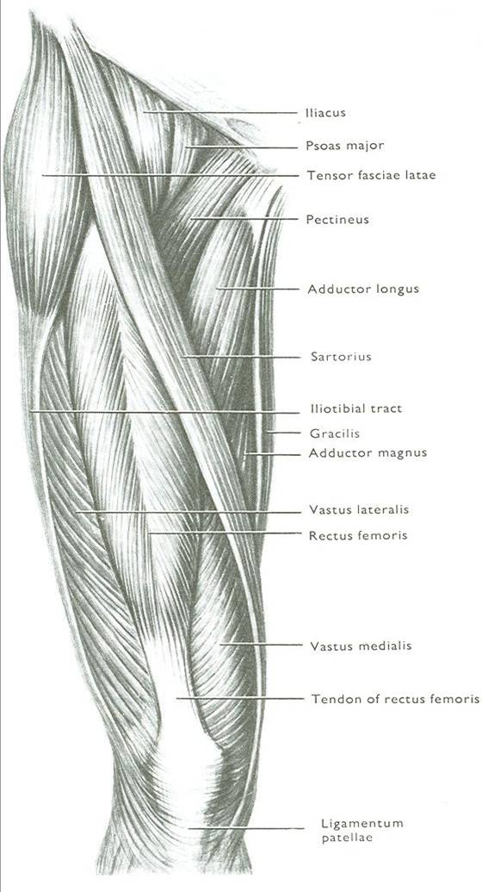
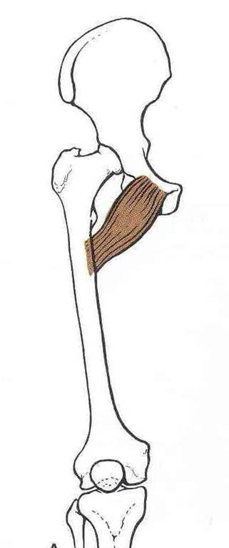
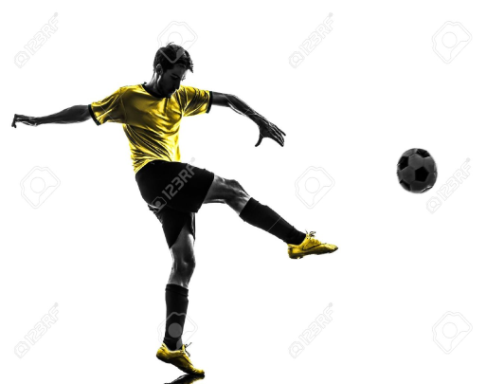
Anterior compartment
3- Pectineus
P
Origin:
Superior pubic ramus.
Insertion:
Back of femur (below lesser trochanter)
Action:
Flexion & adduction of Hip joint.
ملاحظة من الدكتورة: مثل شخص يشوت كورة

Slide 9
Anterior compartment
4- ILIOPSOAS: ILIACUS & PSOAS MAJOR
(/ˈsoʊ.əs/ or /ˈsoʊ.æs/)
نفس الاسم لأن لهم نفس الانسيرشن
Origin:
Iliacus: ilium of hip bone
Psoas: transverse process of lumbrical vertebral
INSERTION
Lesser trochanter of femur
ACTION
Flexion of hip joint
I
P
M
I
P
M

Slide 10
Medial Compartment
MUSCLES:
Adductor longus
Adductor brevis
Adductor magnus (Adductor part)
Gracilis
ACTION:
adduction of hip joint
N.B.: Gracilis also flexes knee joint (Mainly)+ adduction of thigh .
Nerve supply:
obturator nerve

Slide 11
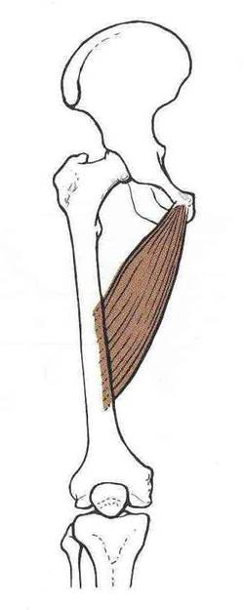
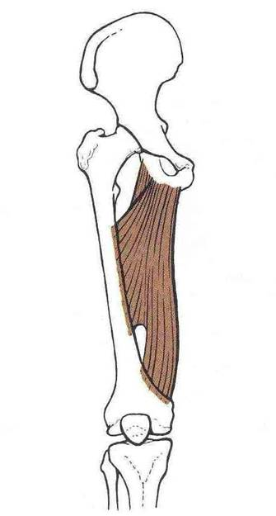
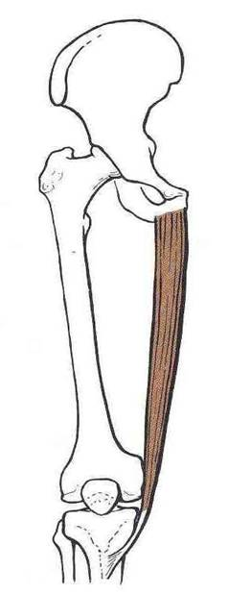
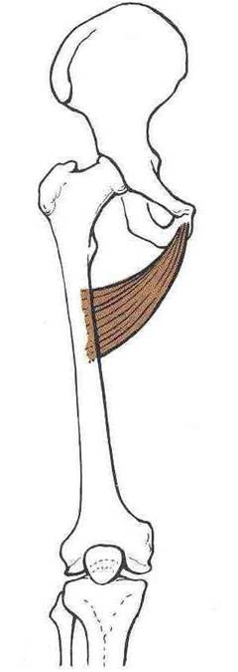
Medial Compartment
Body of pubis
Body of pubis
Inferior pubic ramus
Inferior pubic ramus
Ischial ramus.
Origin :
Adductor part
Adductor hiatus
Hamstring part
SGS: same insertion(Upper part of medical surface of tibia)
= same action (flexes knee joint )
S: Sartorius (Anterior compartment)
G: Gracilis (Medial Compartment)
S: semitendnous (part of Hamstrings) (Posterior Compartment)
ماقنس = أكبر من اللونقس
- Adductor longus
- Adductor brevis
- Adductor magnus
(adductor part)
- Gracilis
Insertion :
Posterior border of femur (Linea Aspera)
Upper part of medial surface of tibia (behind sartorius)

Slide 12
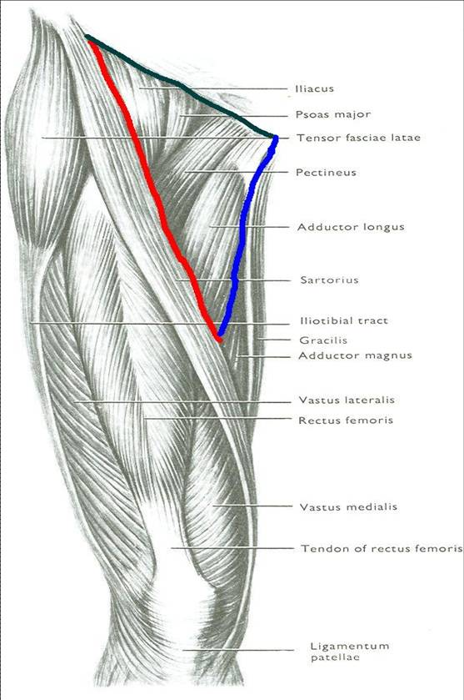
Femoral Triangle
Base: inguinal ligament
هو موضع مهم للجراحين لما يسوون عملية Inguinal hernia
I
PM
SITE:
Upper third of front of thigh
BOUNDARIES:
Base: inguinal ligament
Lateral: medial border of sartorius
Medial: medial border of adductor longus
ROOF:
Skin
Fasciae: superficial & deep
FLOOR: From medial to lateral
Adductor longus
Pectineus
Psoas major
Iliacus
Lateral:
medial border of sartorius
P
A
L
Medial:
medial border of adductor longus
S

Slide 13
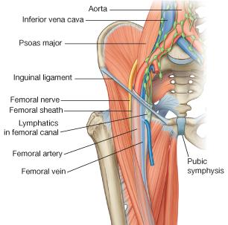
Femoral Triangle
CONTENTS:
Femoral vein
Femoral artery
Both vein & artery are enclosed in a fascial envelope (Femoral sheath)
Femoral nerve (out side femoral sheath)مهم !
Deep inguinal lymph nodes

Slide 14
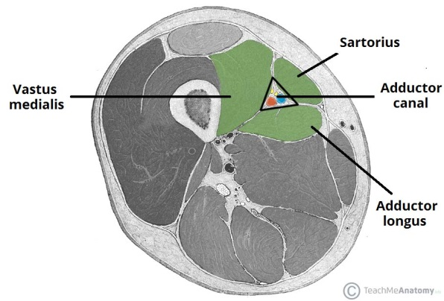
ADDUCTOR CANAL (Subsartorial canal) اسم آخر لها . لأنها تقع تحت السارتوريل
Definition: intermascular passage for A fascial envelope for femoral artery & vein (+nerve)
Other def. : it is an aponeurotic tunnel of femoral artery & vein
Site: In middle third of front of thigh
Extent: From apex of femoral triangle to adductor hiatus (in adductor magnus)
Boundaries:
*Roof (anterior): Sartorius
*Floor (posterior): Adductor longus & magnus

Slide 15
Compartments of thigh
Summary
Anterior compartment
Nerve supply:
Femoral nerve.
Medial compartment
Nerve supply:
obturator nerve
Posterior compartment
Nerve supply:
Sciatic nerve.
Adductors of the hip:
Adductor longus.
Adductor brevis.
Adductor margnus (adductor part)
gracilis
Extensor of the knee:
Quadriceps femoris.
Flexors of the hip:
sartorius.
Pectineus.
Psoas major.
Iliacus
Flexors of knee & extensors of hip:
hamstrings
Extensors
of hip
of knee
Quadriceps femoris
Hamstrings
Flexors
of hip
of knee
Hamstrings
1. Sartorius
2. Pectineus
3. psoas major
4. Iliacus

Slide 16
Quiz
Q1:Adductor canal is intramuscular passage that contain fascial envelope for:
A)Femoral artery
B)Femoral vein
C)Femoral nerve
D)All of the above
Q2:Which of the following is not enclosed in a fascial envelope:
A)Femoral artery and femoral nerve
B)Femoral vein
C)Femoral artery and femoral vein
D)Femoral nerve
Q3:The floor of femoral triangle includes all of the following except:
A) Adductor longus
B) Illiopsoas
C) Psoas major
D) Iliacus
Q4:The site of femoral triangle is:
A)Lower third of back of thigh
B)Upper third of front of thigh
C)Lower third of front of thigh
D)Upper third of back of thigh
Q5:Which of the following flexes the knee joint?
A)Gracialis
B)Illiopsoas
C)Adductor longus
Q6:Body of pubis is the origin of:
A)Abductor longus
B)Gracialis
C)Adductor longus
1)D 2)D 3)B 4)B 5)A 6)C

Slide 17
Quiz
Q7:What’s the action of Pectineus muscle upon hip joint?
A)Flexion
B)Extension
C)Flexion and adduction
D)Extension and adduction
Q8:Which muscle of the quadriceps femoris in the anterior compartment can not be seen?
A)Rectus femoris
B)Vastus lateralis
C)Vastus intermedius
D)Vastus medialis
Q9:Which muscle acts by extending the knee joint?
A)Sartorius
B)Hamstrings
C)Gracialis
D)Vastus medialis
Q10:What is the insertion of the quadriceps femoris?
A)Into the patella
B)Into the tuberosity of the tibia through ligamentum patella
C)Both a and b
D)None of the above
7)C 8)C 9)D 10)C

Slide 18
Leaders:
نواف الخضيري
جواهر أبانمي
غادة المزروع
Members:
هبه الناصر
شوق البقمي
شذا الغيهب
ندى الدخيل
ريما الشايع
لمى الفوزان
العنود ابوحيمد
anatomyteam436@gmail.com
@anatomy436

