Slide 1
Gluteal Region and Back of Thigh
Color Code
Important
Doctors Notes
Notes/Extra explanation
Editing File

Slide 2
Objectives
Know contents of gluteal region:
Groups of Glutei muscles and small muscles (Lateral Rotators).
Nerves & vessels.
Foramina and structures passing through them as:
1-Greater Sciatic Foramen.
2-Lesser Sciatic Foramen.
Back of thigh : Hamstring muscles.

Slide 3
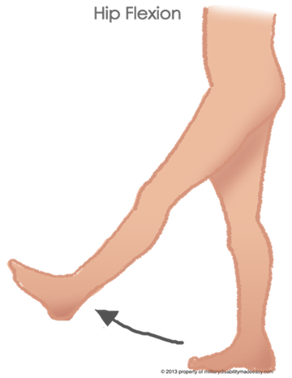
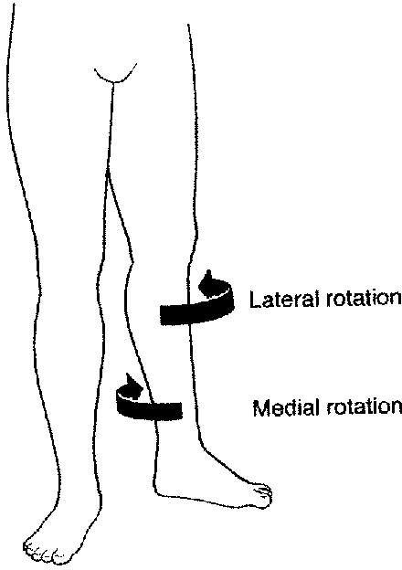
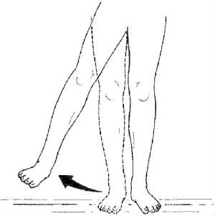
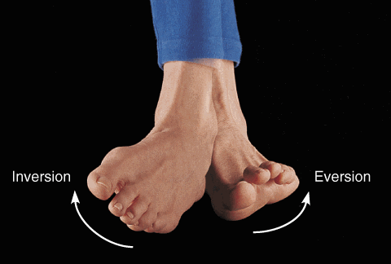
Movements of the lower limb
Hip = Thigh
Knee=Leg
Foot=Ankle
Flexion/Extension
Flexion/Extension
Flexion/Extension
Rotation
Extension
Flexion
Adduction/Abduction
Inversion/Eversion
Adduction
Abduction

Slide 4
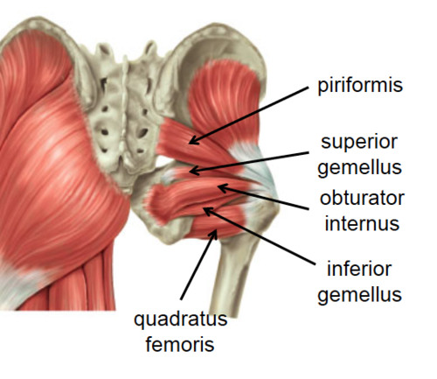
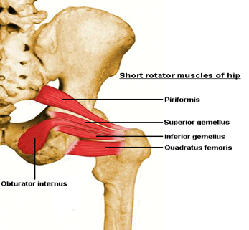
Contents Of Gluteal Region:
Muscles / Nerves / Vessels
1- Muscles:
Glutei:
Gluteus maximus.
Gluteus medius.
Gluteus minimus.
Group of small muscles (Lateral Rotators):
1.Piriformis.
2.Obturator internus
3.Superior gemellus
4.Inferior gemellus
5.Quadratus femoris
Abductors:
Gluteus medius.
Gluteus minimus.
Rotators:
Obturator internus.
Quadratus femoris.
Extensor:
Gluteus maximus.

Slide 5
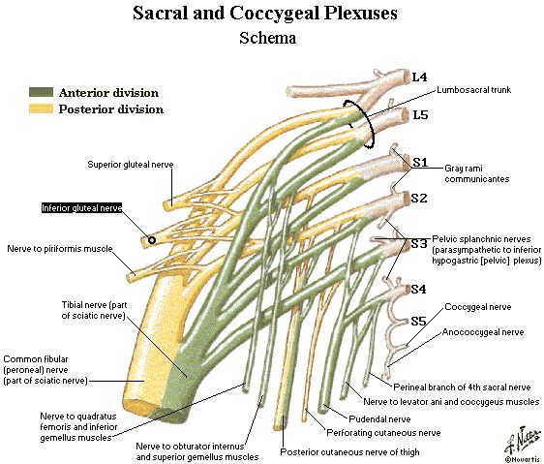
Contents Of Gluteal Region:
Muscles / Nerves / Vessels
2- Nerves (All from Sacral Plexus):
1. Sciatic nerve.
2. Superior gluteal nerve.
3. Inferior gluteal nerve.
4. Post. cutaneous nerve of thigh.
5. Nerve to obturator internus.
6. Nerve to quadratus femoris.
7. Pudendal nerve.

Slide 6
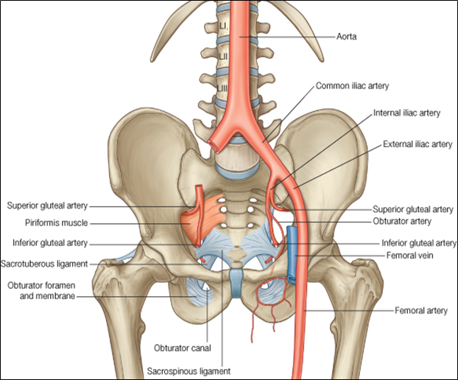
Contents Of Gluteal Region:
Muscles / Nerves / Vessels
3- VESSELS: (all from internal iliac vessels):
1. Superior gluteal
2. Inferior gluteal
3. Internal pudendal vessels.

Slide 7
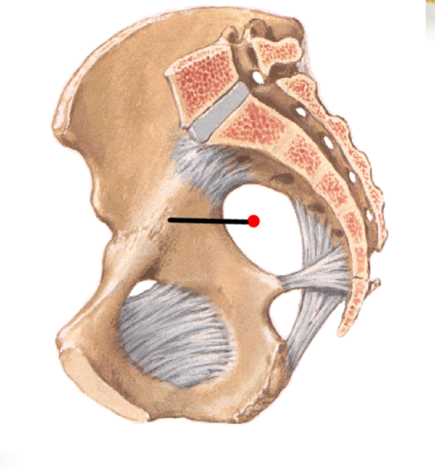
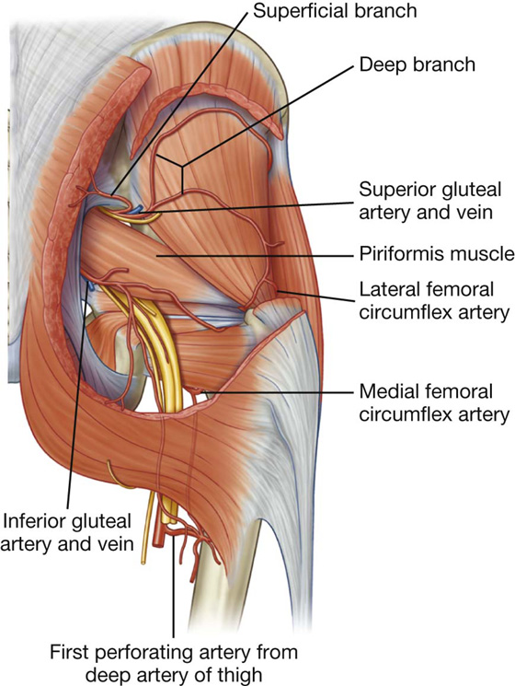
Greater sciatic foreamen: Greater sciatic notch of hip bone is transformed into foramen by: sacrotuberous (between the sacrum to ischial tuberosity) & sacrospinous (between the sacrum to ischial spine )
Structures passing through Greater sciatic foramen :
 | Nerves: | Vessels:
Above piriformis muscle. | Superior gluteal nerves, | 2. Superior gluteal vessels.
3. Piriformis muscle.
Belew piriformis muscle. | 4. Inferior gluteal nerves 5. Sciatic nerve. 6. Posterior cutaneous nerve of thigh.(superficialis) 7. Nerve to quadratus femoris. 8. Nerve to obturator internus. 9. Pudendal Nerve . | 10. Inferior gluteal vessels. 11. Internal pudendal vessels.
Greater sciatic foramen
Lesser sciatic foramen
- Nerve to obturator internus.
- pudendal nerve.
-internal pudendal vessels.
( pass through both greater sciatic and lesser foramen)

Slide 8
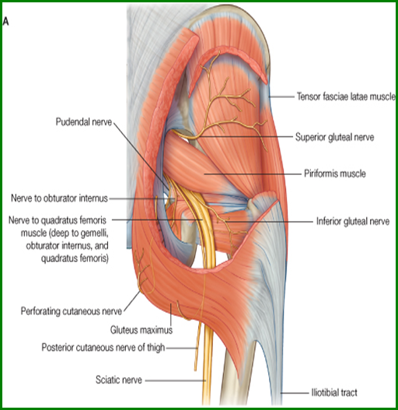
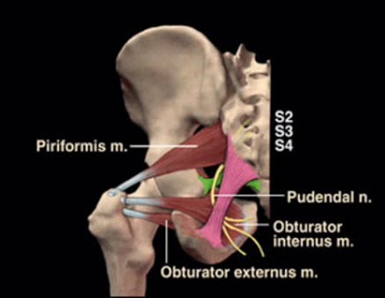
Lesser sciatic foramen: Lesser sciatic notch of hip bone is transformed into foramen by Sacrotuberous & sacrospinous ligaments.
Structures passing through Lesser sciatic foramen
Tendons | Nerves | Vessels
1.Tendon of obturator internus. | 2. Nerve to obturator internus. 3. Pudendal nerve. | 4. Internal pudendal vessels.

Slide 9
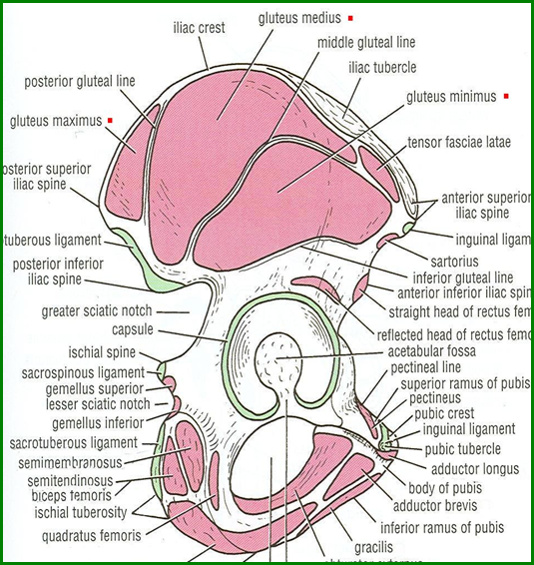
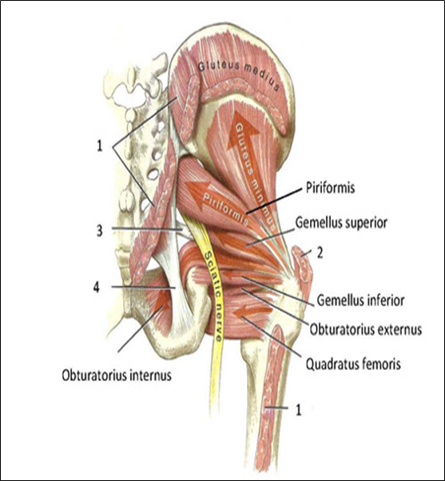
Glutei Muscles Origins
Gluteus minimus:
Anterior part of the gluteal surface of ilium.
Gluteus medius:
Middle part of the gluteal surface of ilium.
Gluteus maximus:
Posterior part of the gluteal surface of ilium.
Main origin: Back of sacrum & coccyx & back of Sacrotuberous ligament.

Slide 10
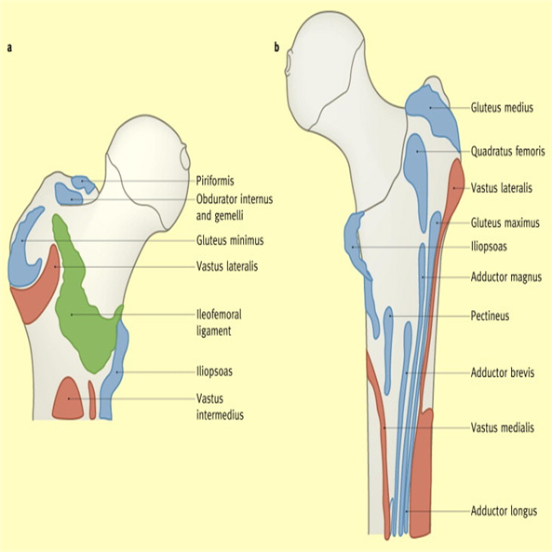
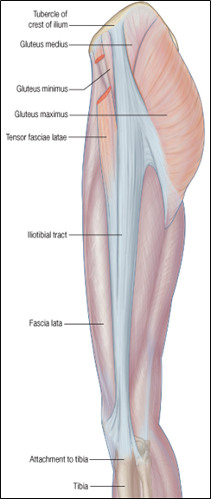
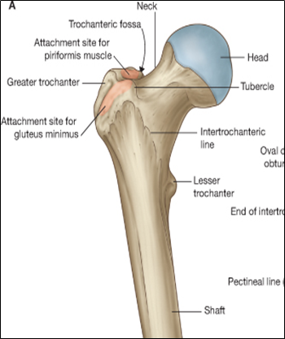
Glutei Muscles Insertions
Gluteus minimus:
anterior surface of the greater trochanter
Gluteus medius:
lateral surface of the greater trochanter
Gluteus maximus:
Main insertion: 1. iliotibial tract
(iliotibial tract : thickening of the lateral part of deep fascia of the thigh)
Other insertion: 2. gluteal tuberosity of the femur.

Slide 11
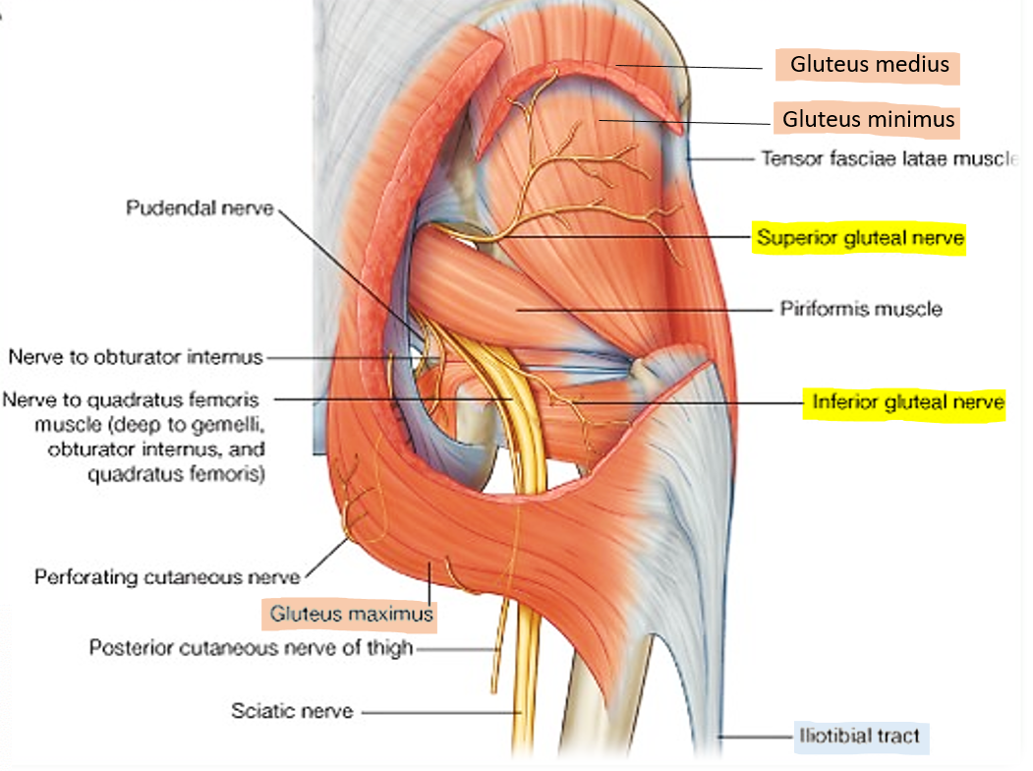
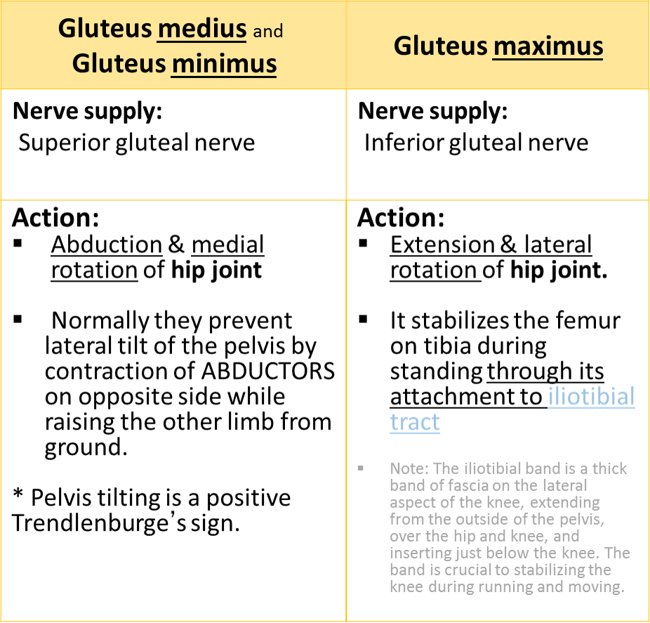
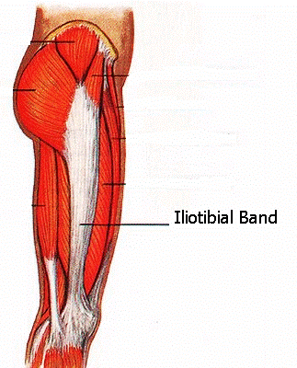
Glutei Muscles Nerve Supply & Actions

Slide 12
Continued...
Right pelvic tilt (the left side of the pelvis is elevated higher than the right side) as in picture.
This requires a muscular effort by the hip abductors (glutei medii and minimi of opposite side) to pull the pelvis up.
Trendelenburg gait: is an abnormal gait that is usually found in people with weak abductor muscles of the hip which are supplied by the superior gluteal nerve
Helpful video for understanding https://www.youtube.com/watch?v=DkSTr7K-eAo

Slide 13
Glutei Muscles (Summary)
Muscle | Origin | Insertion | Action | Nerve Supply
Gluteus minimus: | Anterior part of the gluteal surface of ilium | anterior surface of the greater trochanter | 1. Abduction & 2. medial rotation of hip joint. 3. prevent lateral tilt of the pelvis by contraction of ABDUCTORS on opposite side, on raising the other limb from ground. | Superior gluteal nerve
Gluteus medius: | Middle part of the gluteal surface of ilium, | lateral surface of the greater trochanter
Gluteus maximus: | Posterior part of the gluteal surface of ilium, Main origin: Back of sacrum & coccyx & back of Sacrotuberous ligament. | 1.Main insertion: iliotibial tract 2.Other insertion: gluteal tuberosity of the femur. | 1. Extension & 2. lateral rotation of the hip joint. 3. Stabilizes the femur on tibia during standing (Through its attachment to iliotibial tract) | Inferior gluteal nerve

Slide 14
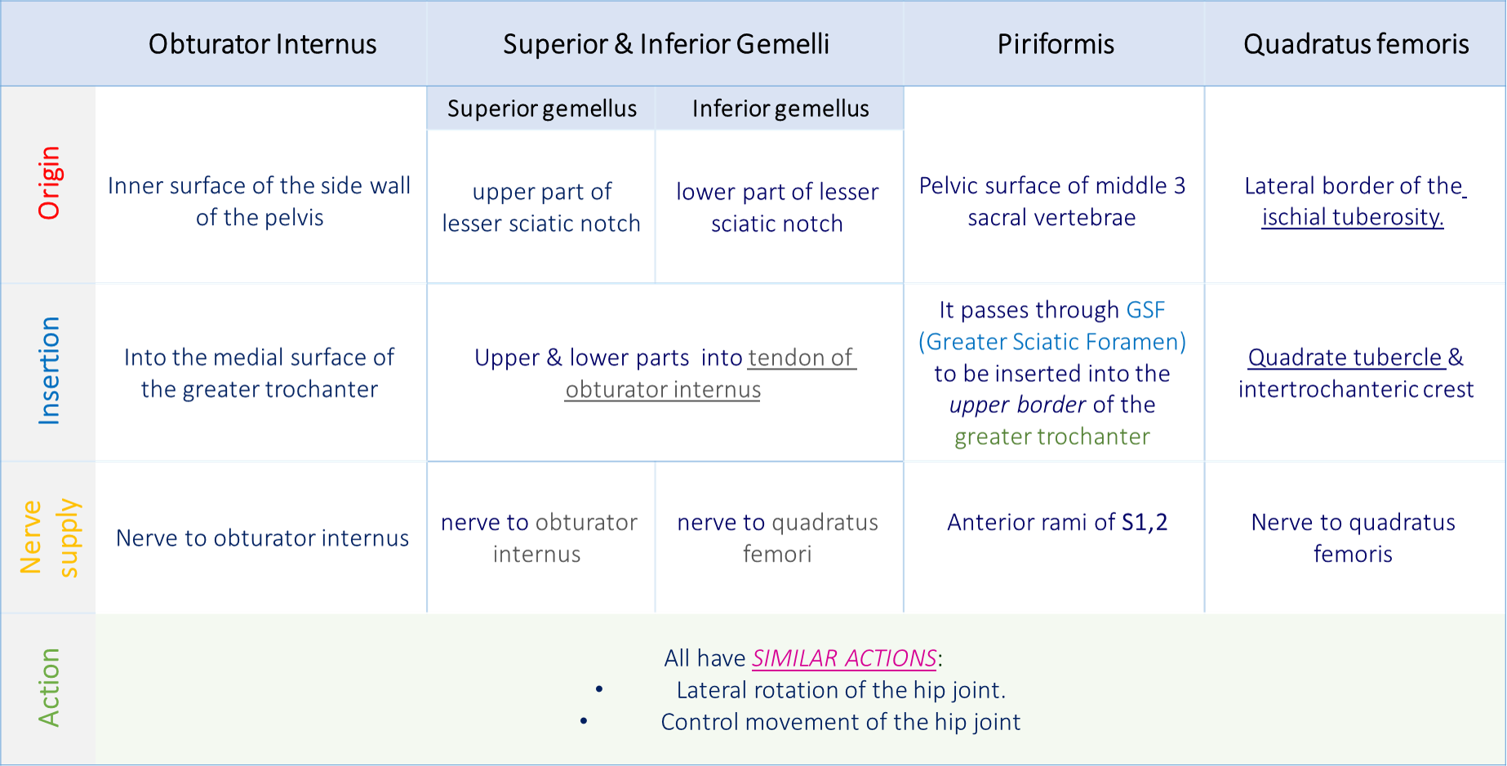
Small Muscles (Lateral Rotators) important
See next slide for picture

Slide 15
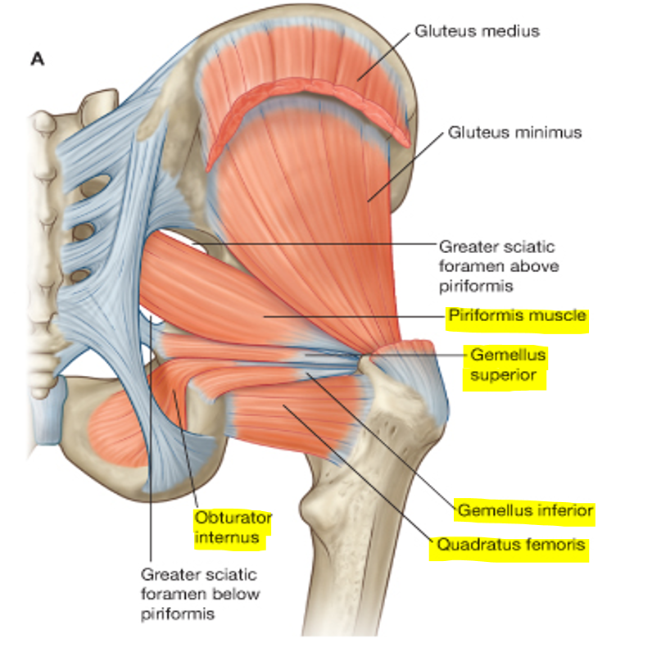
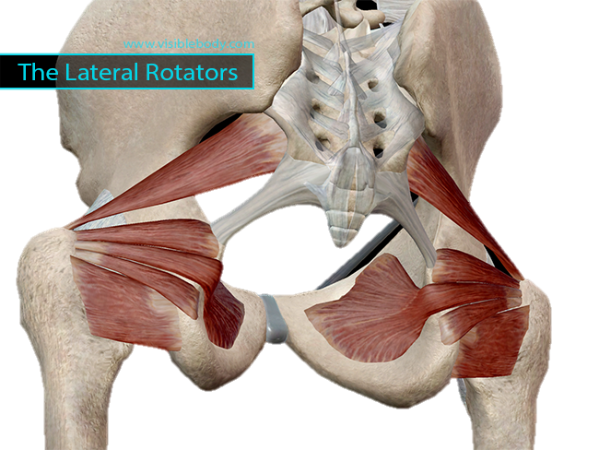
Small Muscles (Lateral Rotators) important

Slide 16
Nerves
Name | Course | Branch
SUPERIOR GLUTEAL | Passes through GSF, above piriformis, then between gluteus medius & minimus. | 1) Muscular to gluteus medius, minimus & tensor fasciae lata. 2) Articular to hip joint.
INFERIOR GLUTEAL | Passes through GSF, below piriformis, then deep to gluteus maximus. | Muscular to gluteus maximus
NERVE TO QUADRATUS FEMORIS | Passes through GSF, below piriformis. | 1) Muscular to quadratus femoris & inferior gemellus 2) Articular to hip joint
POSTERIOR CUTANEOUS NERVE TO THIGH | Passes through GSF, below piriformis, then descends deep to deep fascia. | Cutaneous branches to: gluteal region, back of scrotum in males (labium majus in females) back of thigh & upper part of back of leg.
SCIATIC | Passes through GSF, below piriformis, then superficial to: ischial spine, superior gemellus, tendon of obturator internus, inferior gemellus, quadratus femoris & adductor magnus. | • No branches in gluteal region. • Divides into tibial & common peroneal nerves, in the middle of back of thigh.

Slide 17
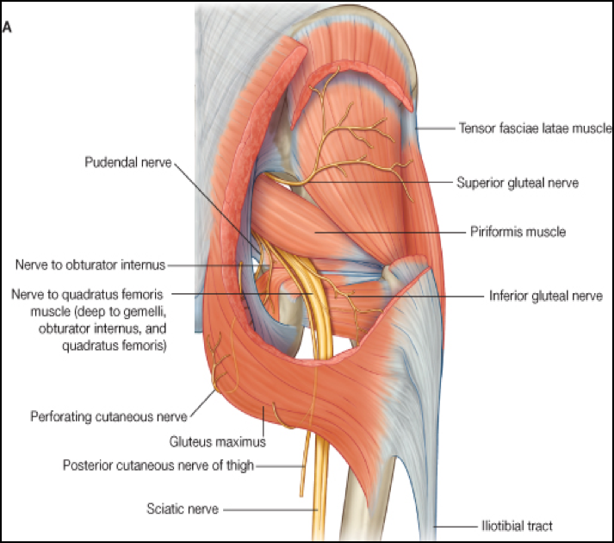

Slide 18
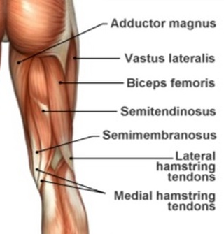
Posterior Compartment Of The Thigh
Contents
Muscles | Blood supply | Nerve supply
Hamstring muscles: Biceps femoris. Semitendinosus. Semimembranosus. Ischial part of adductor magnus. | Branches of the profunda femoris artery. | Sciatic nerve.

Slide 19
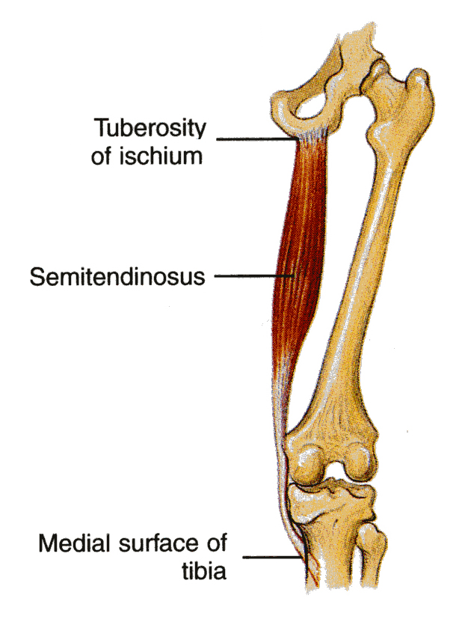
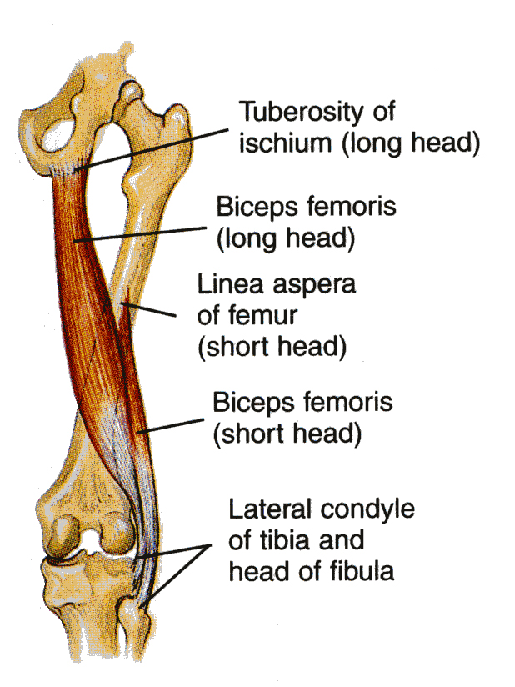
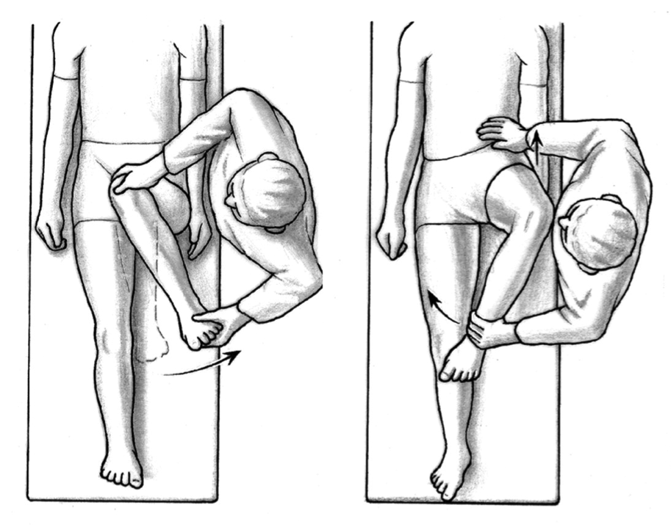
1. Biceps femoris
Posterior Compartment Of The Thigh: Muscles
2. Semitendinosus
Origin | The long head from the ischial tuberosity. The short head from the linea aspera .
Insertion | Mainly into the head of the fibula.
Nerve Supply | The long head is supplied by the tibial part of sciatic; the short head is supplied by the common peroneal part of the sciatic.
Action | Flexion of knee. Lateral rotation of flexed leg. Long head (only): extends hip.
Origin | Ischial tuberosity
Insertion | Upper part of the medial surface of the shaft of the tibia (SGS)*
Nerve Supply | Tibial portion of the sciatic.
Action | Flexes and medially rotates the leg at the knee joint Extends the thigh at the hip joint
Remember:
*SGS (semitendinosus / gracialis / sartorius):
Three muscles that have the same insertions.
Extra information:
Their tendons join and form Pes anserinus
Lateral
Medial

Slide 20
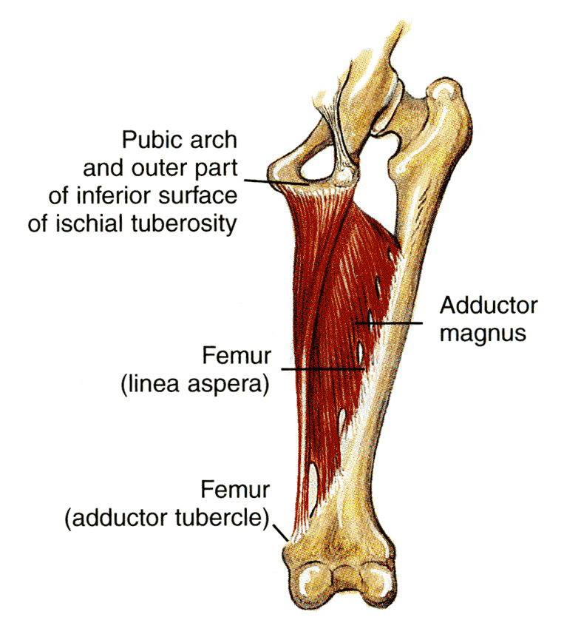
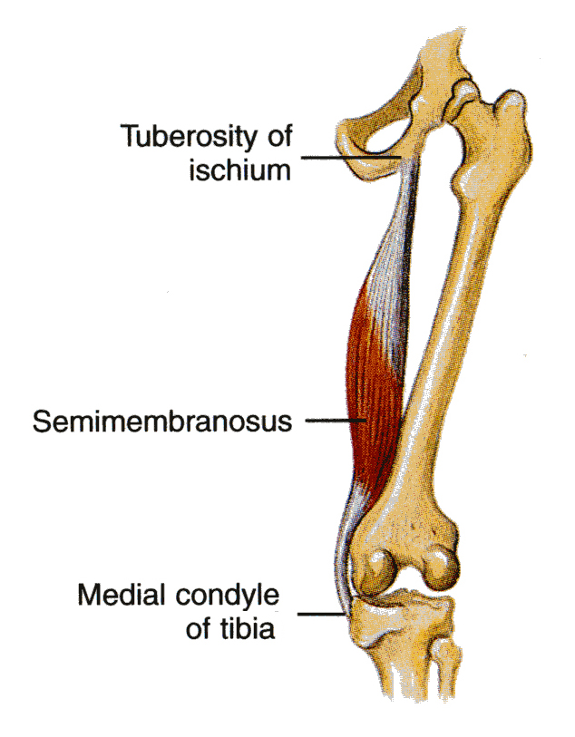
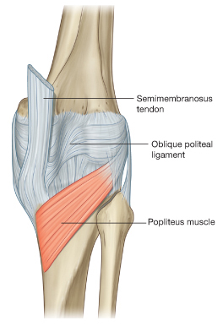
4. Adductor Magnus (Hamsting part)
Posterior Compartment Of The Thigh: Muscles
3. Semimembranosus
Origin | Ischial tuberosity
Insertion | Posterior surface of the medial condyle of the tibia. It forms the oblique popliteal ligament, which reinforces the capsule on the back of the knee joint.
Nerve Supply | Tibial portion of the sciatic.
Action | Flexes and medially rotates the leg at the knee joint Extends the thigh at the hip joint
Origin | Ischial ramus and ischial tuberosity
Insertion | Adductor tubercle of the medial condyle of the femur
Nerve Supply | The tibial portion of the sciatic
Action | Extends the thigh at the hip joint
Note:
The adductor magnus has 2 parts: adductor part and hamstring part. The 2 parts have different origin, insertion, action and nerve supply. They are also in different compartments of the thigh

Slide 21
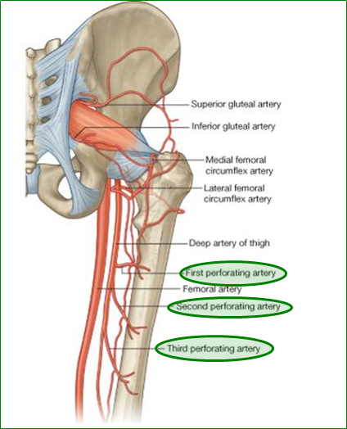
Posterior Compartment Of The Thigh: Blood Supply
The four perforating branches of the profunda femoris artery (deep artery of thigh) provide a rich blood supply to this compartment.
The profunda femoris vein drains the greater part of the blood from the compartment.

Slide 22
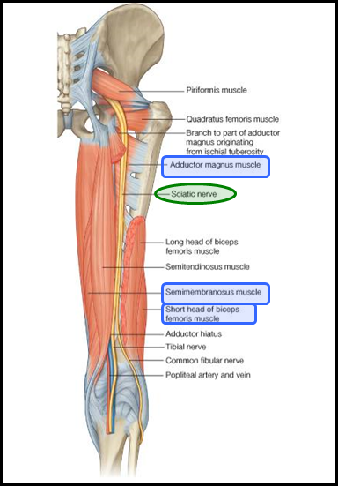
Posterior Compartment Of The Thigh: Nerve Supply
Sciatic Nerve
The sciatic nerve, a branch of the sacral plexus (L4 and 5; S1, 2, and 3), leaves the gluteal region as it descends in the midline of the thigh.
It is overlapped posteriorly by the adjacent margins of the biceps femoris and semimembranosus muscles.
It lies on the posterior aspect of the adductor magnus.
In the lower third of the thigh it ends by dividing into the tibial and common peroneal nerves.
Common fibular nerve =common peroneal nerve

Slide 23
Summary of Posterior Compartment
HAMSTRINGS | Muscle | Origin | Insertion | Action | Nerve Supply
 | Biceps femoris | The long head: the ischial tuberosity. The short head: the linea aspera . | Mainly into the head of the fibula. | 1. Flexion of knee. 2. Lateral rotation of flexed leg. Long head (only): extends hip. | The long head: tibial part of sciatic the short head: the common peroneal part of the sciatic.
 | Semitendinosus | Ischial tuberosity | Upper part of the medial surface of the shaft of the tibia (SGS)* | 1.Flexes and 2.medially rotates the leg at the knee joint 3. Extends the thigh at the hip joint | Tibial portion of the sciatic
 | Semimembranosus |  | Posterior surface of the medial condyle of the tibia. (forms the oblique popliteal ligament)
 | Adductor magnus (hamstrings part) | Ischial ramus and ischial tuberosity | Adductor tubercle of the medial condyle of the femur | 1. Extends the thigh at the hip joint

Slide 24
Summary of Posterior Compartment
Actions
Muscles | Action
Semimembranosus Semitendinosus Biceps femoris | Flexion of knee.
Semimembranosus Semitendinosus | Medially rotates the leg
Biceps Femoris | Lateral rotation of flexed leg.
Semimembranosus Semitendinosus Long head : biceps femoris Adductor magnus (hamstring part) | Extends the thigh at the hip.
Extension
Flexion

Slide 25
Questions
5. The sciatic nerve most commonly divides into tibial & common peroneal nerves, in:
A. Gluteal region.
B. The middle of back of lower third thigh.
C. The lateral of back of lower third thigh.
D. Below Piriformis.
6. Name the branches of Posterior Cutaneous Nerve Of Thigh?
7. Insertion of ADDUCTOR MAGNUS (HAMSTRING PART):
Adductor tubercle of the medial condyle of the tibia.
Abductor tubercle of the medial condyle of the femur.
Posterior surface of the medial condyle of the tibia.
Adductor tubercle of the medial condyle of the femur.
1. What is the structure that pass through greater and lesser foramen:
Nerve to obturator internus.
pudendal nerve.
internal pudendal vessels.
All of them
2. What ligaments form the greater and lesser foramen?
3. The main insertion of gluteus maximus is
iliotibial tract.
anterior part of the gluteal surface of ilium.
lateral surface of the greater trochanter.
gluteal tuberosity.
4. Which one of the following is NOT one of the Hamstring muscles?
A. Biceps femoris.
B. Semitendinosus.
C. Triceps femoris.
D. Semimembranosus.
Answers:
D
Sacrotuberous & sacrospinous
A
C
B
It has cutaneous branches to 1. gluteal region, 2. back of scrotum in males (labium majus in females) 3. back of thigh & 4. upper part of back of leg.
7. D

Slide 26
Questions
10. How many branches does the sciatic nerve have in the gluteal regoin?
0
1
2
3
11. Which of the following forms the obliques popliteal ligament?
Biceps glutei
Semitendinosus
Semimembrinosus
Adductor magnus
8.Sciatic nerve lies in the :
posterior aspect of the adductor magnus.
anterior aspect of the adductor magnus.
posterior aspect of the semimembranosus .
posterior aspect of the biceps femoris.
9. A patient presented to the ER with tilting of the pelvis when lifting one of the legs while walking (see picture).
What muscles are affected?
What nerve(s) is supplying them?
The patient had a positive trandelenburg sign. What does this mean?
What is the name of this condidtion?
Answers:
8. A
9. a) Gluteus Medius and Gluteus Minimus.
b) Superior gluteal nerve.
c) When lifting (opposite) leg the pelvis tilts down on the non-paralyzed opposite side,
d) Gluteal gait.
10. A
11. C

Slide 27
Leaders:
Nawaf AlKhudairy
Jawaher Abanumy
Ghada Almazrou
Members:
Dania Alkelabi
Deena AlNowiser
Jawaher Alkhayyal
Nourah Al Hogail
Razan AlQahtani
Safa Al-Osaimi
anatomyteam436@gmail.com
@anatomy436

