Slide 1
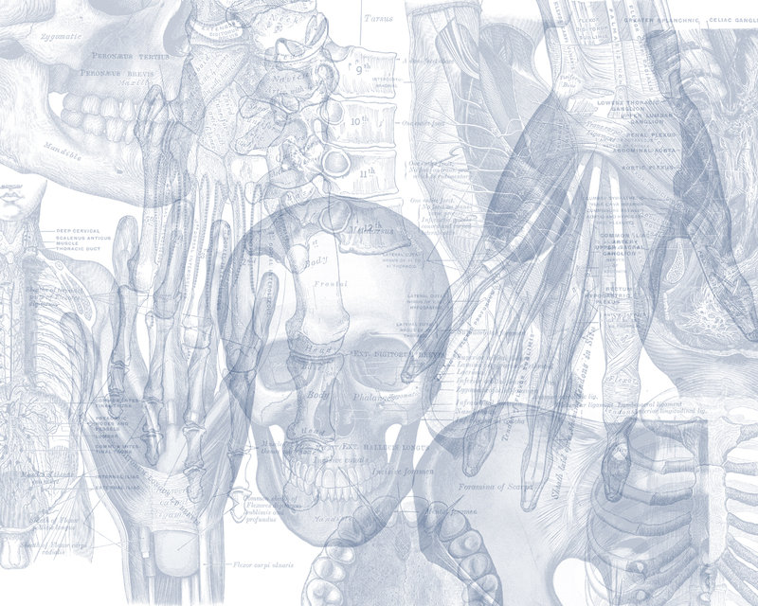
Sciatic Nerve
Color Code
Important
Doctors Notes
Notes/Extra explanation
Editing File

Slide 2
Objectives
Describe the anatomy (origin, course and distribution) of the sciatic nerve.
List the branches of the sciatic nerve.
Describe briefly the main motor and sensory manifestations in case of injury of the sciatic nerve or its main branches.

Slide 3
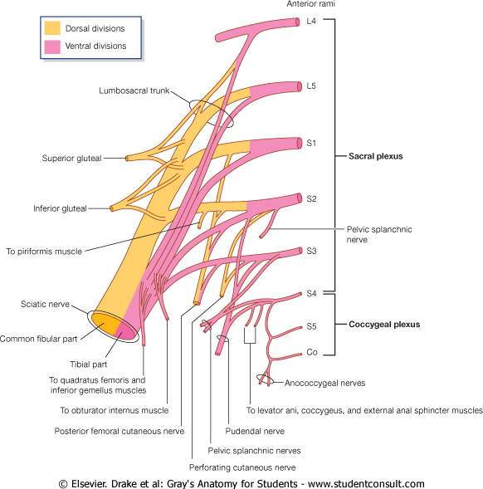
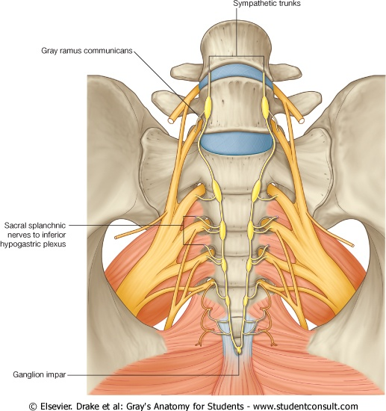
Sciatic nerve
It is the largest branch of the plexus & the largest nerve of the body.
Origin :
From the Sacral Plexus , (L4,L5, S1,S2,S3).
Sacral Plexus
Formation:
Ventral (anterior)(lower division) rami of a part of L4 & whole L5 (lumbosacral trunk) + S1,2,3 and most of S4.
Site:
On the posterior wall of the pelvis, In front of Piriformis muscle.
4
5
The nerve in front of the muscle

Slide 4
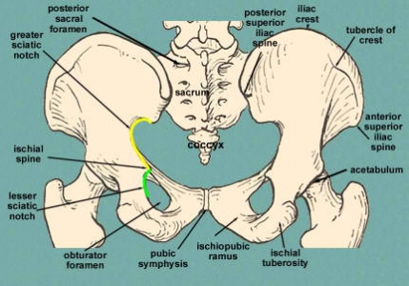
Course & Distribution
It leaves the pelvis through greater sciatic foramen, below the piriformis
then passes (between 2 bones) in the gluteal region (ischial tuberosity & greater trochanter)
then to posterior compartment of thigh.
Termination:
In the middle of the back of the thigh* It divides into 2 branches:
Tibial (medial popliteal) enter the popliteal fossa
Common Peroneal or lateral popliteal or (Fibular). Outside popliteal fossa
*يختلف مكان التفرع من شخص لآخر

Slide 5
Branches of Sciatic Nerve
3-Common Peroneal
2-Tibial
1- in thigh (before It divides)

Slide 6
Extra:
^في الشريحة القادمة لما نقول التيبيال بارت فاحنا نقصد هذا مو اذا تفرع وصار مستقل ونفس الشيء للكومن بيرونيل

Slide 7
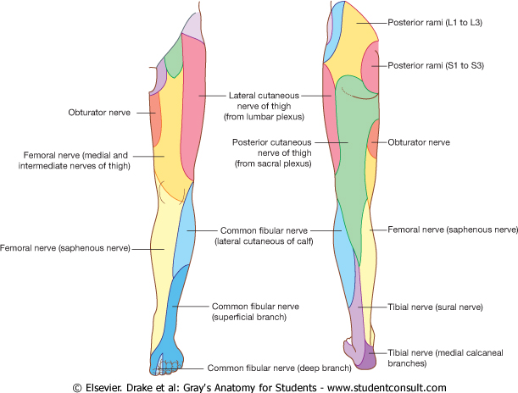
Branches of Sciatic Nerve 1- in thigh (before It divides)
cutaneous
(all sciatic branches) To the skin of all leg & foot
Areas supplied by saphenous nerve (branch of femoral nerve )
Muscular
To Hamstrings
(Flexors of knee & extensors of hip)
The short head of biceps receives its branch from lateral popliteal (common peroneal part)
(through tibial part) it gives:
1- Hamstring(Ischial) part of Adductor Magnus
2- Long head of Biceps Femoris
3- Semitendinosus
4- Semimembranosus
except
except
للحفظ : Hambi skies on the same sea

Slide 8
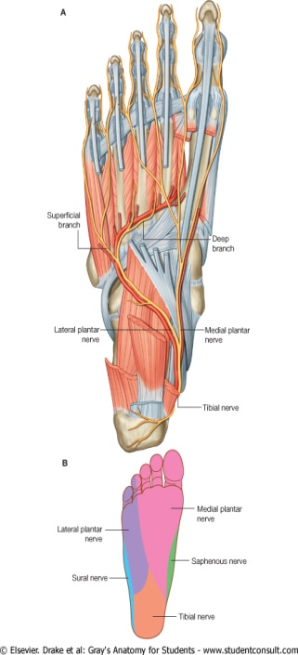
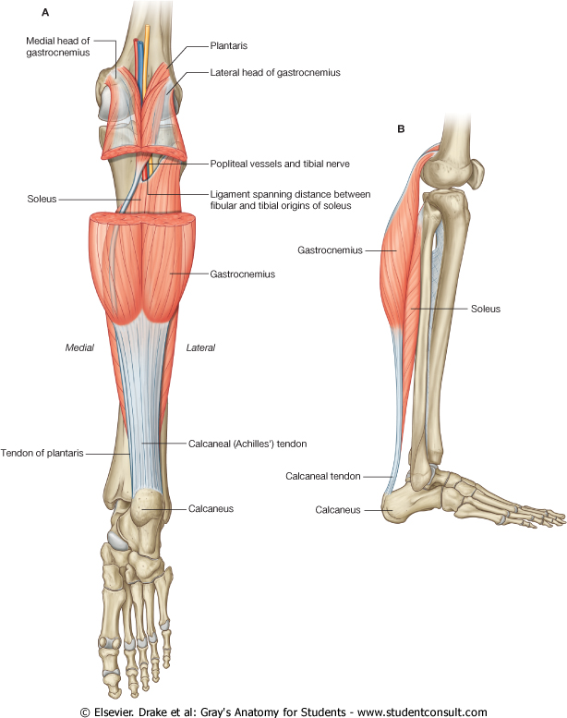
Branches of Sciatic Nerve 2- Tibial nerve
Course: Bisect the popliteal fossa. it is the most superficial structure in the popliteal fossa. عشان كذا هي أكثر شيء ممكن ينقطع.
recall: ^while the deepest structure is the artery
Descends through popliteal fossa to posterior compartment of leg, accompanied with posterior tibial vessels.
Passes deep to flexor retinaculum (through the tarsal tunnel, behind medial malleolus) to reach the sole of foot where it divides into 2 terminal branches (Medial & Lateral planter nerves).
Muscular Branches: (in leg) + Hamstrings in thigh
Muscles of posterior compartment of leg:
1- Planter flexors of ankle
2- Flexors of toes
3- ONE Invertor of foot (tibialis posterior).
+ All Intrinsic muscles of sole. (by medial & lateral branches)

Slide 9
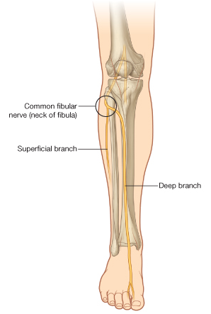
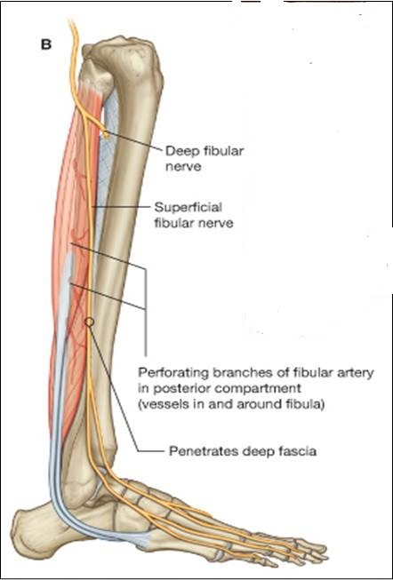
Branches of Sciatic Nerve 3- Common Peroneal (Fibular) Nerve
Course:
- Leaves the lateral angle of popliteal fossa & turns around the lateral aspect of neck of fibula, (Dangerous Position) لأن هذا المكان غير متغطي بعضلات!
- Then divides into:
1- Superficial peroneal or (Musculocutaneous) :
to supply the Lateral compartment of the leg.
2- Deep peroneal or (Anterior Tibial):
to supply the Anterior compartment of the leg.
Muscular Branches: (+ short head of biceps)
Muscles of anterior & lateral compartments of leg:
1- Dorsi flexors of ankle,
2- Extensors of toes,
3- Evertors of foot.

Slide 10
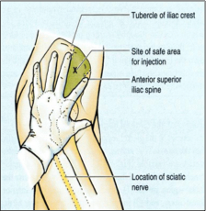
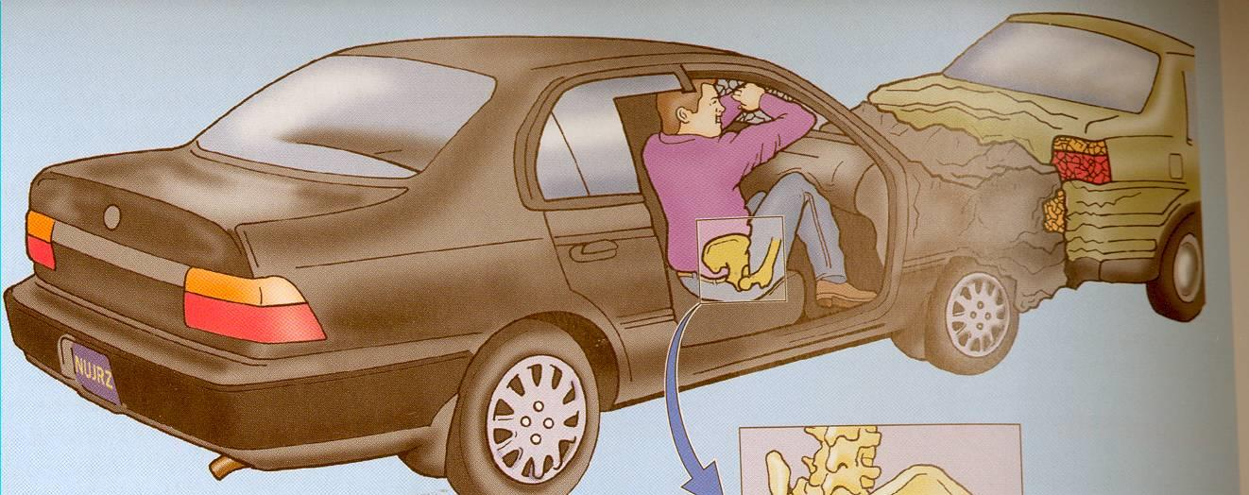
Sciatic Nerve Injury -Causes
The sciatic nerve is frequently injured by:
1- Badly placed intramuscular injections in the gluteal region.
To avoid this, injections should be done into the gluteus maximus or medius.
(into the upper outer (lateral) quadrant of the buttock)
*Most nerve lesions are incomplete, in 90% of injuries, the common peroneal (part of the nerve) is the most affected.
Because: The common peroneal nerve fibers lie superficial in the sciatic nerve.
2-- Posterior dislocation of the hip joint
بسبب حادث سيارة مثلاً
Posterior = Head of femur يرجع للخلف
فيضغط على الشيء اللي موجود خلفه اللي هو
sciatic nerve!

Slide 11
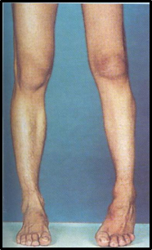
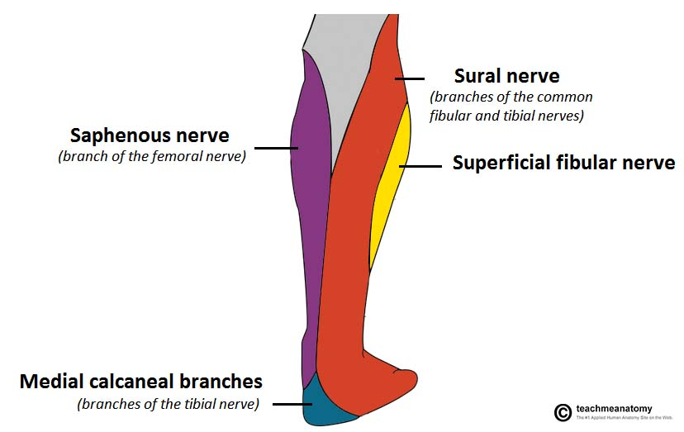
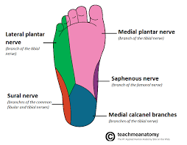
لما نمشي الحركات اللي نسويها هي والعضلات المسؤولة عن هذه الحركتين تغذيها تفرعات من فلما يصير لها انجري ما تصير ولا حركة من الثنيتن فإيش يصير بالرجل؟ يصير لها بسبب الجاذبية
NS:
Sartorius : Femoral nerve
Gracilis : Obturator nerve
gluteus maximus : Inferior gluteal nerve
Dorsiflexion & plantarflexion
Sciatic Nerve Injury -Effects
sciatic nerve
drop
Motor :
Weak flexion of the knee (sartorius &
gracilis are intact).
Weak extension of hip (gluteus
maximus is intact).
Marked wasting(atrophy) of the muscles below the knee.
All the muscles below the knee are
paralyzed, and the weight of the foot
causes it to assume the plantar-flexed position OR Foot Drop.
Stamping gait.(high steppage gait)
مثل تلزيق الطوابع يكون بسرعة
Sensory :
Sensation is lost below the knee, except for a narrow area down the medial side of the lower part of the leg (purple) and along the medial border of the foot as far as the ball of the big toe, which is supplied by the saphenous nerve (branch of femoral nerve).
recall
Stamping gait https://www.youtube.com/watch?v=SWvEU8FYMFc + Foot Drop: https://www.youtube.com/watch?v=J7-L9MFRXD8

Slide 12
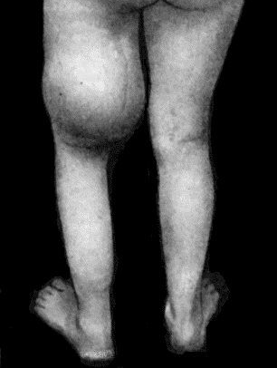
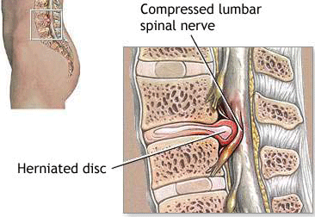
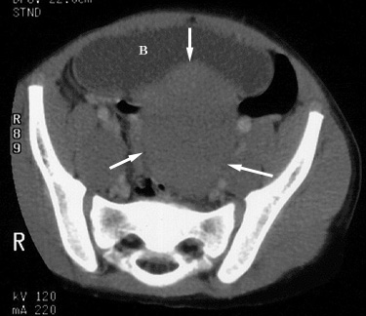
Sciatica
عرق النَّسّا
Vitamin B12 also promotes the regeneration and growth of nerve cells. Neuropathy, such as sciatic nerve pain, numbness or tingling, in some cases has been found to be caused and made worse by deficiencies of vitamin B12 in the body
Sciatica describes the condition in which patients have pain along the sensory distribution of the sciatic nerve. فقط ألم العضلات تشتغل تمام
Thus the pain is experienced in:
1-the posterior aspect of the thigh
2-the posterior and lateral sides of the leg
3-and the lateral part of the foot.
Causes of Sciatica:
Prolapse of an intervertebral disc, with pressure on one or roots of the lower lumbar and sacral spinal nerves
Pressure on the sacral plexus or sciatic nerve by an intrapelvic tumor
Inflammation of the sciatic nerve or its terminal branches.
Treatment is according to the Cause.
Sciatica - Everything You Need To Know: https://www.youtube.com/watch?v=XS2BTLYsn5w

Slide 13
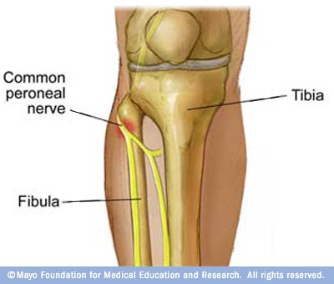
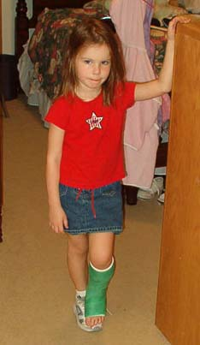
Common Peroneal Nerve Injury: Causes أكثر عرضة للإصابة من التيبيل
The common peroneal nerve is in an exposed position as it leaves the popliteal fossa it winds around neck of the fibula to enter peroneus longus muscle, (Dangerous Position).
The common peroneal nerve is commonly injured
1- In Fractures of the neck of the fibula and
2- By pressure from casts or splints.
جبس أو جبيرة

Slide 14
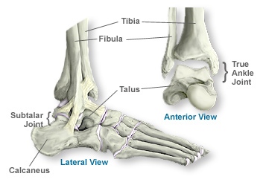
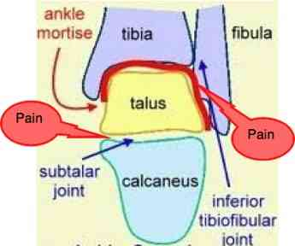
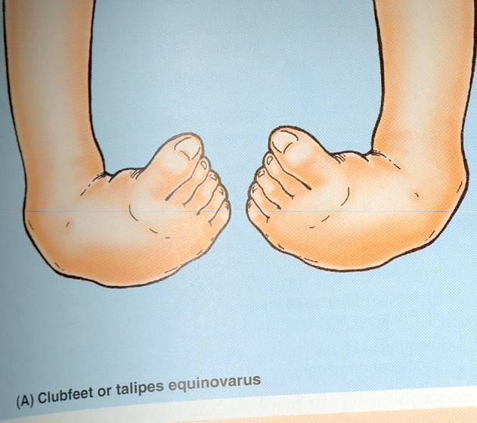
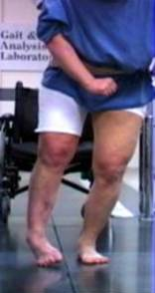
Common Peroneal Nerve Injury: Manifestations
ankle joint & subtalar joints
Dorsiflexion eversion
1- Motor:
The muscles of the anterior and lateral compartments of the leg are paralyzed,
As a result, the opposing muscles (in the posterior compartment of the leg) , the plantar flexors of the ankle joint & the invertors of the subtalar joints, cause the foot to be Plantar Flexed (Foot Drop) and Inverted, an attitude referred to as Equinovarus. if it is from birth it called Talipes* Equinovarus (تبقى كذا للأبد)& if it is from injury it called Paralytic equinovarus(تأخذ وقت على ما تتصلح)
ولان العضلات الخلفيه ماتضررت“anterior and lateral compartment” الإعاقة اللي تتبع الإصابة لهذا العصب تكون بسبب ضعف الغضلات اللي يغذيها
وتشتغل لأن يتم تغذيتها من “Tibial nerve”
Equinovarus.
2- Sensory : على حسب البرانش اللي تكون فيه الإصابة , إذا كل الاثنين فكل الأربعة التالية
Sensation is lost between the first and second toes.(deep peroneal)
Dorsum of the foot and toes.(Superficial peroneal)
Medial side of the big toe.(Superficial peroneal)
Lateral side of the leg.(Superficial peroneal)
Superficial peroneal
Musculocutaneous
deep peroneal
Anterior Tibial
*Talipes = قدم مشوهة خلقة

Slide 15
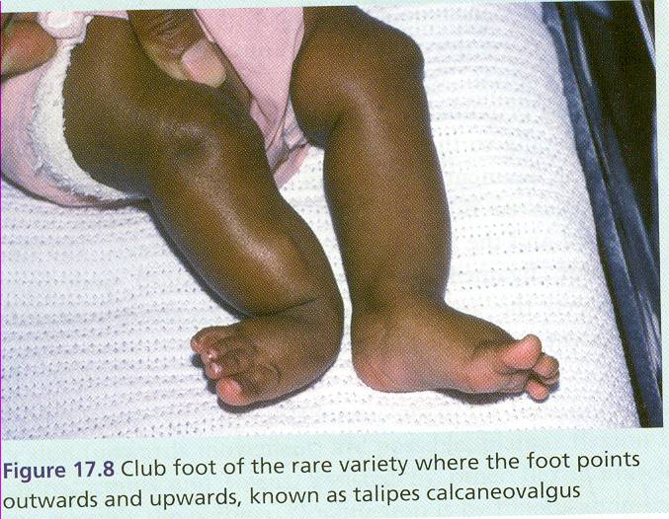
Tibial Nerve Injury
Because of its deep and protected position, the tibial nerve is rarely injured.
Complete division results in the following clinical features:
1-Motor:
All the muscles in the back of the leg and the sole of the foot are paralyzed.
The opposing muscles Dorsiflex the foot at the ankle joint and Evert the foot at the subtalar joint, an attitude referred to as Calcaneovalgus.
If congenital : Taleps Calcaneovalgus
If acquired : paralytic Calcaneovalgus
Note: it is the opposite of foot drop
2-Sensory:
Sensation is lost in the sole & on the Lateral side of the leg and foot
Trophic ulcers in the sole.لأنه يمشي وما يحس باللي تحت فممكن تصير له إصابات ما يدري عنها
(also seen in case of Sciatic nerve injury )

Slide 16
Summary
Origin of SCIATIC NERVE: from the sacral plexus (L4,L5, S1, S2,S3).
Effect of sciatic nerve injury:
MOTOR EFFECT
Paralysis of :
1- Hamstrings
2- All muscles of Leg & Foot
SENSORY EFFECT
Loss of sensation of the areas supplied by sciatic nerve (below knee).
EXCEPT area supplied by the (Saphenous nerve).
Movements affected :
Flexion of knee
Extension of hip
All movements of the leg& Foot

Slide 17
Summary
Common Peroneal Nerve Injury
-The muscles of the anterior and lateral compartments of the leg are paralyzed
plantar flexors of the ankle joint
&
the invertors of the subtalar joints
Calcaneovalgus
Tibial Nerve Injury
The muscles of the posterior compartments of the leg and the sole are paralyzed
Dorsiflex the foot at the ankle joint
&
Evert the foot at the subtalar joint
Equinovarus
If congenital : Taleps
If acquired : paralytic

Slide 18
Quiz
1:Which of the following nerve is the largest nerve of the body?
A)Radial nerve.
B)Ulnar nerve.
C)Sciatic nerve.
D)Peroneal nerve.
2:The site of sacral plexus:
A)On the anterior wall of the pelvis, in front of piriformis muscle.
B)On the posterior wall of the pelvis, in the back of piriformis muscle.
C)On the posterior wall of the pelvis, in front of piriformis muscle.
D)On the anterior wall of the pelvis, in the back of piriformis muscle.
3:Which one of theses muscles is supplied by common peroneal nerve?
A)Long head of biceps.
B)Short head of biceps.
C)Hamstring.
D)Semitendinous.
4:The most frequent injuries of the sciatic nerve is:
A)Badly placed intramuscular injections in the gluteal region.
B)Posterior dislocation of hip joint.
C)Both a and b.
D)None of the above
1)C 2)C 3)B 4)C

Slide 19
Quiz
5:When all muscles below the knee are paralyzed, the weight of the foot causes it to assume the:
A)Plantar position.
B)Foot drop.
C)Stamping gait.
D)All of the above.
6:In the tibial nerve’s course, it descends through popliteal fossa to the:
A)Anterior compartment of the leg.
B)Posterior compartment of the leg.
C)Posterior compartment of thigh.
D)Anterior compartment of the thigh.
7:Muscles of posterior compartment of the leg: planter flexors of ankle, flexors of toes and one invertor of foot:
A)Tibialis posterior.
B)Peroneus teritus.
C)Plantaris
D)Calf muscle.
8:Which muscle of these is not one of the anterior and lateral compartments of leg?
A)Dorsi flexors of ankle.
B)Planter flexors of ankle.
C)Evertors of foot.
D)Extensors of toes.
5)D 6)B 7)A 8)B

Slide 20
Leaders:
نواف الخضیري
جواھر ابانمي
غادة المزروع
Members:
العنود ابو حیمد
ھبه الناصر
شذا الغیھب
شوق البقمي
لمى الفوزان
ریما الشایع
ندى الدخیل
أمیرة نیازي
anatomyteam436@gmail.com
@anatomy436

