Slide 1

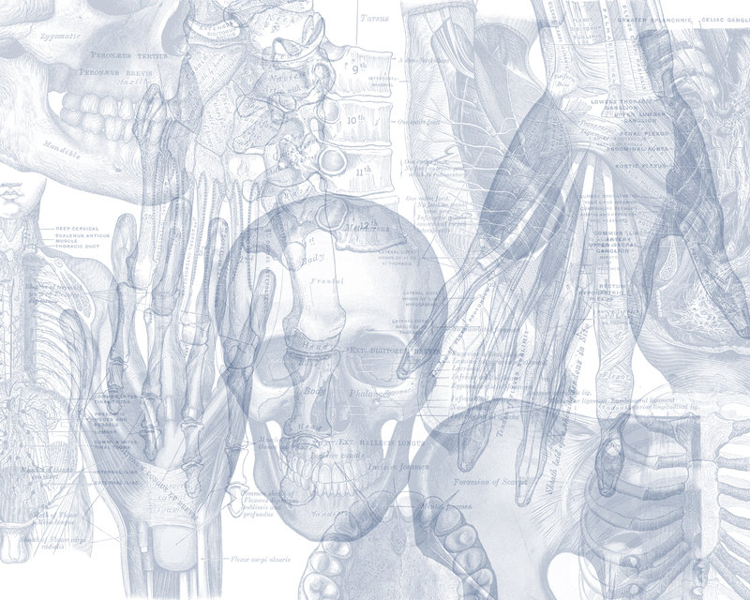



Vasculature of Lower Limb
Color Code
Important
Doctors Notes
Notes/Extra explanation
Editing File

Slide 2

Objectives
List the main arteries of the lower limb.
Describe their origin, course distribution & branches.
List the main arterial anastomosis .
List the sites where you feel the arterial pulse.
Differentiate the veins of LL into superficial & deep
Describe their origin, course & termination and tributaries
Some related clinical points
Overview of the lecture:
Arteries
Veins

Slide 3
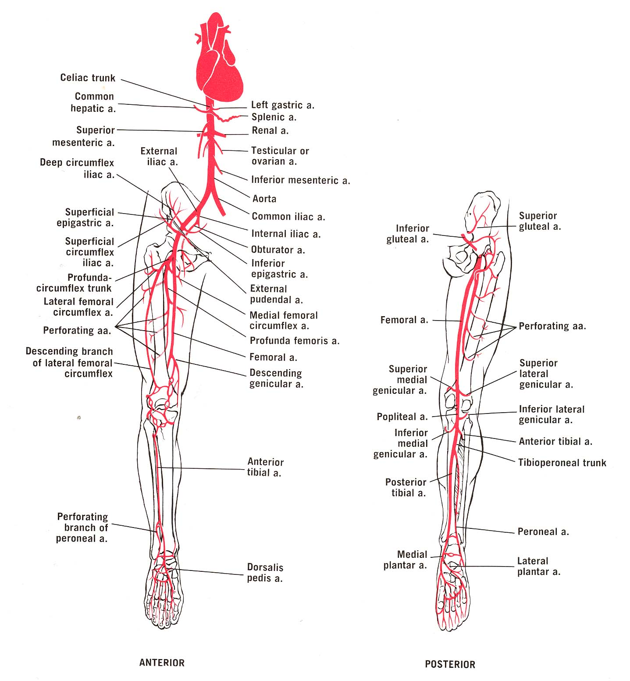
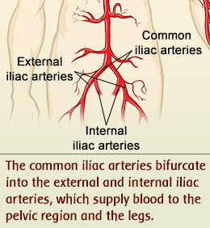
Arteries Of Lower Limb
Extra
(Lower limp)

Slide 4
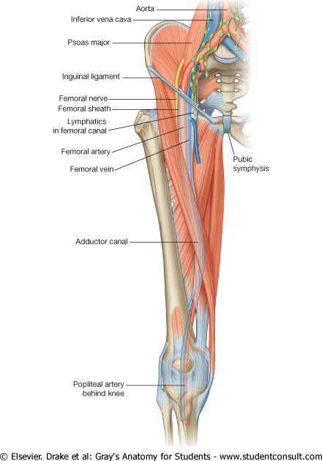
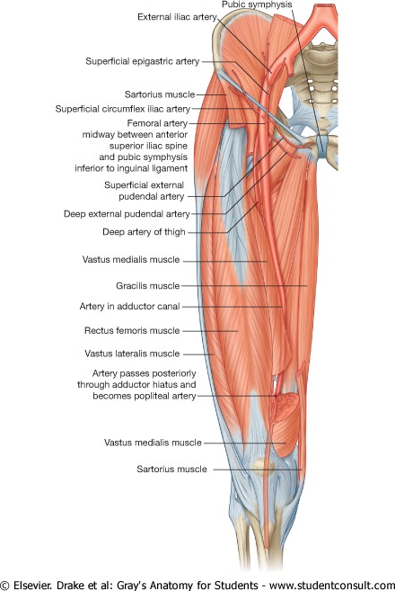
Femoral Artery
Femoral artery/ vein
At the inguinal ligament:
The vein lies medial to the artery.
At the apex of the femoral triangle:
The vein lies posterior to the artery.
At the opening in the adductor magnus:
The vein lies lateral to the artery
It is the main arterial supply to the lower limb.
Origin:
It is the continuation of the External iliac artery.
Beginning:
How does it enter the thigh?
Behind the inguinal ligament (it is btw anterior superior iliac spine & pubic tubercle), midway at the midinguinal point(هنا يصبح اسمه Femoral a( between the anterior superior iliac spine and the symphysis pubis.
  Termination
The femoral artery terminates(ينتهي) by passing through the Adductor Canal (deep to sartorius)
It exits the canal by passing through the Adductor Hiatus (& enters popliteal fossa) and becomes the Popliteal artery.

Slide 5
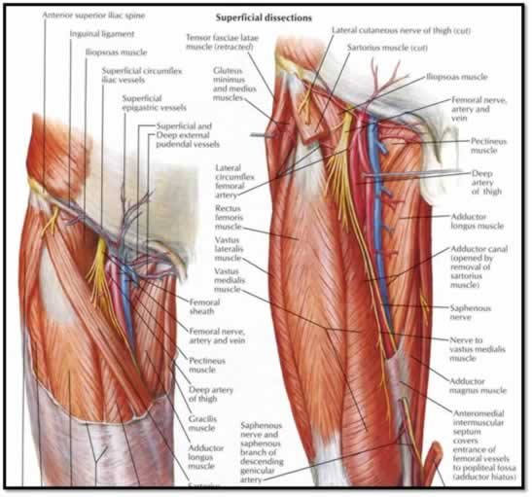
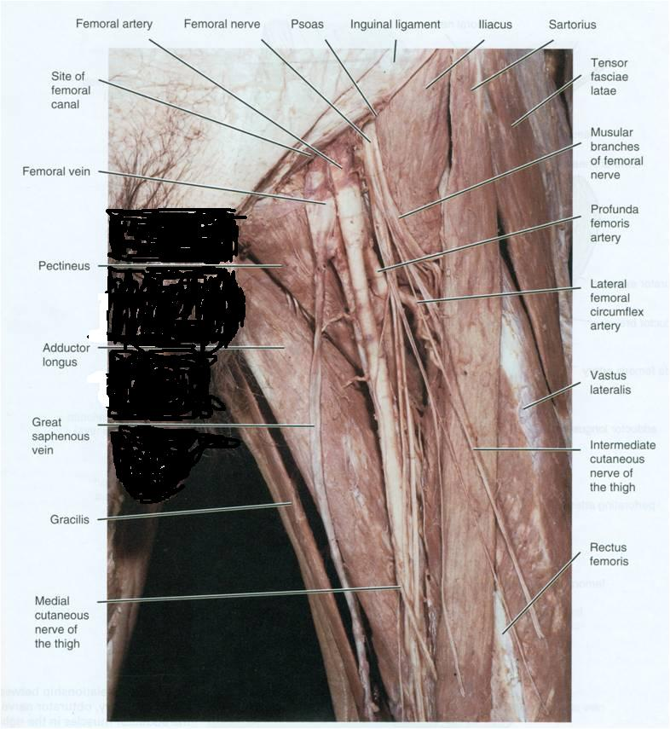
Femoral Artery
Relation
Upper part: Skin & fascia.(its superficial)
Lower part: Sartorius.
Relations (in the femoral triangle)
Anteriorly
Medially
Posteriorly
Laterally
Femoral nerve and its branches
Femoral vein
“VAN” from medial to lateral
Psoas (separates it from the hip joint), Pectineus & Addcutor longus

Slide 6
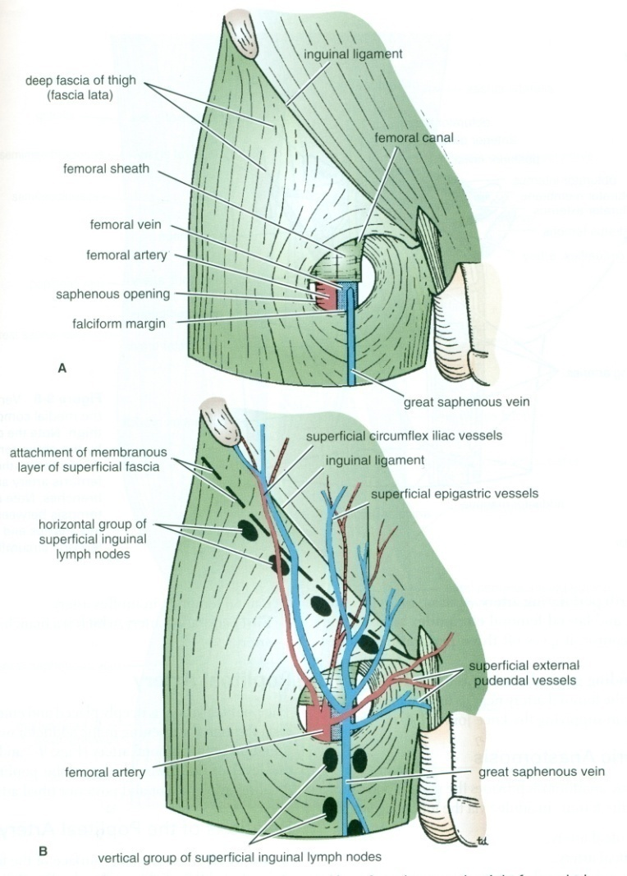
Femoral Artery
Branches
Where the internal Genitalia gets its supply from branch (Superficial internal Pudendal & Deep internal Pudendal) of internal iliac artery
*3 superficial and 2 deep
The femoral artery supplies:
Lower abdominal wall, Thigh & External Genitalia, through the following branches:
1.Superficial Epigastric.(supply Lower abdominal wall)
2.Superficial Circumflex iliac.(passing upward & lateral)+(supply Lower abdominal wall)
3.Superficial External Pudendal.
4.Deep External Pudendal.
5.Profunda Femoris (Deep Artery of Thigh)
^أهم وأكبر تفرع
يتفرع منه lateral side
Then pass behind it to be medial and supply the medial side of thigh
(supply External Genitalia)
Pudendal = of or relating to or near the pudendum(الفرْج)

Slide 7
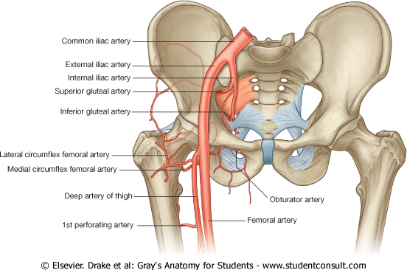
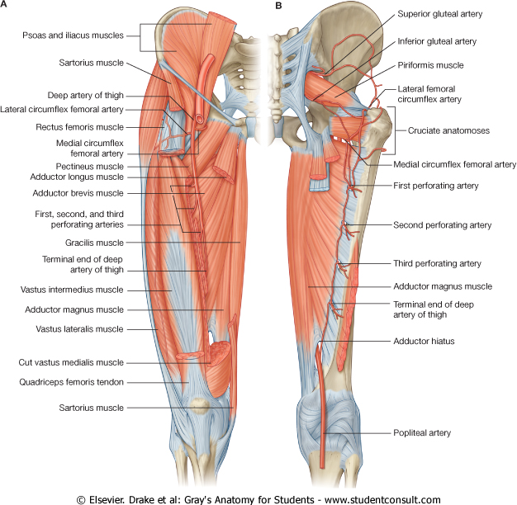
Branches Of Femoral Artery:
Profunda Femoris Artery:
عشانه مهم وكبير ندرسه بالتفصيل
It is an important, large artery to the medial compartment of the thigh. It is the main arterial supply to the thigh.
Arises from the lateral side of the femoral artery(4cm below the inguinal ligament).
It Passes medially behind the femoral vessels.
Branches:
Medial & Lateral circumflex femoral arteries.
Three Perforating arteries. The perforating arteries, usually three in number, are so named because they perforate(pierce)(تثقب-تخترق) the tendon of the Adductor magnus to reach the back of the thigh.
It ends by becoming the 4th perforating artery.

Slide 8
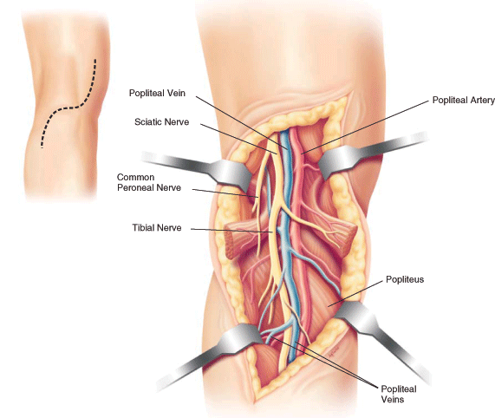
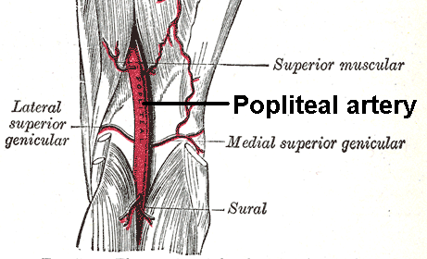
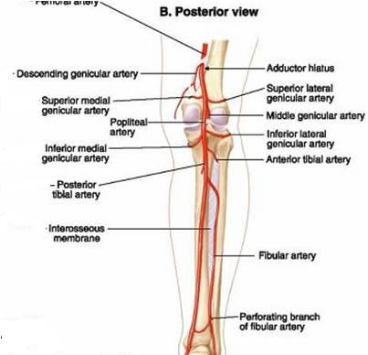
Popliteal Artery
It is the continuation of Femoral artery.
It enters the Popliteal fossa through an opening in the Adductor Magnus.
Is a It is the deepest structure in the Popliteal Fossa (posterior to the Popliteal Vein & Tibial Nerve)
Remember: Tibial Nerve is the most superficial structure here
عشان كذا الواحد ممكن يتعور في التيبيل نيرف بس ما يكون فيه نزيف
ولما يكون فيه كسر في الجزء السفلي من الفيمر احتمال كبير يقطعه, فلما احد ينكسر في هذا المكان لازم محد يحركه وينقل علطول للمستشفى
it runs close (the closest structure ) to the capsule of the knee joint.
Termination:
It Ends At the lower border of Popliteus muscle, it dividies into:
Anterior and Posterior Tibial Arteries.

Slide 9
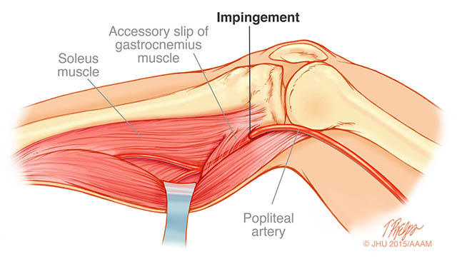
Popliteal Artery
Relations:
Anterior:
Popliteal surface of the femur.
Posterior:
Popliteal vein.
Popliteus muscle.
Knee joint.
skin and fascia.
Tibial nerve.

Slide 10
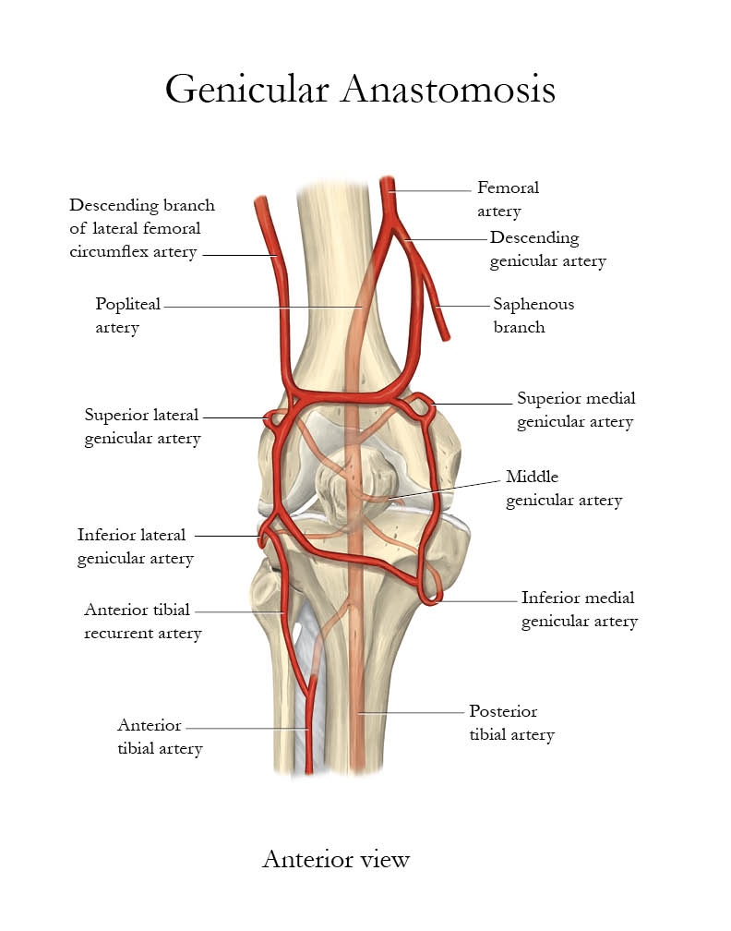
Popliteal Artery
Branches (before Termination):
Muscular: (+articular to the knee joint)
Five Genicular* branches to the articular capsule and ligaments of the knee joint.
Genicular Anastomosis:
Formed from the Five genicular branches of the popliteal artery.
It is an important anastomosis around the knee.
هنا أهميتها It compensates (يعوض) for the narrowing of the Popliteal artery during prolonged flexion of the knee.مثل الجلسة بين السجدتين في الصلاة
*Genicular means related to the knee
لكن د.جميلة قالت أن معناها شيء له علاقة بالمفاصل عموماً

Slide 11
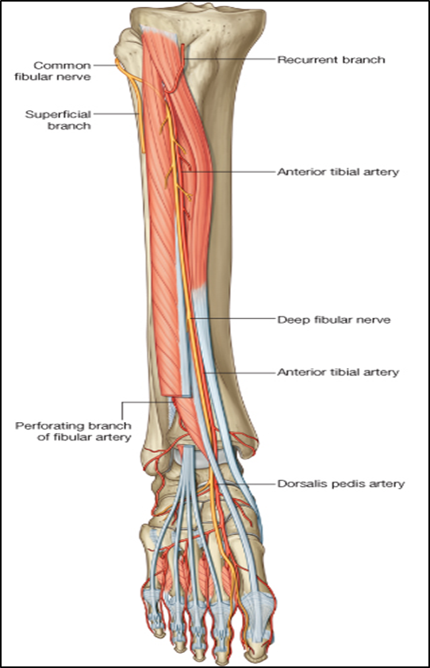
Anterior Tibial Artery:
It is the smaller of the two terminal branches of the popliteal artery.
It enters the anterior compartment of the leg through an opening in the upper part of the interosseous membrane). Where it descends with (company with) the Deep Peroneal nerve.
It supplies structures in the Anterior Compartment of the Leg & Dorsum of foot.
In its upper part, it is Deep.
In its lower part, it is Superficial (in front of the lower end of the tibia)
Branches:
Muscular& Anastomotic
It ends at the ankle joint midway between the malleoli where it becomes the Dorsalis Pedis artery
Pedis = foot

Slide 12
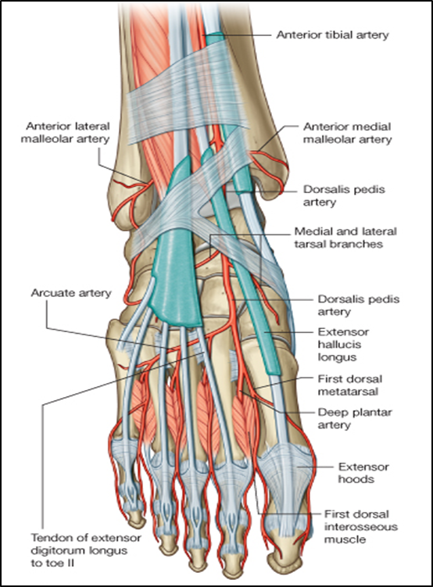
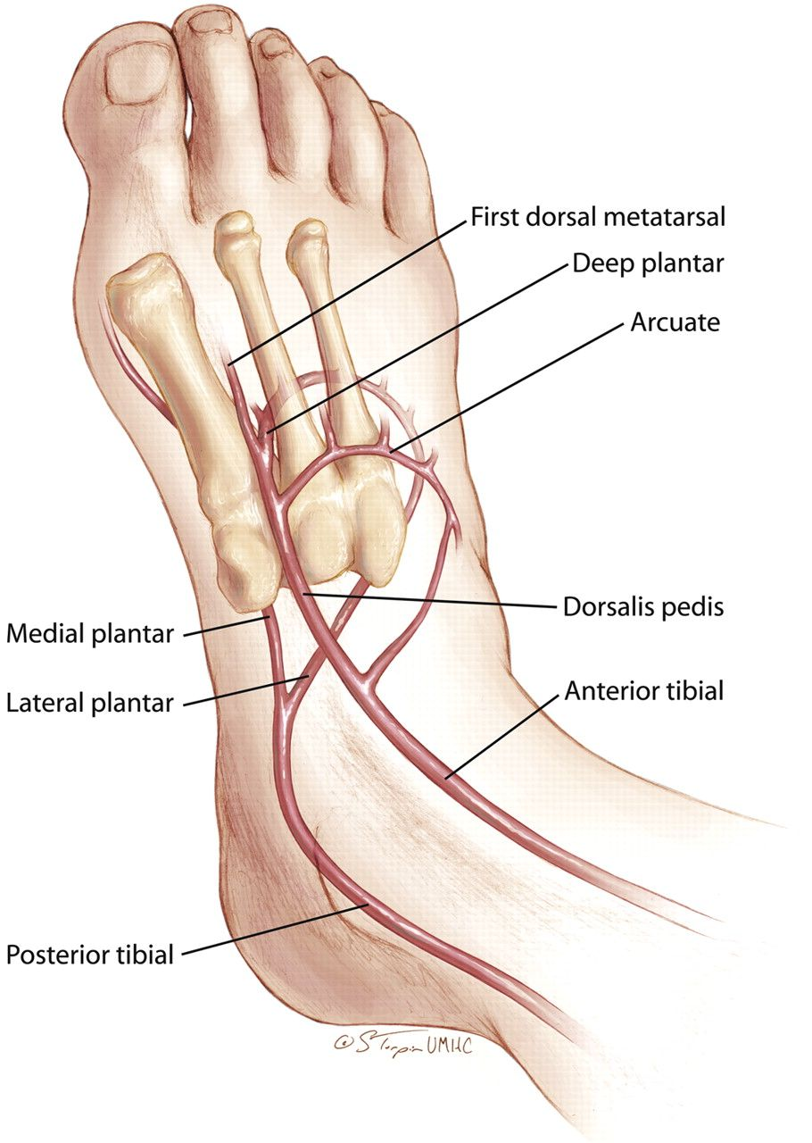
*A diminished dorsalis pedis pulse usually suggests vascular insufficiency resulting from arterial disease
Dorsalis Pedis Artery:
It is the main source of blood supply to the toes.
Begins in front of ankle joint as a continuation of the Anterior Tibial artery.
It is superficial in position.
Crossed by the inferior extensor retinaculum and the first tendon of extensor digitorum brevis.
Medially:
Tendon of extensor hallucis longus.
Laterally:
1.Deep peroneal nerve
2.extensor digitorum longus.
It Terminates by passing between the two heads of the 1st dorsal interosseous* muscle. Where it divides into deep plantar artery and 1st dorsal metatarsal artery (to the sole to join the plantar arch) and the first dorsal metatarsal artery.
It joins the Lateral plantar artery to complete the Plantar Arch.
Branches:
1.Lateral tarsal artery.
2.Arcuate artery. (to make Arcuate arch)
3.1st dorsal metatarsal artery.
*interosseous = بين العظام

Slide 13
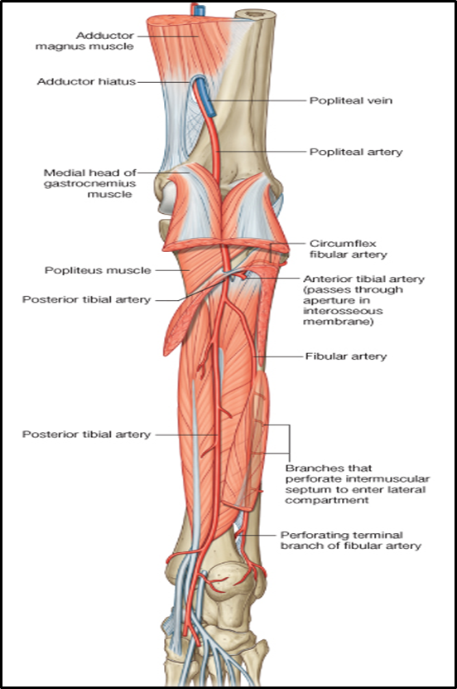
Posterior Tibial Artery:
The larger terminal branch of the popliteal Artery. provides the main blood supply to the Posterior(+lateral) compartment of the Leg & Sole of the Foot.
Above: lies on the posterior surface of Tibialis Posterior.
Below on the posterior surface of Tibia.
Its lower part is covered by Skin & Fascia only.
Passes Behind Medial Malleolus , Deep to Flexor Retinaculum .
Terminates by dividing into: Medial & Lateral plantar arteries.
Branches:
1. Peroneal (Fibular) artery:
large artery, descends behind the fibula (the largest and most important branch of the lateral compartment of the leg).
It gives :
1. Nutrient artery to the fibula.
2. Muscular branches.
3. Perforating branch to lower part of front of leg.
4. Shares in the Anastomosis around the ankle joint.
2.Nutrient* artery to the tibia. (the largest nutrient artery of the body). Each bone in the body has nutrient artery
3. Calcaneal arteries: supply the Heel.لما يقع شخص من ارتفاع وينكسر الكعب ما يحتاج يجبسونه لأنه غني بالبلود سبلاي
4. Anastomotic branches to anastomosis around ankle joint.
5. Medial & Lateral plantar arteries.
*Nutrient=أي ارتري داخل لعظم يغذيه

Slide 14
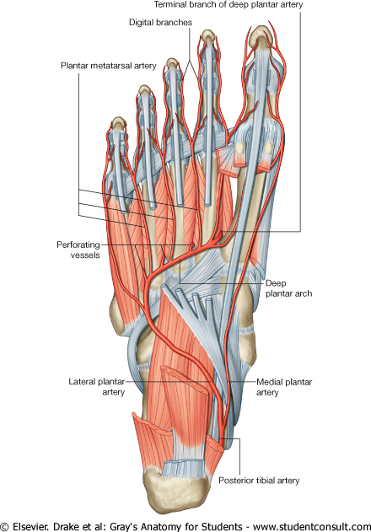

Medial Plantar Artery:
Lateral Plantar Artery:
The larger terminal branch of the posterior tibial artery.
At the base of the 5th metatarsal bone, it curves medially to form the Plantar Arch.
Which Joins the Dorsalis pedis artery at the proximal end of the 1st intermetatarsal space.
Plantar arch is completed by lateral plantar artery and branch from dorsalis pedis artery.
Branches: Muscular, Articular and Cutaneous.
The Plantar Arch gives Plantar Digital Arteries. + planter metatarsel
The arch supplies the skin, fascia and muscles in the sole and plantar digital arteries to the adjacent digits .
Digital Arteries
The smaller terminal branch of the posterior tibial artery.
Arises beneath the Flexor Retinaculum.
Ends by supplying the medial side of the big toe.It supplies mainly the muscles of the great toe, and gives most of plantar digital arteries.
Its superficial branch supplies the skin of the medial side of the sole (of the big toe).
Branches: Muscular, Articular and Cutaneous.
Deep Plantar Arch
Lateral Plantar artery
Medial Plantar artery
Helpful video
Remember: Arcuate arch in the dorsum of foot
Plantar arch In the sole of foot

Slide 15
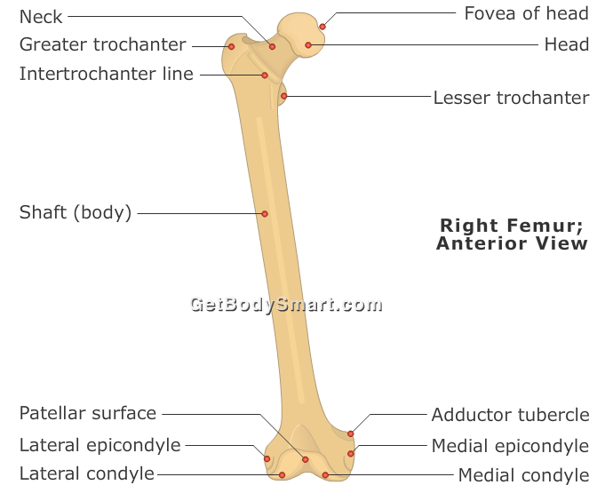
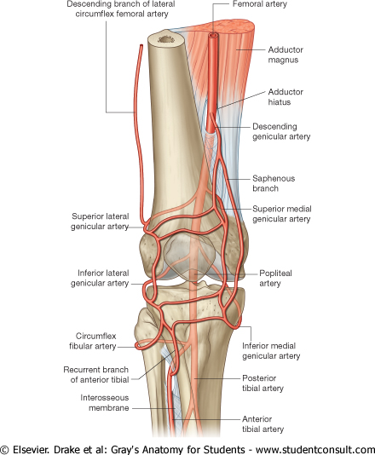
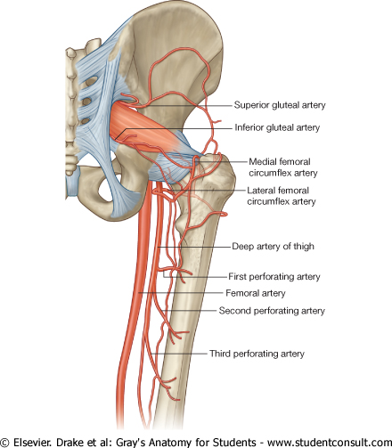
Arterial Anastomosis:
*Note: cruciate means they are arranged in a cross/plus sign
TROCHANTERIC
(supplies the head and neck of femur)هنا أهميته
Genicular Anastomosis:
Around the knee
أهميتها It compensates for the narrowing of the Popliteal artery during prolonged flexion of the knee.
Cruciate*
Provides connection between Internal iliac and Femoral arteries (external iliac).
(It supplies blood to the lower limb in case of ligation of the femoral artery)هنا أهميته
extra:^ سبب التسمية
بما انهم على شكل +
فهم أربعة فروع (فوق
يمين
يسار
تحت)
Formed from the Five genicular branches of the popliteal artery.
Inferior gluteal.
Medial circumflex femoral.
Lateral circumflex femoral.
First perforating
1: branch of Internal iliac , 2,3,4: branches of Profunda Femoris = Femoral arteries = external iliac
Superior gluteal.
Inferior gluteal.
Medial circumflex femoral.
Lateral circumflex femoral
د.جميلة تقول بس رقم 3 و 4 في هذا الانستموزز

Slide 16
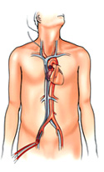
Cannulation of Femoral Artery
because of the superficial position of the femoral artery, it is used for left cardiac angiography*.
A long catheter is inserted percutaneously (عبر الجلد)into the artery and passed up the external iliac artery, common iliac artery , aorta to the left ventricle.
* Angio = blood vessels

Slide 17
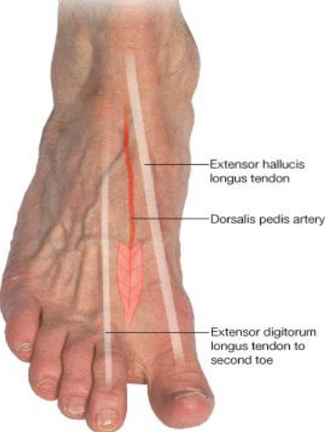
Where To Feel The Peripheral Arterial Pulse ?
Sites of Peripheral Arterial Pulse
Popliteal artery:
Because of the deep position of the artery, its pulsations are best felt in the inferior (lower)part of the popliteal fossa ( here the artery is related to the tibia). نضغط باتجاه التيبياDeep in the popliteal fossa medial to the midline.
Weakening or loss of the popliteal pulse is a sign of femoral artery obstruction.
Posterior tibial artery:
Taken Postero inferior to the medial malleolus (in the groove between the malleolus and the heel) The flexor retinaculum must be relaxed by inverting the foot. Palpation of PT pulse is essential for examining patients with occlusive(انسداد) peripheral arterial diseases.
Femoral artery:
Inferior to the lingual ligament and midway between the anterior superior iliac spine and symphysis pubis.
How to Stop bleeding from the femoral artery? (مؤقتاً)
By pressing the artery directly posterior against the superior pubic ramus and the femoral head.
Dorsalis pedis artery:
It is easy to be felt being subcutaneous, over the tarsal bones between the tendons of Extensor hallucis longus and Extensor digitorum longus
Some people have congenitally non palpable DP pulse, the anomaly is usually bilateral.أما لو في رجل واحدة فقط ففي مشكلة في الفسلز لكن مو جينية

Slide 18
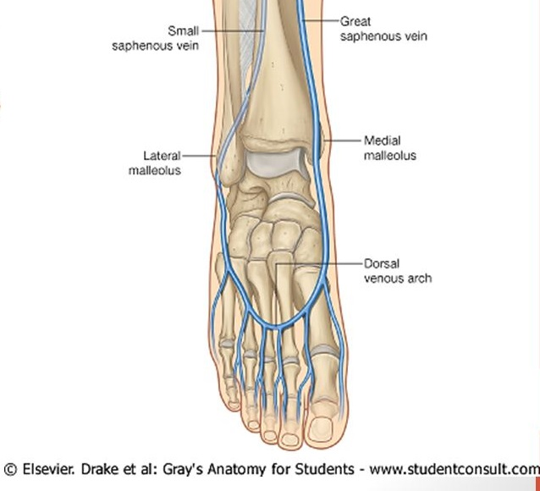
Veins Of Lower Limb:
The superficial & deep veins have valves which are more numerous in the deep veins.
The blood passes from the superficial to the deep veins.
دائماً
The veins of the LL are classified into:
Superficial system
Deep system
Superficial Veins : lie in the subcutaneous tissue (GSV , SSV) :
Dorsal Venous arch (network) Receives most of the blood of the foot through Digital and Communicating veins.
Then it’s Drained on the Medial side by the Great Saphenous vein. Lateral side by the Small saphenous vein.
Deep veins: deep to the deep fascia and accompany all major arteries (Femoral, Popliteal veins).
GSV : Grater saphenous vein , SSV : Small saphenous vein

Slide 19
Great Saphenous Vein:
The Longest Superficial vein of the body.
Begins from the medial end of the dorsal venous arch (as the medial marginal vein).الصمامات فيها أكثر لأنها أطول فتقريباً فيها 12 صمام
Ascends:
A-In front of the Medial Malleolus(وهذا المكان ثابت عن كل الناس) accompanied by the (Saphenous nerve).
B- Posterior to the Medial Condyle of the femur.
C- Passes through the Saphenous Opening (in the facsia) (2.5-3.25) cm below and lateral to the pubic tubercle.
Terminates in: Femoral Vein.
Because of its constant position in front of the medial malleolus, it is used for saphenous cutdown especially in infants, obese and shocked patients.
عشان موقعه ثابت دائما فنقدر بعد ندخل فيه حقنة وريدية اذا احتجنا في الطوارئ مثلاً
What is cut-down?
Venous cut-down is an emergency procedure in which the vein is exposed surgically and then a cannula is inserted into the vein under direct vision. It is used to get vascular access in trauma and hypovolemic shock patients when peripheral cannulation is difficult or impossible. The saphenous vein is most commonly used.

Slide 20
Small Saphenous Vein:
Originates from the lateral end of the dorsal venous arch.
Where the great one Begins from the medial end of the dorsal venous arch
Ascends:
Behind the lateral Malleolus along with the Sural nerve; along the middle of the back leg (in company with the Sural nerve)
Where the great one Ascends In front of the Medial Malleolus(المكان الثابت عن كل الناس) accompanied by the Saphenous nerve).
Termination:
It may join the Great Saphenous vein.
joins the Popliteal vein
3. Or *Bifurcates:
One branch joins the Great saphenous and the other joins the Popliteal vein.يختلف من شخص لآخر
*Bifurcates: Divides into two parts

Slide 21
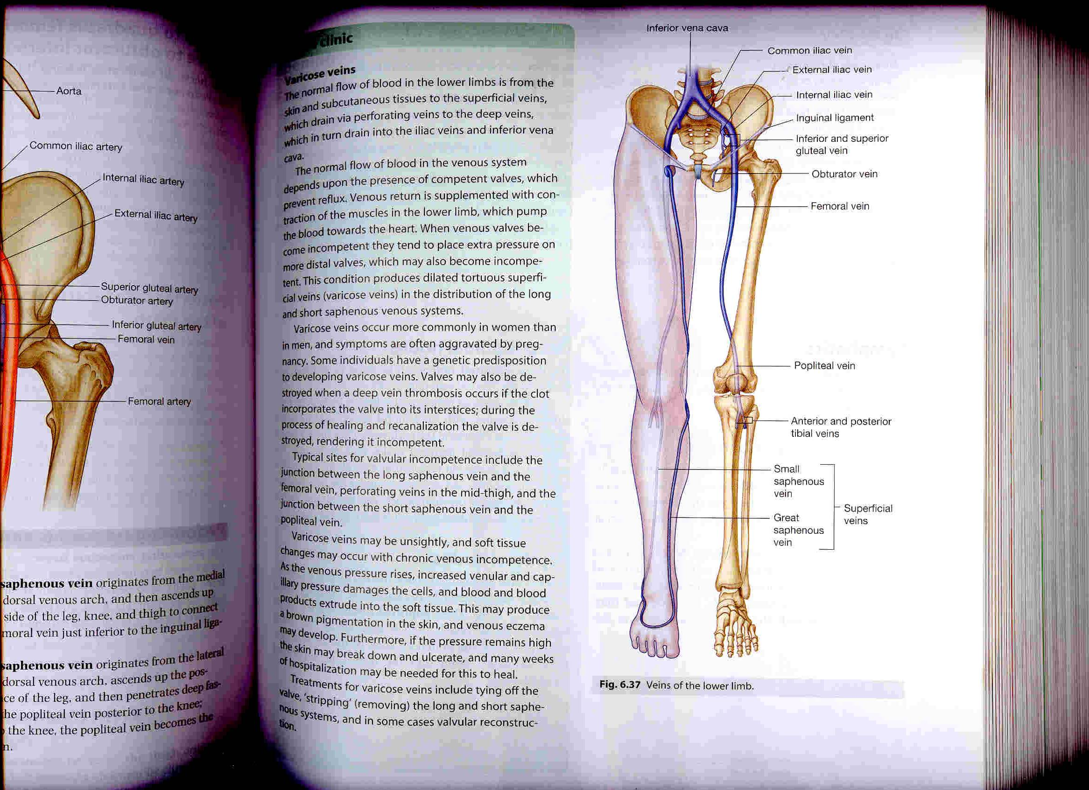
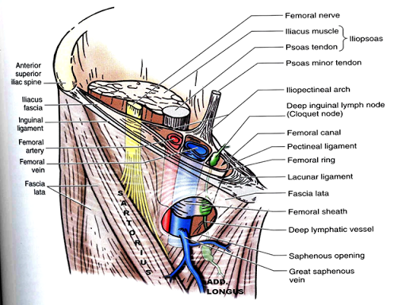
Deep Veins:
Popliteal vein:
formed by the union of venae comitantes around the anterior and posterior tibial artery.
It is posterior to popliteal artery.
Femoral vein: A continuation of popliteal vein.
Course:
Enters the thigh by passing through the opening in adductor magnus.
Leaves the thigh in (through) the Intermediate compartment of femoral sheath.
Passes behind inguinal ligament to become external iliac vein.
هذه الصورة لإيضاح النقطة 2 و 3
Femoral sheath surrounding artery & vein and lymph node

Slide 22
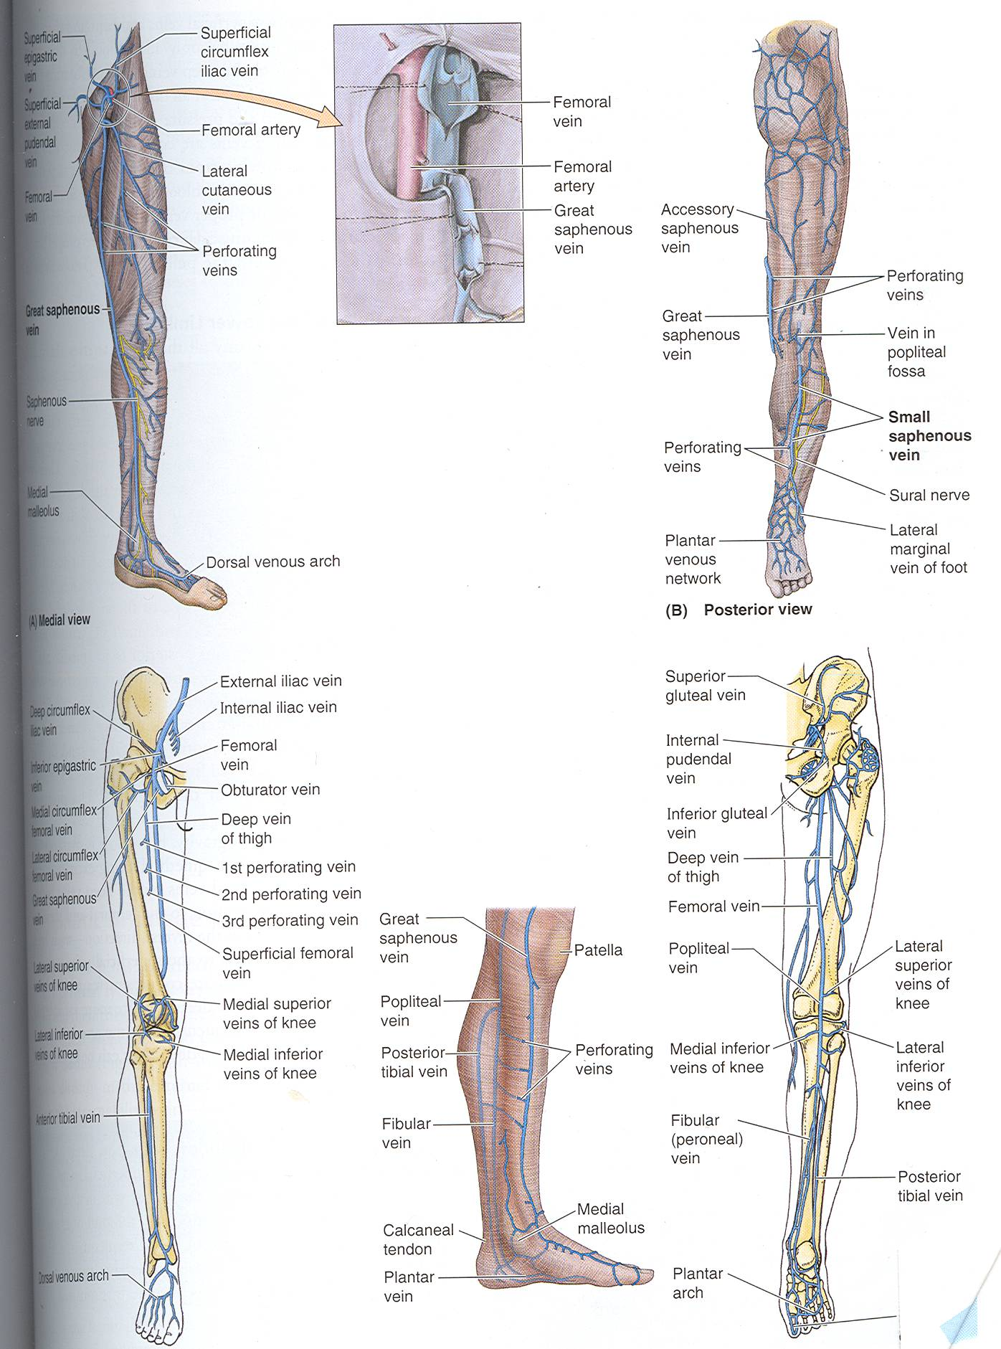
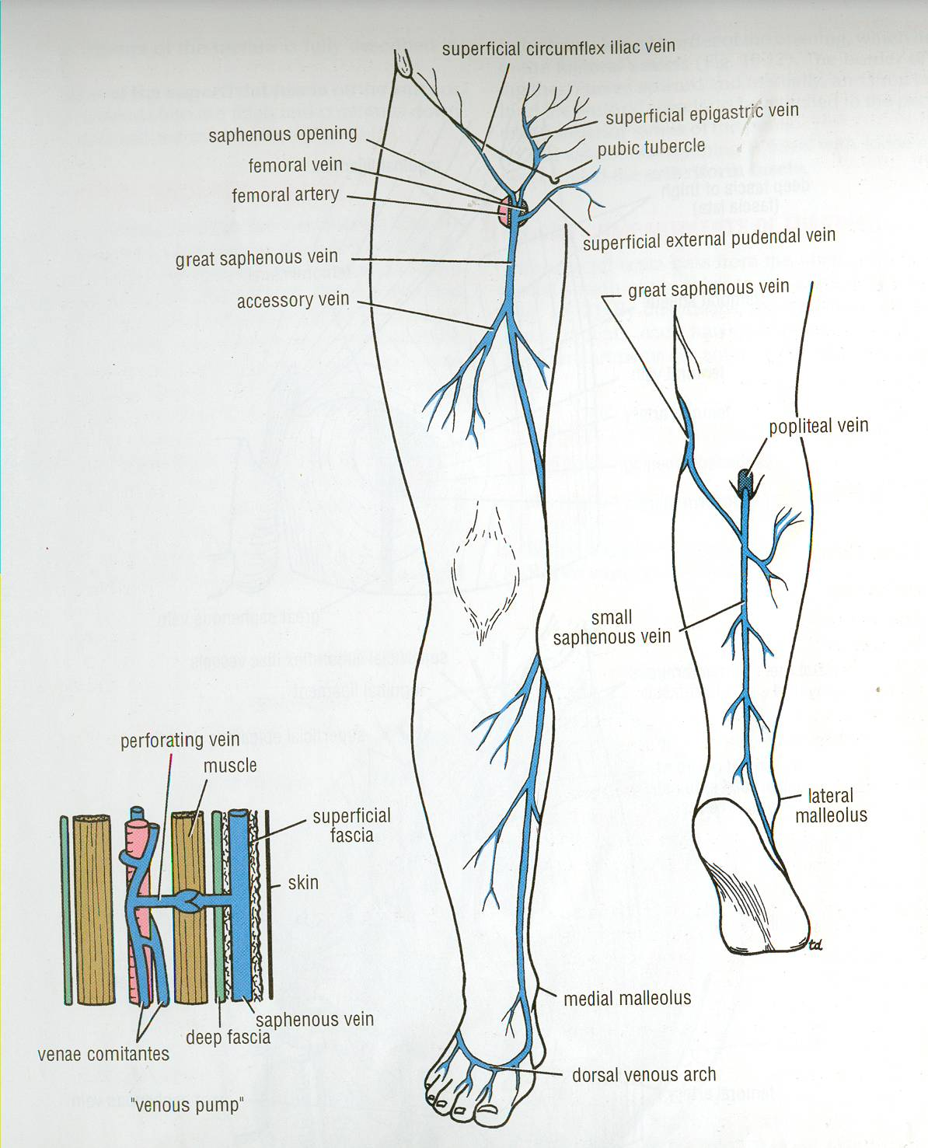
:Venae Comitantes
Perforating Veins:
They are deep veins that accompany all the major arteries and their branches.
Usually paired
They are contained within the vascular sheath of the artery, whose pulsations help to compress and move blood in the veins especially during exercise.
(the arteries help in moving the blood through the venae comitantes)هنا أهميتها
عشان كذا لما الواحد يطول وهو واقف يغمى عليه لأنه الدم ما قدر يرجع للقب , فالعسكري مثلا اللي يحتاج يوقف لمدة طويلة لازم بين فترة وفترة يحرك عضلات ساقه خاصةً
Connect superficial veins (great saphenous vein) with the deep veins along the medial side of the calf.
Penetrate the deep fascia(وهذا سبب تسميتها) close to their origin from the superficial veins.
The perforating veins pass through the deep fascia at an oblique angle so during muscular contraction, they are compressed. This also prevents blood flowing from the deep to the superficial veins..
Their valves only allow blood to flow from the superficial veins to the deep veins.
In some cases, such as in varicose veins, the valves weaken, leading to the flow of blood in the opposite direction ( from deep to superficial)

Slide 23
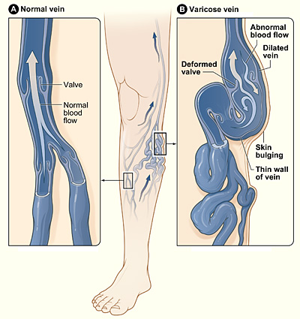
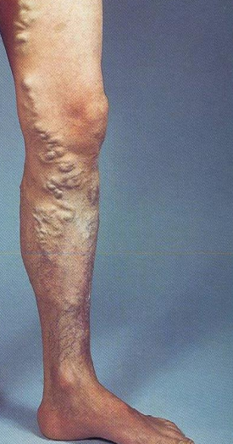
Varicose Veins:= الدوالي
Only on the girls’ slides
Varicose veins
definition: | Cause: | Result:
It is the dilatation and degeneration of the superficial veins that may be complicated by ulcers. It is more common in the posteromedial part of the lower limb. | It is because of the incompetence of the valves in the perforating veins or valves within the great saphenous vein itself. فالدم ما صار يروح للأوردة العميقة ويتجمع في السطحية فقط أو حتى ينتقل من العميقة للسطحية ! incompetence of the valves ممكن يكون بسبب الحمل أو ضعف طبيعي فيها أو ورم | This allows the passage of high pressure blood from the deep veins to the superficial veins فتتوسع الأوردة السطحية نتيجة تجمع الدم فيها ويصير لون الدم أغمق ثم تتلفف(تتعرك) *مثل الصورة* ثم يتفجر وهذا التفجر يسبب قرحة ! اسمها Varicose ulcer
Extra picture for understanding

Slide 24
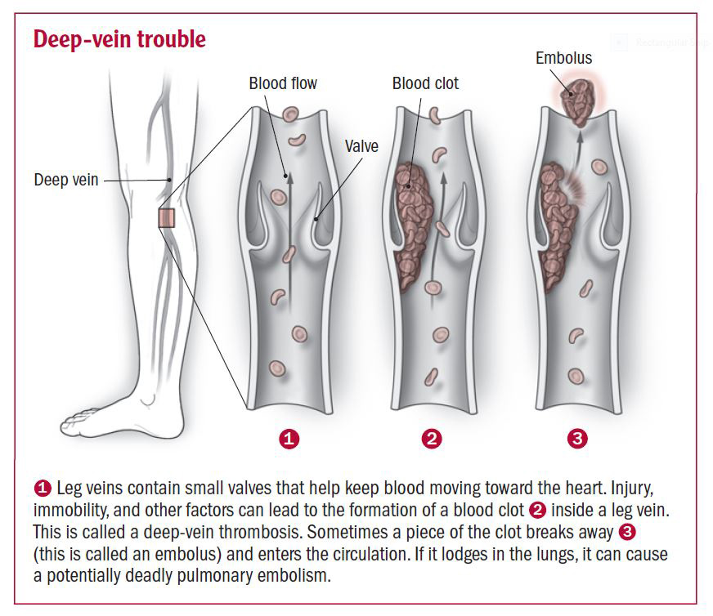
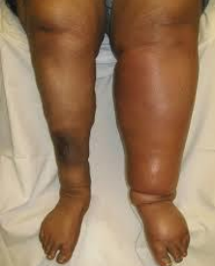
Deep Vein Thrombosis (DVT) :
Only on the girls’ slides
Definition: it is when a blood clot (thrombus) forms in one of the deep veins of the lower limb.
The veins of the lower limb are subject to venous thrombosis after a bone fracture.أو بسبب الاستلقاء على السرير لمدة طويلة
Venous stasis is the main cause by pressure on the veins from the bedding during prolonged hospital stay and aggravated by muscular inactivity.فالمريض بعد الجراحة لازم يتحرك
Thrombophlebitis (inflammation of the wall of a vein with associated thrombosis) may develop around the vein.
Pulmonary thromboembolism (blockage of a pulmonary artery in the lung) may occur when a thrombus breaks free from the lower limb vein and passes to the lungs.
فمثلاً بعد 7 أيام من الجراحة تصيب المريض هذه الحالة بسبب أنه ما تحرك! فانتقلت الجلطة من أوردة الأطراف السفلى إلى الأوردة الرئوية ثم للرئة !

Slide 25
MCQs
1. At the opening of adductor magnus the femoral vein lies .......... to the femoral artery ?
A. Lateral
B. Medial
C. Anterior
D. Posterior
2. Which one of the following Completes the Plantar arch ?
A. Lateral Plantar Artery
B. Lateral tarsal artery.
C. Dorsalis Pedis Artery
D. A and C
3. Which of the following is Inferior to the lingual ligament and midway between the anterior superior iliac spine and symphysis pubis?
A-Posterior Tibial
B-Popliteal
C-Femoral
D-Dorsalis Pedis
4. The superficial vein has more valves than the deep vein :
A- True
B-False
5. The popliteal vein is ………. to popliteal artery:
A. Anterior
B. Posterior
C. Medial
D. Lateral
Answers:
1.A
2.D
3.C
4.B
5.B

Slide 26
SAQ
Q1.Mention the terminal branch of Posterior Tibial Artery.
Q2.What are the sites of peripheral arterial pulse?
Q3.Describe the function of perforating veins.
Q1:
1-medial plantar arteries.
2-lateral plantar arteries.
Q2:
1-Femoral
2-Popliteal
3-Posterior Tibial
4-Dorsalis Pedis
Q3:They connect the superficial veins to the deep veins, and they maintain the blood flow from the superficial veins to the deep veins.

Slide 27


Leaders:
Nawaf AlKhudairy
Jawaher Abanumy
Ghada Almazrou
Members:
Yazeed AlSuhaibani
Abdulmalik alhadlaq
Mohammed nasr
Majed alzain
Talal alhuqayl
Hamad Alkhudhairy
Mohammed Habib
Abdulhakim Alonaiq
Abdullah Jammah
Mohammed alkahil
Abdulaziz alsalman
anatomyteam436@gmail.com
@anatomy436

