Slide 1
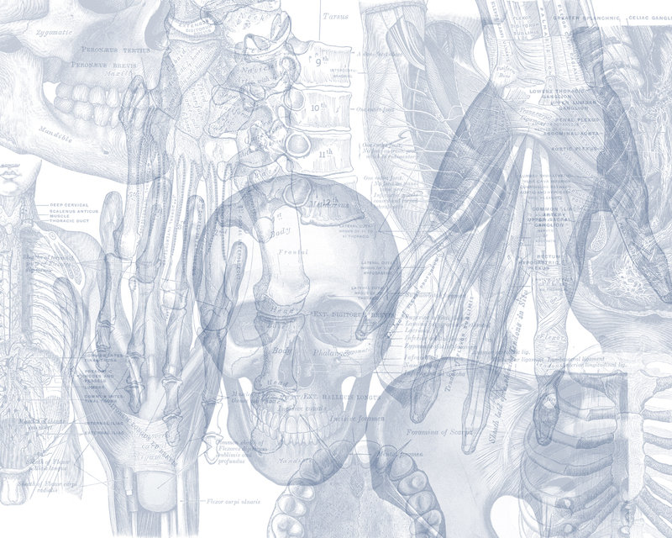
Popliteal Fossa, Posterior Compartment of leg & Sole of foot
Color Code
Important
Doctors Notes
Notes/Extra explanation
Editing File

Slide 2
Objectives
At the end of the lecture you should know:
The location, boundaries & contents of the popliteal fossa.
The contents of posterior fascial. compartment of the leg.
The structures hold by flexor retinaculum at the ankle joint.
Layers forming in the sole of foot & bone those form the arches of the foot.

Slide 3
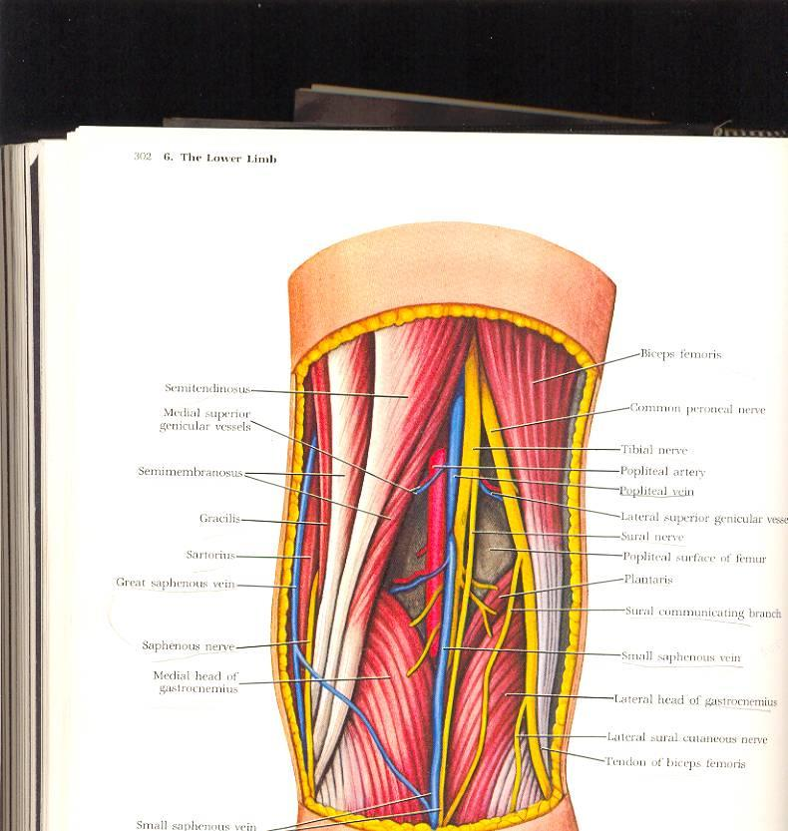
Popliteal Fossa
Is a diamond-shaped intermuscular space at the back of knee
Boundaries
Laterally | Above: biceps femoris. Below: lateral head of gastrocnemius & plantaris
Medially | Above: semitendinosus & semimembranosus Below: medial head of gastrocnemius
Roof | Skin, superficial fascia and deep fascia of the thigh
Base | Popliteal surface of femur, posterior ligament of knee joint and popliteus muscle

Slide 4
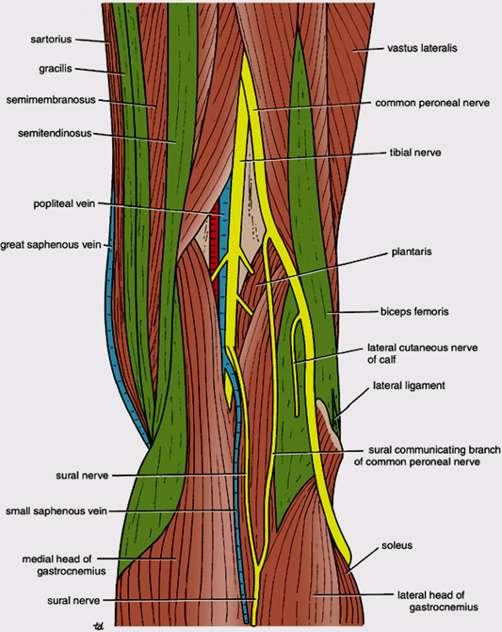
Content Of Popliteal Fossa
1. Popliteal vessels (vein and artery)
2. Small saphenous vein.
3. Tibial nerve.
4. Common peroneal nerve.
5. Posterior cutaneous nerve of thigh.
6. Connective tissue & popliteal lymph nodes.
The deepest structure is POPLITEAL ARTERY*
4
1
3
2

Slide 5
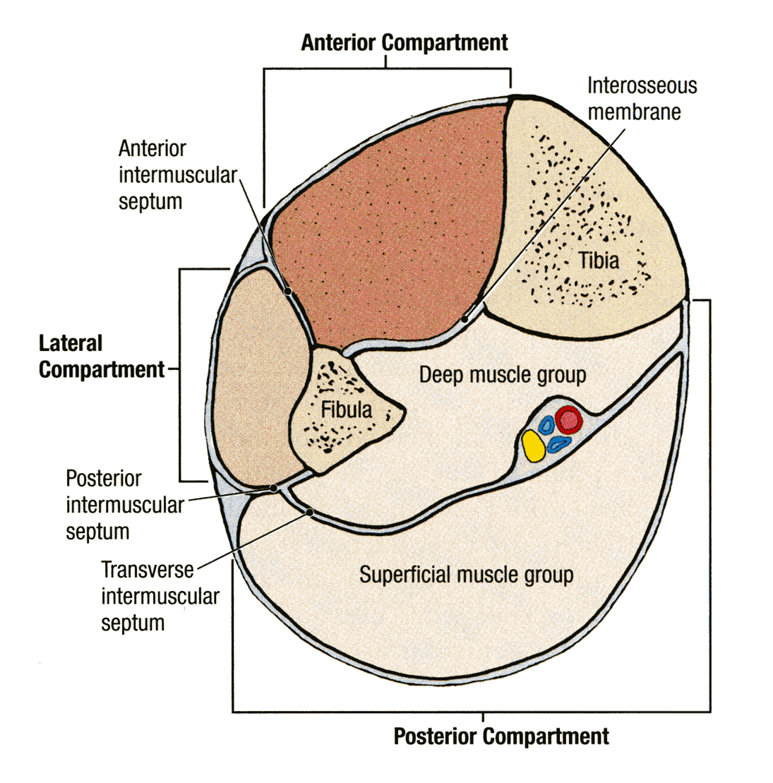
Contents Of The Posterior Fascial Compartment Of The Leg
Recall: the leg is divided into 3 compartments (anterior, lateral and posterior) by the interosseous membrane, anterior intermuscular septum and posterior intermuscular septum.
The posterior compartment is further divided into 2 groups (superficial and deep).
The deep transverse fascia of the leg is a septum that divides the muscles of the posterior compartment into superficial and deep groups.
Contents:
Superficial group of muscles
Deep group of muscles
Posterior tibial artery
Tibial nerve

Slide 6
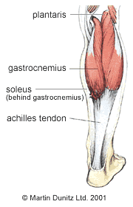
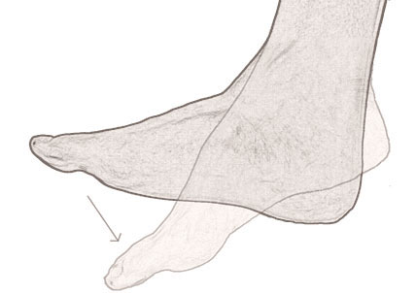
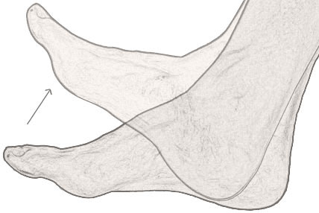
Superficial Group
Muscle | Origin | Insertion | Nerve | Action
Gastrocnemius | Lateral head: from lateral condyle of femur. Medial head: from above medial condyle. | Posterior surface of calcaneum via tendo calcaneus | Tibial nerve | Plantar flexion at ankle joint. flexes knee joint.
Soleus | Shafts of tibia (soleal line) and fibula |  |  | Together with gastrocnemius and plantaris is powerful plantar flexor of ankle joint. provides main propulsive force in walking and running
Plantaris ( a very thin muscle ,some people may not have it ) | Lateral supracondylar ridge of femur | Posterior surface of calcaneum |  | Plantar flexion at ankle joint. flexes knee joint.
Remember *
Plantarflexion:
Flexion of the ankle
Dorsiflexion:
Extension of the ankle

Slide 7
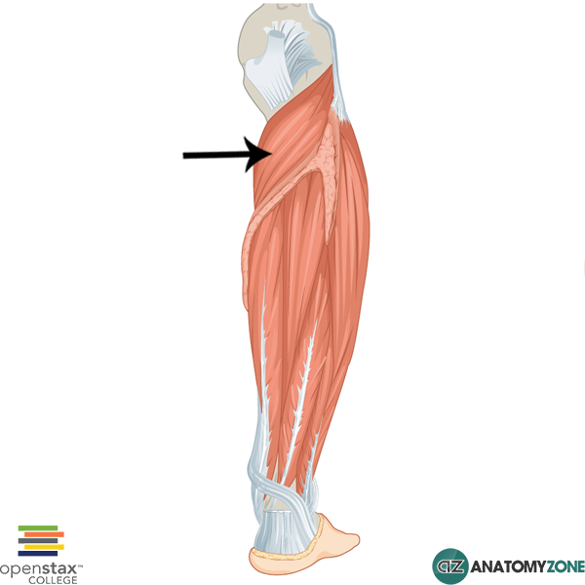
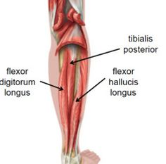
Deep Group
Popliteus | Origin : groove on lateral surface of lateral condyle of femur (Intracapsular). Insertion : Posterior surface of tibia above soleal line. Action : flexes the knee and Unlocks knee joint by lateral rotation of femur on tibia (or slight medial rotation of leg which accompanies the flexion)
They are all supplied by the tibial nerve
Flexor digitorum longus | Origin : Posterior surface of shaft of tibia. Insertion : Bases of distal phalanges of lateral 4 toes. Action : Flexes phalanges of lateral 4 toes and PF*. Supports medial and lateral longitudinal arches
Flexor hallucis longus | Origin : Posterior surface of shaft of fibula. Insertion : Base of distal phalanx of big toe. Action : Flexes phalanx of big toe and PF*. Supports medial longitudinal arch
Tibialis Posterior | Origin : Posterior surface of tibia & fibula and interosseous membrane. Insertion : Tuberosity of navicular bone and All tarsal bones except talus. Action : inverts foot at subtalar and transverse tarsal joints and PF*. supports medial longitudinal arch
PF* : -Plantar Flexes foot at ankle joint.

Slide 8
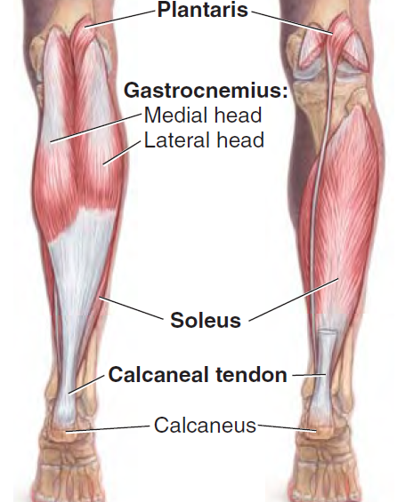
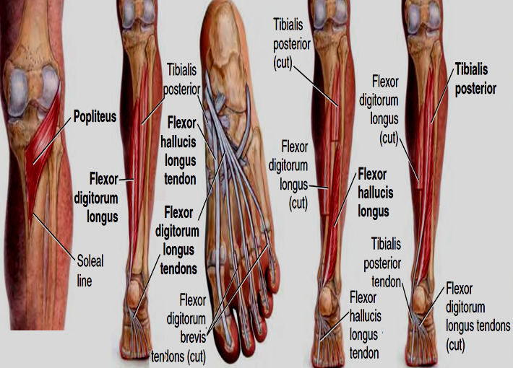
Superficial Group
Deep Group

Slide 9
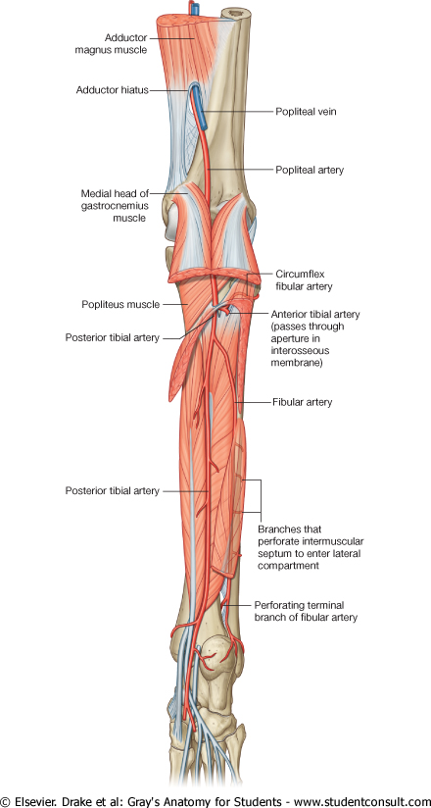
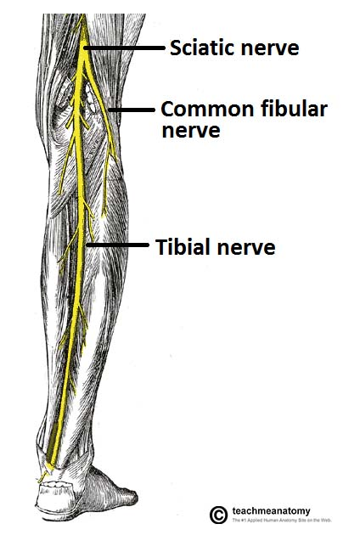
Posterior Tibial Artery And Tibial Nerve
Posterior tibial artery is one of the terminal branches of the popliteal artery.
The tibial nerve is the larger terminal branch of the sciatic nerve in the lower third of the back of the thigh.
it supply the Muscles of posterior compartment of leg.

Slide 10
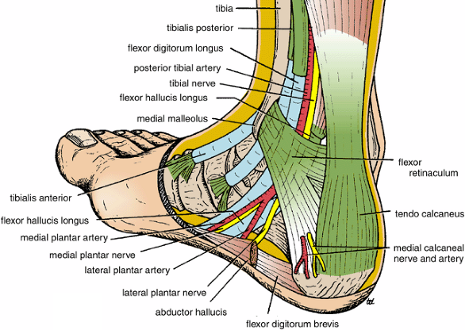
Flexor Retinaculum
Extend from back of medial malleolus to medial side of calcaneum.
Structures passing posterior to medial malleolus, deep to flexor retinaculum:
Medial to lateral :
Tibialis posterior tendon
Flexor digitorum longus tendon
Posterior tibial artery with venae comitantes
Tibial nerve
Flexor hallucis longus tendon
(All the tendons are surrounded by a synovial sheath)

Slide 11
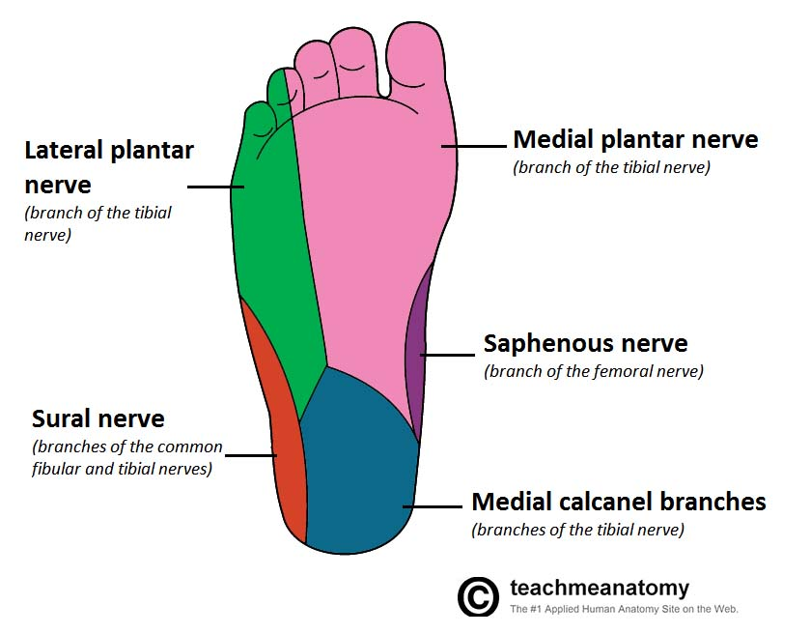
Sensory Nerve Supply
The sensory nerve supply to the skin of
the sole of the foot is derived from:
Lateral plantar nerve innervate the lateral third of the sole.
Tibial nerve innervates the medial side of the heel.
Medial plantar nerve innervate the medial two thirds of the sole.
Only on the boys’ slides

Slide 12
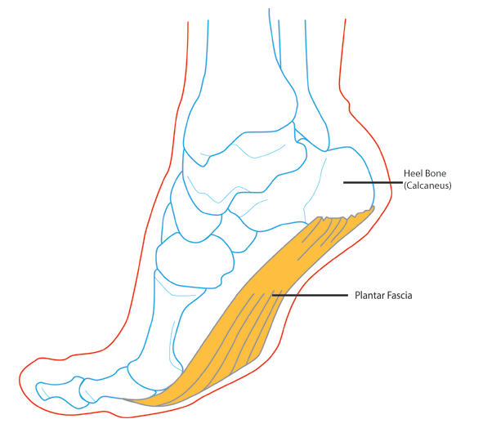
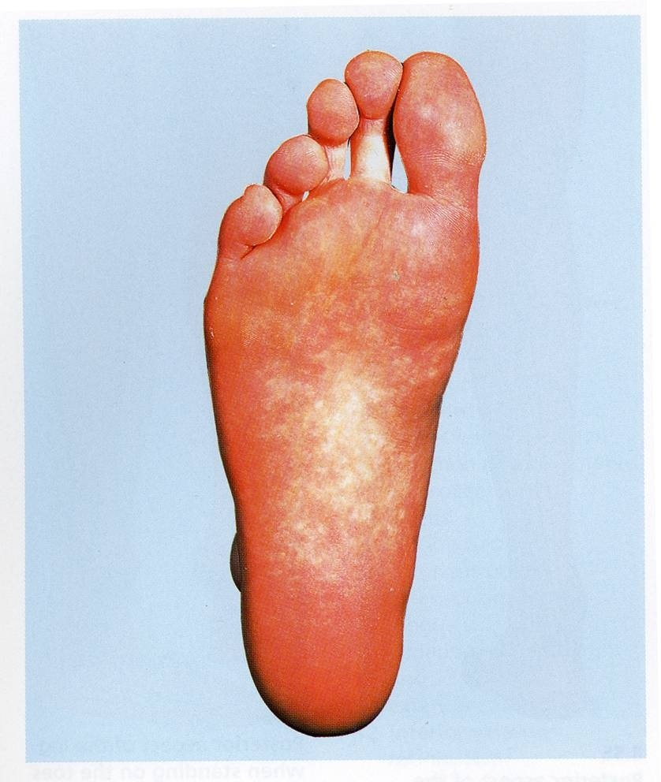
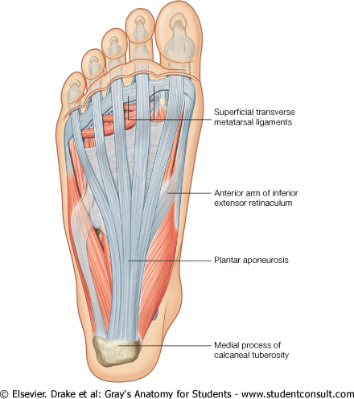
Sole Of The Foot
Only in the girls’ slides
Deep Fascia
The skin of the sole of the foot is thick and hairless( (بدون شعر
The skin of the sole shows a few flexure creases at the sites of skin movement
Sweat glands are present in large numbers.
The plantar aponeurosis is a triangular thickening of the deep fascia that protects the underlying nerves, blood vessels, and muscles.
Its apex is attached to the medial and lateral tubercles of the calcaneum.
The base of the aponeurosis divides into five slips that pass into the toes.
Extra picture for understanding
Five slips
apex

Slide 13
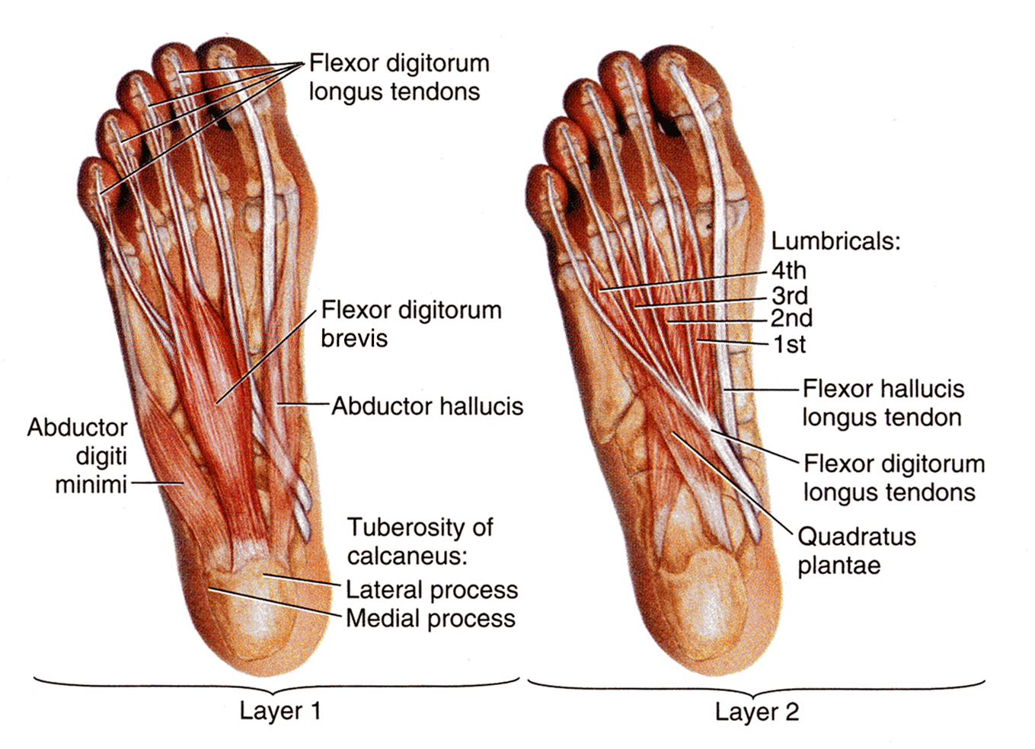
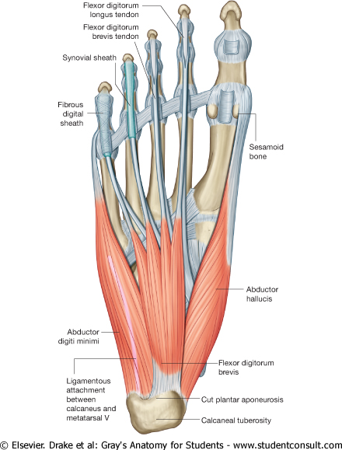
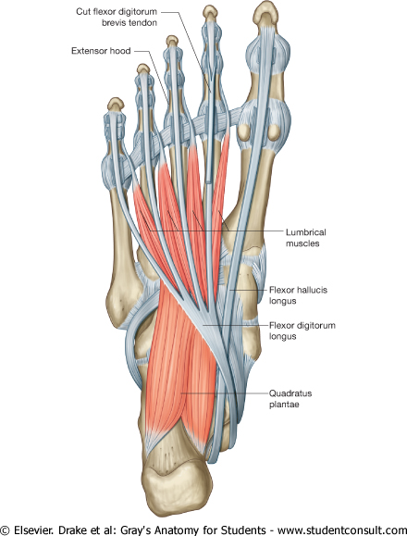
Muscles Of The Sole Of The Foot
The muscles of the sole are conveniently described in four layers from superficial to deep.
Superficial(First Layer)
Deep(Fourth Layer)
First Layer
Second Layer
1- Abductor hallucis
2- Flexor digitorum brevis
3- Abductor digiti minimi
1- Quadratus plantea
2- Lumbricals (4 muscles)
3- Flexor digitorum longus tendon*
4- Flexor hallucis longus tendon*
نفس الصور اللي على اليمين واليسار ولكن للتوضيح أكثر
2
4
1
3
3
1
2
*Only the TENDON not the muscle
To remember: only the even layers have tendons (2,4)

Slide 14
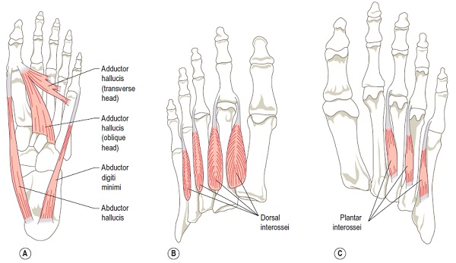
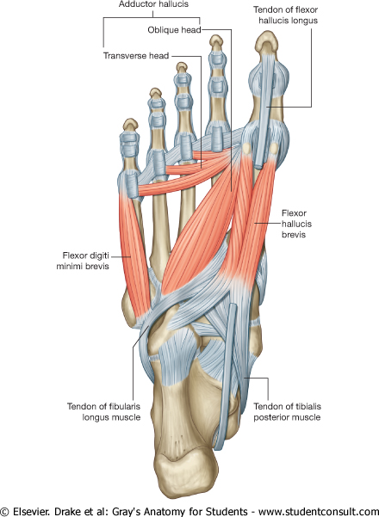
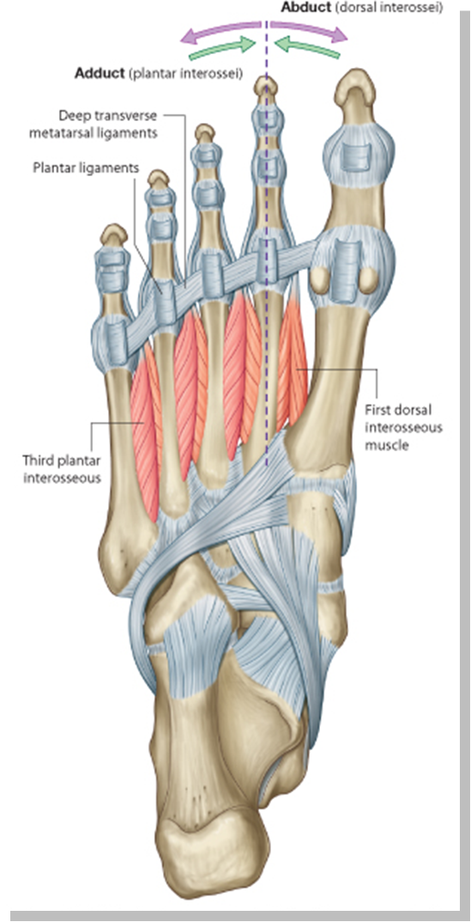
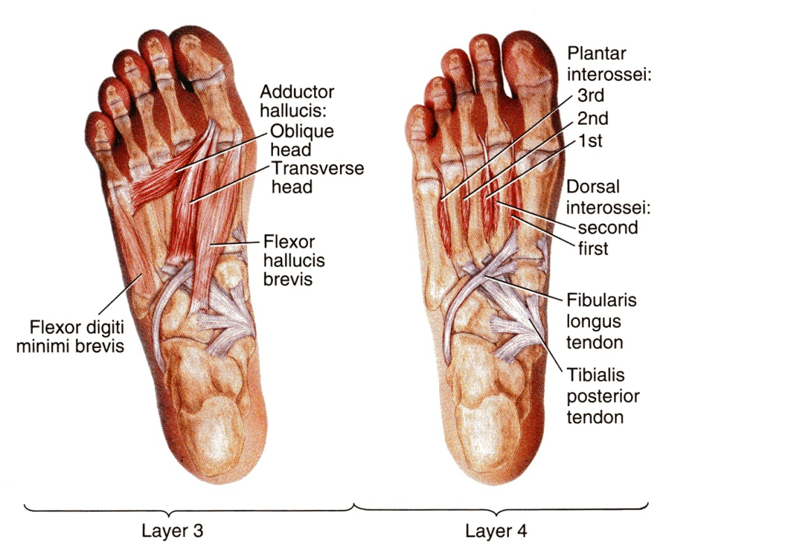
Muscles Of The Sole Of The Foot Cont.
The muscles of the sole are conveniently described in four layers from superficial to deep.
Superficial(First Layer)
Deep(Fourth Layer)
Third Layer
Fourth Layer
Extra
1-Flexor hallucis brevis
2-Adductor hallucis
3-Flexor digiti minimi brevis
1-Interossei, (3 plantar + 4 dorsal).
2-Peroneus longus tendon,
3-Tibialis posterior tendon
2
1
نفس الصور اللي على اليمين واليسار ولكن للتوضيح أكثر
Interossei
1
3
2
Peroneus longus tendon
*Only the TENDON not the muscle
To remember: only the even layers have tendons (2,4)
Tibialis posterior tendon
3

Slide 15
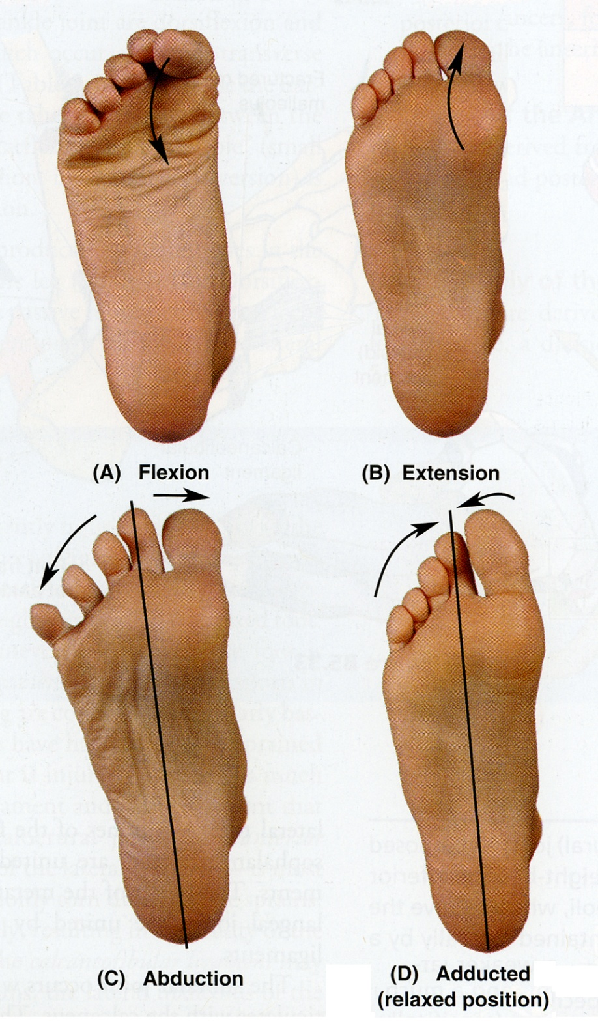
Functions Of The Small Muscles Of The Sole Foot
Metatarsophalangeal joints
Interphalangeal joints
Movement | Muscle
Flexion(A) | Flexor digitorum brevis Lumbricals Interossei Flexor hallucis brevis Flexor hallucis longus Flexor digiti minimi brevis Flexor digitorum longus
Extension(B) | Extensor hallucis longus Extensor digitorum longus Extensor digitorum brevis
Abduction(C) | Abductor hallucis Abductor digiti minmi Dorsal interossei
Adduction(D) | Adductor hallucis Plantar interossei
Movement | Muscle
Flexion(A) | Flexor hallucis longus Flexor digitorum longus Flexor digitorum brevis Quadrate plantae
Extension(B) | Extensor hallucis longus Extensor digitorum longus Extensor digitorum brevis
Unlike the small muscles of the hand, the sole muscles have few delicate functions and are chiefly concerned with supporting the arches of the foot.
Although their names would suggest control movements of individual toes, this function is rarely used in most people.
In both tables
Muscles in boldface are chiefly responsible for movement; the other muscles assist them

Slide 16
Fibrous flexor sheath:
The inferior surface of each toe, from the head of the metatarsal bone to the base of the distal phalanx, is provided with a strong fibrous sheath, which is attached to the sides of the phalanges.
The fibrous sheath, together with the inferior surfaces of the phalanges and the interphalangeal joints, forms a blind tunnel in which lie the flexor tendons of the toe.
Synovial flexor sheath:
The tendons of the flexor hallucis longus and the flexor digitorum longus are surrounded by synovial sheaths.

Slide 17
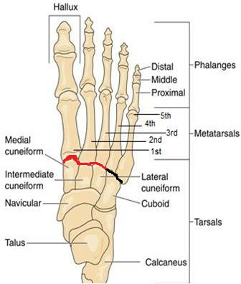
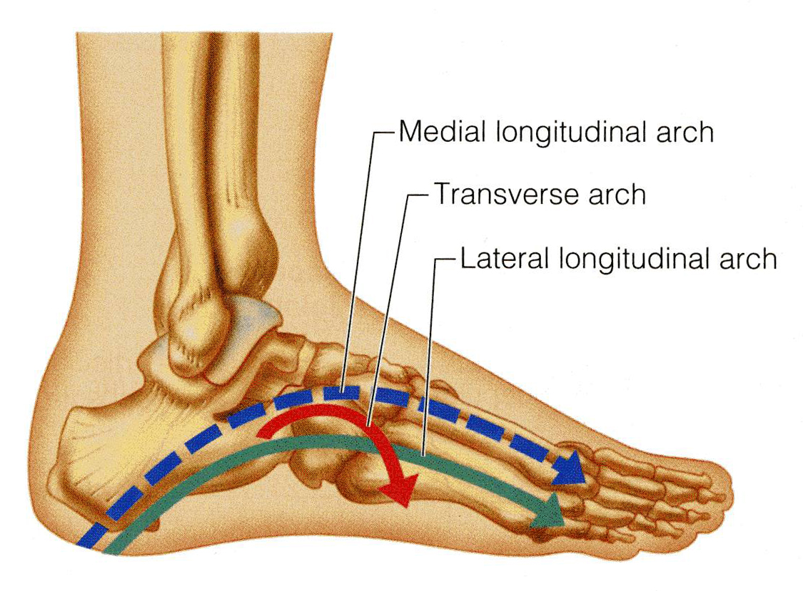
Arches of the Foot
Medial longitudinal arch
Is formed of calcaneum, talus, navicular, 3 cuneiform bones, and first medial 3 metatarsal bones
Only on girls’ slides
Transverse arch
Lies at the level of tarso-metatarsal joints, formed of bases of metatarsal bones, cuboid & 3 cuneiform bones.
Lateral longitudinal arch
Is formed of calcaneum, cuboid & lateral 4th & 5th metatarsal bones
Functions:
Weight bearing
Support walking & running
Provide potential space for neurovascular bundle of the sole
Act as shock absorber
In young child the foot appears to be flat because of presence of a large amount of subcutaneous fat on the sole of foot

Slide 18
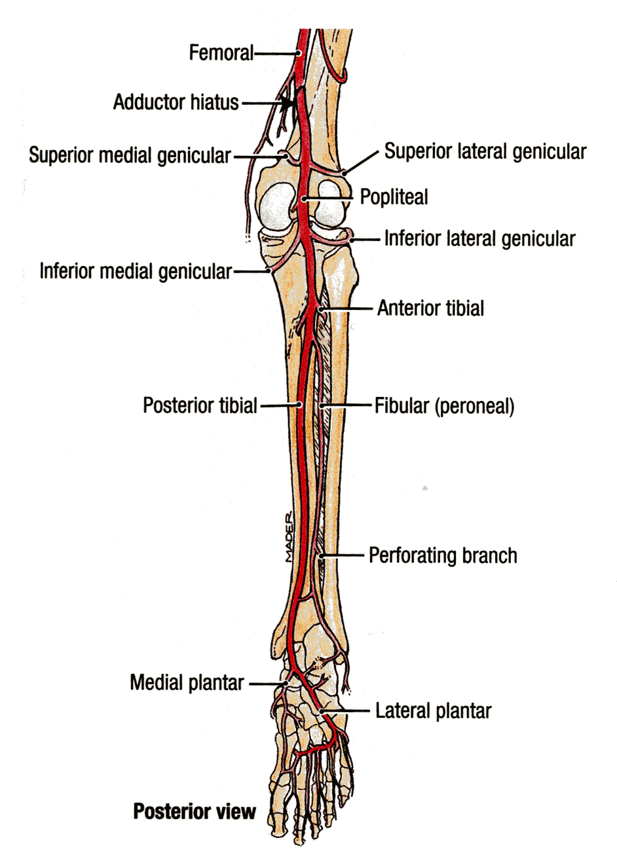
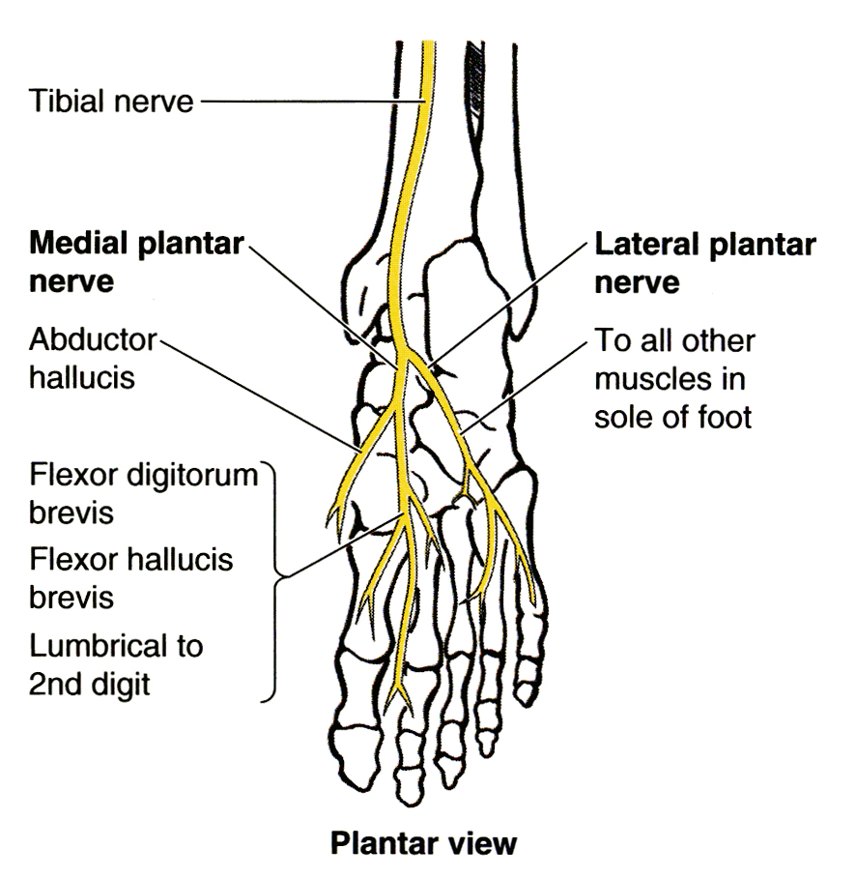
Medial And Lateral Planter Nerves And Arteries
The medial plantar nerve is a terminal branch of the tibial nerve.
The lateral plantar nerve is a terminal branch of the tibial nerve.
The medial plantar artery is the smaller & lateral plantar artery is the larger of the terminal branches of the posterior tibial artery.
(1st lumbrical )
Only on the boys’ slides

Slide 19
MCQs
1. Deep muscles of the leg is part of :
Anterior compartment
Posterior compartment
Lateral compartment
Non of these
2. Which one of the following muscles provides the main propulsive force in walking and running ?
Gastrocnemius
Soleus
Plantaris
Popliteus
3. Which one of the following muscle is inserted in Posterior surface of calcaneum ?
Tibialis Posterior
Plantaris
Gastrocnemius
B & C
4. Tibialis posterior is inserted in all tarsal bones except talus : A. True B. False
5. The apex of the plantar aponeurosis is attached to:
Metatarsals.
Interphalangeal joints.
Tarsometatarsal joint.
Medial & lateral tubercles of calcaneum.
6. Which of the following nerves is supplying 1st lumbrical :
A. Branch of peroneal nerve
B. Medial plantar nerve
C. Lateral plantar nerve
D. Saphenous nerve
ANSWERS:
1.B
2.B
3.D
4.A
5.D
6.B

Slide 20
SAQs
Q1.Define the plantar aponeurosis.
Q2.Why does the sole of the foot appears flat in children?
Q3.Mention three Structures passing posterior to medial malleolus :
Answer1: It is a triangular thickening of the deep fascia that protects the underlying nerves, blood vessels and muscles.
ANSWER2: subcutaneous fat
ANSWER3:Answer:
Tibialis posterior tendon
Tibial nerve
Flexor hallucis longus tendon

Slide 21
Leaders:
Nawaf AlKhudairy
Jawaher Abanumy
Ghada Almazrou
Members:
abdulaziz alangari
Rayan alqarni
Abdulrahman alrajhi
Abdulaziz almohammed
Yazeed AlSuhaibani
Abdulmalik alhadlaq
Mohammed nasr
Majed alzain
Talal alhuqayl
Hamad Alkhudhairy
Mohammed Habib
Abdulhakim Alonaiq
Abdullah Jammah
Mohammed alkahil
Abdulaziz sulaiman
anatomyteam436@gmail.com
@anatomy436

