Slide 1
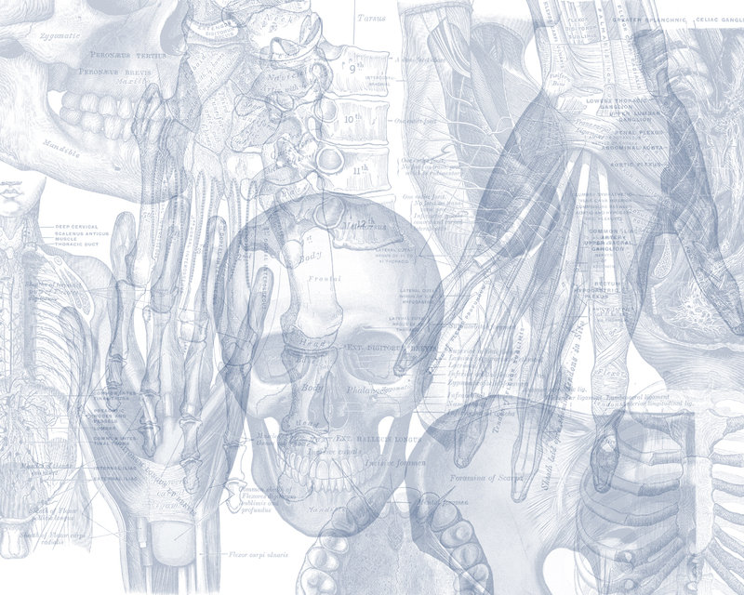
Frontal, Lateral compartment of Leg and Dorsum of Foot
Color Code
Important
Doctors Notes
Notes/Extra explanation
Editing File

Slide 2
Objectives
Identify the deep fascia of leg
Identify the fascial compartments of the leg
Describe the anatomy of the anterior & lateral compartments
List the contents of each compartment (muscles, vessels & nerves)
Describe the anatomy and contents of the dorsum of the foot

Slide 3
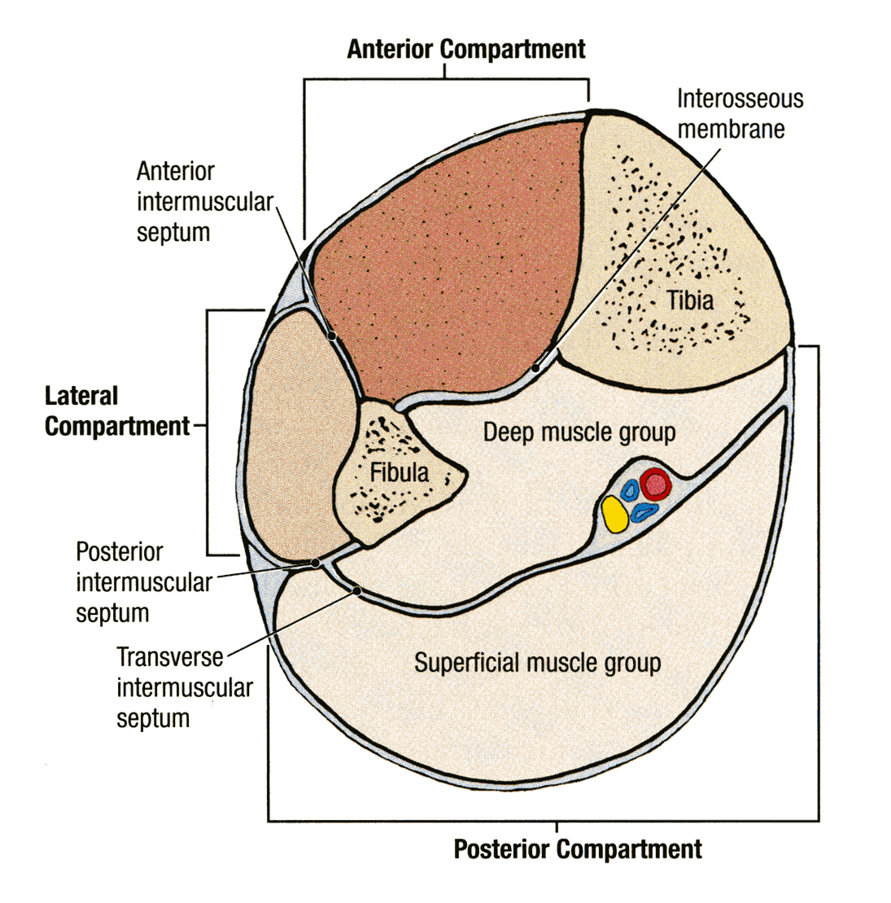
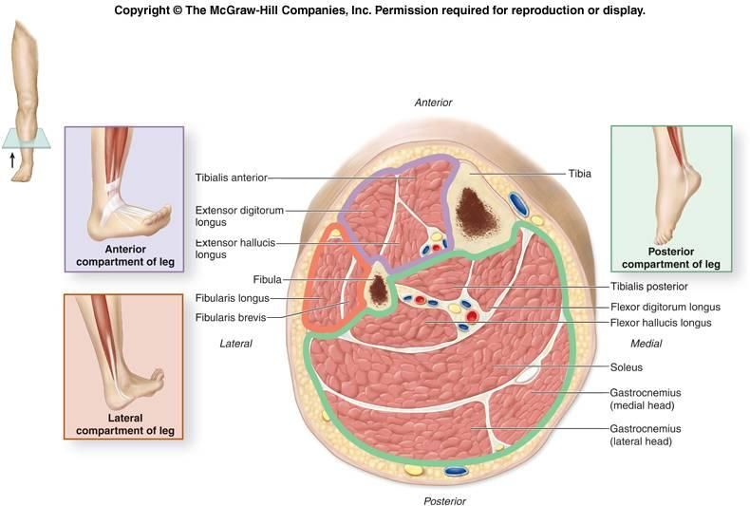
Fascia of the Leg
The deep fascia surrounds the leg and is attached to Anterior & Medial borders of Tibia.
Two Intermuscular Septa
Pass from the deep aspect of this fascia to be attached to :
Anterior border of fibula (Anterior intermuscular septum)
Posterior border of fibula (Posterior intermuscular septum)
Interosseous membrane:
A thin & strong membrane, that binds the interosseous borders of tibia & fibula. It binds the two bones and provides attachment for muscles.
The interosseus membrane and the two intermuscular septa divide the leg into
(3) Compartments :
1. Anterior 2. Lateral (peroneal) 3. Posterior
Each one has its own Muscles (with specific action), Blood vessels and Nerves.

Slide 4
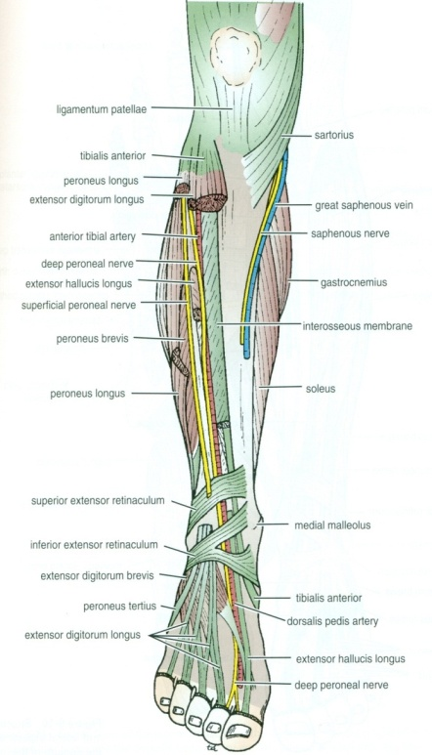
Anterior Compartment Criteria (Contents)
Muscles :
All muscles take origin from the fibula EXCEPT Tibialis Anterior .
Nerve supply:
Deep Peroneal.
Blood Supply:
Anterior tibial.
Action: Dorsiflexion of the ankle joint & Extension of the toes & (Inversion).

Slide 5
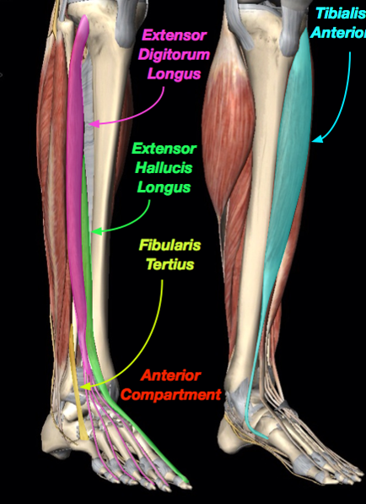
Anterior Compartment Muscles
Tibialis Anterior
Extensor Digitorum Longus
Extensor Hallucius* Longus
Peroneus Tertius**
*Hallucius = big toe
**Fibularis Tertius = Pernous tertius

Slide 6
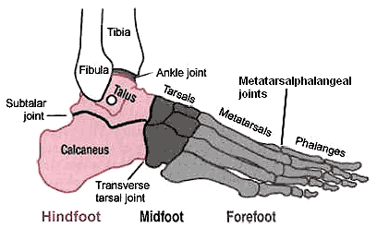
Recall the bones and joints of the foot

Slide 7
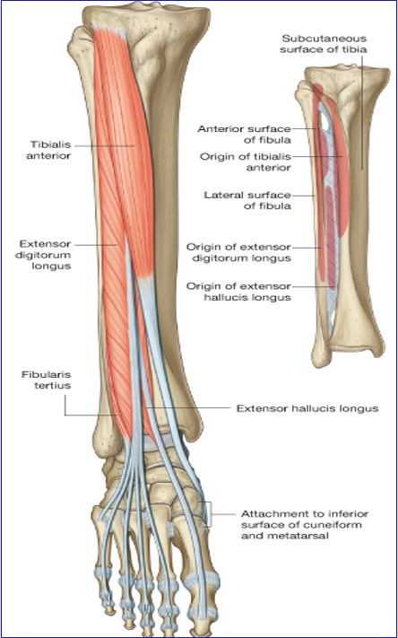
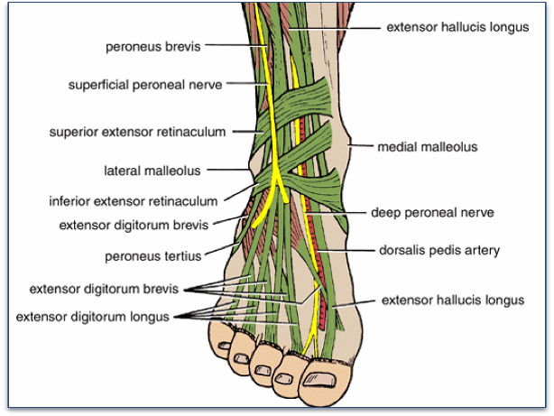
Anterior Compartment Muscles

Slide 8
Anterior Compartment Muscles
Plantar flexion = flexion of ankle/foot
Dorsi flexion = extension of ankle/foot
Muscle | Origin | Insertion | Action
Tibialis anterior. | Lateral surface of shaft of tibia & interosseous membrane. | Medial cuneiform & base of 1st metatarsal bone. | Extends foot at ankle joint. Inverts foot at subtalar & transverse tarsal joints. Holds up medial longitudinal arch of foot.
Extensor Digitorum Longus. | Anterior surface of shaft of fibula. | Extensor expansion of lateral four toes. | Extends toes. Dorsi flex foot at ankle joint.
Peroneus tertius. | Anterior surface of shaft of fibula. | Base of 5th metatarsal bone. | Dorsi flex foot at ankle joint. Everts foot at subtalar and transverse tarsal joints.
Extensor hallucis longus. | Anterior surface of shaft of fibula. | Base of distal phalanx of great toe. | Extends big toe. Dorsi flex foot at ankle joint. Inverts foot at subtalar and transverse tarsal joints.

Slide 9
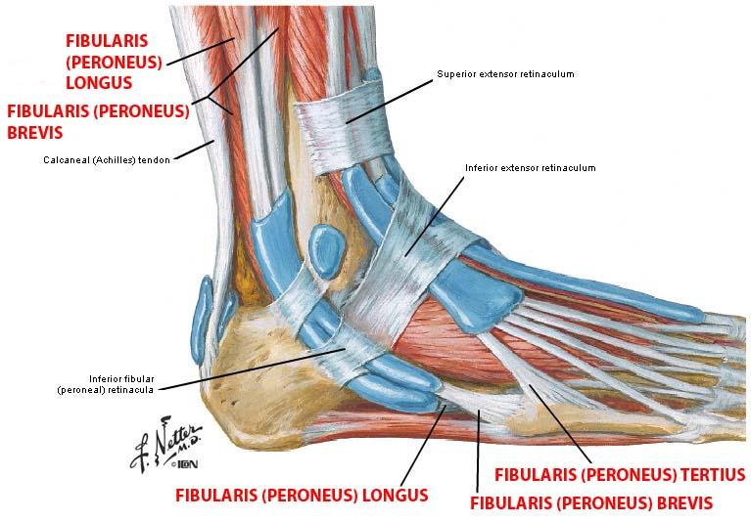
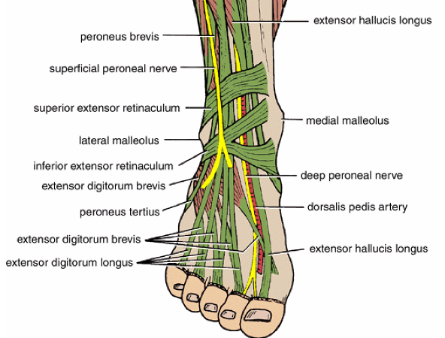
Extensor Retinaculum
A thickening of deep fascia that keep the long tendons around ankle joints in position.
Superior Extensor Retinaculum:
Attached to anterior surface of tibia and fibula above the ankle.
(above the lateral and medial malleolus)
Inferior Extensor Retinaculum:
Y-shaped and located inferior to ankle.

Slide 10
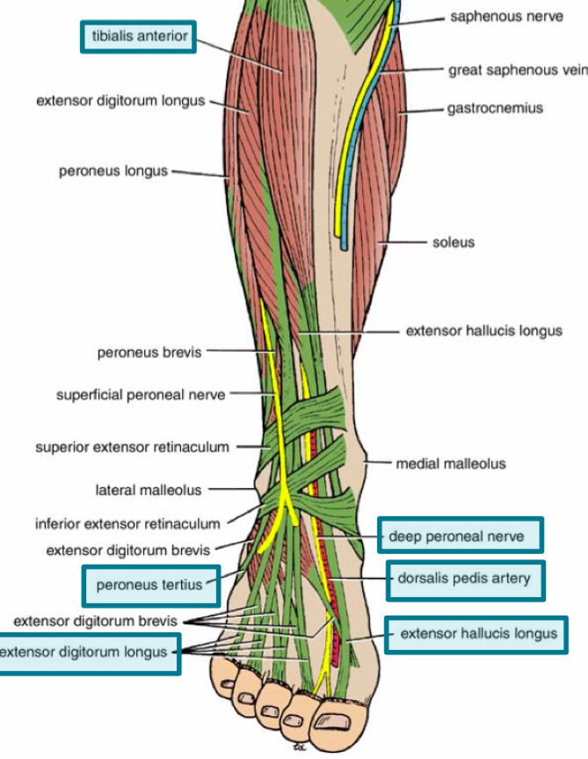
Structures Passing Deep to Extensor Retinaculum:
From medial to lateral:
Tom Has a Very Nice Dog & Pigeon
1- Tibialis anterior
2- Extensor hallucis longus
3- Dorsalis pedis artery (vessel)
4- Dorsalis pedis nerve (nerve)
5- Extensor digitorum longus
6- Peroneus tertius

Slide 11
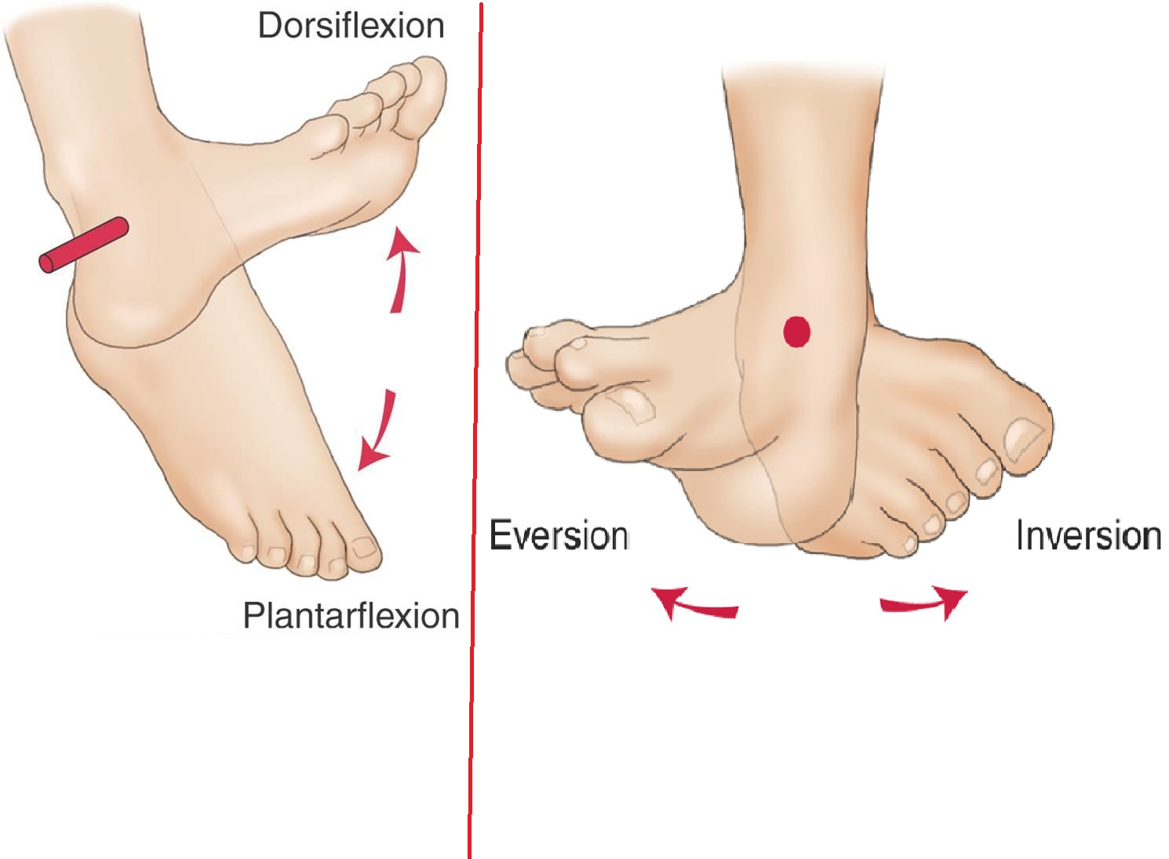
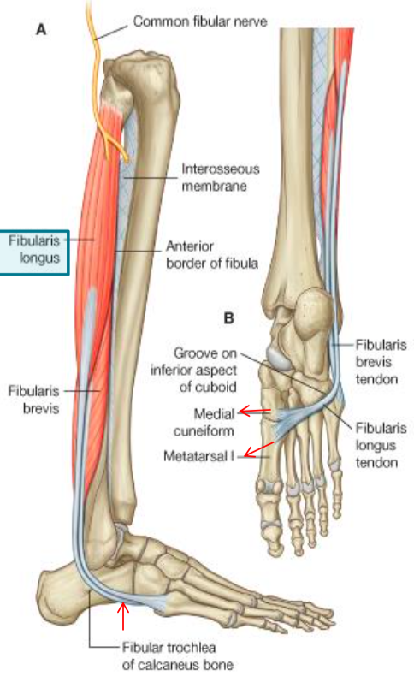
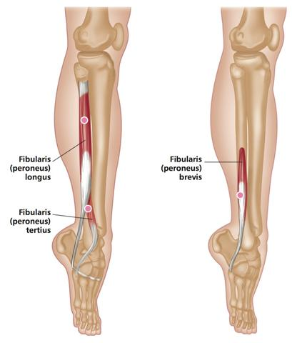
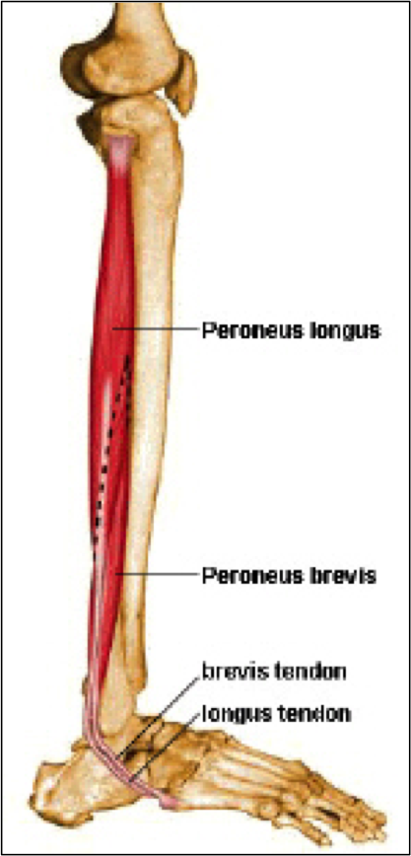
Lateral Compartment: Muscles
The lateral compartment contains only 2 muscles.
The general action is Plantar flexion and Eversion
Muscle | Origin | Insertion | Action | Nerve | Blood Supply
Peroneus Longus | Lateral surface of shaft of fibula | Base of first metatarsal and the medial cuneiform (same as tibialis anterior) | 1.Plantar flexes foot at ankle joint 2.Everts foot at subtalar and transverse tarsal joints 3. Supports lateral longitudinal and transverse arches | Superficial Peroneal (Musculocutaneous) | Peroneal Artery
Peroneus Brevis |  | Base of fifth metatarsal bone. (same as peroneus tertius) | 1.Plantar flexes foot at ankle joint; 2.Everts foot at subtalar and transverse tarsal joint 3. Supports Lateral longitudinal arch of foot.
NOTE: Peroneus = Fibularis

Slide 12
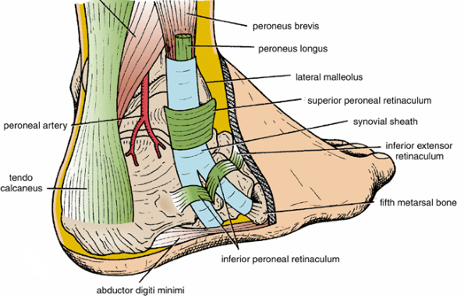
Peroneal retinacula
Synovial Sheaths of Peroneal Longus & Brevis:
1-Superior peroneal retinaculum
Connects the lateral malleolus to calcaneum & holds the tendons of peroneus longus & brevis
2-Inferior peroneal retinaculum
Above the inferoir peroneal retinaculum tendons of peronei are surrounded by a single common tubular synovial sheath,
deep to inferior peroneal retinaculum, they have separate sheaths

Slide 13
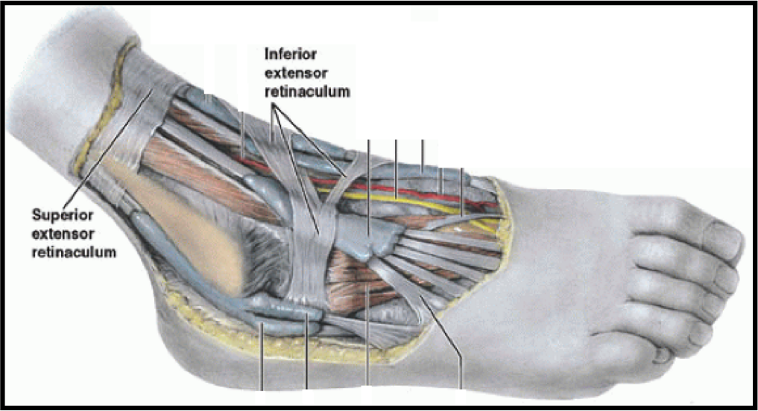
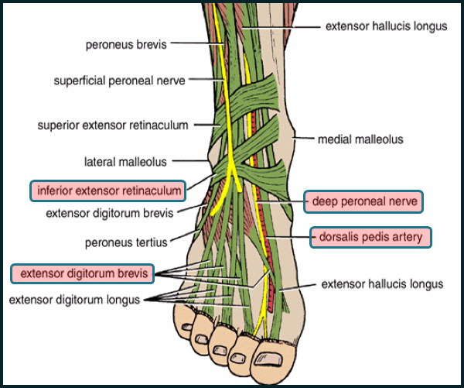
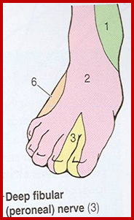
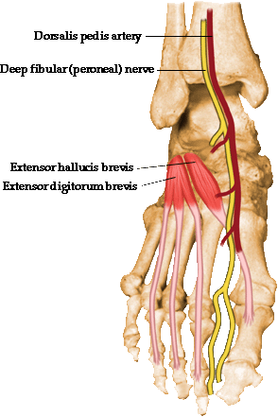
Dorsum of foot Contents
Deep Fascia of Dorsum of Foot
It is very thin, but just distal to ankle joint, it is thickened to form Inferior extensor retinaculum.
Muscles: Extensor Digitorum Brevis
Blood Vessel: Dorsalis Pedis
Nerves: DEEP & Superficial Peroneal
Muscle | Origin | Insertion | Innervation | Action
Extensor Digitorum Brevis | Anterior part of upper surface of the Calcaneum & from the Inferior extensor retinaculum | tendons into the proximal phalanx of the big toe (extensor hallucis brevis) and long extensor tendons to second, third, and fourth toes | Deep fibular nerve | Extension of toes
The muscle has 4 tendons (since it is called digitorum): one on the big toe and 3 on the 2nd 3rd and 4th toes. We call the part that inserts into the big toe extensor hallucis longus, but they are all collectively known as extensor digitorum brevis

Slide 14
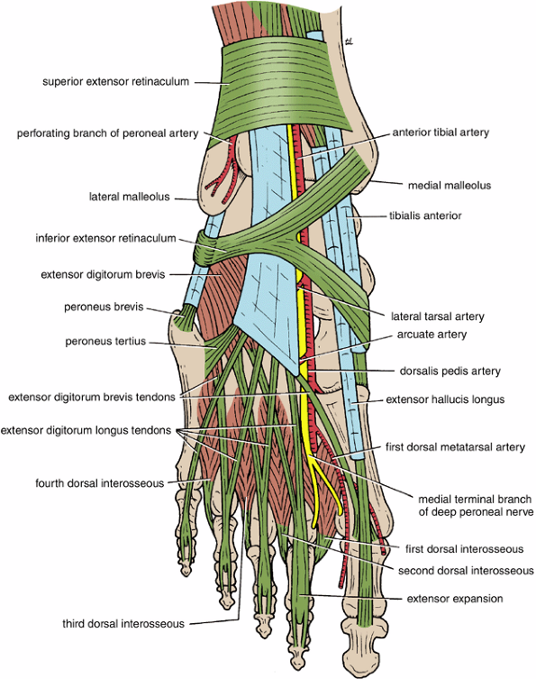
Insertion of Long Extensor Tendons (Extensor Expansion)
The tendons of Extensor digitorum longus pass to the lateral four toes.
- Each tendon to the 2nd , 3rd & 4th toes is joined on its lateral side by a tendon of Extensor digitorum brevis.
- The extensor tendons form:
a Fascial Expansion (Extensor Expansion) on the dorsum of each toe.
-The expansion divides into (3) parts:-
~Central part: inserted into the Base of Middle phalangese.
~Two Lateral parts: inserted into the Base of Distal phalangese.
The (Extensor Expansion) receives insertion of :
Interossei & Lumbrical muscles.

Slide 15
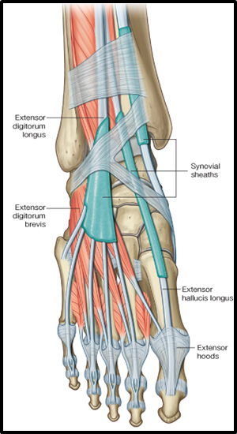
Synovial Sheaths of Extensor Tendons on the Dorsum of Foot
Tibialis anterior & Extensor hallucis longus
Both have their own synovial sheath
Extensor digitorum longus & Peroneus tertius
have a common sheath, it extends to the level of Base of 5th Metatarsal bone.

Slide 16
Summary
Structures Passing Deep to Extensor Retinaculum:
The interosseus membrane and the two intermuscular septa divide the leg into
Anterior Compartment
Muscles
Tibialis Anterior
Extensor Digitorum Longus
Extensor Hallucius Longus
Peroneus Tertius
(all take origin from fibula EXCEPT tibialis anterior)
Genreal Action
Dorsiflexion of the ankle joint & Extension of the toes & (Inversion).
Innervation
Deep peroneal
Lateral (Peroneal) Compartment
Muscles
Peroneus longus
Peroneus brevis
General Action
Plantar flexion and Eversion
Innervation
Superficial peroneal
From medial to lateral:
Tom Has a Very Nice Dog & Pigeon
1- Tibialis anterior
2- Extensor hallucis longus
3- Dorsalis pedis artery (vessel)
4- Dorsalis pedis nerve
5- Extensor digitorum longus
6- Peroneus tertius
Contents of dorsum of foot
Muscles: Extensor Digitorum Brevis
Blood Vessel: Dorsalis Pedis
Nerves: Deep & Superficial Peroneal
Posterior Compartment

Slide 17
Questions
1- Which muscle can evert the foot?
A-Tibialis Anterior.
B- Extensor Digitorum Longus.
C- Peroneus Tertius.
D- Extensor Hallucis Longus.
2- The Peroneus tertius is inserting from anterior surface of fibula to :
A- Extensor expansion of lateral four toes.
B- Base of distal phalanx of great toe.
C- Base of 5th metatarsal bone.
D- Medial cuneiform & base of 1st metatarsal bone.
3- The interosseus membrane and the two intermuscular septa divide the leg into ____ compartments.
A- 1
B- 2
C- 3
D- 4
4- Peroneus tertius is the most medial muscle passing down the extensor retinaculum.
A- True
B- False
5- The peroneus longus is inserted into:
A- Base of first metatarsal
B- The medial cuneiform
C- The lateral cuneiform
D- Both a&b
6- The blood vessel that supplies the dorsum of foot is the dorsialis pedis
A-true
B-false
7- The Extensor Expansion receives insertion of:
A- Interossei
B- Lumbricals
C- Tibialis anterior
D- A & B
1- C
2- C
3- C
4- B
5- D
6- A
7- D

Slide 18
Leaders:
Nawaf AlKhudairy
Jawaher Abanumy
Ghada Almazrou
Members:
Deena AlNowiser
Lama AlTamimi
Norah Alshabib
Razan AlQahtani
Thikrayat Omar
Wejdan Alzaid
anatomyteam436@gmail.com
@anatomy436

