Slide 1
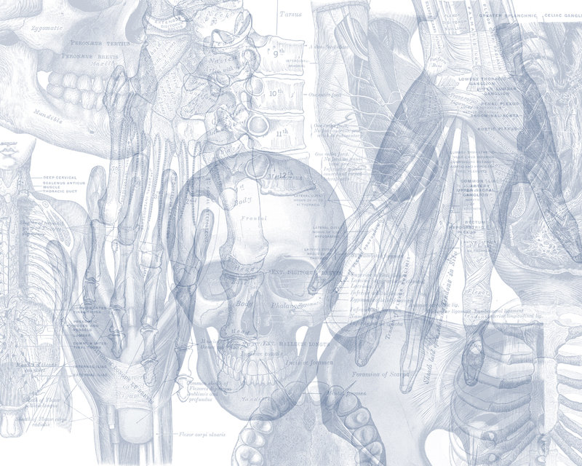
BONES OF THE UPPER LIMB
المحاضرة تتضمن ا اسئلة متعددة الاختيار و اسئلة خطية
Color Code
Important
Doctors Notes
Notes/Extra explanation
Editing File

Slide 2
Objectives
At the end of the lecture, students should be able to:
o List the different bones of the Upper Limb.
o List the characteristic features of each bone.
o Differentiate between bones of right and left sides.
o List the articulations between the different bones.

Slide 3
Please make yourself familiar with these terms to better understand the lecture…
Terms | Meaning | Example
Ridge | The long and narrow upper edge, angle, or crest of something | The supracondylar ridges (in the distal part of the humorous)
Notch | An indentation, (incision) on an edge or surface | The trochlear notch (in the proximal part of the ulna)
Tubercles | A nodule or a small rounded projection on the bone | Dorsal tubercle (in the distal part of the radius)
Fossa | A hollow place (The Notch is not complete but the fossa is complete and both of them act as the lock of the joint) | Subscapular fossa (in the concave part of the scapula)
Tuberosity | A large prominence on a bone usually serving for the attachment of muscles or ligaments (is a bigger projection than the Tubercle) | Deltoid tuberosity (in the humorous) and it connects the deltoid muscle
Processes | A V-shaped indentation (act as the key of the joint) | Coracoid process (in the scapula)
Groove | A channel, a long narrow depression sure | Spiral (Radial) groove (in the posterior aspect of the humorous)
Interosseous border | Between bones (the place where the two parallel bones attach together by the interosseous membrane) | Lateral interosseous sharp end of the ulna
Spine | Thick projecting ridge of bone | Spine of the scapula
Articulation | Meeting of two bones to make the joints | The articulation between the glenoid cavity and humorous
Union of the bone | The healing and coming together of the fracture | Union of the scaphoid bone fracture

Slide 4
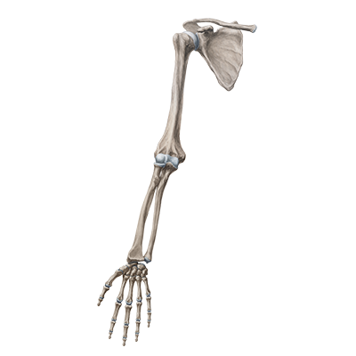
Bones of the upper limb:
it consists of the following:
Pectoral girdle (scapula and clavicle) it is very light and it allows the upper limb to have exceptionally free movement.
Arm(humerous)
Forearm(radius and ulna)
Wrist(carpals)
Hand bones(metacarpals and phalanges)

Slide 5
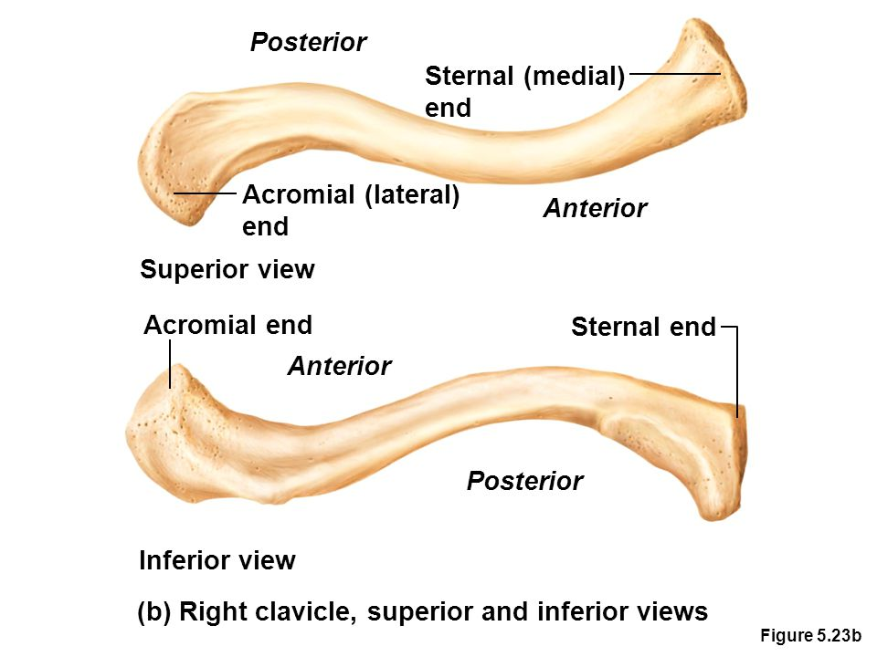
CLAVICLE:
It is a doubly curved long bone with no medullary (bone marrow) cavity, lying horizontally across the root of the neck. It is subcutaneous (under the skin) throughout its length.
It has the appearance of an elongated capital letter (S) lying on one side.
If the clavicle is broken, the whole shoulder region caves in medially.
Functions
It serves as a rigid support from which the scapula and free upper limb are suspended keeping them away from the trunk, so that the arm has maximum freedom of movement.
Transmits forces from the upper limb to the axial skeleton.
Provides attachment for muscles.
It forms a boundary of the cervicoaxillary canal for protection of the neurovascular bundle of the UL.
Body (shaft):
The medial 2/3 of the body (shaft) is convex forward.
The lateral 1/3 is concave forward.
It has two surfaces:
Superior: smooth as it lies just deep to the skin.
Inferior: rough because strong ligaments bind it to the 1st rib
It has two ends:
Its medial (Sternal) end is enlarged & triangular.
Its lateral (Acromial) end is flattened

Slide 6
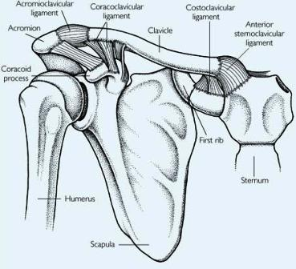
Articulation Of Clavicle:
Medially, sternoclavicular Joint
with the Manubrium
Laterally, Acromioclavicular Joint
with the Acromial end of the scapula
Inferiorly, costoclavicular Joint
with the 1st rib
تذكر أن فيه فرق بين ☺
Acromial → Lateral End Of Clavicle
Acromion → One Of The Three Processes in Scapula

Slide 7
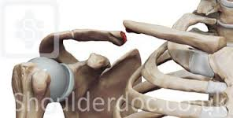
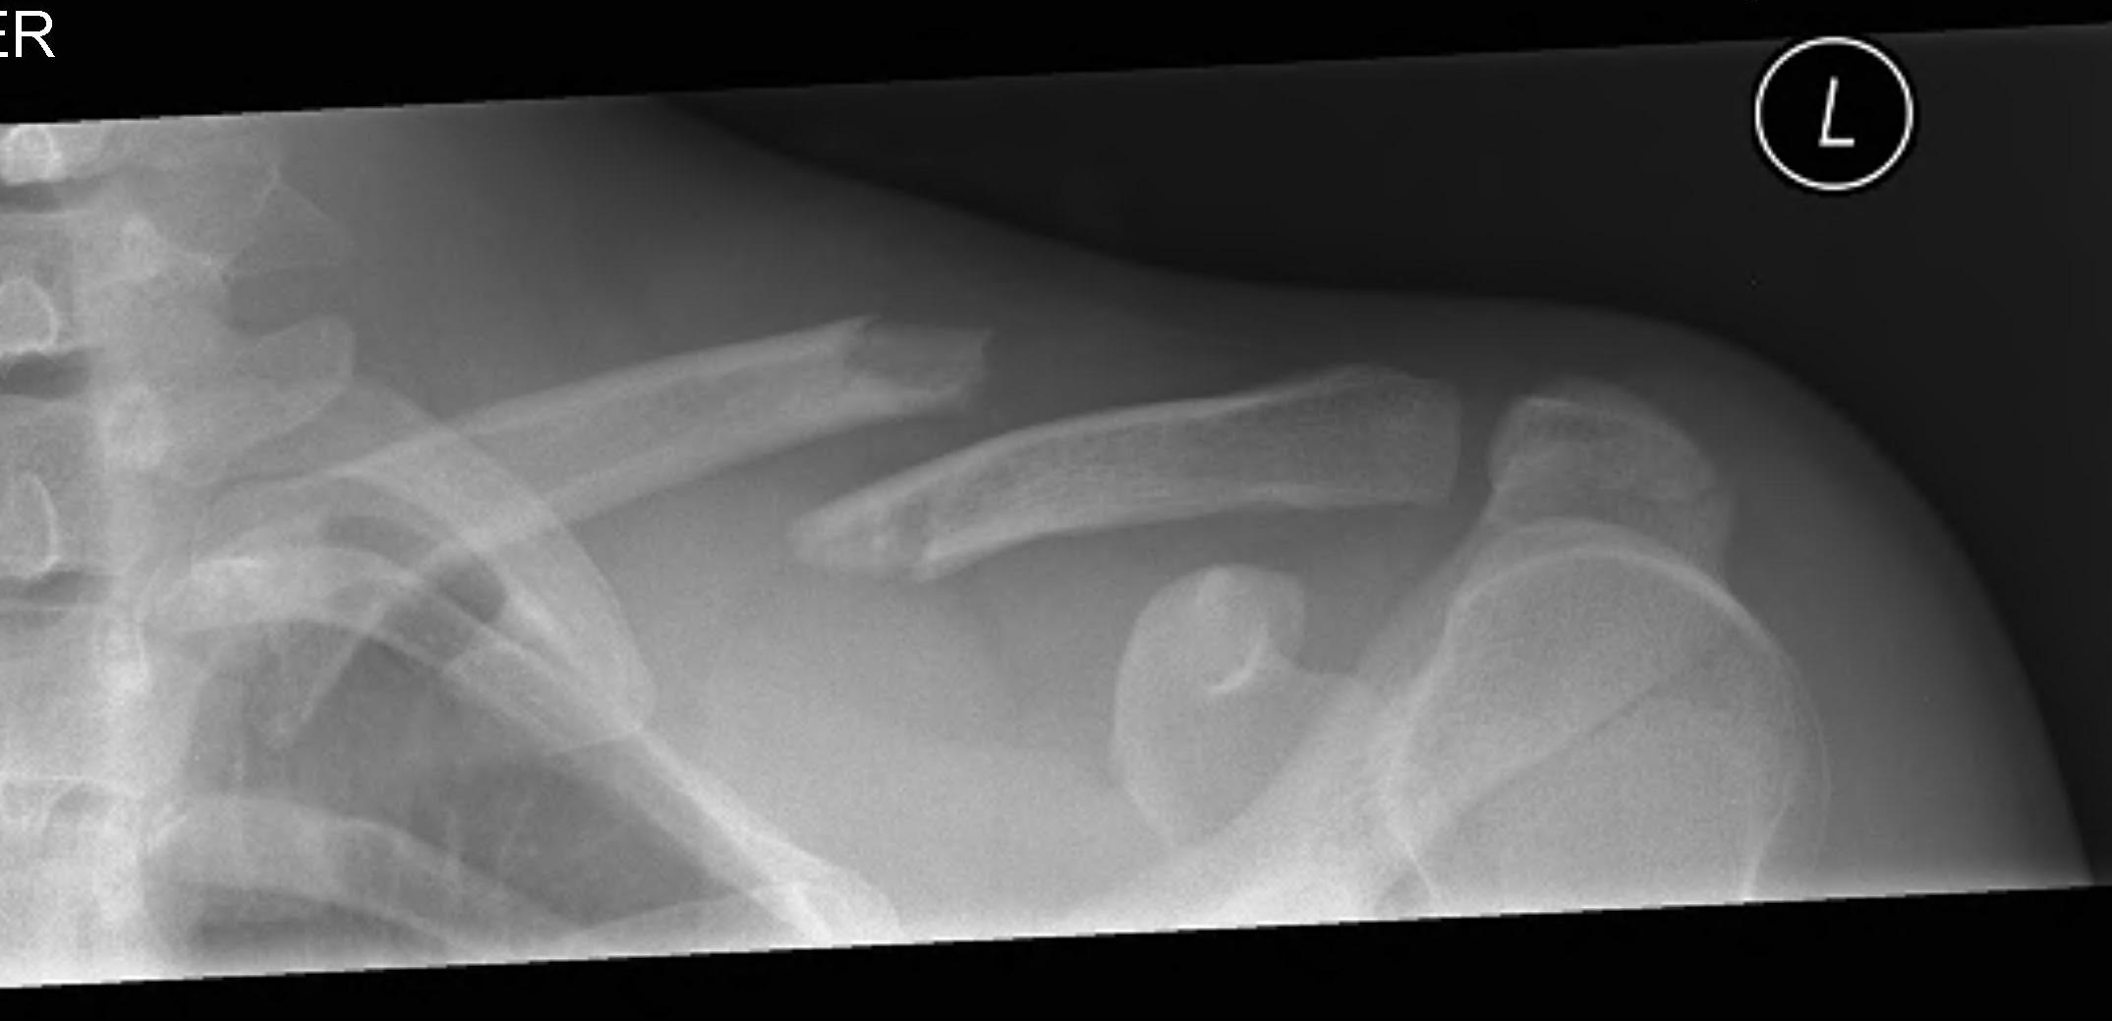
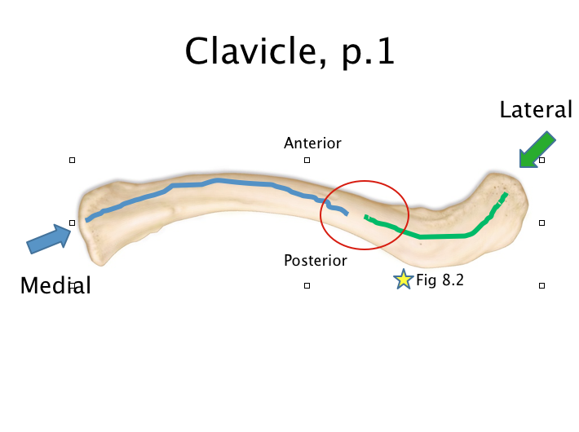
Fractures Of The Clavicle:
The clavicle is commonly fractured especially in children as forces are impacted to the outstretched hand during falling.
The weakest part of the clavicle is the junction of the middle and lateral thirds. (Check The 3nd Image)
After fracture, the medial fragment is elevated يرتفع (by the sternomastoid muscle), the lateral fragment drops because of the weight of the UL. UL= Upper Limp
The lateral fragment may be pulled medially by the adductors of the arm.
The sagging (يتدودل (☺limb is supported by the other.
3nd image
(The middle and lateral thirds)

Slide 8
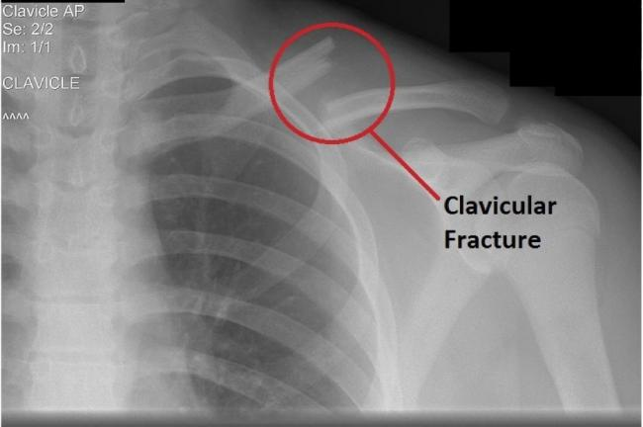
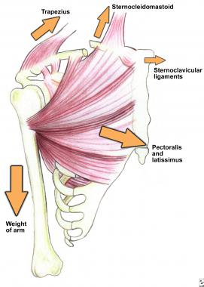
Clinical significance of clavicle fracture:
Fracture of the clavicle:
A function of the clavicle is to transmit forces from the upper limb to the axial skeleton. Thus, the clavicle is the most commonly fractured bone in the body. Fractures commonly result from a fall onto the shoulder, or onto an outstretched hand.
The most common point of fracture is the junction of the medial 2/3 and lateral 1/3.
After fracture, the lateral end of the clavicle is displaced inferiorly by the weight of the arm, and medially, by the pectoralis major. The medial end is pulled superiorly, by the sternocleidomastoid muscle.
Only on the boys’ slides

Slide 9
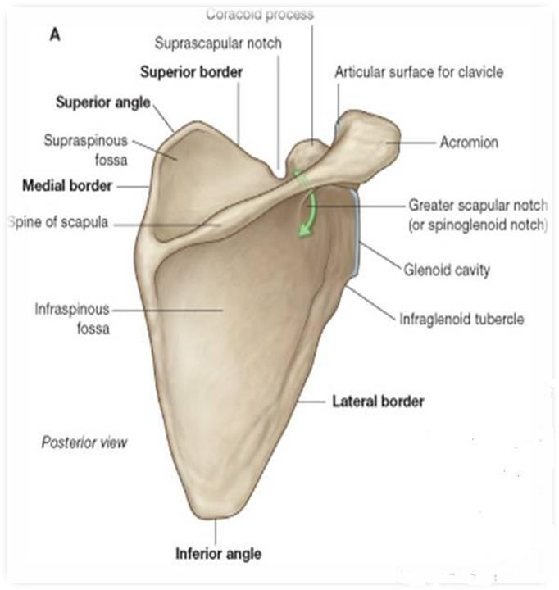
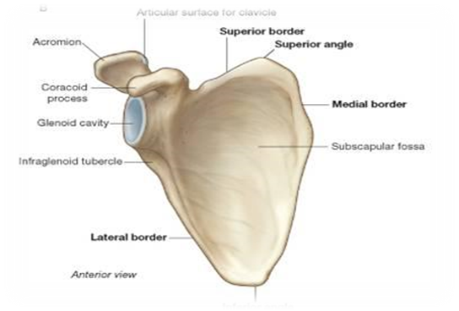
Scapula:
It is a triangular flat bone, extends between the 2nd to 7th ribs.
Three Processes:
1.Spine: a thick projecting ridge of bone that continues laterally as the flat bone expands.
2.Acromion: forms the subcutaneous point of the shoulder.
3.Coracoid: a beaklike process. It resembles in size, shape and direction a bent finger pointing to the shoulder.
Three Borders:
1. Superior, 2. Medial (Vertebral) 3. Lateral (axillary): terminates at the lateral angle (the thickest) part of the bone.
Three Angles :
1.Superior 2.Inferior 3.Lateral (forms the Glenoid cavity: a shallow concave oval fossa that receives the head of the humorous.)
Two Surfaces :
Convex posterior: surface is divided by the spine of the scapula into the smaller Supraspinous Fossa - above the spine and
the larger Infraspinous Fossa - below the spine.
Concave Anterior (Costal) Surface , it forms the large Subscapular Fossa.
Suprascapular notch: It is a nerve passageway, medial to coracoid process. -Suprascapular nerve
Function:
1- Gives attachment to muscles.
2- Has considerable degree of movement on the thoracic wall to enable the arm to move freely.
3- The glenoid cavity forms the socket of shoulder joint .
(Because most of the scapula is well protected by muscles most of its fractures involve the protruding subcutaneous acromion )

Slide 10
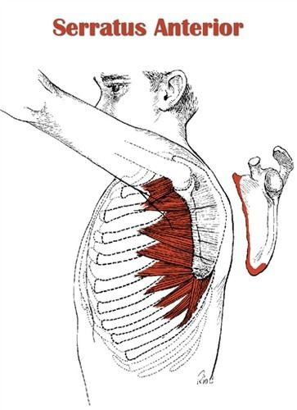
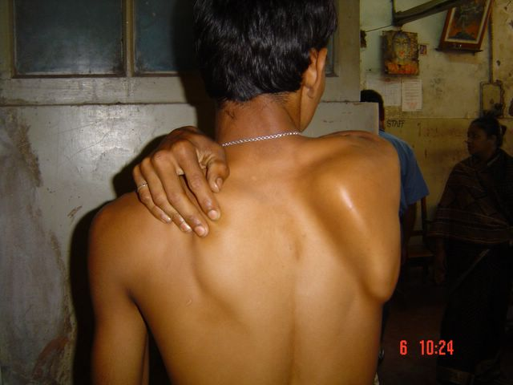
Winged scapula:
Clinical appearance:
It will protrude posteriorly
Etiology :
The serratus anterior muscle pulls the scapula against the ribcage. The long thoracic nerve innervates this muscle , if the nerve becomes injured (as in radical mastectomy) the scapula protrudes.
Symptoms :
The patient has difficulty in raising the arm above the head (difficult in rotation of the scapula)
The medial border and inferior angle of the scapula will no longer be kept closely applied to the chest wall

Slide 11
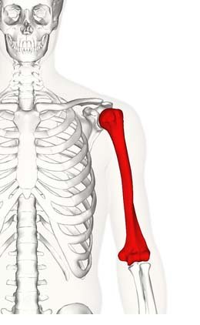
ARM (HUMERUS):
A Typical long bone
It is the largest bone in the Upper Limb
Humerus
Proximal End
Shaft
Distal End
Head
Anatomical Neck
Deltoid tuberosity
Trochlea
Coronoid
Fossa
Surgical
Neck
Lesser
Tubercle
Capitulum
Radial
Fossa
Spiral (Radial)
groove
Greater Tubercle
Olecranon
Fossa

Slide 12
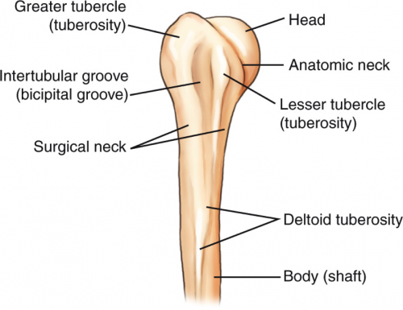
Proximal End of Humerus:
Head : (faces medially) Smooth and forms 1/3 of a sphere , it articulates with the glenoid cavity of the scapula .
Anatomical Neck : formed by a groove separating the head from the tubercles .
Surgical Neck : a narrow part distal to the tubercles. It is a common fracture site of the humerus .
Greater tubercle : at the lateral margin of the humerus .
Lesser tubercle : projects anteriorly . The two tubercles are separated by Intertubercular Groove (Intertubercular Sulcus/ Bicipital Groove) .

Slide 13
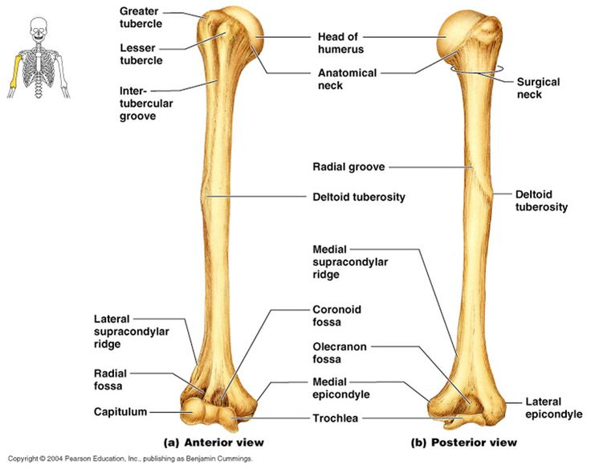
Shaft of Humerus:
Has two prominent features :
Radial
groove
Deltoid Tuberosity(بروز أو نتوء) :
A rough elevation laterally for the attachment of deltoid muscle .
Deltoid
tuberosity
Spiral (Radial) groove :
Runs obliquely down the posterior aspect of the shaft .
It lodges the important radial nerve and vessels .
Note: Tuberosity in bones are usually for attachment of muscles .

Slide 14
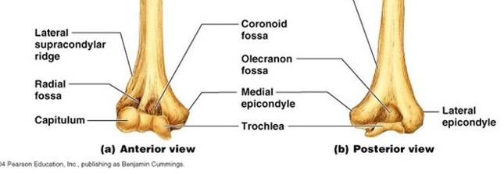
Distal End of Humerus:
Widens as the sharp medial and lateral Supracondylar Ridges and end in the Medial (can be felt) and Lateral Epicondyles.
They provide muscular attachment.
Distal end of Humerus
Anteriorly
Trochlea : (medial) for articulation with ulna .
Capitulum: (lateral) for articulation with radius.
To remember:
Trochlea > ulna
Capitulum > radius
Coronoid fossa : above the trochlea ,
Radial fossa : above the capitulum .
Posteriorly
Olecranon fossa : above the trochlea .

Slide 15
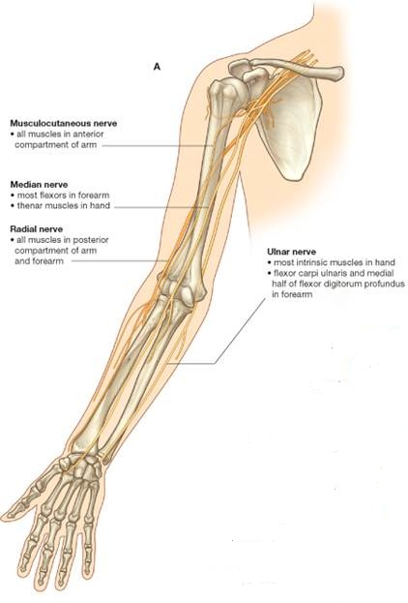
Fractures of the Humerus:
Surgical neck fractures are the most common fractures of the humerus especially in old people with osteoporosis.
Fractures result from direct falling on the hand ( transition of force through the bones of forearm of the extended limb).
In younger people fracture of the great tubercle results from falling on the hand when the arm is abducted.
The body of the humerus can be fractured by a direct blow to the arm or by indirect injury as falling on the outstretched hand .
Nerves affected in fractures of humerus:
Fracture type | Nerve affected
Surgical neck | Axillary nerve
Radial groove | Radial nerve
Distal end of humerus | Median nerve
Medial epicondyle | Ulnar nerve

Slide 16
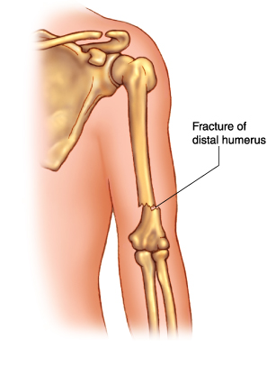
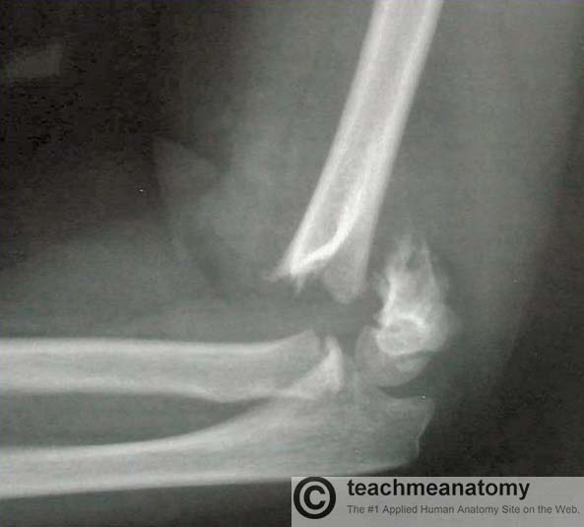
Distal humeral fracture:
Medial epicondyle fracture are common fracture type of the distal humerus
A supraepicondylar fracture occurs by falling on a flexed elbow
It is a transverse (horizontal) fracture, spanning between the two epicondyles
Direct damage or swelling can cause interference to the blood supply of the forearm from the brachial artery.
The resulting ischemia Volkmann’s ischemic contracture- uncontrolled flexion of the hand , as flexor muscle become fibrotic and short . There also can be damage to the median ulnar or radial nerves .
Only on the boys’ slides

Slide 17
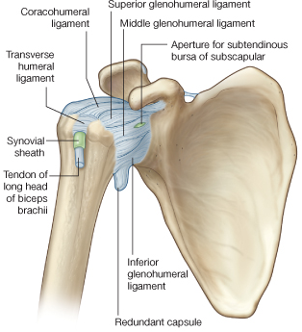
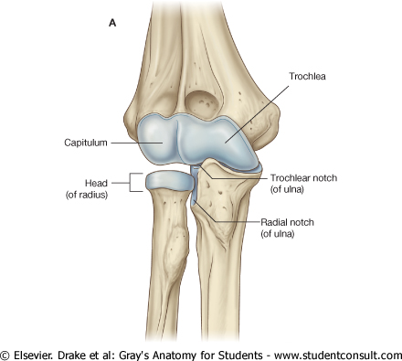
Articulations:
Head of the humerus with the glenoid cavity of the scapula form the Shoulder joint.
Lower end (Trochlea & Capitulum) with the upper ends of the radius & ulna form the Elbow joint.
Only on the boys’ slides

Slide 18
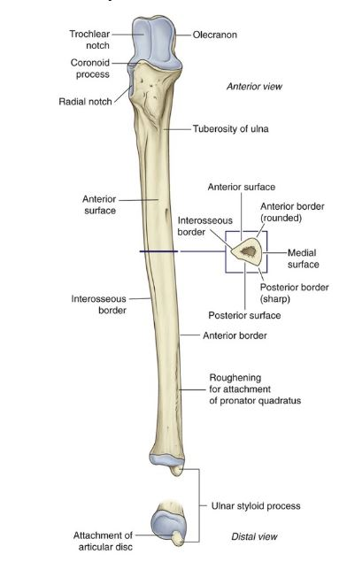
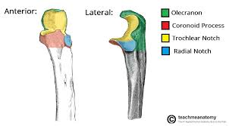
Ulna:
Is the stabilizing bone of forearm.
It is the medial and the longer of the two bones of the forearm.
Video on ulna
Ulna of left forearm
Ulna of right forearm

Slide 19
Ulna
The prominence of the elbow*. projects Proximally from the posterior aspect (side).
Proximal (upper) end:
Olecranon process
Trochlear notch
Coronoid process
Radial notch
Tuberosity of ulna
Distal (lower) end:
Small round head that lies distally at the wrist
Ulnar styloid process (medial side)
Shaft (body):
Thick & cylindrical superiorly, but decreases in diameter inferiorly. (سميك في الأعلى و لكن يقل سمكه (قطره) إذا اتجهنا للأسفل)
Three surfaces:
Three borders:
Anterior surface
The part that articulates with the trochlea of humerus.
Medial surface
Projects anteriorly
A smooth rounded concavity(شكل مقعر) Lateral to coronoid process. (articulate with head of radius).
Posterior surface
Inferior to coronoid process.
Posterior border: (the part you can feel on the length of the ulna) is sharp.
Interosseous border (lateral), attachment for the interosseous membrane.
Anterior border
Notes
*The pointed part of the elbow (which you can feel)
-Prominence: الجزء البارز
-Projects:يبرز
-Articulates: يرتبط (يكون مفصل)
-surfaces are between borders
- The process lodges with the fossa.
Ex: coronoid fossa (on humerus) & coronoid process (on ulna)
Extra: Also in the upper end: supinator fossa that allows for the movement of the radial tuberosity. There is also a supinator crest posterior to the supinator fossa.

Slide 20
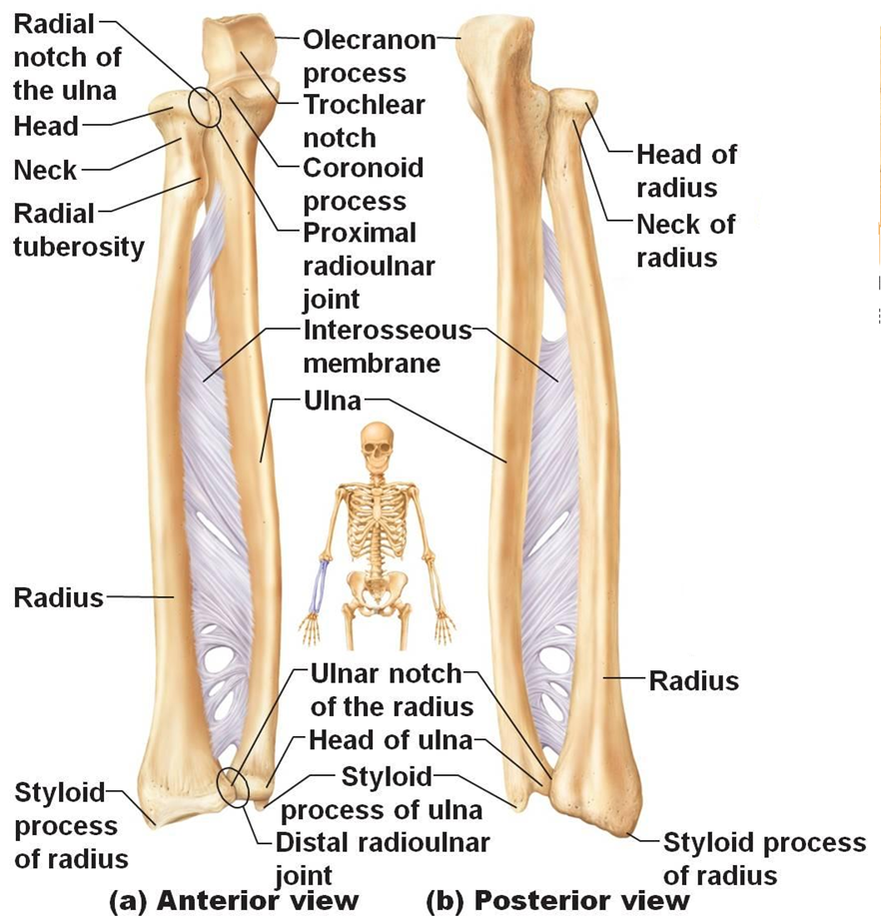
Ulna and Radius Articulations:
Interosseous membrane
Proximal radioulnar joint
Elbow joint
Distal radioulnar joint
The distal end of the humerus with the proximal ends of the radius and ulna.
It mainly allows for flexion and extension.
A flexible membrane that connects ulna and radius
Between the head of the radius and the radial notch of the ulna
Between the head of the ulna and the ulnar notch of the radius
extra: the distal end of the radius articulates with the scaphoid and lunate bones at the wrist joint.
Only on the boys’ slides

Slide 21
The Radius: it is the shorter and the lateral bone of the forearm.
Proximal end (upper)
2-the neck
1-the head of the radius which is small, circular and the center of the cavity is concave to articulate with the capitulum
3- the radial tuberosity which is medially directed and separates the proximal end from the body

Slide 22
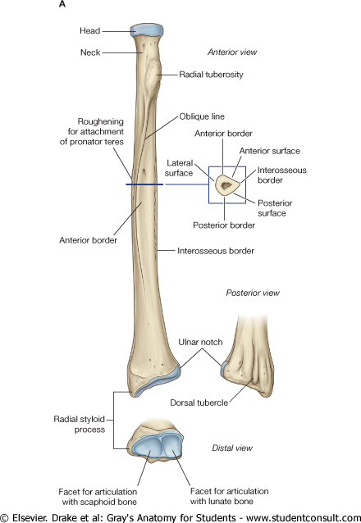
The Shaft and Distal End of the Radius
The distal end (lower)
Its rectangular
Its medial aspect (side) forms a concavity called the Ulnar notch to accommodate the head of the ulna.
Radial Styloid process that extends from the lateral aspect.
Dorsal tubercle that projects dorsally.
The shaft
It has a lateral convexity
It gradually enlarges as it passes distally

Slide 23
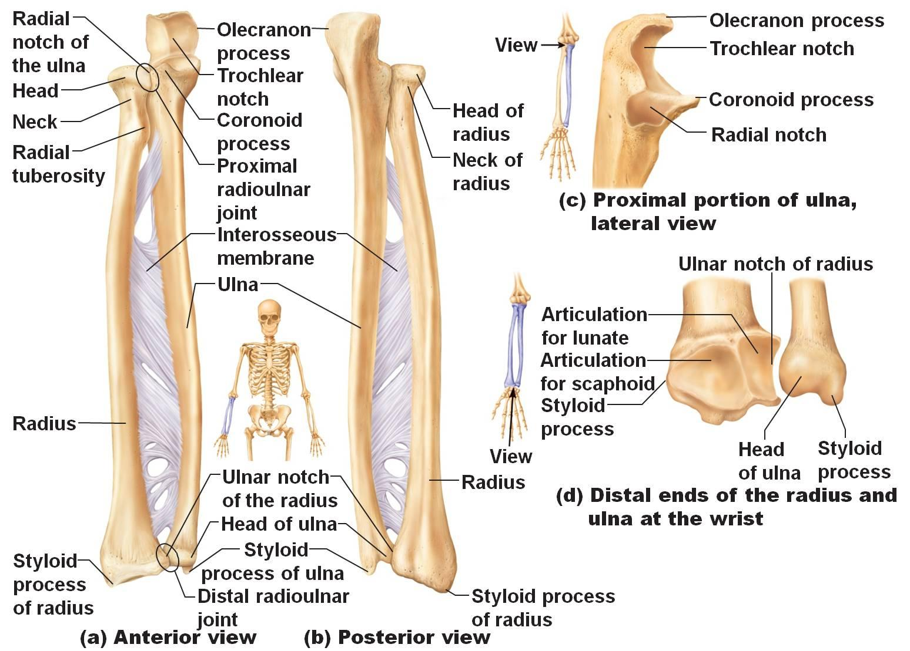
Extra picture for understanding

Slide 24
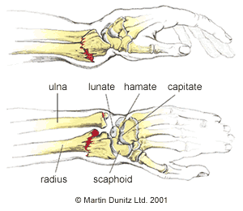
Fracture of the Radius and Ulna
Because the radius & ulna are firmly bound by the interosseous membrane, a fracture of one bone is commonly associated with dislocation of the nearest joint.
Colle’ s Fracture (fracture of the distal end of radius) is the most common fracture of the forearm.
It is more common in women after middle age because of osteoporosis. بسبب انخفاض مستوى الاستروجين بعد سن الياس (تم شرحه بالتفصيل في الباثولوجي)
It causes dinner fork deformity.
It results from forced dorsiflexion of the hand as a result to ease a fall by outstretching the upper limb.
The typical history of the fracture includes slipping.
Because of the rich blood supply to the distal end of the radius, bone union is usually good. (only in girls slides)

Slide 25
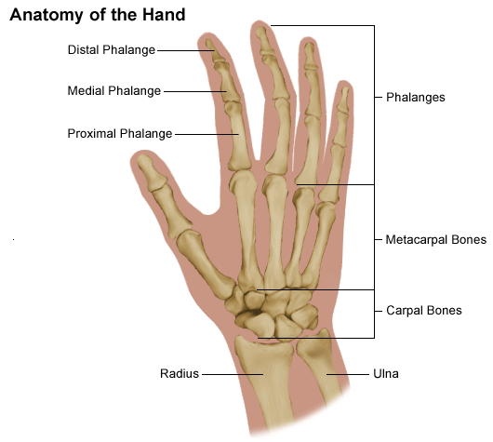
Hand
Carpals
Wrist
Phalanges
Fingers
The palm
Metacarpals

Slide 26
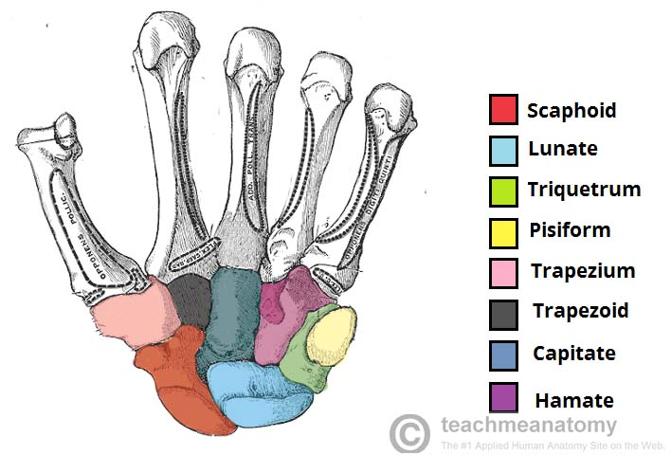
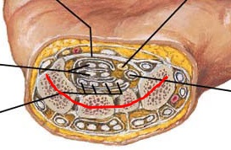
The Wrist:
Composed of 8 carpal bones arranged in two irregular rows, each of 4 bones .
These small bones give flexibility to the wrist.
The Carpus presents Concavity on their Anterior surface & convex from side to side posteriorly.
From Lateral to Medial
The Distal row : 1- Trapezium 2- Trapezoid 3- Capitate 4- Hamate
The Proximal row : 1- Scaphoid 2- Lunate 3- Triquetral 4- Pisiform
To remember the carpal bones (435) :
Sally Left The Party To Take Cathy Home
سلوى لازم تلعب بوكر تلعب تخسر كله هلس

Slide 27
Fracture of The Scaphoid:
scaphoid is the most commonly fractured carpal bone and it is the most common injury of the wrist.
It is the result of a fall onto the palm when the hand is abducted.
Pain occurs along the lateral side of the wrist especially during dorsiflexion and abduction of the hand
Union of the bone may take several months because of poor blood supply to the proximal part of the scaphoid.

Slide 28
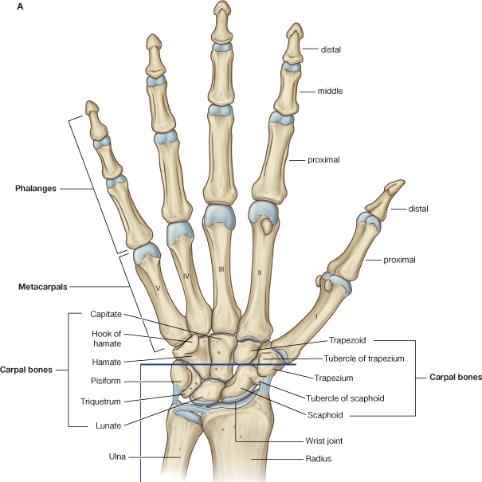
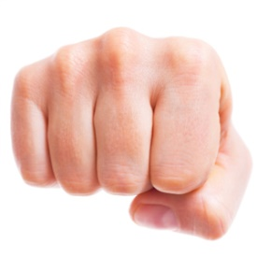
Metacarpals:
Forms the skeleton of the hand
Position:
Between the carpus and the phalanges.
Features:
Head(distal), shaft(middle), and base(proximal).
Count:
5 metacarpal starting from the thumb 1-5.
N.B:
The first metacarpal (thumb) is the shortest and most mobile.
The base of the metacarpals articulates with the carpel bones.
The third metacarpal has a styloid process on the lateral side of the base.
The distal ends (Heads) articulate with the proximal phalanges to form the Knuckles of the fist.
Notes: In the hand the head is always distal and the base is proximal (the opposite of the arm and forearm).
Head
Shaft
Base
Knuckles
عشان ما تنسونها نقدر نطرق بها الباب ودايم نعبر عن صوت الطق بـ (knock knock)

Slide 29
Phalanges (digits):
Position:
Connected to the metacarpals distally.
Features:
Head(distal), body(middle shaft), base(proximal).
Count:
14 total.
3 in each finger.
Except 2 in the thumb.
N.B:
The proximal phalanx are the largest.
The middle are medium sized.
The distal are the smallest, flattened and expanded distally to form the nail beds.
Notes: In the hand the head is always distal and the base is proximal (the opposite of the arm and forearm).
Small
Medium
Large

Slide 30
Articulations:
Name of articulation | Wrist joint | Carpometacarpal joints | Metacarpophalangeal joints | Interphalangeal joints
Description | Distal end of the radius + raw of proximal carpals. | Distal row of the carpals + proximal raw of metacarpals. | Distal heads of metacarpal + proximal raw of phalanges. | The phalanges with each other.
Only on the boys’ slides

Slide 31
Upper limbs
Pectoral Girdle
Scapula
Clavicle
Arm
Hand
Forearm
Humerus
Wrist
Radius (Lateral)
Ulna (Medial)
Metacarpals
Carpal bones
Phalanges

Slide 32
Multiple choice questions
1-Transmits forces from the upper limb to the axial skeleton:
A-Humerus
B-Clavicle
C-Scapula
D-Femur
Answer :B
2 – What is the most common carpal bone to be subjected to fracture ?
A – Lunate
B – Trapezoid
C – Scaphoid
D – Surgical line
Answer : C
3-Which of the following form the fingers ?
A-Metacarpals
B-phalanges
C-Carpals
D-Tarsals
Answer :B
5-The part of the ulna that allows for the movement of the head of the radius in the proximal radioulnar joint is:
Radial notch
Ulnar notch
Trochlear notch
Supinator fossa
Answer : A
6-What is connected to the wrist joint?
Distal row of the carpals + proximal row of metacarpals.
Distal end of the radius + row of proximal carpals.
Distal heads of metacarpal + proximal row of phalanges.
The phalanges with each other.
Answer: B
7- The most common place of fractures in Humerus is :
Head
Medial epicondyle
Surgical Neck
Trochlea
Answer : C
8- Which one of these structures of the distal end of Humerus helps in articulation with Radius :
A.Trochlea
B. Capitulum
C. Olecranon fossa
D. Coracoid process
Answer : B

Slide 33
SHORT ANSWER QUESTIONS:
Q1-Identify the proximal row of carpals:
Answer: scaphoid, lunate, triquetral, pisiform
Q2-The part of the ulna that forms the prominence of the elbow is known as:
Answer: olecranon process
Q3-What are the features of the metacarpals and which is distal or proximal or middle?
Answer:
Head(distal)
Shaft(middle)
Base(proximal)
Q4-A 70 years old male present to the emergency with a fracture in his arm , the history of the patient shows that he felt on his arm in the bathroom .
What is the most common site of fracture in this case ?
Ans : The surgical neck in the Humerus
What nerve in his arm is going to be affected ?
Ans : The Axillary nerve
3. What is the pathological cause that can be seen here , Explain why ?
Ans: Osteoporosis since that he is an elderly person .

Slide 34
Q5:A man had trauma in his back , his scapula protrudes posteriorly and he can’t rise his hand above his head .
What does he complain of ? And what’s the name of the muscle and the nerve ?
Answer: winging of the scapula, Serratus anterior that is innervated by the long thoracic nerve
The weakest part of the clavicle is :
Answer: The junction between the medial 2/3 and the lateral 1/3
Q6:what are the functions of scapula ?
Answer:
1.attachment to muscles.
2.Arm movement
3.Formation of shoulder joint

Slide 35
Members:
Yazeed AlSuhaibani
Abdulmalik alhadlaq
Mohammed nasr
Majed alzain
Talal alhuqayl
Hamad Alkhudhairy
Mohammed Habib
Abdulhakim Alonaiq
Abdullah Jammah
Mohammed alkahil
Abdulaziz alsalman
Leaders:
Nawaf AlKhudhairy
Jawaher Abanumy
Ghada Almazrou
anatomyteam436@gmail.com
@anatomy436

