Slide 1
JOINTS
Color Code
Important
Doctors Notes
Notes/Extra explanation
Editing file

Slide 2
Objectives
By the end of the lecture, students should be able to:
Define the term “Joint” .
Describe the classification of the 3 types of joints & give an example of each.
Describe the characteristics of synovial joints.
Describe the classification of synovial joints & give an example of each.
List factors maintaining stability of joints.
Recite “Hilton’s law” for nerve supply of joints.

Slide 3
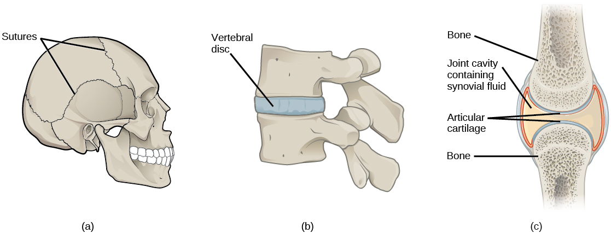
Definition
What is a joint? It is the site where two or more bones meet together. Another def. : it is the meeting of two or more articulating joints
Classification of joints
Joints are classified according to the tissues that lie between the bones into:
A. Fibrous
B. Cartilaginous
C. Synovial

Slide 4
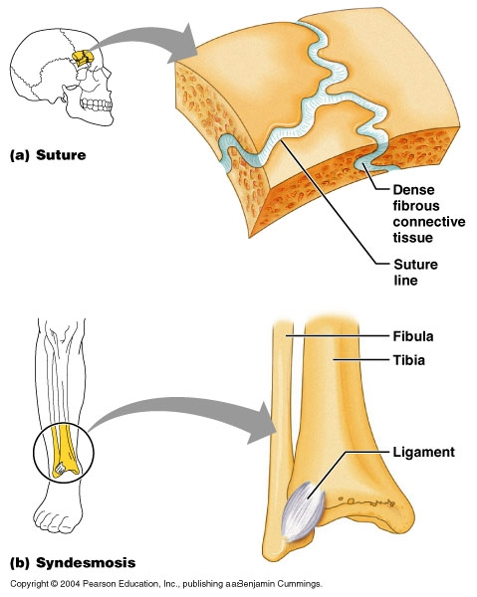
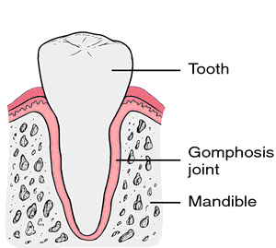
1) Fibrous Joints
The articulating surfaces are joined by fibrous connective tissue, where No or very mild movement.
1. Skull sutures: Temporary (as it ossify later)
2. Inferior tibiofibular joints (syndesmosis):
minimal movement, permanent joints.
3. Gomphosis: dental alveolar joints. Articulation between root
of the tooth with mandible or maxilla
مهمة الأمثلة تجي عليها أسئلة (المثال ولأي نوع)

Slide 5
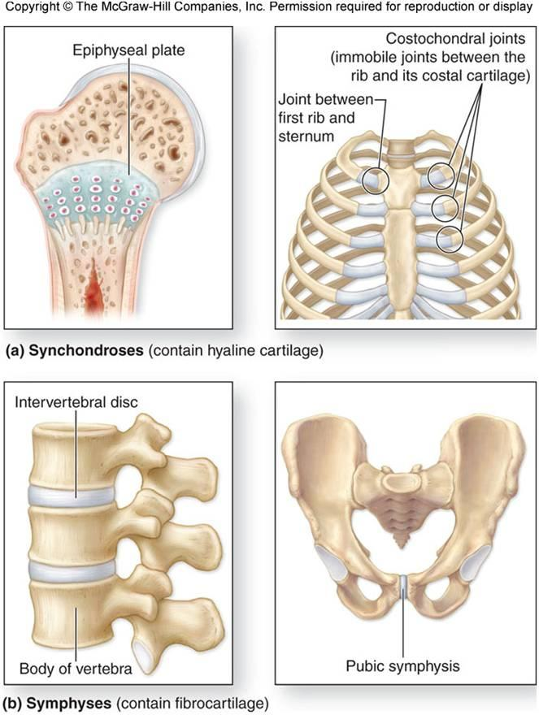
2) Cartilaginous Joints
When two bones are joined by cartilage the formed joint is called “cartilaginous joint”
and are classified into 2 types:
Primary Cartilaginous (synchondrosis):
The bones are united by a plate or a bar of hyaline cartilage.
No movement, temporary joints (ossify later).
Example:
Between the Epiphysis and the Diaphysis of a growing bone.
Between the First Rib and the Sternum (1st sternocostal joint).
(The rest of the sternocostal joints are synovial plane joints.)
Secondary Cartilaginous:
The bones are united by a plate of fibrocartilage.
Their articulating surfaces are covered by a thin plate of hyaline cartilage.
Little movement, permanent joints.
The are called Midline joints. Because they are mainly found in the axial skeleton (midline of body)
Example: (in axial)
Joints between the Vertebral Bodies (intervertebral discs).
Symphysis Pubis.
plate of hyaline cartilage
hyaline cartilage.
Any articulating surface will has a plate of hyaline cartilage
plate of fibrocartilage

Slide 6
2) Cartilaginous Joints :summery
When two bones are joined by cartilage the formed joint is called “cartilaginous joint”
 | Primary Cartilaginous (synchondrosis): | Secondary Cartilaginous:
Structure | The bones are united by a plate or a bar of hyaline cartilage. | The bones are united by a plate of fibrocartilage. Their articulating surfaces are covered by a thin plate of hyaline cartilage. They are called Midline joints.
Degree of movement and duration | No movement, temporary joints (ossify later). | Little movement, permanent joints.
Examples | Between the Epiphysis and the Diaphysis of a growing bone. Between the First Rib and the Sternum (1st sternocostal joint). (The rest of the sternocostal joints are synovial plane joints.) | Joints between the Vertebral Bodies (intervertebral discs). Symphysis Pubis.
Pictures

Slide 7
3) Synovial Joints - Characteristic features
Freely movable joints.
The 2 bones are joined by a fibrous capsule, which is attached to the margins of articular surfaces & enclosing the joint.
The articular surfaces are covered by a thin layer of hyaline cartilage (articular cartilage).
A joint cavity enclosed within the capsule. The internal surface of it.. is Synovial membrane
Synovial membrane :
a thin vascular membrane lining the inner surface of the capsule. It produces the Synovial fluid
Synovial fluid :
a lubricating fluid produced by the synovial membrane in the joint cavity.
The fluid minimizes the friction between the articular surfaces.

Slide 8
3) Synovial joints
- Classification
Synovial joints can be classified according to:
•The arrangement of the articular surfaces.
•The range of movement that are possible
So according to the range of movement, synovial joints are classified into:
•Plane synovial joints.
•Axial synovial joints:
3 branches
Note: plane joints do not have an axis

Slide 9
3) SYNOVIAL JOINTS
I - PLANE SYNOVIAL JOINTS
The articulating surfaces are flat and the bones slide on one another,
producing a gliding movement.
Examples:
1.Intercarpal Joints.
+ Intertarsal Joints.
2.Sternoclavicular
3. Acromioclavicular joints.
4.Between the 2nd -7th sternocostals

Slide 10
3) SYNOVIAL JOINTS
II - AXIAL SYNOVIAL JOINTS
Movements occur along axes:
1.Transverse(x-axis):
2.Longitudinal(y-axis):
3.Antero-posterior(z-axis):
flexion & extension occur.
rotation occurs.(M-L)
abduction & adduction occur.
Axial joints are divided into:
- Uniaxial.
- Biaxial.
- Multi-axial (polyaxial).

Slide 11
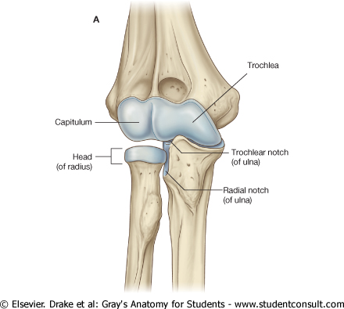
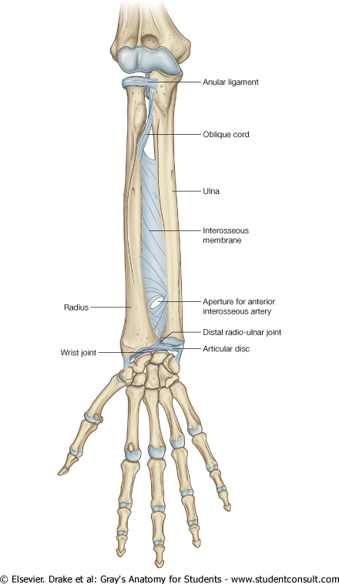
Important always mentioned in exams.
A) UNIAXIAL* SYNOVIAL JOINTS
Type: | Hinge joint | Pivot joint
Axis: | Transverse** | Longitudinal
Movement: | Flexion & extension | Rotation (s-p)
Example: | Elbow and ankle joints | Radio-ulnar joints and atlantoaxial joint
*one axis
**مثل حركة اللابتوب
Elbow
Radio-ulnar

Slide 12
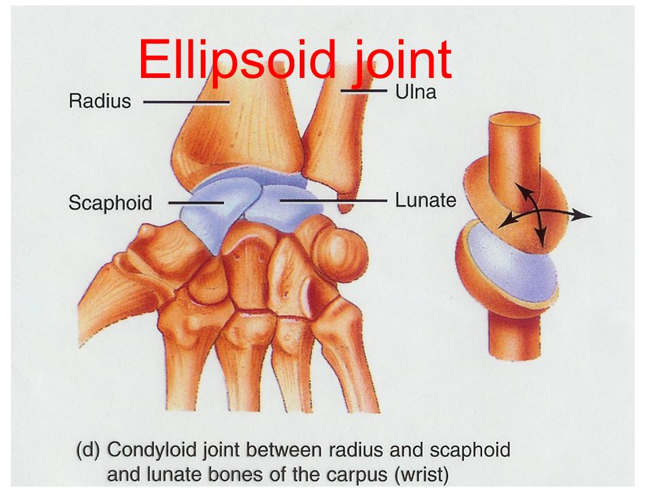
B) BIAXIAL* SYNOVIAL JOINTS
Type: | Ellipsoid** joint | Saddle joint
Axis: | Transverse + antero-posterior | Transverse + antero-posterior + Longitudinal (limited)
Movement: | Flexion & extension + abduction & adduction but rotation is impossible | As ellipsoid joints (Flexion & extension + abduction & adduction) + a small range of rotation***
Example: | Wrist joint | Carpometacarpal joint of the thumb
Further info.: | An elliptical convex^^^ fits into an elliptical concave articular surface. | The articular surfaces are reciprocally concavoconvex^. They resemble a saddle^^ on a horse’s back.
*Two axis.
** بيضاوي.
^ العظمة نفسها فيها جزئين واحد مُحدّب والثاني مُقعّر. فتكون العظمة الثانية المرتبطة فيها وتكوّن المفصل معها شكلها عكس الأولى (مثلًا الأولى بدايتها مُحدّبة الثانية تصير بدايتها مُقعَرة وهكذا.)
^^ سرج الحصان.
^^^ هنا الجزء المُقعّر والجزء المُحدّب يكونون بعظمتين منفصلتين.
*** زي لما نسبّح

Slide 13
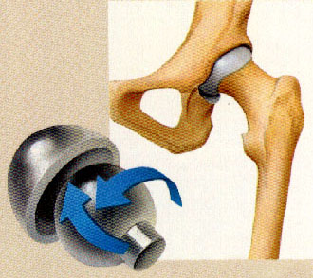
C) POLYAXIAL* SYNOVIAL JOINTS
Type: | Ball-and-socket joints
Axis: | All axis
Movement: | Flexion & extension + abduction & adduction + rotation along a separate axis.
Example: | Shoulder joint. Hip Joint.
Further info.: | A ball–shaped* head of a bone fits into a socket-like concavity of another.
*In Shoulder joint, ball is the head of humerus and socket is Glenoid cavity of scapula (shallow سطحي). In Hip joint, ball is the head of femur and socket is acetabulum of hip bone (very deep). For that (shallowness and deepness) the stability is more in acetabulum than Glenoid cavity. *Glenoid cavity is stabilized by ligaments* ^don’t be afraid of details will explain later.
**نفس ما قالت دكتورة سناء «كُل ما تشتهيه من الموفمنت هنا».
*has all range of movements.

Slide 14
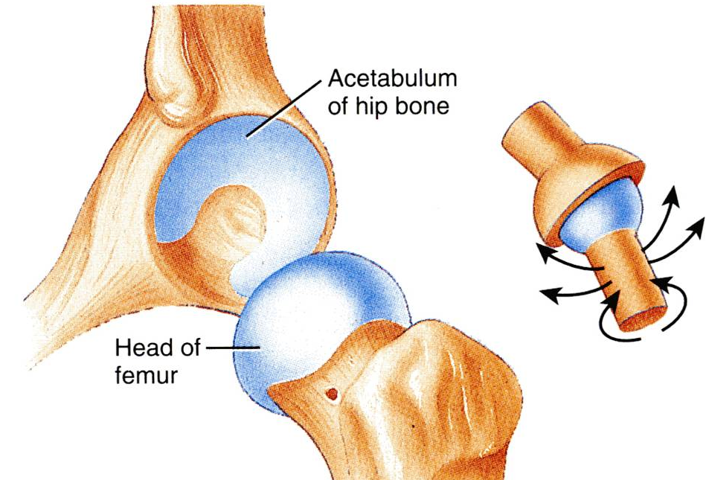
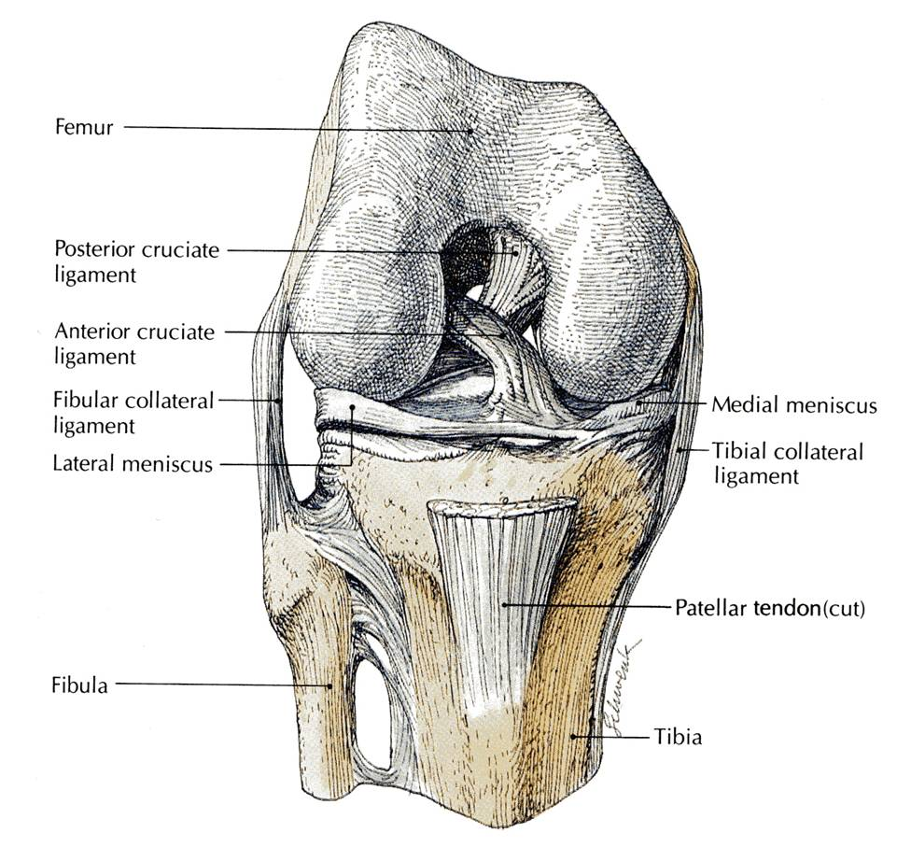
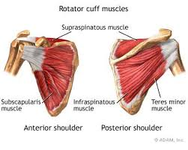
Stability Of Synovial Joints
It depends on :
3- Tone of the surrounding muscles: | 2-Strength of the ligaments: | 1-The shape of articular surfaces
In most joints, it is the major factor controlling stability. -Ex: The short muscles (rotator cuff muscles) around the shoulder joint -keeps the head of the humerus in the shallow glenoid cavity. Note: the muscle does not have to be contracted the tone is enough to stabilize the joint | -Ex: cruciate ligaments of the knee joint -They prevent excessive movement in a joint. | -ex: the ball and socket shape of the Hip joint is a good examples of the importance of bone shape to maintain joint stability. -The hip joint is more stable than the shoulder joint because The hip has Deep concavity that gives more support than The shoulder which is shallowly concave and needs more support into it. -The shape of the bones forming the Knee joint has nothing to do for stability.

Slide 15
Nerve supply of joints
The capsule and ligaments receive an abundant sensory nerve supply. Not with joint cavity!
Hilton’s Law: “A nerve supplying a joint also supplies the muscles moving that joint and the skin overlying the insertions of these muscles.”

Slide 16
Summary:
Joint is the site where two or more bones come together, whether movement occurs or not between them.
Joints are classified according to the tissues that lie between the bones into 3 types: fibrous, cartilaginous & synovial.
Synovial joints are freely movable & characterized by the presence of : fibrous capsule, articular cartilage, synovial membrane & joint cavity containing synovial fluid.
Synovial joints are classified according to the range of movement into: plane and axial.
Axial are divided according to the number of axes of movements into: uniaxial, biaxial & polyaxial or multiaxial.
Stability of synovial joints depends on: shape of articular surfaces, ligaments & muscle tone.
Joints have same nerve supply as muscles moving them.

Slide 17
Summary:
JOINT
Fibrous
Skull sutures*
syndesmosis
Cartilaginous
Primary
(synchondrosis)
Secondary
Gomphosis
Between the Epiphysis and the Diaphysis of a growing bone.*
Between the First Rib and the Sternum & (1st sternocostal joint).*
(intervertebral discs).
Symphysis Pubis.
Synovial
AXIAL
Plane
UNIAXIAL
BIAXIAL
POLYAXIAL
Hinge
Ankle joint
Pivot
Radioulnar joint
Ellipsoid
Wrist joint
Saddle
Carpometacarpal thumb
Shoulder & hip joint
1.Intercarpal Joints.
+ Intertarsal Joints.
2.Sternoclavicular
3. Acromioclavicular joints.
4.Between the 2nd -7th sternocostals
*No movement, Temporary (as it ossify later)

Slide 18
Summary:
Stability Of Synovial Joints
The shape of articular surfaces
Strength of the ligaments:
Tone of the surrounding muscles:
rotator cuff muscles around the shoulder joint
cruciate ligaments of the knee joint
ball and socket shape of the Hip joint

Slide 19
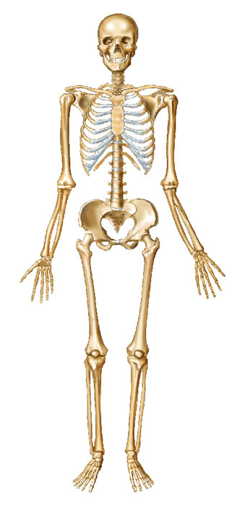
sutures in skull
No movement
Temporary
Example of : Fibrous joint
Shoulder
ball and socket
Flexion, extension, adduction, abduction, and rotation
Ex. Of : Polyaxial Synovial Joint
sternoclavicular joint
Articaulate surface is flat
Gliding movement
Ex. Of :Plane Synovial Joint
Between vertebrae in column
Secondary
Articulate surfaces covered by hyaline cartilage
Limited movement
Permanent
Ex. Of: Cartilaginous joint
Radioulnar joint
Pivot
Longitudinal
Rotation
Ex. Of : Uniaxial Synovial joint
Wrist
Ellipsoid
Flexion, extension, adduction, abduction
Ex. Of: Biaxial Synovial joint
Carpometacarpal joint of thumb
Saddle
Flexion, extension, adduction, abduction, and limited rotation
Ex. Of : Biaxial Synovial Joints
Epiphyseal plate in femur
Primary Bones are joined through hyaline cartilage
No movement
Temporary
Ex. of: Cartilaginous joint
Ankle
Hinge joint
Transverse movement
Flexion and extension
Ex. Of : Uniaxial Synovial Joint

Slide 20
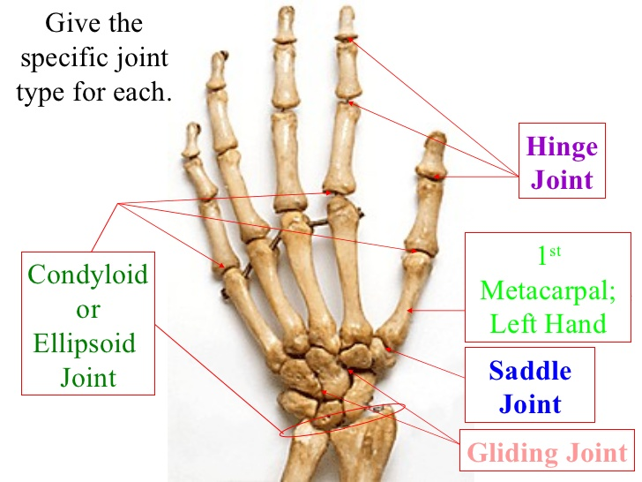
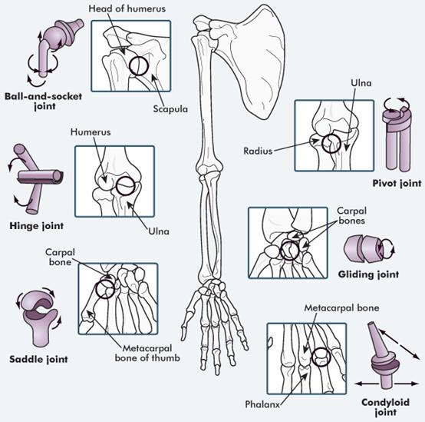
Summary
Carpometacarpal joint of the thumb
Intercarpal Joints.
BIAXIAL
+Wrist joint

Slide 21
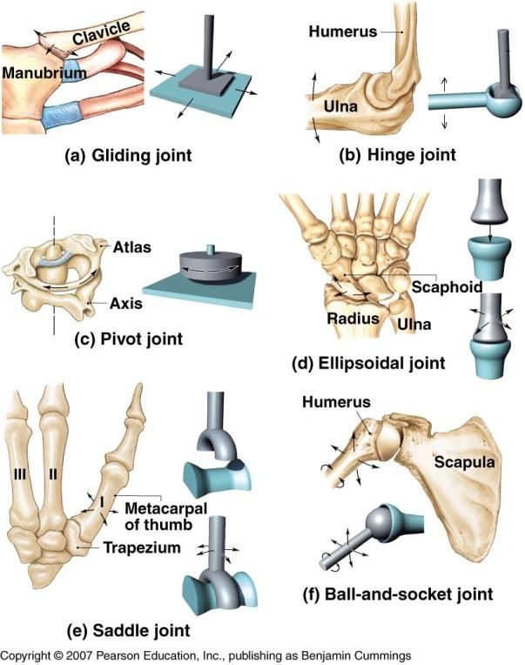
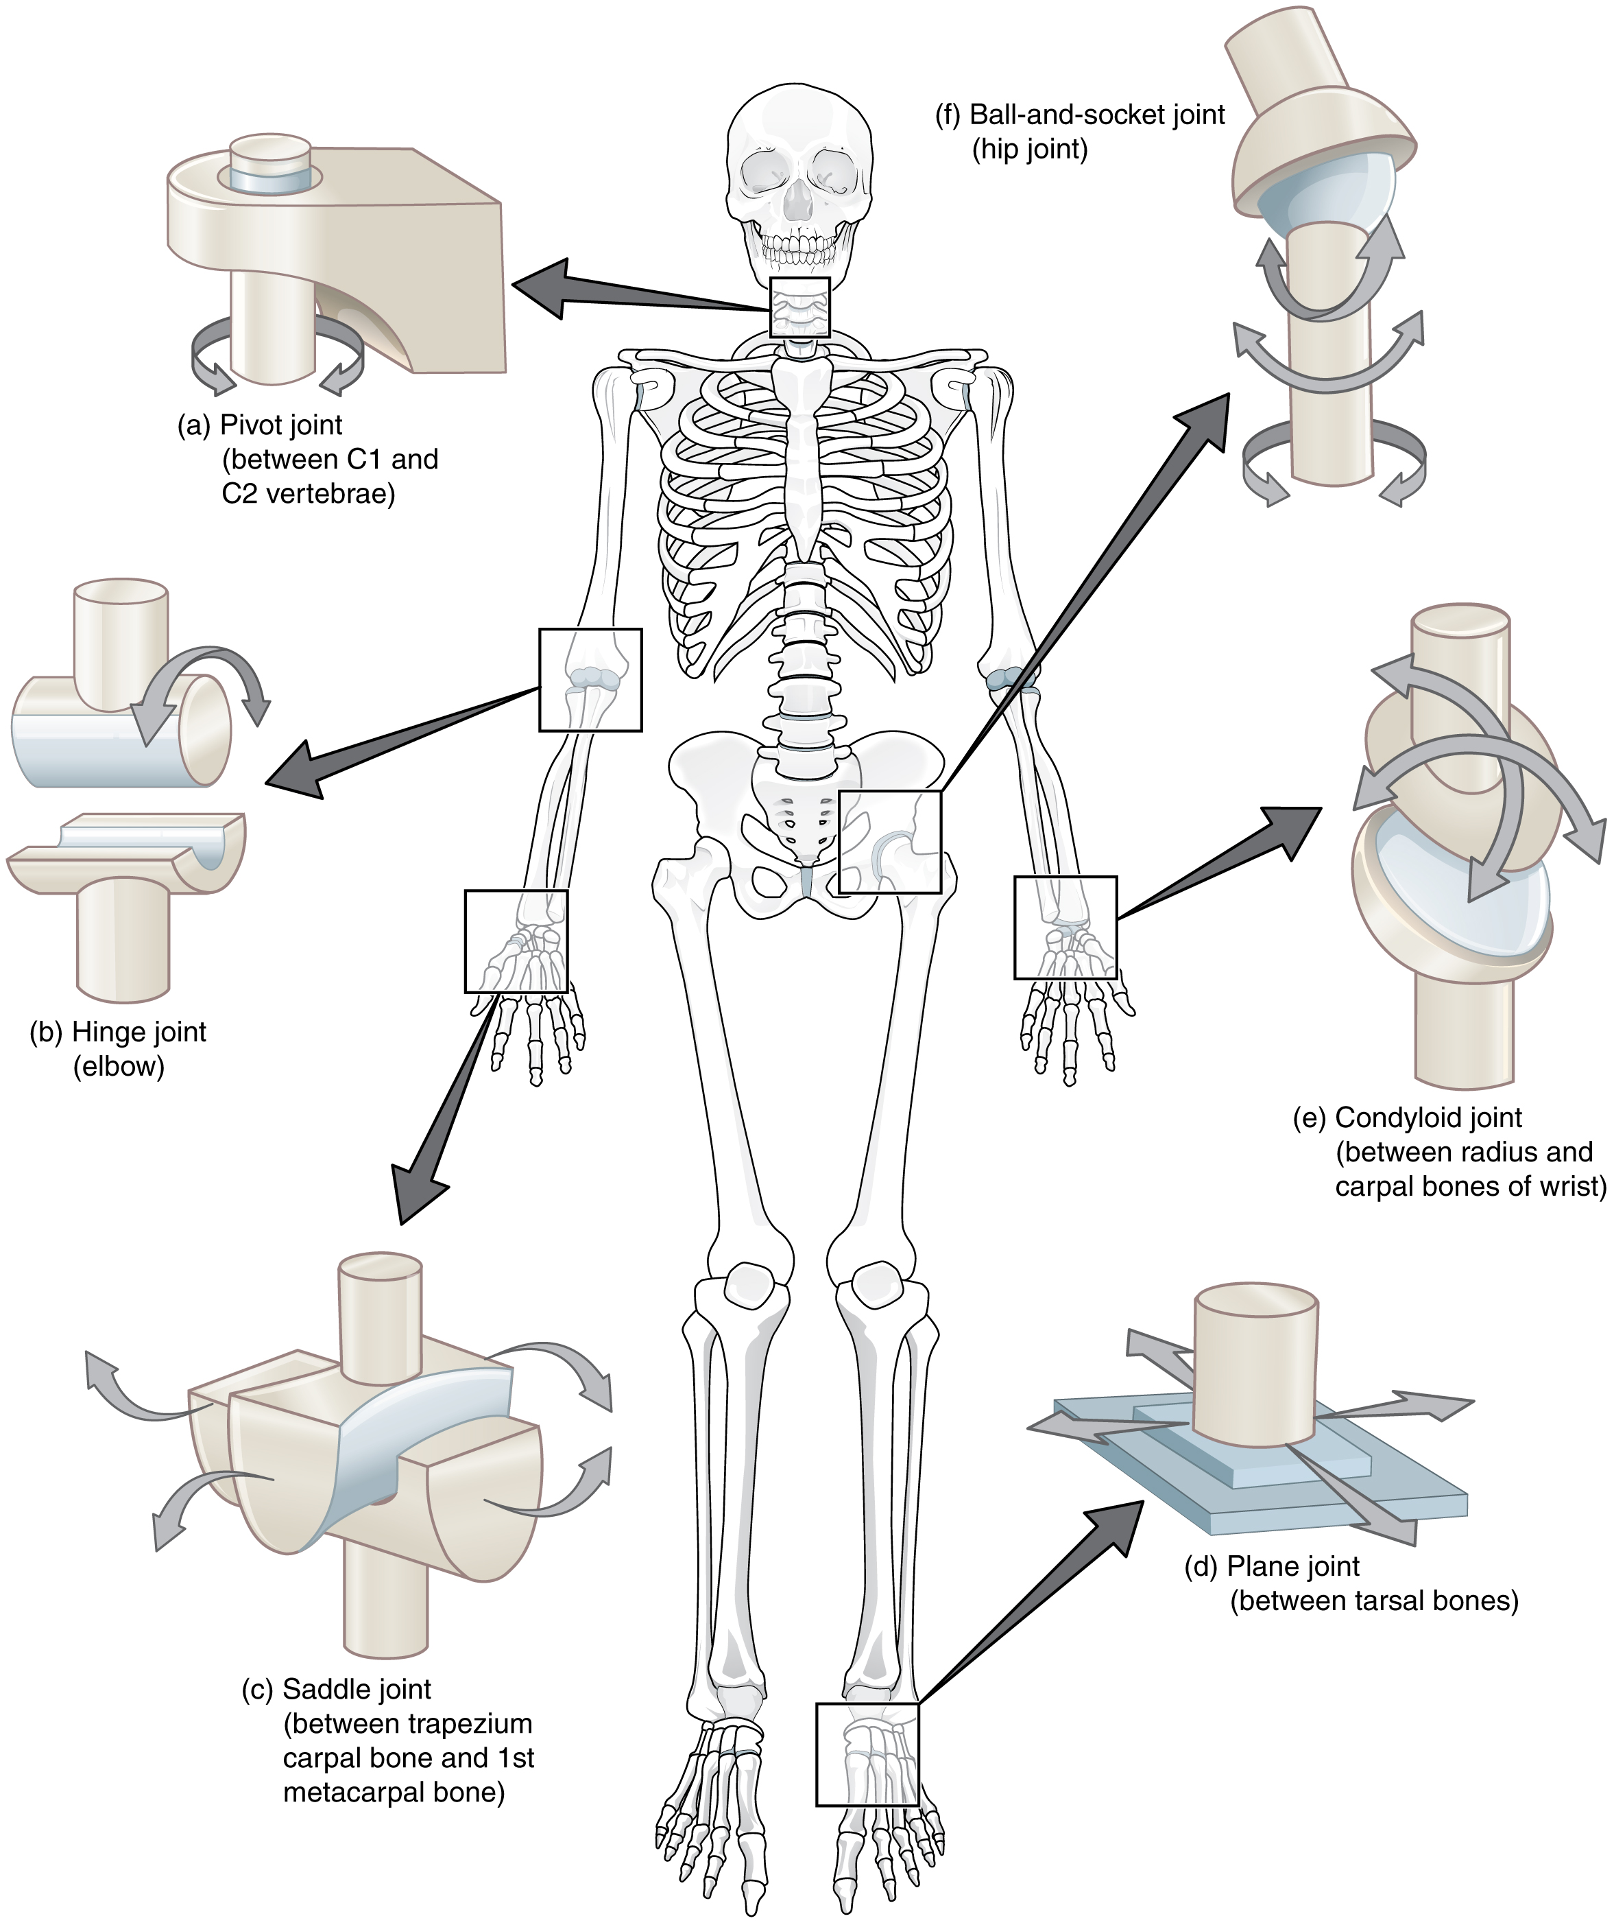
Summary

Slide 22
Questions
4) Primary cartilaginous joint are bones joined by fibrocartilage.
True
False
5) Articular capsule is a thin vascular membrane lining the inner surface of the capsule.
True
False
6) According to the range of movement synovial joints are classified into :
plane and axial
proximal and distal
plane and distal
7) Elbow is one of which these joints:
Hinge synovial joint
Pivot synovial joint
Plane synovial joint
1) What is the classification of gomphosis?
Fibrous
Cartilaginous
Axial Synovial
Plane Synovial
2) Which of the following joints has a minimal movement?
Skull sutures
Inferior tibiofibular joint
1st sternocostal rib
Gomphosis
3) Which of the following joints has a free range of movement?
Primary cartilaginous joint
Secondary cartilaginous joint
Synovial joint
1) A
2) B
3) C
4) B
5) B
6) A
7) A
8) C

Slide 23
11) A 40 year old obese woman came to see an orthopedic doctor for her left knee pain, the MRI Showed a tear in the cruciate ligaments. What is expected in her case?
A. muscular atrophy around knee
B. excessive movement of joint
C. ball and socket joint dislocation
D. loss of sensation
12) Which of the following is a primary cartilaginous joint?
1st sternocostal joint
2nd sternocostal joint
8th sternocostal joint
12th sternocostal joint
13) Hiltons law states that the nerve supplying a joint also supplies :
The muscles moving the joint
The skin overlying the insertion of the muscles
The bones
A & B
8) Wrist is one of which these joints:
Hinge synovial joint
Pivot synovial joint
Ellipsoid synovial joint
9) Carpometacarpal joint of the thumb is Saddle joint. It has:
All range of movement except rotation
All range of movement including a small range of rotation
All range of movement including a large range of rotation
10) The main factor of joint stability in most joints is:
A. Shape of articular surfaces
B. Strength of the ligaments
C. Tone of muscles around it
D. Shape of bones of the joint
8) C
9) B
10) C
11) B
12) A
13) D

Slide 24
Leaders:
غادة المزروع
جواهر ابانمي
نواف الخضيري
Members:
نجد الذيب
نورة السهلي
بدرية الصباغ
سمية الغامدي
ريما العتيبي
رنا باراسين
آمال الشيبي
anatomyteam436@gmail.com
@anatomy436

