Slide 1
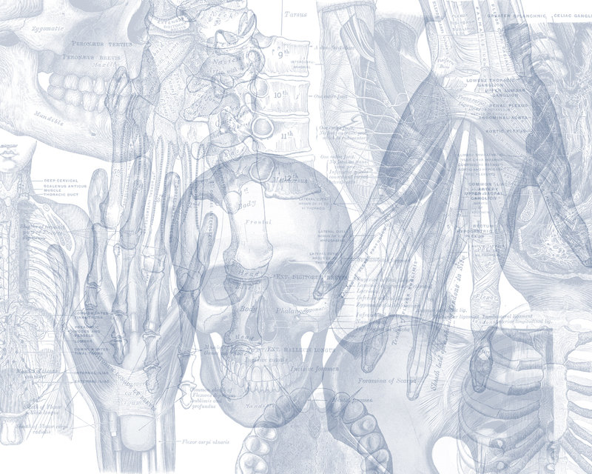
Shoulder Region
Color Code
Important
Doctors Notes
Notes/Extra explanation
Editing File

Slide 2
Objectives
List the name of muscles of the shoulder region.
Describe the anatomy of muscles of shoulder region regarding: attachments of each of them to scapula & humerus, nerve supply and actions on shoulder joint
List the muscles forming the rotator cuff and describe the relation of each of them to the shoulder joint.
Describe the anatomy of shoulder joint regarding: type, articular surfaces, stability, relations & movements.

Slide 3
Recall (the brachial plexus)

Slide 4
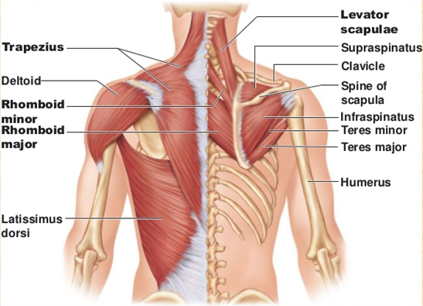
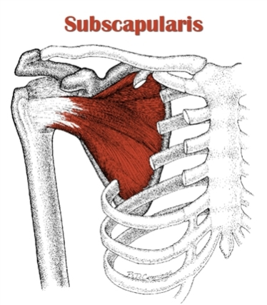
Muscles of Shoulder Region
These are the muscles connecting scapula to humerus (move humerus through shoulder joint):
Deltoid
Supraspinatus
Infraspinatus
Teres minor
Teres major
Subscapularis

Slide 5
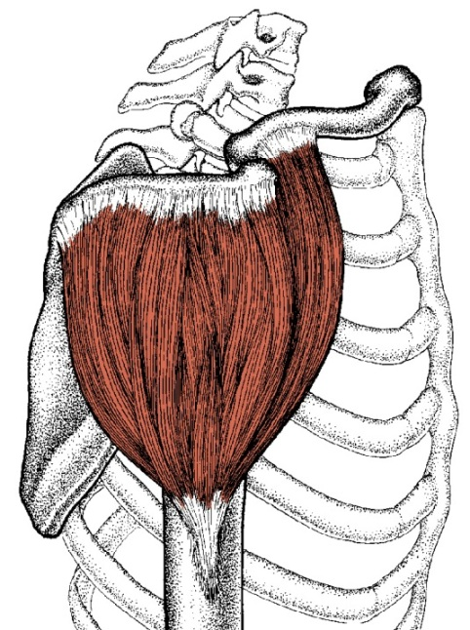
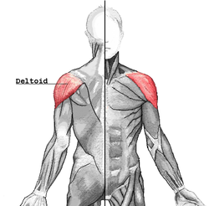
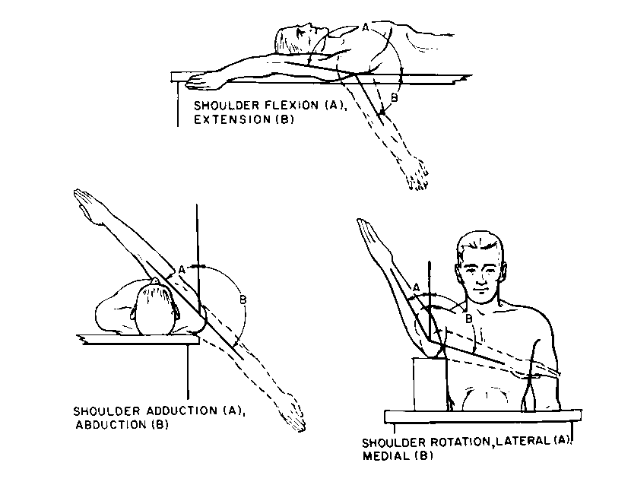
Muscles of Shoulder Region Deltoid
A triangular muscle that forms the rounded contour of the shoulder.
Origin: lateral ⅓ of clavicle (anterior fibers),
acromion (middle fibers),
and spine of scapula (lateral fibers).
(=Insertion of trapezius).
Insertion: deltoid tuberosity of humerus.
Nerve supply: Axillary nerve.
Actions:
Anterior fibers: flexion and medial rotation of humerus (arm, shoulder joint).
Middle fibers: abduction of humerus from 15-90 degrees.
Posterior fibers: extension & lateral rotation of humerus.
If all the fibers are working together the action is abduction (since the flexion and extension cancel each other)

Slide 6
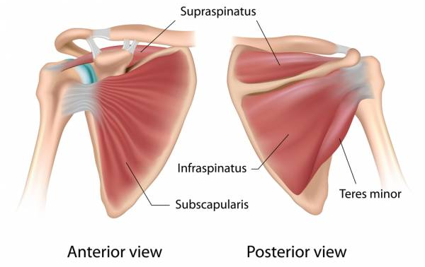
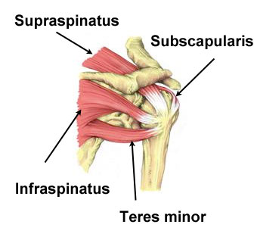
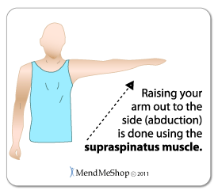
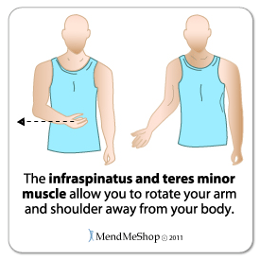
Muscles of Shoulder Region Supraspinatus & Infraspinatus
 | Supraspinatus | Infraspinatus
Origin | Supraspinous fossa | Infraspinous fossa
Insertion | Greater tuberosity of humerus.
Nerve Supply | Suprascapular nerve.
Action | Abduction of humerus from 0° - 15° | lateral rotation of humerus.
video

Slide 7
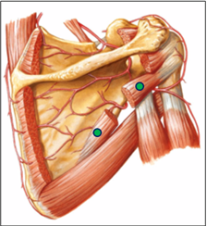
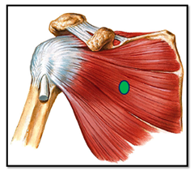
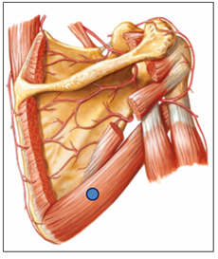
Teres Minor
Muscles of Shoulder Region
Teres Major
Subscapularis
Origin: lateral (Axillary) border of Scapula.
Origin: lateral border of scapula.
Origin: subscapular fossa.
Insertion: medial lip of bicipital groove of humerus (with latissimus dorsi & pectoralis major).
Insertion: lesser tuberosity of humerus.
Insertion: greater tuberosity of humerus.
Nerve supply: upper & lower subscapular nerves.
Nerve supply: axillary nerve.
Nerve supply:lower subscapular nerve.
Action: lateral rotation of humerus.
Actions: extension, adduction & medial rotation of humerus (same as action of latissimus dorsi).
Action: medial rotation of humerus.
Posterior view of scapula
Anterior view of scapula

Slide 8
Shoulder Joint
Type: Synovial, multiaxial (ball and socket)
Articular surfaces:
Head of humerus (ball)
Glenoid cavity (socket)
Stability:
Unstable (easy to dislocate سهل الخلع) because:
Head of humerus is 3 times larger than glenoid cavity
Capsule is redundant (مرخية وغير مشدودة)
Few ligamentous support: glenoid labrum (frame of fibrocartilage which increases the depth) and coracohumeral
MAIN SUPPORT: muscles around the joint (rotator cuff) it is the main support because the capsule and the ligaments in this case aren’t enough to support the shoulder joint
Wide range of movement
Range of movement & stability
علاقة عكسية

Slide 9
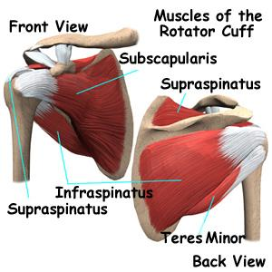
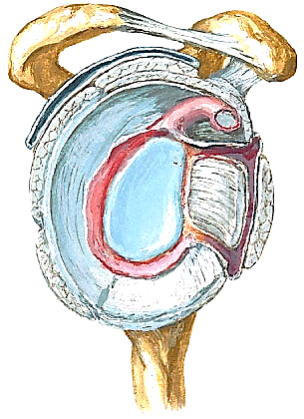
Rotator Cuff
Rotator cuff: A tendinous cuff around the shoulder joint covering its Anterior, Posterior and Superior aspects
NO muscle inferiorly (deficient) → site of potential weakness
Usually dislocation of the shoulder is downward which may cause injury of the axillary nerve (that is why dislocation is the common cause for axillary nerve injury).
The acromion and the coracoid process and the ligament in between them prevent the shoulder from dislocating upward and that is why it is most likely to dislocate the shoulder downward.
It is formed of 4 muscles (SITS) 4 out of the six muscles of the shoulder joint:
Supraspinatus, Infraspinatus, Teres minor & Subscapularis
The tone of these muscles help in stabilizing the shoulder joint.
Only tone is enough to stabilize the joint… no need for the muscle to contract
S
I
S
T
Site of potential weakness inferiorly in the rotator cuff

Slide 10
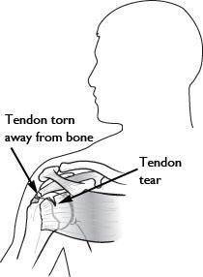
Rotator Cuff Injury
Rotator cuff can be damaged due to:
trauma (during playing baseball)
disease (in older individuals such as osteoporosis)
Trauma can tear or rupture one or more tendon(s) forming the cuff. Patients with rotator injury will present with pain, shoulder instability, and limited range of motion
Supraspinatus tendon is the most common site of rotator cuff injury

Slide 11
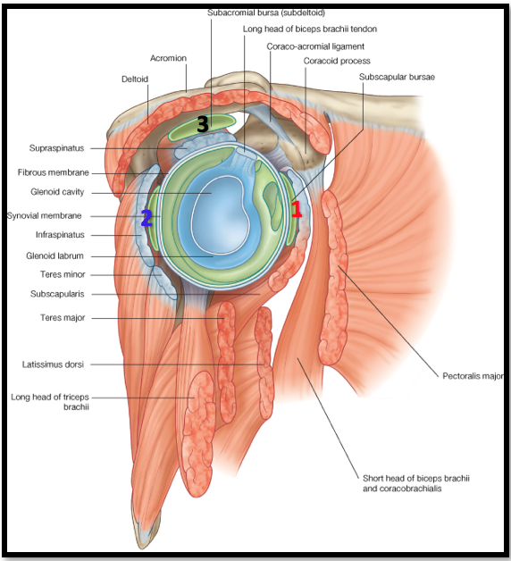
Bursae In Relation To Shoulder Joint
They reduce friction between tendons, joint capsule & bone.
They are liable to be inflamed following injury of rotator cuff muscles.
1) Subscapularis bursa: between subscapularis tendon & capsule.
2) Infraspinatus bursa: between infraspinatus tendon & capsule.
3) Subacromial bursa: between deltoid, supraspinatus and capsule.

Slide 12
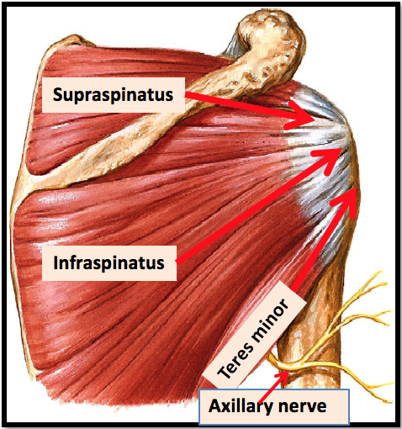
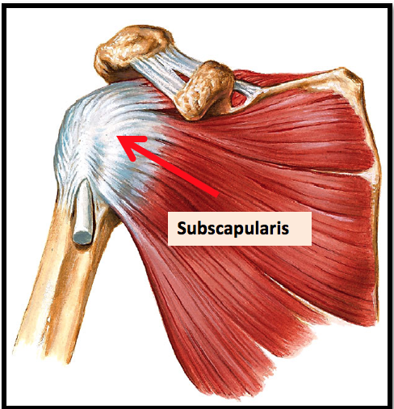
Relations Of Shoulder Joint
ANTERIOR: subscapularis.
POSTERIOR: infraspinatus, teres minor.
SUPERIOR: supraspinatus.
INFERIOR: axillary nerve.

Slide 13
Movements of Shoulder Joint
The shoulder joint can do ALL movements (flexion, extension, abduction, adduction, medial rotation, lateral rotation)
FLEXION
1. Anterior fibers of deltoid 2. Pectoralis major 3. Coracobrachialis (muscle of arm) 4. Short head of biceps brachii (muscle of arm)
ABDUCTION
1.From 0° - 15°: Supraspinatus 2. From 15° - 90 °:
Middle fibers of deltoid
EXTENSION
1.Posterior fibers of deltoid 2. Latissimus dorsi 3. Teres major
MAIN
ASSIST

Slide 14
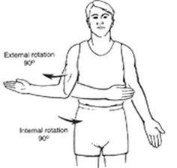
Movements of Shoulder Joint
The shoulder joint can do ALL movements (flexion, extension, abduction, adduction, medial rotation, lateral rotation)
ADDUCTION
1.Pectoralis major 2. Latissimus dorsi 3. Teres major
MEDIAL ROTATION
1.Pectoralis major 2. Latissimus dorsi 3. Teres major 4. Anterior fibers of deltoid
5. Subscapularis
LATERAL ROTATION
1.Posterior fibers of deltoid 2. Infraspinatus 3. Teres minor
MAIN
Pectoralis major, latissimus dorsi, and teres major are all inserted in the bicipital groove
Pectoralis major – lateral lip
Latissimus dorsi – groove
Teres major – medial lip
ASSIST
To Remember:
A Lady between 2 Majors

Slide 15
Summary
Muscles Of Shoulder Region:
Origin: scapula.
Insertion: humerus.
Action: move humerus (SHOULDER JOINT)
Nerve supply: anterior rami of spinal nerves through brachial plexus.
Rotator Cuff: 4 muscles in scapular region surround and help in stabilization of shoulder joint (supraspinatus, infraspinatus, teres minor, subscapularis).
Shoulder joint:
1.Type: synovial, ball & socket
2.Articular surfaces: head of humerus & glenoid cavity of scapula
3.Stability: depends on rotator cuff
4.Relations: rotator cuff and axillary nerve
5.Movements: flexion, extension, abduction, adduction, medial & lateral rotation

Slide 16
Muscle | Deltoid | Supraspinatus & Infraspinatus | Teres Minor | Teres Major | Subscapularis
Origin | lateral 1/3 of clavicle ,acromion and spine of scapula (= insertion of trapezius). | 1.Supraspinatus: supraspinous fossa. 2.Infraspinatus: infraspinaous fossa. | lateral (Axillary) border of Scapula. | lateral border ofscapula. | subscapular fossa.
Insertion | deltoid tuberosity of humerus. | greater tuberosity of humerus. | greater tuberosity of humerus. | medial lip of bicipital groove of humerus (with latissimus dorsi & pectoralis major). | lesser tuberosity of humerus.
Nerve supply | axillary nerve. | Suprascapular nerve. | axillary nerve. | lower subscapular nerve. | upper & lower subscapular nerves.
Action | 1.Anterior fibers: flexion & medial rotation of humerus (arm, shoulder joint). 2.Middle fibers: abduction of humerus from 15° - 90 °. 3.Posterior fibers: extension & lateral rotation of humerus. | 1.Supraspinatus: abduction of humerus from 0° - 15°. 2.Infraspinatus: lateral rotation of humerus. | lateral rotation of humerus. | extension, adduction & medial rotation of humerus (as action of latissimus dorsi). | medial rotation of humerus.

Slide 17
Questions
1. Which one of the following muscles is inserted into the lesser tuberosity of the humerus?
Subscapularis
Deltoid
Teres major
Infraspinatus
2. Which one of the following muscles is part of the rotator cuff?
Subscapularis.
Deltoid.
Teres major.
Rhomboid minor.
3. Regarding the shoulder joint, which one of the following statements is correct?
It is a stable joint.
It is a synovial joint of hinge variety.
Latissimus dorsi muscle adducts shoulder joint.
Downward dislocation of shoulder joint may cause injury to the radial nerve.
4. Bursae ______ friction between tendons, joint capsule & bone.
Increase.
Reduce.
Doesn’t affect.
5. Which of the following is related to shoulder joint inferiorly?
Subscapularis.
Teres minor.
Axillary nerve.
6. A patient injured his suprascapular nerve. Which of the following actions will be completely lost?
Abduction (0°-15°)
Abduction (15°-90°)
Lateral rotation
Medial rotation
7. The subacromial bursa is between?
8. A little boy came to the emergency department after falling from a tree. An xray showed that he dislocated his shoulder. List the muscles of the rotator cuff.
Answers:
A
A
C
B
C
A
Answers:
7. Deltoid, supraspinatus and capsule.
8. Supraspinatus, Infraspinatus, Teres minor & Subscapularis

Slide 18
Leaders:
Nawaf AlKhudairy
Jawaher Abanumy
Ghada Almazrou
Members:
Dania Alkelabi
Deena AlNowiser
Jawaher Alkhayyal
Nourah Al Hogail
Rawan Alharbi
Razan AlQahtani
Safa Al-Osaimi
anatomyteam436@gmail.com
@anatomy436

