Slide 1
Surface Anatomy of the Upper and Lower Limbs
Color Code
Important
Doctors Notes
Notes/Extra explanation
Editing File

Slide 2
Objectives
By the end of the lecture, students should be able to:
Palpate and feel the bony the important prominences in the upper and the lower limbs.
Palpate and feel the different muscles and muscular groups and tendons.
Perform some movements to see the action of individual muscle or muscular groups in the upper and lower limbs.
Feel the pulsations of most of the arteries of the upper and lower limbs.
Locate the site of most of the superficial veins in the upper and lower limbs.
NOTE: most of the information in this lecture is more practical than theoretical. Try to focus on the things that we’ve taken before.

Slide 3
What is Surface Anatomy?
It is a branch of gross anatomy that examines shapes and markings on the surface of the body (on the skin) as they are related to deeper structures.
It is essential in locating and identifying anatomic structures prior to studying internal gross anatomy.
It helps to locate the affected organ / structure / region in disease process.
Why do we study surface anatomy?
When we say surface anatomy of the liver, for example, we mean its normal position on the skin, and this is important to know so we can determine if it is normal or not and give a primary diagnosis of the organ before going deeper. Also if there is an injury to a certain area we can predict which organs, vessels, nerves will be affected.

Slide 4
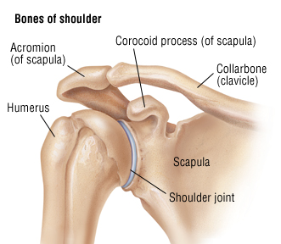
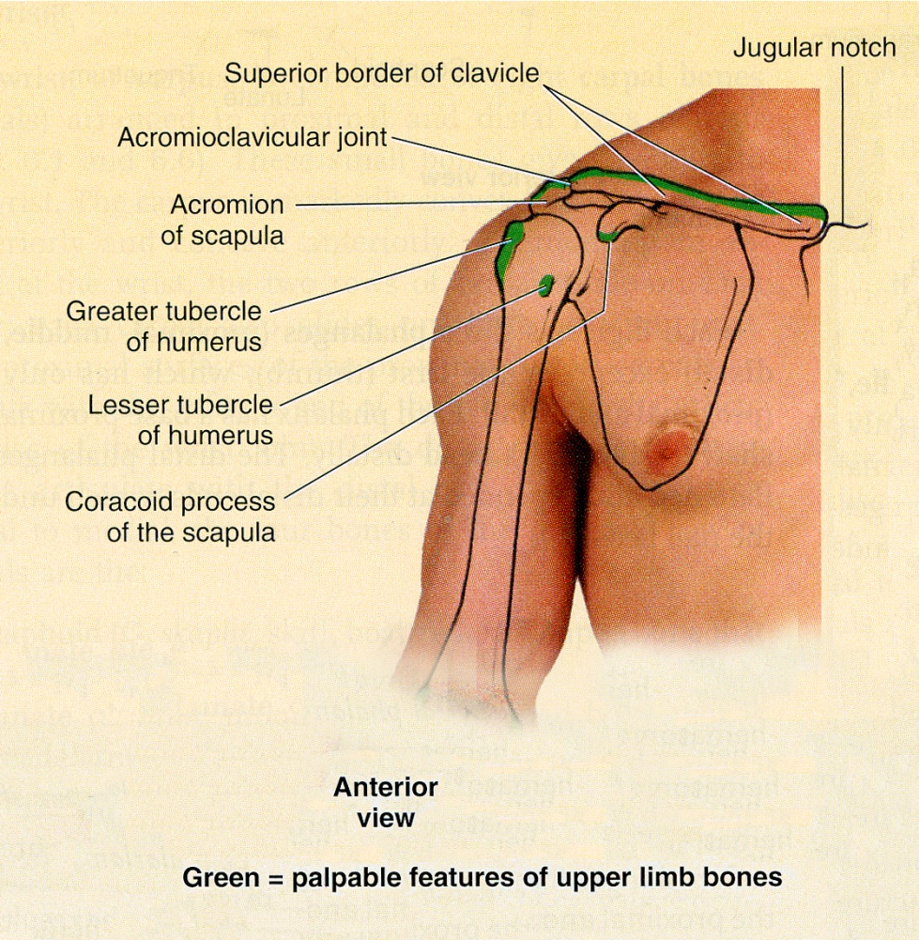
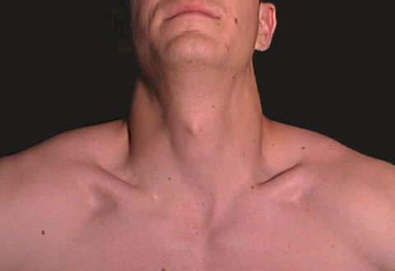
Upper Limb Bones (Clavicle)
The clavicle is subcutaneous and can be palpated throughout its length.
Its sternal end projects little above the manubrium.
Between the 2 sternal ends of the 2 clavicles lies the jugular notch (suprasternal notch).
The acromial end of the clavicle can be palpated medial to the lateral border of the acromion, of the scapula. particularly when the shoulder is alternately raised and depressed.
The large vessels and nerves to the upper limb pass posterior to the convexity of the clavicle.
These 2 pictures are extra

Slide 5
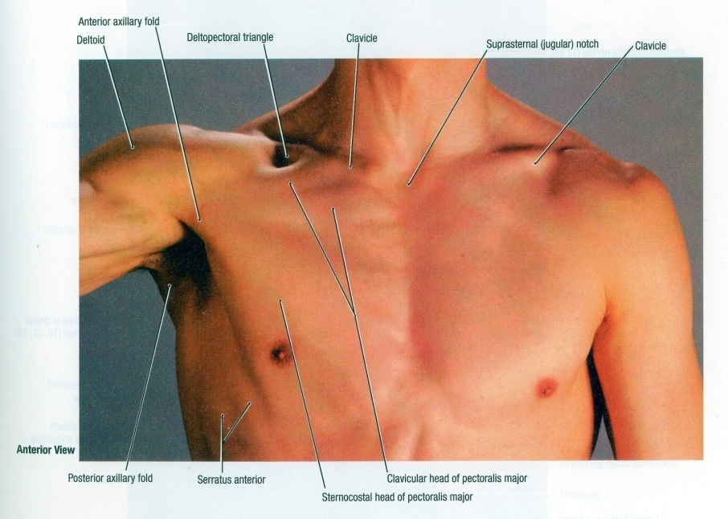
Upper Limb Bones (Scapula)
Extra
The coracoid process of scapula can be felt deeply below the lateral one third of the clavicle in the Deltopectoral GROOVE or clavipectoral triangle.
The clavipectoral or the (Deltopectoral) triangle is the slightly depressed area just inferior to the lateral third of clavicle.
Superiorly:
Clavicle
The clavipectoral triangle is bounded by:
Medially:
Pectoralis major
Laterally:
Deltoid

Slide 6
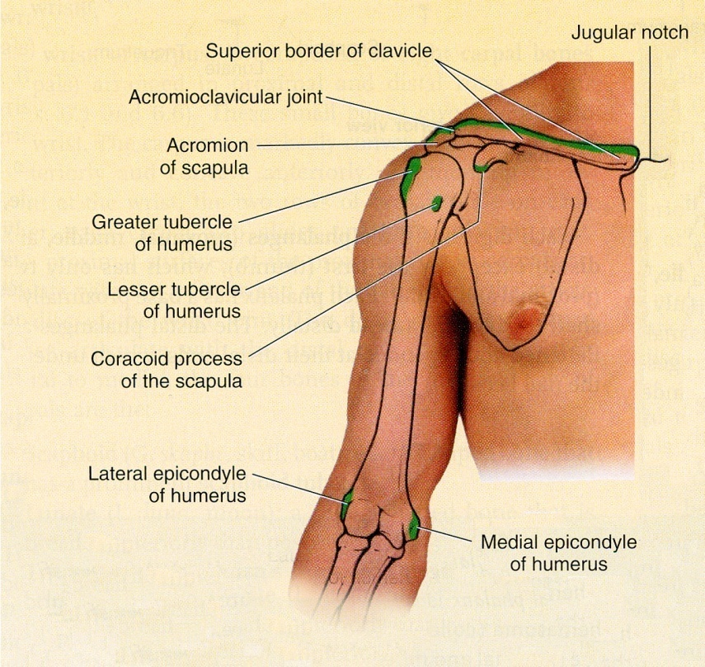
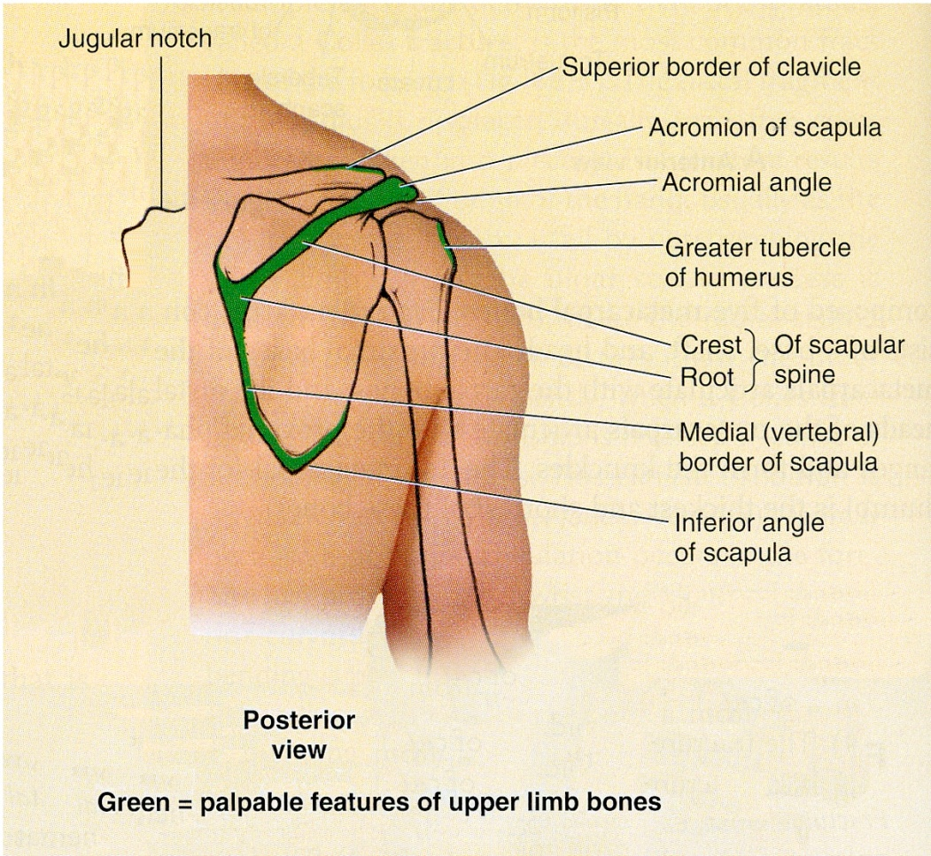
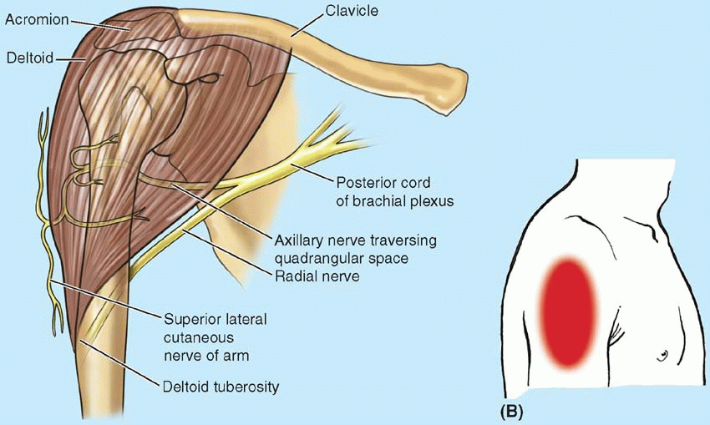
Upper Limb Bones (Arm)
The lateral and posterior borders of the acromion meet to form the acromial angle.
The greater tubercle of humerus can be felt by deep palpation through the deltoid muscle, inferior to the acromion when the arm is by the side.
In this position, the greater tubercle is the most lateral bony point of the shoulder.
The shaft of the humerus may be felt in different areas through the muscles surrounding it.
The medial and lateral epicondyles of the humerus are palpated on the medial & lateral sides of the elbow region.
Inferior to the acromion, the deltoid muscle forms the rounded contour of the shoulder.

Slide 7
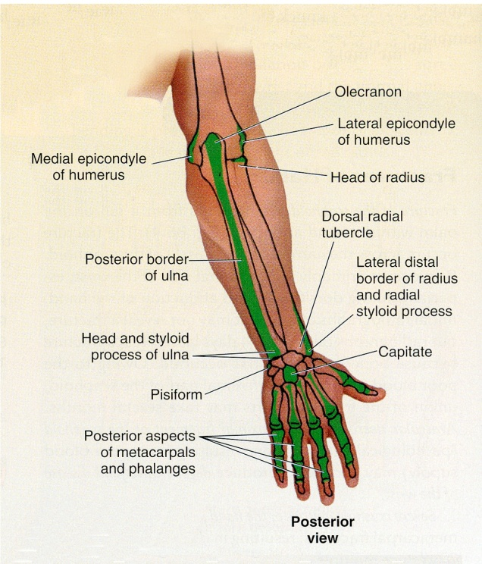
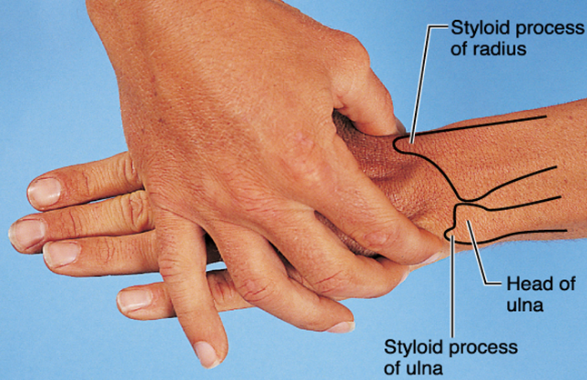
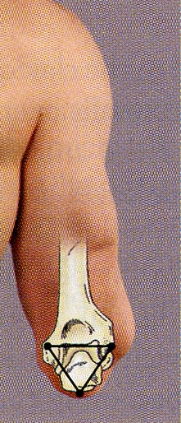
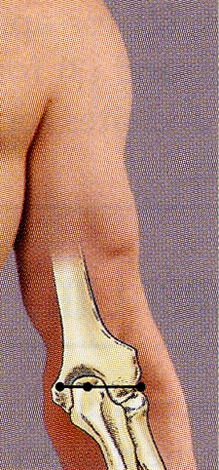
Upper Limb Bones (Forearm)
The head of ulna forms a rounded subcutaneous prominence that can be easily seen and palpated on the medial side of the dorsal aspect of the wrist.
The pointed subcutaneous ulnar styloid process may be felt slightly distal to the ulnar head when the hand is supinated.
The olecranon and posterior border of the ulna lie subcutaneously and can be palpated easily.
These 2 pictures are extra
2
1
When the elbow joint is extended (1), the tip of the olecranon process, the medial and the lateral epicondyles lie in a straight line.
When the elbow is flexed (2), the olecranon forms the apex of an equilateral triangle (مثلث متساوي الاضلاع), of which the epicondyles form the angles at its base.
Fractures of any of these structures will disturb this arrangement. (so when we take an xray we wont be able to see the triangle)

Slide 8
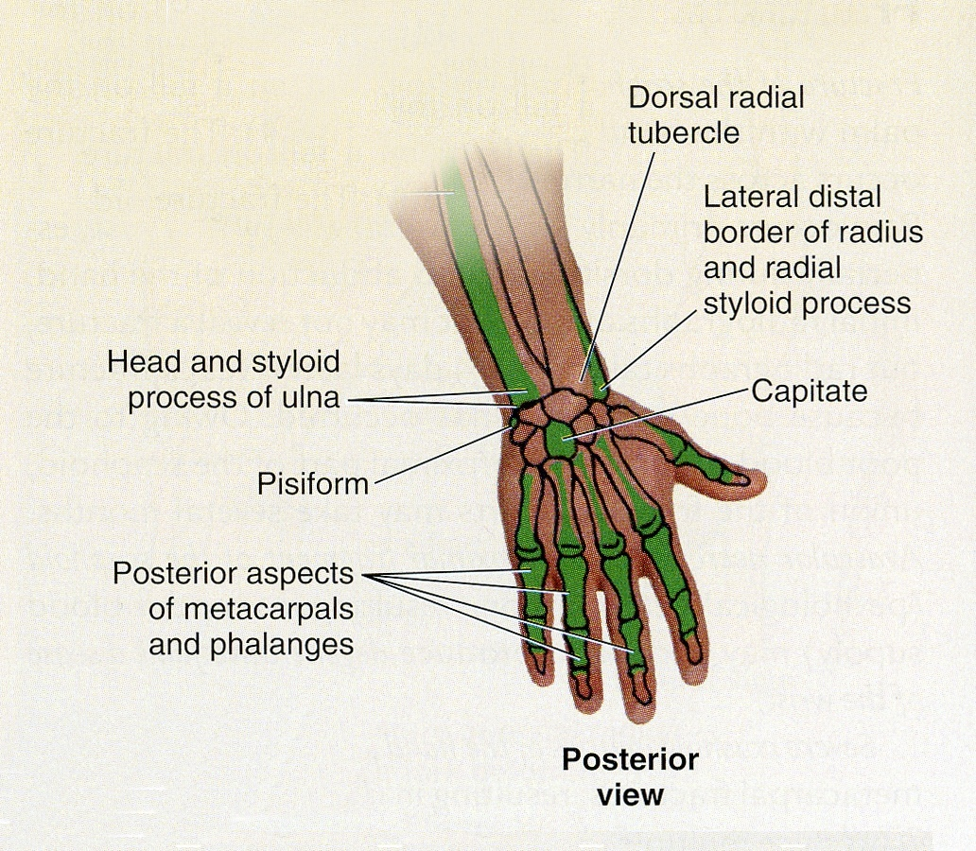
Upper Limb Bones (Wrist and Hand)
3rd metacarpel
Knuckles of hand
The head of radius can be palpated and felt to rotate in the depression on the posterolateral aspect of the extended elbow, just distal to the lateral epicondyle of the humerus with supination and pronation.
The radial styloid process can be palpated on the lateral side of the wrist in the anatomical snuff box.
It is approximately 1 cm distal to that of the ulna.
Knuckles of finger
The metacarpals, although they overlapped by the long extensor tendons of the fingers, they can be palpated on the dorsum of the hand.
The heads of the metacarpals form the knuckles of the hand.
Notice that the 3rd metacarpal head is the most prominent.
The dorsal aspects of the phalanges can be easily palpated.
The knuckles of the fingers are formed by the heads of the proximal and middle phalanges.

Slide 9
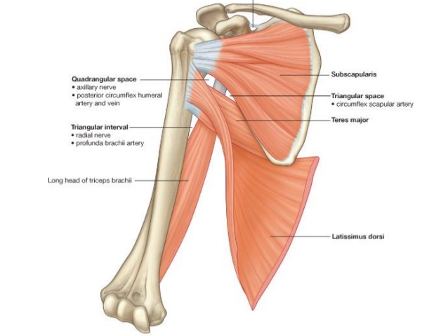
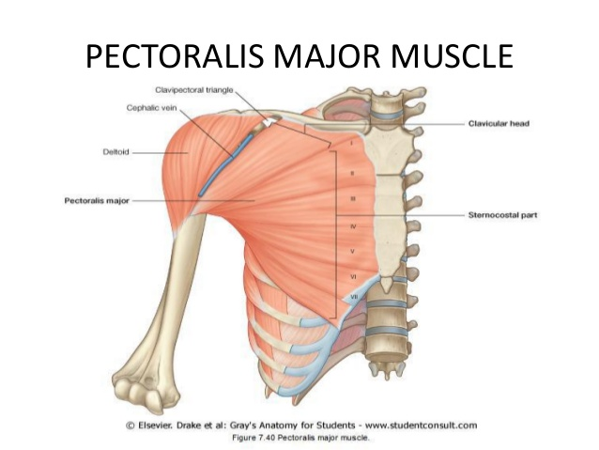
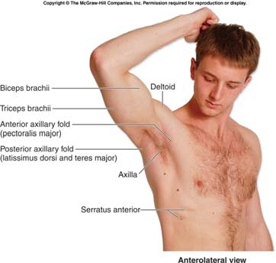
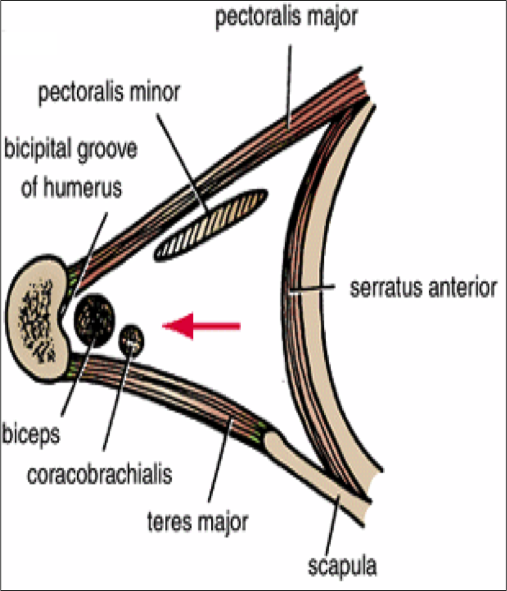
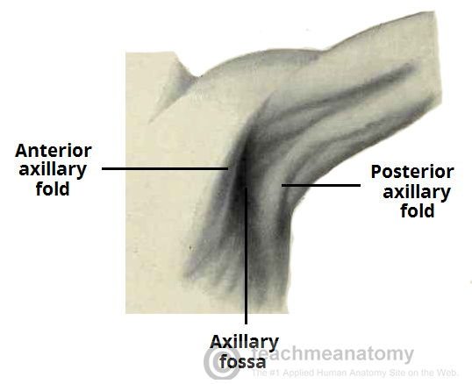
Upper Limb
Recall
Axillary Folds
The anterior axillary fold is formed by the lower margin of the pectoralis major, and can be palpated by the finger.
This can be made by asking the patient to press his or her hand against the ipsilateral hip.
The posterior axillary fold is formed by the tendons of latissimus dorsi and teres major muscles.
Axilla
The axilla should be examined with the forearm supported and the pectoral muscles relaxed. The patient will relax their hand and you will carry and hold the arm and examine the axilla.
When the arm is by the side, the inferior part of the head of the humerus can be easily palpated through the floor of the axilla.
The pulsations of the axillary artery can be felt high up in the axilla, and around the artery are the cords of the brachial plexus.
The medial wall of the axilla is formed by the upper ribs covered by the serratus anterior.
The lateral wall is formed by the coracobrachialis and biceps brachii and the bicipital groove.
Extra

Slide 10
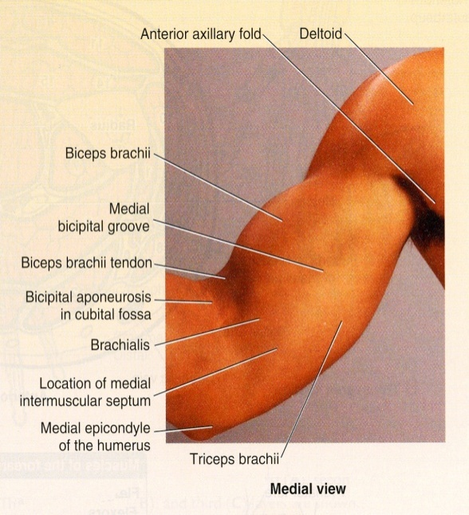
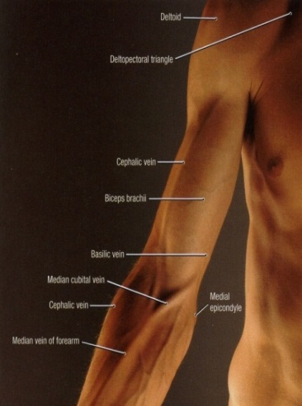
Upper Limb
The borders of the deltoid are visible when the arm is abducted against resistance.
The distal attachment of the deltoid can be palpated on the lateral surface of the humerus (deltiod tuberosity of the humerus).
Biceps brachii & triceps brachii form bulge on the anterior and posterior surfaces of the arm.
The biceps tendon can be palpated in the cubital fossa, immediately lateral to the midline.
The triceps tendon can be palpated where it is attached to the olecranon process.
There are 2 grooves: Medial and lateral grooves separate the bulges formed by the biceps and triceps.
The cephalic vein ascends superiorly in the lateral groove and
The basilic vein ascends in the medial groove.

Slide 11
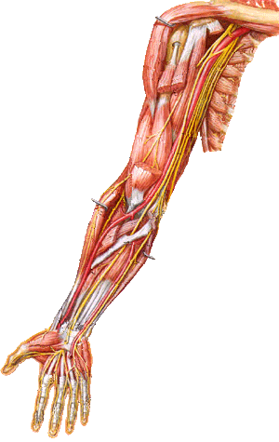
Upper Limb
Brachial Artery
A
B
The brachial artery can be felt pulsating deep to the medial border of the biceps.
To stop bleeding by pressure on the artery in the upper half of the arm it is pushed laterally against the humerus (A).
In the lower half it is pushed posteriorly (B).
In the cubital fossa, it lies beneath the bicipital aponeurosis (C).
At the level of the neck of the radius, it divides into radial and ulnar arteries (D).
C
D
Brachial artery
To stop an artery from bleeding we have to press it against a bone. So depending on the position of the artery on the bone we decide how to push/apply pressure

Slide 12
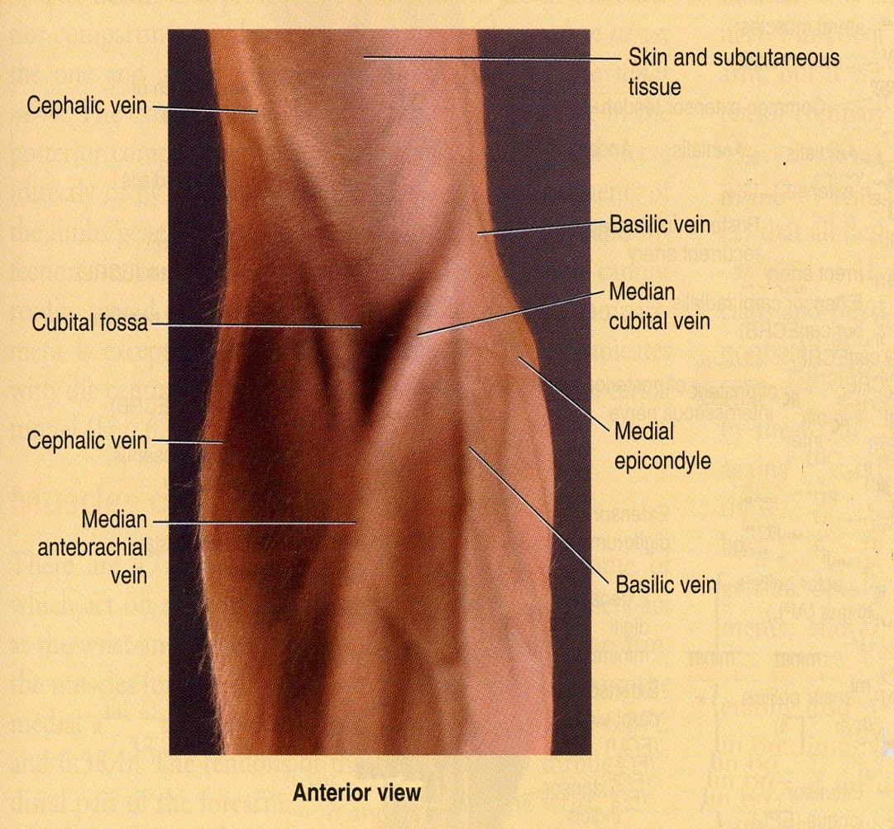
Upper Limb
Cubital Fossa
In the cubital fossa, try to locate:
Cephalic vein
Basilic vein and
Median cubital vein are clearly visible.
The median cubital vein connects the cephalic and the basilic veins .
It crosses over the bicipital aponeurosis.
It is the vein of choice for IV line, WHY?
Because it is very superficial and its position is fixed

Slide 13
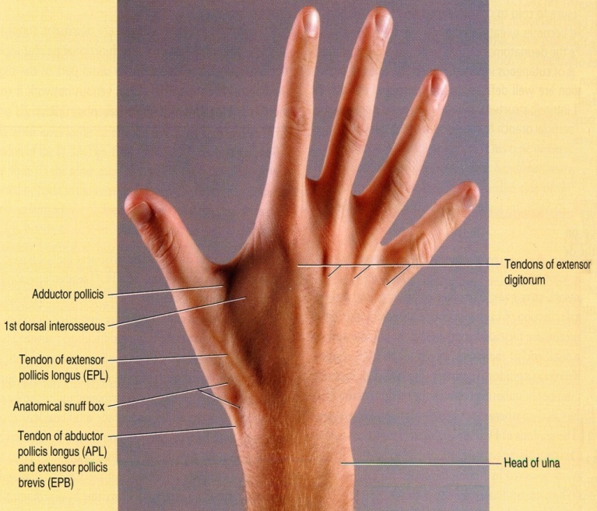
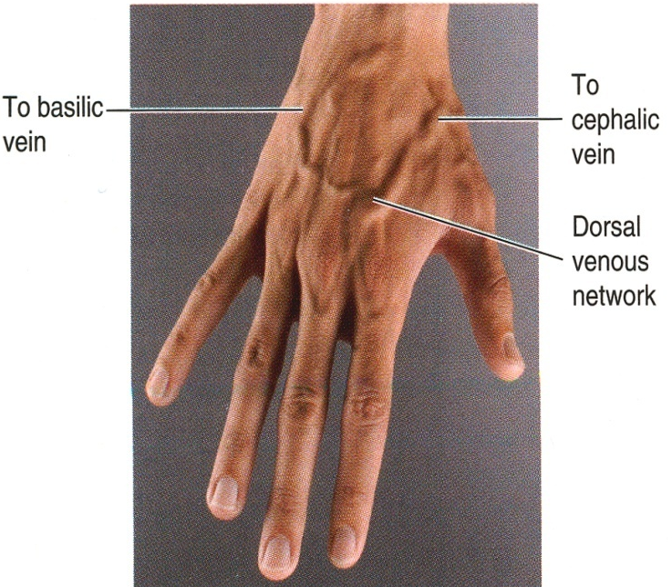
Upper Limb
Dorsum of Hand
The dorsal venous network:
The network of superficial veins can be seen on the dorsum of the hand.
The network drains upward into the cephalic vein laterally, and the basilic vein medially.
The tendons of extensor digitorum, extensor indicis, and extensor digiti minimi can be seen and felt as you extends your fingers.
Keep in mind this description is in the anatomical position and in the picture we are looking at the hand posteriorly

Slide 14
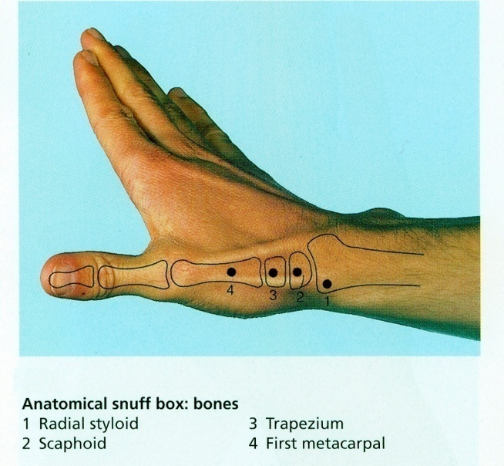
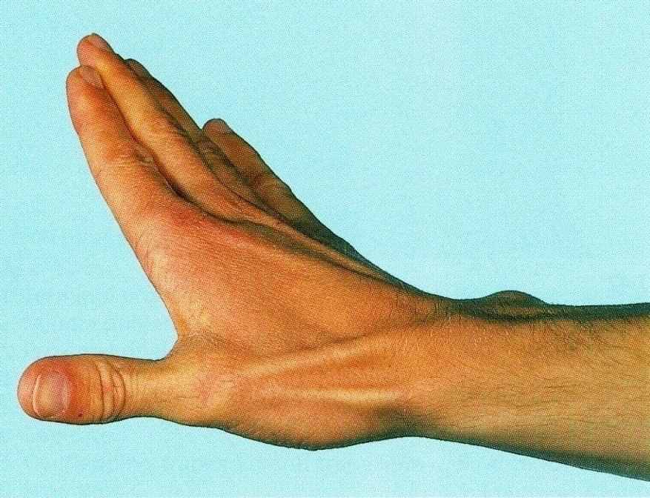
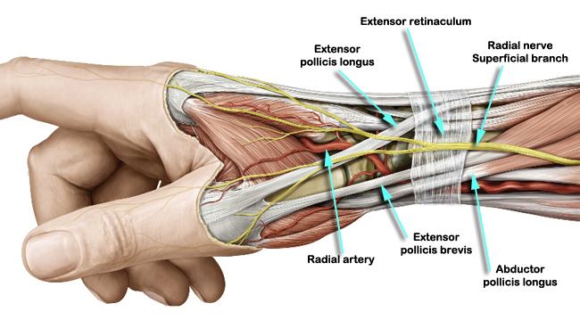
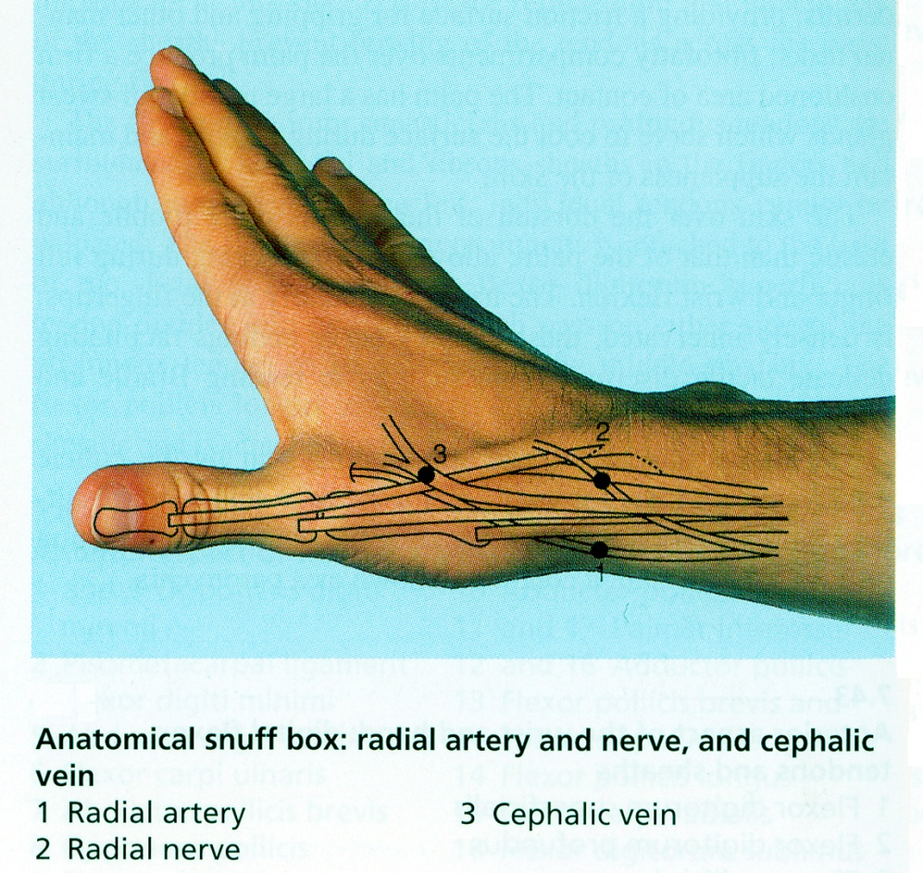
Upper Limb
Anatomical Snuff Box
It is a depression on the lateral aspect of the wrist joint which is accentuated when you extends your thumb.
Boundaries
The snuff box is bounded :
Anteriorly or laterally by 2 tendons:
Abductor pollicis longus
Extensor pollicis brevis
Posteriorly or medially by extensor pollicis longus
In its proximal part the radial styloid process is palpable.
The scaphoid bone is also palpable in the distal part of the anatomical snuff box.
Also, the radial artery pulsation can be felt against the floor of the snuff box.
More superficially, the anatomical snuff box is crossed by
The cephalic vein.
The radial nerve.
Extra

Slide 15
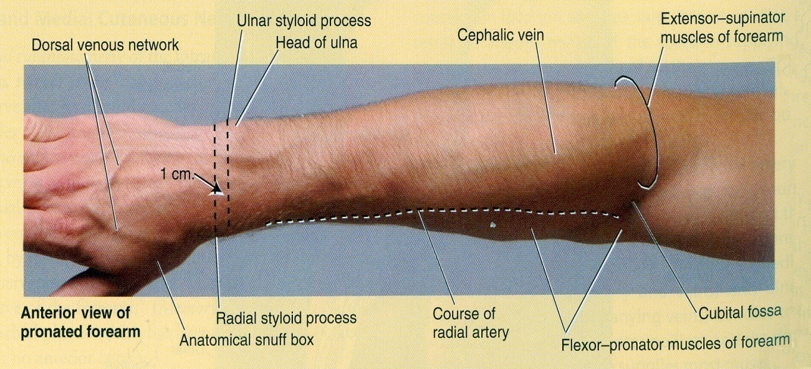
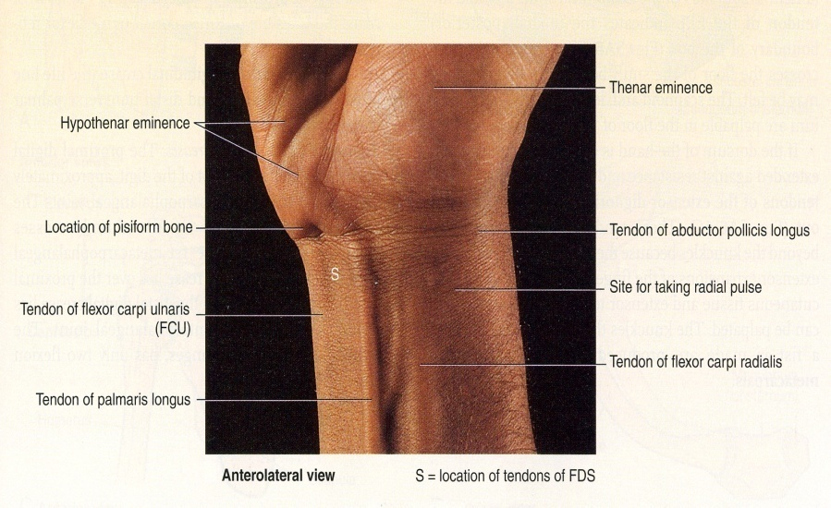
Upper Limb
Radial Artery
Radial Artery pulsation:
Universally, its pulsations can easily be felt anterior to the distal third of radius.
Here it lies just beneath the skin and fascia lateral to the tendon of flexor carpi radialis muscle
The Radial artery can be drawn by a line extends from the midpoint of the cubital fossa to the base of the styloid process of radius.

Slide 16
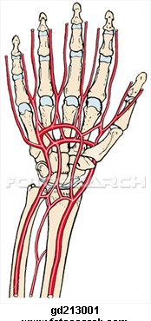
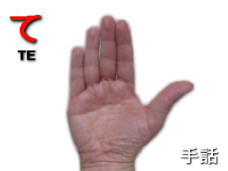
Upper Limb
Palmer Arches
Superficial Palmar Arterial Arch.
The superficial palmar arterial arch is located in the central part of the palm and lies on a line drawn across the palm at the level of the distal border of the fully ex-tended thumb.
Deep Palmar Arterial Arch.
The deep palmar arterial arch is also located in the central part of the palm ( proximal to the superficial one), lies on a line drawn across the palm at the level of the proximal border of the fully extended thumb.
Distal border
Proximal border

Slide 17
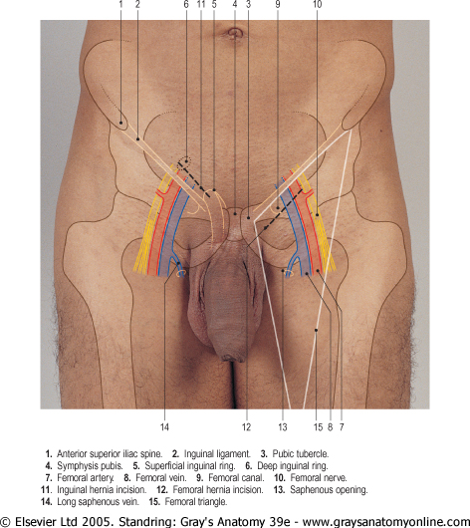
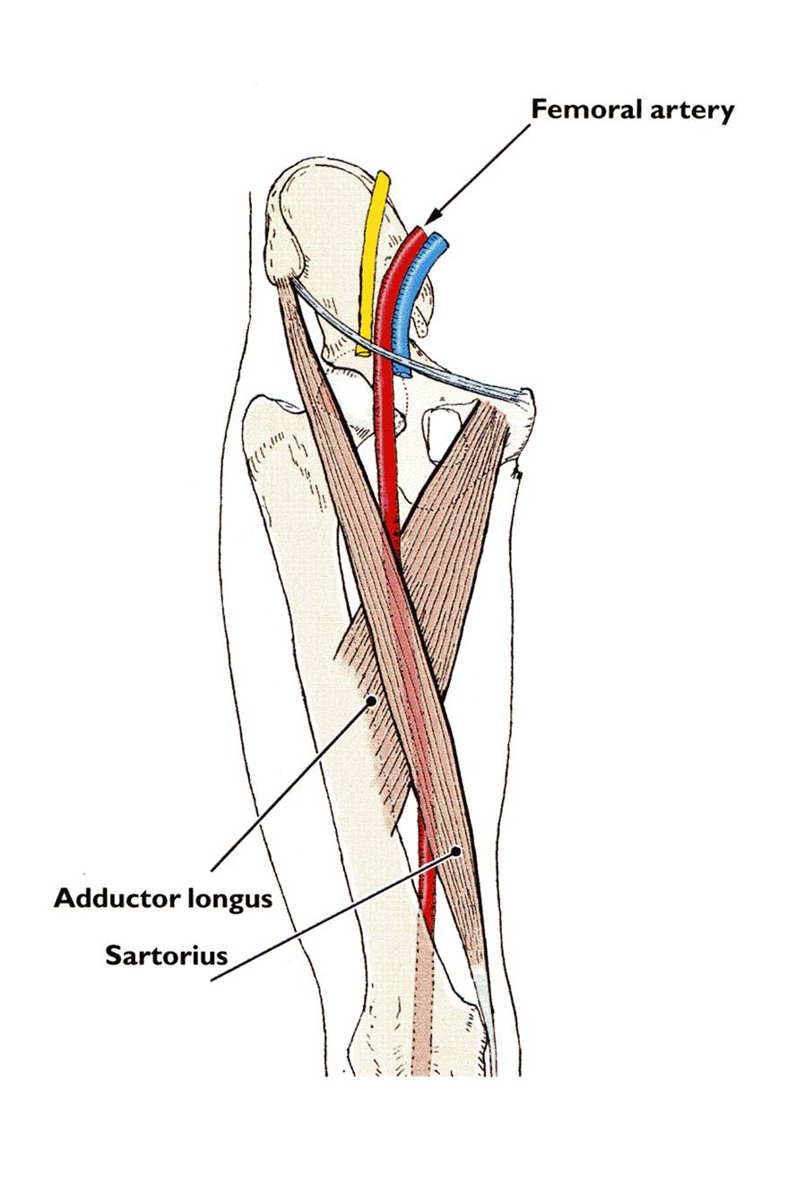
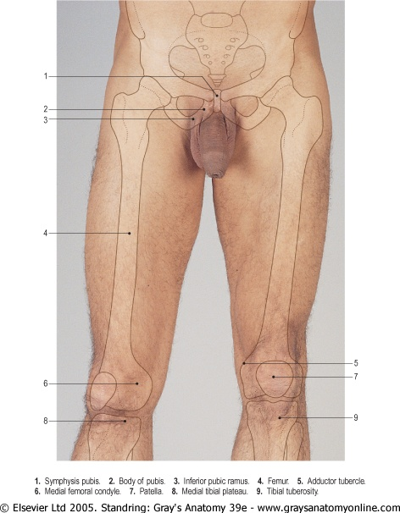
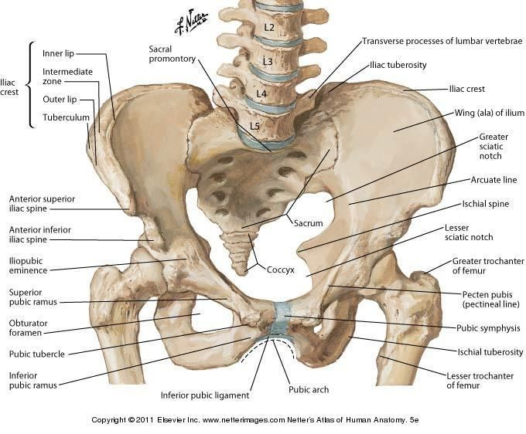
Inguinal Ligament
Lower Limb
Inguinal Region
Extra
The inguinal ligament extends between:
The pubic tubercle and
The ASIS (anterior superior iliac spine).
In the mid-inguinal point you can feel the pulsations of the femoral artery.
The femoral vein lies on the medial side of the artery.
While the femoral nerve lies lateral to the artery.
All of the following structures are palpable in the inguinal region:
Symphysis pubis
Body of pubis
Pubic tubercle*
ASIS (anterior superior iliac spine)
Extra
Midinguinal point:
It is a point on the inguinal ligament midway between the symphysis pubis and the ASIS.
The femoral artery is an important site for vascular access as a large number of arteriographic* procedures are undertaken through its percutaneous puncture, (coronary angiography).
*The pubic tubercle is a land mark for 2 types of hernias
*Radiologic visualization of the arteries following injection of a radiopaque substance.

Slide 18
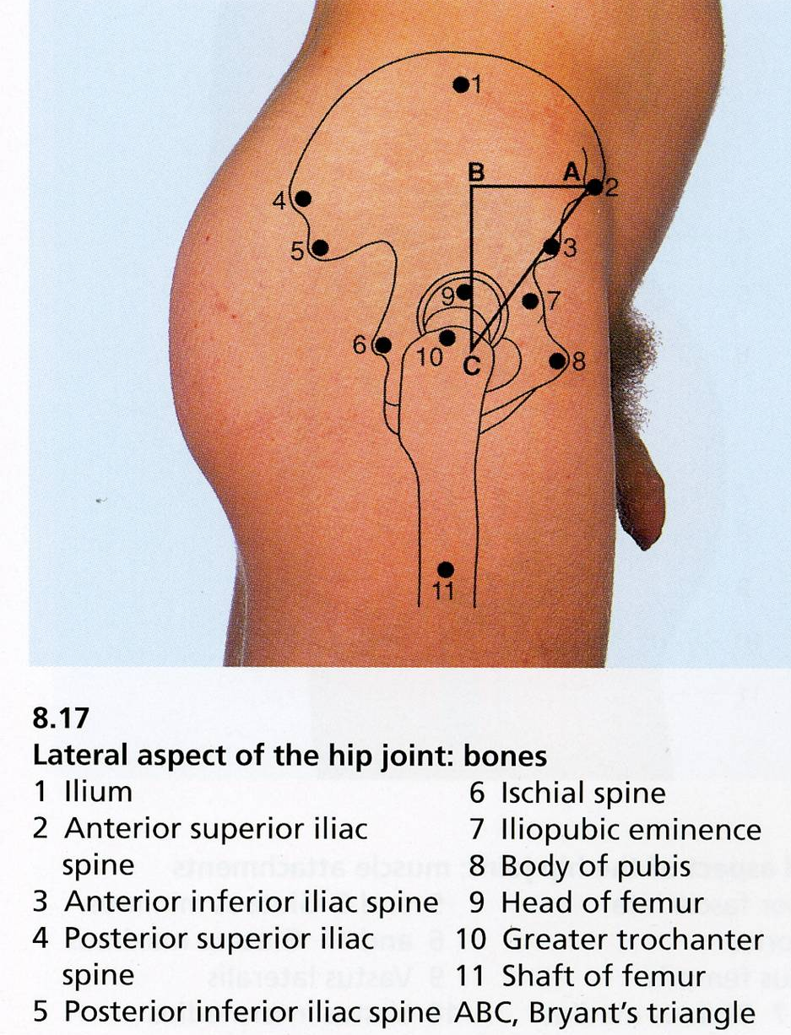
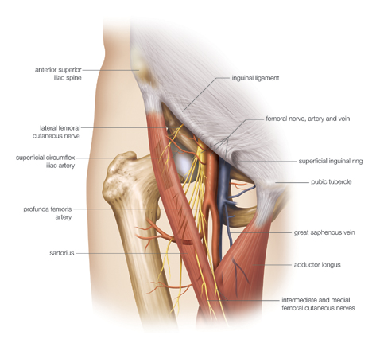
Lower Limb
Inguinal Region
Femoral Triangle
The femoral triangle can be seen as a depression below the fold of the groin in the upper part of the thigh.
In a thin or muscular subject (patient), the boundaries of the triangle can be identified when the thigh is flexed, abducted, and laterally rotated.
The base of the triangle is formed by the inguinal ligament, the lateral border by the sartorius and the medial border by the adductor longus
The iliac crest is subcutaneous and can be palpated throughout its length, from the ASIS (anterior superior iliac spine) to the PSIS (posterior superior iliac spine).
The greater trochanter of the femur is also subcutaneous and can be palpated on the lateral aspect of the hip joint behind and distal to the ASIS.
Extra

Slide 19
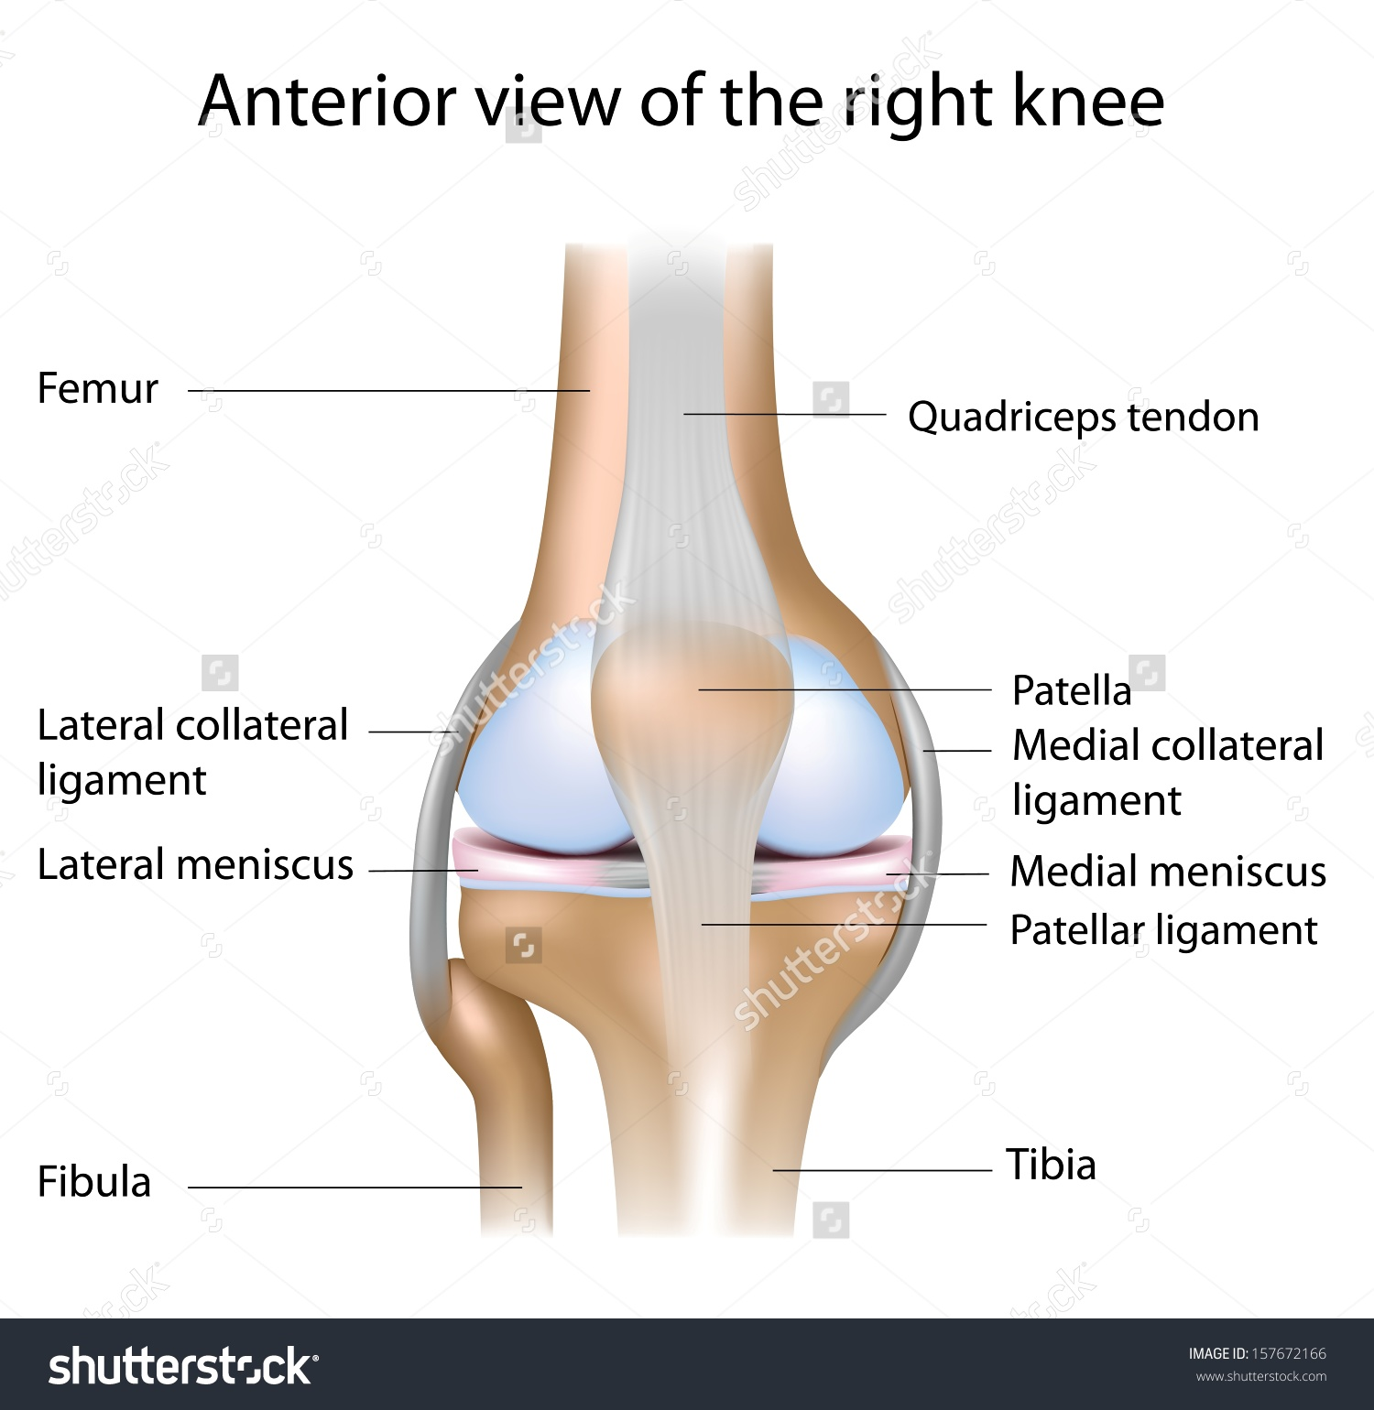
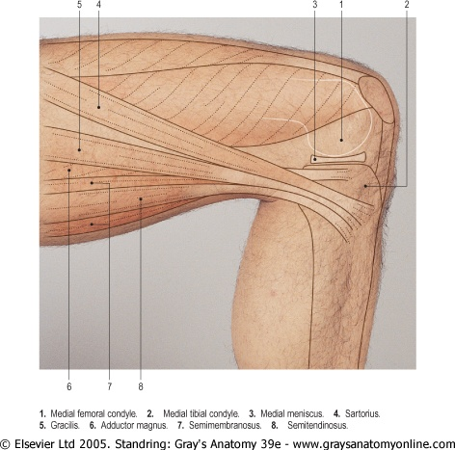
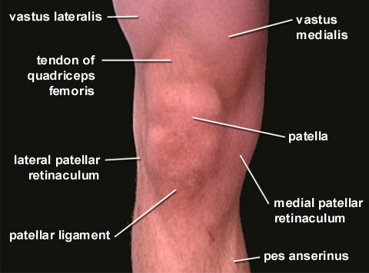
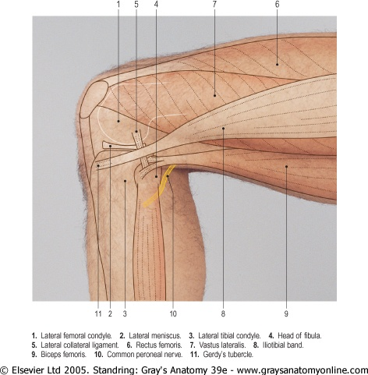
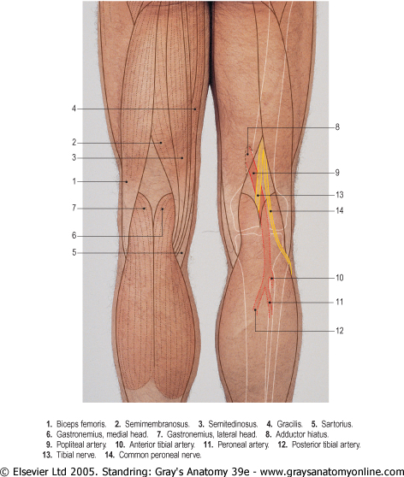
Lower Limb
Knee Region
Extra
On the medial aspect of the knee joint try to palpate:
Medial femoral condyle
Medial tibial condyle
The 3 tendons of (SGS)
Sartorius.
Gracilis
Semitendinosus.
In front of the knee joint the patella and the ligamentum patellae (or patellar ligament) can be easily palpated.
The ligamentum patellae can be traced downward as it is attached to the tibial tuberosity.
The condyles of the femur and tibia can be recognized on the sides of the knee and the joint line can be identified between them.
On the lateral aspect of the knee joint try to palpate:
Lateral femoral condyle
Lateral tibial condyle
Head of the fibula
Neck of the fibula
Tendon of biceps femoris.
In the back of the knee and leg try to palpate:
The boundaries of the popliteal fossa.
The pulsation of the popliteal artery which is deeply situated in the fossa.

Slide 20
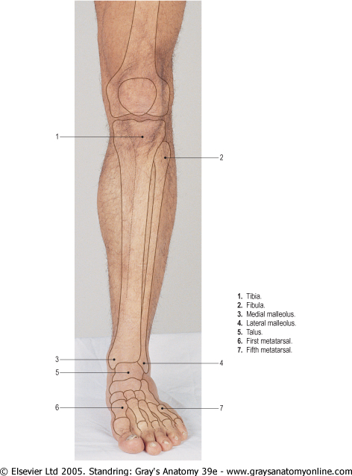
Lower Limb
Leg and Foot
On the dorsum of the foot try to palpate:
The tuberosity of the 5th metatarsal
The tubercle of navicular.
The metatarsals.
The long extensor tendons:
Tibialis anterior
Extensor hallucis longus.
Extensor digitorum longus.
Peroneus tertius.
Also, try to feel the pulsation of the dorsalis pedis artery between the tendons of extensor hallucis longus & extensor digitorum longus.
On the anterior aspect of the leg and knee joint and try to palpate:
The patella.
The tibial tuberosity.
The anterior border of the tibia, (shine).
The medial tibial condyle.
The medial surface of the tibia.
The medial malleolus.
The lateral malleolus.

Slide 21
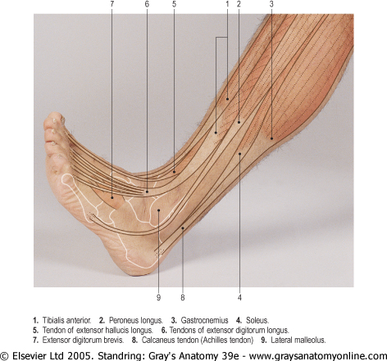
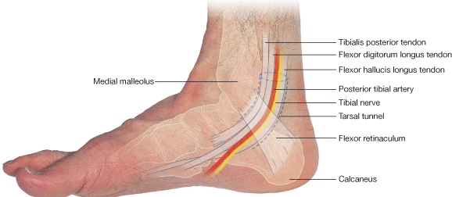
Lower Limb
Leg and Foot
On the lateral aspect of the leg try to palpate:
The tendons of peroneus longus and brevis.
The tendon Achilles.
The lateral malleolus.
On the Medial aspect of the ankle try to palpate and feel:
The medial malleolus.
The tendons of tibialis posterior
The tendon of flexor digitorum longus.
The posterior tibial artery*
The calcaneus.
* To palpate the pulse of the artery we ask the patient to invert their foot (to relax the flexor retinaculum).

Slide 22
Questions
4. Which tendon of the following muscles makes the anterior axillary fold?
Teres major
Pectoralis major
Teres minor
Pectoralis minor
5. Which of the following descends in the lateral bicipital groove?
Cephalic vein
Basilic vein
Saphenous vein
Median cubital vein
6. A patient arrived in the ER suffering from dehydration. The doctor requested that he have a saline drip. Which of the following veins should we use to start the I.V. line?
Cephalic vein
Basilic vein
Saphenous vein
Median cubital vein
The clavipectoral triangle is medially bound by:
Clavicle
Deltoid
Pectoralis Major
Pectoralis Minor
2. An x-ray was taken of patient’s arm posteriorly while it was flexed. The normal equilateral triangle was disturbed. Which of the following structures is most likely affected?
Olecranon process
Radial styloid process
Head of femur
Head of fibula
3. Which of the following structures make up the knuckle of the hand?
Head of proximal phalanges
Head of distal phalanges
Head of metacarpals
Base of metacarpals
Answers:
C
A
C
B
A
D

Slide 23
Questions
10. What are the boundaries of the femoral triangle?
11. List 3 major structures passing through the femoral triangle.
12. While palpating the medial aspect of the knee what 3 tendons can we feel?
13. What are the boundaries of the anatomical snuff box?
7. The pulsation of which of the following arteries can be felt in the snuff box?
Brachial artery
Femoral artery
Radial artery
Ulnar artery
8. The inguinal ligament extends between the pubic tubercle and ______.
Anterior superior iliac spine
Anterior inferior iliac spine
Posterior superior iliac spine
Posterior inferior iliac spine
9. A patient suffering from a myocardial infarction underwent a coronary angiography. Which of the following arteries was used to gain vascular access?
Axillary artery
Femoral artery
Brachial artery
Radial artery
Answers:
10. The base of the triangle is formed by the inguinal ligament, the lateral border by the sartorius and the medial border by the adductor longus.
11. Femoral artery, femoral nerve, and femoral vein.
12. We can feel the tendons of (SGS)
Sartorius.
Gracilis
Semitendinosus.
13. The anatomical snuff box is bound anteriorly by tendons of Abductor pollicis longus and Extensor pollicis brevis and posteriorly by extensor pollicis longus tendon.
Answers:
7. C
8. A
9. B

Slide 24
Leaders:
Nawaf AlKhudairy
Jawaher Abanumy
Ghada Almazrou
anatomyteam436@gmail.com
@anatomy436

