Slide 1
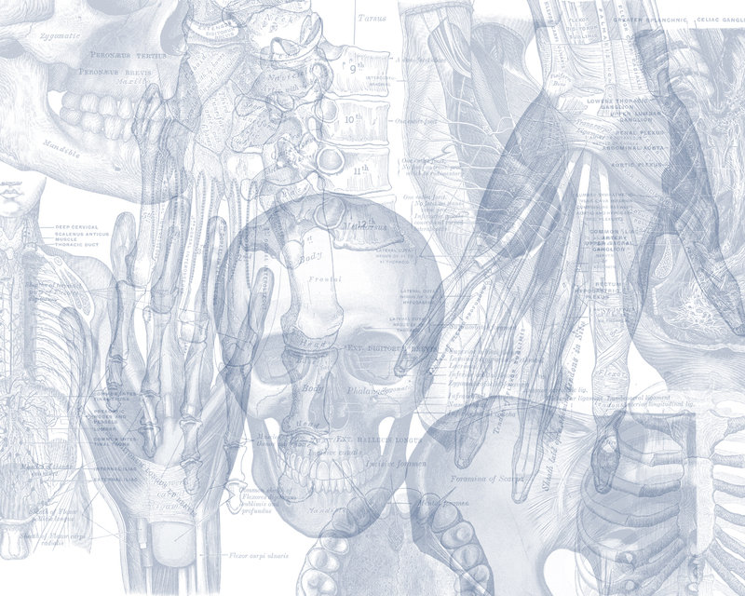
Hip, Knee & Ankle Joints
Color Code
Important
Doctors Notes
Notes/Extra explanation
By Biochemistry team
Editing File

Slide 2
Objectives:
List the type & articular surfaces of the hip, knee and ankle joints.
Describe the capsule and ligaments of the hip, knee and ankle joints.
Describe movements of hip, knee and ankle joints and list the muscles involved in these movements.
List important bursae in relation to knee joint.
Apply Hilton’s law about nerve supply of joints.

Slide 3
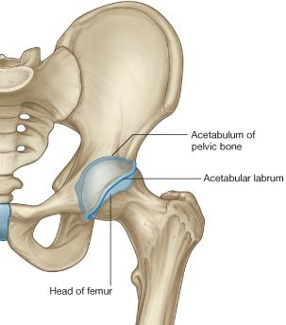
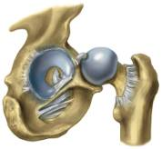
Hip joint
TYPE:
Synovial, Ball & Socket joint.
ARTICULAR SURFACES:
Acetabulum of hip (pelvic) bone (socket)
Head of femur (ball)
Acetabular Labrum:
C-shaped fibrocartilaginous collar attached to margins of acetabulum, and increases its depth for better retaining of head of femur.
Acetabular labrum

Slide 4
Hip joint
Capsule
Attached Medially to hip bone :
1. Labrum acetabulare.
2. Transverse acetabular ligament.
Posteriorly :
Halfway along the posterior aspect of the neck. (Part of the neck lies inside the capsule and the other part is outside it).
Anteriorly :
the neck of the femur is completely inside the capsule
Basically the capsule covers the neck of the femur completely anteriorly but posteriorly it only covers half of it.
Only on the girls’ slides

Slide 5
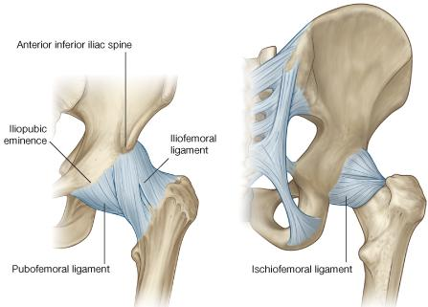
Hip joint
Ligaments
Intra-capsular (3)
Extra-capsular (3)
➤Iliofemoral ligament:
Y-shaped, anterior to joint, limits extension
➤ Pubofemoral ligament:
antero-inferior to joint, limits abduction & lateral rotation
➤ Ischiofemoral ligament:
posterior to joint, limits medial rotation
➤ Acetabular labrum:
fibro-cartilaginous collar attached to margins of acetabulum
to increase its depth for better retaining of head of femur.
➤ Transverse acetabular ligament:
converts acetabular notch into foramen through which pass acetabular vessels
➤ Ligament of femoral head:
carries vessels to head of femur

Slide 6
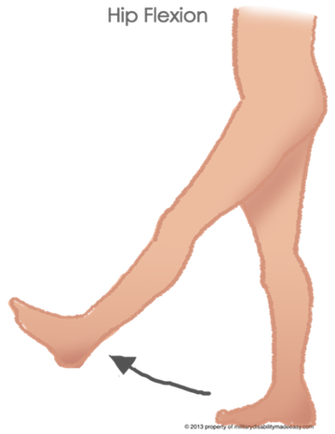
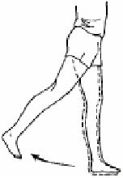
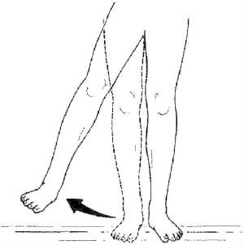
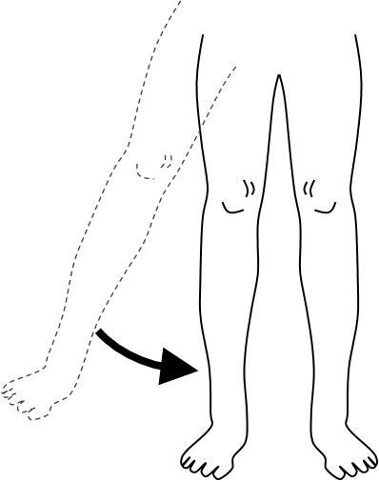
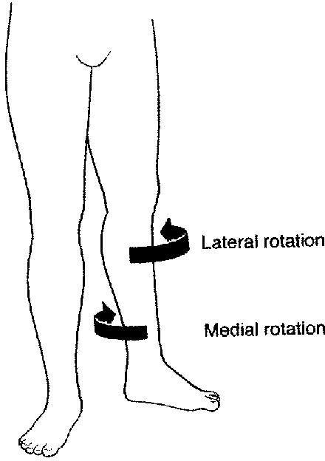
Hip joint
Movements
Flexion | Extension | Abduction | Adduction | Medial Rotation | Lateral Rotation
1-Iliopsoas (main flexor) | 1-Hamstrings (main extensor) | 1-Gluteus medius | 1-Adductors | 1-Gluteus medius | 1-Gluteus maximus
2-Sartorius | 2-Gluteus maximus (powerful extensor) | 2-Gluteus minimus | 2-Gracilis | 2-Gluteus minimus | 2-Quadratus femoris
3-Pectineus | ----------- | 3-Sartorius | ----------- | ----------- | 3-Piriformis
4-Rectus femoris | ----------- | ----------- | ----------- | ----------- | 4,5-Obturator externus & internus

Slide 7
Hip joint
Blood Supply
The main arterial supply is from branches of the circumflex femoral arteries especially the medial).
The blood passes to the joint through :
(1) Retinacular fibers of the neck.
(2) Ligament of the head of the femur.
Damage of the retinacular fibers as in fracture neck of the femur can results in Avascular necrosis of the head of the femur.
Fracture neck of the femur is common after age of (60) years especially in women because of Osteoporosis.
Only on the girls’ slides

Slide 8
Hip joint
Stability
The hip joint is one of the most stable joints of the body because of :
(1) The Head of the femur fits very accurately in the acetabulum due to
The acetabulum is very deep and its depth is increased by the labrum acetabulare.
The labrum acetabulare forms a firm grip on the head of the femur.
The atmospheric pressure resists separation between the head of the femur and the acetabulum.
The three strong Extrinsic ligaments.
(3) The Surrounding strong muscles.
Only on the girls’ slides

Slide 9
Hip joint
Disloctaion
CONGENITAL
More common in girls and associated
with inability to adduct the thigh. (so the lower limb is abducted)
The upper lip of the acetabulum fails to develop adequately.
The head of the femur rides up out of the acetabulum onto the gluteal surface of the ileum.
TRAUMATIC
It is common in motor vehicle accidents when the thigh is flexed and adducted.
The dislocated head is displaced posteriorly to lie on the posterior surface of the ileum.
In posterior dislocation the sciatic nerve is liable to be injured.
Only on the girls’ slides

Slide 10
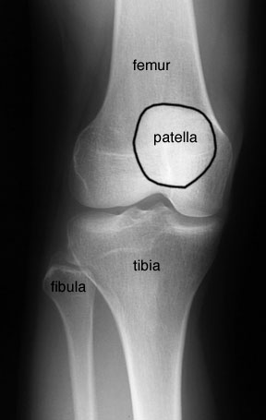
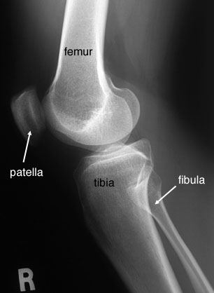
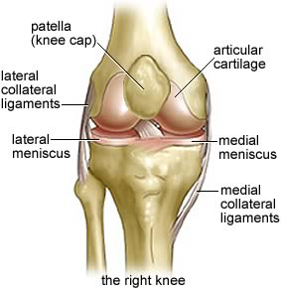
Knee joint
Three bones:
-Femur
-Tibia
-Patella
Three articulations:
-(2)Femro-tibial articulation:
between the 2 femoral condyles & upper surfaces of the 2 tibial condyles .
Type: synovial, modified hinge
-Femoro-Patellar articulation:
between posterior surface of patella & patellar surface of femur. Type: synovial, plane
FUNCTIONS:
1. Weight bearing.
2. Essential for daily activities: standing walking & climbing stairs.
3. The main joint responsible for sports: running, jumping , kicking etc.

Slide 11
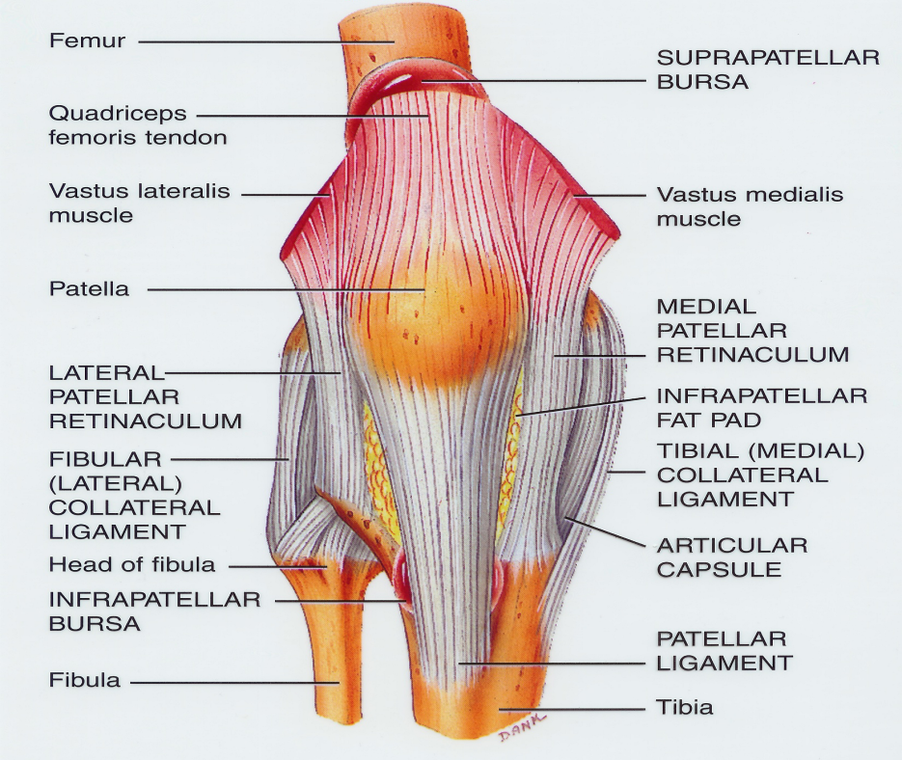
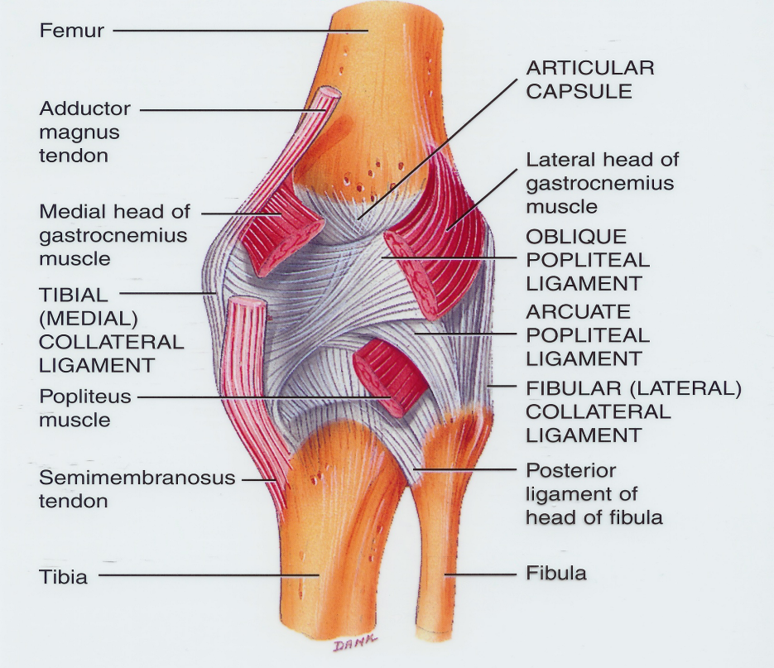
Knee joint
Capsule
The capsule is deficient anteriorly and replaced by:
-Quadriceps femoris tendon.
-Patella.
-Ligamentum patellae .
Possesses 2 openings:
for popliteus tendon.
for communication with suprapatellar bursa .

Slide 12
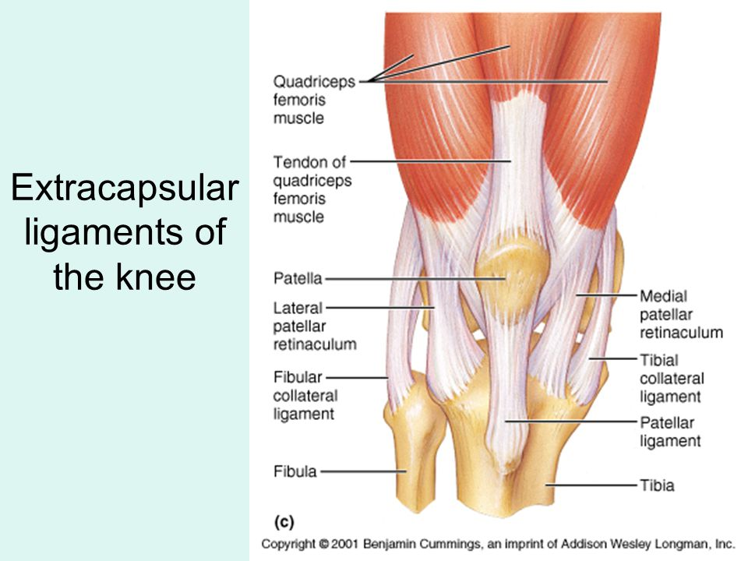
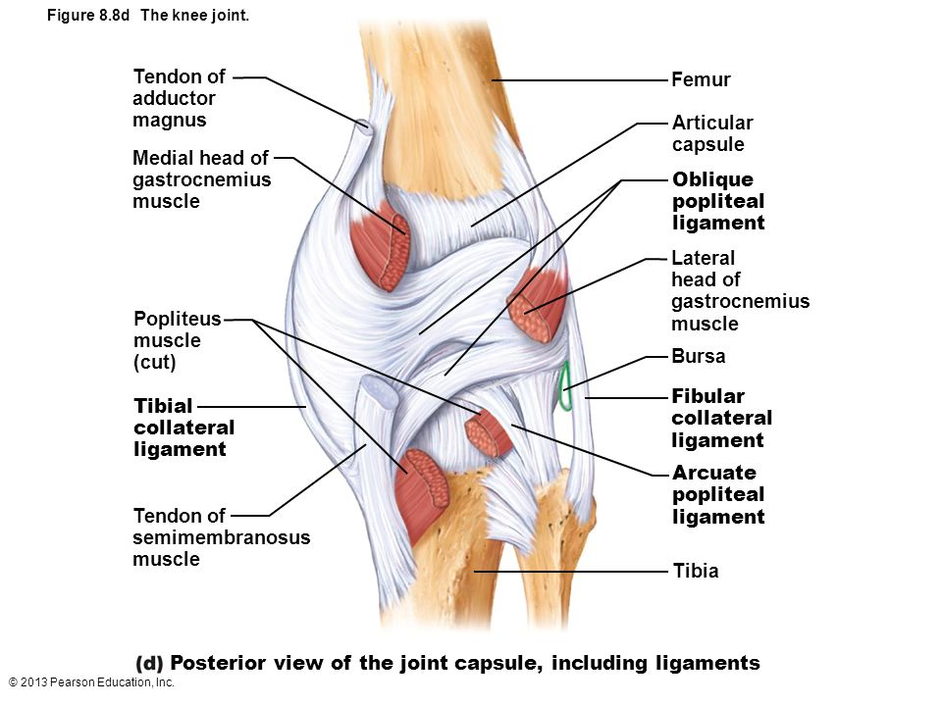
Knee joint
Ligaments
Extracapsular ligaments (4)
Ligamentum patellae (patellar ligament):
from patella to tibial tuberosity.
Medial (tibial) collateral ligament:
from medial epicondyle of femur to upper part of
medial surface of tibia (firmly attached to
medial meniscus).
Tibia is located medially, so it goes with the medial epicondyle of femur
Lateral (fibular) collateral ligament:
From lateral epicondyle of femur to head of fibula
(separated from lateral meniscus by popliteus tendon).
fibula is located laterally, so it goes with the lateral epicondyle of femur
Oblique popliteal ligament:
extension of semimembranosus tendon

Slide 13
Knee joint
Ligaments
Intra-capsular Ligaments
MENISCI
They are 2 C-shaped plates of fibro-cartilage.
The medial meniscus is large & oval.
The lateral meniscus is small & circular
ATTACHMENTS:
Each meniscus is attached by anterior & posterior horns into upper/articular surface of tibia.
The outer surface of medial meniscus is also attached to capsule & medial collateral ligament: medial meniscus is less mobile & more liable to be injured.
FUNCTIONS
They deepen articular surfaces of tibial condyles.
They serve as cushions between tibia & femur.

Slide 14
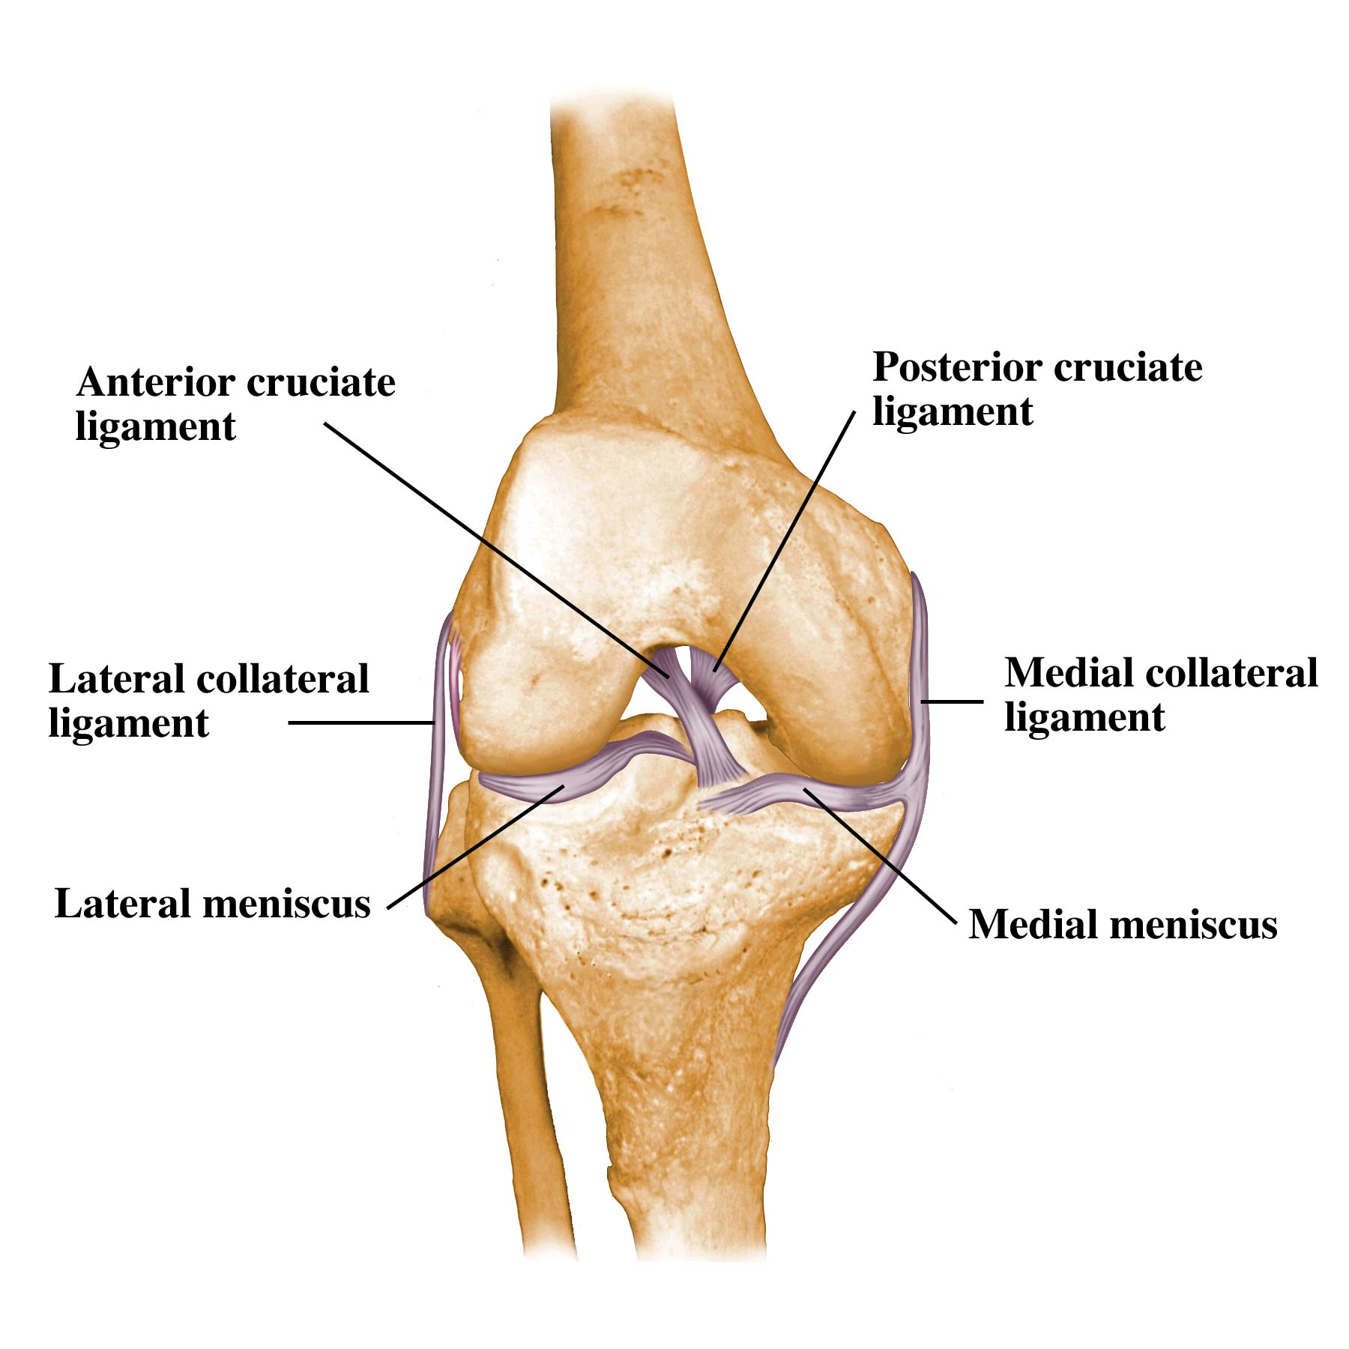
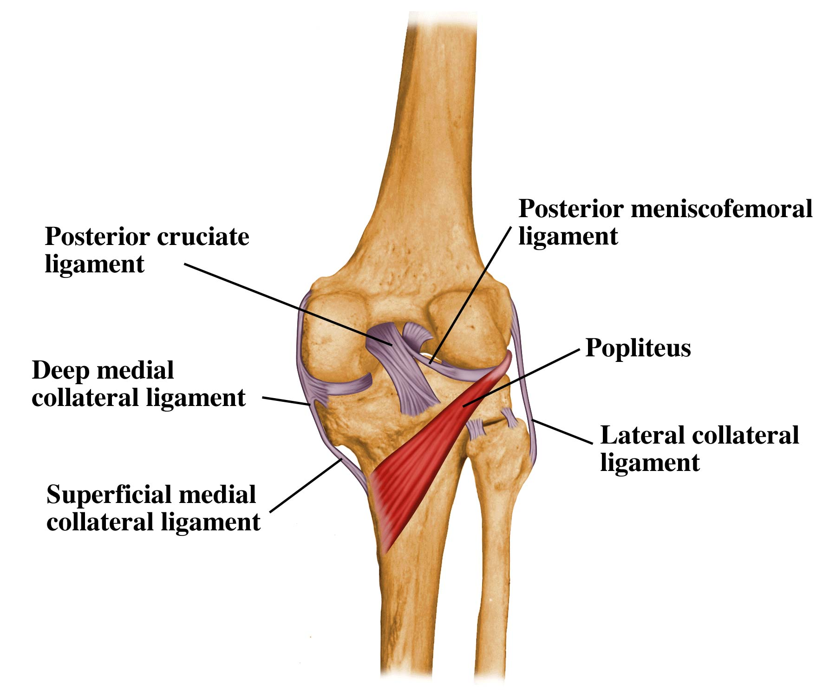
Knee joint
Ligaments
Intra-capsular Ligaments
ANTERIOR & POSTERIOR CRUCIATE LIGAMENTS
Two in number, situated in the middle of the joint.
They are called Cruciate because they cross each other
Have received the names Anterior and Posterior, from the position of their attachments to the tibia.
ATTACHMENTS:
Anterior cruciate: from anterior part of intercondylar area of tibia to posterior part of lateral condyle of femur.
Posterior cruciate: from posterior part of intercondylar area of tibia to anterior part of medial condyle of femur.
FUNCTIONS:
Anterior cruciate: prevents posterior displacement of the femur on the tibia and the tibia from being pulled anteriorly when the knee joint is extended.
It is taught in Hyper extension.
Posterior cruciate: prevents anterior displacement of the femur on the tibia and the tibia from being pulled posteriorly when the knee joint is flexed. It is taught in Hyper flexion

Slide 15
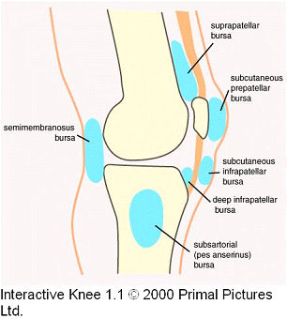
Knee joint
Bursae
Suprapatellar bursa | Deep infrapatellar bursa | Popliteal bursa | Prepatellar bursa | Subcutaneous infrapatellar bursa
-between femur & quadriceps tendon. communicates with synovial membrane of knee joint. Clinical importance? | -between tibia & ligamentum patella. | -between popliteus tendon & capsule. communicates with synovial membrane of knee joint. | -between patella & skin. | -between tibial tuberosity & skin.

Slide 16
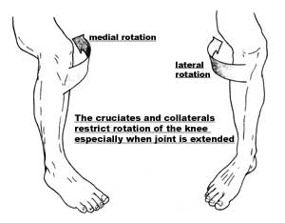
Knee joint
Movements
*A normal hinge joint can only do flexion and extension but since the knee joint can also do some degree of rotation it is considered as a modified hinge joint
Flexion | Extension | Active rotation (performed when knee is flexed)*
 |  | A) Medial rotation: | B) Lateral rotation:
1. Mainly by hamstring muscles: biceps femoris , semitendinosus & semimembranosus. 2. Assisted by Sartorius , gracilis & popliteus. | Quadriceps femoris. | 1. Mainly by semitendinosus & semimembranosus. 2. Assisted by Sartorius & gracilis. | Biceps femoris

Slide 17
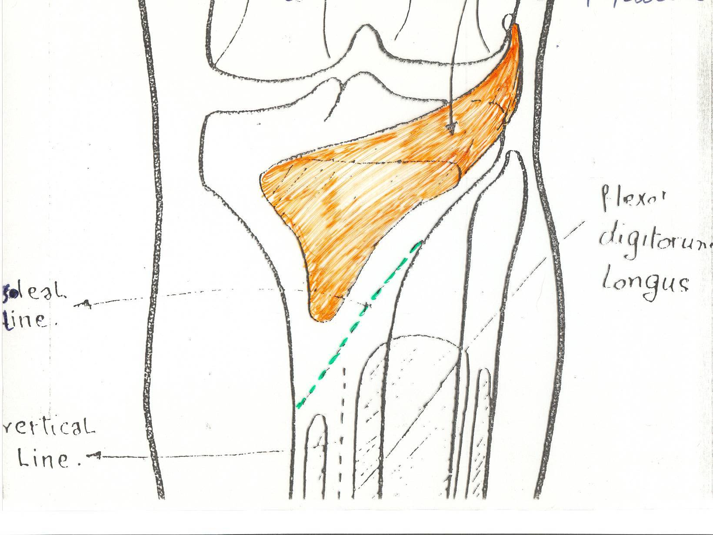
Knee joint
Movements
Inactive (Dependent) Rotation
Locking Of Knee
Unlocking Of Knee
The joint assumes the position of full extension.
It becomes a rigid structure.
The menisci are compressed between the tibial and femoral condyles.
Results mainly by tension of anterior cruciate ligament.
Tightening of all the major ligaments.
The femur is medially rotated on the tibia (Lateral rotation of tibia).
Medial rotation of tibia (lateral rotation of femur) , at the beginning of flexion.
Performed by popliteus to relax ligaments & allow easy flexion.
popliteus

Slide 18
Knee joint
Stability
1. Muscles:
2. Ligaments:
• Quadriceps particularly the inferior fibers of the Vasut lateralis and medialis.
• Many sport injuries can be preventable through appropriate training and conditioning of the muscle.
The knee joint can function well following a ligamentous strain if the quadriceps is intact.
Only on the girls’ slides

Slide 19
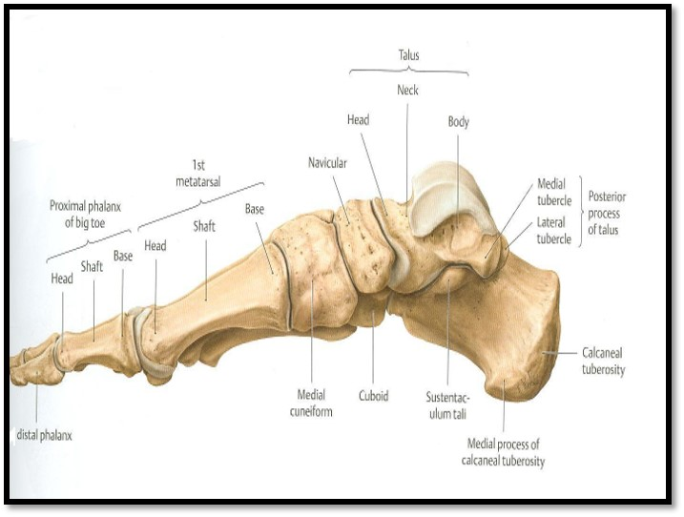
Skeleton of foot
Tarsals: Calcaneus-talus-navicular-cuboid-three cuneiform bones
Metatarsals:1st to 5th medial to lateral metatarsal
Phalanges: each toe has 3 phalanges except big toe has 2

Slide 20
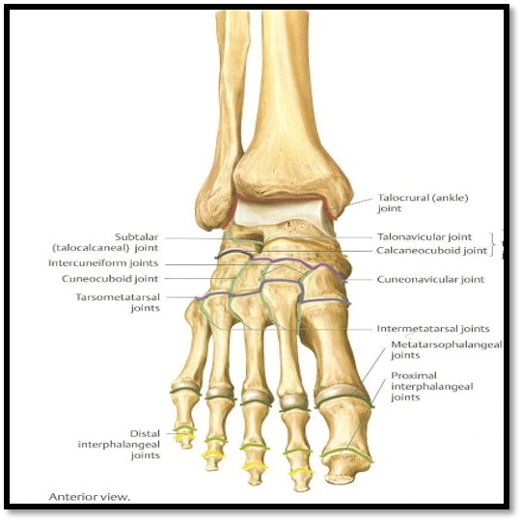
Ankle joint
TYPE:
It is a synovial, hinge joint.
ARTICULAR SURFACES:
UPPER:
A socket formed by: the lower end of tibia, medial malleolus & lateral malleolus.
2. LOWER:
Body of talus.
Hinge joint :
A hinge joint is a bone joint in which the articular surfaces are molded to each other in such a manner as to permit motion only in one plane.
So the movement will only be flexion + extension

Slide 21
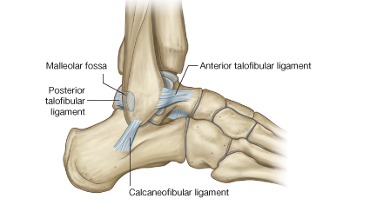
* As a hinge joint, medial and lateral ligaments are important ( for flexion and extension )
Ankle joint
Ligaments
MEDIAL (DELTOID) LIGAMENT:
A strong triangular ligament.
Apex: attached to medial malleolus.
Base: subdivided into 4 parts:
Anterior tibiotalar part.
Tibionavicular part.
Tibiocalcaneal part.
Posterior tibiotalar part.
LATERAL LIGAMENT:
Composed of 3 separate ligaments (WHY?).
Anterior talofibular ligament.
Calcaneofibular ligament.
Posterior talofibular ligament.

Slide 22
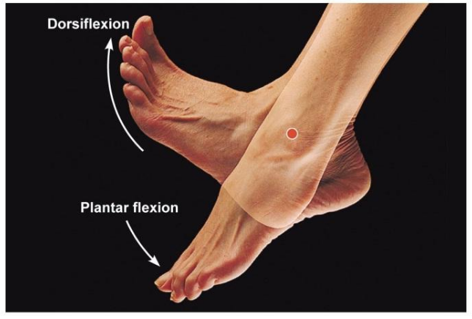
Ankle joint
Movements
DORSIFLEXION:
Performed by muscles of anterior compartment of leg:
1-tibialis anterior.
2-extensor hallucis longus.
3-extensor digitorum longus
4-peroneus tertius .
PLANTERFLEXION:
Initiated by soleus
Maintained by gastrocnemius,
Assisted by other muscles in posterior compartment of leg:
1- tibialis posterior.
2-flexor digitorum longus .
3- flexor hallucis longus .
+ muscles of lateral compartment of leg :
1-peroneus Longus .
2-peroneus brevis .
N.B.
INVERSION & EVERSION MOVEMENTS occur
at the talo-calcaneo-navicular joint. Or simply subtalar joint
NOT ON ANKLE

Slide 23
Nerve supply of all JOINTS
HILTON’S LAW:
“The joint is supplied by branches from nerves supplying muscles acting on it”.

Slide 24
Leaders:
Nawaf AlKhudairy
Jawaher Abanumy
Ghada Almazrou
Abdullah Almana (Biochemistry)
Members:
Yazeed Almotairi
Mohammed Alaseri
Fahad Alotaibi
Talal Altukhaim
Mohammed Habeeb
Fahad Alzahrani
Hamad Alhasoon
Saleh Altuwaijri
Mohammed Hakami
Abdulaziz Alsumali
Mohammed Almuhawas
Khalid Alqahtani
anatomyteam436@gmail.com
@anatomy436

