Slide 1
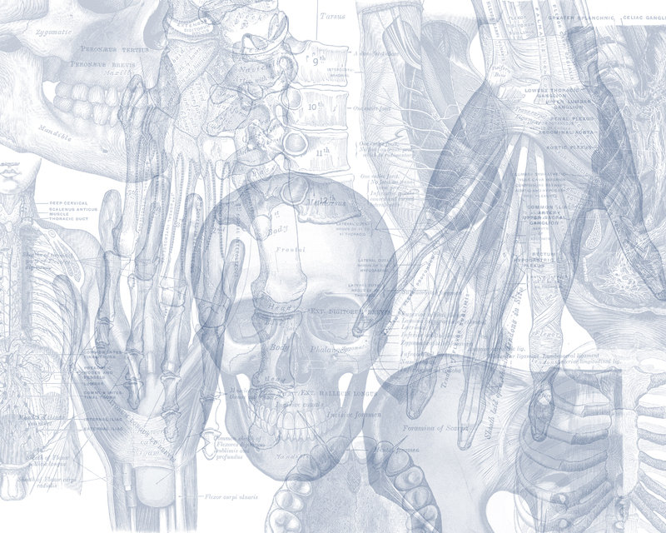
Thoracolumbar Spine
Color Code
Important
Doctors Notes
Notes/Extra explanation
By Biochemistry team
Editing File

Slide 2
Objectives
At the end of the lecture, students should be able to:
Distinguish the thoracic and lumbar vertebrae from each other and from vertebrae of the cervical region
Describe the characteristic features of a thoracic and a lumbar vertebra.
Compare the movements occurring in thoracic and lumbar regions.
Describe the joints between the vertebral bodies and the vertebral arches.
List and identify the ligaments of the intervertebral joints.

Slide 3
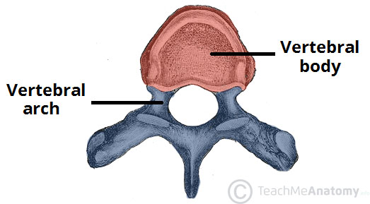
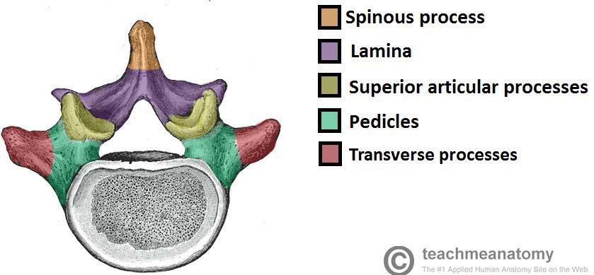
Introduction to Vertebrae
There are approximately 33 vertebrae which are subdivided into 5 groups based on morphology and location: cervical, thoracic, lumbar, sacral, and coccygeal.
Typical Vertebra
All typical vertebrae consist of a vertebral body and a posterior vertebral arch.
Vertebral body:
weight-bearing part. The size increases inferiorly as the amount of weight supported increases.
Vertebral arch:
Extending from the arch are a number of processes for muscle attachment and articulation with adjacent bones.
It consists of:
Two pedicles (towards the body)
Two lamina (towards the spine)
Spinous process
Transverse process
Superior and inferior articular processes. (for articulation with adjacent vertebra)
The vertebral foramen is the hole in the middle of the vertebra. Collectively they form the vertebral canal through which the spinal cord passes.
Vertebral foramen

Slide 4
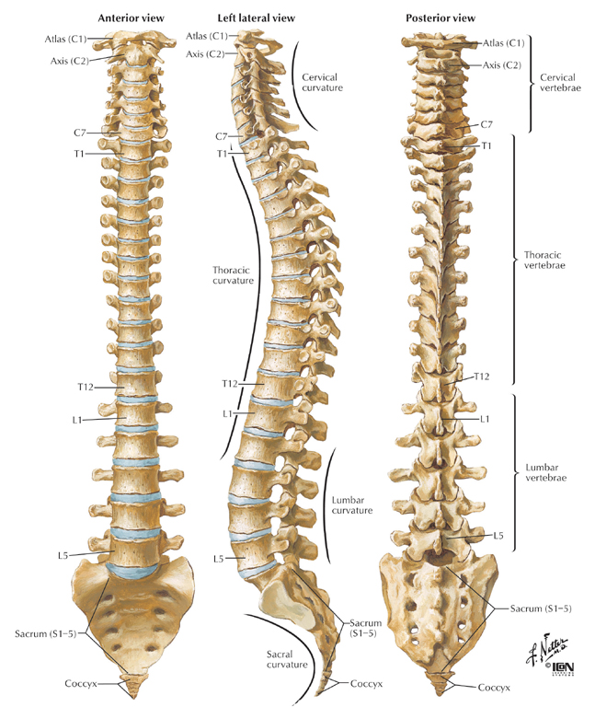
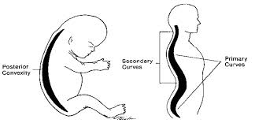
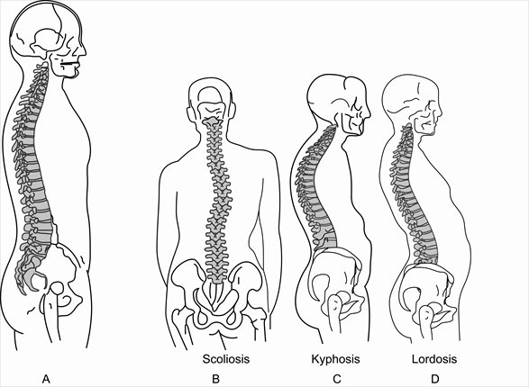
Normal Curvature Of The Human’s Vertebral Column
The vertebral column is not straight, it only looks straight from the posterior and anterior view.
It is curved as seen from the lateral views.
Curves of vertebral column can be divided into:
Primary curves: Thoracic & sacral.
Secondary curves: Cervical & lumbar.
The primary spine is present during embryo life, then after the baby is born and starts moving his head and walking the secondary curves develop.
Embryonic C-shaped vertebral column.
Neonatal & infant starting development 2nd curvature.
Abnormal curvatures of spine:
Exaggerated Thoracic curvature: Kyphosis
Exaggerated Lumbar curvature: Lordosis
Lateral curvature of spine: Scoliosis
Kypho means hunchback (the person has a hump on his back and his height is reduced)
Lordo means curve/swayback (it is derived from Greek describing a person leaning back in a lordly fashion)

Slide 5
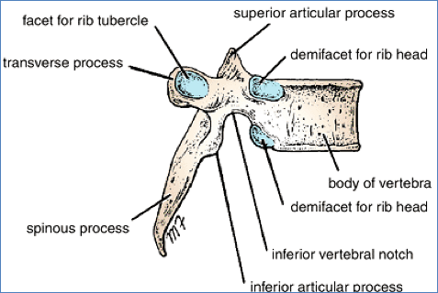
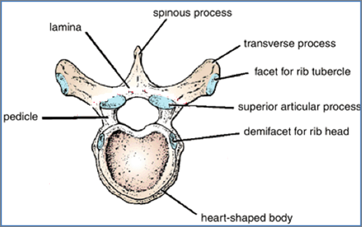
Thoracic Vertebrae
2 Transverse process
2 Superior articular process
2 inferior articular process
1 Spinous process
Most thoracic vertebrae are typical, have bodies, vertebral arches
and seven processes for muscular and articular connections.
Lateral view
Anterior view
The only vertebrae that have special names are C1 “Atlas” , C2 “Axis” and C7 “Prominens”,
while the rest of the vertebrae are named as “First letter of the region + the number of vertebrae”
e.g. Thoracic + number 1 = T1

Slide 6
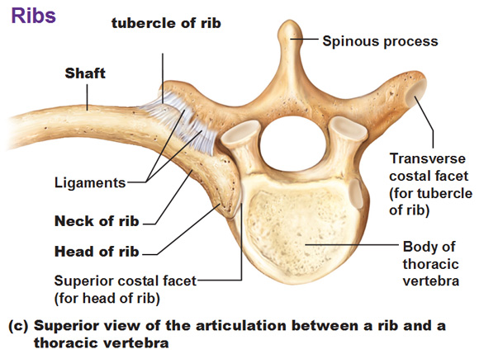
Characteristics Of Typical Thoracic Vertebra
The vertebral foramen is small and circular ”الفتحة الي في النص ”
The body is medium size and heart shaped.
The spines are long and inclined downward.
Costal facets are present on the sides of the bodies for articulation with the heads of the ribs.
Costal facets are present on the transverse processes for articulation with the tubercles of the ribs (T11 and 12 have no facets on the transverse processes).
The superior articular processes bear facets that face backward and laterally, whereas the facets on the inferior articular processes face forward and medially.
The inferior articular processes of the 12th vertebra face laterally, as do those of the lumbar vertebrae.
In THORACIC VERTEBRA from 1-10 the articulation of head of the rib called demicostal facet . Because the head of the rib articulates with 2 VERTEBRA
للربط:
1) Tubercle with Transverse
2) Humans have a head and a body
Extra picture to understand rib articulation

Slide 7
Characteristics Of Typical Lumbar Vertebra
The spinous processes are short, flat, & quadrangular and project backward.
The laminae are thick.
The transverse processes are long and slender.
The pedicles are strong and directed backward.
The vertebral foramina are triangular.
The body is large and kidney shaped.
The articular surfaces of the superior articular processes face medially, and those of the inferior articular processes face laterally.

Slide 8
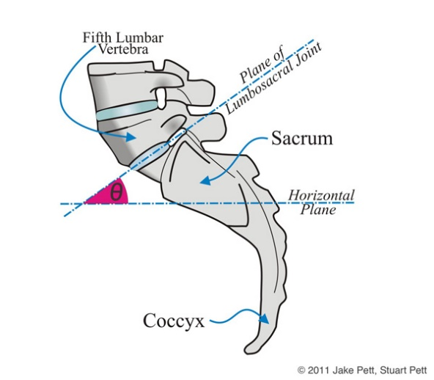
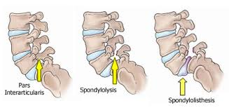
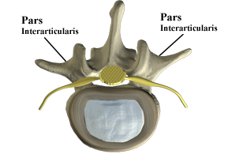
Vertebrae L5
The largest Vertebra.
Distinguished by its massive body and thick transverse processes.
Carries the weight of whole upper body.
L5 body is responsible for the lumbosacral angle between the long axis of the lumbar region of the vertebrl column and that of the sacrum.
Body weight is transmitted from L5 to the base of the sacrum formed by the superior surface of S1 vertebra.
The most common site of:
Spondylolysis which is a defect in the pars interarticularis of the vertebral arch.
Spondylolisthesis which is the forward displacement of a vertebra (over a lower vertebra).
Extra picture for understanding
Pars interarticularis is the space between the 2 articular processes/facets
Extra picture for understandong

Slide 9
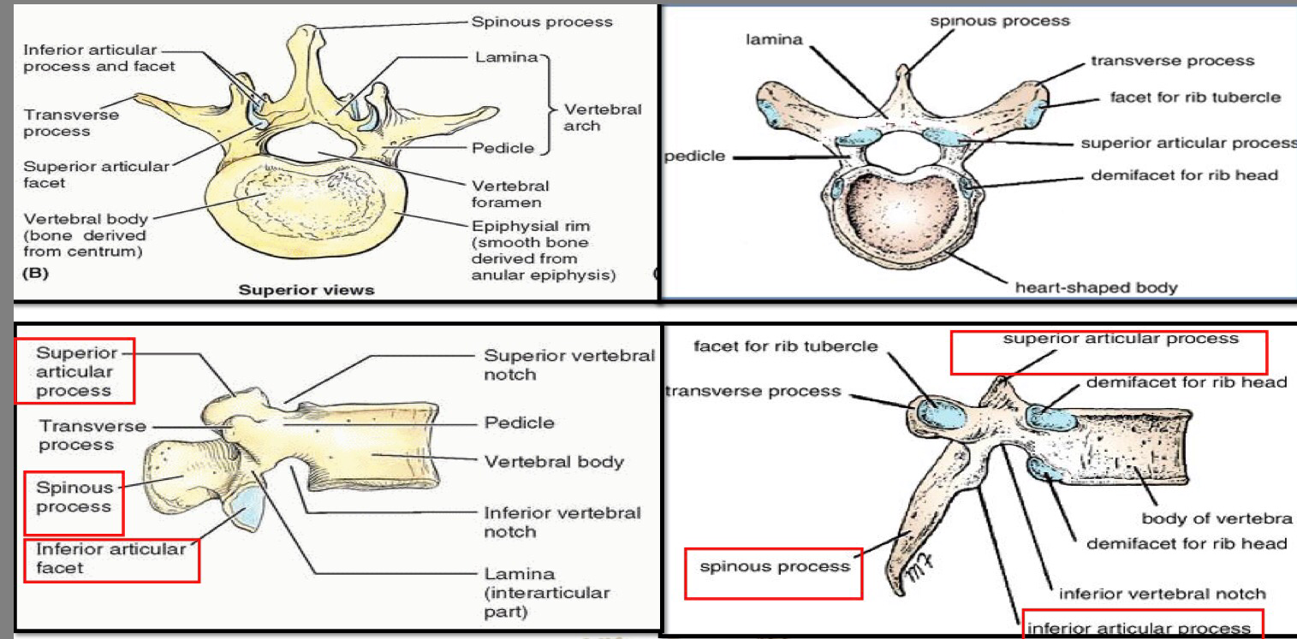
Differentiation between thoracic and lumber vertebrae
Lumbar
Thoracic
Characteristics | Thoracic | Lumbar
Body | Medium sized and heart shaped | Massive size and Kidney shaped
Vertebral foramen | Circular | Triangular
Spinous Process | Long, sharp and projects inferiorly | Short, blunt And projects posteriorly
Transverse Process | Bear facets for ribs (except T11-T12) | Long and slender

Slide 10
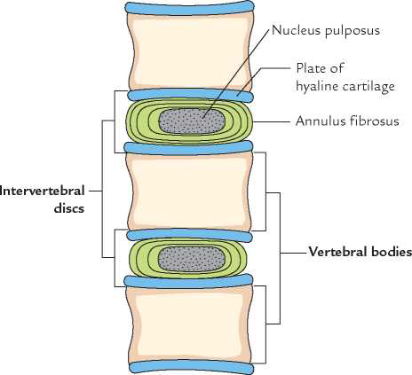
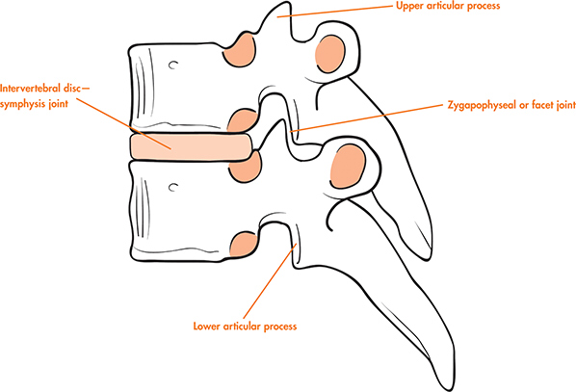
Joints Between Vertebrae :
Joints between two vertebral bodies :
Joints between two vertebral arches:
Superior and inferior articular process are joined by a synovial joint.
It is a cartilaginous joint. (غضروفي )
The upper and lower surfaces of the bodies of adjacent vertebrae are covered by thin plates hyaline cartilage.
Sandwiched between the plates of hyaline cartilage is an intervertebral disc of fibrocartilage .
Collagen fibers of the disc strongly unite the bodies of the two vertebrae.

Slide 11
Intervertebral Discs:
The intervertebral discs are responsible for (1/4) of vertebral column length .
They are thickest in the cervical and lumbar regions, where the movements of the vertebral column are greatest. unlike the thoracic region which is LESS THICK and has less movement .
There are No discs between the : first & the second cervical vertebrae nor the sacrum &coccyx.
Each disc consist of :
Peripheral part: the annulus fibrosus, composed of fibrocartilage .
(annulus= a: no or out, nulus: like nucleus so its not the nucleus or outside it ☺)
(fibrosus= because it’s composed of fibrocartilage)
Central part : the nucleus pulposus, a gelatinous material, a lot of water, few collagen fibers & cartilage cells.
(nucleus= نواة بما انها في المنتصف)
(pulposus= زي البؤبؤ في وسط العين)
Vertebral body
Intervertebral disc
Vertebral body

Slide 12
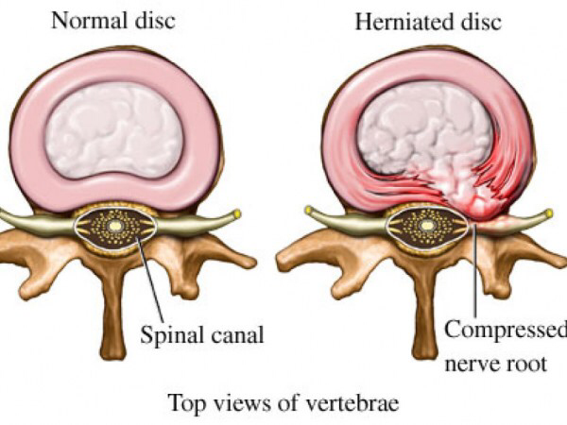
Function of the Intervertebral Discs:
Allow vertebra to rock forward or backward on another like flexion and extension of vertebral column.
Serve as shock absorbers when the load on the vertebral column increased, as when one is jumping from a height.
Sometimes, the annulus fibrosus ruptures, allowing the nucleus pulposus to herniate and protrude into the vertebral canal, where it may press on spinal nerve roots, spinal nerve, or even spinal cord.

Slide 13
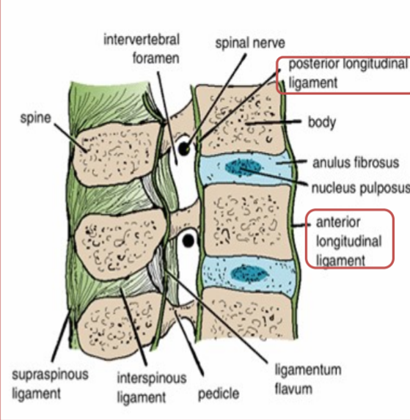
Ligaments
The anterior and posterior longitudinal ligaments run as continuous bands down the anterior and posterior surfaces of the vertebral column from the skull to the sacrum
ـــــــــــــــــــــــــــــــــــــــــــــــــــــــــــــــــــــــــــــــ
The anterior longitudinal ligament is wide and is strongly attached to the front and sides of the vertebral bodies and to the intervertebral discs.
ـــــــــــــــــــــــــــــــــــــــــــــــــــــــــــــــــــــــــــــــ
The posterior longitudinal ligament is weak and narrow and is attached to the posterior borders of the discs.
These ligaments hold the vertebrae firmly together hold the vertebrae firmly together but at the same time permit a small amount of movement to take place between them.

Slide 14
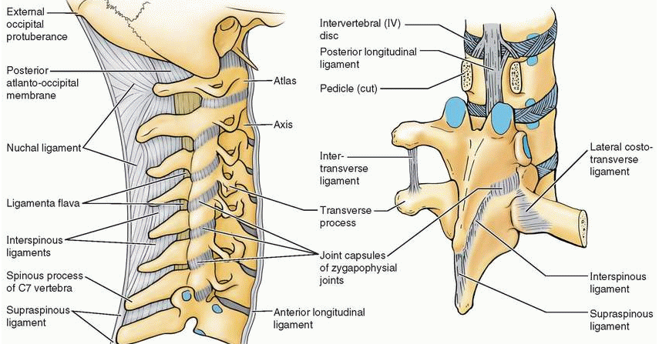
Ligaments
Ligamentum flavum: connects the laminae of adjacent vertebrae.
Interspinous ligament: connects adjacent spines.
Supraspinous ligament: runs between the tips of adjacent spines.
Intertransverse ligaments: run between adjacent transverse processes

Slide 15
Movements Of The Thoracolumbar Spine
The following movements are possible on the spine:
flexion
extension
lateral flexion
Rotation
Circumduction = circular movement
The type and range of movements depend on:
Thickness of the intervertebral discs
Shape and direction of the articular processes.
In the thoracic region, the ribs, the costal cartilages, and the sternum severely restrict the range of movement.
Flexion & Extension Lateral flexion
Extensive in the lumbar regions
Restricted in the thoracic regions
Rotation
Extensive in the thoracic regions
Less extensive in the lumbar regions

Slide 16
Muscles Producing Movements
Thoracic Region :
Rotation produced by semispinalis and rotator muscles, assisted by the oblique muscles of the anterolateral abdominal wall.
Lumbar region :
Flexion | produced by the (1) rectus abdominis and the (2) psoas muscles.
Extension | produced by (1) the postvertebral muscles.
Lateral Flexion | produced by (1) the postvertebral muscles, the (2) quadratus lumborum, and the (3) oblique muscles of the anterolateral abdominal wall. The (4) psoas may also play a part in this movement.
Rotation | produced by the (1) rotator muscles and the (2) oblique muscles of the anterolateral abdominal wall.

Slide 17
MCQs
Q1: Which of the following is a distinctive mark for T11 and T12.
A- Presence of facets on transverse process.
B- Absence of facets on transverse process.
C- Presence of costal facets on body.
D- Absence of costal facets on body.
Q2: The type of cartilage which is present on the surface of the vertebrae bodies is.
A- hyaline cartilage.
B- Elastic cartilage.
C- Fibrocartilage.
D- Regular cartilage.
Q3: anterior longitudinal ligament is.
A- wide and strongly attached.
B- narrow and strongly attached.
C- wide and weakly attached.
D- Narrow and weakly attached.
Q4: Which region of the thoracolumbar spine is most movable.
A- thoracic.
B- lumber.
C- a,b
D- none of the above.
Q5: which one of these movements will be most weakened if the motor neuron supplying psoas muscle is damaged.
A- Flexion.
B- Lateral Flexion.
C- Circumduction.
D- Extension.
Q6: Psoas muscle is a major muscle in the flexion of lumber region.
A- True.
B- False.
Q7: Which one of the following contributes in lordosis of the spine?
A- Exaggerated cervical curvature.
B- Exaggerated thoracic curvature.
C- Exaggerated lumbar curvature.
D- Lateral curvature.
Q8: Which one of the following muscles specifically contributes in lateral flexion of lumbar spine?
A- Semispinalis
B- Quadratus lumborum
C- Psoas major
D- Rectus abdominis
Answers
1. B, 2. A, 3. A, 4. B, 5. A, 6. A, 7. C 8. B

Slide 18
 | Cervical | Thoracic | Lumbar
Number | 7 | 12 | 5
Body | Small, Longer horizontally | Medium, heart shaped | Large, kidney shaped
Vertebral foramen | Triangular | Circular | Triangular
Spinous process | Short, bifid | Long, inclined downward | Short, flat, quadrangular, projects backward
Transverse process | Has transverse foramen |  | Long and slender
Superior articular process | Upward & backward | Backward & laterally | Medially
Inferior articular process | Downward & forward | Forward & medially | Laterally

Slide 19
Leaders:
Nawaf AlKhudairy
Jawaher Abanumy
Ghada Almazrou
Abdullah Almana (Biochemistry)
Members:
Yazeed Almotairi
Mohammed Alaseri
Fahad Alotaibi
Talal Altoukhaim
Mohsmmed Habeeb
Fahad Alzahrani
Hamad Alhasoon
Mohammed Almutlaq
Mohammed Hakami
anatomyteam436@gmail.com
@anatomy436

