Slide 1
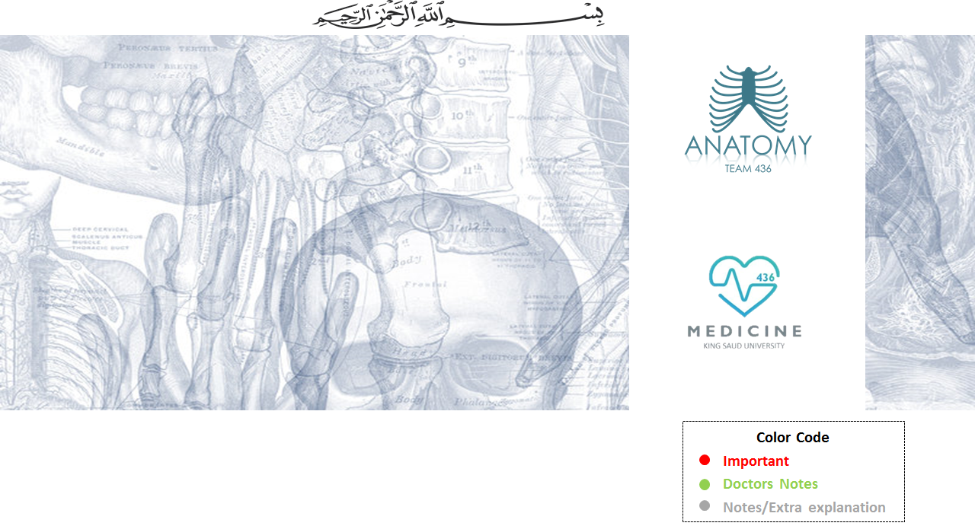
Muscles Of The Back
Editing File

Slide 2
Objectives :
At the end of the lecture, students should be able to:
Distinguish between the different groups of back muscles.
Compare between groups of back muscles as regard their nerve supply and action.
List the back muscles of each group.
Describe the attachments of each muscle of the superficial group, as well as, its nerve supply and action.
Describe the triangles of back and their clinical significance.

Slide 3
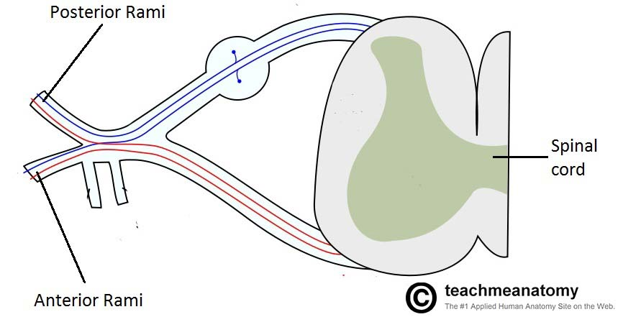
Back Muscles:
They are organized into 3 groups:
1- Deep group
Attached to & involved in the movement of Vertebral column &Head.
2- Intermediate group
Attached to Ribs & serve Respiratory Functions.
3- Superficial group
Attached to & involved in the movement of Upper limbs.
Intrinsic muscles:
*Develop in the Back
*Supplied by Posterior Rami of spinal nerves
Extrinsic muscles:
*Not Developed in the Back
*Supplied by Anterior Rami of spinal nerves
*Exception within the slides…
للتوضيح فقط

Slide 4
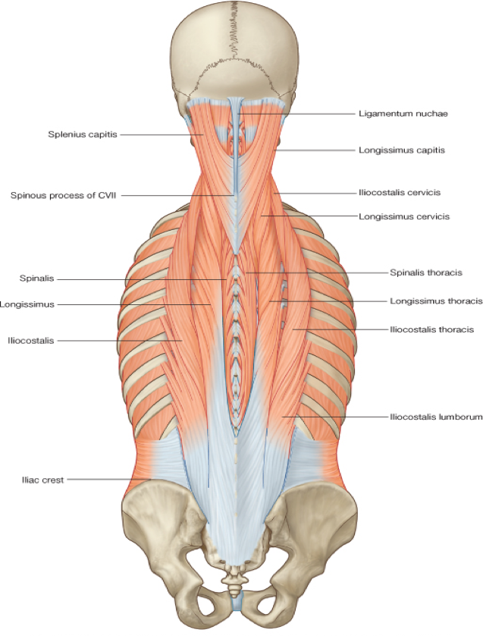
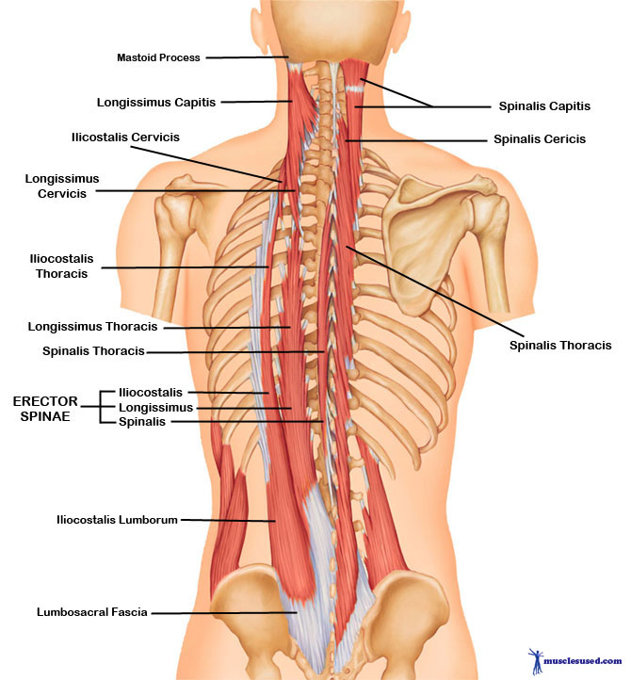
1- Deep Group Of Back Muscles:
They extend from sacrum to the base of the skull.
They include extensors* and rotators* of head & vertebral column. So, It is a set of muscles that straighten and rotate the back.
Their tone is responsible for maintenance of normal curvature of vertebral column.
The largest muscle of this group is “erector spinae” which is formed of 3 vertical columns (from lateral to medial):
iliocostalis,
Longissimus
spinalis.
Ilio=ilium , costa= from rib
لتسهيل الحفظ : اسمك طويل = لونق اسمس ☺
(Note the length and attachment of the muscle fibers)
Extensor: a muscle whose contraction extends or straightens a limb or other part of the body.
Rotator: a muscle whose contraction causes or assists in the rotation of a part of the body.
Erector: a muscle that maintains an erect state of a part of the body or an erect posture of the body.

Slide 5
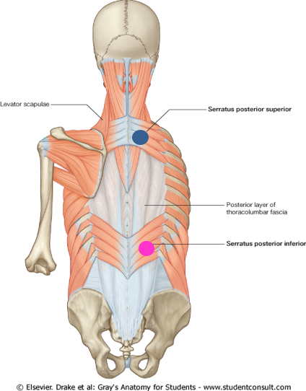
2- Intermediate Group Of Back Muscles:
Intermediate group is separated from the deep group by (thoracolumbar fascia)*
Intermediate group includes 2 muscles:
•Serratus posterior superior (rib elevator).
•Serratus posterior inferior (rib depressor).
Function of:
Serratus posterior superior deep inspiration.
Serratus posterior inferior forced expiration.^
Nerve supply (innervation):
anterior rami of thoracic spinal nerves.
contributes in
contributes in
*غشاء يكون بعد طبقات الجلد (a sheet of connective tissue covering or binding together body structures).
^ in case of asthma or excessive exercise.
#depressor = ينزل لتحت . #elevator = يرفع لفوق. #Serratus = شكل منشاري.

Slide 6
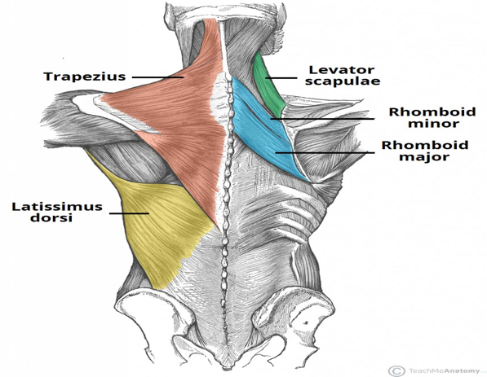
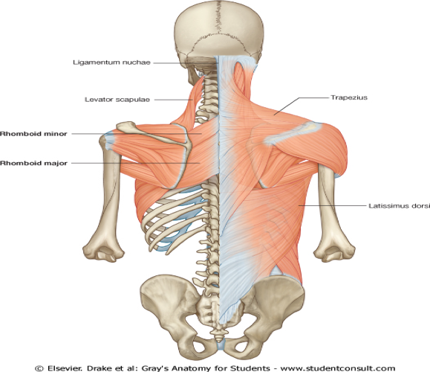
3- Superficial Group Of Back Muscles:
السلايد مهم جدًا !
A- Muscles connecting vertebral column to scapula (move scapula through shoulder girdle joints):
Trapezius.
Levator scapulae.
Rhomboid minor.
Rhomboid major. (Scapula)كلهم ماسكين بال
B- Muscle connecting vertebral column to humerus (move humerus through shoulder joint) :
Latissimus dorsi.
#Levator = رافعة. #Rhomboid = معيّني الشكل .

Slide 7
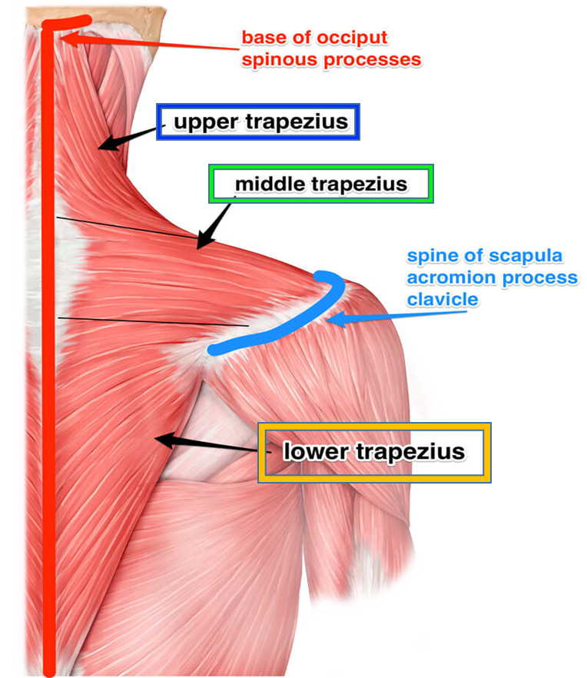
3- Superficial Group Of Back Muscles:
A- Muscles connecting vertebral column to scapula
l- TRAPEZIUS
Origin:
Spines of cervical & thoracic vertebrae
Insertion:
lateral 1/3 of clavicle + acromion & spine of scapula.
Action:
rotation of scapula during abduction of humerus above horizontal. >90 (remember it as if you fell in a TRAP you would raise your arms above your head to try to climb out)
oUpper fibers: elevate (ترفع) scapula.
oMiddle fibers: retract (تعيدها لوضها الطبيعي)scapula
oLower fibers: depress (تخفض او تنزل)scapula.
Nerve supply:
Spinal part of accessory (11th cranial) nerve.

Slide 8
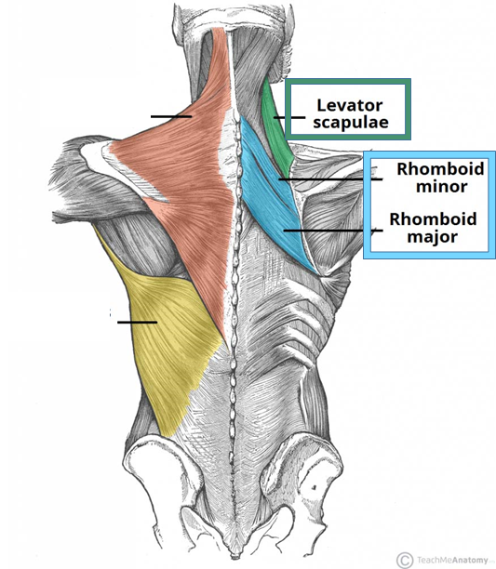
3- Superficial Group Of Back Muscles:
A- Muscles connecting vertebral column to scapula
ll- LEVATOR SCAPULAE
lll- RHOMBOID MINOR & MAJOR
Origin:
Levator scapulae: cervical transverse processes
Rhomboid minor & major: thoracic spines
Insertion:
medial border of scapula.
Nerve supply:
dorsal scapular nerve. From root of brachial plexus (C5)
Actions:
Levator scapulae: elevates scapula.
Rhomboid minor & major: retract scapula.
Note: the muscles involved in retracting the scalpula:
Rhomboid major, rhomboid minor, and middle fibers of trapezium

Slide 9
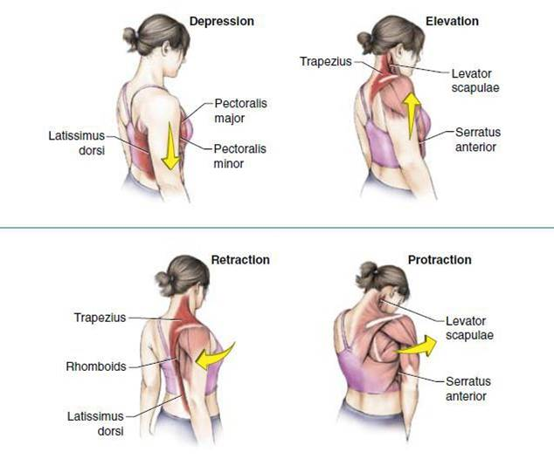
Remember:
للتوضيح فقط

Slide 10
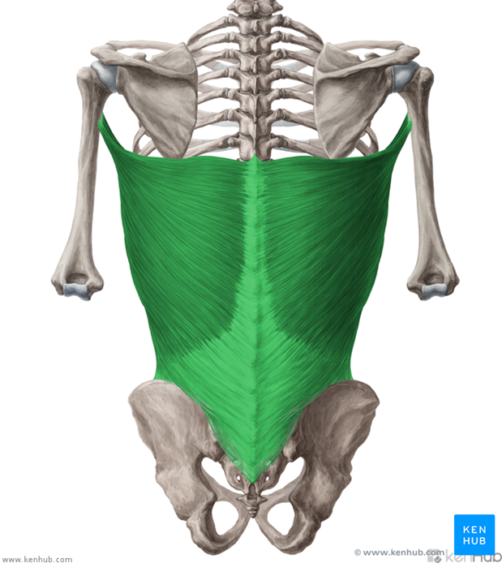
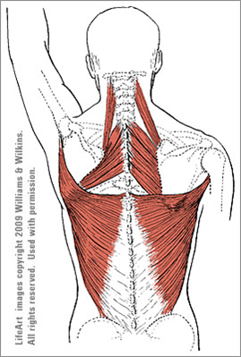
Latissimus Dorsi
3- Superficial Group Of Back Muscles:
B- Muscle connecting vertebral column to humerus
Origin:
spines of thoracic &lumbar vertebrae.
Insertion:
bicipital groove of humerus.
Nerve supply:
thoracodorsal nerve. (C6,7,8) From posterior cord of brachial plexus
(Also called nerve to latissimus dorsi)
Actions:
extension, adduction & medial rotation of humerus (arm, shoulder joint).
It is called the climbing muscle.

Slide 11
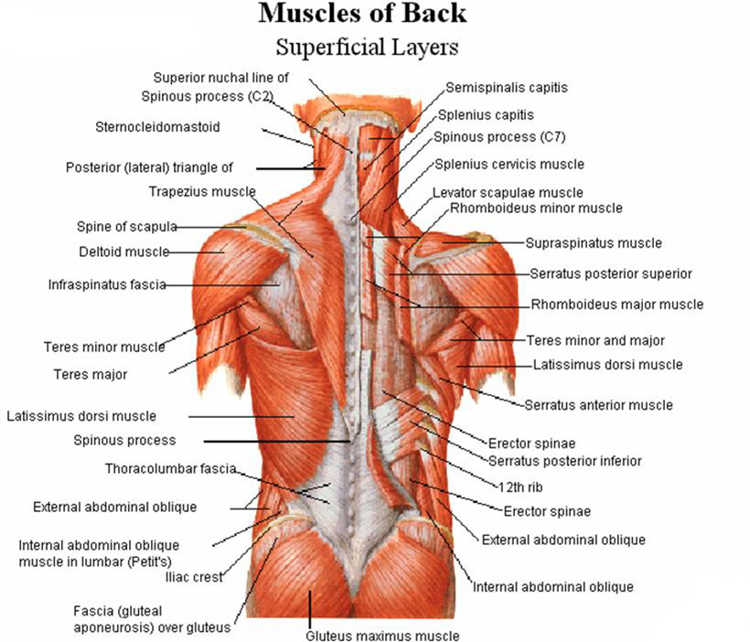
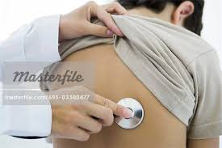
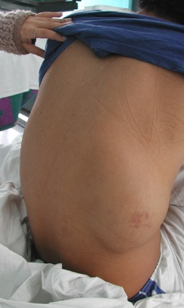
Muscular triangles of back
1- Auscultatory* Triangle:
Boundaries:
- latissimus dorsi
-trapezius
-medial border of scapula.
Site
where breath sounds are most easily heard with a stethoscope.
2- Lumbar Triangle: (Triangle of Petit)
Boundaries :
-latissimus dorsi
-posterior border of external oblique muscle of the abdomen
-iliac crest.
Site
of an abdominal hernia*; or where pus may emerge
from the abdominal wall in extra-abdominal lumbar abscess.
Hernia : فتق
Auscultatory تسمعي:

Slide 12
Summary
Muscles of the back
Extrinsic
Intrinsic
Deep group "vertebral column"
Superficial"upper limb"
Intermediate"ribs and respiratory"
Spinalis
Erector spinae
Longissmus
iliocostalis
Serratus posterior inferior
Vertebral column to Scapula
Serratus posterior superior
Vertebral column to Humerus
Latissimus dorsi
Trapezius
Rhomboid major
Rhomboid minor
Levator scapulae

Slide 13
Summary
group |  | Muscle | Origin | Insertion | Innervation | Function
Deep |  | The largest muscle of this group is “erector spinae” formed of 3 vertical columns (from lateral to medial): iliocostalis, Longissimus , spinalis. | Sacrum | Skull | Posterior Rami of spinal nerves | straighten and rotate the back. extensors and rotators of head & vertebral column
Intermediate |  | Serratus posterior superior | _ | _ | anterior rami of thoracic spinal nerves. | deep inspiration.
 |  | Serratus posterior inferior |  |  |  | forced expiration
Superficial Muscles connecting vertebral column to | scapula | Trapezuis | Spines of Cervical and Thoracic Vertebrae | lateral 1/3 of clavicle + acromion & spine of scapula. | 11th cranial nerve (accessory) | Upper fibers: elevate scapula Middle: retract scapula Lower: depress scapula
 |  | Levator Scapulae | Cervical transverse process | Medial border of scapula | Root of brachial plexus C5 | Elevate scapula
 |  | Rhomboid Major | Thoracic spines | Medial border of scapula | Root of brachial plexus C5 | Retract Scapula
 |  | Rhomboid Minor | Thoracic Spines | Medial border of scapula | Root of brachial plexus C5 | Retract scapula
 | humerus | Latissimus Dorsi | Spines of Thoracic and Lumbar Vertebrae | Biciptal groove of the humerus | Thoracodorsal nerve C6,7,8 | Extension, adduction, and medial rotation of humerus"climbing"

Slide 14
Summary
Muscle | Action
Muscles of deep group | straighten and rotate the back. extensors and rotators of head & vertebral column
Serratus posterior Superior | rib elevator
Serratus Posterior Inferior | rib depressor
Latismuss Dorsi | Extension, adduction, and medial rotation of humerus
Lower fibers of Trapezuis | depress scapula
Levator Scapulae | Elevates scapula
Upper fibers of Trapezuis
Rhomboid major and minor | Retracts scapula
Middle fibers of Trapezuis

Slide 15
Questions:
1- Which of these spinalis, iliocostalis and longissimus lies most laterally? A- Spinalis B- Iliocostalis C- Longissimus D- They all lie in the same plane
2- Which of these groups of muscles form erector spinae? A- Iliocostalis- Multifidus- Spinalis B- Iliocosatlis- Longissimus- Rotatores C- Spinalis- Iliocostalis- Longissmius D- None of the above
3- which of the following separates the intermediate group from the deep group of back muscle:
A- thoracolumbar fascia
B- iliac crest
C- Intervertebral disc
4- which muscle of the following contributes in forced expiration in patient with asthma:
A- Serratus posterior superior
B- Serratus posterior inferior
C- Levator scapulae.
Answers:
1-B
2-C
3-A
4-B

Slide 16
5- all superficial group of back muscles inserts in scapula Except: ​
A- Trapezius. ​
B- Levator scapulae. ​
C- Latissimus dorsi​
​
6- which of the following muscle connects the vertbral column to the humerus: ​
A- levator scapulae ​
B- Latissimus dorsi ​
C- Trapezius ​
​
7- intermediate back muscles supplied by: ​
A- The anterior rami of the lumbar spinal nerve ​
B- The anterior rami of thoracic spinal nerves ​
C- Spinal part of accessory (11th cranial) nerve ​
8- Which of the following is NOT responsible for retracting the scapula?
A- Middle fibers of Trapezius. ​
B- Rhomboid major. ​
C- Latissimus dorsi
D- Rhomboid minor
Answers:
5-C
6-B
7-B
8-C

Slide 17
9- Which nerve supplies the superficial and intermediate group of muscles?
A- Anterior rami of spinal cord
B- Posterior rami of spinal cord
C- Radial plexus root of C5
D- Radial plexus of C6 C7 T1
10- A patient came into the clinic with back pain due to falling. You did the clinical examination and the patient couldn’t raise his left arm above horizontal line. What is the most likely affected muscles?
A- TRAPEZIUS
B- RHOMBOID MINOR
C- LEVATOR SCAPULAE
11- A patient came to the neurology department after a car accident, he was told that his dorsal scapular nerve was affected. What muscle would be affected?
A- TRAPEZIUS
B- RHOMBOID MINOR
C- LEVATOR SCAPULAE
D- RHOMBOID MAJOR
E- ALL B C and D
12- Which nerve supplies the latissimus dorsi muscle?
13- Name two of the muscle triangles of the back?
Answers:
9-A
10-A
11-E
12- thoracodorsal nerve
13-Auscultatory Triangle & Lumbar Triangle

Slide 18
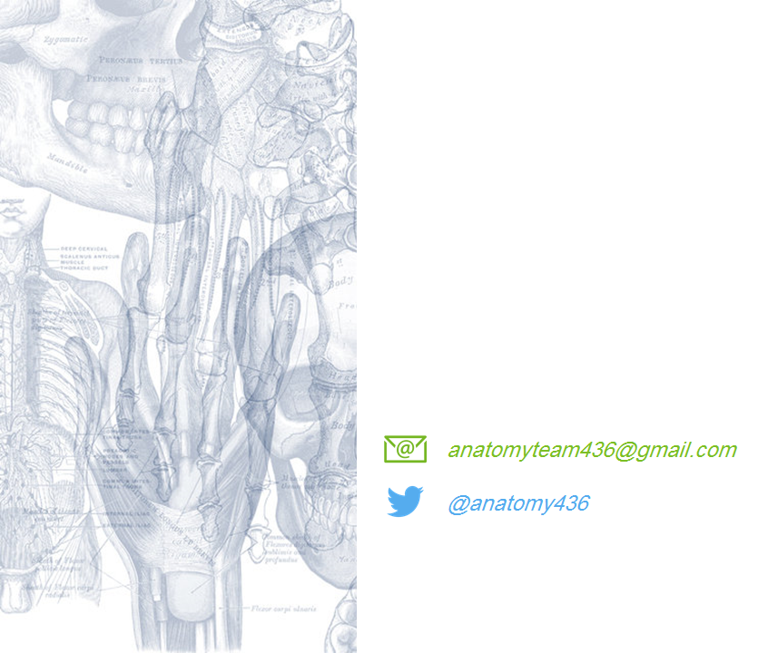
Leaders:
نواف الخضيري
جواهر ابانمي
غادة المزروع
Members:
آمال الشيبي
سمية الغامدي
نورة السهلي
ريما العتيبي
بدرية الصباغ
نجد الذيب
رنا باراسين

