Slide 1
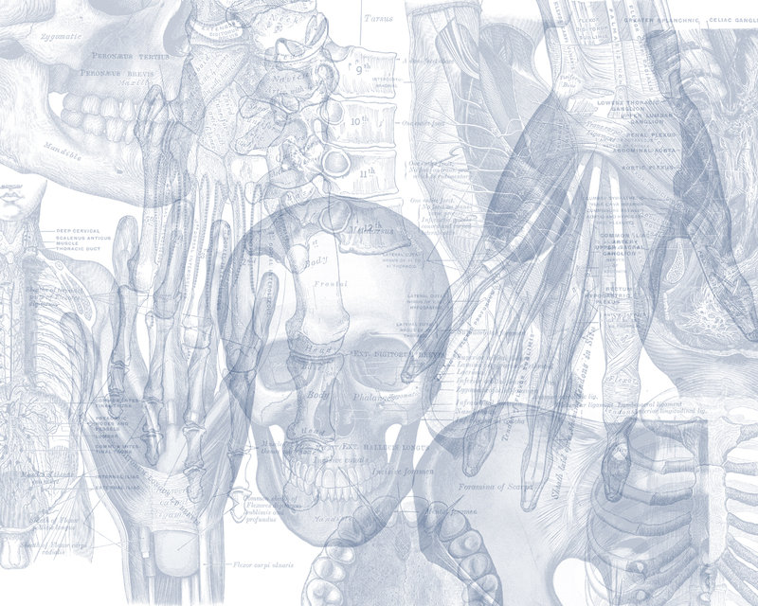
Cervical Spine
Color Code
Important
Doctors Notes
Notes/Extra explanation
Editing File

Slide 2
Objectives
Describe the 7 cervical vertebrae, (typical & atypical (Non-typical)).
Describe the joints between the cervical vertebrae.
Describe the movement which occur in the region of the cervical vertebrae.
List the structures which connect 2 adjacent vertebrae together.
Overview of lecture
-The Cervical Spine
They are 7 in number.
All characterized by presence of foramen transversarium in the transverse process.
They are classified into:
1- Typical: 3rd , 4th ,5th & 6th. (Look exactly the same).
2- Atypical (Non-typical): 1st, 2nd and 7th.
This Video will Explain the lecture in a few minutes: https://www.youtube.com/watch?v=RNUpMNd_u1U

Slide 3
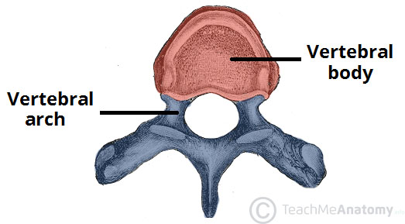
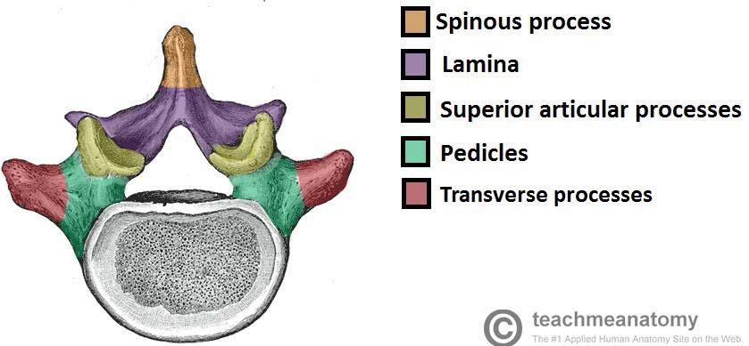
Introduction to Vertebrae
There are approximately 33 vertebrae which are subdivided into 5 groups based on morphology and location: cervical, thoracic, lumbar, sacral, and coccygeal.
Typical Vertebra
All typical vertebrae consist of a vertebral body and a posterior vertebral arch.
Vertebral body:
weight-bearing part. The size increases inferiorly as the amount of weight supported increases.
Vertebral arch:
Extending from the arch are a number of processes for muscle attachment and articulation with adjacent bones.
It consists of:
Two pedicles (towards the body)
Two lamina (towards the spine)
Spinous process
Transverse process
Superior and inferior articular processes. (for articulation with adjacent vertebra)
The vertebral foramen is the hole in the middle of the vertebra. Collectively they form the vertebral canal through which the spinal cord passes.
Vertebral foramen

Slide 4
TYPICAL CERVICAL
Typical cervical vertebrae are 3rd 4th 5th and 6th.
The body is small and longer horizontally than anteroposterior,
the vertebral foramen is large and triangular in shape
2 Vertebral foramen is triangullar in shape.
-The Vertebral foramen is large because there’s an enlargement in the spinal cord in the cervical region to feed the upper limbs.
3 The transverse processes has an oval foramen transversarium* which is wide and large in shape to accumulate the vertebral vessels (arteries veins) that pass inside it.
3
3
Transverse process
2
Passage for: artery and vein
Passage for: Spinal Cord
1
1 The spinous process arises from junction of the two lamina of vertebra is short and bifid (مشقوقة (مثل لسان الثعبان)).
*Transverse foramen or foramen transversarium

Slide 5
TYPICAL CERVICAL VERTABRAE (3rd, 4th, 5th and 6th).
The transverse process
superior articular Facet
The superior articular processes:
Have a facet that face upward & backward.
The inferior articular processes:
Have a facets that, face downward and forward.
The transverse process :
has 2 tubercles one infront and one behind the foramen transversarium.
superior articular processes
inferior articular processes
inferior articular Facet
-Facet = Articular surface. مثل الصلصال
inferior articular processes(باللون البنفسجي)

Slide 6
TYPICAL CERVICAL VERTABRAE (3rd, 4th, 5th and 6th).
Posterior tubercle (المظللة باللون البنفسجي)
Anterior tubercle (المظللة باللون البنفسجي)

Slide 7
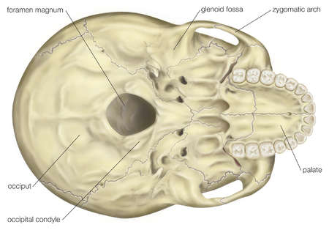
ATYPICAL: ATLAS- C1
Note: the anterior arch lies above the bodies of the rest of the vertebrae
It has No body, No spine.
It has 2 lateral masses connected together by small anterior arch & long posterior arch.
Each lateral mass has articular surface on its upper and lower aspects.
The superior articular surface :
The upper articular surface is kidney-shaped
Articulates with the occipital condyles of the skull.
It forms the Atlanto-Occipital joints.
This joint allows you to nod “say Yes”. (flexion and extension)
Note: the posterior arch lies above the spines of the rest of the vertebrae

Slide 8
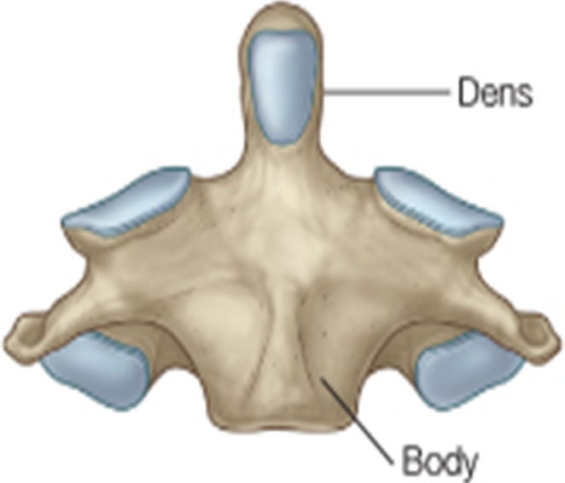
ATYPICAL: ATLAS- C1 (con.)
The inferior articular surface of the atlas:
is circular and articulates with the axis.
It forms the 2 lateral Atlanto-Axial joints.
This joint together with the joint between the dens of axis and the anterior small arch of atlas allow you to “Say No “ lateral rotation of the face.
Extra
Atlanto-axial joint
AXIS
Anterior view

Slide 9
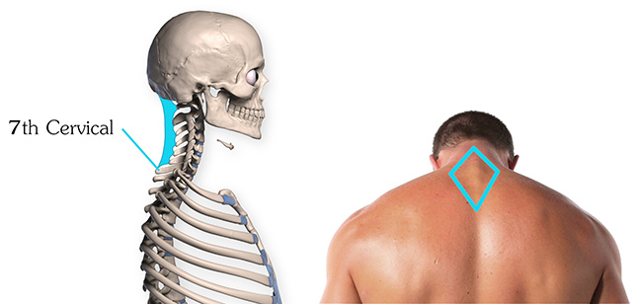
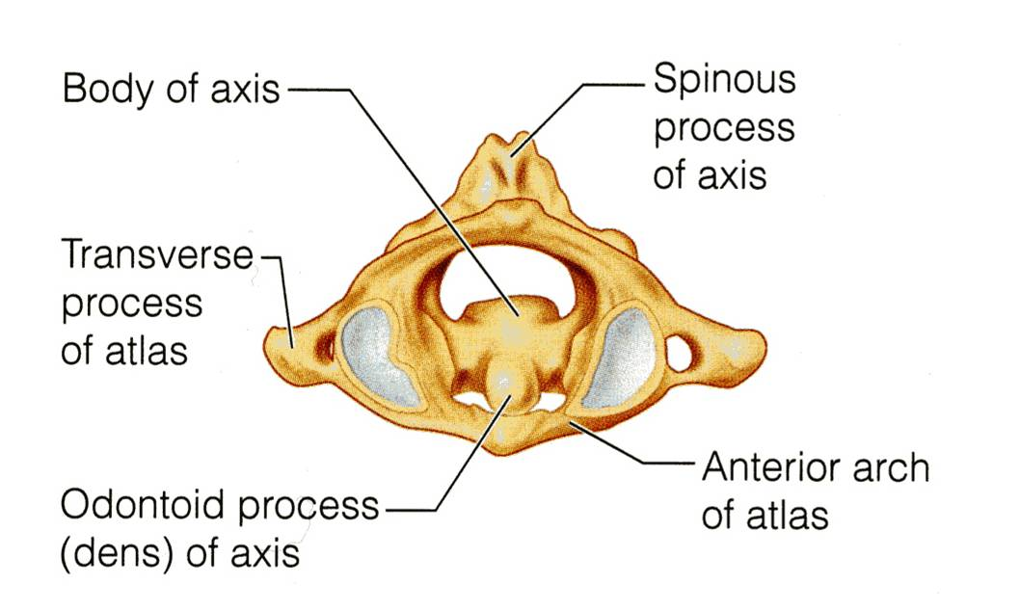
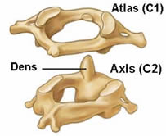
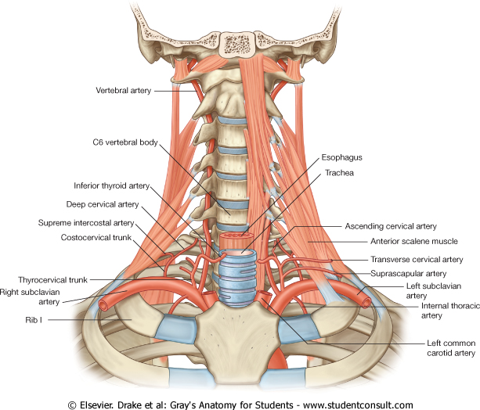
Atypical spines (C2 & C7 ):
AXIS- C 2
7th CERVICAL VERTEBRA
(Vertebra/Cervica Prominens)
It acts as a pivot (محور)for the rotation of the atlas (and the skull) above.
It has a large upright peg-like odontoid process, or dens, which projects upward from the superior surface of the body.
Actually it represents the body of the atlas that has fused with the axis.
It has the longest spinous process which is not bifid.
It is the first spine to be felt subcutaneously¹ in the root of back of neck.(تقدر تشعر فيها بيدك)
The transverse process is large while its foramen transversaium is small and may be absent, and does not transmit the vertebral artery.* (only small accessory vein)
The ligamentum nuchae is attached to it (last slide)
1
C1
C2
* Notice how the artery goes in front of the transverse process instead of going through it
C3
C4
C5
C6
C7

Slide 10
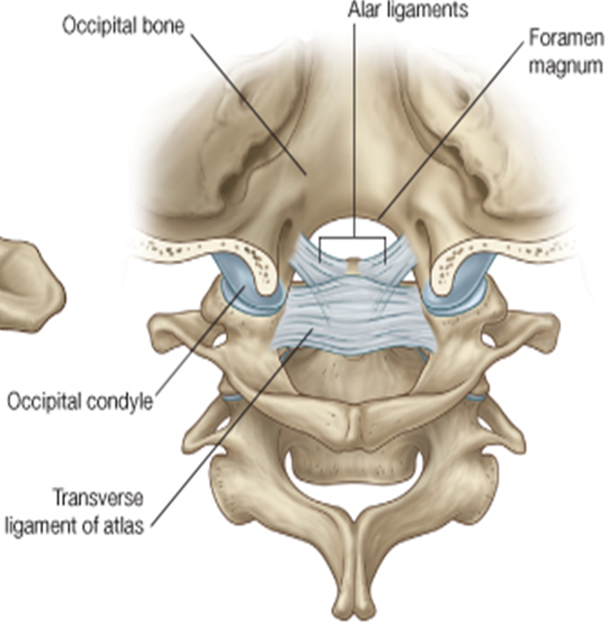
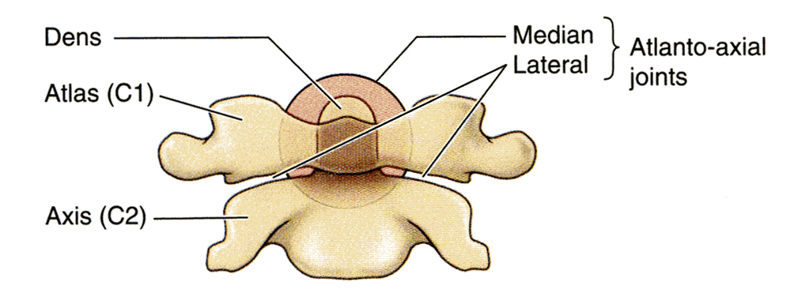
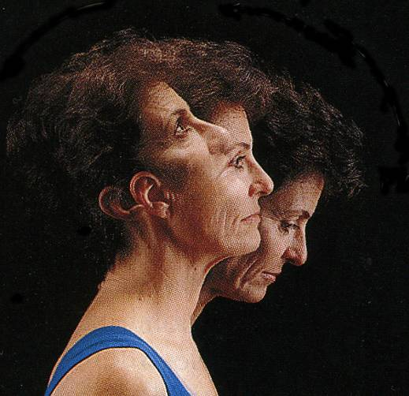
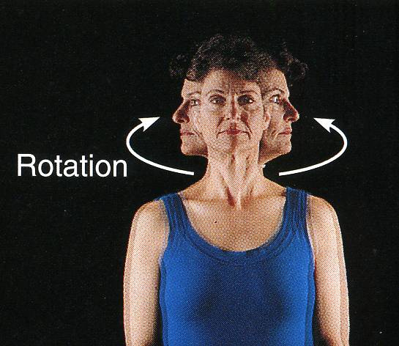
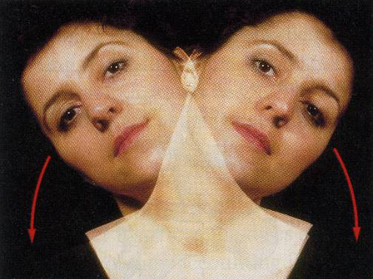
Joints of Cervical Vertebrae:
1.Atlanto-Occipital Joints
2.Atlanto-Axial Joints
The Atlanto-occipital joints are synovial joints:
between the occipital condyles of skull
and the facets on the superior surfaces
(or upper facets) of the lateral masses
of the atlas below.
The Atlanto-axial joints are Three Synovial Joints:
One median: between the odontoid process and the anterior arch of the atlas.
Two lateral: between the inferior facet of lateral masses of the atlas and superior facets of the axis.
MOVEMENTS:
The joints are capable of:
-Flexion
-Extension
-Lateral flexion
They do not rotate.
To help you remember:
When you say yes it is only involves 2 movements (you look down then up) so 2 joints are used.
When you say no it involves 3 movements (you look the right, then to the left, then back to the middle) so 3 joints are used
That is to say yes
MOVEMENTS:
There can be extensive rotation of the atlas and the skull (and thus of the head on the axis).
That is to say NO
Notes:
I should add the title: Joints of Cervical Vertebrae

Slide 11
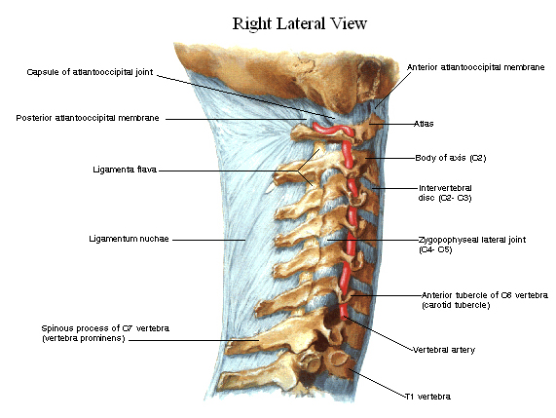
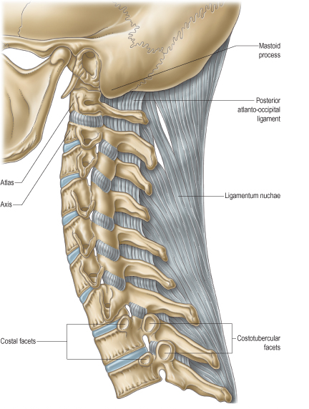
The JOINTS OF THE VERTEBRAL COLUMN BELOW THE AXIS With exception of the first two cervical vertebrae, the other cervical vertebrae articulate with each other by means of:
The JOINTS BETWEEN TWO VERTEBRAL ARCHES
Synovial joints
Intervertebral (zygapophyseal) joints
(Between articular processes)
The joints between two vertebral arches consist of synovial joints between the superior and inferior articular processes of adjacent vertebrae.
The articular facets are covered with hyaline cartilage, and the joints are surrounded by a capsule.
supported by the following ligaments: next slide
The JOINTS BETWEEN TWO VERTEBRAL BODIES
Cartilaginous joints
Intervertebral disc
The upper and lower surfaces of the bodies of two adjacent vertebrae are covered by thin plates of hyaline cartilage.
Between the plates of hyaline cartilage is an intervertebral disc of fibrocartilage.
The collagen fibers of the disc strongly connect the bodies of the two vertebrae.

Slide 12
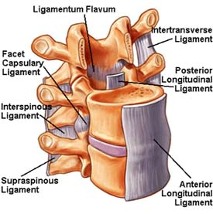
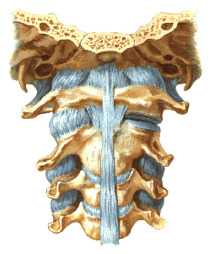
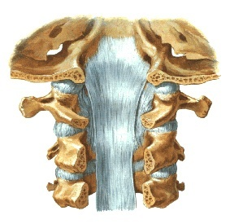
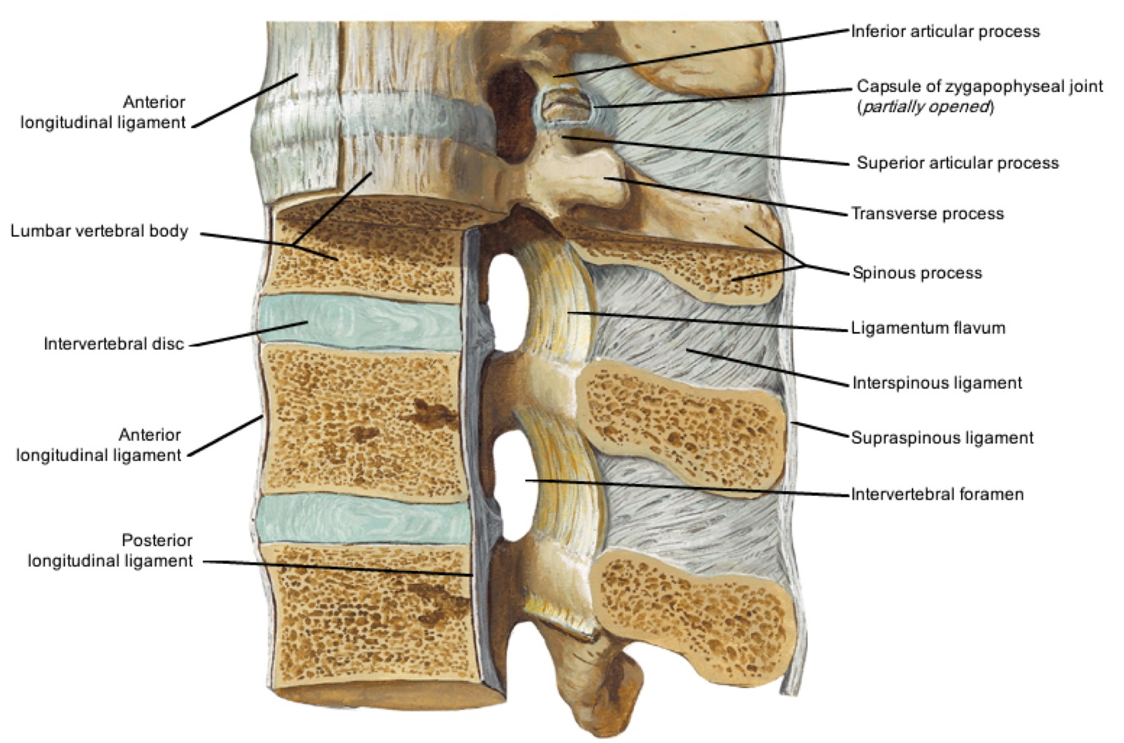
Ligaments
Supraspinous ligament
It runs between the tips of adjacent spines.
Interspinous ligament
It connects adjacent spines.
Ligamentum flavum
Connects the laminae of adjacent vertebrae.
Intertransverse ligaments
They run between adjacent transverse processes.
Anterior
Posterior
The anterior and posterior longitudinal ligaments run as continuous bands along the anterior & posterior surfaces of the vertebral bodies.
These ligaments hold the vertebrae firmly together but at the same time permit a small amount of movement to take place.

Slide 13
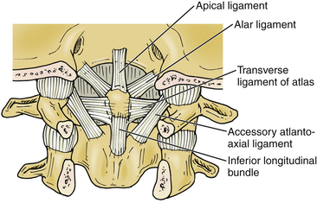
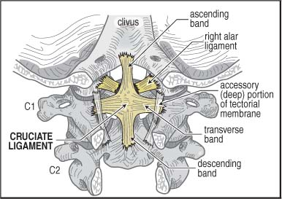
Apical ligament:
median ligament connects apex of odontoid process to foramen magnum (the hole in base of the skull through which the spinal chord passes)
(it is undercover of (covered by) cruciate ligament).
Alar ligaments:
these lie on each side of apical ligament and connect odontoid process to medial side of occipital condyles.
Cruciate ligament:
consists of vertical (between body of axis and foramen magnum) & transverse (binds odontoid process to anterior arch of atlas) parts.
EXTRA
ONLY ON THE GIRLS’ SLIDES

Slide 14
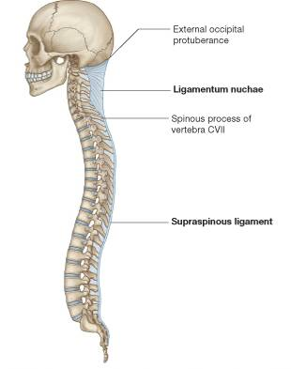
LIGAMENTUM NUCHAE
In the cervical region, the Supraspinous and Interspinous ligaments are greatly thickened to form the strong ligamentum nuchae.
It extends from the external occipital protuberance of the skull to the spine of the seventh cervical vertebra.
Its anterior border is strongly attached to the cervical spines in between.

Slide 15
MCQ’s
SAQ’s
1.The spinous process of the cervical vertebra is short and not bifid: a)True b)False
2.The superior articular surface of The Atlas(C1) Articulates with:
A) Axis(C2) B) C4
C) C3 D) Occipital condyles of the skull.
3.Which of the following is Atypical Cervical spine:
A) C1 B) C3 C) C4 D) C5
4.Which of the following Cervical spine can be felt subcutaneously:
A) C2 B) C4 C) C5 D) C7
5.Witch one of the following is a continuous ligament ?
Ligamentum flavum. B) Interspinous ligament.
C) posterior ligament. D) Intertransverse ligaments
1.What is the difference between the movement of Atlanto-Occipital Joints and Atlanto-Axial Joints?
2.-Enumerate the movements of Atlanto-occipital joint:
3.Which kind of connective tissue is the Intervertebral disc is made of ?
4.A 26-year-old heavyweight boxer was punched on his mandible, resulting in a slight subluxation (dislocation) of the atlantoaxial
joint. The consequence of the injury was decreased range of motion at that joint. What movement would be most affected?
The Answers:
1.Atlanto-Occipital Joints : Flexion, Extension (allow you to say yes) and Lateral flexion
Atlanto-Axial Joints : extensive rotation of the atlas and the skull (allows you to say no)
2. Flexion, Extension, and Lateral flexion
3. Fibrocartilage
4. Rotation, The atlantoaxial joints are synovial joints that consist of two plane joints and one pivot joint and are involved primarily in rotation of the head. Other movements do not occur at this joint.
1.B
2.D
3.A
4.D
5.C

Slide 16
Summary
The cervical vertebrae are 7 in number, classified into typical & atypical (non-typical) vertebrae.
All the typical vertebrae have a foramen transversarium and bifid spinous processes.
Atypical vertebrae (1,2,7) :
1st (Atlas) : has no body nor spine, has short anterior arch and long posterior arch.
2nd (Axis): has odontoid process (dens).
7th (Cervica Prominens) : has longest not bifid spinous process, which can be felt subcutaneously.
Atlanto-Occipital joints are: 2 synovial joints, the function: flexion and extension, and lateral flexion, This joint allows you to say “Yes”.
Atlanto-Axial joints are : 3 synovial joints, the function : extensive rotation, this joint allows you to say “ No”.
JOINTS BELOW THE AXIS are:
I- Synovial joints between their articular processes.
II- Cartilaginous joints between their bodies (intervertebral disc of fibrocartilage).
Ligaments of cervical spines:
Supraspinous ligament, between tips of spines.
Interspinous ligament, between adjacent spines.
Supraspinous & Interspinous ligaments are thickened to form ligamentum nuchae.
Ligamentum flavum, between laminae.
Intertransverse ligaments, between transverse processes.

Slide 17
Leaders:
Nawaf AlKhudairy
Jawaher Abanumy
Ghada Almazrou
Members:
Abdulaziz Alangari
Mohammed Alduayj
Abdulmohsen alghannam
Abdulaziz ALMohammed
Mosaed Alnowaiser
Rayan ALQarni
abdullah hashem
Khalid Al-dakheel
Moayed Ahmad
Abdulmohsen Alkhalaf
Fahad Alzahrani
anatomyteam436@gmail.com
@anatomy436

