Slide 1
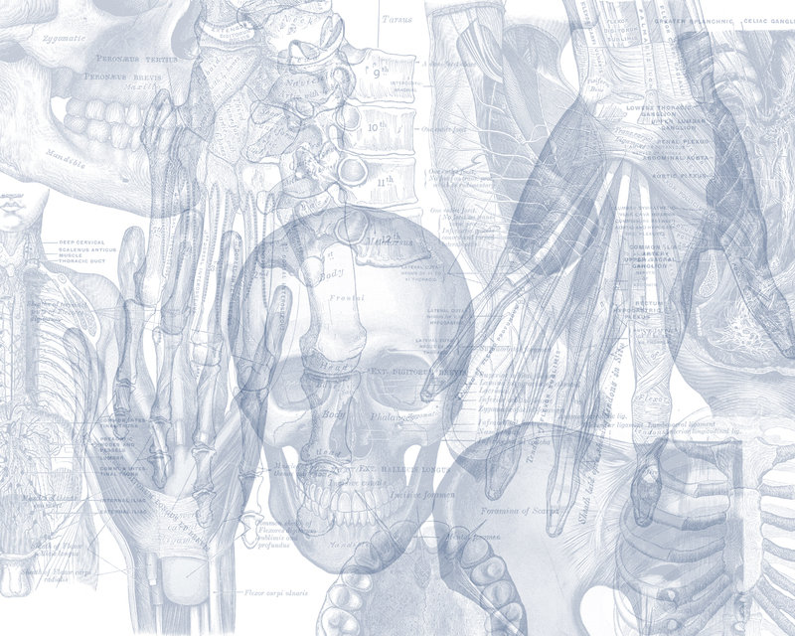
PELVIS & SACRUM
Color Code
Important
Doctors Notes
Notes/Extra explanation
EDITING FILE

Slide 2
Objectives:
Describe the bony structures of the pelvis.
Describe in detail the hip bone, the sacrum, and the coccyx.
Describe the boundaries of the pelvic inlet and outlet.
Identify the articulations of the bony pelvis.
List the major differences between the male and female pelvis.
List the different types of female pelvis.

Slide 3
Overview:
check this video to have a good picture about the lecture:
https://www.youtube.com/watch?v=PJOT1cQHFqA
https://www.youtube.com/watch?v=3v5AsAESg1Q&feature=youtu.be
BONY PELVIS = 2 Hip Bones (lateral) + Sacrum (Posterior) + Coccyx (Posterior).
Hip bone is composed of 3 parts = Superior part (Ilium) + Lower anterior part (Pubis) + Lower posterior part (Ischium)

Slide 4
BONY PELVIS
only on the boys slides’
Location | SHAPE | Structure: Pelvis can be regarded as a basin with holes in its walls. The structure of the basin is composed of:
Pelvis is the region of the trunk that lies below the abdomen. | Bowl shaped | 4 bones | 4 joints
1-sacrum 2-ilium 3-ischium 4-pubic 5-pubic symphysis 6-Acetabulum |  | A. Two hip bones: These form the lateral and anterior walls of the bony pelvis. B. Sacrum: It forms most of the posterior wall. C. Coccyx: It forms most of the posterior wall.

Slide 5
Function
# Primary: The skeleton of the pelvis is a basin-shaped ring of bones with holes in its wall connecting the vertebral column to both femora.
Its primary functions are:
bear the weight of the upper body when sitting and standing;
transfer that weight from the axial skeleton to the lower appendicular skeleton when standing and walking;
provide attachments for and withstand the forces of the powerful muscles of locomotion and posture.
# Secondary:
Its secondary functions; are to
contain and protect the pelvic and abdominopelvic viscera (inferior parts of the urinary tracts, internal reproductive organs);
provide attachment for external reproductive organs and associated muscles and membranes.
• Protect pelvic and abdominal viscera.
• Attachment for organs.

Slide 6
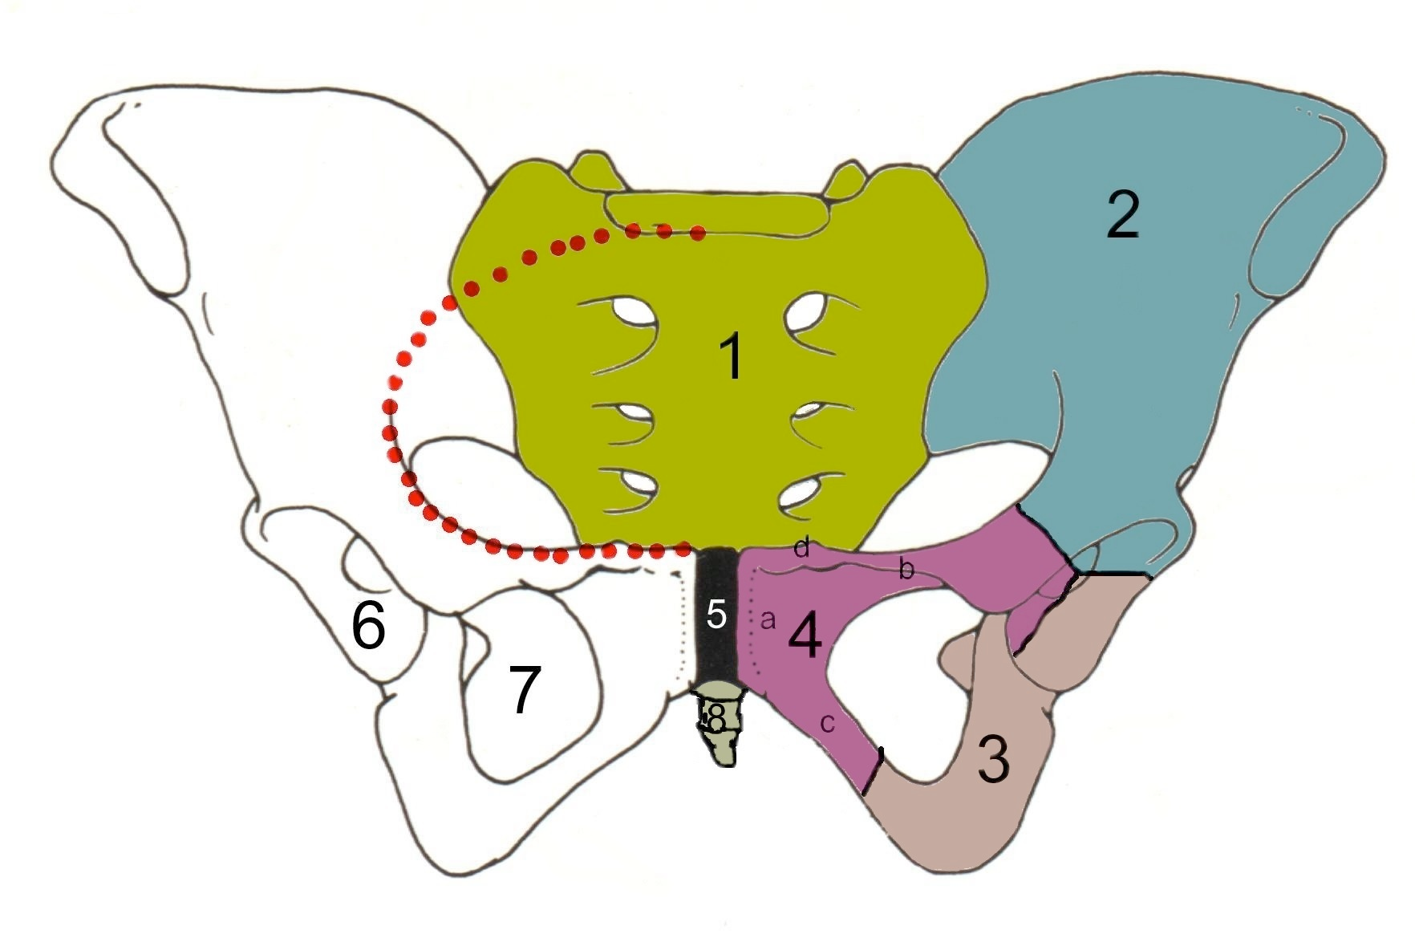
Pelvic Girdle
Compared to the shoulder girdle, the pelvic girdle is thus stronger and heavier.
It is composed of Two Hip (Coxal) Bones.
Each one is a large irregular bone.
Composed of three (elements) bones:
1.Ilium. 2.Ischium. 3.Pubis.
They are joined at a deep socket (the Acetabulum)
During childhood, these sections are separate bones, joined by Y shaped cartilage.
During puberty, they fuse together to form a single bone.
1.Sacrum 2. Ilium 3. Ischium 4. Pubic bone 5. Pubic symphysis 6. Acetabulum 7. Obturator foramen 8. Coccyx
Red line: Terminal line/pelvic brim

Slide 7
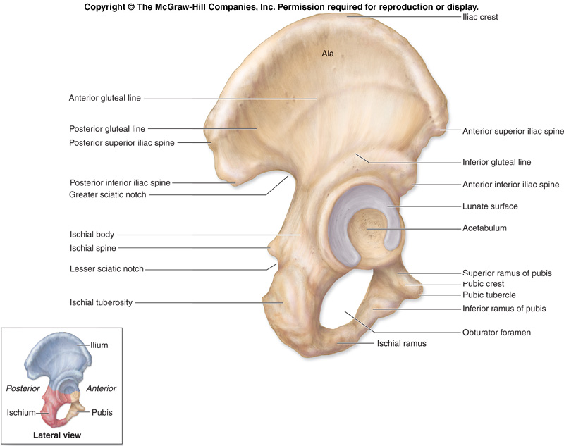
Ilium
It is the Upper Flattened Part of the hip bone.
It Possesses:
Iliac Crest: it is an important anatomical landmark below the waist.
It runs between the Anterior and Posterior Superior Iliac Spines.
Below are the corresponding Anterior and Posterior Inferior Iliac Spines.
It has two surfaces:
1-The Outer Surface: rough and has three Gluteal Lines (anterior, posterior, and inferior) .

Slide 8
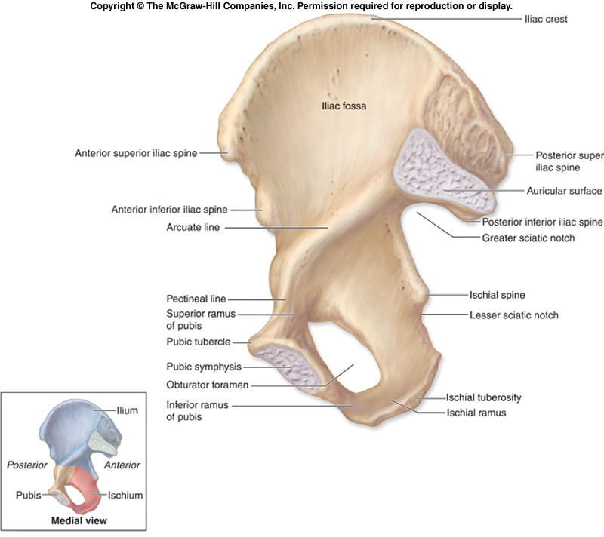
Ilium(con.)
2-The Inner surface shows:
Iliac Fossa (forms false pelvis)
Auricular surface ( for articulation with the sacrum). Looks like an ear (Auricle)
Iliopectinial (Arcuate) Line:
runs Downwards & Forwards,
it separates the False & the True pelvis. (discussed later)

Slide 9
Pubis
Forms the Anterior & inferior part.
It is composed of:
Body; bears the Pubic Crest and Pubic Tubercle.
Two pubic Rami;
Superior & Inferior.
They bound the Obturator Foramen, which is closed partially by the obturator membrane.
The 2 inferior pubic rami (from both hip bones) + ischium form the Pubic Arch
Body of pubis

Slide 10
Ischium
Forms the Inferior and Posterior part of the hip bone
It has;
Ischial Tuberosity:
It is a roughened area that receives body weight in sitting.
Ischial Spine:
Superior to the tuberosity, it is important landmark in pregnant women.
Greater sciatic notch.
Lesser sciatic notch.
#The distance between the 2 spines help us know whether a woman is going to give normal birth or not.
In Living patients:
Greater Sciatic Foramen
Lesser Sciatic Foramen

Slide 11
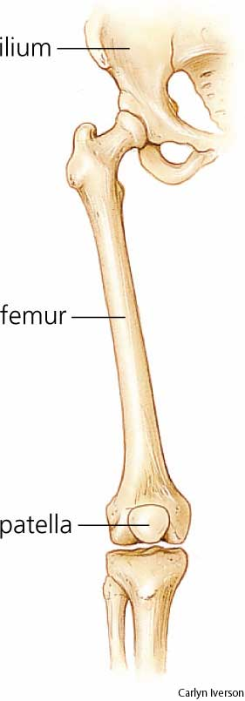
Articulations of Hip Bone
Symphysis Pubis
Sacroiliac Joints
Hip Joints
The acetabulum articulates with the head of the femur.
A secondary cartilagenous joint between the two pubic bones
Strong synovial joints, between the auricular surfaces of both iliac bones and the sacrum.

Slide 12
Sacrum
Coccyx
0
A Single Wedge shaped bone.
(consists of Five rudimentary vertebrae fused together).
Sacral Promontory:
#:The anterior and upper margin.
#: It is tilted forward forming the lumbosacral angle.
The anterior and posterior surfaces possess on each side four Sacral Foramina.
The fused vertebral foramina form the Sacral Canal.
Its lower limit is the Sacral Hiatus.
Consists of four vertebrae fused together forming a single Triangular piece.

Slide 13
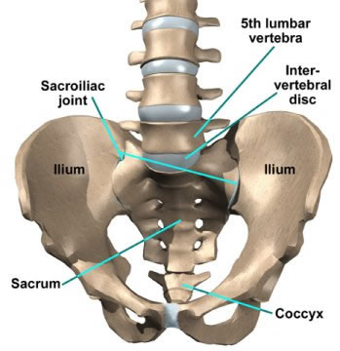
Articulations of Sacrum
Lumbosacral joint
Sacrococcygeal joint
Sacroiliac joints
Lateral articulation with the both Hip bones
The upper border articulates with the 5th Lumber vertebra
The inferior part articulates with the Coccyx.

Slide 14
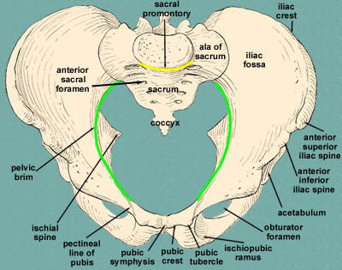
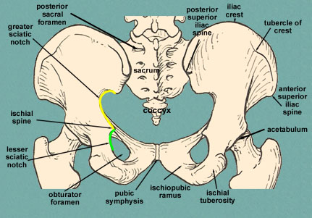
Formina : The holes of the basin.
Anterior sacral foramina:
Obturator foramen:
Greater and lesser sciatic foramina:
These are present on the anterior surface of the sacrum (which forms the posterior surface of
the bony pelvis). Through these foramina pass the anterior rami of the sacral spinal nerves.
Four on each side.
Each lateral wall of the pelvis has a large hole, called the obturator foramen.
In living subjects, this hole is closed by the obturator membrane except for a small opening, which represents the obturator canal .
Obturator nerve passes through this small opening.
These are the major foramina of the pelvis.
In the bony pelvis, they are present as greater and lesser sciatic notches but by the attachment of sacrotuberous and sacrospinous ligaments, these notches are converted to respective foramina.
Through these foramina various structures enter and leave the pelvis. .(*Sacrotuberous: ligament between sacrum and ischial tuberosity. **Sacrospinous: ligament between sacrum and ischial spine)
Notes:
.((*Sacrotuberous: ligament between sacrum and ischial tuberosity. **Sacrospinous: ligament between sacrum and ischial spine

Slide 15
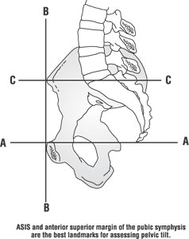
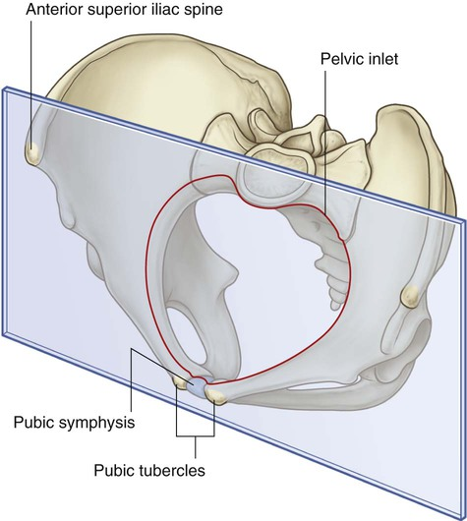
Orientation of the Pelvis
Orientation of the Pelvis: It is the Correct Position of the bony pelvis relative to the trunk (in the anatomical position):
1.Vertical Plane: The anterior-superior iliac spine and the pubic tubercles are in the same vertical plane
2.Horizontal Plane: The coccyx and the upper margin of the pubic symphysis are in the same horizontal plane

Slide 16
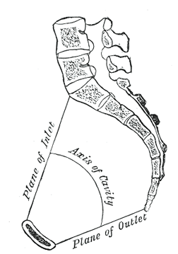
Orientation of the Pelvis
3.The axis of the pelvic cavity: running through the central point of the inlet and the outlet. almost parallels the curvature of the sacrum.
In this position: The anterior surface of the Sacrum is directed forward and downward while the pelvic surface of symphysis pubis faces upward and backward.

Slide 17
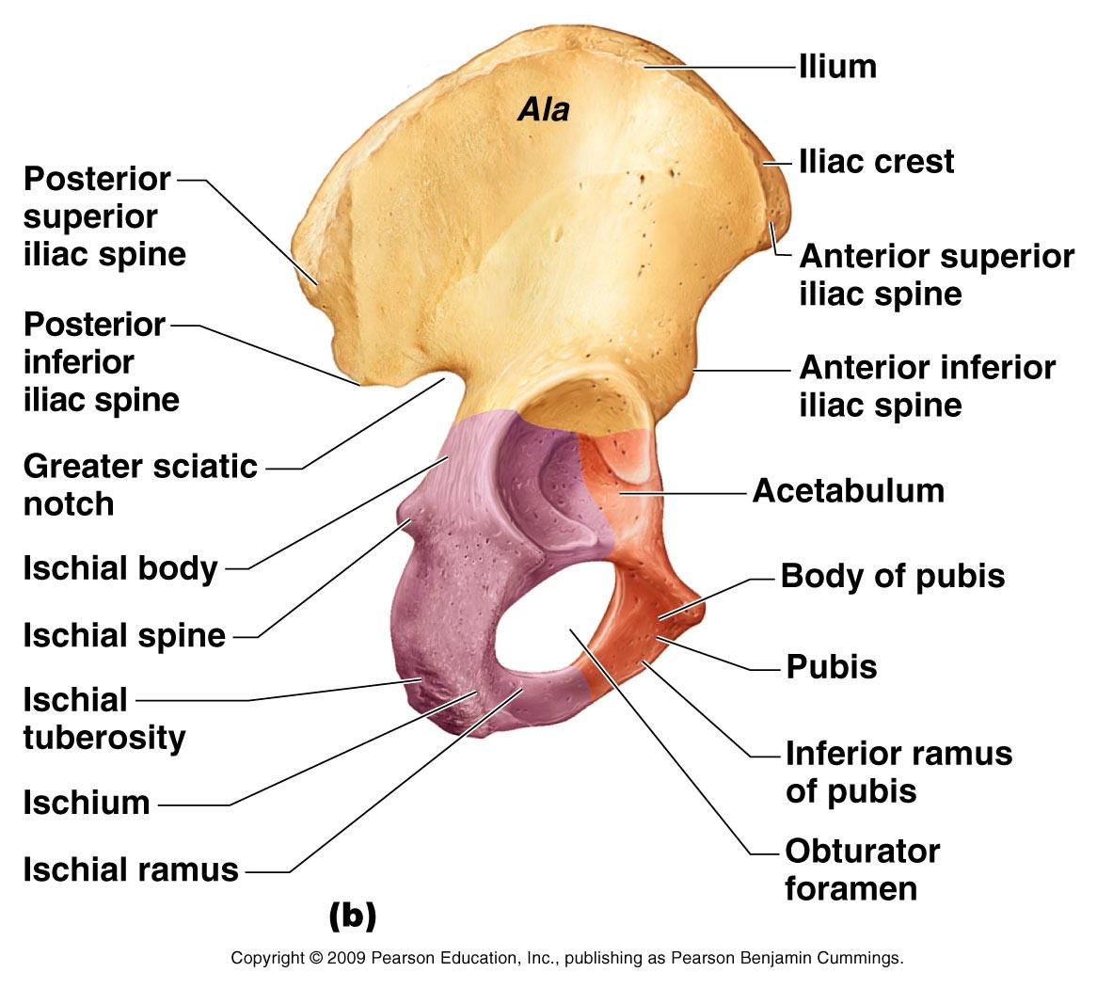
Fractures of the Bony Pelvis
The weakest parts of the bony pelvis are:
Pubic rami.
Acetabula.
Region of sacroiliac joint.
Alae of the ilium.
Pelvic Fractures can result from direct trauma to
the pelvic bones as occurs in car accidents or
by forces transmitted to these bones from the
lower limbs during falls on the feet.
Pelvic fractures may cause injury to:
The pelvic soft tissues, Blood vessels, Nerves, organs.

Slide 18
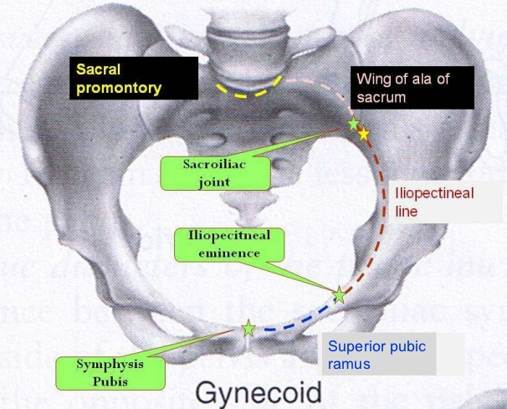
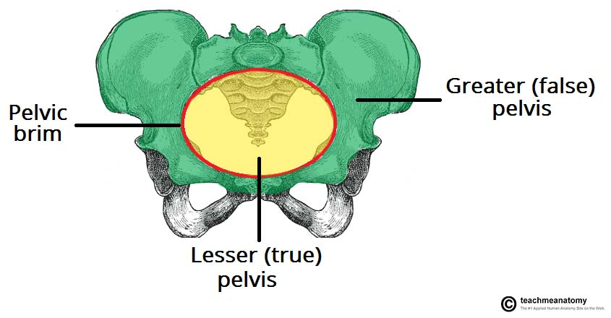
Subdivision of the Bony Pelvis
-The bony pelvis is divided into two parts by the Pelvic Brim.
-The brim is formed
Posteriorly:
Sacral Promontory
Laterally:
Iliopectineal line.
Anteriorly:
Symphysis pubis.
-Above the pelvic brim lies the False Pelvis,
which is not of much clinical importance.
-Below the brim is the True Pelvis

Slide 19
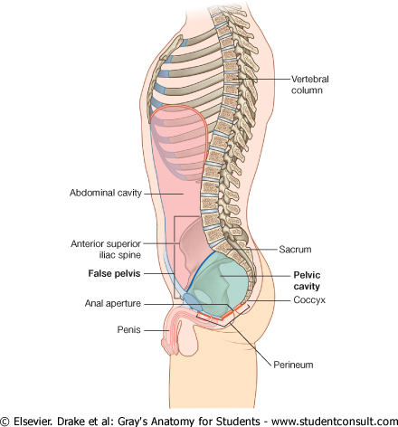
True & False Pelvis
False pelvis
True Pelvis
-Lies superior to the pelvic brim.
-Enclosed by the Fossae of the iliac bones
-Forms the inferior region of the abdominal cavity.
-Houses the Inferior abdominal organs
-Lies inferior to the pelvic brim.
-Encloses the pelvic cavity.
-Contains the pelvic organs.
It has :
Inlet Pelvic walls.
Outlet Pelvic walls.

Slide 20
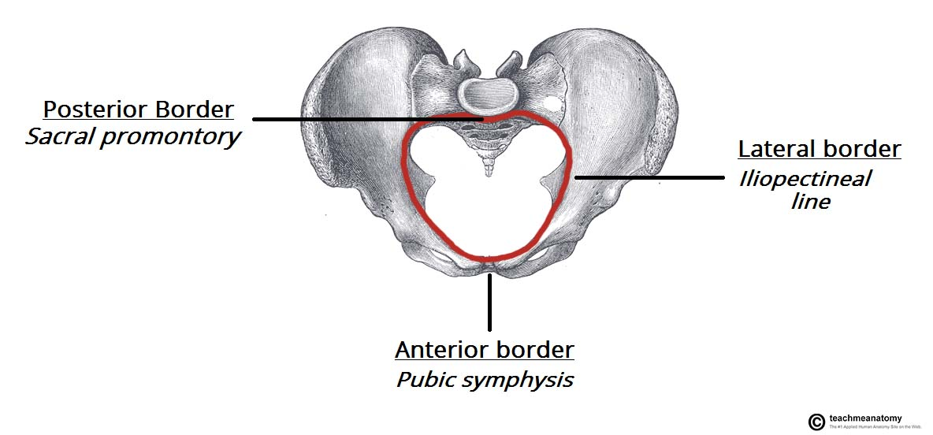
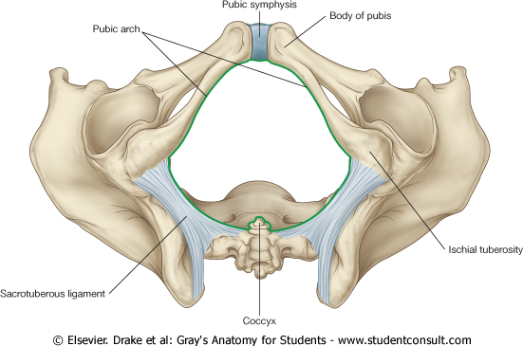
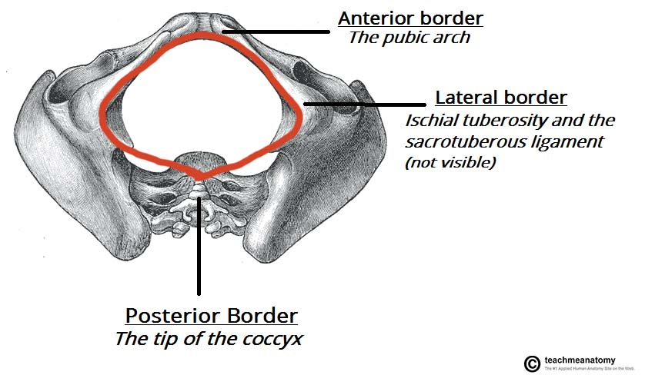
Pelvic Inlet (pelvic Brim) & Pelvic Outlet
Pelvic Inlet (pelvic Brim)
Pelvic Outlet
Bounded by:
-Sacral promontory.
-Iliopectineal lines.
-Symphysis pubis.
Bounded by:
-Coccyx.
-Ischial tuberosities.
-Pubic arches.

Slide 21
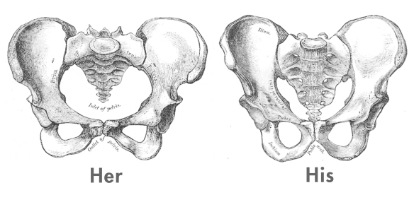
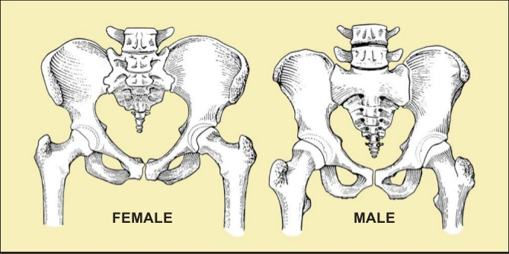
Bony pelvic | Male | Female
General structure | Thick & heavy | Thin, Smaller & lighter
False (major) pelvis | Deep | Shallow
True (lesser) pelvis | Narrow & Deep | Wide & Shallow
Pelvic inlet | Heart shaped | Oval or Rounded
Pelvic outlet | Small | Larger
Pubic arch & subpubic angle | Narrow | Wide
Obturator foramen | Round | Oval
Acetabulum | Large | Small
Because of the everted ischial tubercosities
Pelvic Cavity
Sacrum | Longer Narrower More curved | Shorter Wider Less curved
Length
Breadth

Slide 22
CLINICAL NOTES Types of Obstetrical Female Pelvis
Anthropoid: long narrow and oval shaped.
Gynaecoid:
it is the typical female type
Android: it is funnel shaped with contracted outlet.
(it causes hazards to normal vaginal delivery)
Platypelloid: wide , flattened at the brim, with forward promontory.

Slide 23
Forensic Medicine & Bony Pelvis
female
male
Pelvic inlet
For identification of human skeletal remains, the bony pelvis is of prime focus of attention because sexual differences are clearly visible. Even parts of the pelvis are useful in making a diagnosis of sex.
Pelvic outlet
Pelvic cavity
Pubic arches
wide
Narrow

Slide 24
1.How can you get Pelvic Fractures ? 2.What part of the pelvis that carries the body weight while sitting?
MCQ’s
SAQ’s
1.Which one of the following is a weak part of the pelvis ?
A)Ischial Spine B)Iliac Crest C)Iliac Fossa D)Acetabula
2.During………the pelvic girdle bones fuse together to form a single bone.
Adulthood. B. Puberty.
Childhood. D. Senescence.
3.Houses the inferior abdominal organs : A- Tue pelvis B- False pelvis C- Both of them D- None of them
4.During childhood the sections of bones are separate in :
A- Sacrum B- Hip bone
C- coccyl D- Femur
5.The number of lines in outer surface of ilium of hip bone :
A- 3 B- 4
C- 5 D-6
6.Which of the following bone will be prominent during pregnancy :
A- iliac fossa B- Pubic tubercle
C-Ischial tuberosity D-Ischial spine
3.forensic scientist was asked to identify the gender of human remains in a homicide.
a) Which part of the skeleton will he examine?
b) He determined that the victim was a female. List 3 characteristics he could have seen.
Answers:
1. Direct trauma or transmitted force
2. Ischial tuberosity
3A. The bony pelvis.
3B. The pelvis will be thin, light, and small.
The pelvic outlet is oval or round
The obturator is oval
1.D
2.B
3.B
4.B
5.A
6.D

Slide 25
Members:
Abdulaziz Alangari
Mohammed Alduayj
Abdulmohsen alghannam
Abdulaziz ALMohammed
Mosaed Alnowaiser
Rayan ALQarni
abdullah hashem
Khalid Al-dakheel
Moayed Ahmad
Abdulmohsen Alkhalaf
Fahad Alzahrani
Abdurrahman Almalki
Leaders:
Nawaf AlKhudairy
Jawaher Abanumy
Ghada Almazrou
anatomyteam436@gmail.com
@anatomy436

