Slide 1
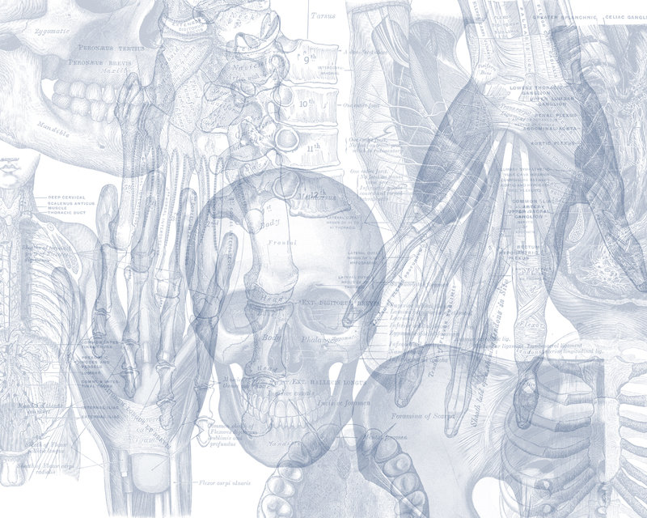
Anatomy of Forearm
Color Code
Important
Doctors Notes
Notes/Extra explanation
Editing File

Slide 2
Objectives
At the end of this lecture, the student should able to:
List the names of the Flexors Group of Forearm (superficial & deep muscles).
Identify the common flexor origin of flexor muscles and their innervation & movements.
Identify supination & pronation and list the muscles produced these 2 movements.
List the names of the Extensor Group of Forearm (superficial & deep muscles).
Identify the common extensor origin of extensor muscles and their innervation & movements.

Slide 3
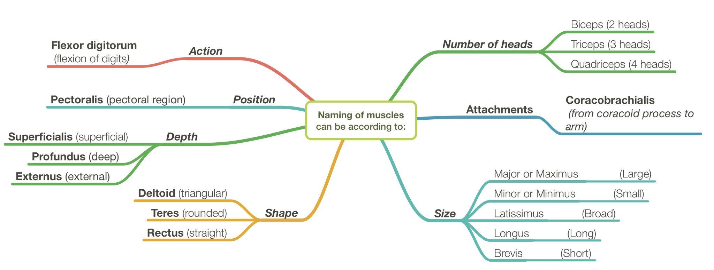
Recall what we took in foundation:
The following pairs always come together (they counter each other so if one is present so is the other)
Flexor & Extensor (flexor carpi ulnaris & extensor carpi ulnaris)
Longus & Brevis (extensor carpi radialis longus & extensor carpi radialis brevis)
Superficialis & Profundus (flexor digitorum superficialis & flexor digitorum profundus)
Major & Minor (pectoralis major & pectoralis minor)
The fingers:
Digitorum = has 4 tendons each attached to a finger
Pollicis = the thumb
Indices = index finger السبابه
Digiti minimi = pinkie

Slide 4
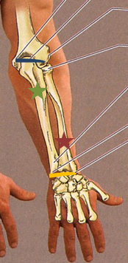
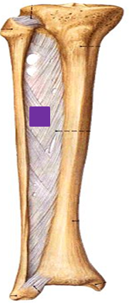
FOREARM
- The radius and ulna are connected by 3 structures: the interosseous membrane, superior radioulnar joint and inferior radioulnar joint
- An interosseous membrane is a broad and thin plane of fibrous tissue that separates many of the bones of the body.
- The forearm extends from elbow to wrist
- It posses two bones radius laterally & Ulna medially.
The two bones are connected together by the interosseous membrane.
This membrane:
1- allows movement of Pronation and Supination while the two bones are
connected together.
2- it gives origin for the deep muscles.

Slide 5
Fascial Compartments of the Forearm
The forearm is enclosed in a sheath of deep fascia, which is attached to the posterior border of the ulna .
This fascial sheath, together with the interosseous membrane & fibrous intermuscular septa, divides the forearm into several compartments, each having its own muscles, nerves, and blood supply.

Slide 6
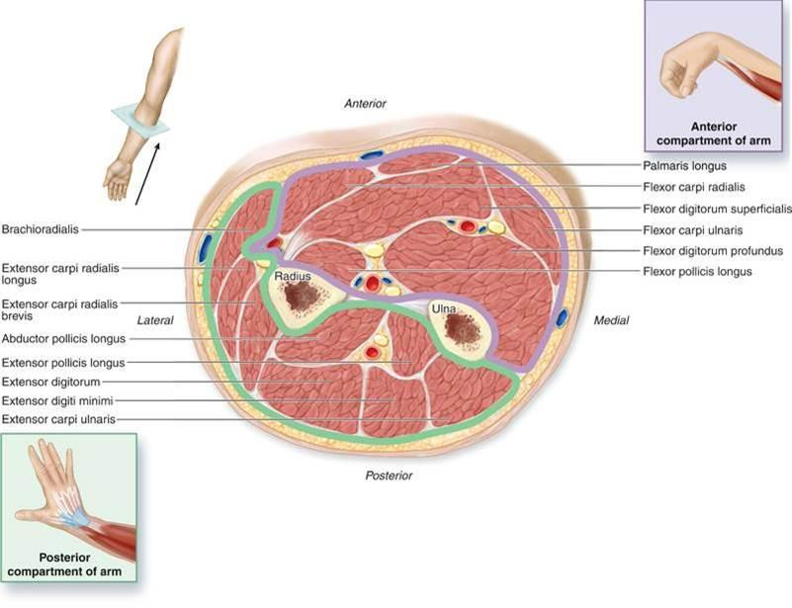
EXTRA

Slide 7
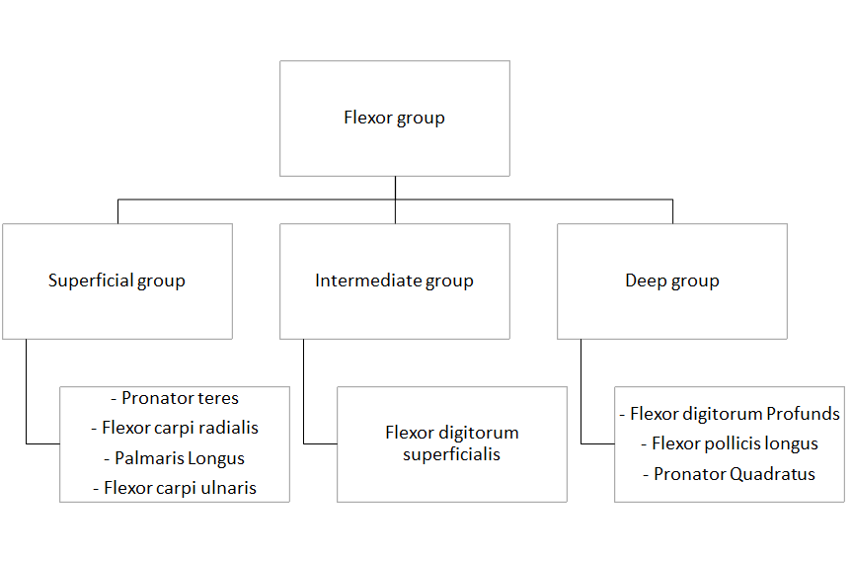
FLEXOR GROUP
These muscles: 8
•Act on the elbow & wrist joints and those of the fingers
•Form fleshy masses in the proximal part and become tendinous in the distal part of the forearm.

Slide 8
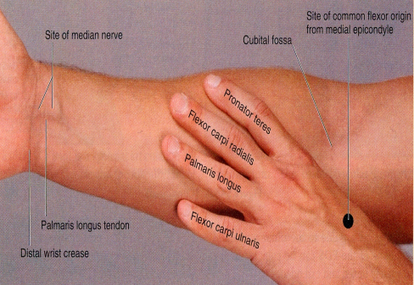
Superficial flexors:
FLEXOR GROUP
Common fascia
*All Arise(originate) from the common flexor origin (front of medial epicondyle)
Pronator teres
Flexor carpi radialis
*All are supplied by the Median nerve Except One > (FCU).
*(FCU): supplied by the Ulnar nerve.
*All cross the wrist joint Except one > Pronator teres (it is short)
Palmaris longus
Flexor carpi ulnaris
Median nerve

Slide 9
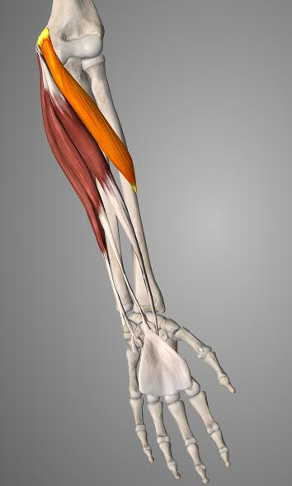
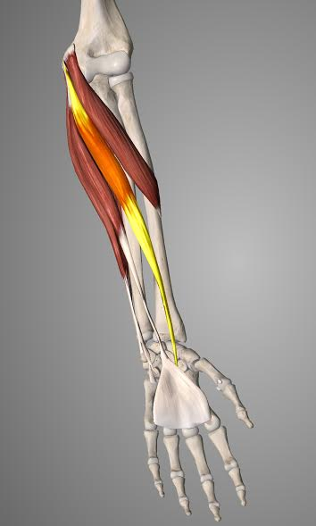
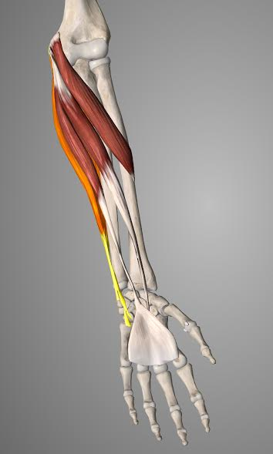
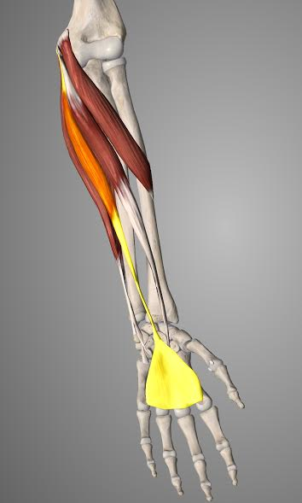
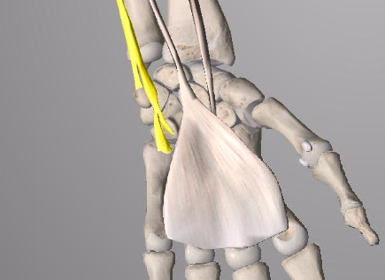
1) Pronator teres
Insertion: middle of lateral surface of radius.
Action: pronation & flexion of forearm.
2) Flexor Carpi Radialis
Insertion: Base of 2nd metacarpal bone.
Action: Flexion & abduction of the Hand.
2nd
Note:
Radialis always inserts at either 2/3 metacarpal since they are lateral.
Ulnaris always inserts at 5th metacarpal because it is medial.
3) Palmaris Longus
Insertion: flexor retinaculum & palmar aponeurosis.
(thickening of deep fascia at the wrist gives flexor retinaculum. And thickening of deep fascia at palm gives the palmar aponeurosis)
Action: Flexes hand & tightens palmar aponeurosis
4) Flexor Carpi Ulnaris
Insertion:
*Pisiform
*Hook of hamate
*5th metacarpal bone
Action: Flexion and adduction of the hand.
All have the Same origin in front of medial epicondyle

Slide 10
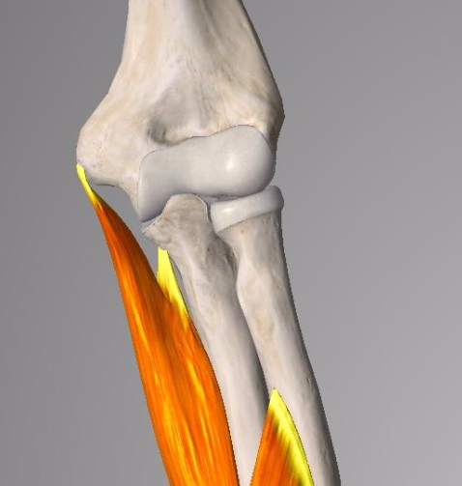
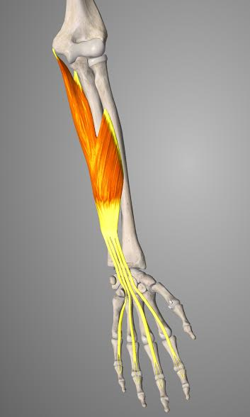
FLEXOR GROUP
Intermediate flexors:
Flexor Digitorum Superficialis
Origin:
• ( Common flexor origin ''medial epicondyle" )
• ( Coronoid process of ulna )
• ( Anterior surface of radius )
Insertion: Base of middle phalanges of medial 4 fingers.
Action: Flexes middle and proximal phalanges of medial 4 fingers, and the hand.
https://youtu.be/iDXUwErttJA

Slide 11
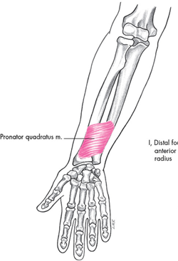
FLEXOR GROUP
Note: The anterior interosseous nerve is a branch of the median nerve
Where as the posterior interosseous nerve is the deep branch of the radial nerve
Deep Flexors:
Flexor pollicis longus
• Origin: Above/in front of Radius
• Insertion: Base of distal phalanx of thumb
• Action: flexes interphalangeal, metacarpophalangeal & carpometacarpal joints of thumb. (all thumb joints)
• Innervation: anterior interosseous nerve
Pronator Quadratus.
• Origin: Above the 2 bones
Boys Slides: Lower 1/4th of front of Ulna.
•Insertion: distal 1/4th of ant. surface of Radius
•Action: pronates forearm (prime mover), and helps to hold the bones together
• Innervation: anterior interosseous nerve
Flexor Digitorum profundus:
• Origin: Above / in front of Ulna
• Insertion: bases of distal phalanges of medial 4 digits
• Action: Flexes distal phalanges of medial 4 digits.
• Innervation: (medial) ulnar nerve
(lateral) anterior interosseous nerve
Note:
Interphalangeal = between 2 phalanges
Metacarpophalangeal = between metacarpal and phalange
Carpometacarpal = between the carpals and metacarpals

Slide 12
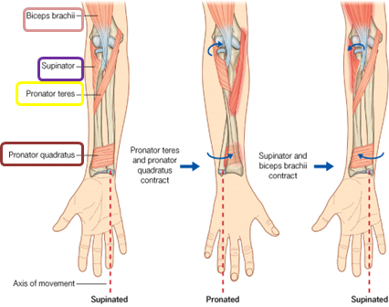
Supination and pronation
It occurs in the superior and inferior radioulnar joints;
- Muscles that produce supination:
§ Biceps brachii.
§ Supinator.
- Muscles produce pronation:
§ Pronator teres.
§ Pronator quadratus.
Brachioradialis puts the forearm in midprone – position*.
( *(الوضعية اللي بالنص بين السوباينيشن والبرونيشن ‘لما تكون اليد نفس السكين‘
Notes:
باقي المربعات حول الكلمات

Slide 13
Posterior compartment:
3 groups
12 muscle
Common Extensor Origin
(front of lateral epicondyle).
Superficial group (5):
1-Extensor carpi radialis brevis
2- Extensor digitorum
3- Extensor digiti minimi
4-Extensor carpi ulnaris
5-Anconeus
Superficial Lateral group (2): (originate from lateral Supracondylar Ridge)
1-Brachioradialis
2-Extensor carpi radialis longus
Deep group (5):
(3 to thumb+ 1 to index + supinator).
1-Supinator.
2-Abductor pollicis longus.
3-Extensor pollicis brevis.
4-Extensor pollicis longus.
5-Extensor indices.
Pollicis = إبهام
Note: The total number of superficial muscles is 7

Slide 14
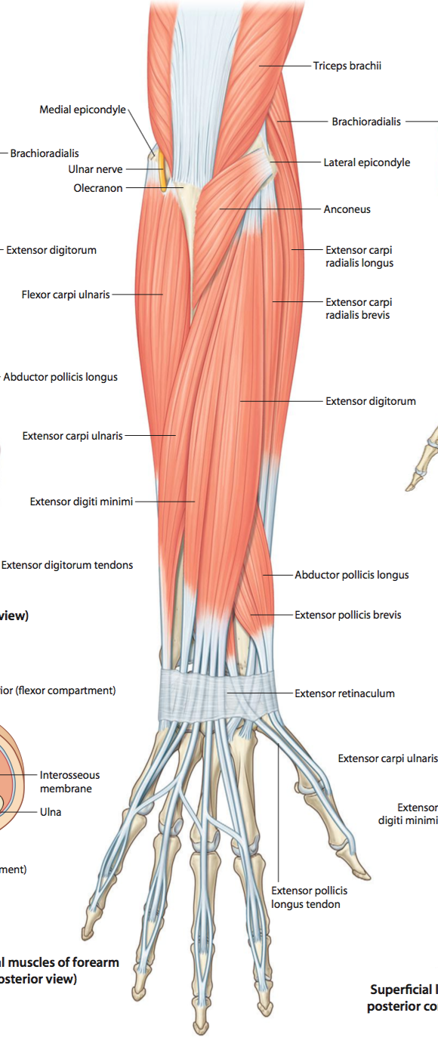
Posterior compartment:
1) Superficial Group
These muscles make up the superficial group of the posterior compartment of the forearm (7 muscles):
Brachioradialis (BR).
Extensor Carpi radialis longus (ECRL).
Extensor Carpi radialis brevis (ECRB).
Extensor Digitorum (ED).
Extensor Digiti minimi (EDM).
Extensor Carpi ulnaris (ECU).
Anconeus (An).
“Big Chocolate Chips, Double Dip Cherries are Amazing”

Slide 15
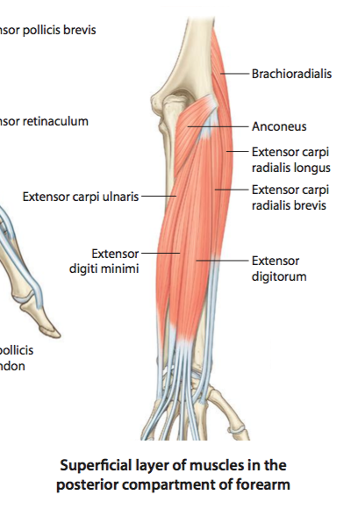
Posterior compartment:
1) Superficial Group
It’s important to know the exceptions
Insertion:
Extensor carpi radialis brevis:
base of 3rd metacarpal bone.
Extensor digitorum:
Extensor expansion of the medial 4 fingers.
Extensor digiti minimi:
Extensor expansion of the little finger.
Extensor carpi ulnaris:
Base of the 5th metacarpal bone.
Anconeus:
Lateral side of the olecranon
Superior part of the posterior (back) of Ulna shaft.
Origin:
Common extensor origin (front of lateral epicondyle of humerus
Except 2 (BR & ECRL: lateral Supracondyle)
All cross the wrist except brachioradialis & anconeus
All are supplied by deep branch of radial nerve (also called posterior interosseous nerve)
Except (ABE):
Anconeus (An).
Brachioradialis (BR).
Extensor carpi radialis longus (ECRL).
^These 3 are supplied by the radial nerve itself.
Note: you have to distinguish whether the innervation is from a nerve or one of its branches.

Slide 16
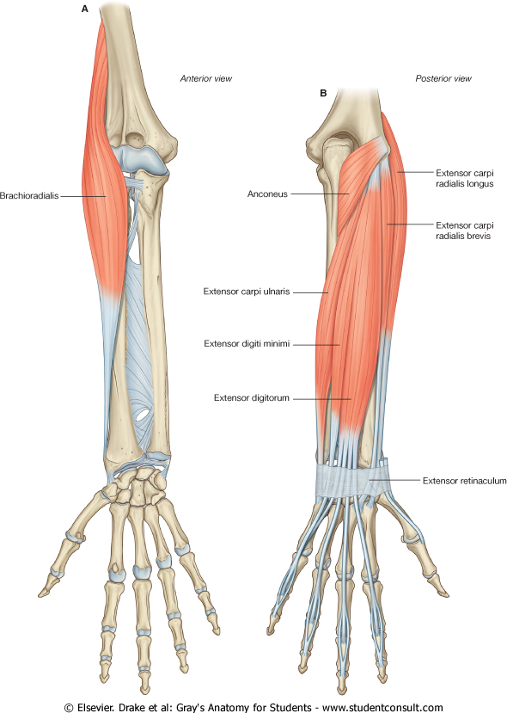
Posterior compartment:
1) Superficial Group
Brachioradials
Origin:
Lateral supracondylar ridge of humerus
Insertion:
Base of styloid process of radius
Action:
Flexes forearm; (elbow).
Rotates forearm to the midprone position
Extensor Carpi radialis longus
Origin:
Lateral supracondylar ridge of humerus
Insertion:
Posterior surface of base of 2nd metacarpal bone
Action:
Extends and abducts hand at wrist joint

Slide 17
Posterior compartment:
2) Deep group:
5 muscles
1- Abductor pollicis longus, (APL).
2- Extensor pollicis brevis, (EPB).
3- Extensor pollicis longus, (EPL).
4- Extensor indicis (EI).
5- Supinator.
These muscles are supplied by:
posterior interosseous nerve (deep branch of radial nerve).
Remember all back muscles of forearm are supplied by the posterior interosseous nerve except ABE by the radial nerve

Slide 18
Dorsal Extensor Expansion:
It is formed on the dorsum of medial 4 fingers
By the union of the tendons of:
1- Extensor digitorum 2- Extensor digiti minimi 3-Extensor indicis 4-Palmar and dorsal Interossei and 5- Lumbricals muscles.
توسيع =
Expansion
The united tendon divides into 3 slips:
2 Lateral:
attached to the terminal phalanges.
1 Median:
attached to middle phalanges

Slide 19
Flexor group
Superficial
Pronator Teres
Flexor Carpi Radialis
Intermediate
Flexor Digitorum Superficialis
Deep
Palmaris longus
Felxor Carpi ulnaris
Flexor Digitorum Profundus
Flexor Pollicis Longus
Pronator Quadratus
Summary
Origin: Front of medial epicondyle
nerve supply: median nerve except Flexor Carpi Ulnaris
- All cross the wrist except Pronator Teres
nerve supply:
ulnar nerve

Slide 20
Posterior Compartments
Superficial
Medial
Lateral
Deep
Abductor Pollicis longus
Extensor carpi radialis brevis
Extensor digitoruim
Extensor digiti minimi
Extensor Carpi ulnaris
Anconeus
Brachioradialis
Extensor carpi radialis longus
Extensor Pollicis brevis
Extensor Pollicis longus
Extensor Incidis
Supinator
Summary
Origin: Lateral epicondyle except Superficial lateral group
Nerve Supply: deep branch of radial nerve except Superficial Lateral group and Ancones (ABE)
- All cross the wrist except Brachioradialis
Origin: lateral supracondyle ridge of humerus
Nerve supply: radial nerve

Slide 21
Summary
Muscles that flex the hand:
1- Flexor Carpi Radialis
2- Flexor Carpi Ulnaris
3- Palmaris Longus
4- Flexor Digitorum Superficialis
Muscle | compartment | Exceptions:
Flexor Carpi Ulnaris | Flexor group | Nerve Supply | Ulnar nerve
Superficial lateral group and Anconeus (ABE) | Posterior Compartments | Nerve Supply | Radial Nerve
Pronator Teres | Flexor group | Wrist crossing | Doesn’t cross
Brachioradialis | Posterior Compartments | Wrist crossing | Doesn’t cross
Anconeus | Posterior Compartments | Wrist crossing | Doesn’t cross
Superficial Lateral group | Posterior Compartments | origin | lateral supracondylar ridge of humerus

Slide 22
Summary
 | Muscle | Insertion
Superficial Medial | Extensor Carpi Ulnaris | Base of 5th metacarpal bone
 | Extensor Digitorum | Extensor expansion of medial 4 fingers
 | Extensor Carpi Radialis Brevis | Base of 3rd metacarpal bone
 | Extensor Digiti Minimi | Extensor expansion of little finger
 | Anconeus | Superior posterior part of shaft of ulna
Superficial Lateral | Extensor Carpi Radialis Longus | Base of 2nd metacarpal bone (posterior)
 | Brachioradials | Base of styloid process of radius
Superficial | Flexor Carpi Radialis | Base of 2nd metacarpal bone
 | Pronator teres | middle of lateral surface of radius.
 | Palmaris Longus | Flexor retinaculum and palmer aponeurosis
 | Flexor Carpi Ulnaris | 5th metacarpal
Intermediate | Flexor Digitorum Superficialis | Middle phalanges of 4 medial fingers
deep | Flexor Digitorum Profundus | Distal phalanges of medial 4 fingers
 | Flexor Pollicis Longus | Distal phalanax of thumb
 | Pronator Quadratus. | distal 1/4th of ant. surface of Radius
Posterior Compartment
(Extensor group)
Anterior Group
(Flexor group)

Slide 23
Questions:
1- Name 3 extensor muscles from the deep group of the posterior compartment?
2- Identify the muscle?
3- Radius and ulna are connected together by:
a.interosseous membrane
b.Thoracolumbar fascia
c.Iliac crest
4- Fascial sheath attached to:
a.Anterior border of the ulna.
b.Posterior border of the ulna.
c.Medial border of the ulna.
5- All of the following muscles produce supination Except:
a. Biceps brachii.
b. Supinator.
c. Pronator teres.
​
6- Which of the following muscle put the forearm in midprone – position: ​
a. Brachioradialis ​
b. Pronator quadratus. ​
c. Biceps brachii. ​
​
7-All superficial flexors of forearm muscles are supplied by......Except FCU, its supplied from..... ​
a. median nerve - axillary nerve ​
b. median nerve – Ulnar nerve ​
c. radial nerve – Ulnar nerve ​
​
8-Insertion of flexor carpi Ulnaris ​
a. 5th metacarpal bone ​
b. 2nd metacarpal bone ​
c. Scaphoid bone
9-What is the common extensor origin?
A)Frontal medial epicondyle of humerus
B)frontal of lateral epicondyle of humerus
C)Radial fossa
D) Coranoid process
1) Supinator, Abductor pollicis longus, Extensor pollicis brevis
2) Abductor pollicis longus (APL)
3) A
4) B
5)C
6)A
7)B
8)A
9)B

Slide 24
Questions:
10- Which muscle is not supplied by deep branch of radial nerve?
A)Extensor Carpi ulnaris
B)Extensor Digitorum
C)Extensor Carpi radialis brevis
D) Extensor Carpi radialis longus
11- The insertion of ECRL is :
A)base of 2nd metacarpal bone
B)base of 3rd metacarpal bone.
C)Base of the 5th metacarpal bone.
D)Extensor expansion of the medial 4 fingers.
12- Which of the following muscles contributes as powerful supinator of forearm?
Palmaris longus
Pronator teres
Biceps brachii
Supinator
13- which muscle is related to common flexor origin?
A) Flexor digitorum profundus
B) Flexor pollicis longus
C) Pronator quadratus
D) Pronator teres
14- Which one of the following forearm flexor muscles is intermediate? ​
A- Flexor digitorum profundus ​
B- Flexor digitorum superficialis​
C- Palmaris longus​
D- Flexor Capri ulnaris​
​ 15- What is the insertion of flexor digitorum profundus?​
A- Bases of middle phalanges of medial 4 fingers.​
B- Bases of distal phalanges of the medial 4 digits. ​
C- Bases of proximal phalanges of the medial 4 digits. ​
D- Middle part of distal phalanges of medial 4 fingers.​ ​
​
16- What is the forearm muscle that can flex the joints of the thumb? ​
​
10)D
11)A
12)C
13)D
14)B
15)B
16) Flexor Pollicis Longus

Slide 25
Leaders:
نواف الخضيري
جواهر ابانمي
غادة المزروع
members:
نجد الذيب
نورة السهلي
سمية الغامدي
آمال الشيبي
رنا راسين
ريما العتيبي
بدرية الصباغ

