Slide 1
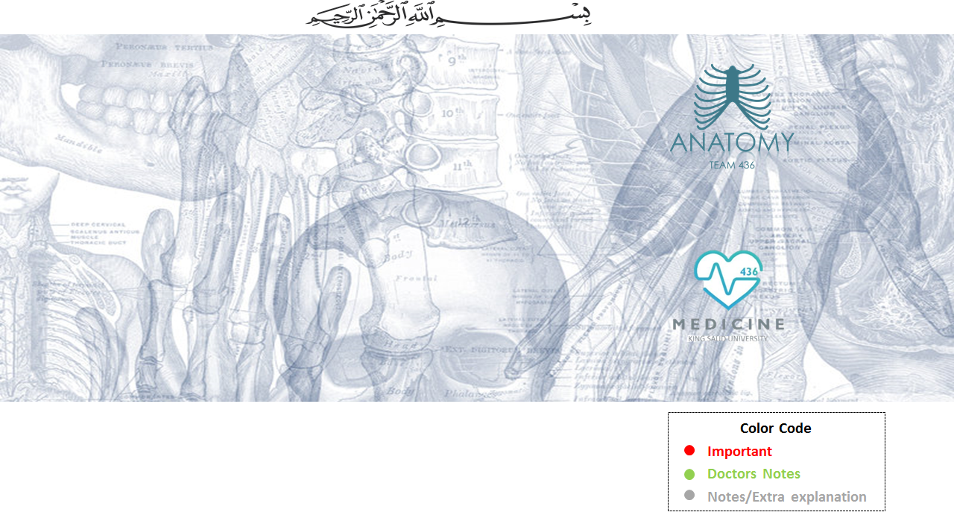
Axillary and Median Nerve
Editing File

Slide 2
Objectives
At the end of the lecture, students should be able to:
Describe the origin, course, relations, branches and distribution of the axillary & median nerves
Describe the common causes and affects of injury to the axillary and median nerves

Slide 3
Brachial plexus
Really Tired..? Drink Coffee

Slide 4
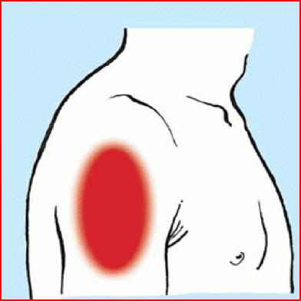
Axillary Nerve
أي عصب ناخذه لازم نعرف من أي قطع من السباينل كورد جاء ، لأن أي ضرر يصير فيهم فهو أيضاً راح يتأثر
Origin: (C 5 &6)-
Posterior cord of brachial plexus
Course:-
It passes inferiorly and laterally along the posterior wall of the axilla to exit(from axilla) q.
Then, it passes posteriorly around the surgical neck of the humerus.
•It is accompanied by the posterior circumflex humeral artery.
Branches:
•Motor to the deltoid and teres minor muscles
•Sensory: superior lateral cutaneous nerve of arm that loops around the posterior margin of the deltoid muscle to innervate skin in that region.

Slide 5
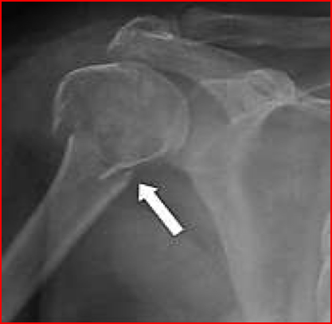
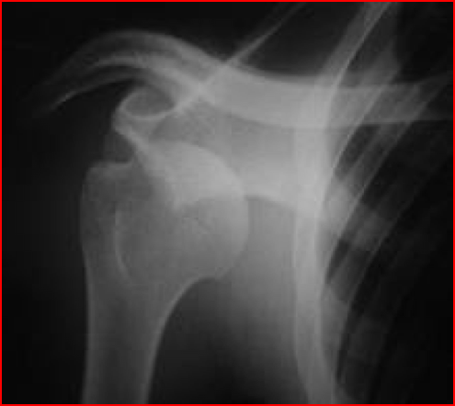
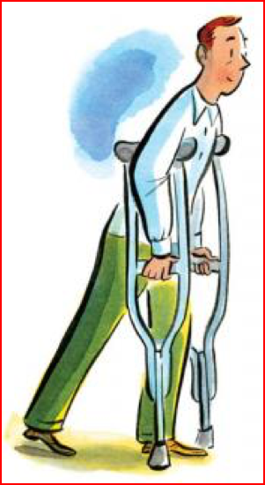
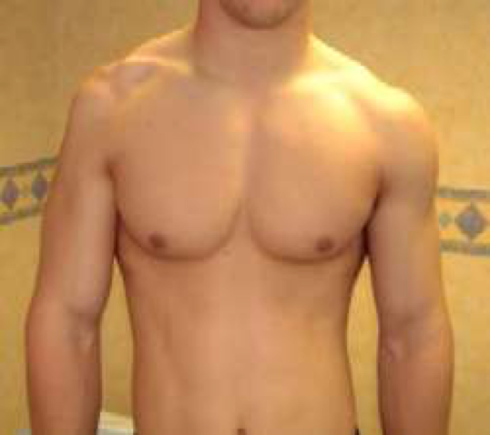
Axillary Nerve Lesion
The axillary nerve is usually injured due to:
1. Fracture of surgical neck of the humerus.
2. Downward dislocation of the shoulder joint
3. Compression. from the incorrect use of crutches.
لأن رأس الهيومرس بيضغط عليه
Effects:
Motor:
1- Impaired abduction of the shoulder (30-90˚)
2- Paralysis of the deltoid and teres minor muscles
The paralyzed deltoid wastes rapidly
As the deltoid atrophies, the rounded contour of the shoulder is flattened compared to the uninjured side
Sensory:
Loss of sensation over the lateral side of the proximal part of the arm
In boys' slides (20 – 90) h
More than 90 = supraspinatus

Slide 6
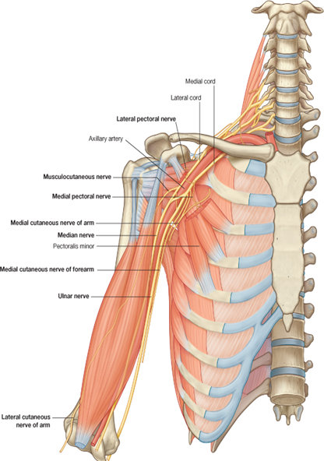
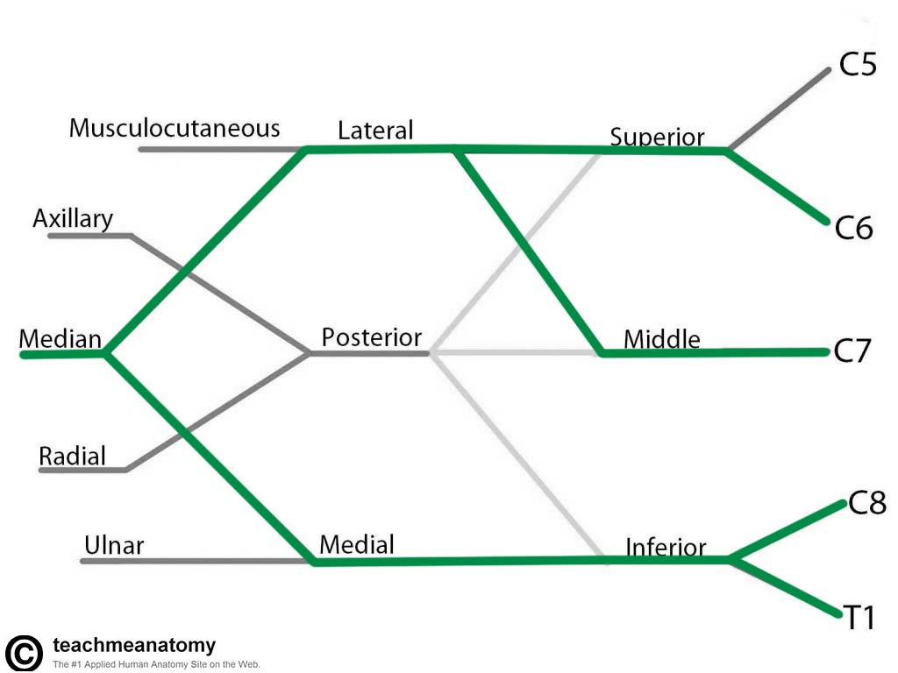
Median Nerve
Nerve roots(Origin:): C5 ,C6,C7,C8 &T1 (in some individuals from C6-T1
The median nerve is formed anterior to the third part of the axillary artery by the union of lateral and medial roots.
axillary artery لما يكمل للـ arm يصير اسمه brachial artery
Originating:
1)The lateral root (C5,6,7):
From the lateral cord of brachial plexus.
2)The medial root (C8&T1):
From the medial cord of brachial plexus.
Don’t confuse the roots from the cords and the roots originating from the spine
lateral roots
medial roots

Slide 7
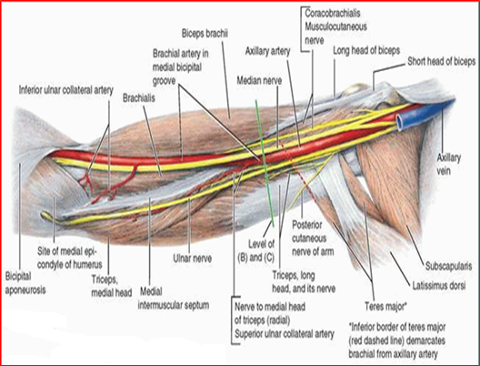
Median Nerve in the Arm
brachial artery Median Nerve
proximal regions lateral to it
Medial region anterior to it
distal regions medial to it
It enters the arm from the axilla at the inferior margin of the teres major muscle.-
•It passes vertically down the medial side of the arm in the anterior compartment and is related to the brachial artery throughout its course
in proximal regions: it lies immediately
(1-lateral) to the brachial artery;
in more distal regions: it crosses to the
(2-medial) side of the brachial artery and lies
anterior to the elbow joint .
- No major branches in the arm or axilla, BUT a branch
to one of the muscles of the forearm, the
(Pronator Teres),this branch may originate
from the nerve immediately proximal
to the elbow joint.

Slide 8
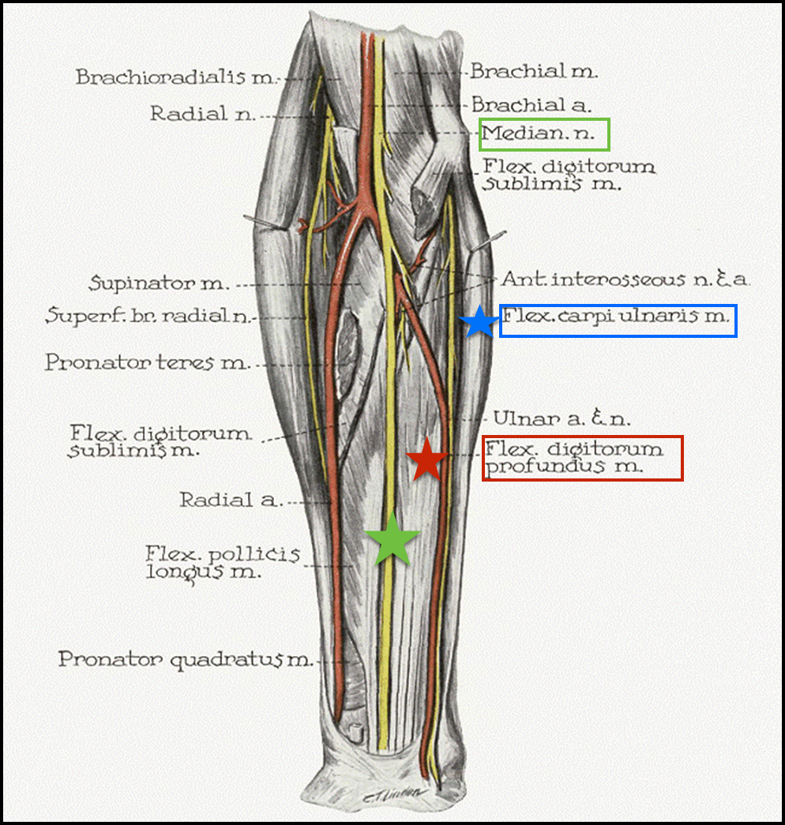
Median Nerve in the forearm
Median nerve passes into the forearm to elbow joint anteriorly
where it innervates most of the muscles in the anterior compartment of the forearm,
(EXCEPT FOR
1- Flexor Carpi Ulnaris
2- the medial half of the Flexor Digitorum Profundus
( which are innervated by the ulnar nerve).
Profundus = deep
فليكسور = تعمل فليكشن
كارباي = للكاربل بونز
والكاربل بونز وينها ؟ في الريست ، إذا تسوي فليكشن للريست :)

Slide 9
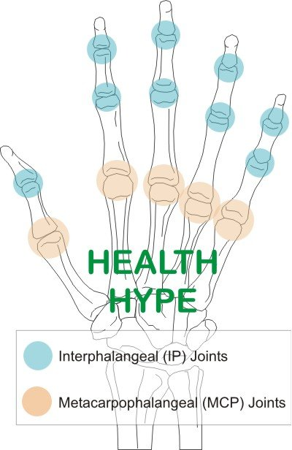
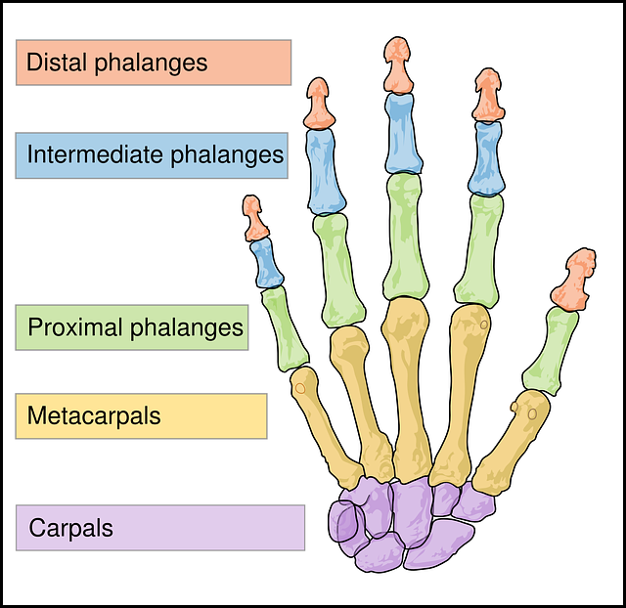
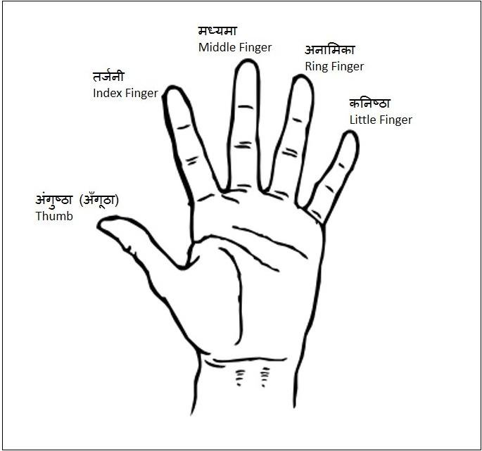
recall
Extra picture*
أحياناً تختلف بعض الأسماء

Slide 10
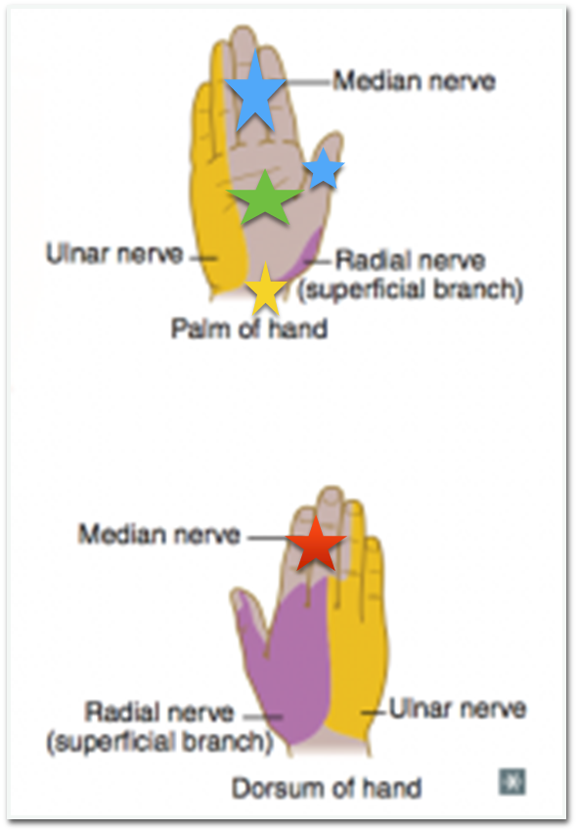
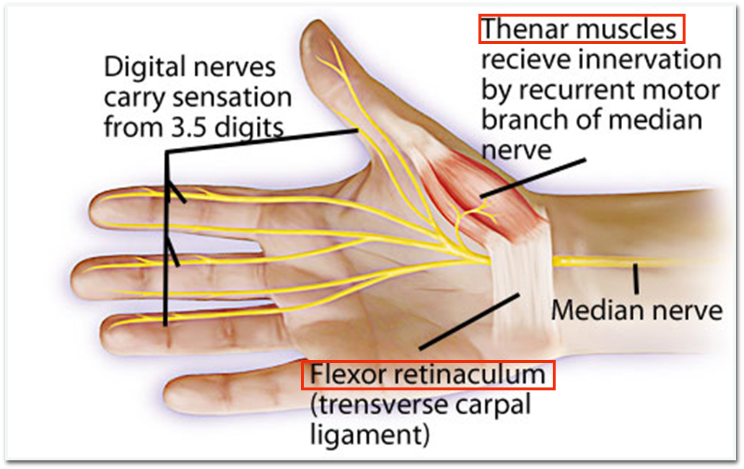
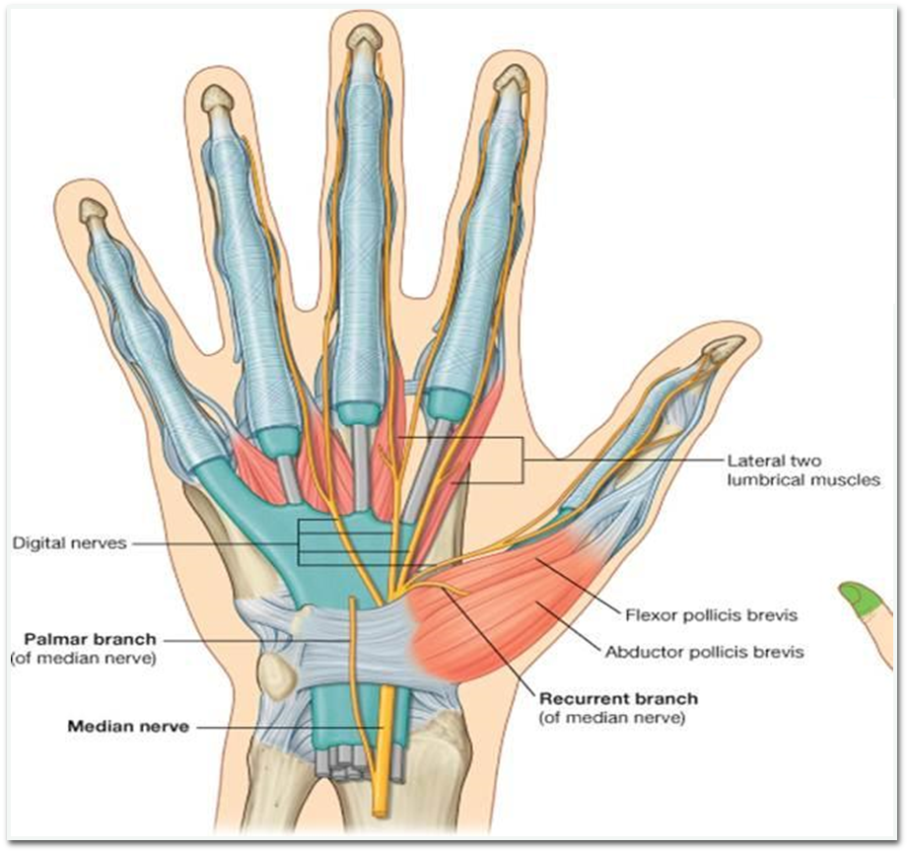
Median Nerve in the hand
The median nerve continues into the hand by passing deep to the flexor retinaculum.
It innervates:
1)Three thenar muscles: associated with the thumb
2)Lateral two lumbrical muscles: associated with movement of the index and middle fingers;
3)Skin over the palmar surface of the lateral three and one- half digits and over the lateral side of the palm and middle of the wrist.
It is Fibrous tissue
Retinaculum = Deep fascia
flexor = at the middle

Slide 11
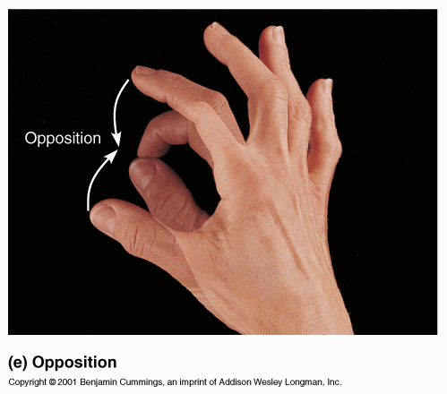
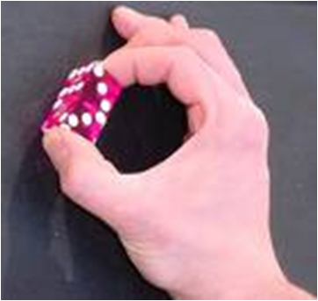
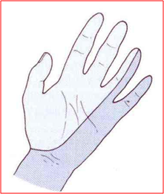
Median Nerve Lesions
Injury of median nerve at different levels causes different syndromes.
In the arm and forarm the median nerve is usually not injured by truma ..way? Because of its relatively deep position .
Median nerve can be damaged :
In the carpal tunnel (deep in flexor retinaculum)
In the elbow region
At the wrist above the flexore retinaculum
The most serious disability of median nerve injuries is the:​
Loss of opposition of the thumb
The delicated pincer-like action is not possible
هي أخطر شيء ، لأن مافي عضلة ثانية تسوي نفس الحركة او عصب ثاني يعوض
Loss of sensation from the thumb and lateral 2½ fingers or3 ½ ) lateral fingers ) & lateral ⅔ of the palm.

Slide 12
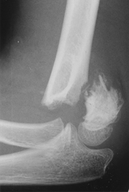
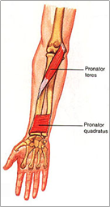
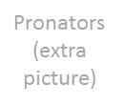
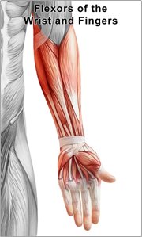
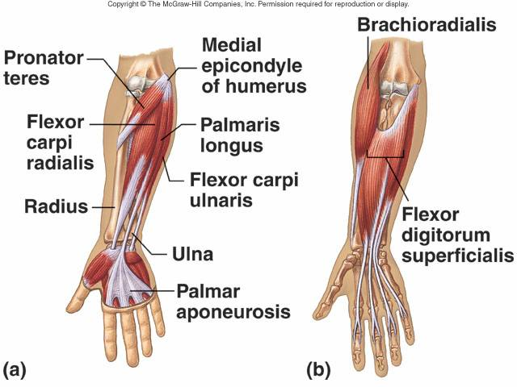
Median Nerve Lesion in Elbow Region
Due to supracondylar fracture of Humerus
Affected Muscles :
1- Pronator muscles of the forearm
2- All long flexors of wrist & fingers except
-flexor crpai unlaris
-1/2 flexor digitorum profundus
Because they are supplied by the ulnar nerve
فليكسور = تعمل فليكشن
كارباي = للكاربل بونز
والكاربل بونز وينها ؟ في الريست ، إذا تسوي فليكشن للريست :)

Slide 13
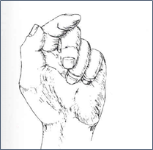
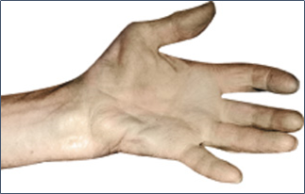
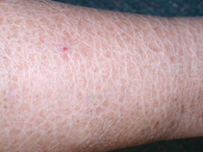
Motor effects
-loss of pronation(hand is kept supine position)
-loss of flexion on interphalangeal joints of index & middle fingers
-weak flexion of ring & little fingers
-weak flexion of wrist & ulnar deviation**
-adduction and lateral rotation of Thumb (loss of flexion of terminal phalanx and loss of opposition)
-wasting of thenar eminence ( look the picture )
-hand is flattened and “Apelike”* (unable to flex 3 most radial digits when asked to make a fist)
Apelike* مثل الشمبانزي
Wasting of thenar eminence
Sensory Effects
Extra picture
Trophic Changes
-Dry and scaly skin
-Easily cracking nails
-Atrophy of the pulp of the fingers
Extra picture
** Two muscles work together to flex the wrist:
Flexor carpi ulnaris and flexor carpi radialis; each on pulls or deviates the wrist towards it. (the ulnaris flexes the wrist and pulls it medially toward the ulnaand the radialis flexes the wrist and pulls it laterally towards the radias). When they work together they cancel each other so as a result there is no deviation. But when the median nerve is damaged the flexor carpi radialis won’t work but the ulnaris will since it is supplied by the ulnar nerve so there will be medial/ulnar deviation as a result

Slide 14
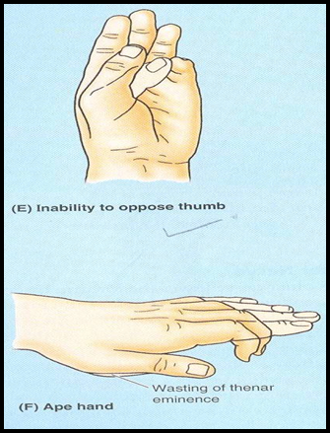
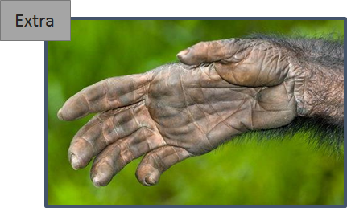
Median Nerve Lesion in the Wrist
Often injured by penetrating wounds (stab wounds or broken glass) of the (لما الشخص يحاول ينتحر)forearm.
Motor:
Thenar muscles are paralyzed and atrophy in time so that the thenar eminence becomes flattened .
Opposition and abduction of thumb are lost, and thumb and lateral two fingers are arrested in adduction and hyperextension position. “Apelike hand”
Sensory & trophic changes are the same as in the elbow region injuries .
NOTE: You have to know each deformity and the muscles/nerves involved

Slide 15
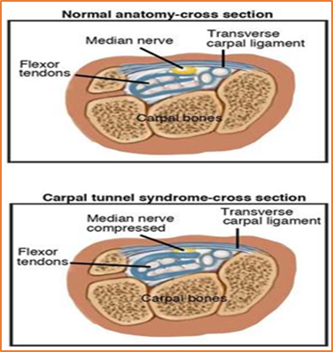
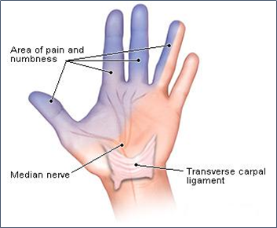
Median Nerve Lesion
deep in flexore retinaculum
(Carpal Tunnel Syndrome)
•The commonest neurological problem associated with the median nerve is compression beneath the flexor retinaculum at the wrist .
•Motor: Weak motor function of thumb, index & middle fingers
•Sensory: Burning pain or ‘pins and needles’ along the distribution of median nerve to lateral 3½ fingers
ØNo sensory changes over the palm as the palmer cutaneous branch is given before the median nerve enters the carpal tunnel .
The symptoms first appear as sensory but when it progresses further the motor symptoms appear.

Slide 16
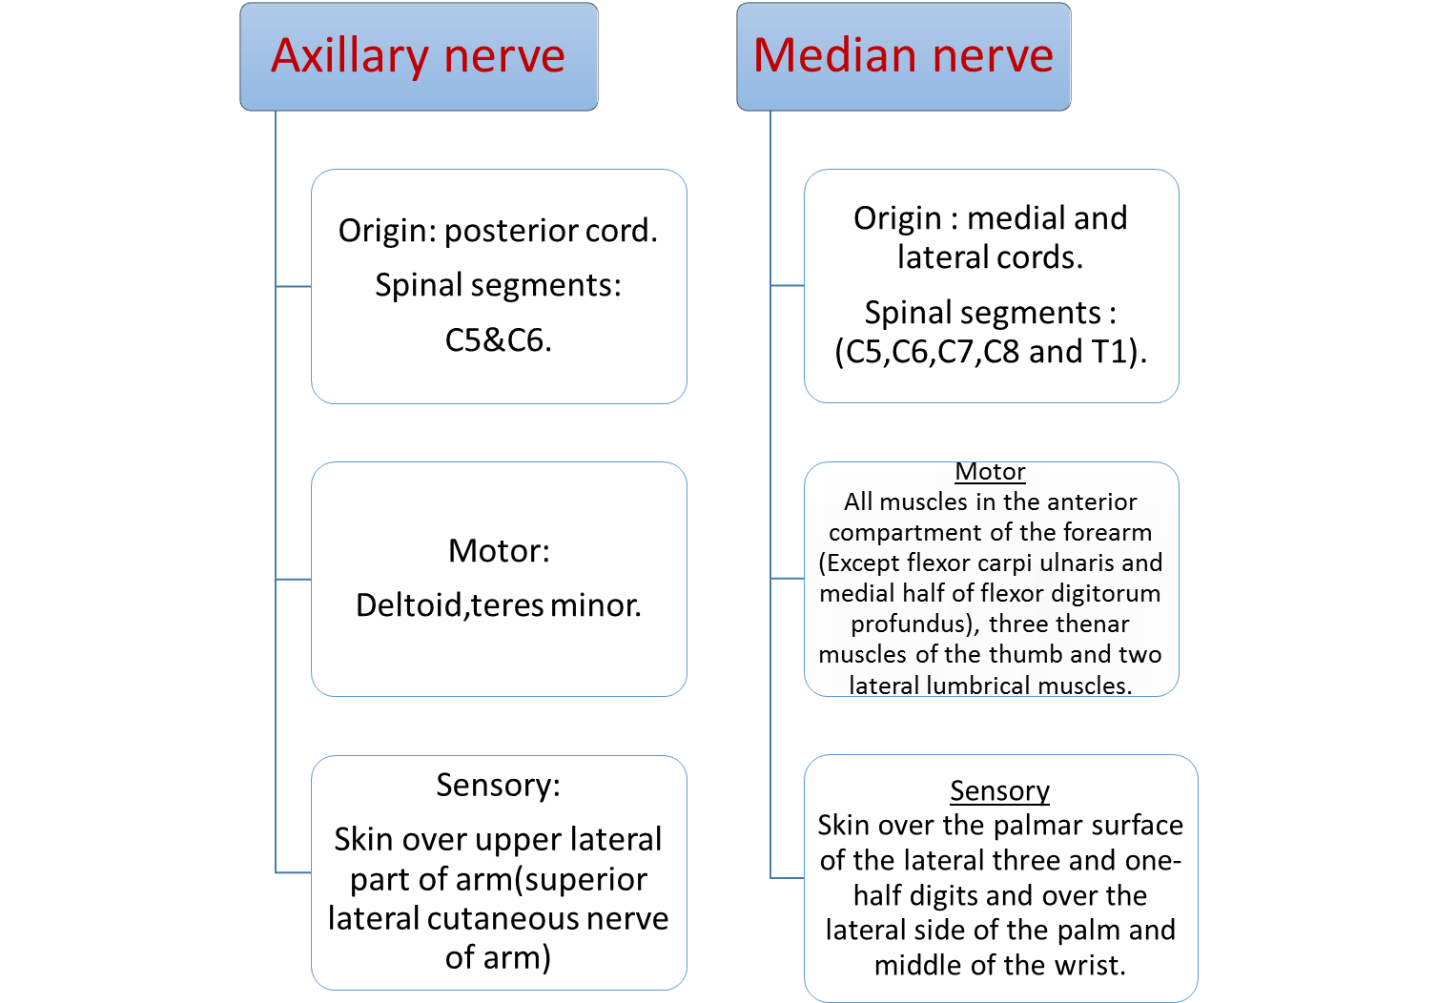
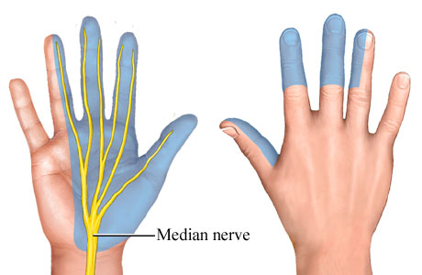
SUMMARY

Slide 17
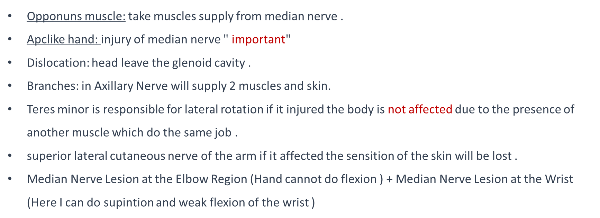
DON’T FORGET
Lateral root from lateral cord Medial root from medial cord
اكثر شي مميز في الميديان نيرف والي يخليه يأخذ شكل حرف *Y*
عشان كذا محد يغلط في الميديان نيرف.
- No major branches of Median Nerve in the arm, BUT a branch
to one of the muscles of the forearm, the
(Pronator Teres),this branch may originate
from the nerve immediately proximal
to the elbow joint.
Apelike

Slide 18
Quiz yourself
1) The median nerve innervates most of the muscles in the anterior compartment of the forearm except?
A)Flexor carpi ulnaris
B)Brochialis
C)Extensor digitorum longus
D)Corachobrachialis
2) The median nerve continues into the hand by passing deep to the?
A)Biceps brachii
B)Axillary nerve
C)Flexor retinaculum
D)Thoracodorsal nerve
3) A physician examined an xray and saw that the patient had a fracture in the surgical neck, which nerve will he be worried about?
A) Axillary
B) Musculocutaneous
C) Radial
D) Brachial
4) Which of the following is a sensory supply of the median nerve?
Palmer lateral 3 and a half digits
Palmer medial 1 and a half digits
3 thenar muscles
3 hypothenar muslcles
5) The median nerve originates from:
Medial cord
Lateral cord
Posterior cord
A & B
1)A
2)C
3)A
4)A
5)D

Slide 19
Quiz yourself
6) Which of the following is trophic change due to median nerve lesion in elbow?
A)Loss of sensation in thumb
B)Apelike hand
C)Dryness of skin
D)Loss of pronation
7) When the injury is in the median nerve at wrist, the thenar muscle become:
A)Paralyzed, Hypertrophy
B)Paralayzed, larger in size
C)Paralyzed, atrophy
D)No change
8) In the median nerve lesion at wrist the hand look like:
A)Apelike hand
B)Claw hand
C) Drop fist
9) The compression in the carpal tunnel syndrome:
A)Above the extensor retinaculum
B)Beneath the flexor retinaculum
C)Above the flexor retinaculum
D)Beneath the extensor retinaculum
6)C
7)C
8)A
9)B

Slide 20
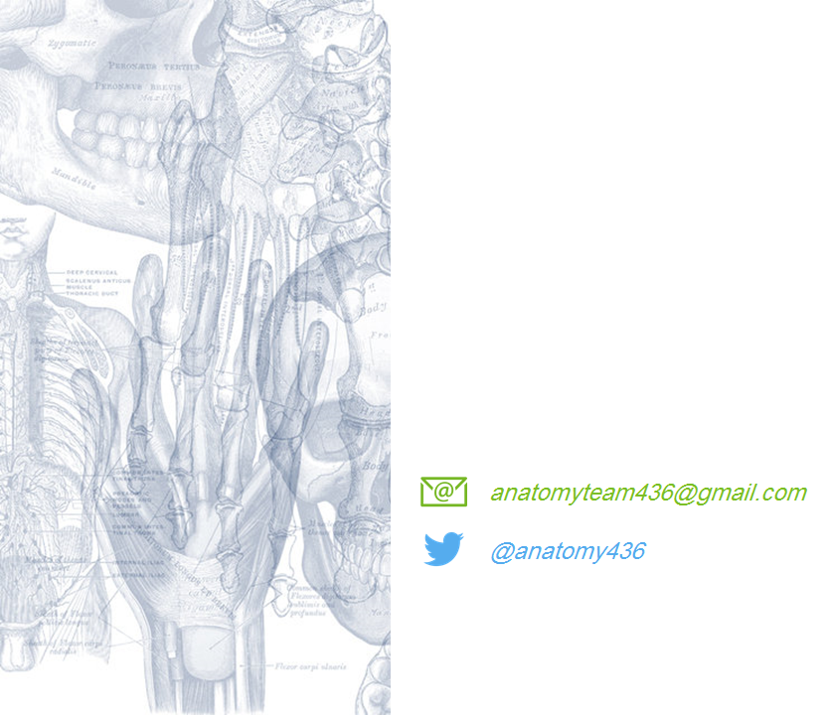
Leaders:
نواف الخضيري
جواهر ابانمي
غادة المزروع
Members:
العنود ابو حيمد
هبه الناصر
شذا الغيهب
شوق البقمي
لمى الفوزان
ريما الشايع
ندى الدخيل
أميرة نيازي

