Slide 1
Glycogen Metabolism
– Color Index:
Important.
Extra Information.
Doctors slides.
436 Biochemistry team

Slide 2
Objectives:
By the end of the lecture. Students should be familiar with :
The need to store carbohydrates in muscle
The reason for carbohydrates to be stored as glycogen
An overview of glycogen synthesis (Glycogenesis)
An overview of glycogen breakdown (Glycogenolysis)
Key elements in regulation of both Glycogenesis and Glycogenolysis (this objective is important for other lectures)

Slide 3
Glycogen Metabolism
Remember metabolism is a mixed up between catabolism and anabolism
Glycogen: is a branched – chain homopolysaccharide of glucose that serves as a form of energy storage made from α -D-Glucose
Glycogen could be found in all types of cells, but in very small amounts (traces of glycogen), the main stores of glycogen are found in skeletal muscle and liver.
Metabolism of Glycogen in Skeletal Muscle:
1- Glycogenesis:(Anabolism)
Synthesis of Glycogen from glucose
2- Glycogenolysis :(catabolism)
Breakdown of Glycogen to Glucose-6-phosphate

Slide 4
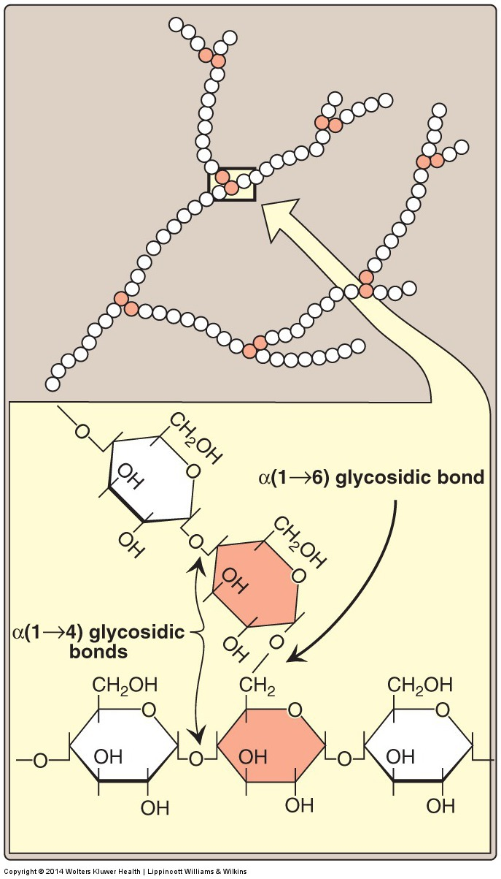
Structure of Glycogen
N.B.
*All glucose residues in human are alpha.
Bonds in Glycogen
The primary glycosidic bond is α (1→4) Glycosidic linkage
Between glucose residues
(linear )
After 8 to 10 residues there is a branch containing α ( 1→6 ) Glycosidic linkage
These polymers of glucose (Glycogen) exist in cytoplasmic granulesحبيبات which contain most of the enzymes necessary for glycogen synthesis and degradation .
Residue is a partial of UDP-Glucose
*كل وحدة من الروابط عندها انزيم مميز يكونها ويفكها

Slide 5
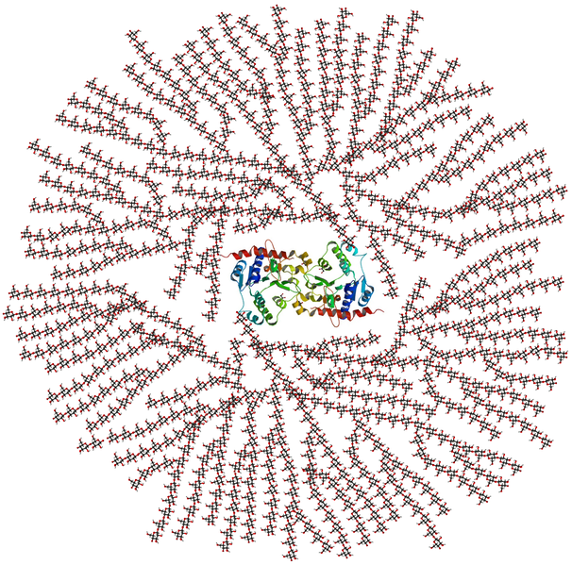
Glycogen Structure
α (1-4) Glycosidic linkage
Between the glucose residues
Why is glycogen a branched-chain ?
To contain high number of homopolysaccharides within a small space.
α ( 1-6 ) Glycosidic linkage
In Branches
The colorful molecule in the middle is a protein called :
Glycogen Primer (Glycogenin )
The hole structure represent a
Glycogen Granule which is present in the Cytoplasm

Slide 6
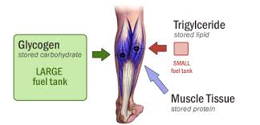
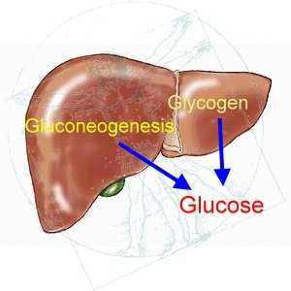
*the aim of glycogenolysis in muscle cells is to generate energy, so it’s better to start from glucose 6-P rather than glucose to avoid losing 1 ATP.
Location and function of glycogen :
Skeletal muscle
liver
Glycogen → Glucose 6-P → Energy
Glycogen → Glucose 6-P → Glucose
400 g of glycogen
make up 1-2% of the weight of resting muscle
100 g of glycogen
make up ~10% of the weight of a well-fed (healthy) adult liver
Fuel reserve (ATP)
(during muscular exercise)
A source for blood glucose
(especially during early stages of fasting 10-17 hours)

Slide 7
GLYCOGENESIS
(Synthesis of Glycogen in Skeletal Muscles)
1- building blocks : Synthesis (UDP-glucose)* (source of all residues that are added to the growing glycogen molecule.)
2- Initiation of synthesis
3- Elongation:
Using the enzyme glycogen synthase (which makes
α 1→4 linkages)
4- Branching:
Using branching enzyme (makes α 1-6 linkages) .
EXPLINATION:
Glucose synthase cannot start making glycogen from nothing, all it does is (1)elongation of pre existing glycogen fragments,
OR via using (2)glycogen primer (glycogenin), it acts like glycogen (UDP chains)
to start the elongation.
*uridine diphosphate glucose is the building block of glycogen
2- Initiation of synthesis :
The enzyme glycogen synthase (which makes α 1→4 linkages) cannot initiate chain synthesis using free glucose. So, it elongates an already existing chain of glucose and therefore requires a primer.
A fragment of glycogen can serve as a primer.
In the absence of a glycogen fragment,
a protein called glycogenin acts as a primer.

Slide 8
Synthesis of Glycogen
1- Glucose 6-P + phosphogluco-mutase (Isomeration) → Glucose 1-P
2- Glucose 1-P + UTP (energy) + UDP-glucose pyrophosphorylase (enzyme) → UDP-glucose unit.
3- Start of elongation by binding of UDP glucose complex to glycogenin (primer) by glycogen synthase (enzyme)
*UDP: a nucleotide and it is an important factor in glycogenesis.
*Before glucose can be stored as glycogen in the liver and muscles, the enzyme UDP pyrophsphorylase forms a UDP glucose complex

Slide 9
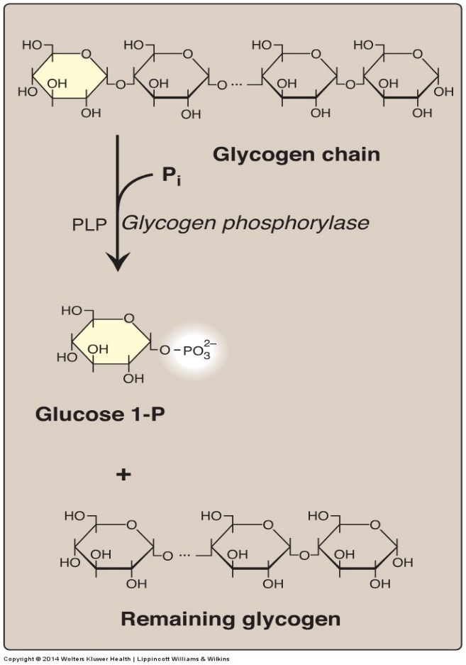
Glycogenolysis
(Breakdown of glycogen in skeletal muscles)
1- Shortening of glycogen chain: by glycogen phosphorylase:
Glycogen phosphorylase contains a coenzyme: pyridoxal phosphate (PLP).
(Note: Pyridoxal Phosphate is a functional form of vitamin B6.)
They cleave (break) α(1→4) bonds of the glycogen chain → Producing glucose 1-P.
Note: After it reaches 4 residues the enzyme will stop cleaving
2- Removal of branches: by debranching enzymes
Cleaving of α(1→6) bonds at the branches of glycogen which releases free glucose directly
(in few quantities because the majority of the bonds are
α (1,4) bonds)
3- Conversion of glucose 1-P to glucose 6-P: Glucose 1-P is converted to glucose 6-P by phosphogluco-mutase .

Slide 10
Glycogenolysis
Fate of Glucose 6-Phosphate (G-6-P)
In the liver: glucose 6-P is converted to free glucose.
In the skeletal muscle: glucose 6-P CAN NOT be converted to free glucose and sent into the blood, because it doesn’t have the enzyme for it. It is used as a source of energy for skeletal muscles during muscular exercise (by anaerobic glycolysis starting from G-6-P step). And produces 2 ATP because it’s in the muscle (anaerobic).
The majority is in the muscle because it’s bigger and more abundant in the body
Note : the ratio of glucose 1-phosphate to free glucose is ~8:1,
meaning every 8 molecules of G-1-P, one molecule of free glucose will be produced

Slide 11
Summery
Glycogenolysis
Glycogenesis

Slide 12
Regulation of Glycogen Metabolism
Synthesis & degradation of glycogen are tightly regulated
IN SKELETAL MUSCLES:
- Glycogen degradation occurs during active exercise
-glycogen synthesis begins when the muscle is at rest
Remember:
Covalent modification: is regulating enzyme activity by adding molecule on it. The most common way is Phosphorylation and dephosphorylation.
Regulation mechanisms
1- allosteric regulation
2-Hormonal regulation
(covalent modification)

Slide 13
(Allosteric regulation)
Regulation of glycogen metabolism
Glycogen phosphorylase
-Inhibited by:(Inhibit glycogen break down)
glucose 6-p (High energy signal in the cell).
ATP (ATP is abundant, no need for more energy).
-Activated by:(activate glycogen break down)
Ca++ (we will explain it in the next slide).
AMP (low energy signal).
Glycogen synthase Activated by: (activate glycogen synthesis)
Glucose 6-p (High energy signal in the cell).

Slide 14
Regulation of Glycogen Metabolism
(Allosteric regulation)
Ca Releasing
Ca⁺² is released from endoplasmic reticulum in response to hormone/neurotransmitter binding to cell-surface receptors which will lead in our case to increase Ca⁺² conc. during muscle contraction.
Formation Ca⁺² calmodulin complex
High conc of Ca⁺² in the Intracellular will lead to formation of calmodulin-Ca⁺² complex (4 molecules of Ca⁺² bind to calmodulin)
Enzyme activation
calmodulin-Ca⁺² complex will activates Ca⁺²-dependent enzyme e.g. glycogen phosphorylase

Slide 15
Regulation of Glycogen Metabolism Hormonal Regulation(Covalent Modification)
قال دكتور الاولاد انه مهم
Muscle Contraction
Skeletal Muscle: Epinephrine/receptor binding
Second Messenger: cAMP
Response: Enzyme phosphorylation
Epinephrine stimulates glycogenolysis
(Skeletal muscle)
Glucagon stimulates
Glycogenolysis
(Liver)
Both use second messenger: cAMP
P
P
Glycogen synthase (Inactive form)
Glycogen phosphorylase (Active form)
Inhibition of glycogenesis
Stimulation of glycogenolysis

Slide 16
Glycogen Storage Diseases (GSD)
A group of genetic diseases that result from a defect (نقص)
in an enzyme required for glycogen synthesis or degradation.
They result in
Excessive accumulation (تجمع) of normal glycogen in a specific tissue
Formation of abnormal glycogen structure
or

Slide 17
Glycogen Storage Diseases (GSD)
GSD Type V (McArdle Syndrome)
Common in saudi arabia
GSD Type II (POMPE DISEASE)
Deficiency of skeletal muscle glycogen phosphorylase
Deficiency of Lysosomal α(1-4) glucosidase.
Brief about Pompe Disease
Absence or deficiency of the lysosomal enzyme $∝$-glucosidase. Which is required to breakdown the complex carbohydrate glycogen and convert it into the simple sugar glucose.
Symptoms:
Progressive proximal muscle weakness (trunk and lower limbs)
Gait abnormalities.
Muscle pain.
Difficulty climbing stairs.
Frequent falls.
Scapular winging.
Difficulty chewing or jaw muscle fatigue.
Prognosis:
These babies die before the age of one year
Brief about McArdle Syndrome
body is not able to break down glycogen, due to Myophosphorylase defect.
Symptoms:
Usually start during early childhood, but diagnosis may not occur until a person is over 20 or 30 years old.
Muscle cramps, pain, stiffness & weakness
Fatigue
Burgundy-colored urine
Exercise intolerance, poor stamina
Prognosis:
People with McArdle disease can live a normal life by managing their diet and physical activity
**They may ask about these diseases as cases, so knowing the etiology & symptoms is imortant

Slide 18
Girls team members:
1- نوره الشبيب.
2- ريم السرجاني.
3- نورة السهلي.
4- ربا برناوي
5- هيفاء الوعيل
Boys team members:
1- محمد المهوس.
2- فهد الزهراني.
3- عبدالعزيز الصومالي.
4- خالد القحطاني.
5- طلال الطخيم.
6- محمد حبيب.
7- حمد الحسون.
8- محمد المطلق
-Contact us:
Biochemistryteam436@gmail.com
twitter.com/436biochemteam
-Team leaders:
عبدالله المانع.
رانيا العيسى.
Reference :
Lippincott’s Illustrated Reviews Biochemistry: Unit II, Chapter 11, Pages 125 - 136.
436 Biochemistry team

