Slide 1
Aerobic And Anaerobic Metabolism
قد يكون السطر الذي حرم عينيك النوم ليلةً شفاءَ لداءِ أرق العليل ليالٍ أطول ..
خلقت بلسماً فلا تشتكي
– Color Index:
Important.
Extra Information.
Doctors slides.
436 Biochemistry team

Slide 2
Objectives:
By the end of this lecture, the should be able to:
Recognize the importance of ATP as energy source in skeletal muscle
Compare three systems of energy transfer in the body
Differentiate between energy metabolism in red and white muscle fibers
Understand how skeletal muscles derive ATP from aerobic and anaerobic metabolism
Discuss the importance of Cori and glucose-alanine cycles in energy metabolism

Slide 3
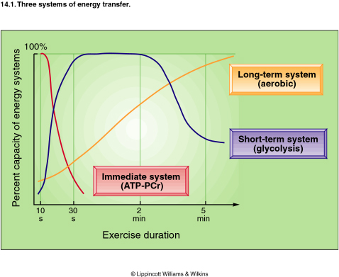
Three systems of energy transfer
Type of system: | Immediate system (ATP-PCr) | Short term system (glycolysis) | Long term system (aerobic)
Type of metabolism: | Anaerobic | Anaerobic | Aerobic
Type of energy source: | Phosphocreatine (PCr) | Glucose | Fatty acid
type of exercise: | High intensity exercise | High intensity exercise (it happens when the muscle is contracting) | Continuous exercise (less intensity)
Duration: | 3-15 sec | 15 sec. to 2 min. | hours
The three systems are overlapping
يعني في الخلية الطاقة دائماً متوفره من خلال ان هذه الانظمة تنتج الطاقة بشكل مستمر

Slide 4
ATP as energy source
Breakdown of ATP into ADP+PO₄ releases energy
ATP as energy source
The main pathway for ATP synthesis is oxidative phosphorylation catalyzed by the respiratory chain
The nucleotide coenzyme adenosine triphosphate (ATP) is the most important form of chemical energy stored in cells
This energy is used for all body functions (biosynthesis, membrane transport, muscle contraction, etc.)
ATP synthase catalyzes the synthesis of ATP
ADP + Pi → ATP

Slide 5
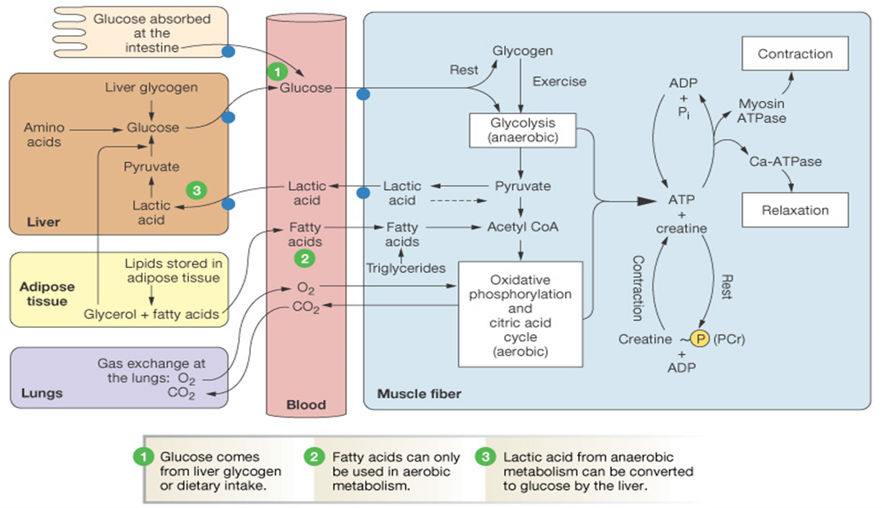
Overview of energy metabolism
adipose tissue will give fatty acid > goes to blood stream > goes to muscle fibers > get converted into Acetyl CoA> undergoes oxidative phosphorylation + O2 produced from the lung (aerobic pathway) to give ATP
The produced ATP will be used for contraction and relaxation.
-myosin ATPase (for contraction)
-Ca-ATPase (for relaxation )
Liver will give glucose from its stored glycogen or amino acid or by undergo gluconeogenesis using fatty acid.
-glucose then will go to blood stream then to the muscle fibers .
When we eat ,glucose is absorbed in the intestine >goes to blood stream > goes to muscle.
*Inside to muscle fibers:
-During rest its stored as glycogen.
-During exercising it undergoes glycolysis (anaerobic pathway) to give ATP
Gas exchange happens at the lungs- when exercising, breathing increases for more O2 supplying.

Slide 6
There are 4 ways for muscle fibers to get ATP :
1- aerobic by red fibers
2-anaerobic by white fibers
3-creatine phosphate
4- by the enzyme adenylate cyclase;
(will take two ADP and produce 1 ATP & 1AMP)
What do we need the ATP for?
Its used in both contraction and relaxation of the muscle .
It will be explained in the next slides.
العضلة في حالة الراحة راح تخزن اي تي بي على صورة كرياتين فوسفيت و جلايكوجين بمجرد ما يصير في حركة تبدأ تستهلك اي تي بي المخزن فيها

Slide 7
Energy metabolism in muscle
Muscle contraction requires high level of ATP consumption
Without constant re synthesis, the amount of ATP is used up in less than 1 sec. of contraction
The muscles can not store energy for more than 1-2 sec.
So, they need constant re synthesis.
Skeletal Muscle
Red Fibers
(Type I)
Suitable For
Prolonged effort
White Fibers
(Type II)
Suitable for fast,
strong contractions
Anaerobic metabolism
(Without O₂ supply)
Aerobic metabolism
(With O₂ supply)
Prolonged effort\ running for long time
Fast, strong contractions\ weight lifting

Slide 8
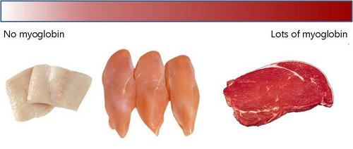
RED MUSCLE FIBERS (Aerobic metabolism)
Red muscle fibers are suitable for prolonged muscle activity
الرياضيون يمتلكون هذا النوع من العضل بسبب الممارسة المستمرة للرياضة
Their metabolism is mainly Aerobic and “Depends on adequate supply of O2”
They obtain ATP mainly from fatty acids
عشان كذا لما الشخص يبي ينحف يسوي تمارين هوائية لانها تستخدم الدهون:)
Fatty acids are broken down by beta-oxidation which will produce Acetyl CoA(A process in which the fatty acids are degraded and energy is Produced), Krebs cycle, and the respiratory chain.
Why its called RED?
Red colour is due to the rich of myoglobin, mitochondria and capillaries
Each one myoglobin binds to ONE molecule of O2 ,while hemoglobinin bind with 4 O2
Myoglobin has higher O2 affinity than haemoglobin
It releases O2 when its level drops .
جاء سؤال في الميد تيرم بنفس الصياغة فركزوا عليها

Slide 9
ATP metabolism in red muscle fibers:
Fatty acids is oxidized into acetyl COA
Acetyl coA enters the krebs cycle
Krebs cycle will give NADH
NADH goes to respiratory chain in presence of O2 given by myoglobin
Production of ATP

Slide 10
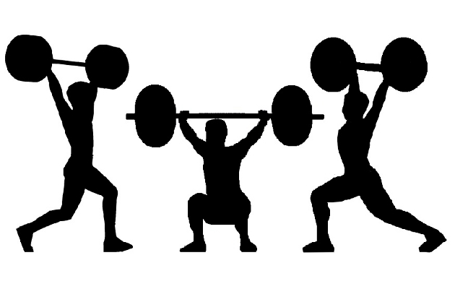
White muscle fibers (anaerobic)
White muscle fibers are suitable for fast, strong contractions
They mainly obtain ATP from anaerobic glycolysis.
During intense muscle activity (weightlifting, etc.) O₂ supply from blood quickly drops, then the muscle will use anaerobic glycolysis.
They have supplies of glycogen that is catabolized and undergoes glycolysis.
-They are white because they have less mitochondria, capillaries and myoglobin
-They make energy from glycogen breakdown
fast

Slide 11
Anaerobic
Pathway:
Glycogen >glucose-1-PO4 > glucose-6-PO4
Why skeletal muscles can’t produce new glucose from lactate?
anaerobic glycolysis
Because:
1- Gluconeogenesis requires much more ATP than is supplied by glycolysis in muscle
2- O2 deficiencies do not arise in the liver even during intense exercise
Therefore, liver always has sufficient ATP for gluconeogenesis
ATP is produced,
NADH+H+ is re-oxidized to maintain glucose degradation and ATP formation
pyruvate will be converted into lactate
Lactate is resynthesized into glucose in the liver by Cori cycle

Slide 12
The
Cori Cycle
In anaerobic glycolysis, the glucose is converted to lactate
Lactate in muscle is released into bloodstream.
Then ,Transported to the liver
Liver converts lactate into glucose via gluconeogenesis
The newly formed glucose is transported to muscles to be used for energy again .

Slide 13
In Muscle: 1- White muscle fibers ( Fast & Strong contraction ) obtain ATP from Anaerobic glycolysis. 2- In Anaerobic glycolysis glucose is converted to lactate.
In the liver:
5- Liver converts lactate into glucose via gluconeogenesis*. 6- the newly formed glucose is transported to muscle to be used for energy again “ complete cycle “.
Summary: Liver converts lactate into glucose via gluconeogenesis, then the newly formed glucose is transported to be used for energy.
Thanks to 435 team
In the bloodstream:
3- Lactate in muscle is released into blood.
4- Transported to the liver.

Slide 14
The glucose-alanine cycle
شرح مختصر
The alanine cycle in the liver doesn’t only provide alanine as a precursor for gluconeogenesis, but also transports to the liver the amino nitrogen arising in muscles during protein degradation. In the liver, it’s incorporated ( يختلط ) into urea for excretion.
ليش تحصل هذي السايكل ؟
عند الفترة الطويلة للصيام وعدم الأكل ( مثل رمضان ) العضلات الحركية تبدأ تتكسر “degraded” ( تصير العضلات هي مصدر الطاقه )
والناتج لتكسر البروتينات اللي في العضلة مادة اسمها ( أمينو نيتروجين ) ترتبط مع البيروفيت ويصير اسمهم (الألانين) ويدخل هذي السايكل عشان يزودنا بالطاقة.

Slide 15
In Muscles
In liver
3
1
MUSCLES PRODUCE :
Pyruvate from glycolysis during
exercise
Amino nitrogen (NH2) from normal
protein degradation
Liver converts alanine back to pyruvate
Alanine – NH2 = Pyruvate
(NH2 is Converted to urea which is excreted later.)
Pyruvate is used in gluconeogenesis ( to produce glucose )
The newly formed glucose is
transported to muscle to be used for energy again.
Pyruvate ( with NH2 ) is
converted to alanine
Pyruvate + NH2 = Alanine
ALANINE IS TRANPORTED FROM THE MUSCLE BY THE BLOOD INTO THE LIVER
NOTE: Alanine is the second important form of transport for amino nitrogen in the blood.
And the first transport form is glutamate.
2

Slide 16
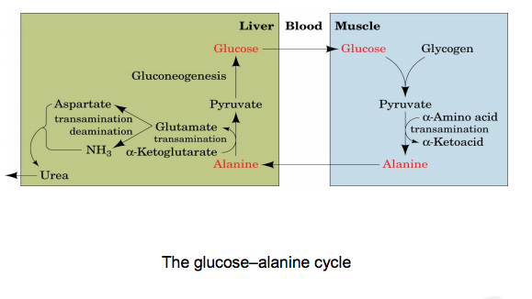
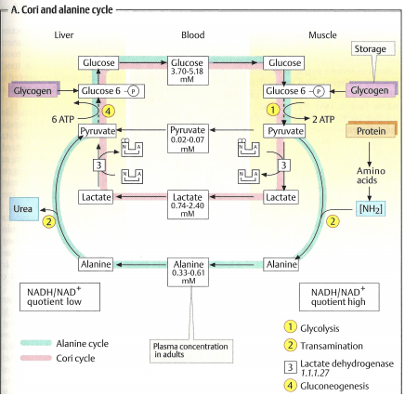
Reactions in skeletal muscle:
glycolysis produces pyruvate.
Pyruvate can be transaminated ( an α-amino acid donates it’s amino group, generating an α-keto acid) to alanine.
(ii) The alanine then enters the blood stream and is transported to the liver.
Alanine is returned to the liver for gluconeogenesis.
(iii) Reactions in liver:
Within the liver, alanine is converted back to pyruvate by deamination ( The removal of amino group ).
Pyruvate is available for gluconeogenesis and the glutamate supplies the urea cycle.
Gluconeogenesis converts pyruvate to form glucose.
The newly formed glucose can then enter the blood for delivery back to the muscle.
--------------------------------------------------------------
3
2
1
الارقام اللي بالدوائر الصفراء اللي بالصورة مو معانا ☺

Slide 17
Exercise and AMPK
In exercise, the metabolic enzymes are regulated thru phosphorylation by AMP-activated protein kinase (AMPK)
EXTRA : By this process the body try to save energy .
During Exercise
(High-energy demand *require* )
Explanation :
- During exercise ATP level goes down and in the same time AMP level goes up .
- When AMP level goes up is activated the AMPK enzyme .
⬇ATP
⬆AMP
Explanation :
- The activation of AMPK enzyme will shot down the anabolic pathway (to save energy) and turn on catabolic pathway (to produce energy).
Activates AMPK
Anabolic
Pathways (Off)
Catabolic pathways
(ON)
⬆ATP

Slide 18
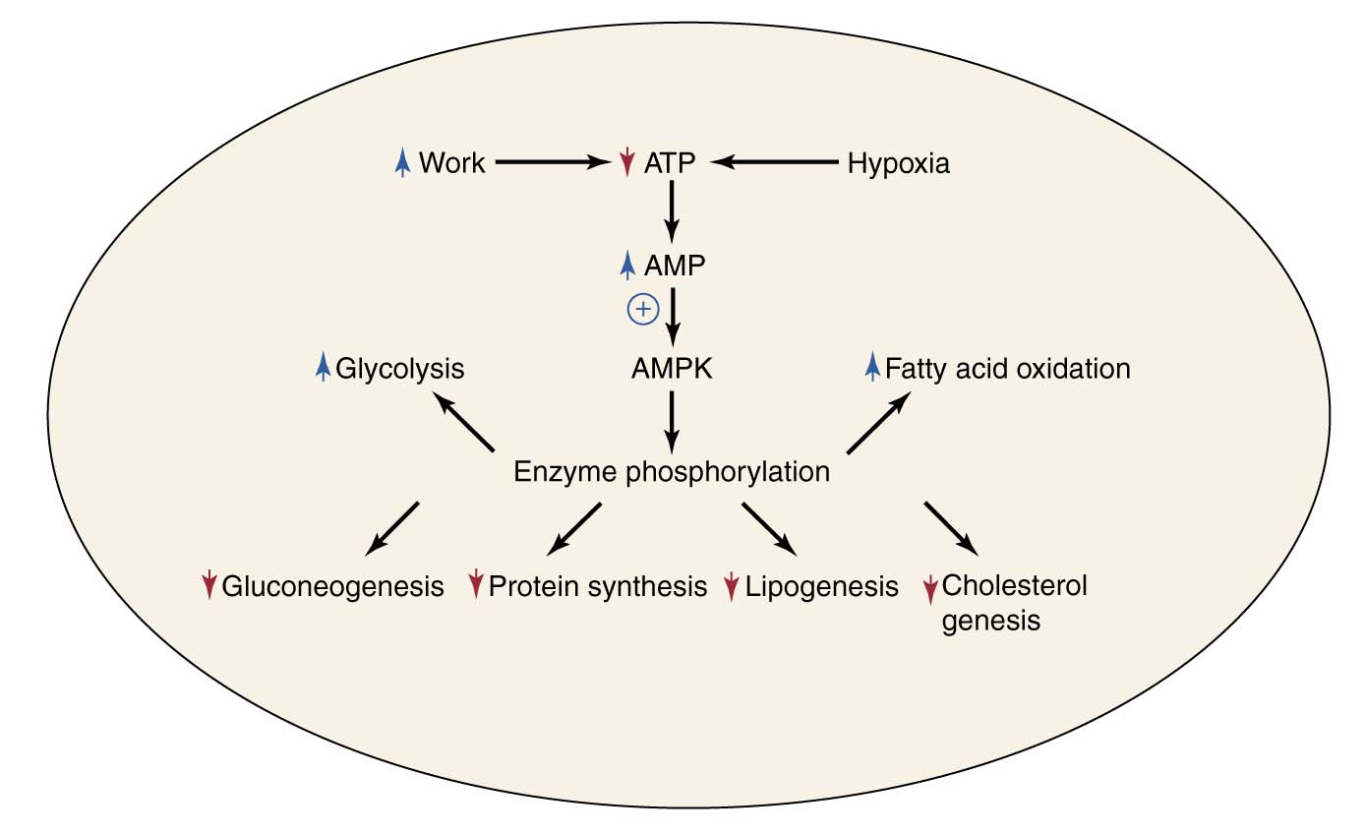
AMPK activation shuts down ATP-requiring processes and stimulates ATP-producing processes

Slide 19
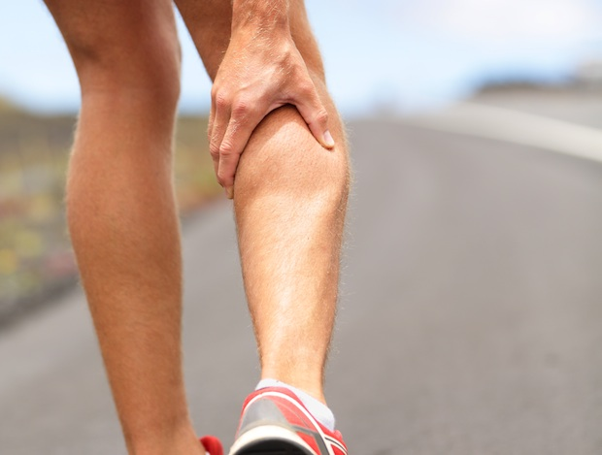
Muscle fatigue and endurance in athletes
Muscle fatigue:
Inability of muscles to maintain a particular strength of contraction over time.
Causes: muscle damage, accumulation of lactic acid.
Athletes are able to change the proportions of red and white muscle fibers by targeted training.
Athletes should train to have more red muscle fibers also they can convert white muscle fibers to red
The red muscle fibers are better for them because it is suitable for prolonged effort + it is an aerobic which doesn’t cause lactic acid formation which leads to muscle fatigue .
The expression of muscle proteins can also change during the course of training.
This provides them with:
High endurance during muscle activity.
Efficient energy production and consumption.
Delayed fatigue.

Slide 20
Summary:
metabolism in muscle
anaerobic
(without O₂)
aerobic
(with O₂)
white fibers
red fibers
ATP from anaerobic glycolysis
ATP from fatty acid
product : lactate
product: CO₂ and H₂O
lactate converted to glucose by cori cycle (liver)
fatty acid broke down by :
1-B-oxidation
2-krebs cycle
3-respiratory chain

Slide 21
Videos
1-Aerobic system:
https://www.youtube.com/watch?v=eqWJbELIB68
https://www.youtube.com/watch?v=PQMsJSme780
2-Anaerobic system:
https://www.youtube.com/watch?v=TcMqVnVG3Zk
https://www.youtube.com/watch?v=uCmNQQWlrc0
3-Comparison:
https://www.youtube.com/watch?v=TcMqVnVG3Zk
https://www.youtube.com/watch?v=uB357EX-fdc

