Slide 1
Creatine Metabolism and Collagen Diseases
– Color Index:
Doctor’s notes
Important.
Extra Information.
Doctors slides.
436 Biochemistry team

Slide 2
Objectives:
By the end of the lecture. Students should be familiar with :
To study the importance of creatine in muscle as a storage form of energy
To understand the biosynthesis of creatine
To study the process of creatine degradation and formation of creatinine as an end product
To understand the clinical importance of creatinine as a sensitive indicator of kidney function
To study the structure, function, types, and biosynthesis of collagen
To understand different diseases associated with collagen

Slide 3
Creatine phosphate
A high-energy phosphate compound
Acts as a storage form of energy in the muscle ( main storage form for intense and immediate muscle contraction )
Provides small but, ready source of energy during first few seconds of intense muscular contraction * it is stored in the muscle, and when intense muscle contraction is needed, such as running as fast as you can, lifting weights. In this cases creatine phosphate gives you the energy immediately ( as the stored ATP is only enough for 3 seconds ).
The amount of creatine phosphate in the body is proportional to the muscle mass * directly proportional, when the mass increases it needs more energy, so it will be stored in higher amounts.

Slide 4
Creatine biosynthesis
Ornithine is a non proteinogenic amino acids that is used to remove ammonia during urea cycle.
(The 20 amino acids we have studied in the foundation block are called “proteinogenic amino acids”)
Sites of biosynthesis:
Kidney:
Liver:
Methyltransferase
Ornithine
Arginine + glycine
Amidino-transferase
Guanidinoacetate
It gives a methyl group
Where creatin is synthesized ? liver
Guanidinoacetate
Methyltransferase
creatine
Note: creatine is not the same as creatinine.
SAM
SAH
SAH: S-Adenocylhomocysteine
1 amino acid is produced:
ornithine
3 amino acids are required:
glycine | arginine | Methionine as (S-AdenosylMethionine) (SAM)

Slide 5
Distribution of body creatine
Transported from liver to other tissues
98% present in skeletal and heart muscles
In skeletal muscles it is converted to high-energy source creatine phosphate (phosphocreatine)
Most of the creatine comes from the diet.
Creatine and creatine phosphate are
non-enzymatic (they don’t require any enzyme)

Slide 6
Creatine degradation
N.B.
This system
does NOT involve the respiratory chain
Creatine and creatine phosphate are spontaneously degraded into their end product which is creatinine and it is excreted in the urine .
So the more muscle mass, the more creatinine will be observed in the urine
Serum creatinine is a sensitive indicator of kidney disease (kidney function test).
Creatinine: inhydryde form of creatine and its very slouble
Spontaneously: it doesn’t require enzyme or energy
Serum creatinine increases with the impairment of kidney function.
Creatine
H₂O
Creatinine
ATP
ATP
Creatine Kinase
Its level depends on the
muscle mass also.
ADP
ADP + H⁺
Pi
Plasma
Creatine phosphate
Glomerular
filtration
Urine

Slide 7
Urinary creatinine
A typical male excretes about 15 mmol creatinine/day
Decrease in muscle mass (Atrophy) (in muscular dystrophy, paralysis) leads to decreased level of urinary creatinine
The amount of creatinine in urine is used as an indicator for the proper collection of 24 hours urine sample
** Note : its level depends on muscle mass, gender, and age.
Cystatin C is also a biomarker for assessing GFR and kidney function, it is better than creatinine because it doesn’t depend in muscle mass, age, or gender. – recall it from the Foundation block ☺ -

Slide 8
Creatine kinase (CK)
Creatine
ATP
ATP
Creatine kinase and creatinine levels are usually checked in testing, beacause checking creatine levels is more difficult.
CK is responsible for generation of energy in contractile muscular tissues as it is the enzyme that used to regenerate ATP from creatine phosphate
CK levels change in cardiac and skeletal muscle disorders because it is mostly found in these tissues ( can be used as a biomarker ) – troponin is better than it for cardiac assessment -
Creatine Kinase
ADP
ADP + H⁺
Creatine phosphate
Explanation:
CK can be used in two reactions ( reversible reactions )
1- generating creatine phosphate, by taking one phosphate group from ATP and convert it to ADP
( during rest ).
2- generating ATP from creatine phosphate, by taking the phosphate from it( C ~ P ) and adds it to ADP
( during intense and immediate muscle contraction ).
*Creatine Kinase isozyme (CK):
CK in brain ( CKBB)
CK in skeletal muscle (CKMM)
CK in cardiac ( CKMB)

Slide 9
Collagen
It's the most abundant protein in the body.
Highly stable molecules, having half-lives as long as several years.
part of connective tissues:
bone, teeth, cartilage, tendon, skin, blood vessels.
Fibrous protein
(Row like structure) that serves structural functions.
Has a long rigid structure.

Slide 10
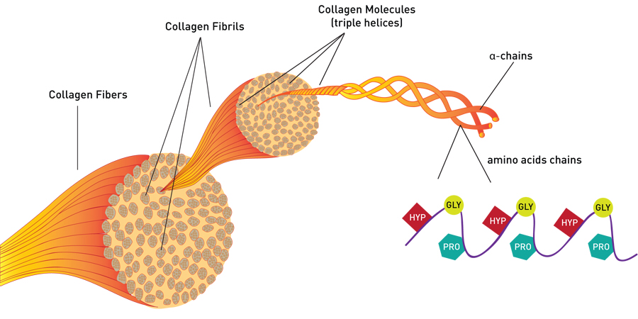
Collagen structure
It's a 1000 amino acids long.
Rich in proline & glycine.
The glycine residues are part of
a repeating sequence, (–Gly–X–Y–)333,
where X is frequently proline and
Y is often hydroxyproline, or hydroxylysine.
Collage consists of three
α-chains wound around one
another in rope like triple helix.
The three polypeptide chains are held together by hydrogen bonds. (interchain hydrogen bonds).

Slide 11
Collagen structure
Proline prevents collagen chains to form α-helix because:
1- It does not have back bone amino group
(it is a ring structure with secondary
amino group). 2-Therefore hydrogen bonding within the helix is not possible
Note: The secondary structure
α-helix is different from collagen helix: hydrogen bond between the chains (interchain)
not
within chains (intrachain).
α-helix
Collagen helix

Slide 12
Non-Standard Amino Acids in Collagen
Proline is converted to Hydroxyproline
Lysine is converted to Hydroxylysine
By *hydroxylase
**(during post-transitional modifications)
The enzyme requires Vitamin C for its function.
*By Adding a hydroxyl group (OH)
** After translation the protein is form, then it’s modified
Why is Hydroxyproline important?
To stabilize the triple- helical structure
Non-Standard Amino Acids in Collagen:
If vitamin C is decreased, the amount of the enzyme (hydroxylase) will be deficient and as a result (proline & lysine) won't be hydroxylated and the resulting collagen will be defected
( doesn't have proper strength)

Slide 13
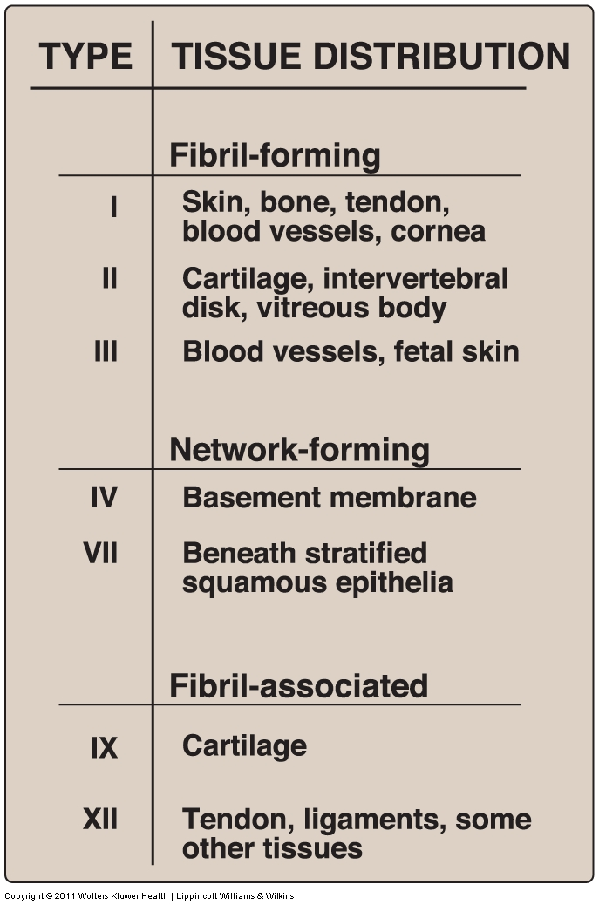
Types of Collagen
You have to memorize it
Types of collagen depend on function and location.
Variations in the amino acid sequence of α-chains result in different properties.
Examples: Type I: ($\text{α}\text{−}$1)₂ (α-2)₁ (Two α-1-chain + $\text{α}\text{−}$2- chain)
Type II: ($\text{α}\text{−}$1)₃ (Three α-1-chain)
Collagen can be categorized into 3 groups,
based on their location and functions :
Fibril-forming (Type 1, 2 and 3) | They are high strength and very tough
Network-forming (Type 4 and 7) | Form networks (Mesh)
Fibril-associated (Type 9 and 12) | They bind to the surface of collagen fibrils for linking them together, and to link them with the other components
Fibril associated collagen is the most abundant

Slide 14
Biosynthesis of Collagen
This process explained in details on the next three slides
Collagen is Synthesized in: fibroblasts, osteoblasts and chondroblasts Pre-pro Pro Mature collagen
Polypeptide precursors (pre-pro) are enzymatically modified to form triple helix which is Secreted from Golgi vacuoles into the extracellular matrix as procollagen
procollagen cleaved by N- and C- procollagen peptidases to release triple helical tropocollagen molecules
Glycosylation of some hydroxylysine residues with glucose or galactose
Tropocollagen molecules spontaneously associate to form collagen fibrils

Slide 15
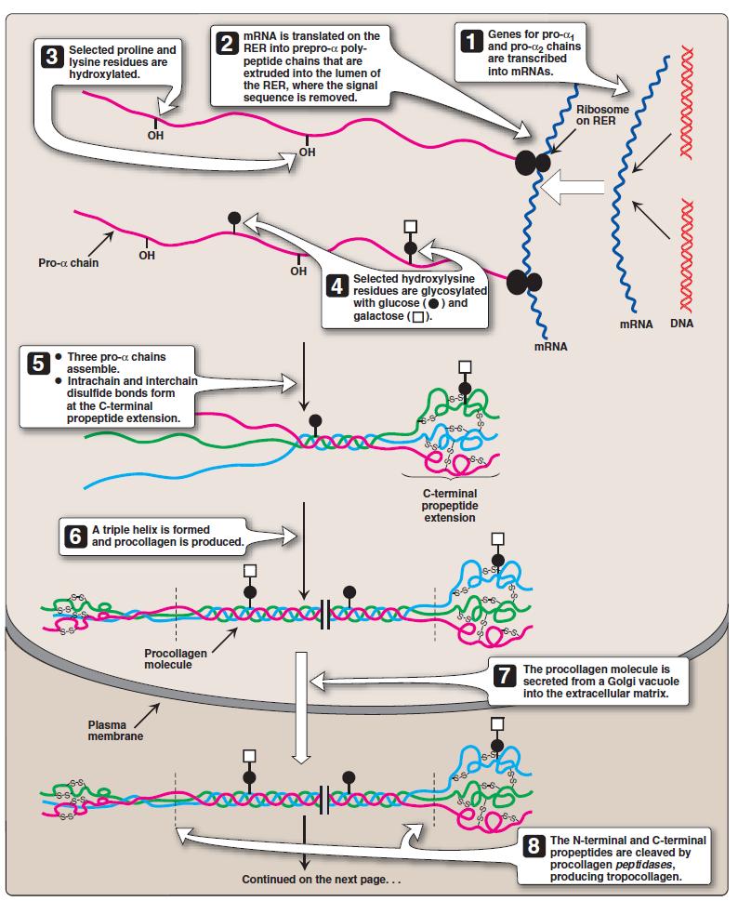
Biosynthesis of Collagen
1
Pro-α chains are transcribed into mRNA
2
This mRNA translated on the RER into prepro-α- polypeptide chains that are extruded (forced out) into RER lumen, where the signal sequence is removed
3
Selected proline and lysine are hydroxylated in the presence of vitamin C
5
4
Glycosylation of selected hydroxylysine residues with glucose or glucosyl-galactose
3 pro-α chains assemble and interchain & intrachain disulfide bonds are formed at the C-terminal propeptide extension.
3-Proline → hydroxyproline & lysine → hydroxylysine
3-Deficiency in vitamin C causes Scurvy disease
4-Glycosylation: the attachment of sugar moieties to proteins
**3 & 4 are post-translational modification steps Which are very important for the proper function of collagen

Slide 16
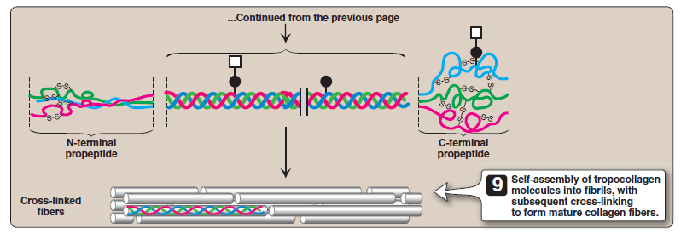
Biosynthesis of Collagen
6
Formation of triple helix
7
The procollagen molecule is secreted through the Golgi apparatus to ECM in Golgi vacuole.
9
8
The N- & C-terminal propeptides of the procollagen molecule are cleaved by procollagen peptidases, producing tropocollagen
Tropocollagen molecules spontaneously associate to form collagen fibrils, then they cross-link to form mature collagen . (explained in next slide)
Procollagen molecule is produced
9- only cleaved tropocollagen molecules is used to form mature collagen fibers by assembly of tropocollagen into fibrils with subsequent cross linking.
N.B. Step 8 & 9 occur in the matrix.

Slide 17
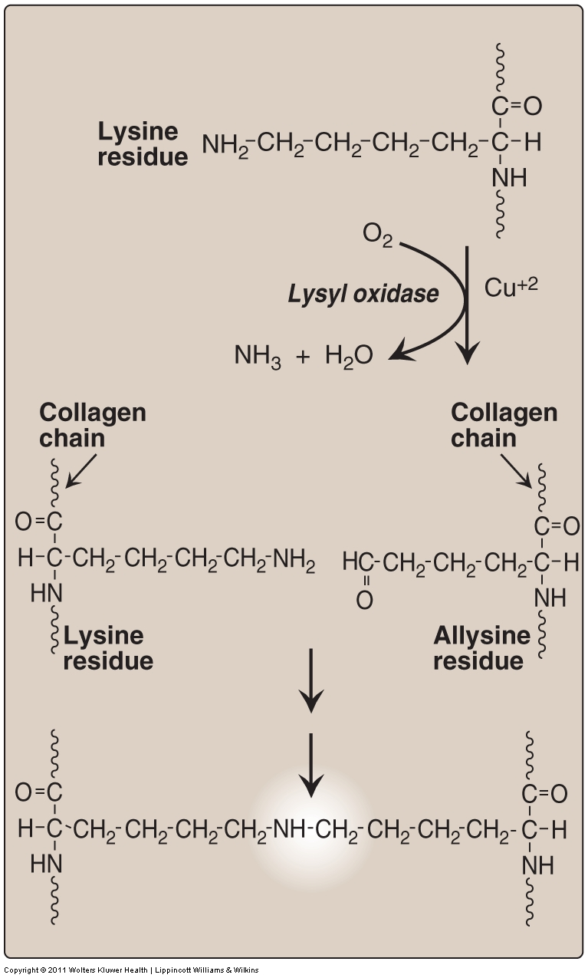
Crosslinking of Collagen Fibrils
1- Lysyl oxidase oxidatively deaminates some of the lysine and hydroxylysine residues in collagen.
(By removing the amino group from lysine and hydroxylysine residues)
2- The reactive aldehydes – allysine and hydroxyallysine condense with lysine or hydroxylysine residues in neighboring collagen molecules to form covalent cross-links
(Deaminated collagen chain binds with non-deaminated collagen chain)
3- This produces mature collagen fibres

Slide 18
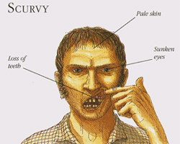
Collagen diseases
Acquired
Genetically inherited
Scurvy due to Vitamin C deficiency
Ehlers-danlos Syndrome
(EDS)
Osteogenesis Imperfecta
(OI)
Acquired Scurvy due to Vitamin C deficiency
(also called sailors disease) :
This disease is due malnutrition and it mainly affects (gums and teeth).
Symptoms :
Bleeding gums , the gums become spongy , painful and inflamed.
Detaching of the teeth from gums .
Skin problems
Enzyme affected : hydroxylase .

Slide 19
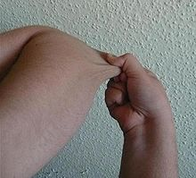
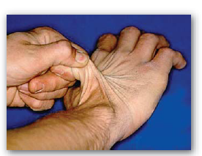
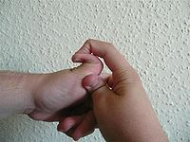
Ehlers-danlos syndrome due to :
deficiency of lysyl hydroxylase or
N-procollagen peptidase
Mutations in the amino acid sequence of collagen 1 , 3 , 5
(The gene is present but mutated)
Characterized by Hyper-extensibility (the skin can become stretched ) of skin and joints.

Slide 20
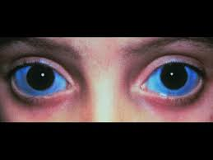
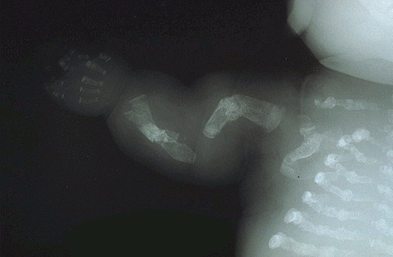
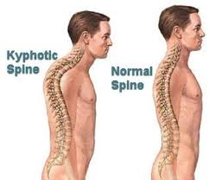
Osteogenesis imperfecta (brittle bone disease):
Characterized by bones that fracture easily, with minor or no trauma (normal weight of the body).
Mutations replace glycine with amino acids having bulky side chains preventing the formation of triple helical conformation.
Type I most common, characterized by mild bone fragility, hearing loss and blue sclerae.
Type II most severe, (in fetus) form and typically lethal in the perinatal period. Fractures are seen in utero.
Type III severe form, fractures at birth, short stature, spinal curvature leading to a humped back (kyphotic) appearance and blue sclerae.

Slide 21
MCQ’s
https://www.onlineexambuilder.com/creatine-metabolism-and-collagen-diseases/exam-120719
Click HERE to have a better look at the Qs

Slide 22
Girls team members:
Boys team members:
١- محمد العسيري
٢- محمد حكمي
٣- طلال الطخيم
٤- صالح التويجري
٥- عبد العزيز الصومالي
٦- فهد الزهراني
٧- محمد حبيب
٨- محمد المطلق
٩- محمد المهوس
1- نورة الشبيب
2-مها الغامدي
-Contact us:
Biochemistryteam436@gmail.com
twitter.com/436biochemteam
-Team leaders:
عبدالله المانع.
رانيا العيسى.
436 Biochemistry team

