Slide 1
Purine degradation and Gout
– Color Index:
Important.
Extra Information.
Doctors slides.
436 Biochemistry team

Slide 2
Objectives:
By the end of the lecture. Students should be familiar with :
Purine degradation pathway.
Fate of uric acid in humans.
Gout and hyperuricemia:
Biochemistry
Types
Treatment

Slide 3
Purine degradation pathway
The major source of dietary nucleic acids (purines and pyrimidines) is meat.
Purine and pyrimidine bases are absorbed by the intestine. (small intestine)
The ingested bases are mostly degraded into different products by degradation pathways.
These products are then excreted by the body (product for purine degradation = uric acid)
Adenosine and guanosine (purines) are finally degraded to uric acid by purine degradation pathway.

Slide 4
Purine degradation pathway
للتوضيح: *من ٤٣٥*
1-Degradation of the nucleic acid into its building blocks “nucleotides”
2-Removal of phosphate group from the nucleotides by the enzyme “nucleotidase”.
٣-تنفك النيوكليوسايدز إلى مكوناتها، سكر رايبوز + قواعد نيتروجينية (إما بيورين أو بيريميدين).
لاحظو ان البيورين هو اللي يعطي يوريك أسيد في نهاية المطاف وليس البيرميدينز!
1-Dietary DNA/RNA
By pancreatic nuclease
2-Nucleotides
By nucleotidases
3-Nucleosides
Remember:
Nucleoside= Nitrogenous base + Ribose
Nucleotide= Nitrogenous base + Ribose + PO₄
A-Free purine bases + ribose
By purine degradation pathway
Are converted to uric acid
B-Free pyrimidine bases + ribose
By pyrimidine degradation pathway
Are converted to Malonyl CoA
By nucleotidases

Slide 5
Major pathway of purine catabolism in animals
AMP deaminase
GMP
AMP
IMP
XMP
H₂O
NH₄⁺
Hydrolyzed by nucleotidase and produce 1 phosphate atom
Adenosine
Adenosine deaminase
Inosine
Xanthosine
Guanosine
H₂O
NH₄⁺
Phosphorylated by purine nucleoside phosphorylase (PNP) which produce Ribose 1-P
*الدكتور ركز على الإنزيمات باللون الأحمر
Xanthine oxidase
Guanine deaminase
Hypoxanthine
Xanthine
Guanine
Xanthine
oxidase
NH₄⁺
H₂O
O₂+H₂O
H₂O₂
O₂+H₂O
H₂O₂
Uric acid

Slide 6
Fate of uric acid in humans
In humans, primates, birds and reptiles the final product of purine degradation is uric acid, which is then excreted in the urine.
Uric acid is less soluble in water.
Reptiles, insects and birds excrete uric acid as a paste of crystals to save water.
Humans excrete uric acid in the urine, they do not have enzymes to further degrade uric acid.
Excessive production of uric acid causes deposition of uric acid crystals in the joints leading to:
Gout.
Hyperuricemia.
Some animals convert uric acid to other products
Allonation
Allanotic acid
Urea
Ammonia

Slide 7
Fate of uric acid in Animals
Uric acid
Ammonia
Primates
Birds
Reptiles
**Degradation of uric acid to ammonia in some animals, doctor said only read names *girls*
Invertebrates
Urate oxidase
Ureaase
Allonation
Allonatioc Acid
Urea
Allonationase
Allonatiocase
Other mammals
Teleost fish
Cartilaginous fish

Slide 8
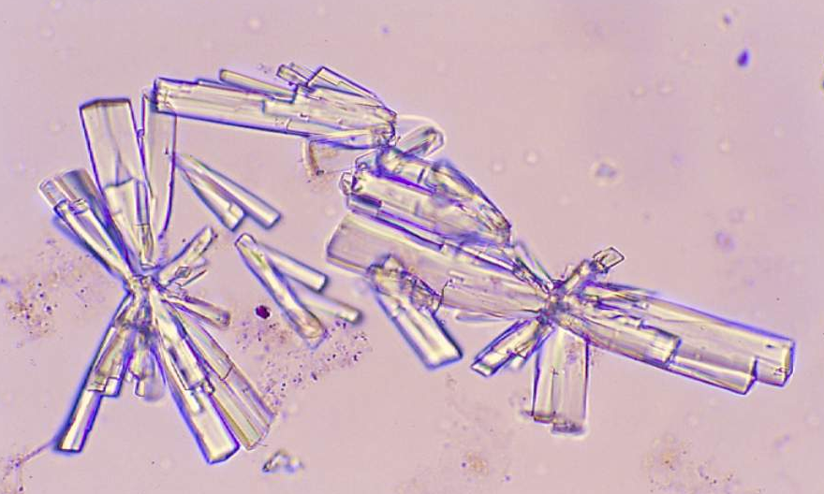
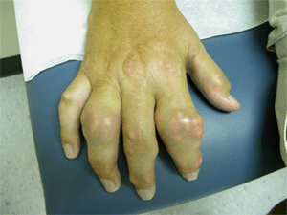
Gout
Gout is a disease due to high levels of uric acid in body fluids.
7.0 mg/dL and above
Uric acid accumulates because of:
Overproduction
Underexcretion
Painful arthritic joint inflammation due to deposits of insoluble sodium urate crystals (especially big toe).
Affects 3 per 1000 people.
Sodium urate crystals accumulate in kidneys, ureter and joints leading to chronic gouty arthritis.
Sodium urate crystals in urine
Swollen joints

Slide 9
Gout
Inaccurately associated with overtreating and drinking.
Alcohol used to be contaminated with lead during manufacture and storage, and lead decreases excretion of uric acid from kidneys causing hyperuricemia and gout.
Excessive meat consumption increases uric acid production in some individuals.
There are two main causes of gout:
Overproduction of uric acid. b. Underexcretion of uric acid.
Primary gout
Due to overproduction of uric acid.
Excessive production and degradation of purine bases (adenine, guanine, hypoxanthine)
Secondary hyperuricemia
Underexcretion of uric acid due to chronic renal disease.
A variety of disorders and lifestyles cause it.
Genetic abnormality in the enzymes of purine degradation.
-Chemotherapy
-Excessive alcohol intake
Excessive consumption of purine-rich food such as meat.
It does not always cause gout (not always followed by gout)

Slide 10
Treatment
Analgesic, anti-inflammatory drugs | To reduce pain and inflammation
Uricoseric acid | To increase uric acid excretion
Xanthine oxidase inhibitor (rate limiting enzyme) Febuxostat Allopurinol | To reduce uric acid production

Slide 11
Videos
Gout: treatment, causes, massage therapy, prevention:
https://www.youtube.com/watch?v=QOa7TLnwFXs&spfreload=10
Gout treatment tips and advice:
https://www.youtube.com/watch?v=btuhyPTwD7Q
Recall:
https://www.youtube.com/watch?v=MA-ouz1LtpM
Gout:
https://www.youtube.com/watch?v=1O3F-b8FfDY
Quiz
https://www.onlinequizcreator.com/purine-degradation-and-gout/quiz-239407

Slide 12
Girls team members:
1-هبة الناصر.
2- زينة الكاف
3-ابتسام المطيري
4- بشرى قوقندي
5-ربى برناوي
6- سمية الغامدي
Boys team members:
1- محمد المهوس.
-Contact us:
Biochemistryteam436@gmail.com
twitter.com/436biochemteam
-Team leaders:
رانيا العيسى.
عبدالله المانع.
Reference :
Lippincott’s Illustrated Reviews Biochemistry: Unit II, Chapter 11, Pages 125 - 136.
436 Biochemistry team

