Slide 1
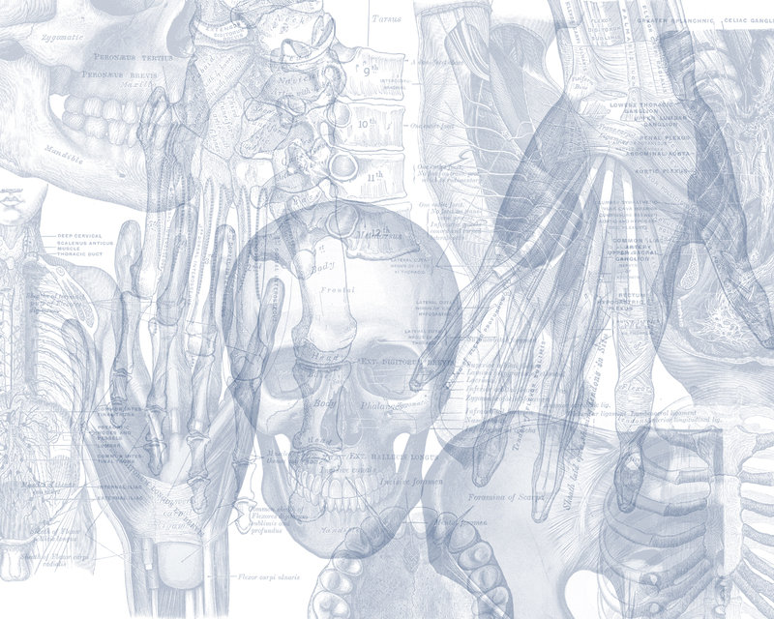
Development of Skeletal & Muscular System
Color Code
Important
Doctors Notes
Notes/Extra explanation
Editing File

Slide 2
Objectives:
List the different parts of mesoderm and the different divisions of somites.
Differentiate bones according to their embryological origin and mode of ossification.
Describe the ossification of long bones.
Describe the main steps for development of limbs.
Differentiate muscles according to their embryological origin.

Slide 3
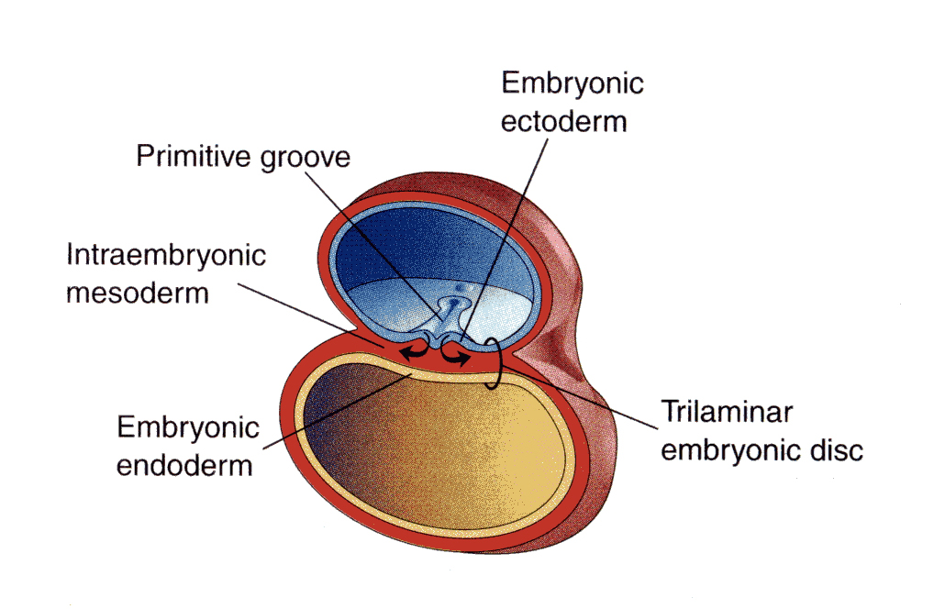
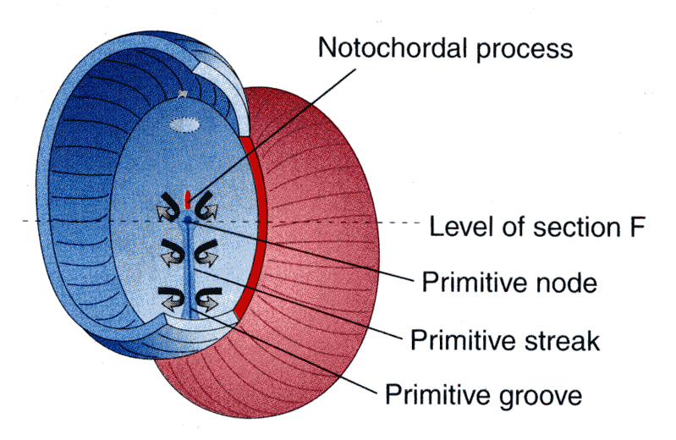
Note: these pictures are form the slides
The doctor’s Introduction
there are three embryonic layers:
1-embryonic ectoderm
2-intraembryonic mesoderm (this layer gives the musculoskeletal system)
3-embryonic endoderm
Amniotic
cavity
Embryo
تخيل أن هناك كرة لو فتحتها من النصف بتشوف زي الdisc مكون من three layers (كما هي مكتوبة في الأعلى)هذا الdisc هو الembryo قام بتقسيم هذه الكرة إلى two cavities :
Yolk sac
1-dorsally(فوق)
2-ventrally(تحت)
Amniotic
cavity
Yolk sac
Extra picture for understanding
Embryo

Slide 4
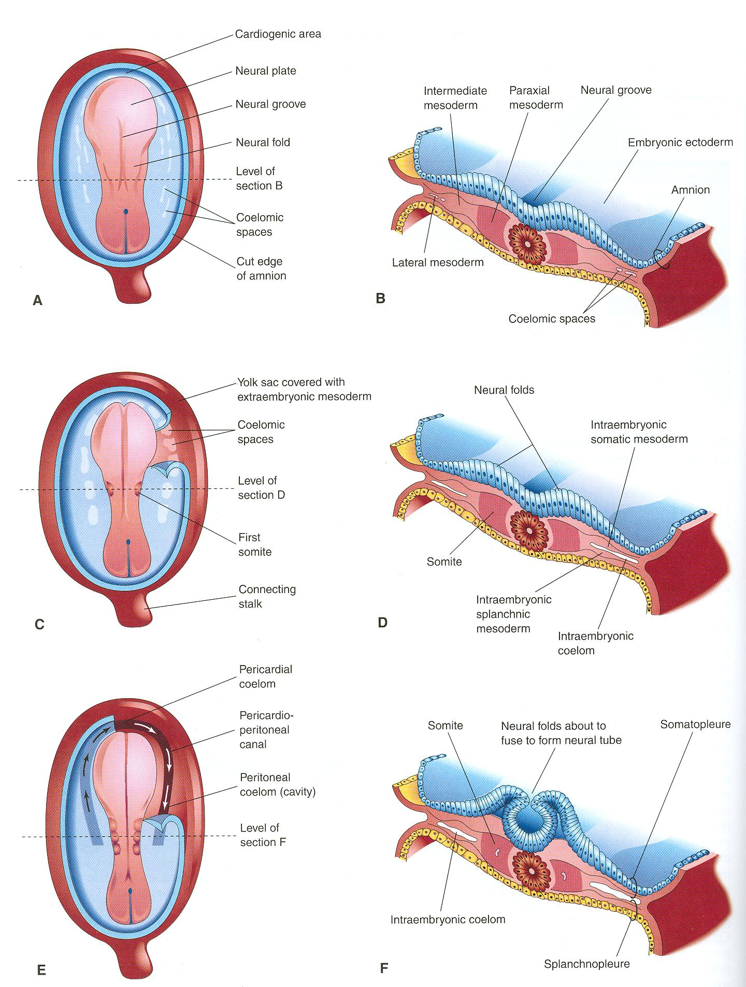
الmesoderm ينبغي أن يملأ الفراغ ما بين ال ectodermو ال endodermولكن في الحقيقة في المنتصف لا يوجد mesoderm يوجد قضيب دائري (rod-like structure) اسمه .Notochord
Mesoderm layer is divided into three parts:
1-paraxial mesoderm. (الجزء الغامق)
2-intermediate mesoderm.
3-lateral mesoderm.(has a central cavity)
لو تلاحظ في الصورة مكتوب somite مكان الparaxial mesoderm طيب ما هو الفرق؟؟
Paraxial mesoderm: Consists of smaller units every unit is called somite
عشان تكون بصورة أوضح تخيلها زي العمود الفقري ((paraxial mesoderm والفقرات المكونة له هي (somite) .
Notochord:
stimulates neural tube formation
The notochord is the axis. After it appears we can differentiate between right and left.
Note: if the notochord does not exist the neural tube will not form
Somatic mesoderm
ال lateral mesoderm يحتوي على intraembryonic coelom تفصله إلى جزئين :
1-جزء علوي قريب من ectoderm ويسمى Somatic mesoderm
2-جزء سفلي قريب من endoderm ويسمى Splanchnic mesoderm
جداري
حشوي
Splanchnic mesoderm

Slide 5
INTRAEMBRYONIC MESODERM
Proliferates between Ectoderm & Endoderm EXCEPT in the central axis of embryo where NOTOCHORD is found.
Back to the previous slide for more understand
Differentiates into 3 parts
Paraxial
mesoderm
Intermediate
mesoderm
Lateral
mesoderm
Somatic mesoderm
Splanchnic mesoderm
-On each side of notochord.
-Divides into units (somites).
divides by intraembryonic coelom into:
between ectoderm & coelom
between endoderm & coelom

Slide 6
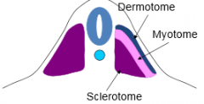
INTRAEMBRYONIC MESODERM Cont.
Neural tube
1
Paraxial mesoderm
Differentiated into units each unit called
3
Somite
SOMITE
Notochord
2
1
2
3
Dermatome
Sclerotome
Myotome
Form skin
forms the axial skeleton except skull
1-Vertebral column
2-Ribs & sternum
Lateral
Medial
Epaxial division
Myoblasts
Hypaxial division
SOMITE
Notochord
Neural tube
SOMITE
Muscles of back
(Extensors of vertebral column and neck)
migrate into limb:
Limb muscles
(to form the flexors and extensors muscles of the limbs)
both upper and lower limb
Muscles of body wall
(abdominal wall , pelvic, thoracic, etc..)
Myotome
Sclerotome
Sclerotome
Myotome

Slide 7
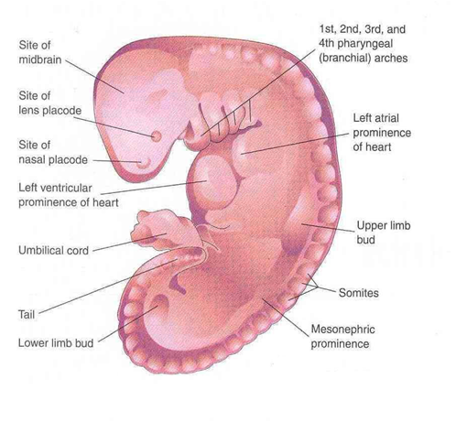
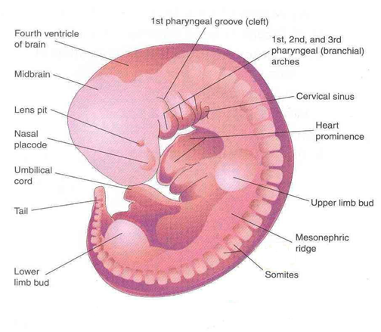
DEVELOPMENT OF LIMBS - 1
1
Mesenchyme from somatic layer of lateral mesoderm
-The limbs bud: appears as an elevation on the ventrolateral body wall resulting from proliferation of mesenchyme of the somatic layer of lateral mesoderm.
-Each limb bud is surrounded by an area of ectoderm.
2
1
2
Doctor Notes:
أول ما يتكون في هذه الbud هو الdistal end وهو الhand والfoot
-Upper limb buds appear at day 26 opposite the lower cervical segments.
-Lower limb buds appear at day 28 opposite the lumbar & sacral segments.
Note: The upper limbs appear 2 days before the lower limbs
28 DAYS
32 DAYS

Slide 8
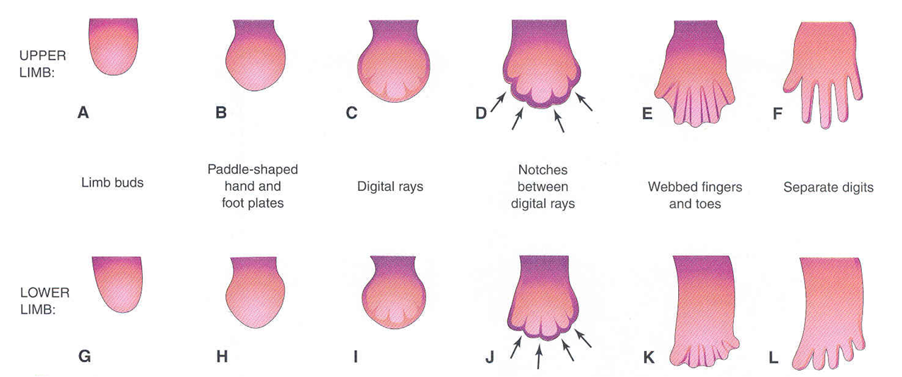
DEVELOPMENT OF LIMBS - 2
A & G:
Apical ectodermal ridge: appears at the apex of limb bud and stimulates proliferation of mesenchyme and elongation of limb bud.
B & H:
Distal ends of buds flatten into paddle-like hand & foot plates.
C & I:
Digital rays: appear as mesenchymal condensations that outline the patterns of digits.
D & J:
Mesenchyme between rays disappears to form notches.
E & K:
Digits form inside rays, elongate & appear webbed.
F& L:
Mesenchyme between digits disappear to separate them.
صارت flatten عشان الأصابع تبدأ تتكون
مرحلة البطه (اليد تصير زي يد البطه)
تكونت الأصابع ولكنها متشابكة كأصابع الكلب والقط
Girls slides:
Notches appear between digital rays
الْdigital rays ظهرت لأن الmesoderm يوجد بزيادة هنا فتكون مكان للأصابع وليس الأصابع
Without the apical ectodermal ridge, the bud won't be proliferate and the limbs will be small

Slide 9
DEVELOPMENT OF LIMBS – 2 Cont.
Mesenchyme from somatic layer of lateral mesoderm
Induces growth of mesenchyme & its transformation into cartilage
Cartilage ossifies by:
Endochondral ossification
Myoblasts migrate from myotomes to form:
Muscles of limbs
بعد اكتمال نمو الأطراف الmyoblasts تهاجر أو تنتقل من الmyotomes إلى الأطراف وتمسك في الغضاريف لتكون العضلات

Slide 10
OSSIFICATION OF LONG BONES
Red: bone
Blue: cartilage
Bone in cartilaginous state
الجنين في رحم امه
Before birth: appearance of primary ossific centers: ossification of diaphysis.
اقترب وقت الولادة، عشان كذا الغضروف تحول الى عظم
diaphysis
Bone age is a good index of general maturation. Bone age is determined by:
1. Appearance of ossific centers in diaphysis & epiphysis (specific for each bone & sex)
2. Disappearance of epiphyseal plate (specific for each bone & sex)
After birth and before puberty: appearance of secondary ossific centers: ossification of epiphysis.
بعد الولادة وأثناء الطفولة يبقى الابيفيسيال لاين غضروف عشان يكمل النمو
Epiphyseal
plate of
cartilage
Between birth and puberty:
Bone increases in size by proliferation of epiphyseal plate
epiphysis
In/after puberty: Ossification of epiphyseal plate: Complete union of epiphysis & diaphysis.
We can determine the age by x-ray because we know when the secondary bones will appear.
بعد البلوغ يتحول الايبيفيسيال لاين الى عظم؛ لعدم الحاجة الى النمو
Growth of bone stops.

Slide 11
DEVELOPMENT OF LIMBS - 3
Originally, limb buds were at right angle (90°) of the trunk with:
-Cranial (preaxial) & caudal (postaxial) borders: radius and tibia are preaxial bones.
-Ventral & dorsal surfaces: flexor muscles are ventral.
During 7th week, adduction of limb buds occurs with 90° rotation:
-In upper limb, rotation occurs laterally: radius is lateral & flexor muscles are anterior.
-In lower limb, rotation occurs medially: tibia is medial & flexor muscles are posterior.
Explanation:
When the limbs first appear they are at a right angle (as if they are abducted at 90°) and they are rotated (the arm is in midprone position). Then in the 7th week adduction occurs and 90° rotation. The arms rotate laterally and the legs rotate medially (to be in the anatomical position). This is why in the end the flexor group in the arm is anterior and in the leg it is posterior.

Slide 12
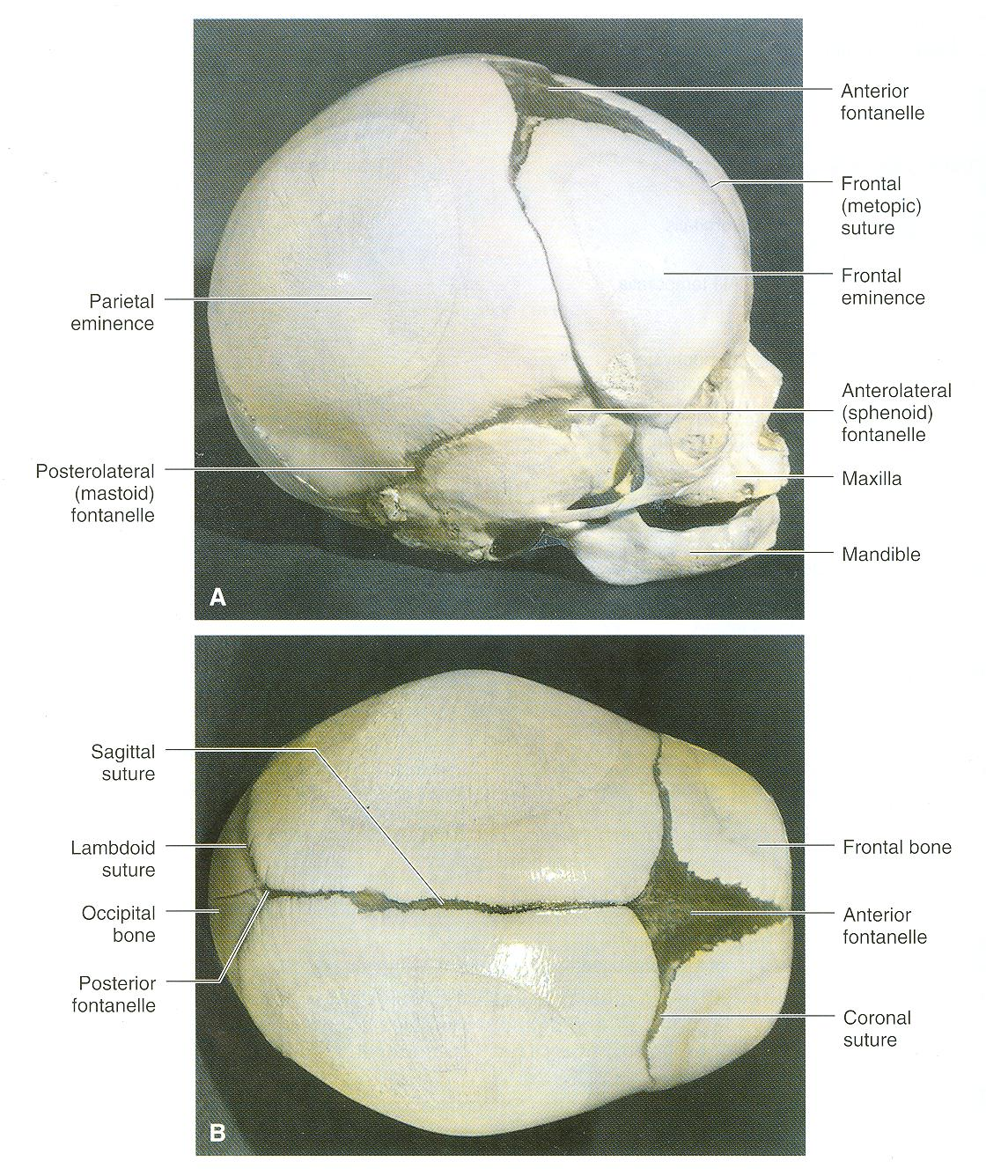
DEVELOPMENT OF CRANIUM (SKULL)
The skull develops from mesoderm around the developing brain.
The skull consists of:
Neurocranium: protective case for brain.
Viscerocranium: skeleton of face.
Bones of skull ossify either by:
*Endochondral ossification or
*Intramembranous ossification
F
P
F
Endochondral: mesenchymal cells -> cartilage -> bone
Intramembranous: mesenchymal celss -> bone (directly)
ST
Z
Max
Mand
Bones of skull that ossify by intramembranous ossification:
F = Frontal
P = Parietal
Z = Zygomatic
ST = Squamous temporal
Mand = Mandible
Max = Maxilla
P
F
P
F

Slide 13
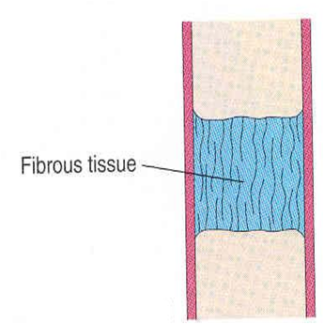
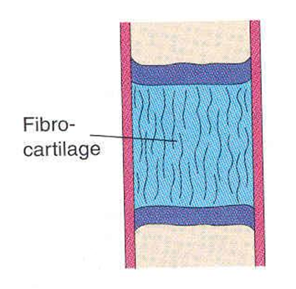
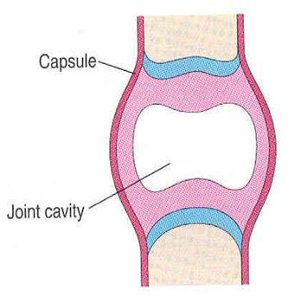
JOINTS
They develop from mesoderm between bones.
Fibrous Joints: mesoderm differentiates into dense fibrous connective tissue.
Synovial Joints:
a synovial cavity is formed inside mesoderm; mesoderm differentiates into synovial membrane, capsule & ligaments.
Cartilaginous Joints: mesoderm differentiates into cartilage.

Slide 14
Summary
LIMBS | MUSCLES | BONE
Mesenchyme from somatic layer of lateral mesoderm proliferates to form limb buds. Apical ectodermal ridge stimulates proliferation & elongation of buds then cartilage formation. All bones of limbs ossify by endochondral ossification EXCEPT: clavicle. Muscles of limbs develop from myotomes. Rotation of limbs occur in opposite direction. Development of upper limb precedes that of lower limb. | All muscles develop from MESODERM EXCEPT: Muscles of iris (eyeball) ECTODERM Myoepithelial cells of mammary & sweat glands, ECTODERM All skeletal muscles develop from myotomes of paraxial mesoderm EXCEPT: some head & neck muscles from mesoderm of pharyngeal arches ــــــــــــــــــــــــــــــــــــــــــــــــــــــــــــــــــــــــــــــــــــــــــــــــــــــــــــــــــــــــــ Cardiac & smooth muscles develop from lateral mesoderm: Cardiac muscles from: splanchnic part of lateral mesoderm Smooth muscles: *In the wall of viscera from: splanchnic part of lateral mesoderm * In the wall of blood & lymphatic vessels from: somatic part of lateral mesoderm | All bones develop from MESODERM. AXIAL SKELETON: *Vertebrae, ribs & sternum: from sclerotomes of somites (paraxial mesoderm) *Skull: from mesoderm surrounding the brain. APPENDICULAR SKELETON: from somatic part of lateral mesoderm All bones ossify by endochondral ossification EXCEPT: Some bones of skull Clavicle

Slide 15
MCQ’s
Q6: Regarding the ossification of long bones, which one of the following statements is correct?
A.Primary ossific centre appears after birth.
B. Secondary ossific centre leads into ossification of diaphysis.
C. Long bones ossify by intramembranous ossification.
D. When epiphysis unites with diaphysis, growth of bone stops.
Q7: Which one of the following is the result of rotation of upper limb?
A.The tibia becomes lateral. B.The flexor muscles become posterior. C.The ulna becomes medial. D.The preaxial digit becomes medial.
Q1: Which one of the following bones is not ossified by intramembranous ossification?
A.Parietal B.Maxilla
C.Humerus D.Clavicle
Q2: Which step is occurring right after Paddle-like hand or foot plates development :
A. Mesenchyme between digits disappear to separate them
B. Apical ectodermal ridge C. Digital rays appearance
D. Endochondral ossification
Q3: Which of the following is developing the muscles of the back :
A. Epiaxial division of myotome B. Hypaxial division of myotome
C.Dermatome D.Sclerotome
Q4: Primary ossific centers appear:
A. Before birth B. After birth
C. Before puberty D. After puberty
Q5: Which one of the following bones ossifies by intramembranous ossification?
A.Vertebra B. Humerus C. Ribs D. Mandible
SAQ’s
Q1: When do the secondary ossific centers appear?
Q2:Which part of paraxial mesoderm do limb muscles develop from ?
Q3: A process in which cartilage calcified to bone in developing embryo is named as : ………………
Answers:
Q1: After birth and before puberty
Q2: Myoblasts
Q3: Endochondral ossification
1.C
2.C
3.A
4.A
5.D
6.D
7.C

Slide 16
Leaders:
Nawaf AlKhudairy
Jawaher Abanumy
Ghada Almazrou
Members:
Abdulaziz Alangari
Mohammed Alduayj
Abdulmohsen alghannam
Abdulaziz ALMohammed
Mosaed Alnowaiser
Rayan ALQarni
abdullah hashem
Khalid Al-dakheel
Moayed Ahmad
Abdulmohsen Alkhalaf
Fahad Alzahrani
anatomyteam436@gmail.com
@anatomy436

