Slide 1




Histology of
Integrated Muscle
Color index :
Doctor’s slides
Important
Extra

Slide 2
Objectives:
By the end of this lecture you should be able to:
Identify and describe the histological structure of the three types of muscle cells and list the differences between them.

Slide 3
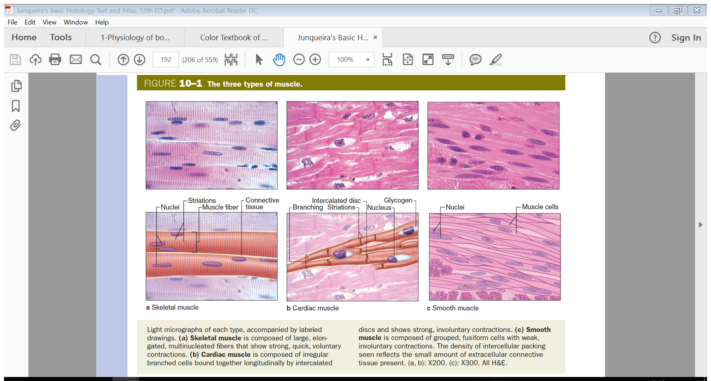
Types of muscle tissue
Skeletal
Cardiac
striated, involuntary.
striated, voluntary.
Smooth
non-striated, involuntary.
Types of muscle tissue:
All Muscular tissue is Made of elongated muscle cells called (fibers).

Slide 4
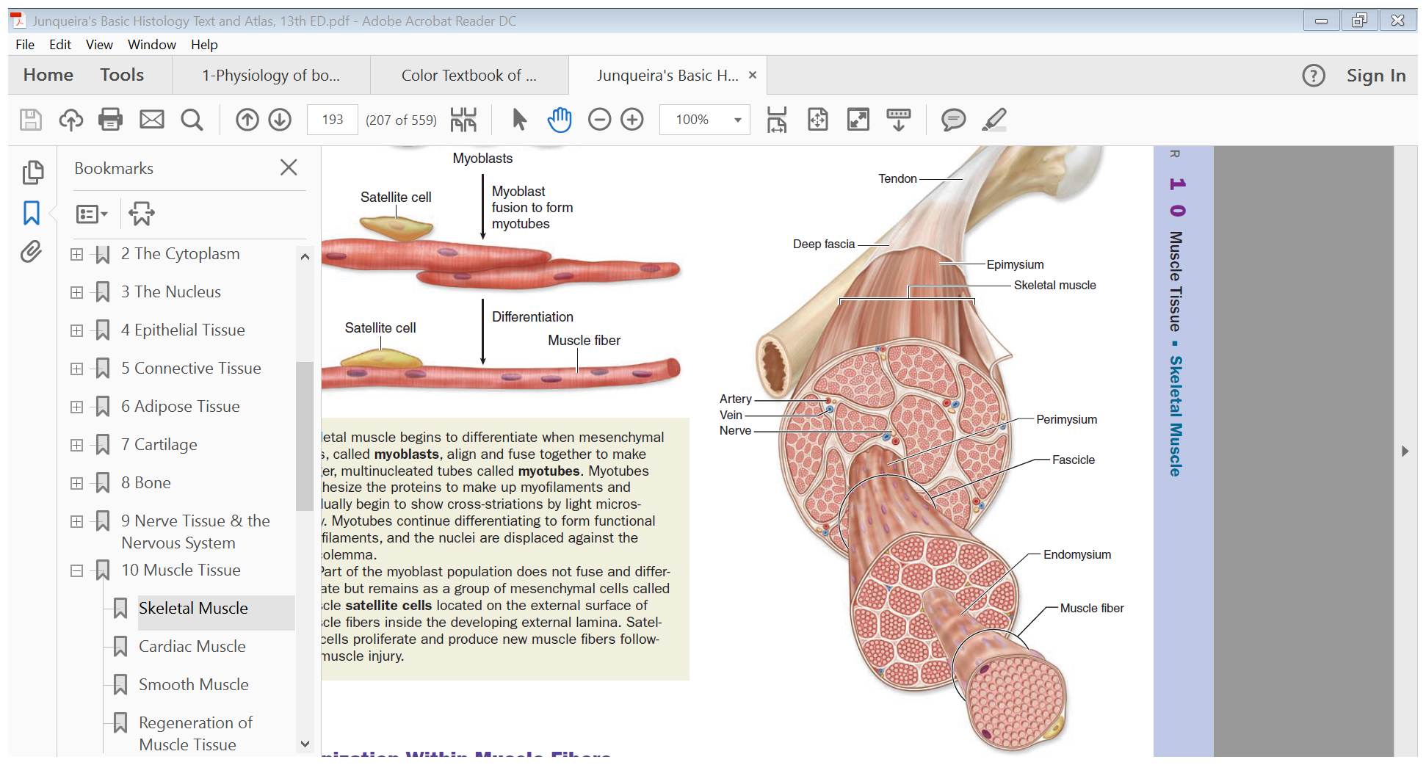
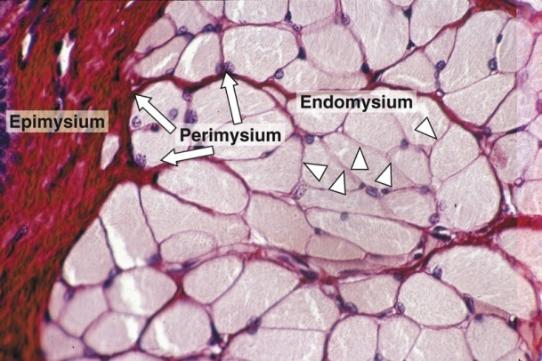
Skeletal muscle
The whole muscle is covered by a C.T. covering, the epimysium.(very thick dense irregular connective tissue )
Consists of parallel skeletal muscle fibers, arranged in bundles, separated by C.T. septa, the perimysium. (less thicker layer of dense irregular connective tissue)
The individual fibers (muscle cells) are separated by C.T. called endomysium.
Mysium = Flesh
Epi = Over
Peri = Surrounding

Slide 5
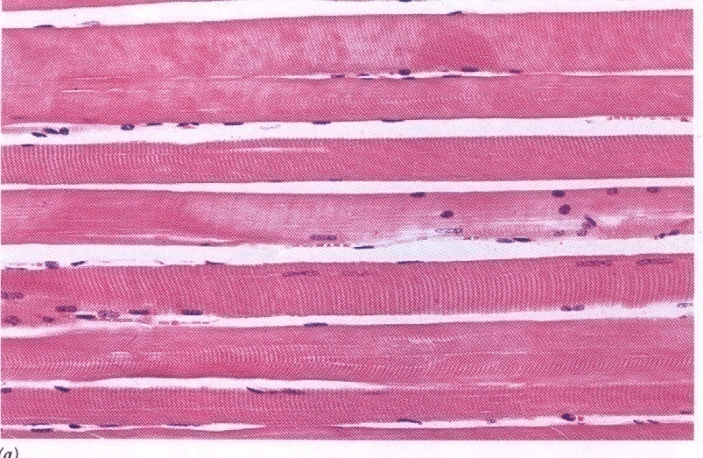
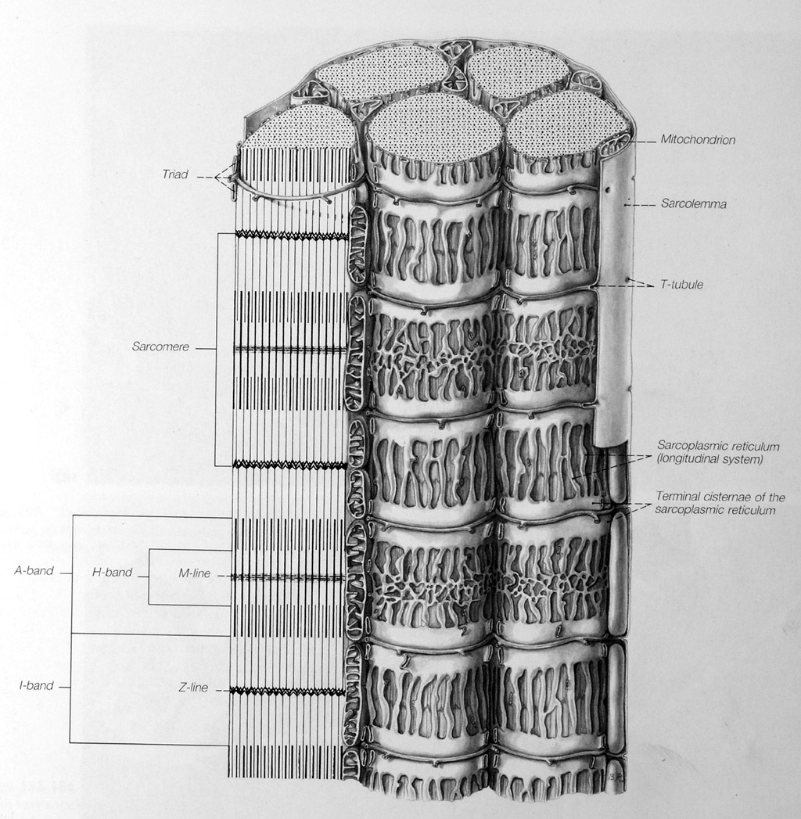
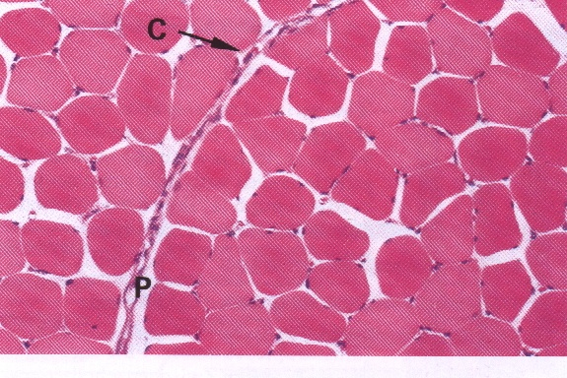
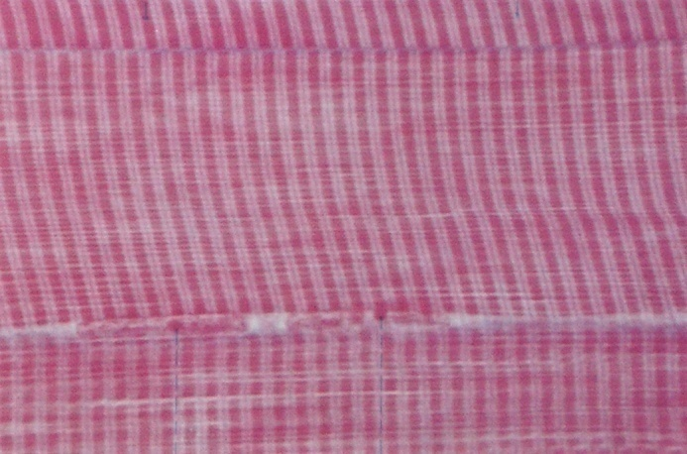
Skeletal muscle fibers
Skeletal Muscle Fibers in Microscope
L.M. Picture
E.M. Picture
Sarcoplasm contains:
* Parallel myofibrils.
* Numerous mitochondria, arranged in rows between the myofibrils.
* Well developed smooth endoplasmic reticulum (sarcoplasmic reticulum-SR).
* Myoglobin pigment. [carry & store O2]
* Glycogen[store food]
* Cylindrical in shape.
* Non-branched.
* Covered by a clear cell membrane, the sarcolemma.
* Multinucleated: nuclei are multiple and are peripherally located (close to the sarcolemma).
* Cytoplasm (sarcoplasm) is acidophilic and shows clear transverse striations
skeletal muscle needs so
much energy that’s why it have so many mitochondria

Slide 6
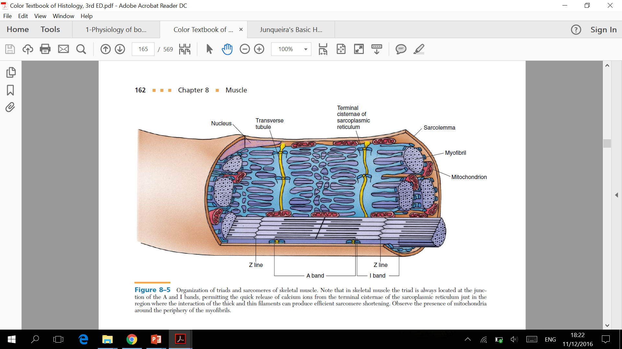
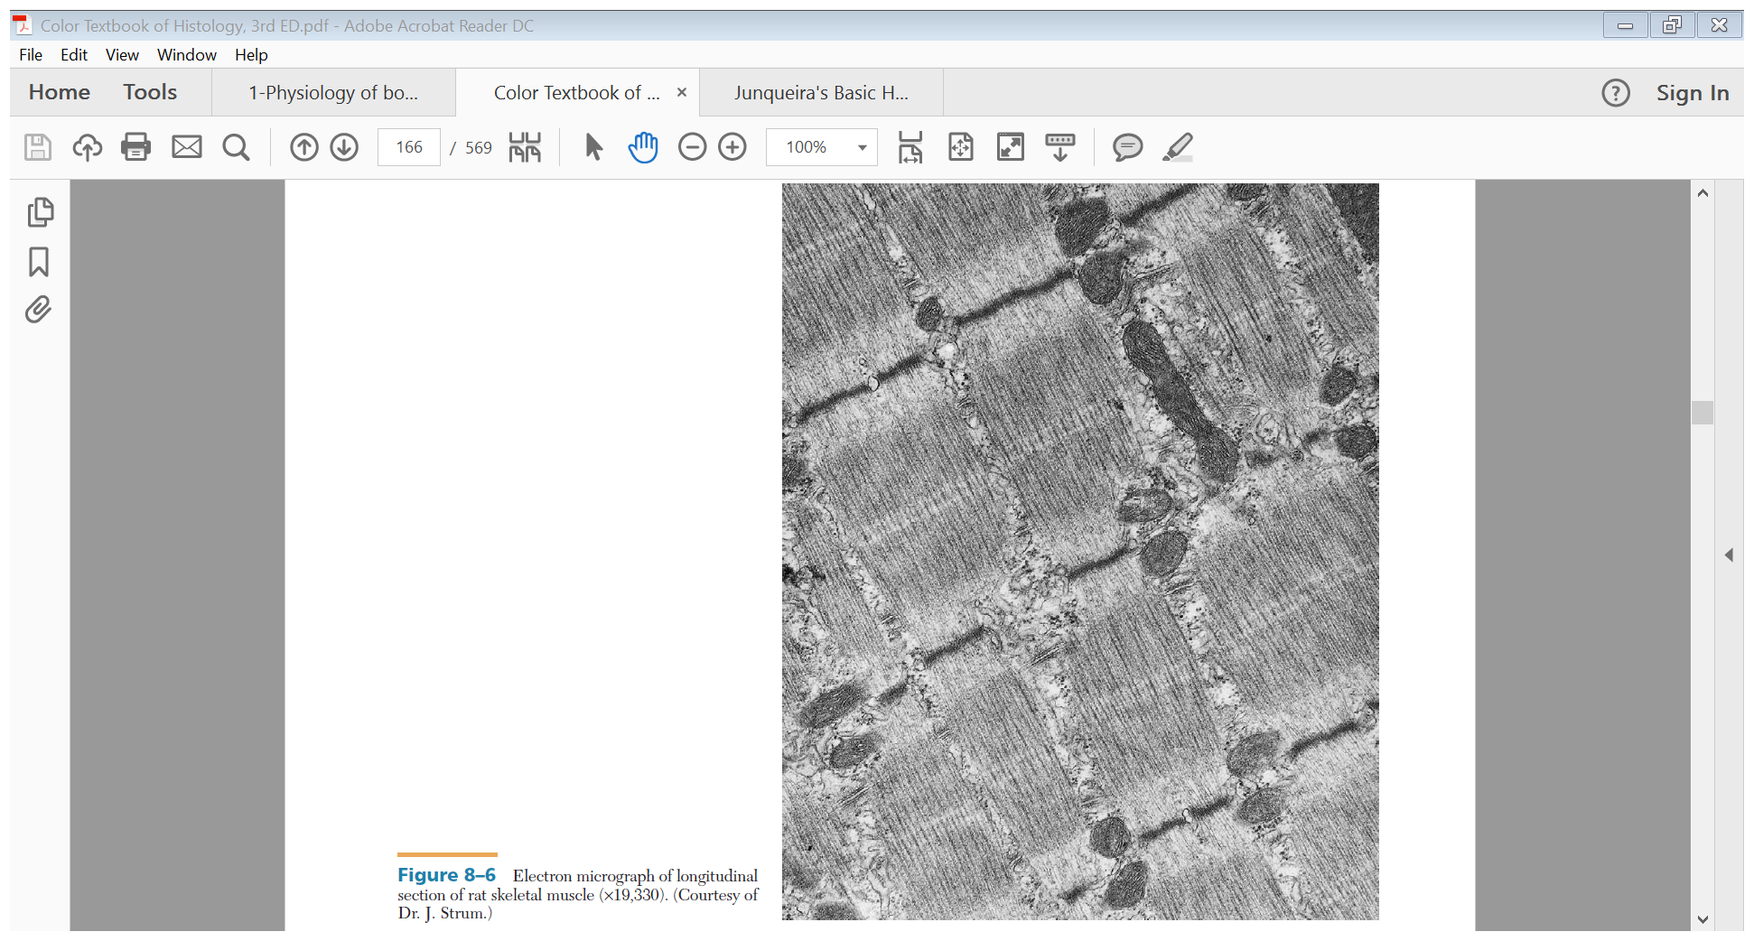
* Myofibrils of Skeletal Muscles
E.M. Picture of Myofibrils :
  Myofibrils are contractile threads (organelles), arranged longitudinally in the sarcoplasm.
  Each myofibril shows alternating dark (A) and light bands (I).
  The A band shows a pale area in the middle (H band) which is divided by a dark line (M line).
  The (I) band shows a dark line in the middle (Z line).
  The sarcomere is the segment between 2 successive Z lines. It is the contractile unit of a myofibril.
  The myofibrils are formed of myofilaments (thick myosin and thin actin).
  The (A) band is formed of myosin myofilaments mainly and the terminal ends of actin myofilaments.
  The (I) band is formed of actin myofilaments.
  note : The (A) band is dark because it contains both myosin and actin. The (I) band and the (H) zone are light because they have only one type of myofilaments (actin in I and myosin in H).
Video to help you understand better

Slide 7
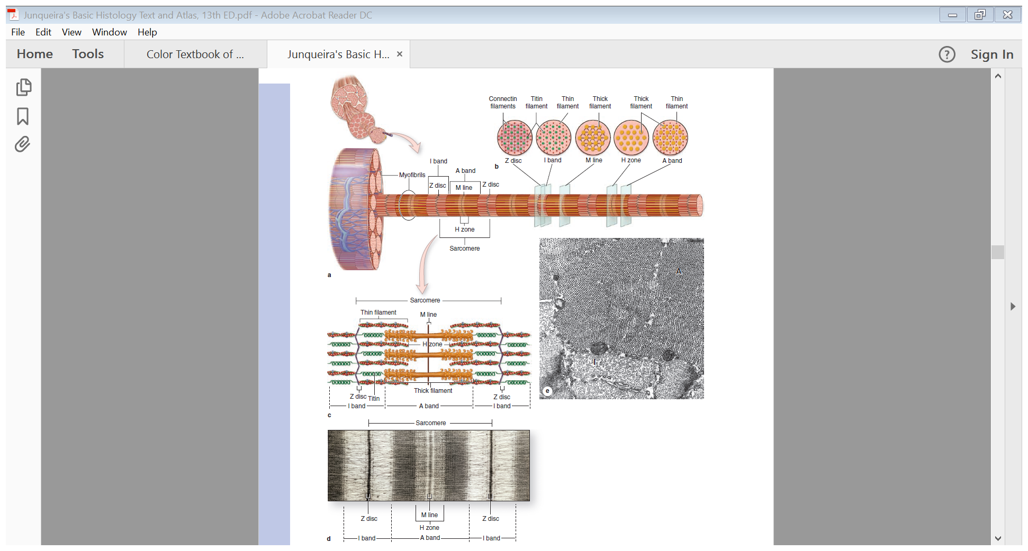
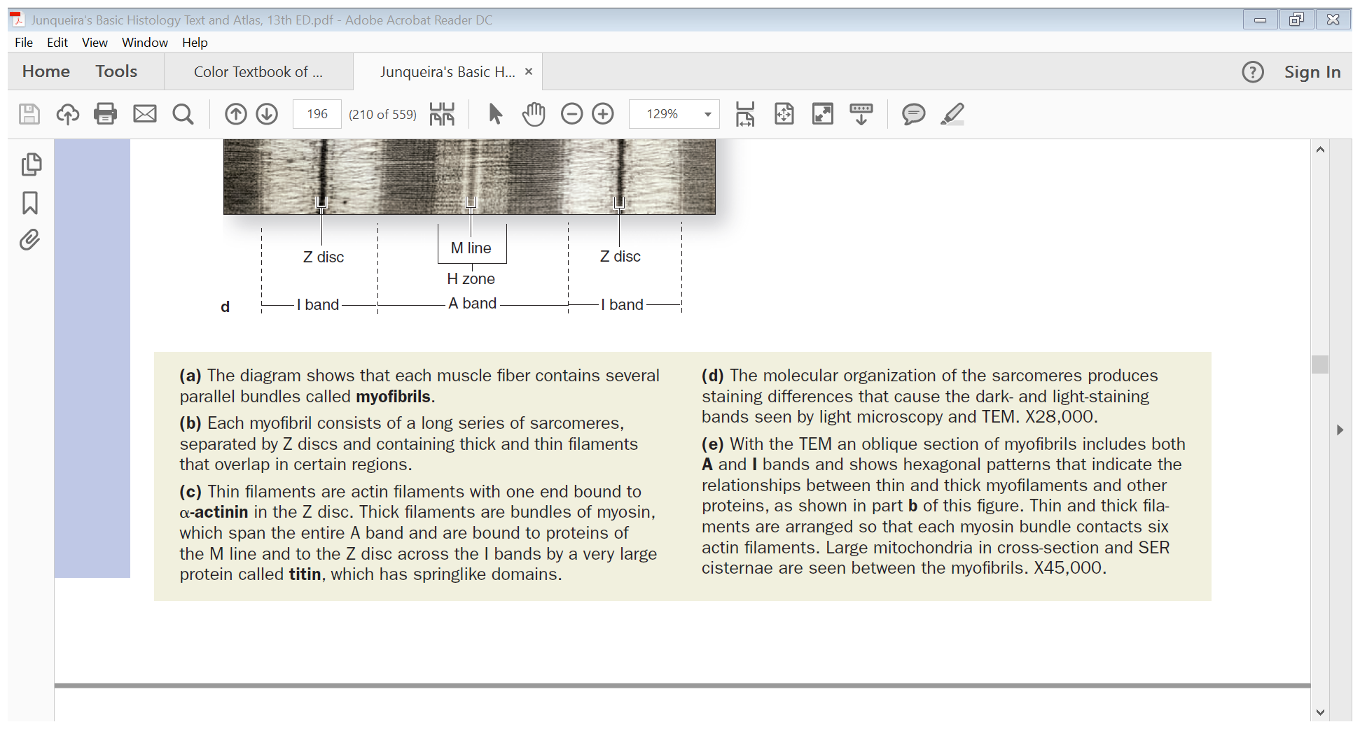
* Extra slide for deeper understanding of skeletal myofibrils

Slide 8
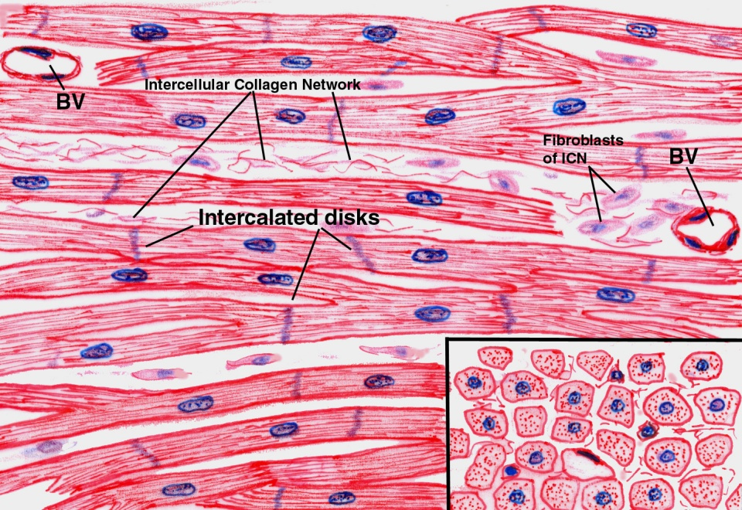
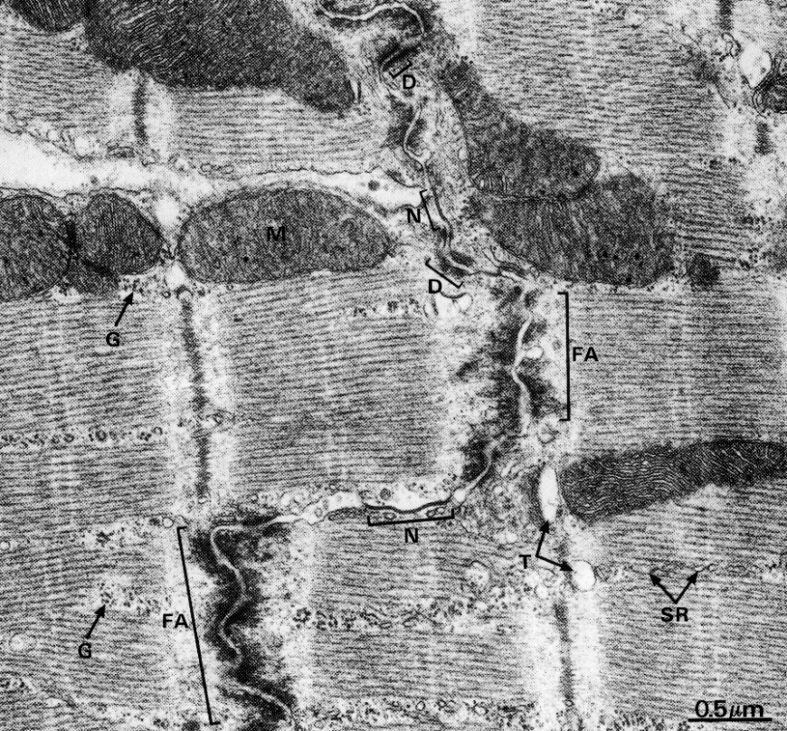
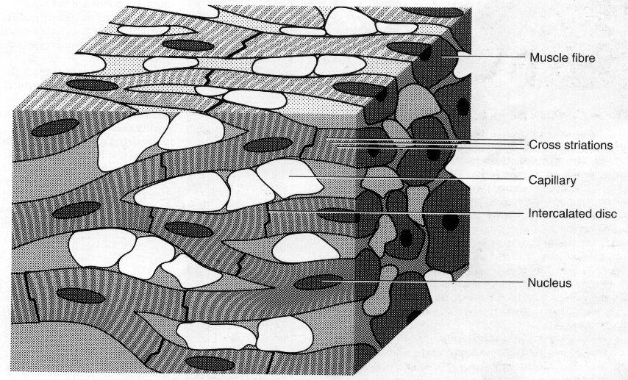
Cardiac muscle
It’s Found in the myocardium and it’s Striated and involuntary.
Cardiac Muscle Fibers :
Light Microscope Picture. | Electronic Microscope Picture.
Cylindrical ( اسطوانية) . Intermediate in diameter between skeletal and smooth muscle fibers. Branch and anastomose ( متشابكة). Covered by a thin sarcolemma. Mononucleated. ( as a cell or fiber it’s a Mononucleated, but as a tissue it’s a multinucleated) The Nuclei are oval and central. Sarcoplasm is acidophilic and shows non-clear striations (fewer myofibrils). Divided into short segments (cells) by the intercalated discs. | Few myofibrils. Numerous mitochondria. Less abundant SR. Glycogen (Food source) & myoglobin ( oxygen source). Intercalated discs: are formed of the two cell membranes of 2 successive cardiac muscle cells, connected together by junctional complexes (desmosomes and gap junctions).
Skeletal muscle is not branched but cardiac muscle is branched because we need every part of the heart to contract at the same time

Slide 9
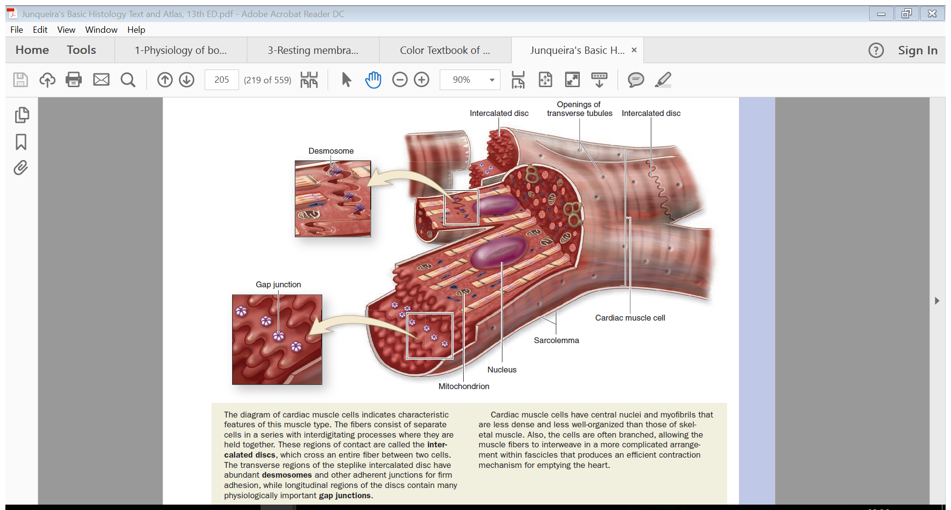
Extra Explanation for desmosomes and gap junctions
So briefly , desomsomes is a structure by which two adjacent cells are attached. and the gap junctions allow communication and passage of impulses between cardiac muscle cells.

Slide 10
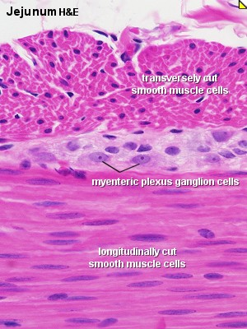
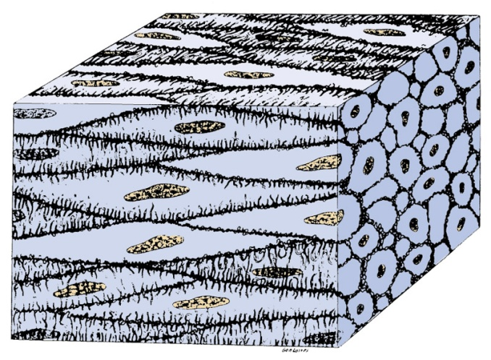
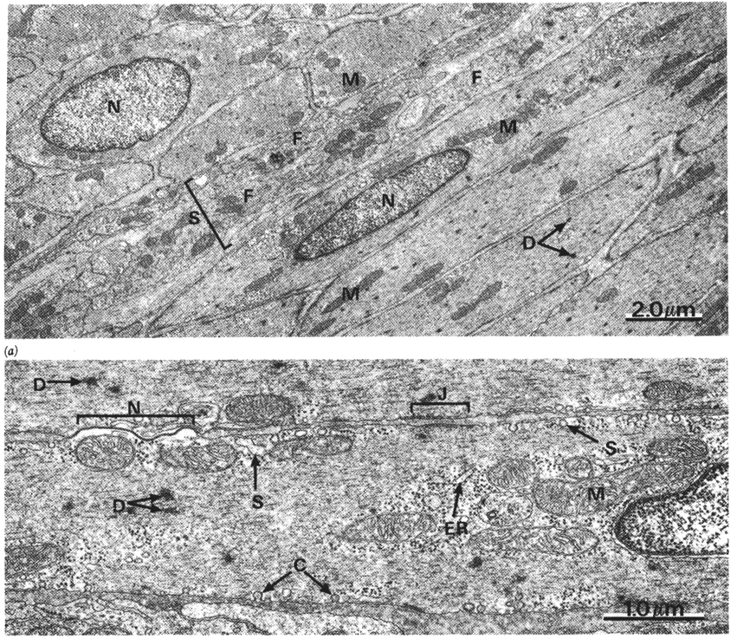
SMOOTH MUSCLE
smooth muscles
Present in walls of blood vessels and viscera (digestive, urinary, genital .... etc).
Non-striated and involuntary.
L.M. Picture of Smooth Muscle Fibers:
Fusiform in shape (spindle-shaped). Small diameter. Non-branched. Thin sarcolemma. Mononucleated. Nuclei are oval & central in position. Sarcoplasm is non-striated and acidophilic.
.
E.M. Picture:
Sarcoplasm contains mitochondria and sarcoplasmic reticulum. Myosin & actin filaments are irregularly arranged (that’s why no striations could be observed). Cells are connected together by gap junctions for cell communication.

Slide 11
REGENERATION OF MUSCLE
Comparison between different types of muscle fibers
 | SKELETAL | CARDIAC | SMOOTH
Site | Muscle attached to skeleton | Myocardium of the heart | Viscera, e.g. stomach
Shape | Cylindrical | Cylindrical | Fusiform
Diameter | Largest | Medium-sized | Smallest
Branching | Non-branched | Branched | Non-branched
Striations | Clear | Not clear | Absent
Intercalated discs | Absent | Present | Absent
Nuclei | Numerous and peripheral | One central nucleus | One central nucleus
Action | Voluntary | Involuntary | Involuntary
Regeneration | Limited | No | Active
(1) Skeletal muscle cells:
- Cannot divide.
- Limited regeneration by satellite cells
(stem cells on the muscle cell’s surface).
(2) Cardiac muscle cells:
No regenerative capacity.
(3) Smooth muscle cells:
- Can divide. (like uterus in pregnency)
- Regenerate from pericytes. ( which is the stem cell of the smooth muscle )
→ active regenerative response.

Slide 12
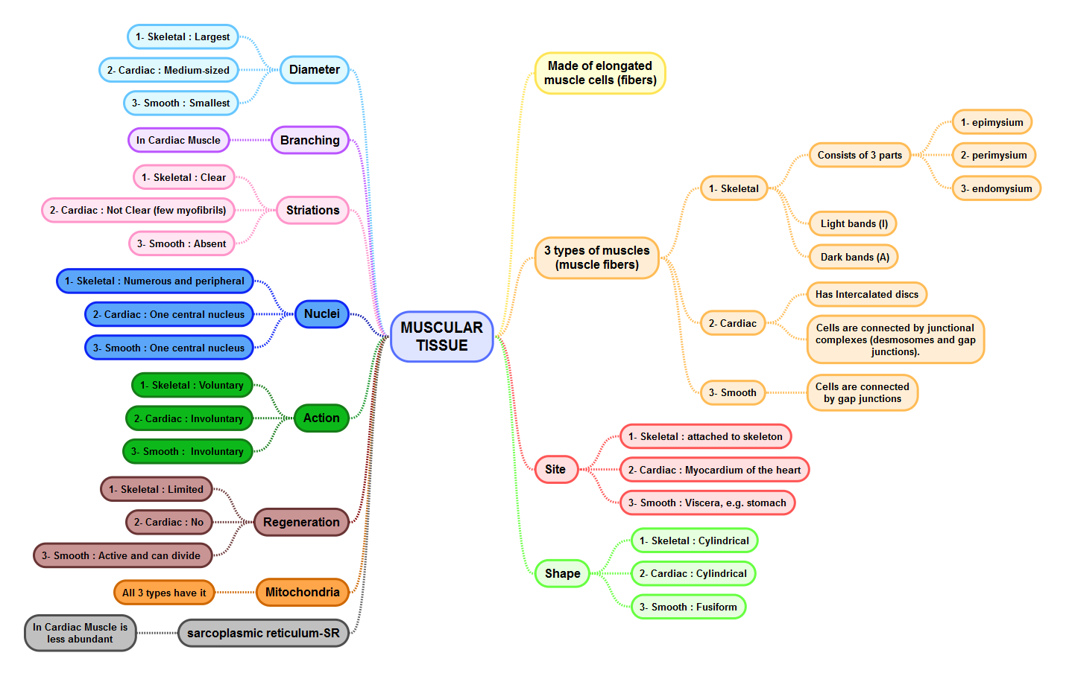

SUMMARY

Slide 13
THANK YOU !
Lecture done by:
Team Leaders :
Ahmed Badahdah
Mutasem Alhasani
Omar Turkistani
Nawaf Aldarweesh
Mohammed Khojah
Amal Al Qarni
Reema AlOtaibi
Faisal AlRabaii
Contact us on HistologyTeam436@gmail.com

