Slide 1

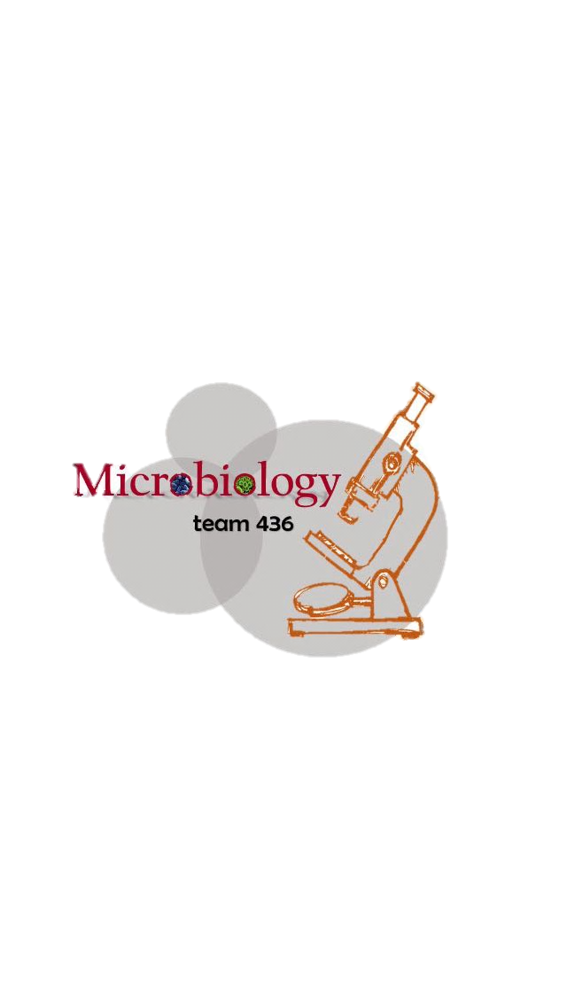
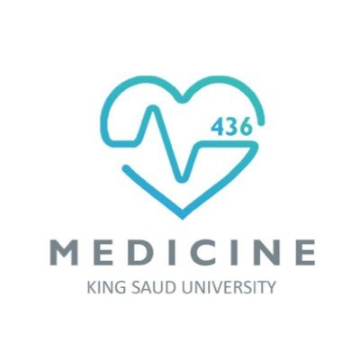
Lecture :
1-Skin and Soft-Tissue Infections
important
Extra notes
Doctors notes
"لا حول ولا قوة إلا بالله العلي العظيم" وتقال هذه الجملة إذا دهم الإنسان أمر عظيم لا يستطيعه ، أو يصعب عليه القيام به .

Slide 2
Objectives:
1. Describe the anatomical structure of skin and soft tissues.
2. Differentiate the various types of skin and soft tissue infections and there clinical presentation.
3. Name bacteria commonly involved in skin and soft tissue infections
4. Describe the pathogenesis of various types of skin and soft tissue infections 5. Recognize specimens that are acceptable and unacceptable for different types of skin and soft tissue infections
6. Describe the microscopic and colony morphology and the results of differentiating bacteria isolates in addition to other non-microbiological investigation
7. Discuss antimicrobial susceptibility testing of anaerobes including methods and antimicrobial agents to be tested.
8. Describe the major approaches to treat of skin and soft tissue infections ,either medical or surgical.

Slide 3
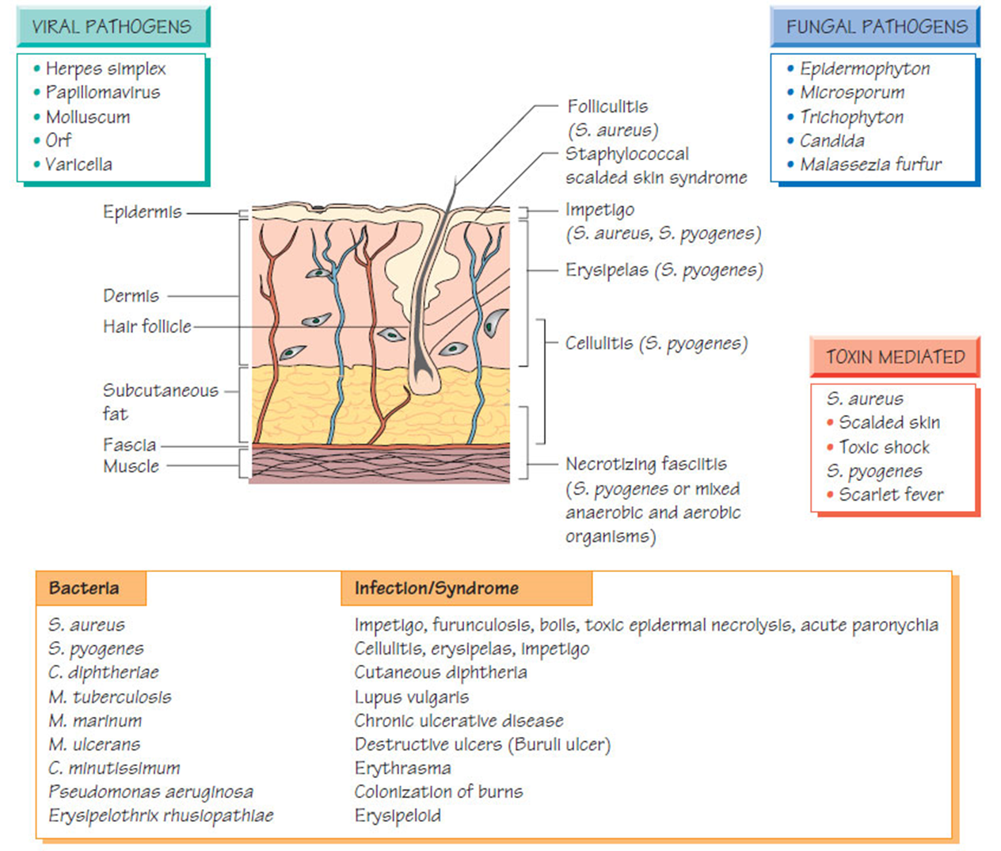
*
*This picture summarize the lecture return to it when you finish.
*Only in males slides

Slide 4
key to developing an adequate differential diagnosis requires:
History:
  patient’s immune status, the geographical locale, travel history, recent trauma or surgery, previous antimicrobial therapy, lifestyle, and animal exposure or bites
Physical examination:
  severity of infection
Investigation:
  -CBCs, Chemistry
  -Swab, biopsy or aspiration*
  -Radiographic procedures*
  -Level of infection and the presence of gas or abscess.
  Diagnostic and therapeutic:
  Surgical* exploration or debridement
  Antibiotics treatment
*Aspirate :For pus or exudate
*Radiology ( CT or X-Ray) : primary to determine if there is bone infection or if there is gas.

Slide 5
Introduction:
*Zoom in the image if not clear
-Soft tissue definition: anything other than bones.
Soft tissue infections : It is a Common disease.
Can be mild to moderate or sever muscle or bone and lungs or heart valves infection.
Most common Cause are: Staphylococcus aureus and streptococcus.
Emerging antibiotic resistance among:
  -Staphylococcus aureus (methicillin resistance).
  -Methicillin drug is the laboratory name for cloxicillin drug
  -Streptococcus pyogenes (erythromycin resistance).
Important to know the:
1- Name of the syndrome.
2- Organisms causing it.
3- Clinical presentation.
4- Antibiotics.
-You should differentiate between epidermis, dermis, subcutaneous infections and is it invading other tissues like muscles or bones to choose the right management.
-The more the organism has powerful toxins and enzyme the more it spread deeply, and he may devolve gas gangrene. For example : clostridium perfringase

Slide 6
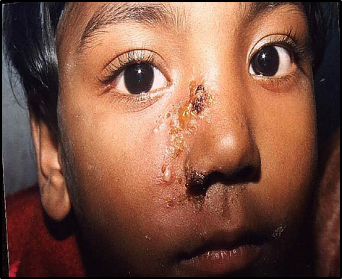
Impetigo - (pyoderma*):
Definition / causes / characteristics / treatment
Definition:
It’s a common skin infection, in Children 2–5 years in tropical or subtropical regions. Very superficial in epidermis
Causes:
Always caused by β-hemolytic streptococci (Nonbullous) and/or S.aureus (Bullous*)
Characteristics:
Systemic symptoms are usually absent.
Consists of discrete purulent* lesions (Blister* if it rupture, it’s produce fluid (honey crust))
Exposed areas of the body( face and extremities)
Skin colonization- Inoculation by abrasions, minor trauma, or insect bites
Poststreptococcal glomerulonephritis*.
(anti–DNAse B) :(antideoxyribonuclease B) ; if there is a lot of AntiDNAse in the test then it means he have impetigo .
Treatment:
Cefazolin: covers Both Staphylococcus and streptococcus.
Cloxacillin: covers Staphylococcus only
Erythromycin: covers streptococcus only
Mupirocin It may lead to immune complication in some cases.
*After infection of impetigo by "group A"(beta hemolytic) Streptococcus , the patient might have post streptococcal glomerulonephritis.
streptococcal glomerulonephritis: it is immunological response which affects kidney,
it is primarily antigen-antibody complex reaction. This antibody is produced against cell wall of "A streptococcus "and accumulate in the glomerulus and cause acute glomerulonephritis and shows reversible renal failure
If patient has cellulitis, 1st drug you think of
= Cefazolin
Pyoderma*:any skin disease that is pyogenic (has pus))
Purulent*: صديدي
Blister*: الحبة أو البثرة
Bulbous* =pus

Slide 7
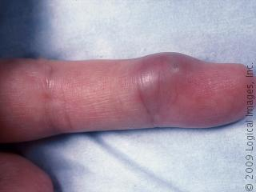
Cutaneous abscesses:
Definition / causes / characteristics / treatment
Definition:
Collections of pus within the dermis and deeper skin tissues.
Causes :
Typically polymicrobial, S. aureus alone in ∼ 25 %
Do Gram stain,culture, and systemic antibiotics
Characteristics:
Painful, tender, and fluctuant
Multiple lesions:
cutaneous gangrene.
severely impaired host defenses.
extensive surrounding cellulitis.
high fever.
Treatments:
Incision and evacuation* of the pus.(فتح الخراج واستخراج الصديد منه)
Antibody: Cloxacillin (S.Aureus only)
        *Evacuation =drainage

Slide 8
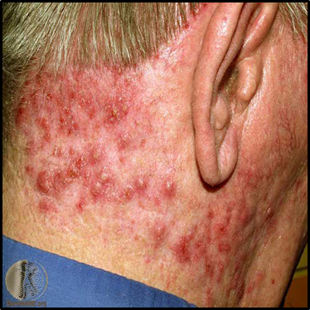
Furuncles and carbuncles:
Definition / causes / characteristics / treatment
Definition:
Furuncle or bolis: infection of the hair follicle (folliculitis) ,small and affect one hair follicle
Carbuncle: infection of many hair follicles, big and with coalescent inflammatory mass
  Causes:
  usually caused by S. aureus
Characteristics
  extends through the dermis into the subcutaneous tissue (so it is Deeper than Cutaneous abscesses.)
Carbuncle present in the back of neck especially diabetes patients
Treatment:
Larger furuncles and all carbuncles require incision and drainage.
Systemic antibiotics are usually unnecessary
-S. aureus it is the normal flora in anterior nares
Outbreaks* of Furunculosis:
Caused by MSSA*, and MRSA*
Families, prisons ,sports teams
Inadequate personal hygiene
Repeated attacks of furunculosis
Presence of S. aureus in the anterior nares- 20-40%
Mupirocin ointment(اسم مرهم)-to eradicate staphylococcal carriage nasal colonization
إذا فيه إصابة في العائلة راح تاخذهم كلهم وتاخذ منهم
Nose swap
وتشوف مين يحمل البكتيريا وتسوي له
Decolonization
وتعطيه معقمات ، للاستحمام مثلا
+ topical antibiotics
Outbreaks*:تفشي MSSA*=methicillin sensitive staph-aureus MRSA*= methicillin resistance staph-aureus
الكاربنكل عبارة عن أكثر من فرنكل

Slide 9
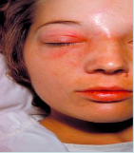
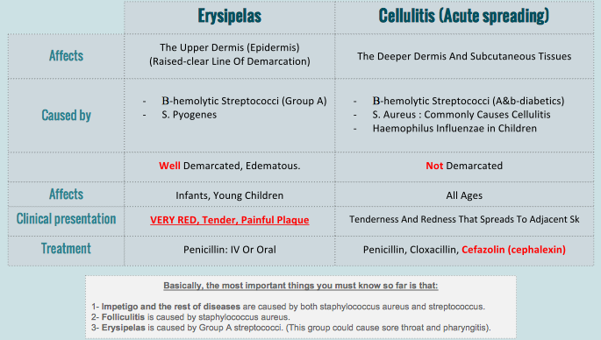
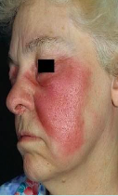
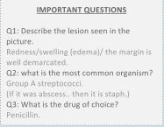
Erysipelas and Cellulitis:
Team 435 ملخصها بشكل رائع ومختصر
*important
(Group A Strept)
(S. Aureus Only)
(Drug of Choice)
فيه تكملة للسيلولتس في السلايد الجاي

Slide 10
Cont-Cellulitis:
Risk factors:
  Obesity, venous insufficiency, lymphatic obstruction (operations), preexisting skin infections-ulceration, or eczema,
  CA-MRSA ( Community Association MRSA)
    Carry Panton-Valentine leukocidin gene
    More sensitive to antibiotics
    Can lead to sever skin and soft tissue infection or septic shock
Treatment:
  Vancomycin or linazolid in case of MRSA
  Clindamycin, TMP-SMZ for CaMRSA
Diagnosis and Treatment
Clinical diagnosis Symptoms and Signs
High WBCs, blood culture rarely needed
Aspiration and biopsy might be needed in diabetes mellitus, malignancy, animal bites, neutropenia (Pseudomonas aeruginosa ),immunodeficiency, obesity and renal failure
Observe for progression to sever infection(increased in size with systemic manifestation ie . fever, leukocytosis

Slide 11
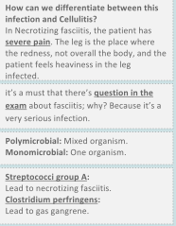
Necrotizing Fasciitis:
**
Also known as flesh eating disease.
It is a rare deep skin and subcutaneous tissues infection.
The Most serious infection in Microbiology can kill patient.
Deep inflammation of fascia, systemic
Usually present in diabetic patient
Sometimes present with as cellulitis
Most common in arms, legs, and abdominal wall and is fatal in 30%-40% of cases.
Two types:
  Type 1: is Polymicrobial
  Type 2 :which is Monomicrobial. (caused by one microorganism)
Caused by:
  Fournier’s gangrene (testicular), ( if localized in the testis or scrotum, or perineal region ), Necrotizing cellulitis ( another name for it ).
  Group A streptococcus ( streptococcus pyogens )
  Staphylococcus Aureus or CA-MRSA ( community acquired – methicillin resistant staph aureus )
  Clostridium Perfringens ( gas in tissues )
  Bacteroides Fragillis ( other causative microorganism )
  Vibrio Vulnificus ( liver function )
  Gram negative bacteria ( synergy يعني متعاونة مع بكتيريا ثانية ) : E.Coli , klebseilla, Pseudomonas.
  -Fungi
** important (from 435 team)

Slide 12
Doctors Notes
Most important sign is SEVERE PAIN.
It is considered a clinical emergency.
Type 1 can be clostridium perfringens and group A streptococcus
Type 2 is group A alone
It is confirmed by biopsy. Also, MRI is used before that.
We do a Gram stain for it to determine the type ( 1or 2 ) and choose the correct antibiotic.
We can give 2 antibiotics ( Penicillin and Clindamycin ) to treat it because it is an emergency, BUT surgery is always the best treatment.
you don’t have to memorize the risk factors for Necrotizing Fasciitis , but read it

Slide 13
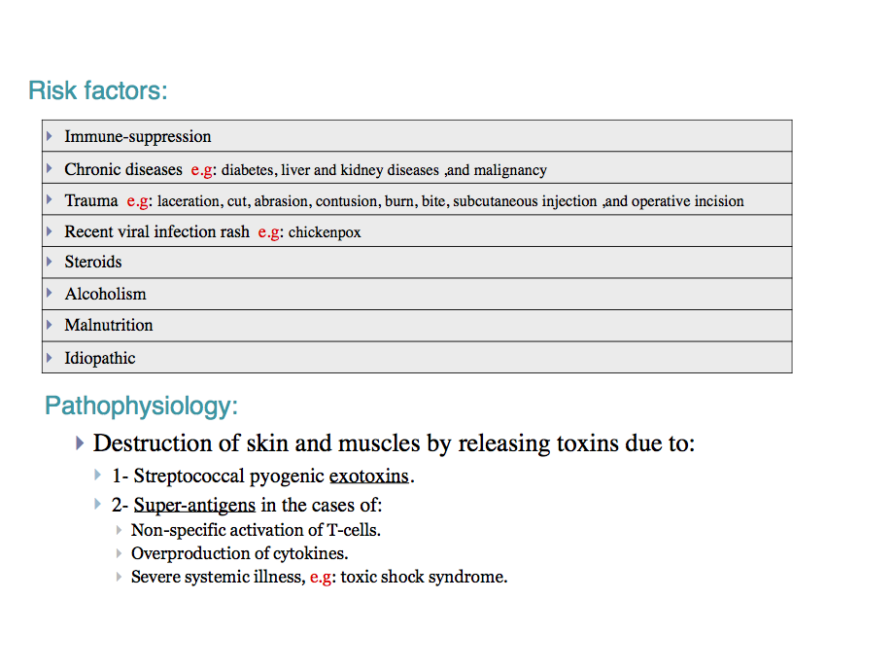
Necrotizing Fasciitis:
  Super-antigens :are super inducer for immune system)

Slide 14
Necrotizing Fasciitis:
Signs and symptoms:
  Rapid progression of sever pain with fever , chills (typical)
  Swelling , redness, hotness, blister, gas formation, gangrene and necrosis
  Blisters with subsequent necrosis , necrotic eschars
  Diarrhea and vomiting (very ill)
  Shock organ failure
  Mortality as high as 73 % if untreated
Diagnosis:
A delay in diagnosis is associated with a grave prognosis and increased mortality
Clinical-high index of suspicion
Blood tests :
  CBC-WBC , differential , ESR
  BUN (blood urea nitrogen)- to check for renal failure.
Surgery debridement : amputation
Radiographic studies:
  X-rays : subcutaneous gases
  Doppler CT or MRI - to evaluate the spread.
Microbiology:
  Culture &Gram's stain
    ( blood, tissue, pus aspirate)
  Susceptibility tests

Slide 15
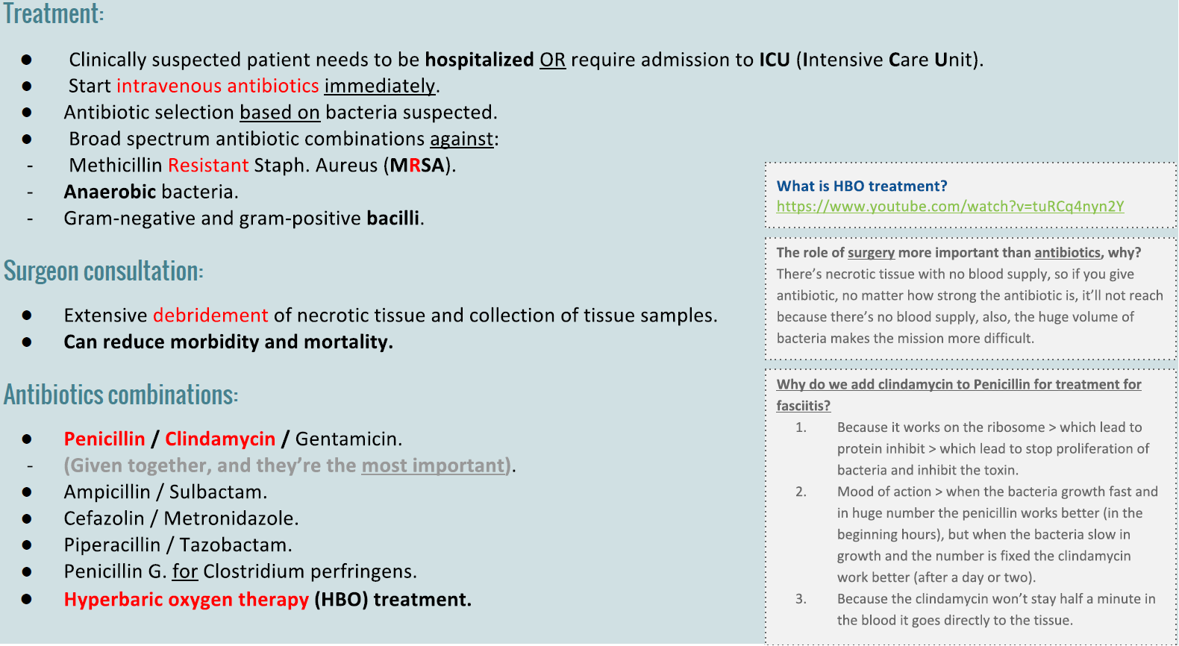
Necrotizing Fasciitis:
Treatment:
If clinically suspected patient needs to be hospitalized OR require admission to ICU(intensive care unite).
Start intravenous antibiotics immediately.
Antibiotic selection based on bacteria suspected.
broad spectrum antibiotic combinations against:
  MRSA: methicillin-resistant Staphylococcus aureus (MRSA)
  Anaerobic bacteria
  Gram-negative and gram-positive Bacilli
Surgeon consultation :
  Extensive Debridement of necrotic tissue and collection of tissue samples
  Can reduce morbidity and mortality
Antibiotics combinations :
  Penicillin/clindamycin/gentamicin.
  (Given together, and they’re the most important)
  Ampicillin/sulbactam
  Cefazolin plus metronidazol
  Piperacillin/tazobactam
  Clostridium perfringens - penicillin G
Hyperbaric oxygen therapy (HBO) treatment
https://www.youtube.com/watch?v=tuRCq4nyn2Y
**
** important (team435)

Slide 16
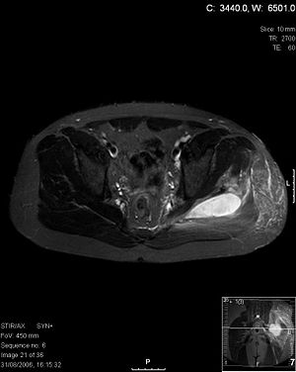
Pyomyositis:
Definition: Acute bacterial infection of skeletal muscle, usually caused by Staph. Aureus.
No predisposing penetrating wound, vascular insufficiency or contiguous infection.
Most cases occur in the tropics (الدول الاستوائية).
60% of cases outside of tropics have predisposing risk factors (RF):
Diabetes mellitus, ethyl alcohol, liver disease, steroid prescriptions, HIV, hematologic malignancy.
History:
- Blunt trauma or vigorous exercise (50%), then period of swelling without pain.
- 10-21 days later : pain, tenderness, swelling and fever.
Pus can be aspirated from muscle.
3rd stage: sepsis, later metastatic abscesses if untreated.
Diagnosis:
X-ray, US, MRI or CT.
Treatment:
Surgical drainage and antibiotics.
You can read this slide

Slide 17
Doctors Notes
- staph arues is resistant to penicillin
-S. aureus it is the normal flora in anterior nares
- cafazolin is the drug of choice in treatment of impetigo
-we usually treat pus by draining it
- erysipelas is well defined
- erysipelas is most common in legs
- cellulitis is poorly-defined
- necrotizing fasciitis is treated with surgery and antibiotics
If the abscess deep> anaerobic+ gram +ve
If it superficial > staph

Slide 18
Other Specific Skin Infections
Epidemiology | Common Pathgen(s) | Therapy
Cat/Dog Bites | Pasturella multocida; Capnocytophaga | Amox/clav (Doxy; FQ or SXT + Clinda)
Human bites | Mixed flora eikenella corrodens | Hand Surgeon; ATB as above
Fresh water injury | Aeromonas | FQ; Broad Spectrum Beta-lactam
Salt water injury (warm) | Vibrio vulnificus | FQ; Ceftazidime
Thorn , Moss | sporothrix schenckii | Potassium iodine
Meat-packing | Erysipelothrix | Penicillin
Cotton sorters | Anthrax | Penicillin
Cat scratch | Bartonella | Azithromycin

Slide 19
TAKE HOME POINTS
Most commonly caused by Staphylococcus aureus and Streptococcus pyogenes
Risk factors for developing SSTIs include breakdown of the epidermis, surgical procedures ,crowding, comorbidities, venous stasis, lymphedema
Most of the infection are mild and can be managed on an outpatient basis In case
Most SSTIs can be managed on an outpatient basis, although patients with evidence of rapidly progressive infection, high fevers, or other signs of systemic inflammatory response should be monitored in the hospital setting.
Superficial SSTIs typically do not require systemic antibiotic treatment and can be managed with topical antibiotic agents, heat packs, or incision and drainage.
Systemic antibiotic agents that provide coverage for both Staphylococcus aureus and Streptococcus pyogenes are most commonly used as empiric therapy for both uncomplicated and complicated deeper infections.

Slide 20
Summary:
 | Impetigo | Coetaneous abscesses | Furuncles /Carbuncles | Erysipelas | Cellulitis | Necrotizing fasciitis
Part affected | epidermis | Dermis and deeper skin tissue | dermis and subcutaneous tissue | Upper dermis | Deep dermis and subcutaneous tissue | Deep skin and subcutaneous tissue
Etiology | Caused by Beta Hemolytic streptococci / Staph. Aureus | Staph Aureus or polymicrobial | Staph Aureus | Beta hemolytic streptococci group A | Beta hemolytic streptococci (diabetics) Staph. Aureus (trauma) Homophiles influenza (children) | Streptococcus A and Clostridium perfrenges
Characteristics | Systemic symptom usually absent | Painful, tender and fluctuant | Hair follicle infection (folliculitis) | Red , tender , painful plaque | Risk factors : obesity , venous insufficiency , lymphatic obstruction, preexisting skin infection , ulceration , eczema | The most serious infection in Microbiology. Associated with gangrene and shock organ failure. Associated with gangrene and shock organ failure
Treatment | Cefazolen | Incision and evacuation of pus | Systemic antibiotics are usually unnecessary | Penicillin | Penicillin, cloxacillin Cefazolen | Penicillin , Clindamycin and Surgery
Did you study well ?
https://www.onlineexambuilder.com/micro-1/exam-121025

Slide 21
SAQ:
42 year old male with Diabetes Mellitus came with sever pain, fever and his right leg was swelling, redness and blisters with subsequent necrosis.
Q1: What is the most likely Diagnose in this case ?
Necrotizing fasciitis
Q2: How can we differentiate between this infection in this case and cellulitis, Both of them, the patient come with pain and mild redness ?
In Necrotizing fasciitis, the patient has SEVER PAIN and feels heaviness in the leg infected.
Q3: Can radiologist confirm our diagnose ?
Yes , by X-rays to see if there is any subcutaneous gases or not.
by MRI & CT for soft tissue.
Q4: If we say that this case is Type(I) infection. What does it mean ?
This infection cause by polymicrobial agent ( mixed organisms / more than one ).
Q5: List some organism can cause this infection ?
Group A streptococcus / Clostridium perfringens / Bacteroides fragilis / Fungi.
Q6: The surgeon play an important role in this case by removing the necrotic tissue and sending a sample to Microbiology lab.
What is the purpose of sending that sample after removing the necrotic tissue ?
To Know what are the causative organisms and therefore determine the suitable Antibiotics for treatment .
Q7: Why in this case we recommend to use combinations of Penicillin-clindamycin ?
The Clindamycin is more penetrate into soft tissue.
The Clindamycin works on the ribosome which lead to inhibit the synthesis of proteins which are in this case the toxins.
Q8: Streptococcus pyogenes are destroying the skin and muscle by releasing exotoxins which sometimes known as (Superantigen). What does it mean ?
They are a class of antigen that cause non-specific activation of T-cells, therefore overproduction of cytokines which may lead to Severe systemic illness such as Toxic shock syndrome.
The answers are below the questions , ZOOM to see it clear =)

Slide 22

GOOD LUCK!
MICROBIOLOGY TEAM:
Waleed Aljamal (leader) Shrooq Alsomali (leader)
Ibrahim Fetyani
Meshal Eiaidi
Khalid Alhusainan
Hussam Alkhathlan
Faisal Alqumaizi
Abdulaziz Alangari
Khalid Alshehri
Nasir Aldosarie
Mohammad Al-Kahil
Rawan Alqahtani
Hanin Bashaikh
Jawaher Alkhayyal
Reem Alshathri
Ohoud Abdullah
Lama Al-musallam
Wateen Alhamoud
Ruba Barnawi
Shooq Albugami
The Editing File
We are waiting for your feedback
@microbio436
436microbioteam@gmail.com

