Slide 1


Lecture :
mycetoma and other Subcutaneous Mycoses
important
Extra notes
Doctors notes
"لا حول ولا قوة إلا بالله العلي العظيم" وتقال هذه الجملة إذا دهم الإنسان أمر عظيم لا يستطيعه ، أو يصعب عليه القيام به .

Slide 2
Objectives:
Acquire the basic knowledge about mycetoma and the clinical features of the disease
Acquire the basic knowledge about other common subcutaneous mycosis and their clinical features.
Know the main fungi that affect subcutaneous tissues, muscles and bones.
Identify the clinical settings of such infections
Know the laboratory diagnosis, and treatment of these infections.

Slide 3
Subcutaneous Mycoses:
Definition : Fungal infections involving the dermis, subcutaneous tissues, muscle and may extend to bone.
They are initiated by trauma to the skin.
Are difficult to treat and surgical intervention(تدخل جراحي) is frequently employed.
Diseases in healthy host, however, more severe disease in immunocompromised host.

Slide 4
Subcutaneous Mycoses
Mycetoma
Subcutaneous zygomycosis
Sporotrichosis
Pheohyphomycosis
Rhinosporidiosis
Lobomycosis
Chromoblastomycosis
1-4 will explained in detail in the next slides BUT 5,6 and 7 are in the schedule slide ()

Slide 5
Mycetoma:
Definition and characteristic \ Etiology \ Diagnosis \ Treatment
Mycetoma is a chronic, granulomatous disease of the skin and subcutaneous tissue, which sometimes involves muscle, and bones. (in the beginning localized and painless )
It is characterized by Swelling , abscess formation, and multiple draining sinuses that exude characteristic grains of clumped organisms .
It typically affects the lower extremities, but also other areas of the body e.g. hand, back and neck.
The disease was first described in the Madura district of India in 1842, (Madura foot). ( don’t memorize the date)
Mycetoma is endemic in tropical, subtropical, and temperate regions. Sudan, Senegal, Somalia, India, Pakistan, Mexico, Venezuela
Is more common in men than in women (ratio is 3:1).
Commonly in people who work in rural areas, framers
Because this infection is done by trauma usually , and the men usually work as a farmer so they most likely to get trauma than women.

Slide 6
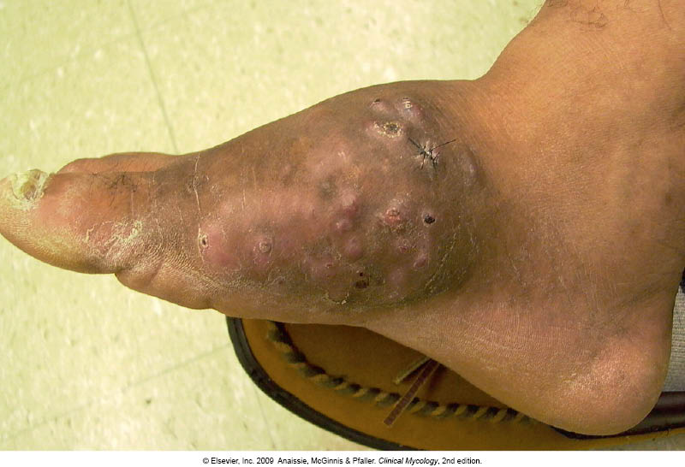
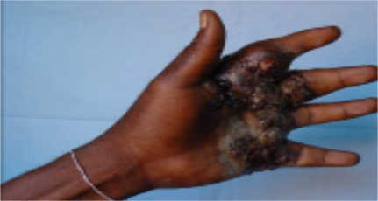
Mycetoma:
Definition and characteristic \ Etiology \ Diagnosis \ Treatment
Mycetoma is acquired via trauma of the skin
Trauma
painless subcutaneous firm nodule is observed
massive swelling with skin rupture, and sinus tract formation
old sinuses close and new ones open, draining exudates with grains (granules)
Grains may sometimes be seen with the naked eye.

Slide 7
Mycetoma:
Definition and characteristic \ Etiology \ Diagnosis \ Treatment
Classified as :
2-Actinomycetoma :
  Caused by aerobic filamentous bacteria (Actinomycetes) gram positive
The most common are:
Actinomadura madurae
Streptomyces somaliensis
Nocardia brasiliensis
      Color of grains yellow, white, yellowish-brown, pinkish – red.
      There is no black
1-Eumycetoma:
Caused by a several mould (filaments) fungi
The most common are :
Madurella mycetomatis
Madurella grisea
Pseudallescheria boydii
The color of grains is black or white
There are many species of Actinomycetes, some of them anaerobic which we already had taken in Anaerobic lecture which commonly affect the oral cavity especially after tooth extraction , and some of them are aerobic which we are talking about them here .

Slide 8
Mycetoma:
Definition and characteristic \ Etiology \ Diagnosis \ Treatment
-Clinical samples:
|Biopsy tissue (Superficial samples of the draining sinuses are inadequate) , (deep biopsy is more accurate* )
|Pus with grains
|Blood (for serology only i.e antibody and antigen)
1-Direct microscopic examination | 2-Culture
-Histological sections: Hematoxylin-Eosin, -Smears: 1-fungi: Stain with Giemsa , Gomori methenamine silver 2-Actinomycetes: Stain with Gram (Actinomycetes) -Grains : (Observing the size of the filaments , the color of the grain) e.g. White-to-yellow grains indicate P . boydii, Nocardia species, or A. madurae infection. Black grains indicate, Madurella species infection. | Media such as Sabouraud dextrose agar (SDA) to isolate fungi -Fungi are identified based on the macroscopic and microscopic features. Blood agar to isolate bacteria. -For Actinomycetes biochemical and other tests are used for identification
*Because the superficial layer of the skin may contain mixed microbe at least the normal flora.

Slide 9
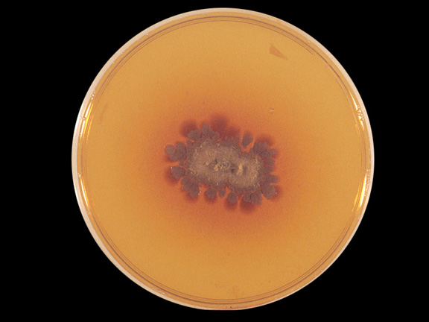
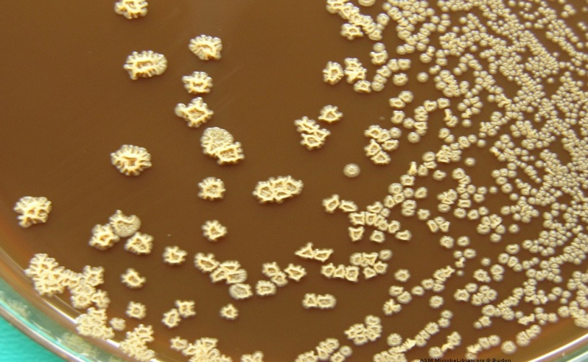
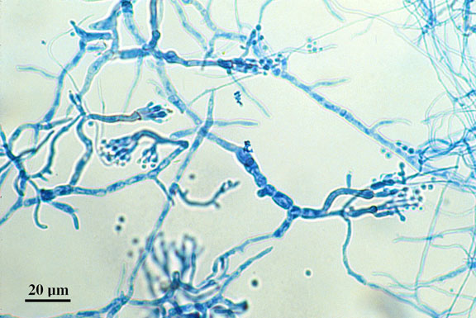
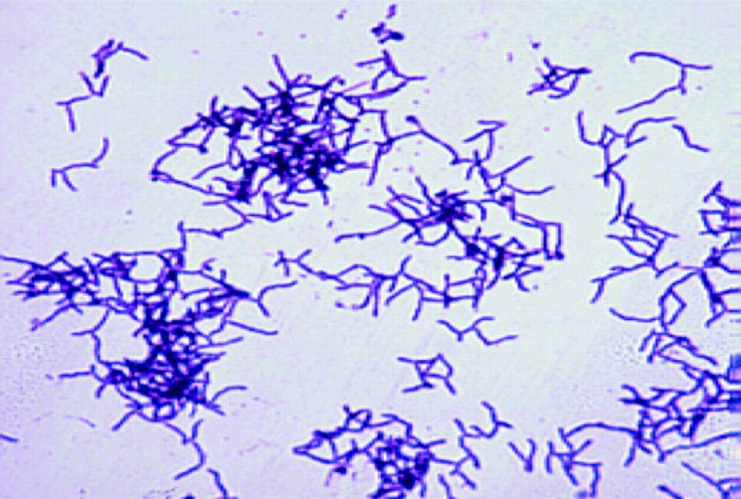
Mycetoma:
SDA
Brownish - wrinkled - seems to be dry - with orange pigmentation around it
- Dry – wrinkled – small
Septated hyphae with conidia=spores
After we stained it by gram stain
Gram+ branching filaments bacteria

Slide 10
Mycetoma
Definition and characteristic \ Etiology \ Diagnosis \ Treatment
Therapy is suggested for several months or years (1-2 years or more)
  Actinomycetoma generally respond better to treatment than eumycetoma
Radiologic tests (bone radiographs) if bone involvement is suspected
Surgical Care: In eumycetoma, surgical treatment (debridement or amputation) in patient not responding to medical treatment alone and if bone is involved
  1-Eumycetoma :
  - Itraconazole
  2-Actinomycetoma:
    Trimethoprim-sulfamethoxazole
    With either Dapsone Or Streptomycin
    - Combination of 2 drugs is used
Dapsone is Common than Streptomycin, which required to be given IV

Slide 11
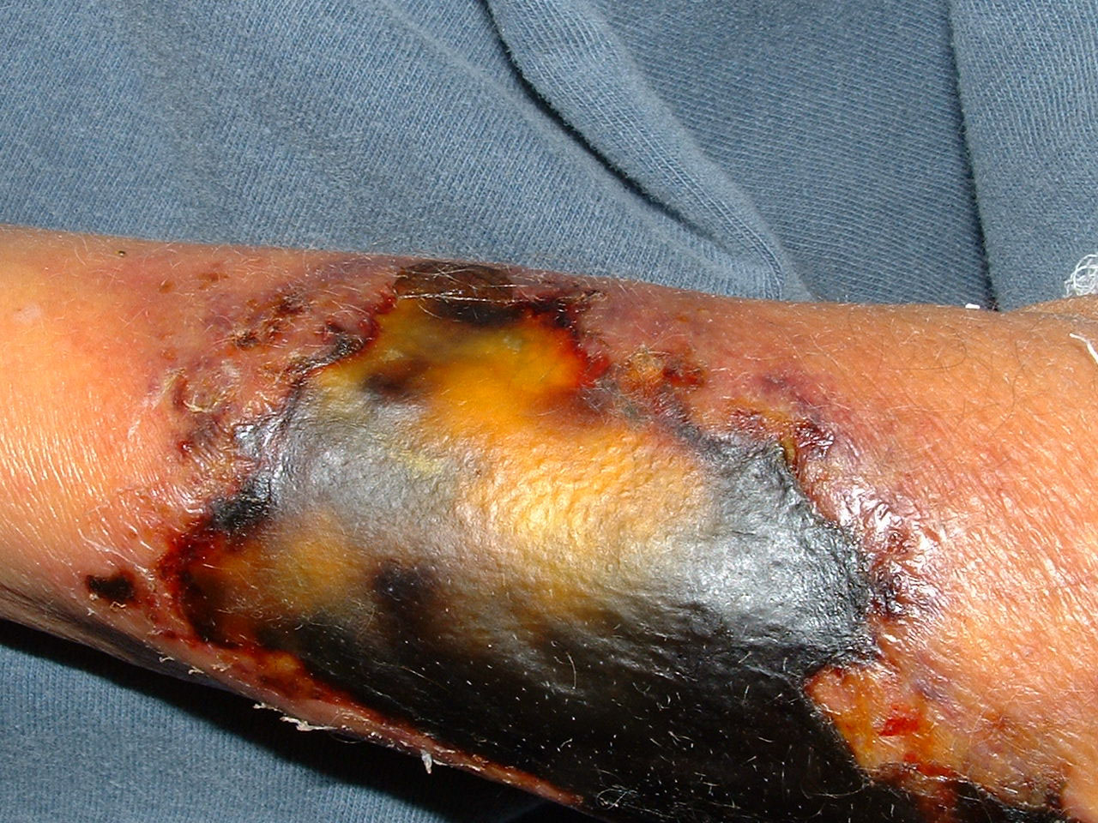
Subcutaneous zygomycosis:
Definition and characteristic \ Etiology \ Diagnosis \ Treatment
  Chronic localized firm Subcutaneous masses. (they are usally Localized – nodule – painless )
facial area or other like hand, arm, leg, thigh.
Firm swelling of site with intact skin-Distortion. with NO abscess or sinuses (differentiate with Mycetoma).
Direct spread to adjacent bone and tissue.
Acquired via traumatic implantation of spores, needle-stick, tattooing, contaminated surgical dressings, burn wound
Etiology:
-Mould fungi of the Zygomycetes:
1-Entomophthorales (chronic) :
Conidiobolus coronatus, Basidiobolus ranarun,
2- mucorales (acute).Rhiceos, Mucos
There is no sinus formation and abbesses unlike Mycetoma, the most characteristic feature here is the necrosis.
- Mainly caused by entomophthorales
it’s more in male.
  It present according to the etiology:
  If its conidiobolud we will find it in the face
  If its basidiobolus we will find it in the limb
  GI or abdominal mass
  (Black necrosis )
  Mostly caused by mocurales cause it mostly affected blood vessels
  هذا يعني انها تسوي invasion necrosis and infarction which lead to black necrosis..

Slide 12

Subcutaneous zygomycosis:
Definition and characteristic \ Etiology \ Diagnosis \ Treatment
Laboratory Diagnosis:
Specimen: Biopsy tissue
Treatment:
Oral Potassium iodide (KI)
Amphotericin B
Posaconazole
  In most disease we take biopsy or pus because its subcutaneous sample
1-Direct microscopy: | 2-Culture:
stained sections or smears: broad non-septate hyphae | Culture on SDA

Slide 13
Phaeohyphomycosis:
Definition and characteristic \ Etiology \ Diagnosis \ Treatment
Is a group of fungal infections caused by dematiaceous (darkly pigmented) fungi widely distributed in the environment
Subcutaneous or brain Abscess (ranging from simple nodule to systemic or brain abscess)
Presents as nodules or erythematous plaques with no systemic involvement
Affected site: Thigh, legs, feet, arms
  Affected normal host
Etiology:
Diagnosis:
Treatment:
Dematiaceous mold fungi.
common:
Cladosporium,
Exophiala,
Wangiella,
Cladophialophora,
Bipolaris
Specimens: Pus,biopsy tissue
1-Direct Microscopy:
KoH and smears will show *brown septate fungal hyphae
2-Culture: On SDA
The treatment of choice is Surgical excision of the lesion
Antifungal:
Itraconazole, Posaconazole
*Shows as brown septate fungal hyphae because is caused by dematiaceous which are darkly pigmented fungi.

Slide 14
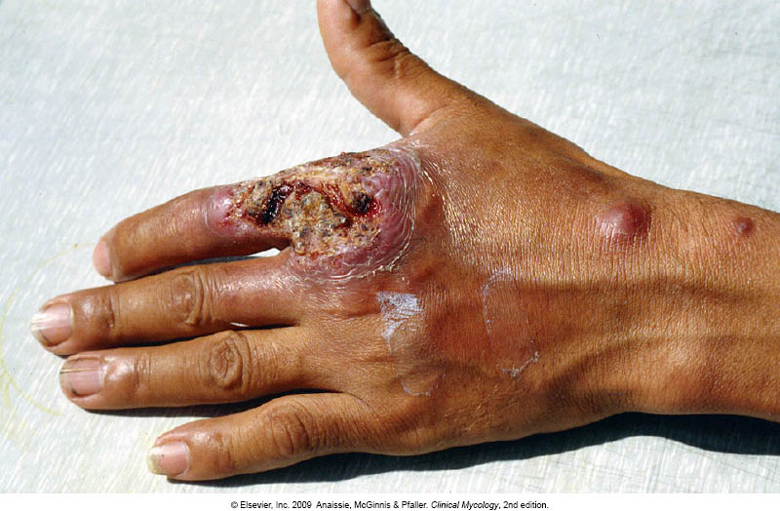
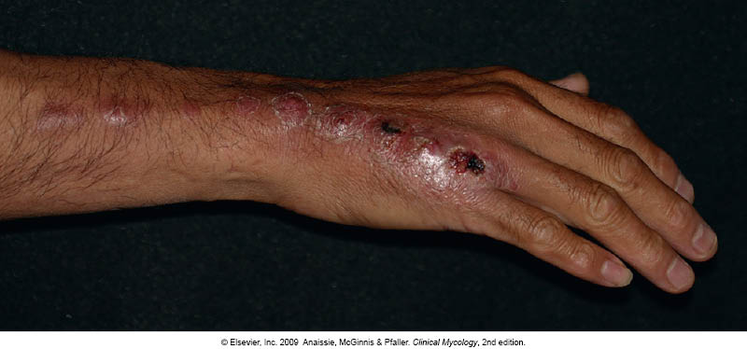
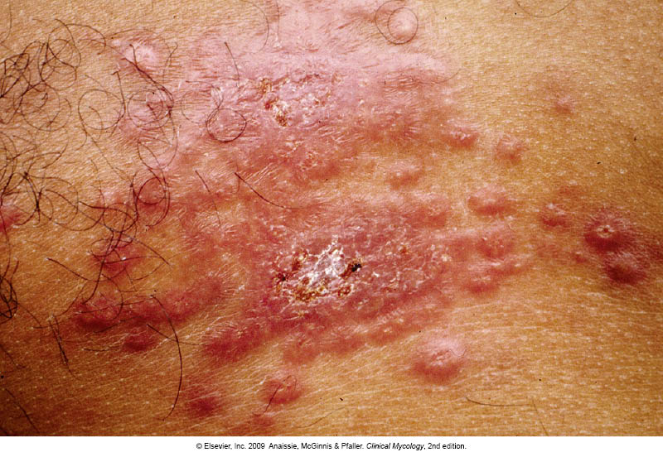
Sporotrichosis:
Definition and characteristic \ Etiology \ Diagnosis \ Treatment
Subcutaneous , deep cutaneous or systemic fungal infection
Inoculation (embedded) into the skin
Can present as:
  plaque (subcutaneous nodules)
  Lymphanginitic
  Dissiminated it means spread to other area by hematoginitics
  : which spread along the line of lymphatic drainage
Etiology:
Sporothrix schenckii its a *Dimorphic fungus
Laboratory Diagnosis:
Specimen: Biopsy tissue, pus
1-Direct Microscopy: smear will show Finger-like yeast cells or Cigar shaped
2-Culture: On SDA at room temperature and at 37ºC
Because they already had taken from someone’s body so they will be in yeast form .
Treatment
Itraconazole, KI (potassium iodide)
  1- yeast which is grow at body temperature or
  2- mold/hyphal/filamentous which is grow at room temperature
Remember : *dimorphic : have 2 forms (mold and yeast ) depending on changing in the environmental factor (tempreture)

Slide 15
Other subcutaneous fungal infections
Lobomycosis | Rhinosporidiosis | Chromoblastomycosis | Phaeohyphomycosis | Sporotrichosis
Subcutaneous Nodular lesions, keloids | Granulomatous, mucocutaneous polyps | Subcutaneous Verrucous plaques, cauliflower aspect, hyperkeratotic, Ulcerative | Subcutaneous or brain Abscess Nodules and erythematous plaques | Subcutaneous or systemic infection Nodular subcutaneous lesions, verrucous plaques or Lymphatic | Clinical features
Obligatory parasitic fungus Lacazia loboi | Obligatory parasitic fungus Rhinosporidium seeberi | Dematiaceous mould fungi | Dematiaceous (darkly pigmented) mould fungi | Dimorphic fungus Sporothrix schenckii | Etiology
Biopsy tissue | Biopsy tissue | Biopsy tissue | Biopsy tissue | Biopsy tissue | Clinical sample
Chains of yeast cells | Spherules with endospores | Muriform cells (sclerotic bodies) | Brown setpate hyphae | Elongated yeast cells | Direct Microscopy
Surgery | Surgery | Surgery (Antifungal therapy) | Surgery (Antifungal therapy) | Potassium iodide Itraconazole | Treatment

Slide 16
They are uncommon and not as isolated clinical problem
Result from:
  -Hematogenous dissemination
  -Presence of foreign body
  -Direct inoculation of organism (trauma, surgery , etc) Direct inoculation from closely related site Or due to the presence of foreign body
  -Spared through direct extension of infection to the bone
e.g.
Rhinocerebral zygomycosis
Aspergillosis
mycetoma
Osteomyelitis
Joint infections
Bone and joint infections:
Etiology:
Candida species
Aspergillus species and mould fungi
Blastomyces dermatiditis
Coccidioides immitis
Histoplasma capsulatum
Paracoccidiodes brasiliensis

Slide 17
Summary:
mycetoma
Characteristics :
Multiple draining sinuses that exude grains.
Sporotrichosis
Chronic localized firm Subcutaneous masses
Sporotrichosis
Subcutaneous , deep cutaneous or systemic fungal infection
Can present as:
Types of mycetoma
Eumycetoma : caused by fungi, treated with itraconazole .
Actinomycetoma: caused by aerobic filamentous bacteria, treated by Trimethoprim-sulfamethoxazole, Dapsone, Streptomycin “Combination of 2 drugs is used”
Chronic and Granulomatous disease
Swelling
Abscess formation
characteristics :
Firm swelling of site with intact skin-Distortion
Direct spread to adjacent bone and tissue.
Treatment:
Oral Potassium iodide (KI) Amphotericin B Posaconazole
plaques (subcutaneous nodules) , Lymphanginitic
and Dissiminated .
Phaeohyph-omycosis
Is a group of fungal infections.
caused by : dematiaceous (darkly pigmented) fungi widely distributed in the environment
Characterized by:
Subcutaneous or brain Abscess
treated with: The treatment of choice is Surgical excision of the lesion Antifungal ( Itraconazole, Posaconazole)
https://www.onlineexambuilder.com/micro-2/exam-121053
Did you study well ?

Slide 18
Summary:
Subcutaneous Mycosis
Mycetoma
Rhinosporidiosis
Lobomycosis
Phaeohyphomycosis
Subcutaneous Zygomycosis
Sporotrichosis
Chromoblastomycosis
Drugs:
Itraconazole for treatment of (Eumycetoma, phaeohyphomycosis, Sporotrichosis)
Posaconazole for treatment of (Zygomycosis and phaeohyphomycosis)
    Oral Potassium iodide (KI) for treatment of (Zygomycosis and Sporotrichosis)
    Amphotericin B for treatment of (Zygomycosis)
    Trimethoprim-sulfamethoxazole for treatment of (Actinomycetoma).
Surgical excision of the lesion for treatment of Most of them (Phaeohyphomycosis, chromoblastomycosis, rhinosporidiosis and lobomycosis, Mycetoma)

Slide 19
Thank you heba alnasser

Slide 20

GOOD LUCK!
MICROBIOLOGY TEAM:
Waleed Aljamal (leader) Shrooq Alsomali (leader)
Ibrahim Fetyani
Meshal Eiaidi
Khalid Alhusainan
Hussam Alkhathlan
Faisal Alqumaizi
Abdulaziz Alangari
Khalid Alshehri
Nasir Aldosarie
Mohammad Al-Kahil
Rawan Alqahtani
Hanin Bashaikh
Jawaher Alkhayyal
Reem Alshathri
Ohoud Abdullah
Lama Al-musallam
Wateen Alhamoud
Ruba Barnawi
Shooq Albugami
The Editing File
We are waiting for your feedback
@microbio436
436microbiologyteam@gmail.com

