Slide 1
Lecture :
Microbiology of Bone and Joint Infections
important
Extra notes
Doctors notes
"لا حول ولا قوة إلا بالله العلي العظيم" وتقال هذه الجملة إذا دهم الإنسان أمر عظيم لا يستطيعه ، أو يصعب عليه القيام به .

Slide 2
Objectives:
Define osteomyelitis and arthritis
Know that the two conditions can happen together or separately.
Differentiate between acute and chronic osteomyelitis and arthritis
Know the pathogenesis and risk factors of both osteomyelitis and arthritis
Realize that bone and joint infections can be acquired through blood or directly from adjacent affected organs and tissues.
Know the commonest causative agents of arthritis and osteomyelitis.
Know the laboratory diagnosis and investigation of both conditions.
know the management and treatment of both osteomyelitis and arthritis.

Slide 3
Introduction
Bone & joint infections may exist separately or together.
Both are more common in infants and children
Usually caused by
1- blood borne spread المنتقله عن طريق الدم, but can result from
2- local trauma or spread from
3- contiguous التيشيو الملاصق او القريب soft tissue infection.
Often associated with foreign body at the primary wound site.
If not treated lead to devastating effect
Note: Bacteremia is presence of bacteria in the blood.

Slide 4
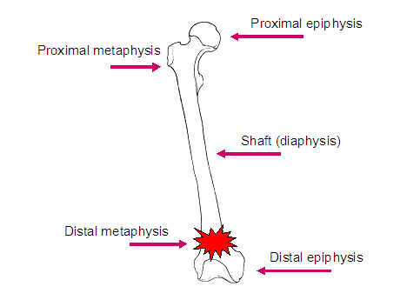
What is Acute Osteomyelitis:
Definition:
Acute osteomyelitis is acute infectious process of the bone and bone marrow .
Duration:
1) a short duration
few days for hematogenously* (also called primary) acquired infection
2) last several weeks to months
if secondary to contiguous focus* of infection
In association with peripheral vascular disease (chronic disease)
diabetes mellitus ,severe atherosclerosis, vasculitis
Most commonly in metaphysis
* عن طريق الدم
* Relapse رجوع المرض can occur if only osteomyelitis is treated without treating the surrounding tissue infection (focus)

Slide 5
How they reach | Risk Group
Primary Hematogenous route site:(Metaphysis of long bones ) | Children and infants common Adult less common (may occur due to reactivation of a quiescent (خامد)focus of infection from infancy or childhood)** -most cases are due to S.AUREUS -S. Aureus septic arthritis (begins in the diaphysis) -Vertebral- GU infection -Candida –Venous Catheter | Infant : S.aureus, group B streptococci , gram –ve rods like E.coli.
 |  | Children: S.aureus, group A streptococci, H.influenzae.
Contiguous soft tissue focus | Post operative infection, contaminated open fracture, soft tissue infection , puncture wounds | Gram positive cocci, Gram negative bacilli, anaerobes, and poly-microbial infection.
Special clinical situations | Prosthesis (أعضاء صناعية) | Coagulas -negative staphylococci, and corynebacterium (normal flora of skin) Propionebacterium, and S.aureus in foreign body infections
 | Nosocomial infections ( hospital acquired infection ) and IV drug use | Enterobacteriacea and Pseudomonas
 | Fist injuries, and diabetic foot and dicubitus ulcers, | Streptococci ,, anaerobes
 | in sickle cell patients | a.Aureus , Salmonella or S. pneumoniae
 | Human/ animal bites; | Eikenella, Pasturella multocida
 | AIDS. Mostly chronic | M.tuberculosis or M. avium (Mycobacterium tuberculosis ( MTB) or Mycobacterium avium )
 | Infection after trauma ,injury or surgery | S.aureus, group A Streptococcus,Gram negative rods, anaerobes.
-RED: very important,Make sure you know it all.- The rest: give it a quick read and focus on the underlined.
**معناه شخص أصيب بانفكشن وهو صغير ورجعت له لمن كبر

Slide 6
What is Acute Osteomyelitis:
Patient presentation:
Systemic manifestations occurs in less than 50% of patients.
Acute osteomyelitis usually of abrupt مفاجئonset
Acute onset of bone pain, fever with rigors and diaphoresis تعرق غزير.
Symptoms usually of less than 3 week’s duration.
Local signs : soft tissue swelling, erythema, warmth, point tenderness, percussion tenderness over the vertebral body & limited mobility of the involved extremity.
Clinical presentation & blood tests:
Differential diagnosis:
Acute osteomyelitis usually of abrupt onset
fever
localized pain , heat , swelling
Tenderness of affected site
(one or more bones or joints affected in hematogenous spread).
May be local tissue infection (abscess or wound) .
Blood test: leukocytosis, high ESR and C-reactive protein.
Primary and metastatic bone malignancies
Trauma
Acute rheumatic arthritis
Hemarthrosis
Ewing sarcoma
Vertebral compression fracture.

Slide 7
What is Acute Osteomyelitis:
Diagnosis
Laboratory | Radiological
CBC (Count Blood Cell): Leukocytosis may or may not occur Erythrocyte sedimentation rate (ESR) elevated, but could be normal as well (not specific). | X-ray : normal early in disease, soft tissue swelling , subperiosteal elevation seen early and Bone destruction changes seen by 2-4 weeks
Blood culture. Aspiration of overlying abscess “Biopsy” if blood cultures are negative, and it’s most specific. | MRI highly sensitive & specific, preferred for vertebral osteomyelitis and cases associated with contiguous foci of infection or peripheral vascular disease.
 | CT Scan used as alternative of MRI.
 | Technetium bone scan, Gallium and Indium-111 labelled WBC scan* (detection within 3 days of onset). Maximum effect to rule out osteomyelitis.
*Indium-111 labelled WBC scan:
Also called “indium scan”, it’s a nuclear medicine procedure in which while blood cells (mostly neutrophils) are removed from the patient, tagged معلم بعلامة with the radioisotope (نظائر مشعة) Indium-111, and then injected intravenously back into the patient. The tagged leukocytes subsequently localize to areas of relatively new infection.

Slide 8
What is Acute Osteomyelitis:
Organisms | Antibiotics | Duration/Surgery/complication and follow up
Methicillin sensitive (MSSA) Ex: Staph.aureus | Cloxacillin, cefazolin or Clindamycin . | Early treatment is critical Treat for 2-4 weeks parenteral (I.V) followed by oral therapy for a total of at least 6 weeks. Surgery for neurological complications, para-vertebral abscess & hip joint involvement. Complications: septicemia, metastatic abscesses, septic arthritis, chronic osteomyelitis, loss of limb ,or paravertebral abscess. Monthly ESR for 3 months and at 6 months useful to document treatment. Cases due to contiguous source more difficult to eradicate, Relapse common (50%) , surgery indicated.
Methicillin resistant(MRSA) Ex: Staph.aureus | Vancomycin followed by Clindamycin, Linezolid, or TMP-SMX (cannot use Beta-Lactam antibiotics)
Polymicrobial* infection: | Ampicillin-Sulbactam, Piperacillin-Tazobactam or Quinolone with Metronidazole.
S.epidermidis: | Vancomycin and Rifampicin
Enterobacteriacae: | Ceftriaxone
Other Gram negative bacilli: | Quinolones
P. aeruginosa: | Cefepime, Meropenem, or Piperacillin +/- Aminoglycoside.
Anaerobes: | Metronidazole or Clindamycin
*more than one organsm

Slide 9
Chronic Osteomyelitis:
A chronic infection of the bone and bone marrow usually secondary to inadequately treated or relapse of acute osteomyelitis.
Has to be managed carefully, sometimes it is very difficult to handle
Very long chronic disease (May recur many years, decades, after initial episode.)
Majority of them are coming from other site, majority of patients have vascular disease
TB and Fungal are common causes
Risk Factors:
Host Risk Factors:
Penetrating trauma
Prosthetic devices
Animal bites
IV drug use
Peripheral vascular disease
Peripheral neuropathy
Sickle cell disease
Diabetes mellitus
Immunocompromised states.
If the infection tacking long time to heal , Always remember TB epically in elderly and immune compromised patient

Slide 10
Causative Agents:
Chronic Osteomyelitis:
The most common pathogen | Other microorganisms | Decubitus ulcers and diabetic foot infections.
S.aureus | S.epidermidis,enterococci,streptococci,Enterobactericae,Pseudomonas, Acinetobacter spp., anaerobes (Bacteroides, anaerobic streptococci, Clostridium) | Polymicrobial infection common

Slide 11
Chronic Osteomyelitis:
Clinical presentation and DD:
Patient Presentation:
Acute symptoms and systemic manifestations are uncommon.
Sinus tract
Persistent wound drainage
Chronic non-healing ulcer
Local signs may be absent except during acute exacerbation.
Overlying skin may be scarred and adherent to the involved bone.
Differential Diagnosis
Osteoid osteoma
Osteosarcoma
Secondary bony metastases
Paget’s disease of the bone
Gout

Slide 12
In immunosuppressed patients:
Chronic Osteomyelitis:
Mycobacteria Tuberculosis (MTB)
2. Fungi
MTB osteomyelitis (may be seen in immunosuppressed patient)
Primarily results from hemtogenous spread from lung foci
Or, as an extension from a caseating lymph bone ( 50% in spine). It resembles Brucella oesteomyelitis .
TB & Brucella are common in KSA.
Hematogenous osteomyelitis due to fungi eg.
Candida spp.,
Histoplasma
capsulatum,
Aspergillus spp
Other fungi may occur.

Slide 13
Chronic Osteomyelitis:
Diagnosis
1-Laboratory
2-Radiological
WBC normal, ESR elevated but not specific.
Blood culture not very helpful- because as bacteremia rare.
Definite microbiological diagnosis by culture of bone biopsy or FNA & Histological examination
Surgery for diagnosis and therapeutic purposes
Wound /sinus culture not reliable. Isolation of MRSA or vancomycin resistant enterococci should initiate infection control measures.
Radiologic changes complicated by the presence of bony abnormalities
MRI helpful for diagnosis and evaluation of extent of disease.
Combined bone scan and Indium WBC scan.

Slide 14
Chronic Osteomyelitis:
Treatment and Management
2-Medical
1-Surgical
Organisms | Antibiotics
MSSA: | parenteral cloxacillin followed by oral treatment
MRSA & S.epidermidis: | Vancomycin ( with added Rifampicin ) then oral Clindamycin or TMP-SMX.
TB | 4 drugs : INH,RIF ,Pyrazinamide & Ethambutol for 2 ms followed by RIF + INH for additional 4 ms.
Brucella | with Tetracycline and Rifampicin for 2 to 3 months.
Extensive surgical debridement with antibiotic therapy. Parenteral antibiotics for 3-6 weeks followed by long term oral suppressive therapy.
Some patients may require life long antibiotic ,others for acute exacerbations.
Other bacteria treat as acute osteomyelitis.

Slide 15
Chronic Osteomyelitis:
Complications & Prognosis
Prognosis:
Complications:
Recurrence
Loss of limb
Pathological fractures
Primary epidermoid carcinoma of sinus tract
Malignant histocytoma
Secondary amyloidosis
Lymphoma & multiple myeloma( rare)
Relapses are frequent
Doctor’s nots:
You should memorize: the method, drug, major clinical presentation and Two complication

Slide 16
Septic Arthritis:
Defenition :
Septic (Infectious) Arthritis is inflammation of the joint space secondary to infection.
Generally affects a single joint and result in suppurative inflammation.
Hematogenous seeding of joint is most common.
Symptoms:
Pain, swelling, limitation of movement common symptoms
Pathophysiology:
Results from introduction of organisms into joint space as a results of bacteremia or fungemia from infection at other body sites.
Occasionally results from direct trauma, procedures (arthroscopy) or from contiguous soft tissue infection.
Risk factors:
Age – Diabetes – Immunosuppresion - IV drug use - CV catheters - Prior joint damage (rheumatoid arthritis) or procedure (arthroscopy) - H/O sexually transmitted diseases.

Slide 17
Septic Arthritis:
Etiology
-Other Organisms :
-Common Organisms:
Streptococci and aerobic Gram negative bacilli.
Lyme disease due to tick bite in endemic areas uncommon in ksa.
Chronic arthritis may be due to MTB or fungi in Immunocopramized
IV drug user Sternoclavecular or Sacroilliac due to P.aeruginosa
S.aureus is most common cause.
-Common causes of septic arthritis:
Age/special conditions | Common organism
Neonates | S.aureus, group B streptococcus, Gram negative rods.
Infants /children | S.aureus, group A streptococcus, S.pneumoniae, H. influenzae type b
Adults | S.aureus, Neisseria gonorrheae
Sickle cell disease | Salmonella species, S.aureus
Trauma /surgical procedure | S.aureus
Chronic arthritis | MTB, Fungi
Prosthetic arthritis | Skin flora

Slide 18
Septic Arthritis:
Types:
Gonococcal arthritis:
Gonococcal infection most common cause in young, sexually active adults
Caused by Neisseria gonorrheae leads to disseminated infection secondary to urethritis in men /cervicitis in women.
Early diseas: Initially present with polyarthralgia, tenosynovitis( especially of hands and wrist) , fever, skin lesions resulting from NON-suppurative arthritis.
Late disease: If untreated leads to suppurative monoarthritis.
Non-gonococcal arthritis
Nongonococcal arthritis occurs in older adults. Results from introduction of organisms into joint space as a results of bacteremia or fungaemia from infection at other body sites.
Monoarthicular suppurative Arthritis
Knee and wrist are the most common, fever and pain
Swollen and tender join with Joint effusion and limitation of joint movement.

Slide 19
Septic Arthritis:
Diagnosis:
by arthocentesis to obtain synovial fluid for analysis Gram stain, culture & sensitivity
History/examination to exclude systemic illness. Note H/O tick exposure in endemic areas and sexual contact.
Differential Diagnosis:
Samples | Tests
Arthrocentesis should be done as soon as possible; | Synovial fluid is cloudy and purulent Leukocyte count generally > 50,000/mm3,with > 75 % PMN Gram stain and culture are positive in >90% of cases Exclude crystal deposition arthritis or noninfectious inflammatory arthritis.
Blood cultures - Culture of skin lesions can be performed and joint fluid | indicated
Cervix, urethra, rectum & pharynx Swab or urine | If gonococcal infection : suspected for N.gonorrheae for culture and DNA testing for N.gonorrheae.
Skin Rash | Can be culture
Crystal –induced arthritis
Gout, pseudogout
Noninfectious inflammatory arthritis
Acute rheumatoid arthritis
Reactive arthritis
Reiter syndrome, acute rheumatic fever
Trauma
Viral arthritis
Parvovirus B19, Hepatitis B virus.

Slide 20
Septic Arthritis:
Treatment & Management
Treatment: Drainage & antimicrobial therapy important management.
Arthrocentesis with drainage of infected synovial fluid.
Repeated therapeutic Arthrocentesis often needed Occasionally, arthroscopic or surgical drainage/debridement
Antimicrobial therapy should be directed at the suspected organism and susceptibility results:
Nongonococcal infectiuos arthritis: | Gonococcal arthritis:
MSSA: Cloxacillin or Cefazolin MRSA: Vancomycin Streptococci: Penicillin or Ceftriaxone or Cefazolin Enterobacetriacae: Ceftriaxone or Fluroquinolone Pesudomonas: Piperacillin and Aminoglycoside Animal bite : Ampicillin-Sulbactam Lyme disease arthritis: Doxycycline for 1 month. | IV Ceftriaxone ( or Ciprofloxacin or Ofloxacin) then switch to oral Quinolone or Cefixime for 7-10 days.
Change the antibiotics according to sensitivity, Arthrocentesis can repeated and Surgery rarely required

Slide 21
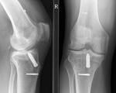
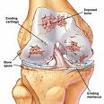
Septic Arthritis:
Prognosis & Complications
Prognosis:
Gonococcal arthritis has an excellent outcome
Risk factors for long –term adverse sequellae include:
Age
Prior rheumatoid arthritis
Poly-articular joint involvement
Hip or shoulder involvement
Virulent pathogens
Delayed initiation or response to therapy
Complications:
Non-gonococcal arthritis: can result in scarring with limitation of movement, ambulation is affected in 50% of cases.

Slide 22
Infections of Joint Prosthesis:
Occur in 1-5% of total joint replacement.
Most infections occurs within 5 years of joint replacement.
Often caused by skin flora
Diagnostic aspiration of joint fluid necessary
Result in significant morbidity and health care costs.
Successful outcomes results from multidisciplinary approach.
Risk factors:
history of superficial wound infection, post surgical complications, underlying illness, any source of bacteremia.
Differential diagnosis:
Aseptic loosening or dislocation of prosthetic joint
Prosthetic debris induced cynovitis &
hemarthrosis

Slide 23
Infections of Joint Prosthesis:
Etiology:
Results from contamination during surgery or post op. wound infection adjacent to the prosthesis.
Factors delay healing ( hematoma, ischemia)
Occasionally result from bacteremia
Prosthesis & bone cement predispose to infection
Occurs at the prosthesis-bone interface
Bacteria adhere to biomaterials and develop a biofilm that protect them from host defenses and antimicrobial agents.
Mostly caused by coagulase negative staph., or S.aureus.
Occasional pathogens: streptococci, enterococci ,and anaerobes
Usually single pathogen ,occasionally polymicrobial
Patient Presentation:
Subacute onset
S.aureus, streptococci,Gram negative rods can cause acute ,rapidly progressive infection
Joint pain ,swelling most common
Fever with acute ,early postsurgical infections
Cellulitis, cutaneous wound, or discharging sinus overlying the joint.

Slide 24
Infections of Joint Prosthesis:
Diagnosis of Prosthetic Arthritis:
ESR and C-reactive protein( CRP ) may be high.
Aspiration & surgical exploration to obtain specimen for culture & sensitivity testing & histopathology.
Skin flora regarded as pathogens if isolated from multiple deep tissue cultures.
Plain X-ray may not be helpful
Arthrography may help define sinus tracts
Bone scan-not specific for infection
Treatment & Management:
Surgical debridement and prolonged antimicrobial therapy
-Surgery: removal of prosthesis
-Antibiotic –impregnated cement during re-implantation
-Antimicrobial for 6 weeks:
Begin empiric IV antibiotic to cover MRSA and Gram negative rods ( Vancomycin+ Cefepime, Ciprofloxacin,or Aminoglycoside)
Chronic therapy with oral drug if removal of prosthesis not possible.

Slide 25
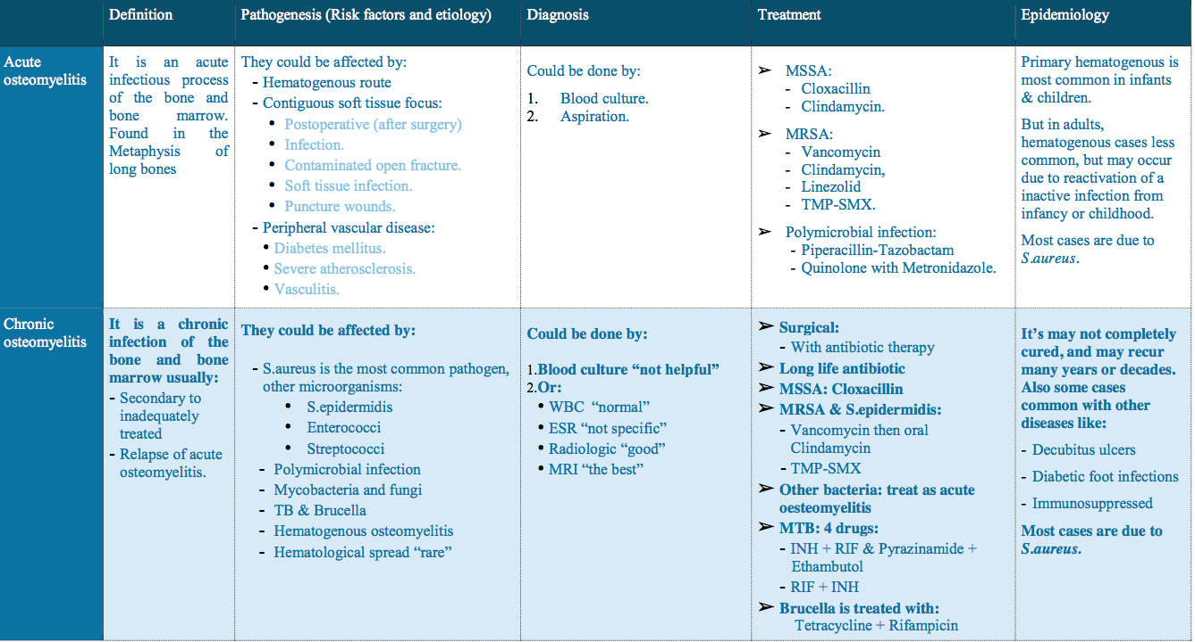

Slide 26
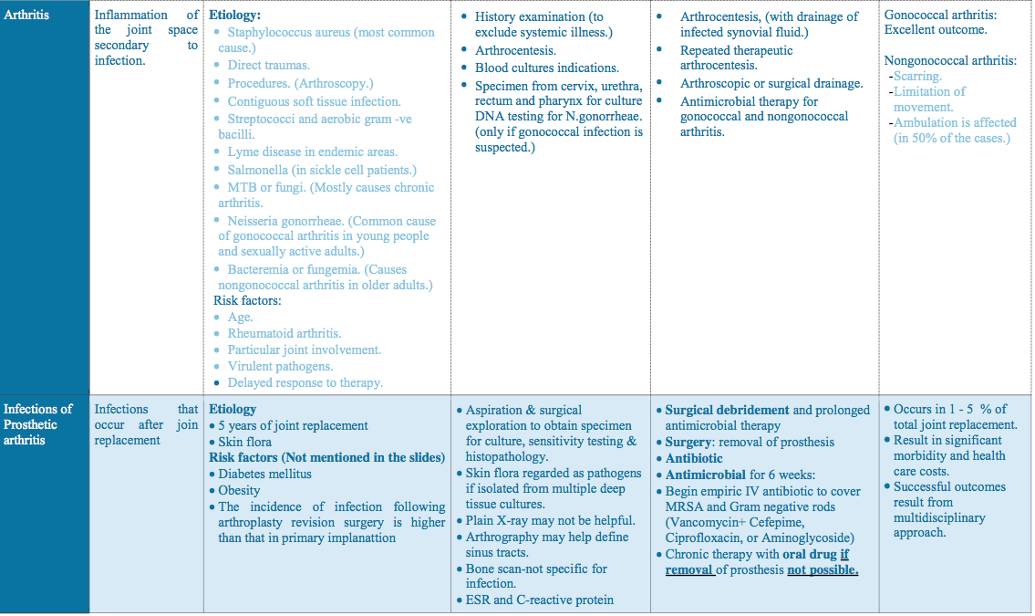

Slide 27
SAQ:
26 years old male with urethritis came with polyarthralgia, fever and skin rash. After taking his history, we found that he traveled to southern east Asia two weeks ago and he had sexual contact. And the blood culture indicates Gram Negative diplococci Bacteria.
Q1: What is the most likely Diagnose in this case?
It could be Gonococcal arthritis (septic Arthritis)
Q2: What is the most likely organism can cause that?
Neisseria gonorrhea bacteria.
Q3: Blood culture is one of the samples that we can take it for diagnosis, list three samples we can take it also in this case?
Arthrocentesis (Synovial fluid) / Culture of skin lesions / Cervix, urethra, rectum Swab / urine
Q4: List three tests will help us in this case?
Synovial fluid / DNA testing for N.gonorrheae / Gram stain / Leukocyte count.
Q5: What is the prognosis in this case?
Gonococcal arthritis has an excellent outcome especially with early stage of this disease.
Q6: What is the treatment & management we recommend in this case?
- IV Ceftriaxone (or Ciprofloxacin or Ofloxacin)
- Then switch to oral Quinolone or Cefixime for 7-10 days.
*zoom to see the answers ;)
Did you study well ? https://www.onlineexambuilder.com/micro-3/exam-122235

Slide 28
SAQ:
Q1: : List some Complications of Chronic Osteomyelitis?
Recurrence / Loss of limb / Pathological fractures Secondary amyloidosis
May develop cancer such as (Malignant histiocytoma / Lymphoma & multiple myelomas )
Q2: List two type osteomyelitis may have indolent “chronic” course?
TB osteomyelitis / fungal osteomyelitis
Q3: How can Mycobacteria Tuberculosis develop into chronic osteomyelitis?
Either Primarily results from hematogenous spread from lung foci
Or As an extension from a caseating lymph bone.
Q4: List some Antibiotics we can use it to treat TB?
Pyrazinamide & Ethambutol for 2 months
followed by Rifampicin(RIF) + Isoniazid (INH) for additional 4 months.
Q5: Infections of Joint Prosthesis Mostly caused by?
coagulase positive staph (S.aureus) / coagulase negative staph (S.epidermidis).
Q6: List Some organism can cause Acute osteomyelitis in infant?
S.Aureus / group B streptococci / E.coli.
Q7: List some Complications of Non-Gonococcal arthritis?
scarring with limitation of movement.
In 50% of cases, ambulation can occur.

Slide 29
GOOD LUCK!
MICROBIOLOGY TEAM:
Waleed Aljamal (leader) Shrooq Alsomali (leader)
Ibrahim Fetyani
Meshal Eiaidi
Khalid Alhusainan
Hussam Alkhathlan
Faisal Alqumaizi
Abdulaziz Alangari
Khalid Alshehri
Nasir Aldosarie
Mohammad Al-Kahil
Rawan Alqahtani
Hanin Bashaikh
Jawaher Alkhayyal
Reem Alshathri
Ohoud Abdullah
Lama Al-musallam
Wateen Alhamoud
Ruba Barnawi
Shooq Albugami
The Editing File
We are waiting for your feedback
@microbio436
436microbiologyteam@gmail.com

