Slide 1
Non infectious arthritis
Objectives:
Know the pathogenesis and clinicopathological features of osteoarthritis (degenerative joint disease).
Know the pathogenesis and clinicopathological features of rheumatoid arthritis.
Know the pathogenesis and clinicopathological features of gout and calcium pyrophosphate arthropathy [pseudogout]
Red : Important
Green: doctors’ notes
Grey: extra
Please check here before viewing the file to know if there any changes or additions.

Slide 2
https://www.youtube.com/watch?v=41IMR_Dp5bs
N.B. Structure of the joint has been covered in histology and anatomy so we won’t discuss it here.
Non infectious arthritis(inflammatory disease of joints):
1- Osteoarthritis. (Degeneration)
2-Rheumatoid arthritis. (Autoimmunity)
3- Gout. (Crystal deposition)
4- Pseudogout.
Osteoarthritis:
Definition: Degenerative bone disorder affecting the cartilaginous surface of the joint (articular cartilage). the very first seen in osteoarthritis is proliferation of chondroblasts. these cells produce enzymes that induce these biochemical changes in the hyaline cartilage.
hyaline cartilage: affected by Osteoarthritis the water content is increased ,the proteoglycans amount or chondrocytes decrease in number with people over the age of 60 the elasticity and compliance of the cartilage is reduced.
It is the most common non-infectious arthritis and it affects all joints and small joints and favors to affect the cervical and lumbar region of vertebral spine, and the incidence increases with age.
- (PRIMARY OSTEOARTHRITIS)
It is a process of wear and tear and what happens is deterioration of the function of the cells leading to their death and it’s related to aging and for those whom are above 60 years old they are highly likely to have this disease. and it’s usually affecting only a few joints.
- (SECONDARY OSTEOARTHRITIS) less than 5% of cases
often involves one or several predisposed joints
It can be also seen in young people but in this case you need to ask:
عندك قصة ربط أو عملية في هذا المكان. فيقول: الله أكبر كيف عرفت يا دكتور؟!
فتقول: If a young person had osteoarthritis it could be due to:
Trauma.
Surgical intervention.
Metabolic disorder.
-Diabetes, ochronosis (a syndrome caused by accumulation of homogentisic acid in connective tissue), hemochromatosis(iron overload).

Slide 3
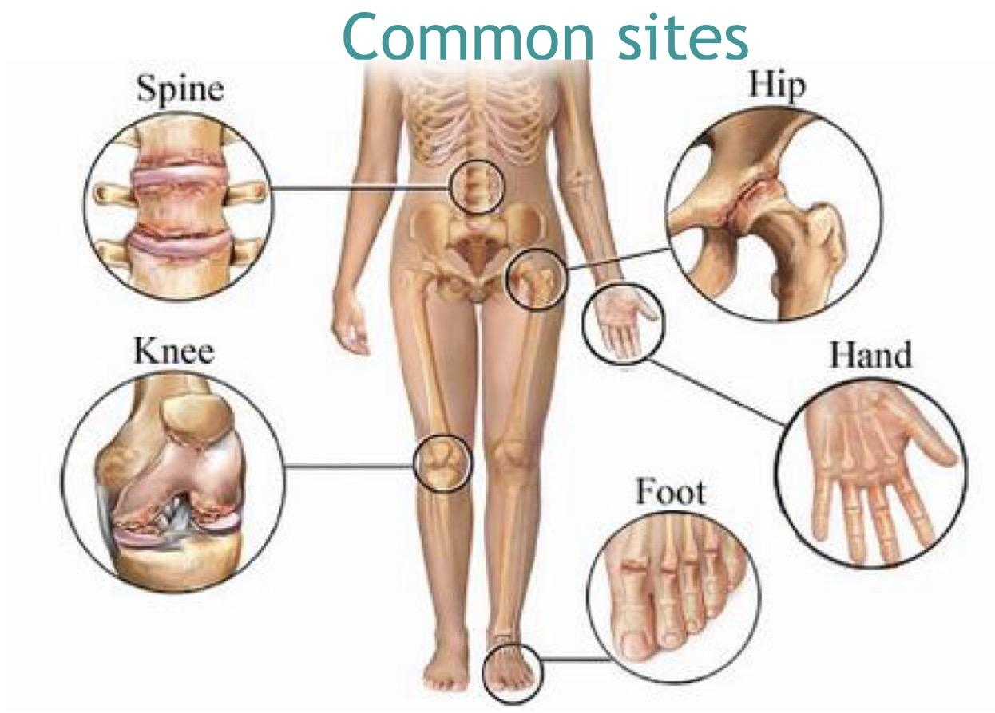
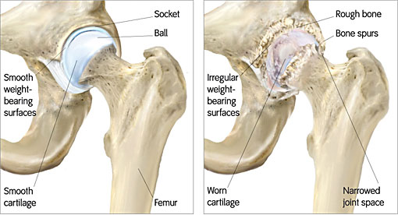
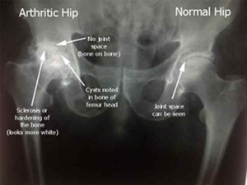
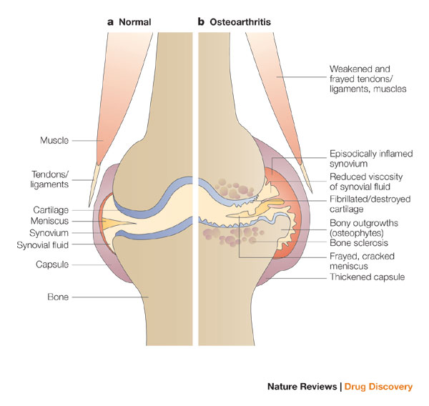
the pathological changes involve:
cartilage (يكون اول شي يتضرر) then→bone→synovium→joint capsule→muscle
(atrophy)
It likes to affects weight bearing joints and
also females more than males.
Females → Knee and hand joints.
Males → Hip joint.
Pathogenesis: Early Osteoarthritis marked by degenerating cartilage.
Space between the bones becomes less because of articular cartilage loss→ bone eburnation → bones will react →new bone formation (proliferation of bone), so it will become wider and more dense and the bone become sclerotic.
there is inflammation and thickening of the joint capsule and synovium.
Common signs of osteoarthritis:
Reduction in joint space.
Pain and friction come with movement.
Osteoporosis could come secondary to osteoarthritis.
New bone formation (Osteophytes): that develops at the margins of the articular cartilage and when they break and detach it goes into the joint space as loose bodies and we call them (Joint mice).
when joint mice form they lead to more secretion of synovial fluid which leads to effusion.
Subarticular bone becomes so dens (Subchondral sclerosis): due to friction which leads to new bone formation.

Slide 4
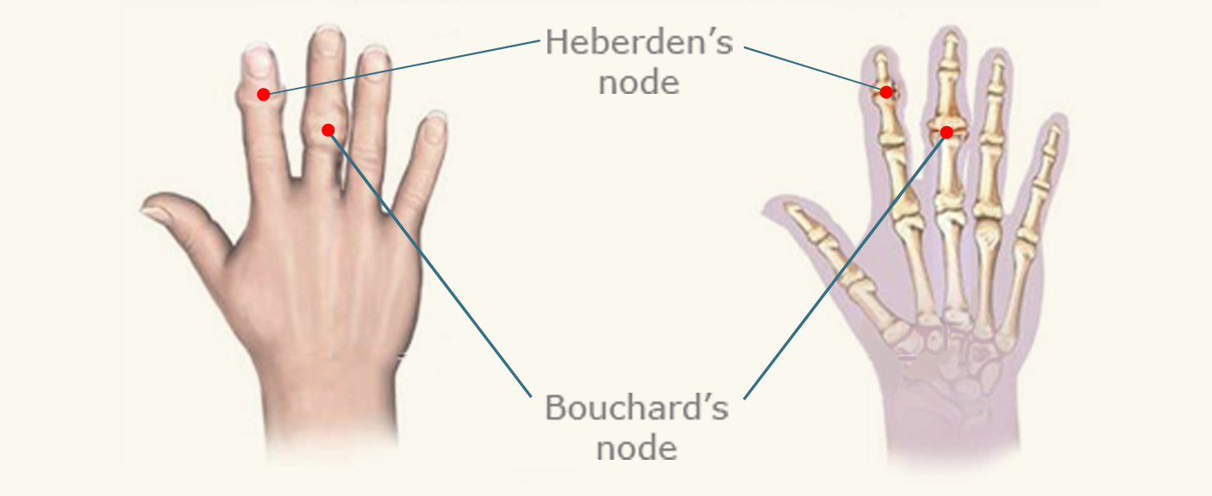
( Bouchard and heberden nodes are osteophytes that occur in hands’ joint )
When osteoarthritis affects proximal interphalangeal joint (PIPJ) we call it → Bouchard’s nodes.
When osteoarthritis affects distal interphalangeal joint (DIPJ) we call it → Heberden's nodes (nodular swellings).
الي مابيعرف proximal & distal وما يعرف lateral & medial هذا يفرقع على كلية الإدارة لأنه space occupying lesion.
قد يصاحبه ألم في ركبته فتفحص يده فيقولك افحص زين افحص تحت ليش عم تتطلع على يدي يا أهبل وطبعاً هو مو أهبل بس يدور على Bouchard’s and Heberden’s nodes لأنك تعرف إن عنده Osteoarthritis.
Cure:
Total join displacement is the only cure for those with very advanced stage of the disease.
For those whom are in early stages medecations prescribed and rest is the cure. علاجها الراحة إلا فقط للحاجة والحاجة هي قضاء الحاجة فنقول: ذهب لقضاء الحاجة.
clinical features
-with increasing deformity (تشويه) of the joint the typical symptoms develop, which are:
pain (which worse with use), morning stiffness(pain which eases up after the joint has been used), limitation in joint movement.
-with involvement of the cervical and lumbar spine, Osteophytes may impinge on the nerve roots causing: pain and pins and needles in the arms and legs(it is a pricking or numbing sensation).
course & prognosis
-Osteoarthrosis is a slowly progressive, chronic joint disability.
-eventually, elderly sufferers may become confined to wheelchairs.
-recent advancements in the technique of joint replacement with prostheses (اطراف صناعيه) have improved the outlook of these patients.

Slide 5
Definition:
https://www.youtube.com/watch?v=Yc-9dfem3lM
Rheumatoid arthritis:
Rheumatoid arthritis is systemic autoimmune disease which may effect joints ( particularly the synovial ) and other tissue.
Rheumatoid arthritis is a chronic inflammatory multisystem disorders but the joints are always involved (in female slide)
(the main difference between osteoarthritis and RA that Osteoarthritis affects only the joint but RA is systemic)
Other tissue like: 1-skin 2-spleen 3-lung 4-heart 5- blood vessels 6- eye 7-lymh node
Rheumatoid arthritis can effect small joint and large joint
More likely to effect small joint than large joint
More likely to effect female than male
Unlike Osteoarthritis the Rheumatoid signs and symptom appear at the rest
Can effect old and young people . when it affect children we call it ( still’s disease )
Rheumatoid arthritis produces nonsuppurative ( NO pus production) proliferative synovitis, may progress to destruction of articular cartilage and joint ankylosis.
Aetiology:
The pathogenesis is not well understood, but it is thought that an initiating agent, possibly a genetic predisposition or environmental factor, triggers immunological dysfunction resulting in persistent chronic inflammation in genetically susceptible individuals.
environmental factor such as: infection ,smoking ,diet or habit
genetic predisposition : HLA-DR4, DR1 .
Cross reaction :is autoimmune disorder .
in the joint , the ongoing inflammation cause destruction of the articular cartilage.( يعني هو في البدايه يأثر على الساينوفل بس اذا استمر راح يأثر على articular cartilage )

Slide 6
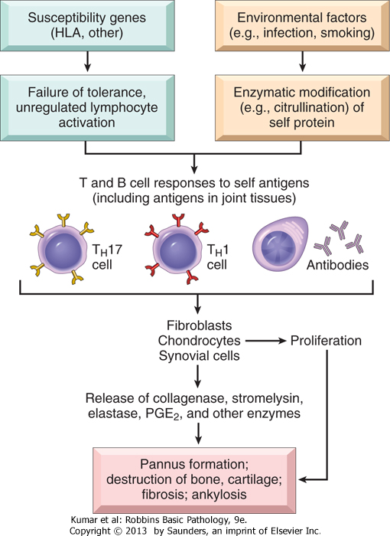
Pathogenesis:
Cross reaction trigger reaction T cell CD4 activate CD4
transform toTH1 and TH17 they secrete cytokine (TNF , IL1-IL7) they act and destroy the joint
in the same time the T stimulate B cell secrete antibody being form the antigen
And it form immune complexes ( type 3 and 4 ) accumulate in the joint trigger complement inflammatory reaction
Because that the anti-TNF are the main drug use in the Rheumatoid arthritis
genetic predisposition or environmental factor
trigger a reaction
Affecting T cell (CD4)
TH1and TH17
B cell
TNF ,IL1 ,IL17
antigen

Slide 7
Pathologic Features:
The disease is synovial disease not cartilage
synovial cell is hyperplasia and inflamed
When you take a biopsy of synovial you will find dense perivascular inflammatory cell infiltrates (frequently forming lymphoid follicles) in the synovium composed of CD4+ T cells (lymphocytes), plasma cells, and macrophages
increased vascularity due to angiogenesis
neutrophils and aggregates of organizing fibrin on the synovial surface
increased osteoclast activity in the underlying bone ➔ bone erosion.
Pannus: is an abnormal layer of fibrovascular tissue , granulation tissue or by proliferating synovial - lining cells . Common sites for pannus formation include over the cornea, over a joint surface (as seen in rheumatoid arthritis),
The pannus can lead to adhesion and deformity
Eventually the pannus fills the joint space, and subsequent fibrosis and calcification may cause permanent ankylosis.
Ankylosis: is a stiffness of a joint due to abnormal adhesion and rigidity of the bones of the joint , it happen because pannus
Secondary Osteoarthritis

Slide 8
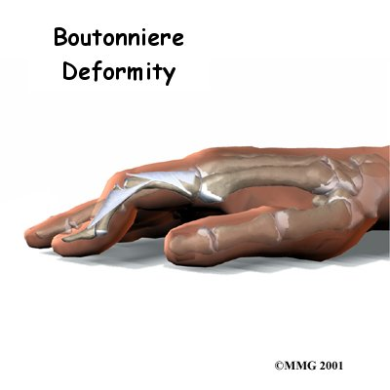
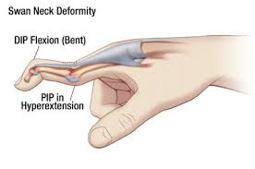
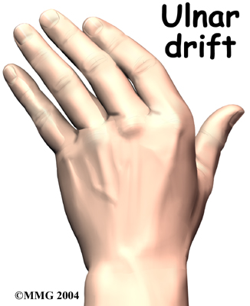
Clinical Features:
Pain ,fatigue ,stiffness , fever ,anemia of chronic disease , lack of energy , swollen, morning stiffness.
symmetric arthritis ( يعني كل الجهتين تتأثر )
anemia of chronic disease: the hemoglobin reduced and the RBC is normochromic there staining is not produced.
characteristic deformities in the joints develop. These include:
Radial deviation at the wrists.
Ulnar deviation at the fingers.
Flexion and hyperextension deformities of the fingers (swan neck and boutonniere deformities).
deformity :1-swan neck deformity 2-boutonniere deformity
Ulnar deviation and their might be a radial drift in . rare cases.

Slide 9
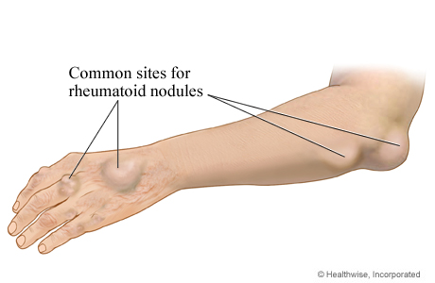
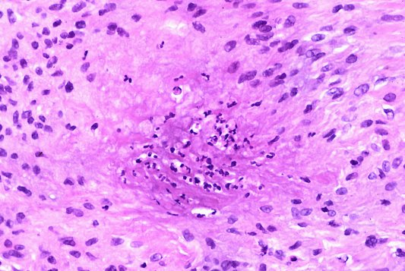
Clinical features:
Subcutaneous Rheumatoid nodule: it very rare but when it present that mean the disease is severe contain collagen necrosis and histiocytes and rim of T cell
Laboratory Findings:
Rheumatoid factor : 80% have IgM autoantibodies to Fc portion of IgG
it is not specific because 20% of people positive and they do not have Rheumatoid arthritis
Anti-CCP (cyclic citrullinated peptides) protein antibodies most specific for a diagnosis of rheumatoid arthritis (is more sensitive test to Rheumatoid arthritis )
ESR and C-reactive protein
X-rays:
Loss of articular cartilage leading to narrowing of the joint space.
Joint effusions. ,Localized osteoporosis. And Erosions.
Prognosis:
Reduces life expectancy by 3-7 years
Death due to amyloidosis, vasculitis, GI bleeds from NSAIDs, infections
from steroids.
Palisading Granulomas

Slide 10
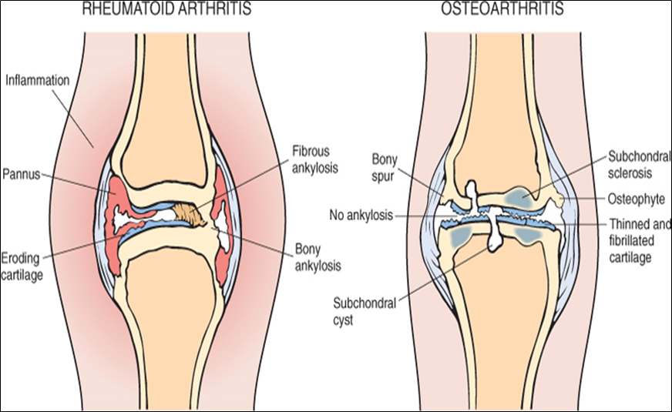
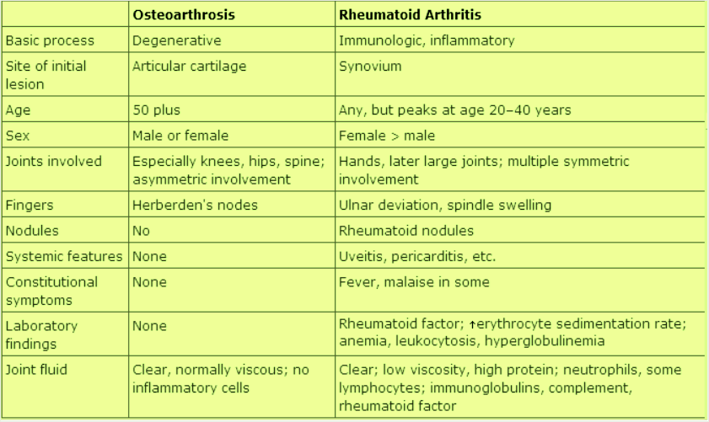
Comparison of the morphologic features of Rheumatoid arthritis and osteoarthritis

Slide 11
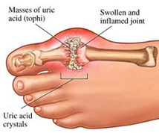
GOUT: It is a metabolic disease caused by Hyperuricemia=excessive amounts of uric acid (an end product of purine metabolism) within tissues and body fluids. Affects about 1% of the population, and shows a predilection for males.
monosodium urate crystals precipitate from supersaturated body fluids and induce an acute inflammatory reaction.
RISK FACTORS:
1- obesity
2- excess alcohol intake and excess consumption of purine-rich foods
3- diabetes, renal failure and the metabolic syndrome.{we consider a patient has the metabolic syndrome when he has at least three of the 5 following problems: 1-obese 2-diabetic 3-dyslipidemia(high blood cholesterol and/or glycerides) 4-high uric acid 5-cvs problems}.
4- polymorphisms in genes involved in the transport and homeostasis of urate .
CAUSES:
1- PRIMARY GOUT (90% OF CASES)
- Overproduction of uric acid.
- Decreased excretion due to renal problems.
- Enzyme defects e.g ( partial HGPRT deficiency ).
2- SECONDARY GOUT (10% OF CASES)
- People who take thiazide, type of drugs work as diuretics (مدر للبول), we use them to treat hypertension ( diuretics increase excretion of body fluids and as a result, blood volume will decrease) and edema (such as that caused by heart failure, liver failure, or kidney failure).they will increased uric acid.
- People who have very quick cell turnover, especially who have cancer, because when we use anti-cancer drugs that kill the cells, the cells have nucleus and inside the nucleus there is purine then the purine metabolize into uric acid. *we give anti-uric acid medication in accompany with anti-cancer drugs to avoid gouty arthritis in cancer patients.
- Chronic renal disease: reduced excretion of uric acid with normal production of uric acid. -Inborn errors of purine metabolism: Lesch-Nyhan syndrome: it is associated with complete deficiency of HGPRT enzyme
https://www.youtube.com/watch?v=SH_ceFaKLA8
gout:

Slide 12
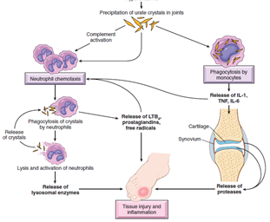
PATHOGENESIS.
when there is an increased level of uric acid in the blood they form crystals "monosodium urate crystals", and these crystal accumulate in the joint , then the crystal irritate the joint , then they cause inflammation.
we have two pathways: the neutrophils pathway and monocytes pathway(macrophages & lymphocytes):
1- activate the complement system by C3a and C5a they are chemoattractants that attract neutrophil.
the neutrophil which contain lysosomal enzymes come to the joint and try to engulf those crystals but after they engulf crystals, they cannot digest them so they release them, with lysosomal enzymes.
those enzymes will attack the tissue and destroy it.
2- stimulate leukotriene B4 “chemotactic” mediating inflammation.
3- the macrophage phagocytize those crystals , then they stimulate the production of cytokine, TNF, IL-1,IL-6 and they participate with the destruction of tissue also.

Slide 13
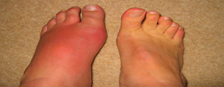
NOT ALL THE PEOPLE WHO HAVE HIGH LEVELS URIC ACID WILL DEVELOP GOUT!
CAUSES:
The disease like to affect the first metatarsal joint "big toe", but it also affect the knee and the shoulder.
It always happen to people who are wealthy, and who drink alcohol, and obese people
And people who have the metabolic syndrome.
Metabolic syndrome: metabolic syndrome is the name for a group of risk factors that raises your risk for heart disease and other health problems, such as diabetes and stroke
He comes to you and says " والله البارح بيني وبينك يادكتور كنا معزومين واكلناا زي الحمير , وبرا كان فيه مشروب , وبيني وبينك مدري ليش الألم جاني"
He come with very savere pain and if you look at the toe you will see it very big "swollen" and reddish.
TREATMENT:
COLCHICINE , Is drug that will stop the chemotaxis.
GOUTY TOPHI: Are large aggregates of urate crystals which are visible with the naked eye. They occur in the joints and soft tissues of people with persistent hyperuricemia, appear as long,slender,needle-shaped monosodium urate crystals. Tophi are pathognomonic for the gout.
A common site for tophi is the pinna of the ear.
HISTOLOGY:
Tophi consist of crystals that are surrounded by:
-macrophages -lymphocytes -often foreign giant cell
OTHER ORGANS:
Besides joints, what other organ is affected in gout?
Approximately 20% of gout patients die of renal failure.
Renal lesions which are caused by:
-precipitation of urates in the medulla forms tophi.
-uric acid stones.
-acute renal failure due to precipitation of urates in the collecting tubes.

Slide 14
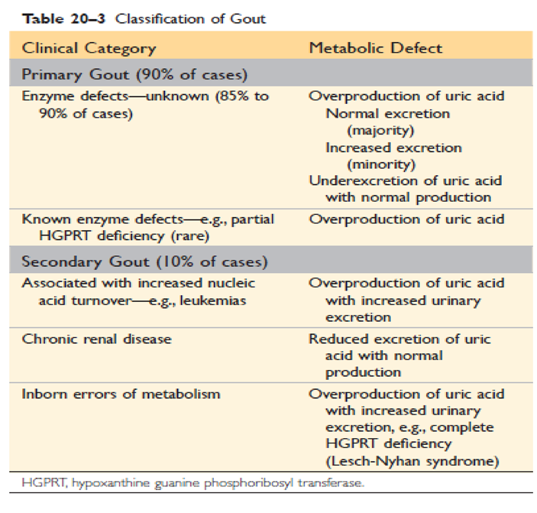

Slide 15
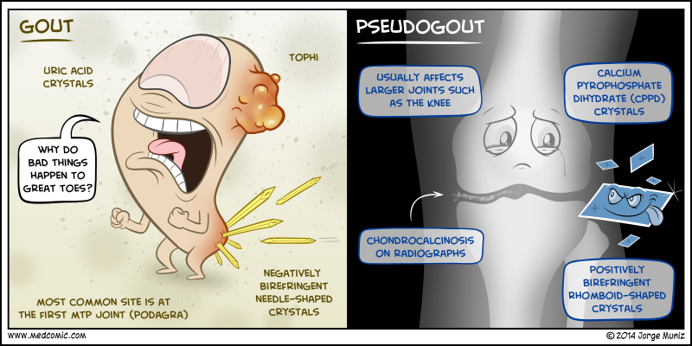
PSEUDOGOUT Also is known as Chondrocalcinosis, calcium pyrophosphate crystal deposition disease.
It can occur in three main settings:
-sporadic (more common in the elderly). -Hereditary -secondary to other conditions, such as previous joint damage, hyperparathyroidism, hypothyroidism, haemochromatosis and diabetes.
The crystal deposits first appear in structures composed of cartilage such as menisci, intervertebral discs, and articular surfaces(Chondrocalcinosis). When the deposits enlarge enough, they may rupture, inducing an inflammatory reaction.
Pseudogout typically first occurs in persons 50 years of age or older, becoming more common with increasing age, although pathways leading to crystal formation are not understood, they are likely to involve the overproduction or decreased breakdown of pyrophosphate.
Pseudogout can be differentiated from gout in three ways:
-the knee is most commonly involved.
-x-ray show the characteristic line of calcification of the articular cartilage
- the crystals look different under polarizing microscopy, they are rhomboid in shape NOT needle-shaped as in gout.
Pseudogout:

Slide 16
Osteomyelitis and septic arthritis
Objectives:
Understand the etiology, pathogenesis and clinical features of osteomyelitis.
Be familiar with some of the terminology used in bone infections like: sequestrum, involucrum, Brodie abscess and Pott’s disease.
Understand the clinicopathological features of tuberculous osteomyelitis and infective arthritis.
Red : Important
Green: doctors’ notes
Grey: extra
Please check here before viewing the file to know if there any changes or additions.

Slide 17
Osteomyelitis
osteomyelitis: it is the inflammation of the bones and bone marrow spaces, it is almost always bacterial.
bacteria that cause osteomyelitis
staphylococcus aureus
the most common in all ages.
beta hemolytic streptococcus
in neonates
salmonella
it is unusuall bacteria of osteomyelitis but it can cause it especially with people who has sickle cells anemia
E.coli (Escherichia coli)
in neonates
here is some Diseases that increase the incidence of osteomyelitis like sickle cell anemia .
Also drugs addiction (if they use unsterile needles) may cause osteomyelitis but with unusual bacteria and it is usually pseudomonas aeruginosa.
Osteomyelitis usually produce chronic discharging sinus especially with people who have diabetes.
Osteomyelitis may look like tumor in the X-RAY, so some times we have to take biopsy and culture it.
Osteomyelitis like to affect the metaphysis and it cause subperiosteal abscess, and then you see areas of density in the X-RAY, but in sometimes -which is unusual- it affect the diaphysis and then I have to test sickle cell anemia by hemoglobin electrophoresis test.
Osteomyelitis can be associated with septic arthritis.
How does the bacteria reach the bone ?
- Hematogenous spread: if the patient has inflammatory focus the Bacteria can travels throw blood stream and go to the bone
- Direct root: like if the patient has an open fracture ( Compound fracture ) where the bone is associated with the rapture of the connective tissue and the skin, and sometimes the fixation of the fracture by foreign bodies like plate, metal pins, screws or wires may lead the bacteria to enter the bone.

Slide 18
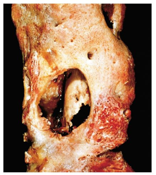
Pathogenesis of osteomyelitis:Inflammation in the metaphysis of the bone causes micro abscesses.These abscesses usually occur beneath (under) the periosteum; so it is called subperiosteal abscesses.Inflammation activates the coagulation cascade and this will lead to the formation of thrombi.Since these thrombi are caused by bacterial infection, it is called septic thrombi. These thrombi causethe death of the bone and form what is called sequestrum (sequestra is the plural).The thrombi accumulate in the bone blood vessels and this will lead to ischemia and the bone will benecrotic.After the sequestrum is formed, some reactive bone (new bone) is formed around it, and this is calledinvolucrum.This new bone actually tries to repair the damage. This involucrum leads to the formation of sinuses.If there is a chronic osteomyelitis (chronic inflammation) the complication which occur to someone whohave a chronic inflammation for 10-20 years is amyloidosis and amyloid is one of a reactive protein(acute phase protein)(amyloid aa) when it accumulate in organs it causes disease.
Resected femur from a patient with chronic osteomyelitis. Necrotic bone (the sequestrum) visible in the center of a draining sinus tract is surrounded by a rim of new bone (the involucrum).
Tuberculous Osteomyelitis:
The organisms usually reach the bone through the bloodstream from the lungs.
Tuberculosis (TB) of the vertebral bodies is a clinically serious form of osteomyelitis, It is called Pott’s Disease.
Pott’s Disease causes vertebral deformity, collapse, and posterior displacement leading to neurologic deficits.
Why are there neurological defects? Because the spinal cord is in the vertebrae, and it would be compressed in Pott’s disease.

Slide 19
Septic (infectious) arthritis
Septic arthritis can be accompanied with osteomyelitis or on its own.
Causes: gonorrhea a sexually transmitted disease
Is discharge from nobel organs (penis)
If not treated fast it can become chronic and cause septic arthritis it called gonococcal arthritis for unknown reason those gonococcus loves to go to the joints. not common but can occur
Caused by Neisseria gonorrhea
Robins:
How can microorganisms reach the joints?
1- Hematogenous dissemination (spread by the blood)
2- Direct inoculation (by trauma to the joint where organisms go directly to the joint)
3- Contiguous spread from osteomyelitis or soft tissue abscess
Infection (septic) arthritis is series because it can cause rapid joint destruction and permanent deformities.
4- Iatrogenic.
5- traumatic.
Bacterial infections almost always cause an acute suppurative arthritis:
Haemophilus influenza predominates in children younger than 2 years.
s.aureus is the main causative agent in older children and adults.
gonococcus is prevalent in older adolescent (مراهق) and young adult.
patient with sickle cell prone to salmonella infection at any age.
both genders affected equally except gonococcal arthritis occur in sexually active women.
The infection involves only a single joint. usually the knee-followed in order by hip, shoulder, elbow, wrist, and sternoclavicular joints.
Risk factor:
immune deficiencies (congenital and acquired).
Debilitating illness.
Joint trauma.
Chronic arthritis of any cause
Intravenous drug abuse.

Slide 20
The classical presentation: sudden onset of pain, redness and swelling of affected joints with restricted range of movement. Fever, leukocytosis and elevated ESR are common.
90% of non-gonococcal septic arthritis the infection only involves one joint knee usually
Joint aspiration typically yield a purulent fluid to identified the causal agent.
Infectious arthritis must be rapidly diagnosed and treated promptly to prevent irreversible and permanent joint damage.
Complications:
Septic arthritis can lead to ankylosis and even fatal septicemia.
However, prompt antibiotic therapy and joint aspiration or drainage cures most patient.
Female

Slide 21
MCQs
Q1: What is the major risk factor of osteoarthritis?
A. Age B. Obesity
C. Trauma D. All above
Answer: D
Q2: The Osteoarthritis affect:
A. Limited Number of joint (Oligoarticular)
B. Long bones
C. All Joint
D. Doesn't affect any joint
Answer: A
Q3: Which of the following joint is usually spared in Rheumatoid Arthritis?
DIP
MCP
PIP
Ankles
Answer: B
Q4: In which of the following disease we can see Osteopenia on X-ray?
A. Rheumatoid arthritis B. Osteoarthritis
C. Gout D. Non of them
Answer: A
Q5: Which of the following is impaired in a case of gout?
A. Protein metabolism B. Ketone metabolism
C. Purine metabolism D. Pyrimidine metabolism
Answer: C
Q6: The accumulation of Calcium Pyrophosphate crystals in small joint is:
A. Gout B. Rheumatoid arthritis
C. Pseudogout D. Tuberculous arthritis
Answer: C

Slide 22
MCQ
Q7: 30 years-old women she is suffering from pain in 4 joints ( 3 fingers joints and knee joint ) and the pain is worse at night when she's trying to relax. On examination, the joints appear warm and swollen . An x-ray was performed and there was a radial deviation of the wrist. What is the type of arthritis ?
a- Rheumatoid arthritis
b- Gout
c- Osteoarthritis
d- Tuberculous arthritis.
Answer: a
Q8: Which of the following is the most specific test for Rheumatoid arthritis?
a- Anti CCP antibody
b- Anti lgM antibody
c- Anti IgA antibody
d- Anti IgG antibody
answer : a
Q9: Rheumatoid arthritis is a systemic disease ?
a- true b- false
Answer: a
Q10: Rheumatoid arthritis is :
a- Auto-immune disease
b- Inflammation
c- Degenerative disease
d- Both a and b
Answer: d
Q11: Formed by proliferating synovial-lining cells admixed with inflammatory cells, granulation tissue, and fibrous connective tissue?
A. Osteophyte
B. Heberden nodes
C. Pannus
D. eburnation
Answer : c

Slide 23
Good Luck
Team leaders:
Fahad Alzahrani – Ashwaq Almajed
Team members
Girls:
Samar Alqahtanii
Fatimah Altassan
Boys:
Fahad Alzahrani
Abdulazeez Alanqari
Abdullah Altwiraqi
Mohammed Almaniee
Waleed Alaskah
Faisal Algharbi
Abdulazeez alhusaini
Faris Aljafar
Motaz Ibraheem
Contact us on: Pathology436@gmail.com
Twitter: @Pathology436

