Slide 1
Skeletal muscle relaxants
Objectives:
Identify classification of skeletal muscle relaxants.
Describe the pharmacokinetics and dynamics of neuromuscular relaxants.
Recognize the clinical application for neuromuscular blockers
Know the different types of spasmolytic.
Describe the pharmacokinetics and dynamics of spasmolytic drugs.
Recognize the clinical application for spasmolytic drugs.
We recommend you to study NEUROMUSCLAR JUNCTION
Lecture in physiology.
إجعلوا أحلامكم كحمام الحرم محرم’’ قتلها.

Slide 2
Skeletal muscle relaxants
Are drugs used to induce skeletal muscle relaxation
دا (Da)هوا (natrilene) اللي تدور عليه يله(Act dirctly) ايش تنتظر
Danatrolene
نقسم اسم الدرق قسمين الأول (Diaze) يشبه كلمة dizzy والدوار يصير بالرأس معناته هالدواء يشتغل على (CNS) والقسم الثاني (zepam) يشبه spasm والتشنج له علاقة بالعضلات, فلما نجمعهم مع بعض نتذكر ان هالدواء يشتغل على الجهاز العصبي المركزي ويعالج العضلات المتشنجة
Diazepam
البكله (Baclo) فين (fen) براسك يعني(CNS acting) وينها بالضبط طيب رابطة شعرك (Act on spinal cord)
“تخيلوا المخ راسها والحبل الشوكي شعرها ف البكله وين؟ اكيد بالشعر يعني تشتغل على الحبل الشوكي“
Baclofen

Slide 3
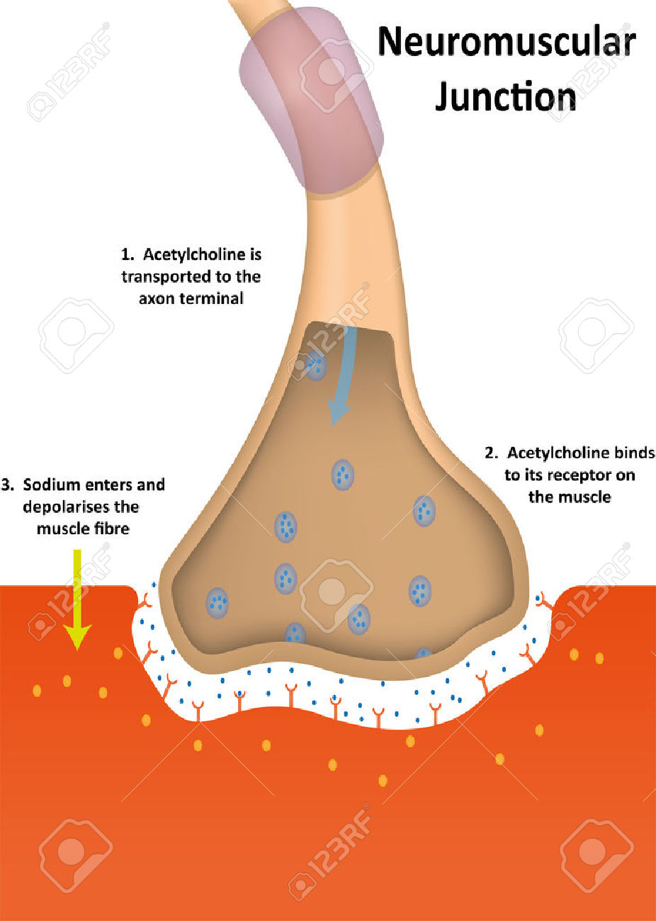
Over all view
Peripherally acting skeletal muscle relaxants (Neuromuscular blockers):
They act by blocking neuromuscular junction or motor end plate leading to skeletal muscle relaxation.
1- Competitive neuromuscular blockers.
(Non-Depolarizing neuromuscular blockers)
Long acting
1- d-tubocurarine (prototype drug)
2- Pancuronium
Short acting
E.g. Mivacurium
2- Depolarizing neuromuscular blockers.
Succinylcholine (suxamethonium)
Intermediate acting
1- Atracurium
2- Vecuronium
Normally in the neuromuscular junction, the acetylcholine will attach with the acetyl choline receptors (in skeletal muscle the receptors are nicotinic receptors type 1 after that a lot of changes will happen and then the muscle will contract. The Neuromuscular blockers basically will block the nicotinic receptors so the acetyl choline can not bind with the receptors and produce its action (muscle contraction) and if the muscle will not contract it will relax ☺.

Slide 4
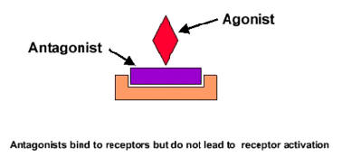
Competitive neuromuscular blockers
Mechanism of action:
Compete with Ach for the nicotinic receptors present in post-junctional membrane of neuromuscular junction or motor end plate. (the competition will be regarding to the concentration, who has more concentration will bind with the receptors, so if the acetyl choline has more concentration it will bind with the receptors, if the drug has more concentration it will bind with the receptors and blocks them
No depolarization of post-junctional membrane (non depolarizing). (they do not produce depolarization to relax the muscle, they just block the receptors)
Because they are competitive drugs we call them antagonist.
The suffix of the competitive neuromuscular blockers:
curium or curonium (so whenever you see this suffix in any drug you immediately realize that this drug is competitive neuromuscular blocker)

Slide 5
Classification of competitive neuromuscular blockers according to their duration of action:
Pharmacokinetics of competitive neuromuscular blockers:
They are polar compounds. (Inactive orally & taken parentally)
Inactive orally & taken parentally (they are polar so they have low distribution, so if I give them orally they will not distribute to the blood, so I give the drug IV to go to the blood immediately).
Do not cross Blood Brain Barrier (BBB) (no central action). Because they are polar as mentioned before.
Do not cross placenta. So no effect on the fetus.
There Metabolism depends mainly upon kidneys and liver. So if there is a disease modifying the liver or the kidney you should give it carefully.
Except: Mivacurium (degraded by acetyl pseudo-cholinesterase).
Atracurium (spontaneous degradation in blood).
Long acting
1- d-tubocuranine (prototype drug) not use clinically.
2- pancuronium
generally, the long acting drugs are metabolized and execrated by the kidneys.
1- atracurium
2- vecuronium
they are metabolized and execrated by the liver.
1- mivacurium
Execrated by pseudo-cholinesterase enzyme in the blood.
Intermediate acting
توبه(Tubo) استخدم هال(curanine) مره ثانية مرره يطول تأثيره بالجسم مع انه أصلي(prototype) بس خلاص انقرض من السوق
Short acting
جربت كريم (curium) نيفيا(miva) = nivea كذابين (pseudo-cholinesterase) مرره مو زين ما يطول بالجسم بسرعه يروح أثره(the shotest one)
قطرة (Atra) وحده من الدم (in blood) على هال (curium) كافية انها تخليه يتحلل من نفسه (Spontaneous degradation)
Atracurium

Slide 6
Pharmacological actions of competitive Neuromuscular blockers:
Skeletal muscle relaxation. Wanted use
They produce different effects on Cardiovascular system
which cause by:
Some release histamine and produce hypotension. The meaning here is the competitive NMBs have the ability to release histamine from the mast cell, and as you now histamine will cause vasodilatation which will cause hypotension
The drugs can release histamine:
d-Tubocurarine*. (Strong histamine releaser).
Atracurium. (Intermediate histamine releaser).
Mivacurium. (Weak histamine releaser).
Others produce tachycardia ( Heart Rate ↑) by the drug Pancuronium.
كيف اعرف ترتيبهم من هالناحية ، واحد يسأل رتبت اللي قلت لك ويرد الثاني تم (TAM)
Pancuronium
كيف اربط ان هالدواء له علاقة بمعدل ضربات القلب ، بنك(Panc) الدم بالجسم هو القلب( increase heart rate).
يعني باختصار عندنا تأثيرين أساسيين لهذول الأدوية:
١- تأثير نبغاه اللي هو انبساط العضلات.
٢- تأثر ما نبغاه على الجهاز القلبي من خلال طريقتين:
-يا إنها تقلل الضغط عشانها تسبب إفراز هيستامين.
-أو إنها تزيد معدل ضربات القلب (على حسب الدوا اللي استعمله).
*Remember that d-tubocuurrarine is a prototype and not used clinically due to its side effects.

Slide 7
Drugs | d – Tubocurarine | Atracurium | Mivacurium | Pancuronium | Vecuronium
Duration of action | Long ( 1- 2 hours) | Intermediate (30 min) | The shortest (15 min) with Fast onset of action | Long (1-2 hours) | Intermediate (40 min.)
Metabolism and execration | Eliminated by kidney 60% - liver 40%. | Eliminated by non- enzymatic chemical degradation in plasma (spontaneous hydrolysis at body pH). So that, it’s the Drug of choice in renal and kidney failure. | pseudo-cholinesterase It’s enzyme in the blood which breaks down the Ach or any drugs like Ach or any other Easter | Excreted by the kidney ( 80 % ). | Metabolized mainly by liver and excreted in bile.
Side effect | It is histamine releaser which leading to: Bronchospasm Hypotension Tachycardia Because of adverse effect , it is not used clinically but we use more safer derivatives | Liberate histamine (Transient hypotension). يعني هو يسبب إفراز الهيستامين بس بكمية قليلة وهالشي يعني فيه انخفاض ضغط لكن برضو مو انخافض كبير. also it may cause bronchospasm which is chemically related to the histamkne. | Transient hypotension (due to histamine release). | Hypertension, tachycardia (due to): ↑norepinephrine release from adrenergic nerve Endings. Anti-muscarinic action (block parasympathetic action). | few side effects : No histamine release. That’s why it has low side effect. No tachycardia.
Contraindications (should be avoid in) | --------- | asthmatic patients. Because they already have bronchospasm. | 1- liver disease 2- Genetic cholinesterase deficiency 3- malnutrition (in any of this disease the duration of action will increase) | patient with coronary diseases | ---------
Potency | A type of curare drugs. | As potent as curare. |  | 6 times more potent than curare.

Slide 8
Important to read
More explanation for the information in the previous table:
Atracurium is a drug injected inside the blood circulation and after 30 minutes it degrades by itself (without the involvement of any enzyme), it degrades because the ph of this drug differs from the ph of the blood which makes the drug unstable, which leads to drug degradation.
So the we can use Atracurium in liver and kidney failure because it can be metabolized by itself.
The liver disease can make the duration of action of Mivacurium longer, because the liver is responsible for the synthesis of the enzyme (pseudo-cholinesterase), which the mivacrurium metabolized by.
Also malnutrition can cause longer duration because if there is no amino acid, which is the main source for protein synthesis while the enzyme is a form of proteins.
The Pancuronium act by the stimulation of sympathetic nervous system by increase releasing of norepinephrine. By the same time the drug inhibit parasympathetic nervous system by blocking muscarinic receptors (parasympathetic receptors), however, sympathetic is stimulated which leads to hypertension and increasing of the heart rate while the parasympathetic is sleeping. So, no revers action.
Anti-histamine pretreatment may prevent side effect that is related to histamine.
Liver diseases will increase the duration of action of the drugs metabolized or excreted by the liver.
As well as kidney diseases

Slide 9
Depolarizing Neuromuscular Blockers
Mechanism of action:
Example: Succinylcholine (suxamethonium)
combine with nicotinic receptors
initial depolarization of motor end plate
muscle twitching
persistent depolarization
Skeletal muscle relaxation
in post- junctional membrane of neuromuscular junction
Persistent depolarization leading to paralysis.
The muscle fibers will not repolarize, therefore the cell is not ready to bind with Ach.
They are agonist drugs
Succinylcholine (suxamethonium) | Action | Side effect | Contra-indications | Duration of action | Metabolism
 | Skeletal muscles: twitching relaxation | *Hyperkalemia which lead to Cardiac arrest. *CVS: arrhythmia. *Eye: ↑ intraocular pressure (due to contraction of extra-ocular muscle). *Produce malignant hyperthermia. *succinylcholine apnea due to deficiency of pseudo-cholinesterase. *GIT: increased intra-gastric pressure leads to regurgitation of gastric content to esophagus and difficulty in opening mouth. regurgitate: bring swallowed food up again to the mouth. | *Glaucoma *Patient with cardiac diseases. | Fast onset (1 min) with short duration of action (5-10 min). Half-life is prolonged in: Neonates. Elderly. Pseudo-cholinesterase deficiency due to: *Liver disease. *Malnutrition. *Genetic cholinesterase deficiency. | Metabolized by pseudo-cholinesterase in plasma.

Slide 10
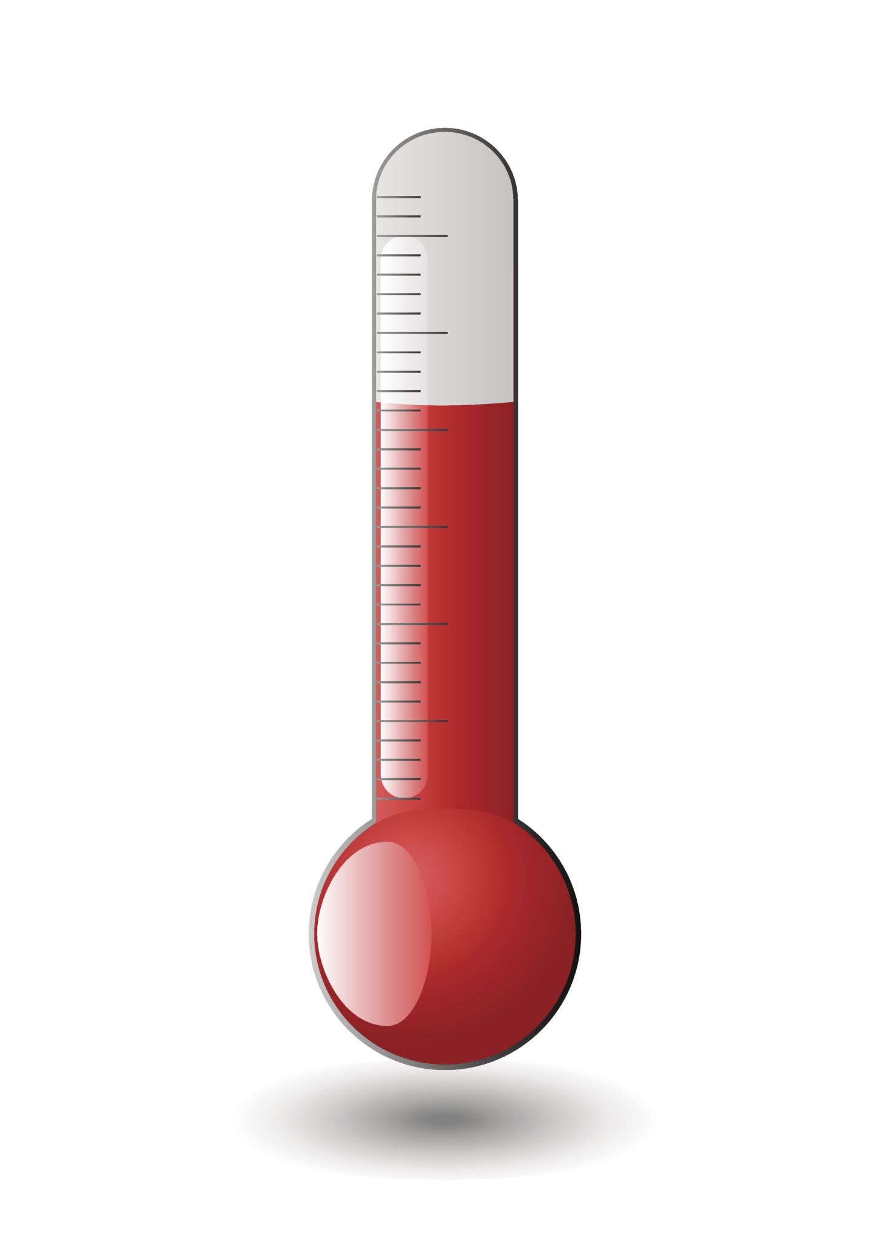
Malignant hyperthermia
Definition: the rare bizarre inherited condition of having a body temperature greatly above normal.
Occurs upon administration of drugs as:
general anesthesia e.g. halothane
neuromuscular blockers e.g. succinylcholine
Mechanism of the disease:
Treatment : Dantrolene
1-
Inability to bind calcium by sarcoplasmic reticulum in some patients due to genetic defect .
2-
4-
Hyperthermia
3-
↑ Ca release
intense muscle spasm

Slide 11
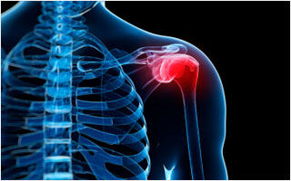
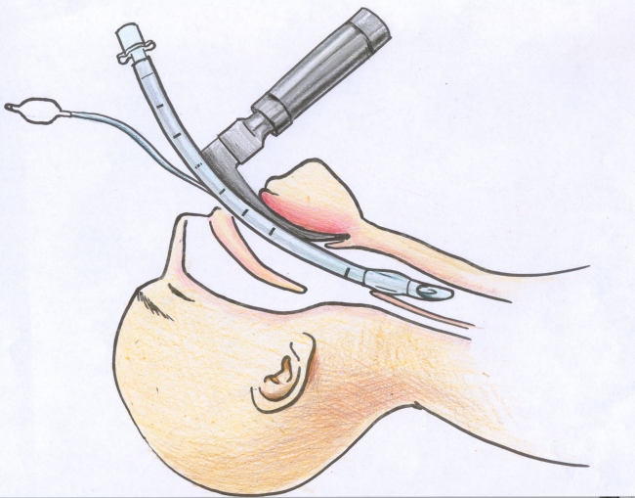
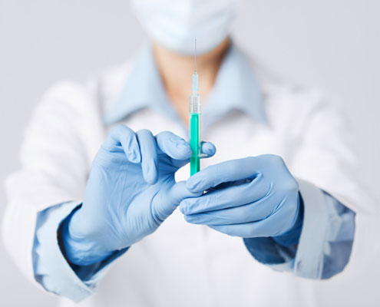
Uses of neuromuscular blockers
control convulsion → electroshock therapy in psychotic patients (before we give electrical shock, we need to relax the muscle, so we use neuromuscular blockers. If we don’t use NMB and give the electrical shock that may cause bone fracture)
Relieve of tetanus and epileptic convulsion.
As adjuvant in general anesthesia to induce muscle relaxation (surgeon use muscle relaxant with the anesthesia to relax the muscle so they can operate easily)
Facilitate endotracheal intubation
Orthopedic surgery.
Drugs and diseases that modify effects of
neuromuscular blockers
Myasthenia gravis: increase the response to muscle relaxants.
Drugs as aminoglycosides* (e.g. streptomycin).
Magnesium sulphate. general anesthetics can potentiate or
enhance the effect of neuromuscular blockers.
*Aminoglycosides
Are Group of antibiotics.

Slide 12
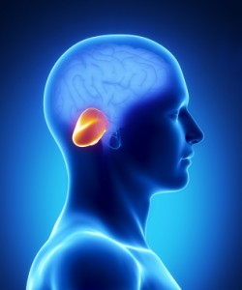
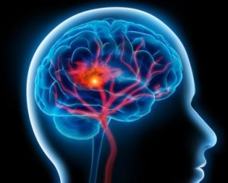
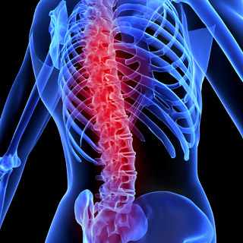
Spasmolytics
Reduce muscle spasm in spastic states
Centrally acting
direct action on skeletal muscles
Example: Baclofen
GABA (gama-amino butyric acid ‘GABA’)* agonist – acts on spinal cord.
Example: Diazepam (Benzodiazepines):
facilitate GABA* action on CNS
Example:
Dantrolene
Uses of spamolytics:
They reduce muscle spasm in spastic static state produced by neurological disorders such as:
spinal cord injury
Cerebral stroke
Cerebral palsy
GABA: γ-Aminobutyric acid is the chief inhibitory neurotransmitter in the mammalian CNS. It plays the principal role in reducing neuronal excitability throughout the nervous system, thus reducing contraction.

Slide 13
Example of Spasmolytic:
Dantrolene | Mechanism of action | Rout of administration | uses
 | It interferes with the release of calcium from its stores in skeletal muscles (sarcoplasmic reticulum). It inhibits excitation-contraction coupling in the muscle fiber (Acts directly on skeletal muscles) | Orally IV ( t $1/2$ = 8-9 hours) | For treatment of: Spastic state Malignant hyperthermia (actually the disease happen because of blocking of the Ca in the sarcoplasmic reticulum and dantrolene releases the Ca from sarcoplasmic reticulum )

Slide 14
 | Drugs | Duration | Mechanism | Metabolism | Side effect
Peripherally acting (Neuromuscular blockers) | D-tubocurarine | Long (1-2 h) | Compete with Ach for the nicotinic receptors present in postjunctional membrane of neuromuscular junction or motor end plate ANTAGONIST | 60% liver, 40% kidney | Bronchospasm Hypotension Tachycardia
 |  |  |  | spontaneous hydrolysis | Transient hypotension bronchospasm
 | Atracurium | Intermediat (30 min)
 |  |  |  | by pseudo-cholinesterase (enzyme) | Transient hypotension
 | Mivacurium | The shortest (15 min)
 |  |  |  | By kidney | *Hypertension tachycardia * ↑ norepinephrine *Antimuscarinic action
 | Pancuronium | Long
 |  |  |  | Metabolized by liver and excreted in bile | A Few No histamine release. No tachycardia.
 | Vecuronium | Intermediate
 | Succinylcholine (suxamethonium) | Short (5-10 min) | combine with nicotinic receptors → initial depolarization → muscle twitching → persistent depolarization → Skeletal muscle relaxation | by pseudo-cholinesterase in plasma | Cardiac arrest Arrhythmia ↑ intraocular pressure malignant hyperthermia succinylcholine apnea
Spasmolytics | Baclofen | - | GABA inhibitor agonist on CNS | - | reduce muscle spasm in spastic states
 | Diazepam (Benzodiazepines) |  | facilitate GABA on CNS
 | Dantrolene | t $1/2 (half−life)$= 8 - 9 h | interferes with the release of calcium from its stores in skeletal muscles inhibits excitation-contraction coupling in the muscle fiber. | - | Treatment of: Spastic states Malignant hyperthermia
Competitive (non depolarized)
Depolarizing
Uses
central
Direct

Slide 15
SAQ
42 pregnant women in her 11th week come with sudden hypotension.
After taking her history, we found that one month ago she had suffered from muscular spasm and the doctor prescribed MIVACURINURN as relaxant drug.
Q1: What is the underlying cause for hypotension in this case ?
Mivacurinurn act as Histamine releaser, which leading to dilatation in the blood vessle and decrease the blood pressure (Hypotension).
Q2: Which classification of skeletal muscle relaxants this drug belong to ?
Peripherally acting → Competitive neuromuscular blockers
Q3:How is it metabolized and Where ?
Metabolized by pseudo-cholinesterase in plasma.
Q4: Is there any risk for her baby if she decide to continue taking this drug during her pregnancy and why/why not ?
No there is not, because it is polar drug so can not cross placenta.
Q5: Later, The investigations show that she had liver disease, Do we expect any change in the duration of action of this drug and why/why not ?
Yes, it will be longer, Because it is metabolized by pseudo-cholinesterase in plasma which is produce mainly by the liver so any disease in the liver , it will lead to decrease the concentration of this enzyme therefore the drug will not metabolized and has longer duration.
Q6: from previous question, list two drugs of choice in this case :
Atracurium / Vecuronium

Slide 16
SAQ
59 male has Glaucoma . 2 weeks ago, he had an abdominal surgery and during operation the surgeon used a relaxant drug. After 9 days, the same patient come again with live-threating condition which is known as malignant hyperthermia and also increasing in the Intraocular pressure. His past medical history includes no kidney or liver disease.
Q1: Which drug do you think was used in his surgery ?
May be Succinylcholine (suxamethonium).
Q2: Which classification of skeletal muscle relaxants this drug belong to ?
Peripherally acting → Depolarizing Neuromuscular Blockers
Q3:How is it metabolized and Where ?
Metabolized by pseudo-cholinesterase in plasma.
Q4: What is its mechanism ?
Combines with nicotinic receptors and activates depolarization of motor end plate
initial stimulation → initial muscle twitching → persistent depolarization → SKM relaxation
Q5: Is it act as Agonist or antagonist drug, and prove your answer :
Succinylcholine act as agonist drug, because it has affanty and prduce action (efficacy)
Q6:list two undesirable Pharmacological Actions of this drug other than increasing in the Intraocular pressure :
Hyperkalemia → Cardiac arrest. / CVS → arrhythmia.
Q7:list two contraindications of this drug other than patient with glaucoma :
Patient with CVS disease / Patient with liver disease
Q8:What is the malignant hyperthermia and its underlying mechanism ?
It is a rare bizarre inherited condition of having a body temperature greatly above normal.
Occurs upon administration of some drugs such as Succinylcholine.
1. Inability to bind calcium by sarcoplasmic reticulum in some patients due to mutation of the (RYR1).
2. Opened RYR1 leads to increased intracellular Ca release which causes intense muscle spasm.
3. Severe rise in body temperature (hyperthermia)
Q9:Which drug of choice to treat malignant hyperthermia ?
Dantrolene
ryanodine receptor

Slide 17
SAQ
Q1: simply explain the mechanism of action of Dantrolene:
Acts directly on skeletal muscles, as it interferes with the release of calcium from its stores in skeletal muscles.
Q2: mention a route to give the Dantrolene :
Orally
IV
Q3: Dantrolene could be used in the treatment of ?
Spastic states
Malignant hyperthermia
Q4: simply explain the mechanism of action of Spasmolytic:
They reduce muscle spasm in spastic states
Q5:spasmolytics could be used in reducing muscle spasm in spastic states
produced by neurological disorders such as:
Spinal cord injury
Cerebral stroke
Cerebral palsy

Slide 18
QUIZ

