Slide 1
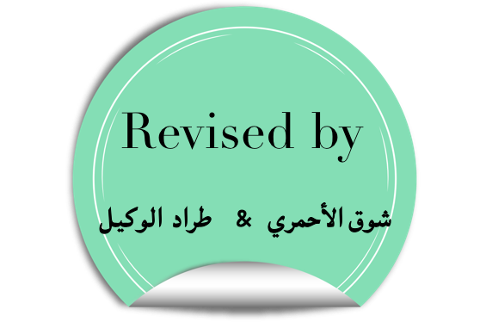
NSAID: Non-Steroid Anti-Inflammatory Drugs
Objectives:
Action of NSAIDs
Effects of and ADRs of NSAIDs
NSAIDs and COX enzyme
Pharmacokinetic properties and pharmacodynamic effects of selected NSAIDs
قد يكون السطر الذي حرم عينيك النوم ليلة, شفاء لداء ارق العليل ليال طوال...
خلقت بلسما فلا تشتكي

Slide 2
Prostaglandins actions (extra)
cause constriction or dilation in vascular smooth muscle cells.
cause aggregation or disaggregation of platelets (COX1) .
induce labor by increasing smooth muscles contraction
regulate inflammation.
acts on thermoregulatory center of hypothalamus to produce fever.
increase glomerular filtration rate.
So for example inhibiting COX1 will decrease blood coagulation, which is sometime desirable when there is a cardio problem or for diabetic patients, and sometimes not, cause it my lead to excessive bleeding.
Also it will increase gastric acid secretion that causes damage of the gastric mucosa which leads to gastric ulcer.
COX-1
Blood clotting
protects gastric mucosa
COX-2
Mediate inflammation
Pain

Slide 3
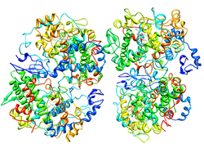
Non-steroidal anti-inflammatory Drugs
A drug class that provide analgesic (pain killer) and antipyretic effect (lower temperature) and have anti-inflammatory effects. In addition, it’s called (non-steroid) to distinguish from steroid drugs.
COX isoforms :
Type | Example
Nonselective (inhibit COX1&2) | Aspirin and Diclofenac
Selective COX-2 ( inhibit only COX-2 | Coxibs
Preferential COX-2 | Meloxicam
COX-3 inhibitors | Paracetamol
COX-1
&
COX-2

Slide 4
Actions of NSAIDs
Blocking of PGs production results in :
Analgesic
NSAIDs inhibit the formation of PGE2 & PGF2 causing analgesia (pain killer) in peripheral tissue.
Antipyretic
NSAIDs inhibit the formation of PGE2 which activates the thermoregulatory center to raise Heat production and inhibit dissipation (Fever) in CNS.
3. Anti-inflammatory
NSAIDs inhibit the formation of PGE2 & PGF2 which cause Redness, swelling, Heat and Pain in association with Bradykinin, Histamine and 5-HT. site of action : peripheral tissue.
افف (EF)الآلم(PAIN) مرره يوجع
لما الدكتور يسأل عندك حرارة (FEVER) ونجاوب أي(E) عندي حرارة
Clinical uses :
Fever
Headache, Migraine(صداع نصفي)
Dental pain, Dysmenorrhea (painful periods)
Common cold
Rheumatoid arthritis / myositis

Slide 5
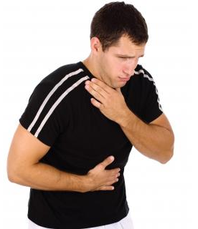
General ADRS
GIT upsets ( nausea, vomiting) mostly caused by non selective.
GIT bleeding & ulceration.
Bleeding.
Hypersensitivity reactions Leukotriene cause hypersensitivity .
Inhibition of uterine contraction.
Salt & water retention.
Impairment of kidney function.
Hemodynamically mediated acute renal failure.
K(I)DN(E)Y = PGI2 & PGE2 for renal function

Slide 6
Nonselective COX-1/COX-2
Examples:
1-Aspirin. 2-Diclofenac. 3-Ibuprofen.
4-Ketoprofen. 5-Naproxen. 6-Piroxicam.
7-Indomethacin.
Aspirin
Mechanism of action :
Inhabit COX (non selective) irreversibly.
Pharmacokinetics :
Higher dose of aspirin has a long plasma half- life.
Metabolized by hydrolysis and then conjugation.
Clinical uses :
Acute rheumatic fever.
Reducing the risk of myocardial infarction (cardioprotective).
Prevention of pre-eclampsia*.
Chronic use of small doses reduce the
incidence of colon cancer.
*Pre-eclampsia: a condition in pregnancy characterized by high blood pressure, sometimes with fluid retention and proteinuria.

Slide 7
ADRS
Clinical dose | Hypersensitivity bronchospasm, rhinitis, conjunctivitis, urticaria
 | Acute gouty arthritis (low doses)
 | Reye's syndrome
 | Impaired haemostasis
 | GIT side effects, dyspepsia, nausea and vomiting
 | Mucosal damage→ hemorrhage
Overdoes | Salicylism ( ringing of ear , vertigo)
 | Hyperthermia
 | Gastric ulceration & bleeding
Reye’s syndrome: is a rare but serious condition that causes swelling in the liver and brain.

Slide 8
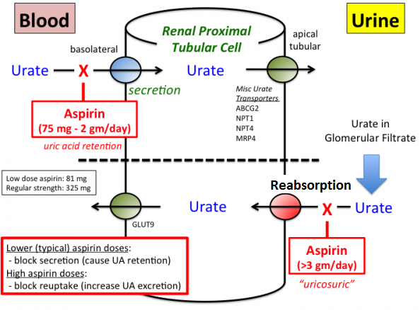
Contraindications
Contraindications of Aspirin
Peptic ulcer.
Patients taking Anticoagulants.
Hemophilic patients.
Children with viral infections.
Pregnancy*.
Gout (small doses).
*Aspirin should be avoided during the third trimester due to possible premature closure of the ductus arteriosus
Low dose = uric acid retention, prevent urate secretion to proximal tubular cell, hence, High in blood, low in urine.
Cause GOUT
Large dose = prevent Urate from reabsorption
Hence high in urine, low in blood
Uricosuric
Treat GOUT.

Slide 9
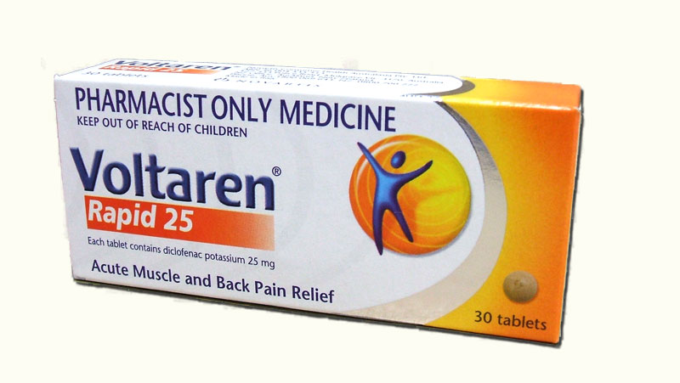
Diclofenac
Clinical uses :
Analgesic.
Antipyretic.
Anti-inflammatory.
Acute gouty arthritis.
Locally to prevent post-operative ophthalmic inflammation.
بالمصري نقول دي(di) كلو (clo) فينك(fenac) عنها بتسبب (ulceration & bleeding) so it is non-selective act on COX-1
Preparations :
Diclofenac (could be given) with misoprostol (type of PGE1) decreases upper gastrointestinal ulceration , but result in diarrhea.
Diclofenac with omeprazole (decrease acid) to prevent recurrent bleeding.
0.1% ophthalmic preparation for postoperative ophthalmic inflammation.
A topical gel 3% for solar keratoses.
Rectal suppository as analgesic .
Oral mouth wash.
Intramuscular preparations.

Slide 10
Selective COX-2 inhibitors
Examples:
1-Celecoxib. 2-Etoricoxib. 3-Paracoxib.
5-Rofecoxib*. 6-Valdecoxib*.
*5+6 Withdraw because of risk of myocardial infarction and stroke.
General action :
Potent anti-inflammatory.
Antipyretic & analgesic.
Lower incidence of gastric upset.
No effect on platelet aggregation(COX-1).
General ADRs :
Renal toxicity
Dyspepsia &
heartburn
Allergy
Cardio
vascular
do not offer the cardio-protective effects of non-selective group. (not anti-platelet).

Slide 11
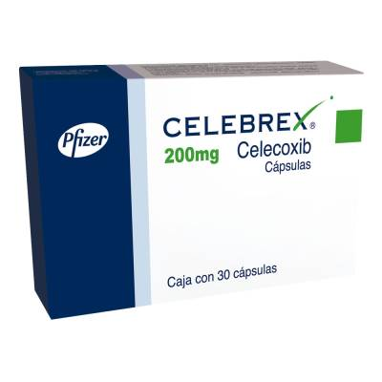
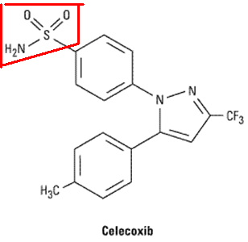
GENERAL CLINICAL USES
Short-term use in postoperative patients.
Acute gouty arthritis.
Acute musculoskeletal pain (cause it’s potent anti-inflammatory).
Ankylosing spondylitis.(inflammation in the joints of spine, leading to pain and stiffness)
Celecoxib
Half-life 11 hours.
Food decrease its absorption (no gastric upset).
Highly bound to plasma proteins.

Slide 12
Preferential COX-2 inhibitors
Examples:
1- meloxicam. 2-nimesulide. 3-nambumetone.
Preferentially inhibit COX-2 over COX-1. particularly at low dose.
Associated with lower GIT symptoms and complains, compared to non-selective COX inhibitors
T ½ = 20 hours.
Used for:
Osteoarthritis.
Rheumatoid arthritis.

Slide 13
Paracetamol (selective COX-3)
General information:
Weak anti-inflammatory effect.
Given orally , well absorbed.
t½=2-4 h.
Metabolized by conjugation at therapeutic doses.
COX-3 is an enzyme that is encoded by the PTGS1 (COX1) gene, but is not functional in humans. COX-3 is the third and most recently discovered cyclooxygenase (COX) isozyme
Clinical uses of Paracetamol:
Commonly used analgesic antipyretic,
for patients with contraindications
to aspirin:-
Peptic or gastric ulcers.
Bleeding tendency.
Viral infections in children.
Allergy to aspirin.
Pregnancy.

Slide 14
Adverse drug reactions
Therapeutic doses
Elevate liver enzymes, No significant ADR.
Large doses
Chronic abuse
Nephrotoxicity
ADRs are mainly on liver, due to its toxic metabolite (N-acetyl-p-benzoquinone imine), which causes liver damage
Treatment of toxicity of paracetamol is by N-acetylcysteine to neutralize the toxic metabolite

Slide 15
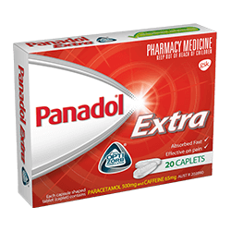
Comparison
Clinical uses of Paracetamol | Contraindications of Aspirin
Peptic or gastric ulcers | Peptic ulcer
Bleeding tendency | Hemophilic Patients, Patients taking Anticoagulants.
Viral infections in children | Children with fever of viral infections
Pregnancy | Pregnancy
Allergy to aspirin | Gout ( small doses )

Slide 16
SAQ 1
A 64 year old male present with mild to moderate musculoskeletal back pain after playing golf. He states that he has tried acetaminophen and it did not help. His past medical history includes diabetes, hemophilia and gastric ulcer.
Q1: Which is the most appropriate NSAID to treat this patient’s pain?
Celecoxib or any NSAIDs act only in COX-2.
Q2: What its mechanism to reduce the pain ?
Block PGs production which will cause the pain such as PGE2 & PGF2.
Q3: Do you think this drug in the future will lead to thrombosis or bleeding ?
Actually NO , because it acts on COX-2 only and does not have any effect on platelet aggregation.
Q4: One of its clinical uses is the treatment of Acute gouty arthritis, list other NSAIDs could used also ?
Diclofenac or Aspirin with large doses.
Q5: Why does this drugs have long half life? Its half life 11 hours.
Because it is highly bound to plasma proteins.

Slide 17
SAQ 2
A 13 year old girl has Acute rheumatic fever after streptococcal infection. She use Aspirin with high doses of 160 mg/kg/day, Aspirin is the drug of choice as anti-inflammatory in this case. Her medical history includes Salicylism .
Q1: What is the mechanism of Aspirin as anti-inflammatory drugs ?
Block PGs production which induces the inflammation such as PGE2 & PGF2.
Q2: What is the metabolite of Aspirin after hydrolysis in phase(I) ?
salicylic acid.
Q3: She has Salicylism, what symptoms do you think she has ?
Ringing in her ears, headache and vertigo.
Q4: Why we can not give hemophilic patients this drug ?
Because it is non-selective NSAIDs and inhibit both COX-1 & COX-2, and COX-1 is important for normal platelet function and aggregation.
Q5: What is the drug which commonly used analgesic antipyretic instead of aspirin in contraindications such as patient with GIT ulceration ?
Paracetamol (Acetaminophen)

Slide 18
QUIZ

