Slide 1
Disease Modifying Anti-rheumatic drugs
Objectives:
Know the pathogenesis of rheumatoid joint damage
Emphasize the rational for early treatment of RA
Define and classify DMARDs
Compare and contrast the advantages and disadvantages of NSAIDs, Steroids and DMARDs in treatment of RA
Know some examples of drugs related to DMARDs.
Explore the pharmacokinetic and pharmacodynamics aspects of the selected DMARDs
Describe the mechanism of action , specific clinical uses , adverse effects of individual drugs.
” كن على قيد الأمل، على قيد الحياة، على قيد التفاؤل"
Doctor’s note

Slide 2
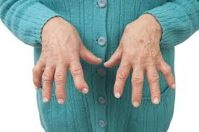
Rheumatoid arthritis
is a chronic autoimmune disorder in which the normal immune response is directed against an individual's own tissue.
Rheumatoid arthritis leading to:
Decline in functional status (due to the distraction of the joint)
Work disability & socioeconomic costs (due to distraction of the joint, so the patient cannot move his limb, and the medication so expensive)
Systemic complications
Co-morbidity & Increased mortality (the disease incurable, the medication just slow the prognosis)
Epidemiology of rheumatoid arthritis:
Affects 1-2 % of the adult population. (1-2% of people around the world have this disease)
It’s common in women than men (2 or 3 times).
Usually appears between ages 25 and 40 years.
The incidence also increases with age, peaking between the 4th and 6th decades. (it means the incidence of the disease is very high between 40 to 60)
Causes pain, disability and loss of function. (again the joint is lost, so the patient cannot move his limbs probably)
Extra:There was an association between high socioeconomic status and lower risk of rheumatoid arthritis. Patients of RA without university degrees was 40% higher compared with those with university degrees.
Note: where’s deformity there’s loss of function
Video might help you

Slide 3
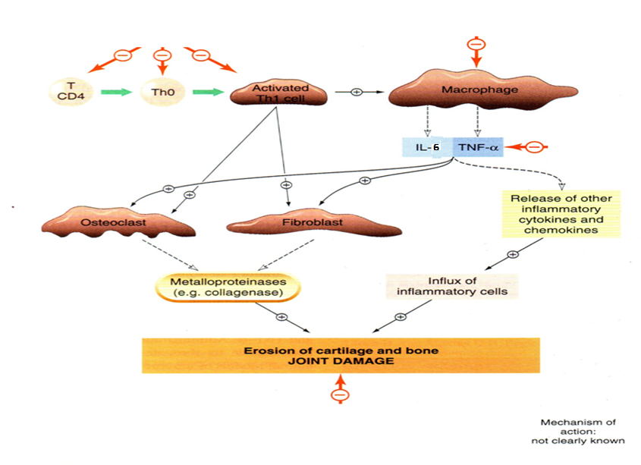
Pathogenesis of Rheumatoid
arthritis
Synovial inflammation and hyperplasia
First there will be inflammation in the joint (especially in the synovial fluid) associated with hyperplasia (the place of the joint got bigger)
autoantibody production (rheumatoid factor)
The inflammation started, so the T-cells and B-cells will stimulate and that will produce antibodies
cartilage and bone destruction (deformity)
the cytokines producing from the inflammatory cells will stimulate the osteoclast (TNF-α) and chondrocyte (which degrades the collagens “cartilage’)
1
Inflammation which will stimulate T-cells (T helper 1)
T-cells stimulate macrophages
Macrophages produces cytokines (TNF-α, IL-6)
Cytokines stimulate osteoclast and fibroblast
Osteoclast and fibroblast lysis proteins (the proteins in the collagen by enzymes called collagenase)
Other way cytokines (TNF-α and IL-6) stimulate more cytokines and more inflammatory cells which damage the bone and cartilage)
The outcomes is there is erosion of the cartilage and bone damage
2
3
4
5
6
7
Video
*the red arrows are where the drugs produce their effect (like inhibit the cytokines)

Slide 4
Extra information about RA
It affect more Than Just Joints, Rheumatoid Arthritis Affects the Rest of Your Body: (signs & symptoms)
Anaemia, osteoporosis, weight loss (because of fatigue), amyloidosis renal, cardiovascular and neurological complication.
Extra: Constitutional symptoms such as fever, loss of appetite and weight loss are also caused by cytokines released into the blood stream. The chronic inflammation caused by RA leads to raised hepcidin levels, leading to anemia of chronic disease where iron is poorly absorbed and also sequestered into macrophages.
Neurological complication, the most common is carpel tunnel syndrome.
Osteoporosis occurs around inflamed joints Most commonly involved are the small joints of the hands, feet and cervical spine caused by inflammatory cytokines.
amyloidosis renal RA may affect the kidney glomerulus directly
cardiovascular risk factors such as blood lipids and blood pressure

Slide 5
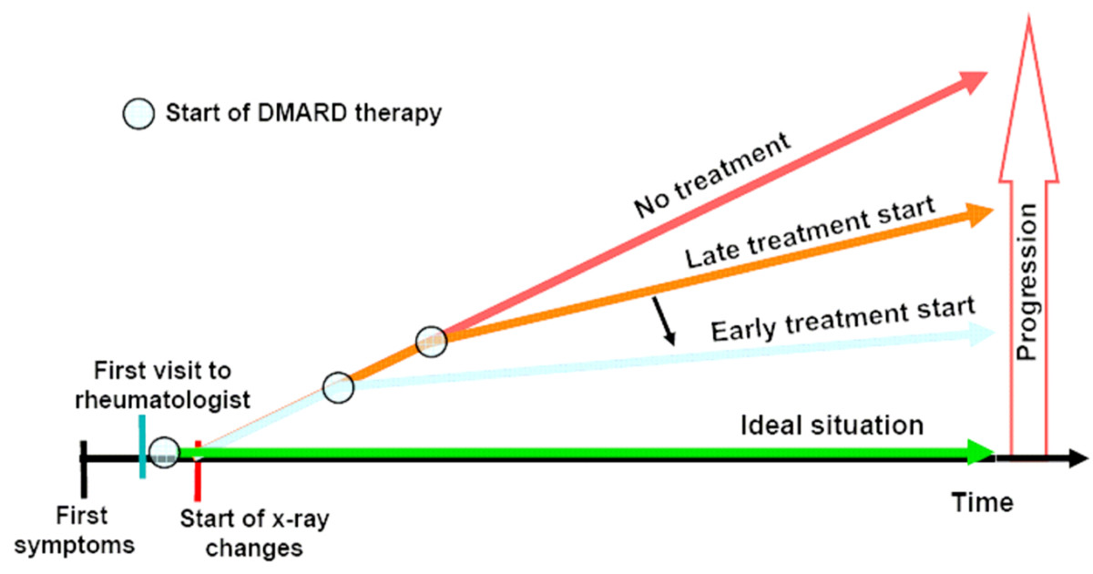
Rational for early treatment
Early phenomenon: joint damage + disability
Less than 2 years of disease activity: bone erosions in 93% of the patients
At 10 years of disease activity: 50% of the patient will be work disabled
Early treatment
long-term benefits of the treatment
The disease has not effect the whole joint or many joints in the body, and the drugs will slow the prognosis of the disease
Late treatment
Sever disease + increasing in the mortality
the disease effect manly so many joints in the body, so the prognosis of the disease is very sever, the drugs cannot treat anything
مختصر الكلام إذا عالجت المرض من بدري بيقل تطور المرض ويقدر الشخص يعيش لوقت طويل
إذا عالجت المريض بعد وقت طويل خلاص المفاصل اختفت وما أقدر أرجعها مره ثانية فالأدوية ما راح تفيد بشي واحتمالية موت المريض عالية
*افهموا إن الأدوية هذي ما تعالج المرض وتخليه يختفي، هي بس تقلل تطور المرض

Slide 6
Drugs use for Rheumatoid Arthritis
Anti-inflammatory drugs with an intermediate rate of action (slower than NSAIDs but faster than other DMARDs). May be administered in low to moderate doses to achieve rapid disease control before the onset of fully effective DMARD therapy. (Used in acute diseases with DMARDs just to relieve the pain until the DMARDs start to produce their action) Reserved for temporary control of severe exacerbations and long-term use in patients with severe disease not controlled by other agents. too toxic for routine chronic use (that means we use glucocorticoids for short time, if we use it for long time it will be toxic) | Glucocorticoids
Rapid onset of action Used in acute cases to relief inflammation & pain Provide partial relief of pain and stiffness (Gives temporary relief and she/he can moves joint easily) Do not slow the progression of the disease Can not stop formation of new deformity Chronic use should be minimized due to the possibility of side effects, including gastritis and peptic ulcer disease as well as impairment of renal function. (that means we cannot use NSAIDs for long time or in high dose) | NSAIDs
Slow onset of action Arrest progression of the disease Prevent formation of new deformity Used in chronic cases when deformity is existing | DMARDs
Comparison between NSAIDs & DMARDs
 | DMARDs | NSAIDs
Onset | Slow | Rapid
Effect of Rheumatoid arthritis | Arrest progression of the disease | No effect on the disease
Deformity | Prevent new deformity | Can not stop the new deformity
Uses | In chronic cases if there is deformity | In acute cases to relief the pain and the inflammation

Slide 7
DMARDs
(Disease Modifying Anti-Rheumatic Drug)
DMARDs
act on the immune system to slow the progression of RA
Biologic
Classical
Infliximab
Tocilizumab
Methotrexate
Hydroxychloroquine
General features of DMARs
Used when the disease is progressing & causing deformities
Have no analgesic effects. (that’s why we use NSAIDs or Glucocorticoids with DMARs)
Their effects take from 6 weeks up to 6 months to be evident. (it takes long time to produce the effect and the patient has pain due to the inflammation that’s why we use NSAID to relief the pain until the effect of DMARs start)
Can not repair the existing damage, but prevent further deformity

Slide 8
 | Methotrexate |  | Hydroxychloroquine
Mechanism of action (the mechanism of actions are so so important in this lecture) | Anti-cancer (high dose): Inhibits dihydrofolate (folic acid) reductase, and folic acid is responsible for formation of thymidine & purine which is important for DNA, so no DNA no proliferation of the cells | Treatment of rheumatoid arthritis (low dose): stimulate adenosine release from cells, producing an anti-inflammatory effect Inhibition of polymorphonuclear chemotaxis Inhibition of T-Cells ( cell-mediated immune reactions) | Stabilization of lysosomal enzyme activity Trapping free radicals (anti-oxide effect) Suppression of T lymphocyte cells response to mitogens Inhibition of leukocyte chemotaxis (rheumatoid arthritis is autoimmune disease which means the problem is the immune cells attack the body, so we need to stop these cells, One of the ways to stop the cells is by inhibit the chemotaxis, so the WBCs will not go to the side of inflammation which will inhibit the inflammation. Other way is by inhibit the cells itself )
Absorption | Approximately 70% absorbed |  | Rapidly absorbed
Half-life | usually only 6–9 hours |  | up to 45 days
Excretion | in the urine, but up to 30% may be excreted in bile |  | -
Side effects | Bone marrow suppression and that will leads to; Leukopenia and anemia. Stomatitisالتهاب الفم, GI ulcerations, and alopeciaسقوط الشعر Folic acid reduces GI & bone marrow effects Teratogenicity .إحداث تشوهات خلقية(so pregnant woman should not use this drug) Hepatotoxicity, Dyspepsiaسوء هضم, Mucosal ulcers Pneumonitis. التهاب رئوي All these effects because of the using of this drug as anti-cancer) |  | Least toxic, no blood tests is required Nausea & vomiting Corneal deposits Irreversible retinal damage (special in Hydroxychloroquine)
Mentoring | Full blood count, ALTفي الكبد, Creatinineعشان الكلية |  | Ophthalmologic evaluation every 6 months
Special features | “Gold standard” for DMARD therapy & is the first-line DMARD for treating RA and is used in 50–70% of patients Metabolized to a less active hydroxylated product Adequate hydration is important with high doses. |  | 50% protein-bound Extensively tissue-bound, particularly in melanin-containing tissues such as the eyes. Highly concentrated within cells → increases intra-cellular pH.

Slide 9
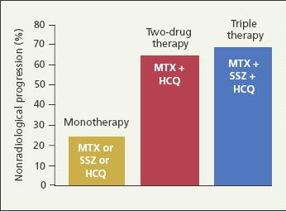
Clinical uses of Hydroxychloroquine
Has not been shown to delay radiographic progression of disease, so it is used for treatment of early, mild disease or as adjunctive therapy in combination with other DMARDs
Used in increasing methotrexate efficacy
* MIX = Methotrexate
**HCQ = Hydroxychloroquine
(to summarize, Hydroxychloroquine not show delay prognosis of RA which means it has weak effect, to make the effect strong we should add another DMARD drug to make combination can produce action, and this drug which we will add is methotrexate)
6 month response, mild anti-rheumatic effect.

Slide 10
Biologic disease modifier
Genetically engineered drugs that are used to modify imbalances of the immune system in autoimmune diseases.
The drugs work by:
Work as agents block
modify the activity of selected cells in the immune system
blocking cytokines, that send signals between those cells
The drugs are expensive
Classification of Biologic disease modifier (so important)
B-cell cytotoxic agent ( Rituximab)
The drugs are look like antibodies which will go to the B-cells and bind with the antigen on the surface of the B-cells, after the drug binds with the antigen it will destroy the B-cells
Anti-IL-6 receptor antibody (Tocilizumab)
The drug binds with the IL-6 receptors, so the IL-6 will not bind with the receptor, so no IL-6 effect
عشان تربطون بين اسم الدوا وطريقة شغله
TNF- blocking agents (Infliximab)
* The drugs look like antibodies which will bind with the TNF-α and inhibit this cytokines to produce its action (inflammation)
T-cell modulating drug ( Abatacept)
Its modulates the immune response by binding to CD80/CD86 on an antigen presenting cell (APC), such as a dendritic cell, thus preventing costimulatory binding to CD28 on naïve T-cell and attenuating T-cell activation.
عشان تربطون الحين طريقة الدوا إنه يأثر على T-Cells والدوا فيه T مرتين
ممكن ينقرأ كذا ابغى(Aba) تي (ta) سيل (cell)
عشان تربطون الطريقة هو يسوي cytotoxic للB-cell والدوا فيه حرف B من B-cell وحرف x من cytotoxic
ممكن نشوف اخر مقطعين باسم الدرق (ilizumab) الجزء الأول منهم يذكرني (il= IL-) والجزء الثاني عدد حروفه ست فيذكرني (6) مع بعض صاروا (IL-6)
عشان تربطون بين اسم التقسيم والدوا المثال عليه، اسم الدوا Infliximab وهو يسكر TNFتخيلوا أول حرف من اسم الدواT بدل Tفتصير كأنها TNF

Slide 11
The Mechanism of inhibiting TNF
In normal the TNF bind to its receptor on cell’s surface
The 1st mechanism of drug (infliximab) by acting as Antibody which prevent TNF from binding with its receptor.
Normally, there is a soluble TNF receptors which neutralize TNF.
The 2nd mechanism of drug (Etanercept) and buffer the effect of the TNF by acting such as our normal Soluble TNF receptor.
“ باختصار الموضوع هو ان عندي طريقتين عشان اثبط أو أمنعه انه يرتبط بالريسبتور حقه
إما عن طريق اجسام مضاده تمنعه ترتبط فيه قبل ما يرتبط بالريسبتور
او عن طريق درق يعمل كانه ريسبتور متحرك يشبه الموجود بجسمنا يروح ويرتبط معه بعيد عن سطح الخلية”

Slide 12
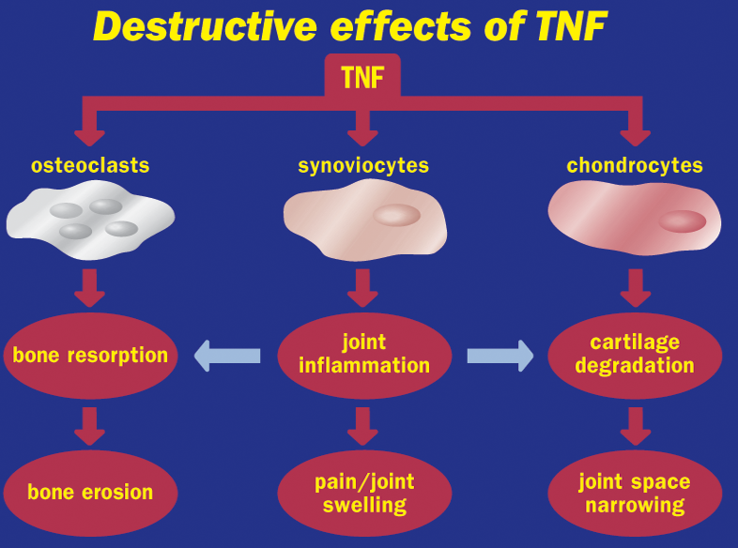
Role of TNF on joint destruction
TNF is cytokine produced from macrophage, in Rheumatoid Arthritis the TNF will stimulate:
this cell will cause bone resorption, and that will lead to bone erosion
synoviocytes: this cell will cause inflammation* in the joint (the synovial fluid of the joint) and as you know inflammation will cause pain and swelling
chondrocytes: this cell will cause degradation of the cartilage, so the cartilage gradually disappeared and that will lead to narrowing in the joint space
Joint inflammation cause bone resorption and
cartilage degradation

Slide 13
 | Infliximab (TNF-α blocking agents) | Tocilizumab (IL-6 blockers)
Definition | A chimeric IgG₁ monoclonal antibody (25% mouse, 75% human) | IL-6 is a proinflammatory cytokine implicated in the pathogenesis of RA With detrimental effects on both joint inflammation and cartilage damage
Mechanism of action | It complexes with soluble TNF-α (and possibly membrane- bound TNF-α)and prevents its interaction with the cell surface receptors. This results in down-regulation of macrophage and T-cell function | binds to membrane IL-6 receptors, blocking the activity of IL-6 in mediating signals that affect cytokine production, osteoclast activation
Route of administration | intravenous infusion with “induction” at 0, 2, and 6 weeks and maintenance every 8 weeks thereafter يعني بعد أول جرعة بأسبوعين أعطيه الدوا، ثم ست أسابيع ياخذه مره ثانيه ثم بعد ثمان أسابيع أعطيه الدوا، ثم خلاص يستمر ياخذه كل ثمان أسابيع | Intravenous (IV) monthly
Half-life | 9–12 days | dose-dependent (يعني حسب الجرعة اللي أعطيه المريض راح يتحدد العمر النصفي فهو مو ثابت)
Clinical uses | use in autoimmune disease like (RA, Ankylosing spondylitis, Crohn’s disease, ulcerative colitis) It may combined with methotrexate, hydroxychloroquine and other non biological DMARDs | As monotherapy: In adult has rheumatoid arthritis In children over 2 years with systemic juvenile arthritis | Combination with methotrexate or other non-biologic DMARDs: Patients with active rheumatoid arthritis not responding to TNF blockers or other biologic drugs
Side effects | Upper respiratory tract infections Activation of latent tuberculosis Infusion site reaction Headache Cough Increase the risk of skin cancers including melanoma | Infusion reactions (allergy reaction at site of infusion) Serious infections ( bacterial, tuberculosis ,fungal ) Increase in cholesterol level Neutropenia, and thrombocytopenia (reversible upon stopping the drug) Decrease in WBCs Increase in liver enzymes
Special features | This drug has chimeric IgG₁ monoclonal antibody so the body could reject it After intermittent administration by elicits human antichimeric antibodies in up to 62% of patients. To prevent the rejection we use the drug in Concurrent therapy with methotrexate | Drug interactions: IL-6 inhibits CYP450, and as you now Tocilizumab inhibit IL-6, so the drug restores the activity of the enzyme (essential for the metabolism of some drugs such as cyclosporine, warfarin). يعني يوقف شغل الأنزيمات اللي بالكبد والدوا هذا يوقف شغل فبالتالي ترجع الأنزيمات تشتغل، وهالشي يأثر على الأدوية اللي تحلل بالكبد
Mentoring |  | Blood tests monthly to see increase in cholesterol liver enzymes decrease in WBCs
IL-6
IL-6

Slide 14
SAQ
28 Female has Rheumatoid arthritis which is an autoimmune disease. She is unable to work due the sever pain and stiffness in her joints, especially her knee and interphalangeal joints. She also has systemic complication such as Amyloidosis.
Q1:What is the first-line DMARD and drug of choice to treat this patient ?
Methotrexate which known as “Gold standard” for DMARD therapy.
Q2:Under which class this drug is ?
Classical DMARDs.
Q3: What is the mechanism of action of this drugs as anti-Rheumatoid arthritis ?
For treatment for this disease we use low dose . It has three mechanisms of action :
Stimulating the adenosine release from cells, producing an anti-inflammatory effect.
Inhibition of T-Cells (cell-mediated immune reactions)
Inhibition of polymorphonuclear chemotaxis
Q4: In which case we can use the same drug but with high dose? Does it have the same previous mechanism ?
In cancer chemotherapy.
and the mechanism is different, it is act by Inhibiting dihydrofolate reductase which lead to reduces thymidine & purine synthesis therefore inhibiting DNA synthesis.
Q5:list some of pharmacokinetical aspect of this drug as anti-Rheumatoid arthritis? absorbed after oral administration / Metabolized to a less active hydroxylated product. /
Excreted principally in the urine, but up to 30% may be excreted in bile.
Q6: Is there any drug you suggest it to increase methotrexate efficacy ?
Yes we can use it with hydroxychloroquine.

Slide 15
SAQ
Q1: Infliximab which known as “Remicade” is one of the common anti-rhuamtoid drug, list other clinical uses of this drug ?
Ankylosing spondylitis / Crohn’s disease / ulcerative colitis.
Q2:Under which class this drug is ?
biologic DMARDs.
Q3: What is the mechanism of action of this drugs as anti-Rheumatoid arthritis ?
The drugs look like antibodies which will bind with the TNF-α or prevent its interaction with the cell surface receptors. This results in down-regulation of macrophage and T-cell function.
Q4:In which route of administration is usually given ?
Intravenous infusion (I.V)
Q5: Why in some cases we recommed the Concurrent therapy with methotrexate?
To decreases the prevalence of human anti-chimeric antibodies against this drug After intermittent administration.
Q6: List two of its ADRS ?
Upper respiratory tract infections.
Increase the risk of skin cancers— including melanoma.

Slide 16
SAQ
Q1:Why does the hydroxychloroquine have long half life ?
Due the extensively tissue-bound and protein-bound.
Q2 : What can we expect when we know that this drug (hydroxychloroquine) has extensively tissue-bound and protein-bound ?
Long half-life of up to 45 days.
Highly concentrated within cells → increases intracellular pH.
Q3:Bone marrow suppression & GI ulcerations are example of ADRS of Methotrexate, is there anything can we give the patient to reduse these effect?
Yes, the Folic acid reduces GI & bone marrow effects especially in the patient with cancer chemotherapy.

Slide 17
QUIZ

