Slide 1
Drugs in gout
Objectives:
Know the pathophysiology of gout
Outline the stages of gout and the therapeutic objectives in each stage
Describe drug and non-drug treatment of gout
Classify drugs used for treatment of gout
Identify the mechanism of action of drugs used for treatment of gout
Study in detail the pharmacology of drugs used for treatment of gout
ليس العار في أن نسقط، ولكنّ العار ألا نستطيع النّهوض
Doctor’s note

Slide 2
Over view of gout
What is gout?
Gout is usually characterized by recurrent attacks of acute inflammatory arthritis with red, tender, hot and swollen joints
Pathogenesis:
Deposits of sodium urate crystals in articular, periarticular, and subcutaneous tissues

Slide 3
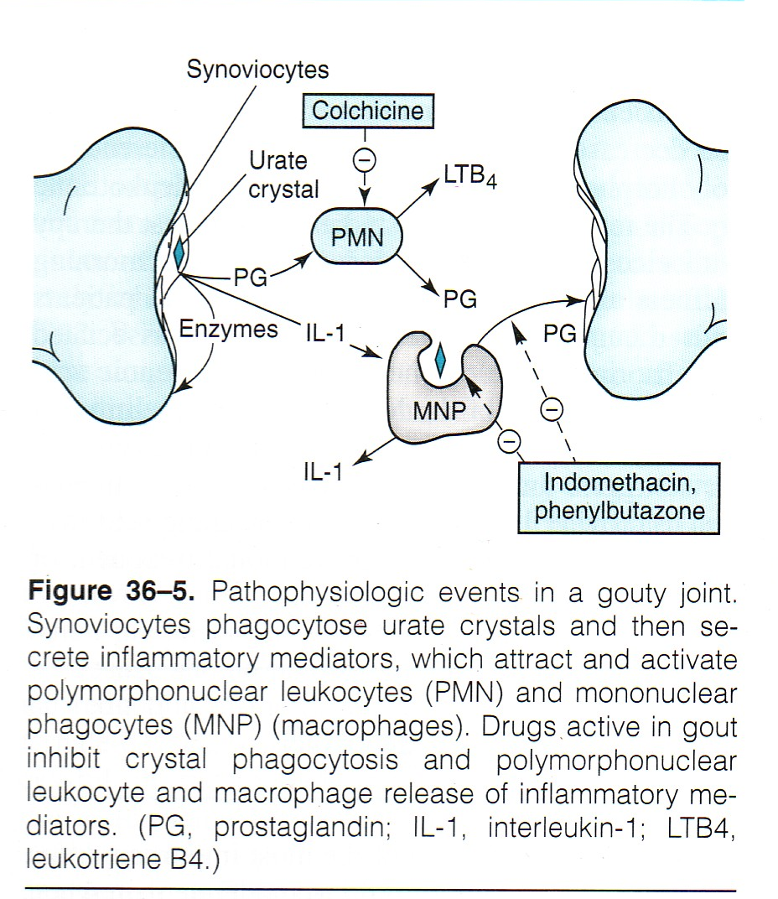
Continue
Epidemiology:
Gout was historically known as "the disease of kings" or "rich man's disease."
Prevalence of hyperuricemia 5%
Prevalence of gout 0.2%
Male to female ratio 10:1
Pathophysiology
The uric acid is a waste product formed from the degradation of purines(NB) through the purines degradation pathway.
Purines → xanthine uric acid
If there is abnormal production and/or execration of uric acid it will cause deposition of Monosodium Urate Crystals(MUC) in joints and this will initiate the inflammation and cause gout.
Xanthine oxidase

Slide 4
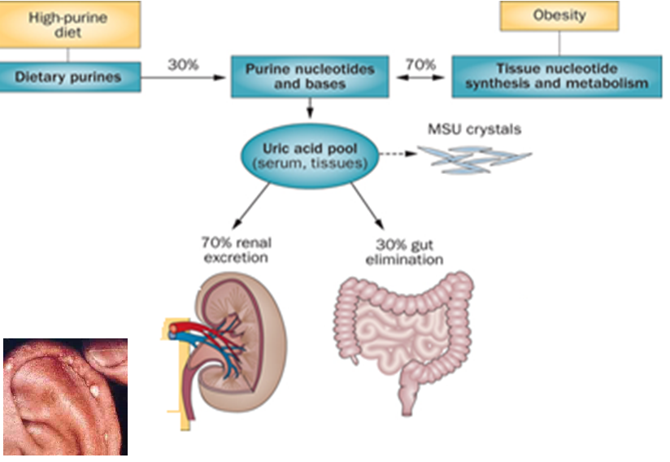
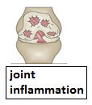
Summary about gout
Nephrolithiasis
Tofi

Slide 5
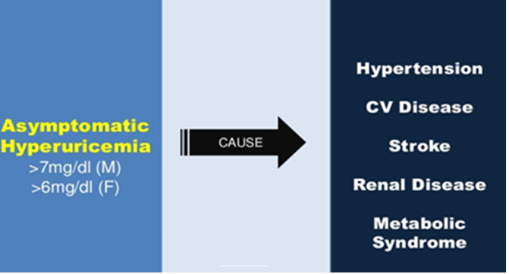
Stages of gout
Stages of gout
asymptomatic hyperuricemia
Intercritical stage
chronic gout
acute intermittent gout
Elevated serum urate with no clinical manifestation of gout
acute inflammation in joint caused by free urate crystals
Management :
Terminate the attack
The intervale between acute flares
Management :
Prevent recurrent attacks
Long-term gout complication
Management:
* Prevent complications
* Lower serum uric acid
In most cases diagnosis of gout is based on clinical presentation, which is quite characteristic: severe pain developing within hours, tenderness, warmth, swelling and erythema, e. g. in the first metatarsophalangeal or metacarpophalangeal joint. Frequently, gout flares up following rich meals and alcohol consumption, in the middle of the night.

Slide 6
Drugs in gout
Treatment of gout
Non-pharmacologic
Pharmacologic
Lifestyle modifications
Loss of weight
Exercise
Diet control
Smoking cessation
Uricostatic (Inhibition of uric acid synthesis)
Uricosuric (ncreasing uric acid execration)
Anti- inflammatory
Tubulin inhibitors
Allopurinol
Febuxostat
Probenecid
Sulfinpyrazone
NSAIDs
Steroids
Colchicine
Aim of pharmacotherapy:
Most therapeutic strategies for gout involve lowering the uric acid level below the saturation point (<6 mg/dL), thus preventing the deposition of urate crystals.
This can be accomplished by:
interfering with uric acid synthesis with allopurinol, Febuxostat
increasing uric acid excretion with probenecid or sulfinpyrazone
inhibiting leukocyte entry into the affected joint with colchicine
administration of NSAIDs

Slide 7
Treatment of acute gout
NSAIDS | NSAIDs are the most commonly used first-line treatment Head-to-head studies show few differences between drugs Full doses of NSAID should be initiated immediately and tapered after resolution of symptoms Should be avoid in: GI ulcer Bleeding or perforation Renal insufficiency Heart failure Use of oral anticoagulants
steroids | Corticosteroids are a good alternative where NSAIDs and colchicine cannot be used or in refractory cases Studies showed equal efficacy between corticosteroid and NSAIDs, with no reported side-effects with short-term use of corticosteroids In elderly people, patients with liver or hepatic impairment, IHD (ischemic heart disease ), PUD (Peptic ulcer disease), hypersensitivity to NSAIDs Route of administration : Intra articularly (preferred route if one or two joints affected) Orally Intramuscularly or intravenously.
Colchicine | Origin of this drug: Alkaloid obtained from autumn crocus The effect: Minimal effect on uric acid synthesis , excretion & is not analgesic | Mechanism: Inhibits cell division by: 1- Inhibits chemotactic factors 2- Inhibits inflamosomes & IL-1 production | Pharmacokinetics: Route of administration: orally Absorption: rapidly absorbed from the GI tract Half-life: Reaches peak plasma levels within 2 hours Rrecycling: in the bile Excretion: unchanged in the faeces or urine Should be avoid in : patients with a creatinine clearance of less than 50 mL/min | Clinical uses: 1- Treatment of gout flares 2- Prophylaxis of gout flares 3- Treatment of Mediterranean fever | Side effect: 1- abdominal: Diarrhea (sometimes severe), Nausea and Vomiting, Abdominal cramps, Dehydration 2- immune: Bone marrow depression 3- cardiac: Cardiac toxicity, arrhythmia, Vascular collapse, Hepatotoxicity , alopecia

Slide 8
Prevention of recurrent attack
Prevention of recurrent attack
Inhibition of uric acid synthesis
Uricosuric drugs (increasing uric acid execration)
Mamalian Uricase (convert uric acid to a more souble form)
Allopurinol
Febuxostat
Probenacid
Sulfinpyrazone
Pegloticase

Slide 9
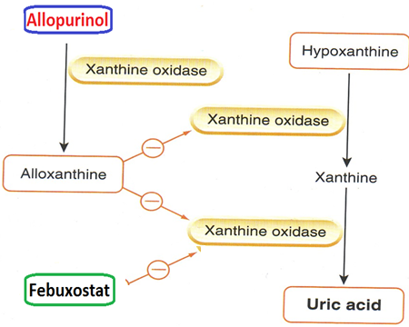
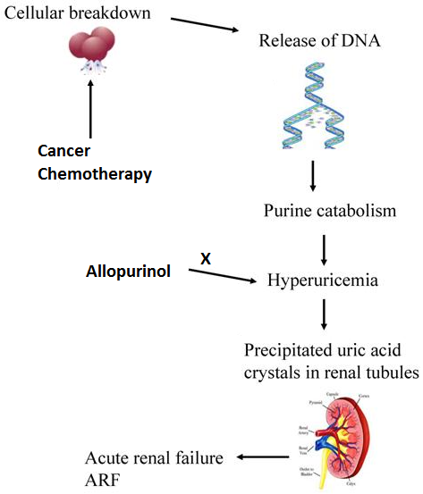
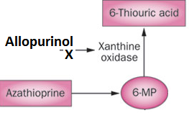
Inhibitors of uric acid synthesis
Mechanism of action: Inhibit xanthine oxidase
Pharmacokinetics:
Absorption: 70%
Protein binding: negligble 5%
Metabolism: Hepatic metabolism, 70% converted to active metabolite (oxypurinol) which eliminated unchanged in urine
ADRS (side effect):
1- Diarrhea, nausea, abnormal liver tests
2- Acute attacks of gout
3- Fever, rash, toxic epidermal necrolysis hepatotoxicity, marrow suppression vasculitis
4- DRESS syndrome (Drug Reaction, Eosinophilia, Systemic Symptoms)
5- 20% mortality rate
Allopurinol
Clinical uses:
Side effect:
Drug Interactions: Warfarin & dicumarol: inhibits their metabolism 6-mercaptopurine and azathioprine: Reduce their metabolism (so so imprtant) ampicillin : Increases frequency of skin rash
Management of hyperuricemia of gout
Uric acid stones or nephropathy
It is a drug of choice in patients with both gout & ischemic heart disease
Severe tophaceous deposits (uric acid deposits in tissues)
Management of hyperuricemia associated with chemotherapy
Prevention of recurrent calcium oxalate kidney stones
Metabolism: it is metabolized by xanthine oxidase into alloxanthine which is pharmacologically active
Allopurinol Hypersensitivity Syndrome
Xanthine Oxidase
Allopurinol
Oxypurinol
Aloxanthine
Toxic Epidermal Necrolysis
Dress Syndrome

Slide 10
Continue
Febuxostat
Clinical use: Indicated for the management of hyperuricemia in patients with gout (as it reduces serum uric acid levels) * Chemically distinct from allopurinol (non purine) * Can be used in patients with renal disease * Oral specific xanthine oxidase inhibitor
Pharmacokinetics: Route of administration: Given orally once daily Absorption: well absorbed (85%) Metabolism: Metabolized in liver , mainly conjugated to glucouronic acid Protein binding: 99% Half-life: (girl’s slide: 8 hours) , (boy’s slide: 4-18 hours) * Given to patients who do not tolerate allopurinol
ADRS (side effect): Increases number of gout attacks during the first few months of treatment Increases level of liver enzymes Nausea, Diarrhea Numbness of arm or leg Headache

Slide 11
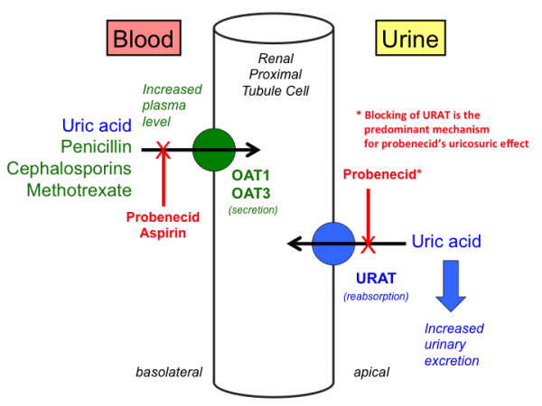
Uricosuric drugs
Uricosuric drugs
Effect: Control hyperuricemia and prevent tophus formation Probenecid moderately effective Increases risk of nephrolithiasis
* Some drugs reduce efficacy (e.g., aspirin)
Contra-indications: patients with renal disease History of nephrolithiasis Recent acute gout Less effective in elderly patients
Probenecid ADRS (side effect): Exacerbation of acute attack Risk of uric acid stone GIT upset Allergic rash | Sulfinpyrazone: Can aggravate peptic ulcer disease Aspirin reduces efficacy of sulfinpyrazone enhance the action of certain anti-diabetic drugs
Mechanism:
Blocks tubular reabsorption of uric acid &
enhances urine uric acid excretion
Probenecid inhibits Urate Transporters (URAT1) in the apical membrane of the proximal tubule
It also inhibits organic acid transporter(OAT)→↑plasma concentration of penicilin
Sulfinpyrazol inhibits URAT1 & OAT4

Slide 12
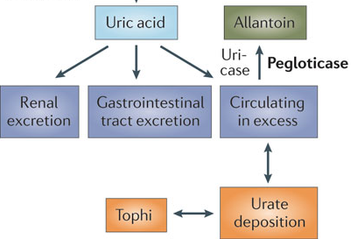
Recombinant mammalian uricase
Pegloticase
Clinical use: Used for the treatment of chronic gout in adult patients refractory to conventional therapy
Route of administration: IV
Half-life: peak decline in uric acid level within 24-72 hours
ADRS (side effect): Infusion reactions Anaphylaxis Gout flare Arthralgia (arthra: joints, algia: pain) Muscle spasm Nephrolithiasis
Mechanism of action:
A uric acid specific enzyme which is a recombinant modified mammalian uricase enzyme
enzymatically convert urate to allantoin, which is more soluble and readily excreted in the urine
allantoin
كانها الن تلينين فتلين وتصير سايلة وتطلع من الجسم

Slide 13
Treatment of gout
Treatment of gout
Non-pharmacologic
Pharmacologic
Lifestyle modifications
Loss of weight
Exercise
Diet control
Smoking cessation
Anti- inflammatory
Inhibition of uric acid synthesis
Allopurinol
Febuxostat
NSAIDs
Steroids
Prevnstion of recurrent attacks
Treat of acute gout
Colchicine
Corticosteroids
Uricosuric drugs
Mamalian Uricase
Probenacid
Sulfinpyrazone
Pegloticase

Slide 14
435 team
Summery of drugs in gout Treatment of acute gouty arthritis
Drug | Mechanism |  |  |  |  | Contraindications, ADRs , uses
 | most commonly used first-line treatment Full doses of NSAID should be initiated immediately and tapered after resolution of symptoms . |  |  |  | ADRs GI ulcer, Bleeding or perforation, Renal insufficiency, Heart failure, Use of oral anticoagulant.
Steroids (Corticoste roid) | Pharmacokinetics It can be given orally, IV, IM, or Intra- articularly . Has equal Efficacy with NSAIDs if the steroidal drugs used for a short period. |  |  |  | Used when NSAIDs are contraindicated or not tolerated. such as elderly people, patients with kidney or hepatic impairment, IHD, PUD.
 | Natural product, obtained from autumn crocus. It was the first line of treatment of gout, but because it causes severe diarrhea, it limits its usage. It inhibits cell division, chemotactic factors, inflamosomes & IL-1 production. Pharmacokinetics: Given orally, Reaches peak plasma levels within 2 hours, Drug undergo enterohepatic recycling and is excreted unchanged in the feces or urine. |  |  |  | Uses: Treatment of gout flares Prophylaxis of gout flares. Treatment of Mediterranean fever Contraindications: renal impairment ADRs Diarrhea, Nausea, Vomiting, Alopecia, Abdominal cramps , Dehydration Bone marrow depression, Cardiac toxicity ,Arrhythmia Vascular collapse Hepatotoxicity
Prevention of gout recurrent attacks
Drug | Overview and Clinical uses |  |  | ADRS |  | Pharmacokinetics
 | Uricostatic drugs (inhibit uric acid synthesis by inhibiting xanthine oxidase )
Allopurinol (purine) | Management of hyperuricemia of gout (especially associated with chemotherapy) Uric acid stones or nephropathy It is a drug of choice in patients with both gout & ischemic heart disease Severe tophaceous deposits Prevention of recurrent calcium oxalate kidney stones has a cardioprotective effect. |  | Diarrhea, nausea, abnormal liver tests Acute attacks of gout Fever, rash, toxic epidermal necrolysis, hepatotoxicity, marrow suppression, vasculitis DRESS syndrome 20% mortality rate |  |  | Drug Interactions ↑Warfarin , dicumarol & 6-mercaptopurine and azathioprine With ampicillin : Increases frequency of skin rash Absorption 70% Protein binding negligible ,5%. Hepatic metabolism, 70% metabolized by xanthine oxidase into alloxanthine (oxyourinol) which is pharmacologically active. eliminated unchanged in urine.
Febuxostat (non purine) more efficacious | Indicated for the chronic management of hyperuricemia in patients with gout can be used in patients with renal disease |  | ↑ gout attacks during the first few months of treatment ↑ liver enzymes Nausea, Diarrhea Headache Numbness of arm or leg |  |  | Given orally once daily, well absorbed(85%) Metabolized in liver , mainly conjugated to glucuronic acid Given to patients who do not tolerate allopurinol. 99% protein bound • t½ = 8h
 | Uricosuric drugs (increase uric acid excretion by Blocking tubular reabsorption)
 | Clinical use: Control hyperuricemia and prevent tophus formation
 | ADRs: GIT upset, Exacerbation of acute attack, nephrolithiasis, Allergic rash. |  |  | Contraindications: History of nephrolithiasis, Recent acute gout, Existing renal disease, Less effective in elderly patients.
 | ADRs can aggravate peptic ulcer disease Increase risk of nephrolithiasis. Not used in patients with renal disease |  |  | Drug Interactions: Aspirin reduces efficacy of sulfinpyrazone enhance the action of certain antidiabetic drugs.
 | Recombinant Mammalian uricase
 | Used for the treatment of chronic gout in adult patients refractory (resistant) to conventional urate- lowering therapy. | ADRs Infusion reactions, Anaphylaxis, Gout flare, Arthralgia, Muscle spasm, Nephrolithiasis |  |  |  | Pharmacokinetics Converts uric acid to allantoin, which is more soluble and readily excreted in the urine. When Given by I.V, they produce peak decline in uric acid level within 24-72 hours

Slide 15
SAQ
A patient suffering from GOUT came to the hospital with extreme fatigue shortness of breath, he was later diagnosed with ischemic heart disease.
Q1: what is the recommended drug for his case ?
Allopurinol
Q2:Explain the mechanism of the used drug ?
Inhibit xanthine oxidase (act as Uricostatic drugs).
Q3: How is it metabolized and what its metabolite ?
It is metabolized by xanthine oxidase into alloxanthine which is pharmacologicaly active.
Q4: In which stage we can use this drug and what is the aim ?
Intercritical stage (Between Acute flares) to Prevent recurrent attacks.
Q5: Name a drug that could interact with it, and the resulted effect ?
Warfarin & dicumarol → inhibits their metabolism
Azathioprine → Reduce the metabolism
Ampicillin → Increases frequency of skin rash
Q6:Give other clinical use for this drug :
Management of hyperuricemia associated with chemotherapy.
Q7: Give 2 adverse effects of the drug ?
Toxic epidermal necrolysis
DRESS syndrome (Drug Reaction, Eosinophilia ,Systemic Symptoms)

Slide 16
SAQ
A 76-year- old patient went to the hospital, with a history of acute renal failure, after few examinations,his uric acid level was above 6mg/dL.
Q1: What is the possible drugs that this patient can take?
Febuxostat
Q2 : What is the mechanism of action for the mentioned drug ?
Inhibit xanthine oxidase (act as Uricostatic drugs).
Q3: List two Anti-gout drugs we can not use it in this case (with patient with renal disease)?
Colchicine / Uricosuric drugs such as Probenacid & Sulfinpyrazone
A 55 lady with Acute gout came to the hospital with sever Diarrhea and Abdominal cramps. After taking her history we found that She in medication with Colchicine.
Q1 : What is the mechanism of action for the Colchicine as anti-gout drug ?
Binds to microtubules in neutrophils
Inhibits cell division
Inhibits chemotactic factors
Inhibits inflamosomes & IL-1 production
Q2: In which stage we can use this drug and what is the aim ?
Acute Falre of gout (during the attack) to Terminate the attack by inhibiting leukocyte entry.
Q3: Sever Diarrhea and Abdominal cramps are examples of ADRs for this drug. List three more ?
Nausea & Vomiting
Bone marrow depression
Hepatotoxicity
Cardiac toxicity, arrhythmia

Slide 17
QUIZ
تم بحمد الله ❤✌

