Slide 1
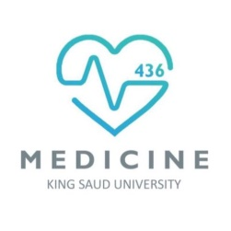
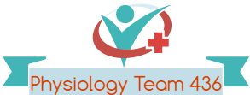
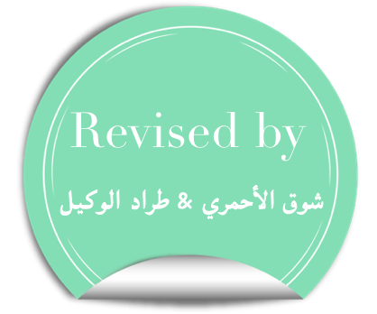
Physiology of Bone
Red: very important.
Green: Doctor’s notes.
Yellow: numbers.
Gray: notes and explanation.
Physiology Team 436 – Musculoskeletal Block Lecture 1
Lecture: If work is intended for initial studying.
Review: If work is intended for revision.

Slide 2
Objectives
Define bone (slide3) and differentiate cortical & trabecular bone (sites and function of each). (slide 5,8)
State the normal levels and forms of ca++ in the ECF and its relation to PO4. (slide 9)
Identify the bone cells and the function of each. (slide 9)
Define bone remodelling and explain the mechanism of bone formation. (slide 16,17)
Define osteoporosis. (slide 26,27)
Discuss the effect of different hormones on bone physiology. (slide 21-25)

Slide 3
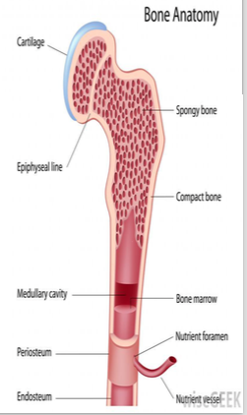
Physiology of Bone
Bone is a special form of connective tissue.
It is well vascularized with total blood flow of 200–400 mL/min in adult humans.
The epiphyseal plate : it is a plate of actively proliferating cartilage, it separates the ends (epiphysis) from the shaft of a long bone.
This separation allows linear bone growth.
Growth ceases (stops) after the epiphyses unite with the shaft (epiphyseal closure).
* in adult who stopped growing the epiphyseal plate replaced with epiphyseal line

Slide 4
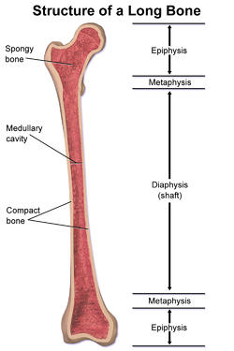
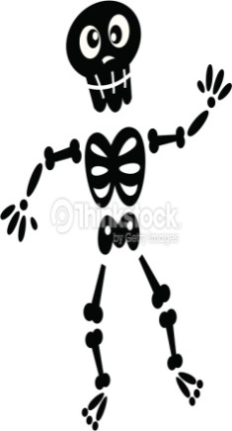
Functions of Bone:
Types and structure of bone:
Types of bones
1- compact (cortical) 80%
2- spongy (trabecular) 20%
1- Homeostasis of Ca++ and PO4.
2- Protects vital organs.
3- Permits locomotion and support against gravity.
4- Formation of blood cells in the bone marrow.
5- Reservoir for calcium & phosphate.

Slide 5
1- Compact Bone (Cortical Bone) 80%
Site: in the outer layer of most bones, where there cells lie in lacunae (gaps).
Function: 80% of the body bone, it has high resistance to bending and torsion.
Compact bone has more bone tissue and less bone space.
Compact bone cells receive nutrients by way of canaliculi (a small channel or duct) from Haversian canals vessels.

Slide 6
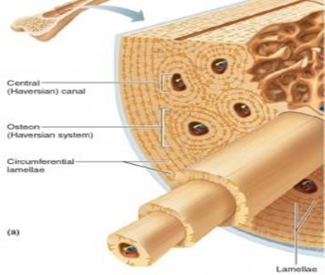
Haversian System (Osteons)
Compact bone is formed of Haversian systems (Osteons)
Osteons or Haversian systems are overlapping circular structures (formations)
Each osteon has a central canal called Osteonic Canal or Haversian Canal
The Osteonic Canal contains : blood vessels ( capillaries, arterioles, venules ), nerves and lymphatic's.
Between Haversian systems are concentric layers of mineralized bone called interstitial lamellae
Collagen is arranged in concentric layers, around the Haversian canals forming cylinders called osteons or Haversian systems.
للتوضيح :
- لدينا تركيب يسمى osteon وهو عبارة عن دوائر متداخلة وبأخر دائرة توجد قناة تسمى osteonic canal هذة القناة يوجد بها الأوعية الدموية.
- الcompact Bone يتكون من أكثر من الosteons متجاورة فنسمي -هذا التجمع – أو النظام ب Haversian System
- هذا النظام لا يوجد إلا بالcompact Bone وهو ما يعطيه الصلابة
Haversian system is the fundamental functional unit of much compact bone.

Slide 7
Extra Notes “compact bone”
From 435

Slide 8
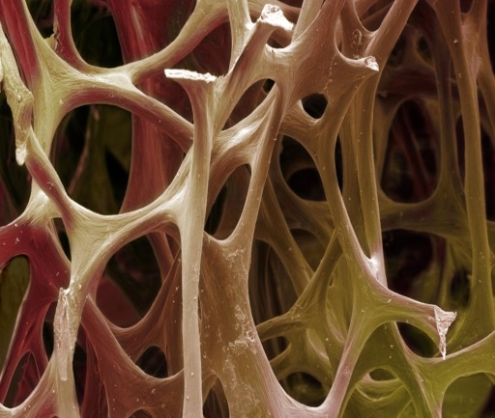
2- Spongy Bone (Trabecular Bone) 20%
Site : inside the cortical bone .
Though it represents only 20% of the skeletal mass, it has 5 times greater surface area than cortical bone.
Function : Because of its large surface, it has faster turnover rate than cortical bone; hence it is more important than cortical bone in terms of calcium turnover.
made up of spicules or plates.
Nutrients diffuse from extracellular fluid (ECF) of bone, into the trabeculae.
The center of the bone contains red, yellow marrow, bone cells and other tissues.
Remember : compact bone Is forming the OUTSIDE layers of Bones, while the spongy forms the INSIDE layers of the bones.
Compared to cortical bone , it is: (1) less dense, (2) more elastic and (3) has a higher turnover rate than compact bone.
Calcium turnover:
حركة الكالسيوم من العظم للدم والعكس
NOTE : ال compact Bone يشكل 80% من عظام الجسم كلها ولكن الspongy bone يشكل 80% من العظم الواحد فيأخذ مساحة أكبر بالعظم الواحد ، غالباً يكون الجزء الأكبر من الFLAT BONES ولهذا السبب لها مساحة كبيرة.

Slide 9
Composition of Compact Bone (Cortical Bone)
Bone Cells: | Matrix:
Osteoblasts: immature bone forming cells that: Secrete collagen -> forming a matrix around themselves -> which then calcifies. Then when the bone forming cells are surrounded by calcified matrix they are called osteocytes. - Function: regulating Ca and Phosphate concentration in bone fluid. | 1) Organic matrix: 30% (contains carbon ) A- Collagen fibers Type I (90-95%): extend along the lines of tensional force to give the bone its tensile strength. (more in next slide) B- Ground substance 5-10% of ECF and Proteoglycans (chondroitin sulphate and hayluronic acid).
2) Osteocytes: are mature osteoblasts surrounded by calcified matrix. (more explanation in next slide) They send processes into the canaliculi that ramify throughout the bone. | 2) Bone salts: 70% (Inorganic) Crystalline salts of Ca++ & PO4 (Hydroxyapatite). The ratio of Ca/P ratio is 1.5 – 2. - Other secondary components: Mg+, Na+, K+, Carbonate ions Exception: Newly formed bones have a higher percentage of matrix (collagen) in relation to salts.
3) Osteoclasts: multinuclear cells Function : that erode and resorb previously formed bone, by phagocytosis and digesting it in their cytoplasm.
Ratio is 1.3 – 2 in boys slide .

Slide 10
Mechanism of Bone Calcification
Osteoblasts: secrete collagen (monomers) and ground substance (proteoglycans).
The collagen monomers polymerize to collagen fibers.
The resultant tissue becomes osteoid, a cartilage-like material.
It differs from cartilage in that calcium salts readily precipitate in it. (has ability to be calcified).
After the osteoid is formed, calcium salts begin to precipitate on the collagen fibers forming the hydroxyapatite crystals.
Osteoblasts become entrapped in the osteoid and are now called osteocytes.
*للتوضيح : الosteoblast في النسيج العظمي تفرز حول نفسها collagen بعدها راح يصير في النسيج collagen fibers وعندها يسمى هذا النسيج ب osteoid ، ثم يبدأ الكالسيوم بالترسب والأرتباط بالكولاجين مما يكون hydroxyapatite crystals .
حين تنتهي هذة العملية يكون قد تكون حول الostoblast الosteoid فتنتهي مهمتها فتتحول للInactive form اللي هو الosteocytes

Slide 11
Tensile and Compressional Strength of Bone
1) Collagen Fibers like those of tendons have great tensile strength.
2) Calcium salts have great compressional strength.
These combined properties plus the degree of bondage between collagen and crystals provide the bony structure that has the tensile and compressional strength.
هذه الصورة تخص السلايد اللي قبل.
N.B: hydroxyapatite crystals fail to be formed in normal tissues except in bone, despite the high levels of Ca & P ions, due to the presence of an inhibitor of precipitation called pyrophosphate.
للتوضيح: لماذا لا يتكون ال hydroxyapatite crystalsفي الأنسجة الأخرى غير العظام ؟ مع الرغم من وجود الكولاجين والكالسيوم فيهم ؟ لأن الأنسجة الأخرى تحتوي على مثبط لأرتباط الكالسيوم بالكولاجين يسمى ب pyrophosphate

Slide 12
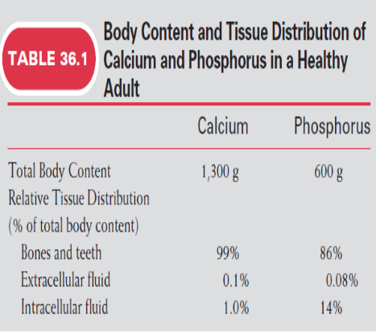
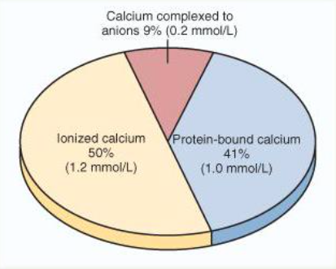
Calcium Levels
Body Calcium Levels:
نسبته في الجسم ككُل
1.5% of body weight
1100 to 1300 grams
Calcium Levels:
Intracellular calcium
99% is in the skeleton.
ECF calcium:
Plasma calcium level : (9 -11 mg/dl)
Average: 9.4 mg/dl
59% (diffusible) = ionized + Complexed
41% (non diffusible) = protein bound
Calcium complexed anions:
ولكن لا يدخل في diffusibleيكون
metabolic or biologic reactions.
Anions
EX :(PO4 , CO2)
Ionized calcium :
و يدخل في diffusibleيكون
metabolic or biologic reactions
Ex:blood coagulation or muscle contraction.
Protein-bound calcium :
diffusibleوليس Boundيكون
Metabolic reactionولا يدخل في
ولكنه يكون مثل المخزن للكالسيوم .

Slide 13
Calcium Homeostasis in Human Body
Calcium enters our bodies from food then it is absorbed in the intestine to the ECF . It will either be deposited in the bone or in the cells; the excess is going to be excreted by the kidney
There is an exchange of Ca between the structures which is responsible for Ca homeostasis.
NOTE: No calcium = No blood coagulation
Ca intake
(1.5 gram/day)
From food
Helpful vid click here

Slide 14
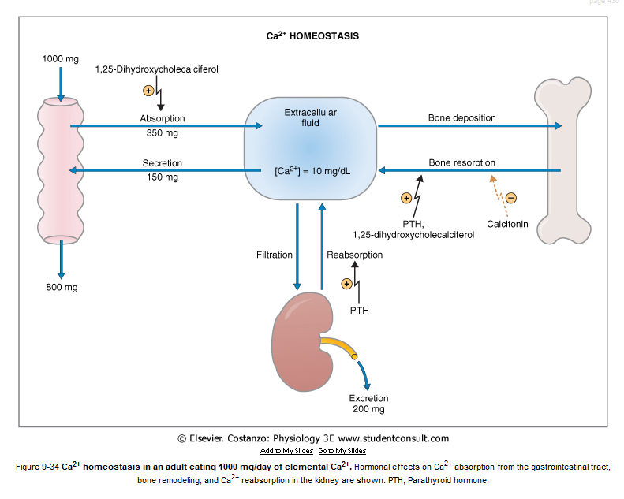
Serum Calcium and Phosphate
Calcium and phosphate in the body react in opposite ways : as blood calcium levels rise, phosphate levels fall and vice versa
إذا زاد الكالسيوم يقل الفسفور و العكس بحيث أن مجموعهم يكون ثابت ( علاقة عكسية)

Slide 15
Exchangeable Calcium
The bone contains a type of exchangeable calcium that is always in equilibrium with the Ca++ ions in the ECF .
Calcium Exchange Between Bone and ECF.
Normally,its amount is about ( 0.4-1%) of the total bone calcium
This calcium is a form of readily mobilizable salt such as CaHPO4 and other amorphous calcium salts يعني يقدر انه يطلع من العظم بسهولة
The importance of exchangeable calcium is that it provides a rapid buffering mechanism to keep the Ca++ ions concentration in ECF from rising to excessive levels or falling to very low levels under transient conditions of excess or decreased availability of calcium.
أهمية الExchangeable calcium أنه بمجرد إنخفاض تركيز الكالسيوم في الجسم الدم يتحرر من العظم ويرفع مستوى الكالسوم، والعكس صحيح فعد إرتفاع الكالسيوم في الدم علطول يرجع يرتبط بالعظم .

Slide 16
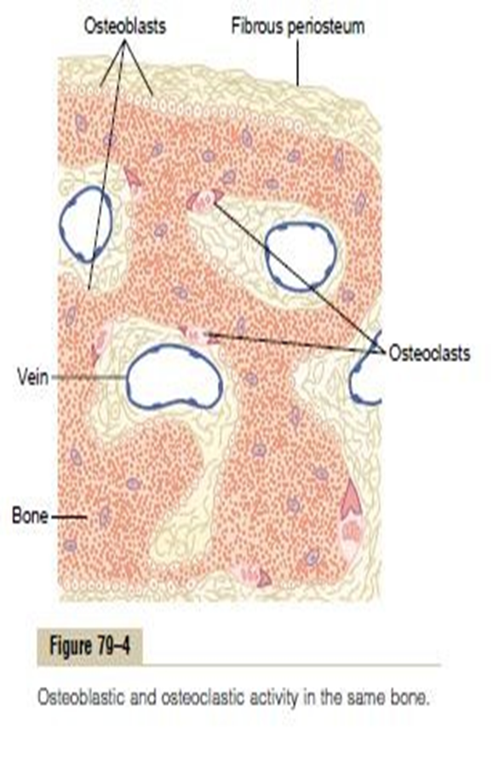
Deposition and Absorption of Bone (Bone Remodeling)
Osteoblasts are found on the outer surfaces of the bones and in the bone cavities.
A small amount of osteoblastic activity occurs on about 4% of all bone surfaces at any given time in an adult, so that at least some new bone is being formed constantly .(باستمرار)
The renewal rate is about 4% per year for compact bone and 20% per year for trabecular bone.
Bone is continually deposited by osteoblasts
Absorbed where osteoclasts are active

Slide 17
Bone Absorption or Resorption
Osteoclasts are large phagocytic multinucleated cells,
They are normally active on less than 1% of the bone surface of an adult
The shape of the bone can be rearranged for proper support of mechanical forces by deposition and absorption of bone in accordance with stress patterns.
The osteoclasts secrete two types of substances:
1-proteolytic enzymes from the lysosomes
2-several acids from the mitochondria and secretory vesicles.
The enzymes dissolve the organic matrix, and the acids cause solution of the bone salts.
The osteoclastic cells also phagocytose minute particles of bone matrix and crystals, dissoluting them and releasing products (like: Ca) into the blood.

Slide 18
Value of Continual Bone Remodeling(أهمية إعادة تشكيل العظم)
old bone becomes relatively brittle(هش) and weak; therefore, new organic matrix is needed as the old organic matrix degenerates . In this manner, the normal toughness(المتانة) of bone is maintained.
The shape of the bone can be rearranged for proper support of mechanical forces by deposition and absorption of bone in accordance with stress patterns
Video
Bone adjusts its strength in proportion to the degree of bone stress and it thickens when subjected to heavy loads.
Therefore, the bones of children are less brittle in comparison with the bones of the elderly, due to more remodeling in children.
عشان كذا الناس اللي تبذل مجهود أكبر و تشيل أشياء ثقيلة و تمشي أكثر تكون العظام عندهم أقوى

Slide 19
Control of the Rate of Bone Deposition by Bone “Stress”
stressكل ما زاد ال
Bone depositionيزيد
و راح يكون العظم اثقل
Bone is deposited in proportion to the load that it must carry.
Continual physical stress stimulates osteoblastic deposition and calcification of bone.
The bones of athletes become considerably heavier than those of no athletes. Also, the bone of the leg in the cast becomes thin and up to 30 % decalcified within a few weeks.
Bone stress also determines the shape of bones under certain circumstances. (e.g. Healing of fractures may start angulated in children then become straight).
وجدوا ان الأطفال اول ما يحصل لهم كسر ممكن الهيلينق للعظم يكون على هيئة انقل يعني ما يكون سترايت ولكن مع مرور الوقت يكون الطفل يمشي على رجله المكسوره فراح يبدأ ال يسوي في هذي الأنقل مما يخليها ترجع سترايت و طبيعية .
remodeling
Deposition

Slide 20
Repair of a Fracture Activates Osteoblasts
Fracture
Large numbers of new osteoblasts are formed from osteoprogenitor cells
followed shortly by the deposition of calcium salts.
(انتفاخ) Shortly a large bulge
of osteoblastic tissue and new organic bone matrix, develops between the two broken ends of the bone
-Fracture of a bone activates all the periosteal and intraosseous osteoblasts involved in the break.
-osteoprogenitor cells, which are bone stem cells in the surface tissue lining bone, called the “bone membrane”.
This is called a callus.
Periosteum: is a membrane that covers the outer surface of all bones

Slide 21
Hormonal Control of Calcium Metabolism & Physiology of Bone
Three major hormones
1, 25 dihydroxycholecalciferol
Parathyroid hormone (PTH)
Calcitonin
a steroid hormone formed from Vitamin D.
secreted by parathyroid gland
secreted by c-cells in the thyroid gland.
How the parathyroid hormone affects remodeling is explained later
How Calcitonin works is explained later
To a lesser extent ; Glucocorticoids, GH, estrogens & various growth factors also affect Calcium Metabolism.

Slide 22
If the Ca level in blood is high the thyroid gland will release calcitonin which will stimulate the Ca deposition in bone and reduce Ca uptake in kidney.
If the Ca level in blood is low the parathyroid gland will release PTH which will stimulate Ca release from bone and increase Ca uptake in kidney and increase Ca uptake in intestines .

Slide 23
Vitamin D

Slide 24
Parathyroid Hormone (PTH)
how does the parathyroid hormone affect remodeling ?
1) Increase absorption of ca++ in intestine.
2) Increase absorption of ca++ in kidney.
3) Stop phosphate absorption
4) Stimulate the kidney to produce 1,25 dihydroxycholecalciferol 5) In bone increase formation & activation of osteoclast which resorption to the bone and release ca++ to blood.

Slide 25
Calcitonin Hormone
How does Calcitonin work ?
Inhibit absorption of ca++ in intestine. 2)Inhibit absorption of ca++ in kidney.
3) Activate osteoblast to increase the ca++ inside the bone.

Slide 26
Osteoporosis
Osteoporosis means : reduced bone density and mass.
Caused by a relative excess of osteoclastic function. Bone matrix and mineral are both lost.
Loss of bone mass is due to :
Lack of physical stress
Malnutrition, lack of vitamin C
Old age, Postmenopausal lack of estrogen
Cushing’s syndrome.

Slide 27
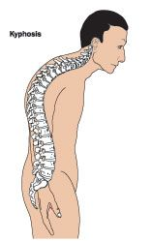
Complications of Osteoporosis
27
The incidence of fractures is increased particularly in the distal forearm (Colle’s fracture), vertebral body, and hip. These areas have a high content of trabecular bone, which is more active metabolically, and is lost more rapidly.
Fractures of the vertebrae with kyphosis produces “widow’s hump” in elderly women with osteoporosis.
Fractures of the hip in elderly are associated with a mortality rate of 12–20%, half of those who survive require prolonged expensive care.
Prevention (may help prevent or slow the progress of osteoporosis):
Increased intake of calcium.
Moderate exercise.

Slide 28
Extra Slide: (Answer to one of Dr. Samy Azer’s questions regarding: Rank Ligand (RANKL) and Osteoprotegerin (OPG))
Question:
To understand:
Ligand: is a small molecule that binds with a larger protein molecule;
For example: an extracellular chemical messenger binding with a plasma membrane receptor.
Special thanks to Leena Alwakeel!

Slide 29
Link to Editing File (Please be sure to check this file frequently for any edits or updates on all of our lectures.)
Quiz
https://www.onlineexambuilder.com/bone-physiology/exam-116528
References:
Girls’ and boys’ slides.
Guyton and Hall Textbook of Medical Physiology (Thirteenth Edition.)

Slide 30
Thank you!
اعمل لترسم بسمة، اعمل لتمسح دمعة، اعمل و أنت تعلم أن الله لا يضيع أجر من أحسن عملا.
The Physiology 436 Team:
Rana Barassain
Alaa Alaqeel Laila Mathkour
Buthaina Almajed
Leena Alwakeel
Wateen alhamoud
Shoag Albugami
Waled Al-askah
Mohammed Alayed
Mohammad almutlaq
Team Leaders:
Qaiss Almuhaideb
Lulwah Alshiha
Contact us:
Physiology436@gmail.com
@Physiology436

