Slide 1
Action Potential of The Excitable Tissues (Nerves + Muscles)
Red: very important.
Green: Doctor’s notes.
Yellow: numbers.
Gray: notes and explanation.
Physiology Team 436 – Musculoskeletal Block Lectures 2 + 3
Lecture: If work is intended for initial studying.
Review: If work is intended for revision.

Slide 2
Objectives
Discuss the resting membrane potential and its genesis.
Know the ionic channels involved in resting membrane potential.
Describe the function Na+-K+ pump and the stages of action potential.
Explain the threshold Potential, local Response and action Potentials.
Describe the electrical changes in membrane potential during the action potential, their chemical bases and excitability changes.
Describe conduction along nerve fibers, role of myelination and how nerve fibers are classified.

Slide 3
Basic Physics of Membrane Potentials
Membrane potentials caused by ion concentration
Differences across a selectively permeable membrane:
The potassium concentration is great inside a nerve fiber membrane but very low outside the membrane. Because of the large potassium concertation gradient from inside toward outside, there is a tendency for extra numbers of potassium ions to diffuse outward through the membrane. When they do, they carry positive charge to the outside. Thus, creating negativity inside because of negative anions (proteins,
sulphate, phosphate ions, large molecules) cannot leave the cell. that remained behind and DO NOT diffuse outward with the potassium.
(remember: diffusion from high concentration → low concentration.)
The Nernst equation describes the relation of diffusion potential to the ion concentration across a membrane: we will later apply this in resting membrane potential. The Nernst equation has a physiological application when used to calculate the potential of an ion of charge z across a membrane.
The Goldman Equation is used to calculate the diffusion potential when the membrane is permeable to several ions
EMF= electromotive force. Z= electrical charge of an ion
ONLY IN MALES’ SLIDES

Slide 4
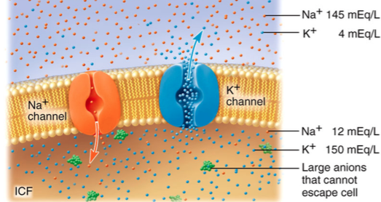
Resting Membrane Potential of Nerves (RMP):
Transport properties of the resting nerve membrane for sodium and potassium:
Sodium-Potassium pump (active transport)
K+ Leak Channels:
RMP: it is the potential difference across the cell membrane during rest, without stimulation between the inner side and the outer side, and it is relatively –ve inside.
Measurement of RMP: using voltmeter
Normal Values : -70 in medium sized nerves and -90 mv in large nerve fibers. (inside the fiber is 90 times more negative)
During rest, the membrane is polarized (the membrane is a wall between the positive outside and negative inside)
There is high molecules of K+ inside the cell and high molecules of Na+ outside the cell.
Potential: difference in charge across plasma membrane.
Current: flow of charge (ions) from one point to another.

Slide 5
Causes (Origin) of Resting Membrane Potential (RMP):
The important factors in the establishment of the normal resting membrane potential of -90 millivolts.
1- Contribution of K+ diffusion potential:-
The cell membrane has tendency to pump potassium (K) (positive charge) out, from high to low, (outflux), causing –ve charge inside, through K leak channels, down its concentration gradient.
(producing energy like Niagara falls, from high to low which gives energy to Canada)
Result: Electro-positivity outside and electro-negativity inside.
RMP is 100 times more permeable to K+ than Na+. (These K+ leak channels may also leak sodium ions slightly but are far more permeable to potassium than sodium)
K diffusion contributes far more to resting membrane potential. (most important) ركز عليها الدكتور
2- Contribution of Na diffusion through the nerve membrane:
Very small amount of Na+ diffuses into the cell (from outside to inside) down its concentration gradient.
The membrane is only slightly permeable to Na+ through K-Na leak channels.
w
3- Contribution of the Na+-K+ pump:
This is a powerful electrogenic pump on the cell membrane.
maintains concentration gradients of K+ and Na+ between the two sides of the membrane.
It pumps 3 Na+ to outside & 2 K+ to inside, causing a net loss of +Ve ions from inside, returning the nerve fibre to the resting state (-4 mV).
Remember: Non-diffusible anions (proteins, sulphate, phosphate ions, large molecules) cannot leave the cell. Therefore, they also contribute to the negativity

Slide 6
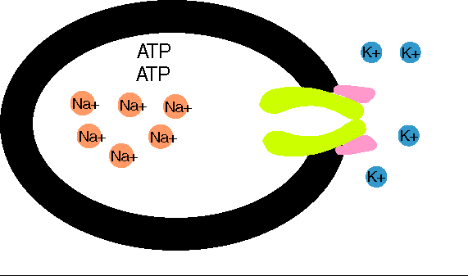
Cont.: Origin of the Normal Resting Membrane Potential
Establishment of resting membrane potentials in nerve fibers under three conditions:
When the membrane potential is caused entirely by K+ diffusion: EMF of K+= -94 mV
When the membrane potential is caused by diffusion of both Na+ & K+ = -86 mV
When membrane potential is caused by diffusion of both Na+ & k+ AND Electrogenic Na+/K+ pump = -90 mV
How did we get this value? Using the Goldman equation:
E.M.F of K+ = -94 millivolts.
E.M.F of Na+ = +61 mV. (that’s why the membrane is SLIGHTLY permeable to Na+)
Using this value in the Goldman equation gives a potential inside the membrane of −86 millivolts.
So the NET MEMBRANE POTENTIAL would be:-
Diffusion potential (caused by K+ & Na+ diffusion) + Electrogenic Na+/K+ pump
(-86 mV ) + (- 4mV) = -90 mV
ONLY IN MALES’ SLIDES

Slide 7
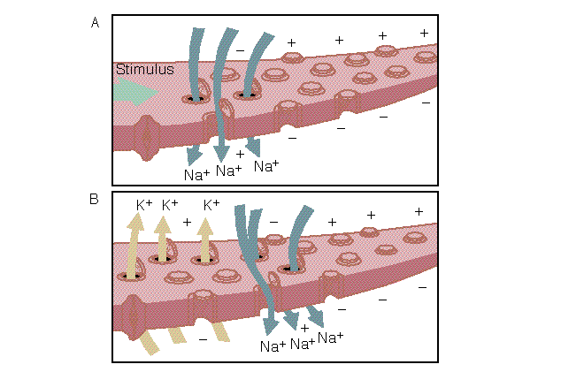
Action Potential (AP):
Nerve signals are transmitted by action potentials, which are rapid changes in the membrane potential that spread rapidly along the nerve fiber membrane. Each action potential begins with a sudden change from the normal resting negative membrane potential to a positive potential and ends with an almost equally rapid change back to the negative potential.
Action Potential: a sudden reverse of membrane polarity (of charges) produced by a stimulus to produce a physiological effect such as:
Transmission of impulse along nerve fibers (transmission of nerve signals)
Release of neurotransmitters
Muscle contraction
Activation or inhibition of glandular secretion
Only Excitable tissue (Nerve and muscles) respond to action potential.
Firing = excitability = action potential = nerve impulse

Slide 8
Stages of Action Potential (AP):
1- Resting stage / Initiation of Action potential | 2- Depolarization | 3- Repolarization
It is the resting membrane potential before the action potential begins. The membrane is “polarized”. Initiation: The (polarized) resting membrane potential rises from -90 to 0. (Gradual depolarization) due to threshold stimulus. | The membrane suddenly becomes permeable to Na+ ions causing Na+ influx to the interior of the axon (upstroke) through opening Voltage gated sodium channels (positive feedback). The membrane charges reverse (more positive inside) Membrane potential rises from 0 to + 35 mv, so all Na channels begin to close suddenly. → (Depolarization ends) This channel ends fast. | K+ outflux through opening Voltage gated potassium channels, this high K conductance (flow) to outside, causes the normal negative resting membrane potential.(Negative inside) (Na+ channels begin to close and the K+ channels open.) This channel is slow, which leads to the next step.
A state of Hyperpolarization follows repolarization. *Will be explained later*

Slide 9
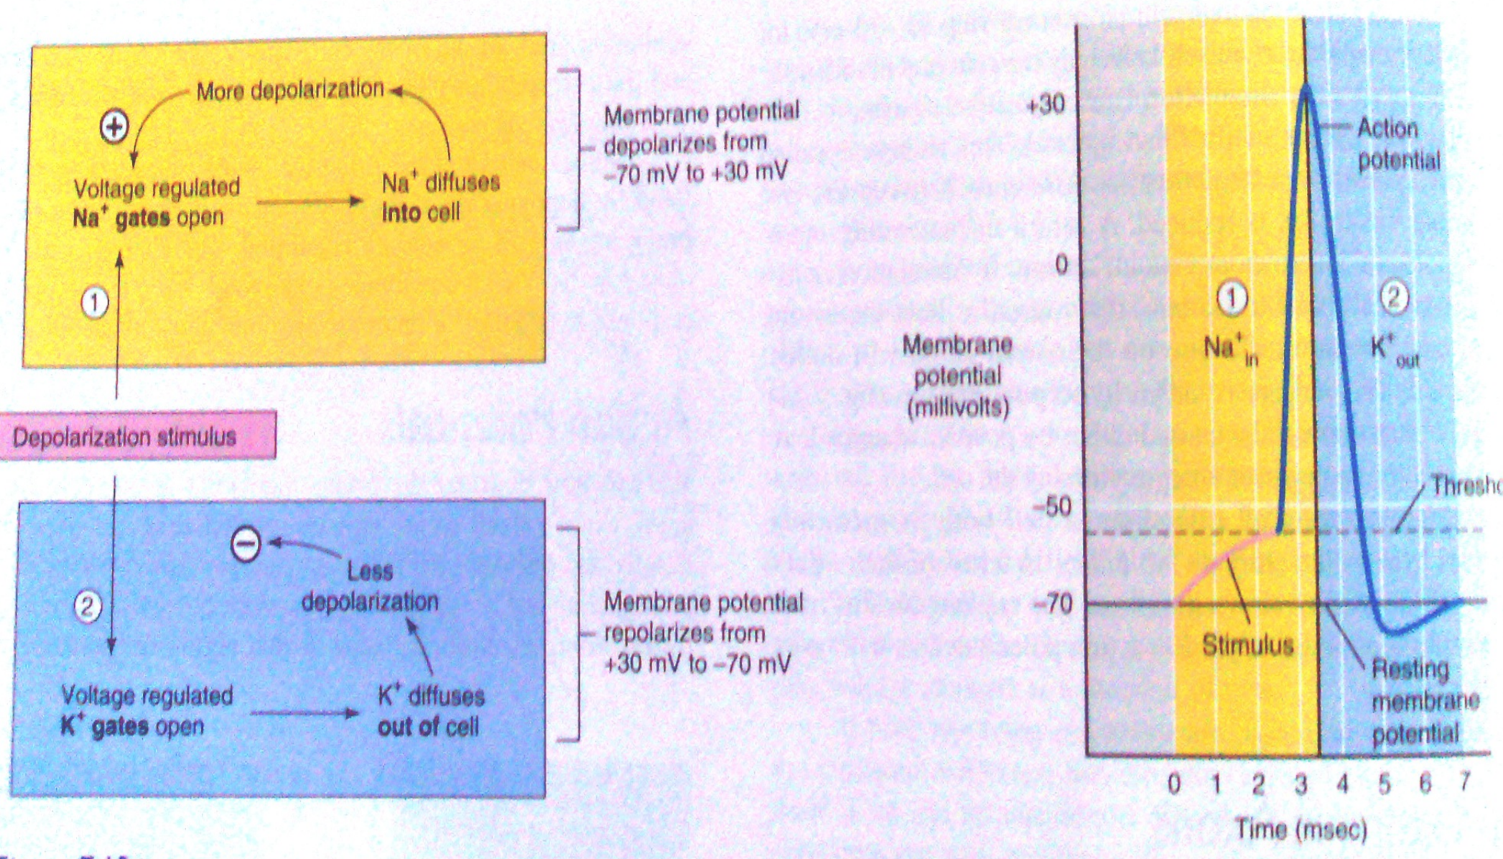
Excitation: *The process of eliciting the action potential*
Basically any factor that causes sodium ions to begin to diffuse inward through the membrane in sufficient numbers can set off opening of sodium channels. This opening of the sodium channels can result from mechanical disturbance of the membrane, chemical effects on the membrane, or passage of electricity through the membrane
Threshold for excitation and “Acute local potentials”
Threshold stimulus:
The membrane potential at which occurrence of the action potential is inevitable.
When a stimulus is strong enough to move RMP from its resting value (-90) to the range of -70mV to -55mV (-65 to 55) which leads to production (start) of an AP or depolarization.
Subthreshold stimulus / Acute subthreshold potential:
Stimulus that results in local depolarization. (local action potential) (does not propagate or move along).
When stimulus is below the threshold.
All or nothing principle: When threshold value for excitation is reached, a full Action Potential is produced, so its intensity can not be increased by increasing stimulus intensity
(suprathreshold).

Slide 10
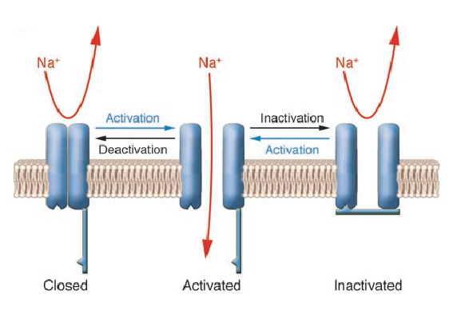
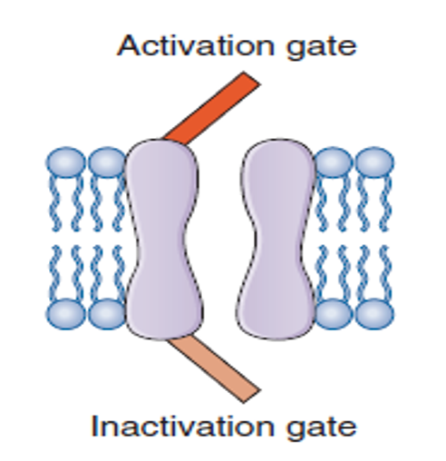
Types of Transport Channels Through the Nerve Membrane
Has 2 gates
Inactivation gate
Activation gate
There are two types:
Voltage gated Na+ channels
Voltage gated K+ channels.
What opens the voltage gated channels? A stimulus strong enough to depolarize them to threshold.
The voltage gated Na+ channel has two gates:
on the outer side of membrane
on the inner side of membrane

Slide 11
First: The Na+ Voltage-Gated Channel: Has three states.
1.Resting state
The activation gate is closed in the resting cell, when the MP* = RMP* is:
-70 to -90 mV.
This prevents entry of Na+ to the interior of the cell through this gate
3.Inactivated state
A few milliseconds after the activation gate opens, the channel becomes inactivated: At the peak of AP the inactivation gate will close the inactivation gate will NOT open by a second stimulus → & the cell becomes Refractoryممانعة )) to another stimulation
*This goes on until the MP has gone back to its resting ( RMP) level ( -70 to -90mV)*
*The activation gate is still open
the inactivation gate is closed*
2.Activated state
Threshold Depolarizing Stimulus: moves the MP from its resting value (-90 mV ) to its threshold value (-65 to -55mV)
This opens the activation gate.
( NB in this case BOTH the activation gate & inactivation gate are open ) → permeability to Na+ becomes increased 500 to 5000 times → Na+ influx
*Na+ flows into the cell in large amounts*

Slide 12
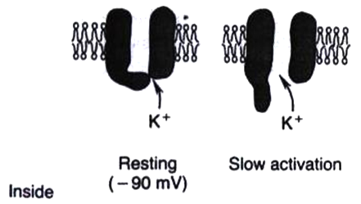
Second: Potassium Voltage Gated Channel (Repolarization)
Has one gate only .
During the resting state:- the gate is closed and K+ can not go out to the exterior
Shortly after depolarization (when the membrane potential rises from -90 mV towards zero):-
The sodium channel begins to be inactivated
The potassium channel opens
K+ exits ( called K+ Efflux)* → Repolarization
#435 TEAM
بوابات الصوديوم : سريعة الفتح, سريعة الإغلاق فبمجرد حدوث تغير في الفولت تفتح البوابة ويدخل فوج من الصوديوم.
sodium voltage-gated channel opens and closes in only milliseconds. And if it reaches 35mV and doesn't close it may cause epilepsy الصرع
بوابات البوتاسيوم: بطيئة الفتح , بطيئة الإغلاق
potassium voltage-gated channels open and close slowly and that's what causes hyperpolarization

Slide 13
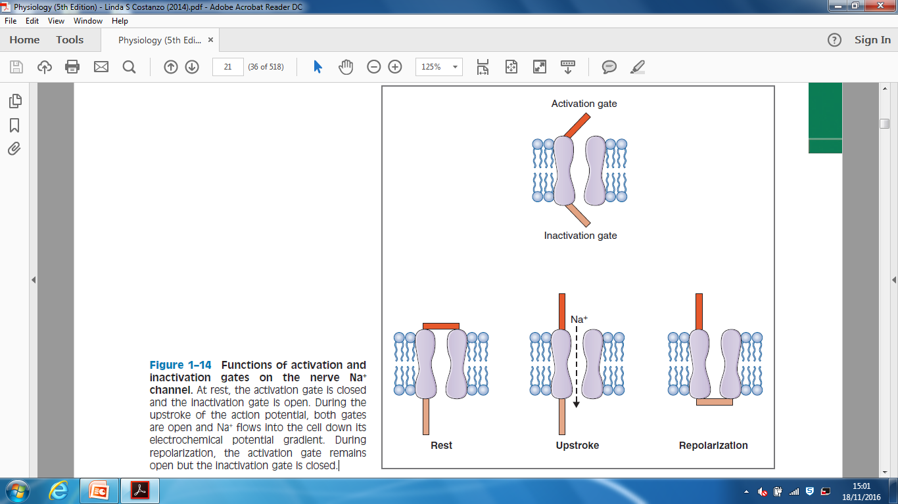
Voltage gated Na+ channels
video
الدكتور نبه على الرسمة وقال انها مهمة مرة

Slide 14
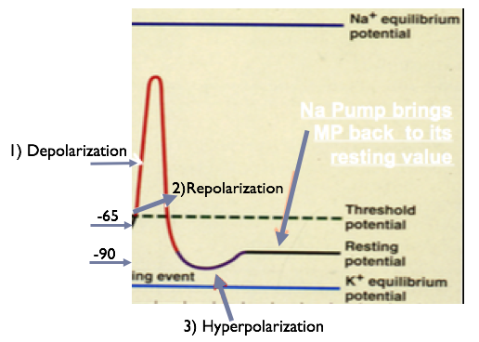
Action Potential (AP)
We need to start from the baseline (Resting State of the cell, RMP)A threshold Stimulus will lead to:
1) Depolarization. 2) Repolarization phase. 3) In some neurons there is a 3rd phase called :Hyperpolarization
Reversal Potential =
+ 35 mV
Threshold Potential
(Firing Level)
= -50 to -65 mV
RMP= -90 mV
Increasing Stimulation
* Action potential occurs when voltage-gated channels are opened!!
Q :What opens the voltage gated channels ?
Opened by a stimulus strong enough to depolarize them to threshold.
( positive after-potential )
video
ONLY IN FEMALES’ SLIDES

Slide 15
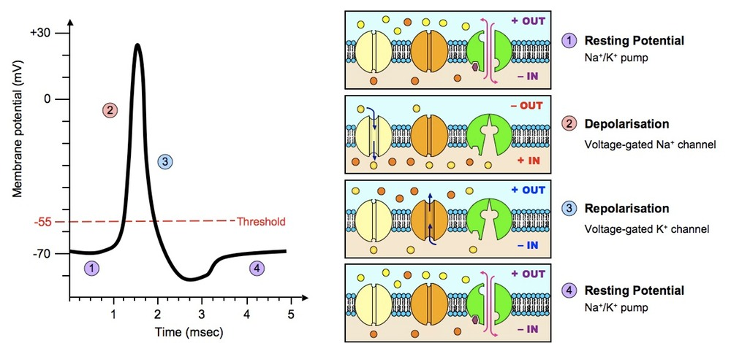
Further Explanation:

Slide 16
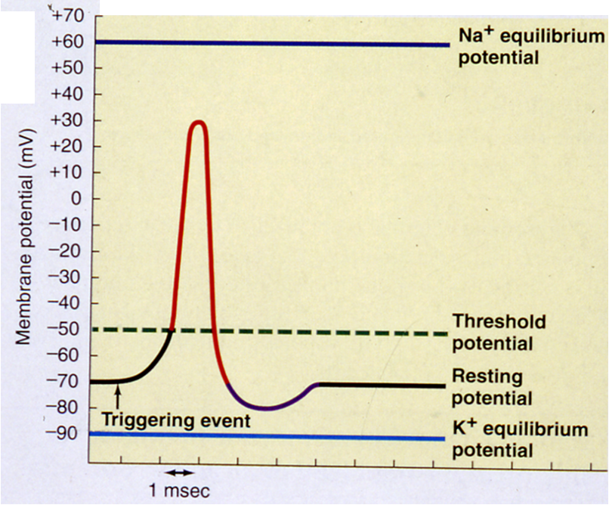
Hyperpolarization:
Hyperpolarization (Positive after-potential): Hyperpolarization is a change in a cell's membrane potential that makes it more negative inside and more positive outside, more than resting membrane potential.)
It inhibits action potentials by increasing the stimulus required to move the membrane potential to the action potential threshold.
Towards the end of each action potential (following repolarization) and continuing for a short period of time, the membrane becomes more permeable to potassium ions. The increased outflow of potassium ions carries positive charges. (the K+ conductance is higher than at rest.)
Na-K pump now starts to move Na+ out & K+ in against their concentration gradient.
While hyperpolarized, the neuron is in a refractory period.
Na-K Pump brings MP back to its resting value
Hyperpolarization

Slide 17
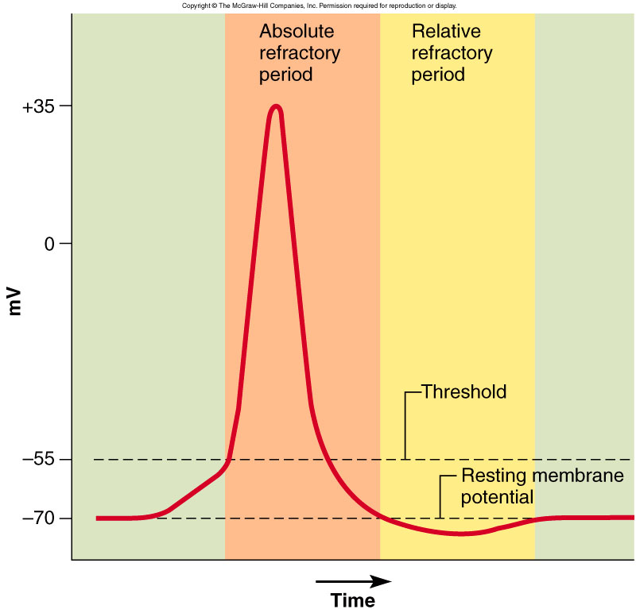
What Happens After Action Potential?
video
Refractory period: few milliseconds
Time during which can’t stimulate neuron a second time
Happens until recovery of resting potential
Two stages:
Absolute refractory period:
The period during which a second action potential cannot be elicited, even with a strong stimulus. (No new action potential possible).
“يعني مهما عطينا محفز ثاني مايستجيب ”
Relative refractory period:
Can trigger new action potential if stimulus is very strong.

Slide 18
Summary of Action Potential : “EXTRA”
When membrane potential (mV) reaches - 70 Na gates will open , and the gates will close when (mV) reaches + 30.
K gates will be open when (mV) reaches +30 , and close when it reaches -90 .

Slide 19
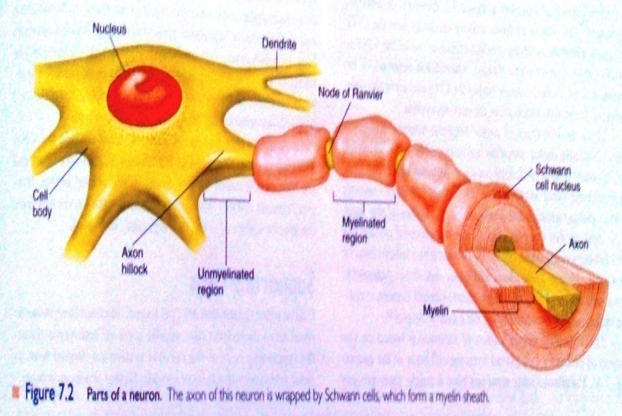
The Neuron
Definition: Unit of function of the central nervous system.
1- Soma: cell body
2- Dendrites: carry nerve impulses
from surroundings to soma.
3- Axon hillock: start of action potential
(because it has a lot of voltage gated Na channels)
4- Axon and axon terminal.
Axon with myelin sheath | Axon without myelin sheath
Myelinated axons diameter: >1um Schwann cells deposit sphingomyelin (which wraps around the axon) 1- increases conduction velocity 2- insulation by the membrane of Schwann cells. (عزل) | Unmyelinated axon diameter: <1um - Type C: in the Post ganglionic Autonomic fibers, and Pain fibers. Also has schwann cells but not wrapped around the axon.
Only in male slides:
An Excitable tissue is the tissue has the capability to respond to an adequate stimulus.
Examples are: nerves and muscles
ONLY IN FEMALES’ SLIDES

Slide 20
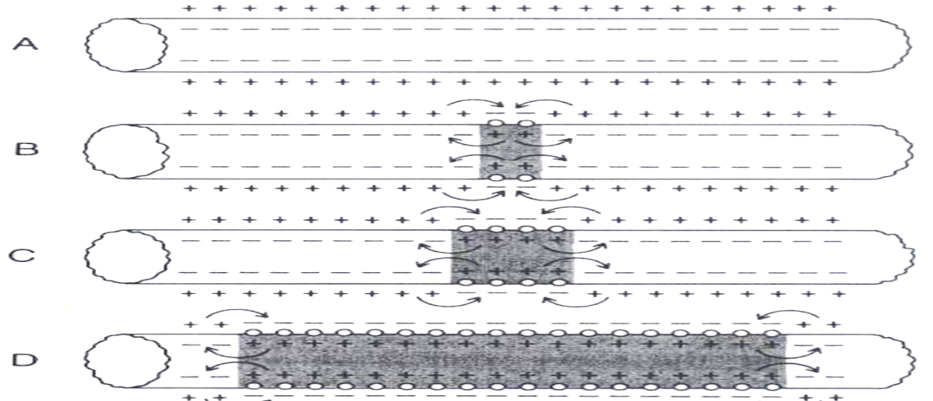
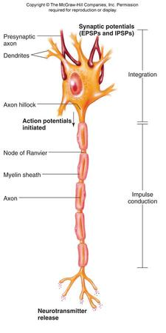
Direction of AP Propagation (Conduction)
video
Artificial Electrical Stimulation :-
Under Artificial condition of electrical stimulation in the laboratory , the AP propagates in both directions .
But normally, AP starts in axon hillock & propagates distally in one direction
AP starts at axon hillock Because it is full of voltage gated Na channels
Azaxon hillock

Slide 21
Propagation of Action Potential
Myelinated nerve fibers | Non- myelinated nerves
Saltatory conduction ( jumping) Many times faster transmission Action potential skips from one node of Ranvier to the next Value:- 1- ↑ velocity of conduction of nerve impulses 2- Conserve energy for axon because only nodes depolarize لان عدد AP أقل بالتالي يحتاج طاقة أقل لذلك يعتبر energy conserving | (local circuits)=point to point Slower Depolarization pass by local circuits.

Slide 22
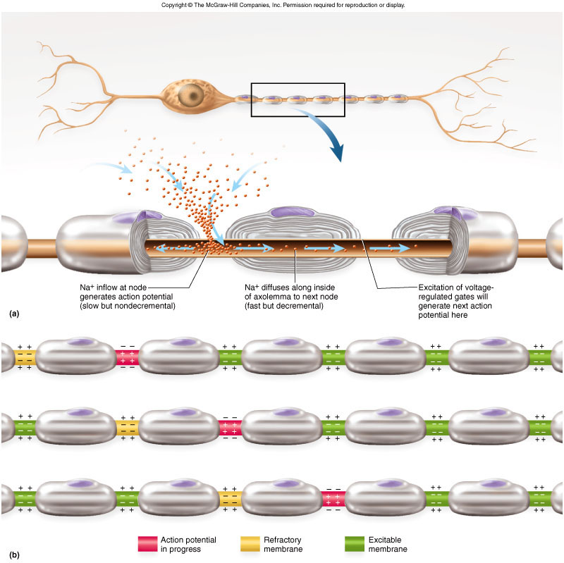
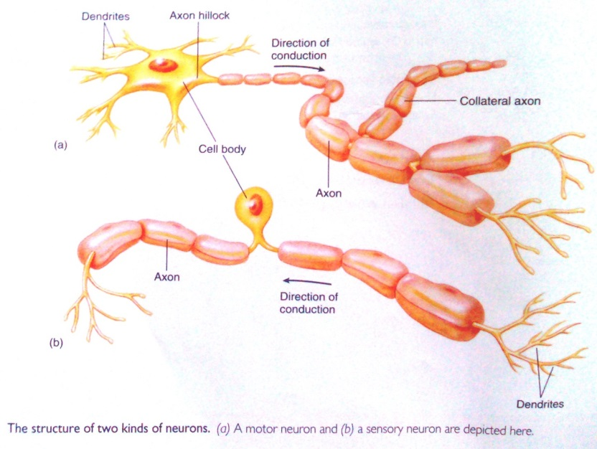
Propagation of Action Potential

Slide 23
Conduction Velocity
It is the speed at which action potentials are conducted (propagated) along a nerve or muscle fiber.
Mechanisms that increase conduction velocity along a nerve (influences speed of action potential):
Axon / Nerve diameter:
The larger the diameter, the faster the speed of transmission because large fibers offers less resistance to local current flow so, more ions will flow.
كل ما زاد الdiameter قلت المقاومة فيزيد AP
(علاقة عكسية)
Myelination:
Myelin is an insulator that makes it more difficult for charges to flow between intracellular and extracellular fluids.
The layers of Schwann cell membrane contain the lipid substance sphingomyelin (a lipid substance) which is excellent electrical insulator that decreases ion flow through the membrane.
Node of Ranvier: small uninsulated area where ions can flow with ease.
Small diameter →slower transduction
large diameter →faster transduction

Slide 24
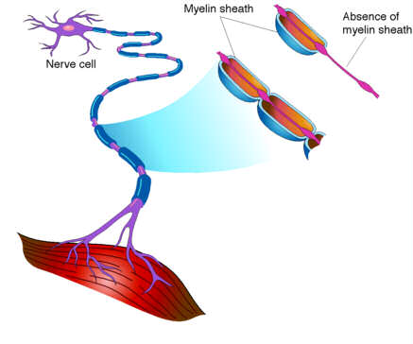
What Happens if Myelination is Lost?
video
Multiple sclerosis:
Autoimmune disease (Immune system attacks the myelin sheaths surrounding axons as well as the axons themselves).
Usually affect young adults.
Causes blindness, problems controlling muscles ,ultimately paralysis.
The myelin sheaths are lost
Scar tissue (scleroses) replaces some damaged cells
Other now unmyelinated axons sprout Na+ channels

Slide 25
Extra: “435” Excitation-the process of eliciting the action potential (Threshold for excitation and “Acute Local Potentials”)

Slide 26
ONLY IN FEMALES’ SLIDES
Changes (a series of changes in polarity) that occur through the nerve after stimulation by threshold stimulus:
1- Chemical changes.
2- Thermal changes.
3- Excitability changes.
4- Electrical changes (nerve action potential):
It is the potential difference along the nerve membrane after stimulation by one threshold stimulus.
Most important factors:
Threshold stimulus, and Voltage-gated Na and K channels.
Nerve signals (impulses) which are transmitted via nerve action. They’re transmitted as a wave of depolarization.
- Oscilloscope: Measures rapid changes in membrane potential.
Propagation: action potential propagates through the nerve to stimulate other neurons (starts from axon hillock because it has the most Voltage gated sodium channels)

Slide 27
Link to Editing File (Please be sure to check this file frequently for any edits or updates on all of our lectures.)
Quiz
https://www.onlineexambuilder.com/rmp-ap/exam-117621
References:
Girls’ and boys’ slides.
Guyton and Hall Textbook of Medical Physiology (Thirteenth Edition.)

Slide 28
Thank you!
اعمل لترسم بسمة، اعمل لتمسح دمعة، اعمل و أنت تعلم أن الله لا يضيع أجر من أحسن عملا.
The Physiology 436 Team:
Nouf Aloqaili
Rana Barasain
Norah Alshabib
Sundus Alhawamda
Ruba Barnawi
Heba Alnasser
Lama Alfawzan
Fahad Al Fayez
Muhammad Al Mutlaq
Team Leaders:
Qaiss Almuhaideb
Lulwah Alshiha
Contact us:
Physiology436@gmail.com
@Physiology436

