Slide 1
Motor Unit
Red: very important.
Green: Doctor’s notes.
Yellow: numbers.
Gray: notes and explanation.
Physiology Team 436 – Musculoskeletal Block Lecture 4
Lecture: If work is intended for initial studying.
Review: If work is intended for revision.

Slide 2
Objectives
Recognize the organization of the Nervous System. (slide 3,4)
Identify the differences between central nervous system (CNS) & peripheral nervous system (PNS). (slide 5)
Understand the function & the recruitment of the motor unit. (slide7,12)
Appreciate effect of motor units number on motor action performance. (slide 8,9,10,11,15,16)

Slide 3
Organization of the Nervous System *Important*

Slide 4
(PNS)

Slide 5
Organization of the Nervous System Cont.
The Central Nervous System: It is the part that integrates the sensory information that it receives from different parts of the body, and coordinates the body’s activity.
It consists of :
The Brain which is protected by the skull.
The Spinal cord which is protected by the vertebrae.
Both are enclosed in the meninges.
The Peripheral Nervous System (PNS):is divided in terms of function:
Sensory Neurons : collect information from the various sensors located throughout the body and transmit the information to the brain.
Motor Neurons : conduct signals to activate muscle contraction.
Motor neurons system is subdivided into:
Somatic nervous system.
Autonomic nervous system.
Skeletal muscle activation is initiated through neural activation.

Slide 6
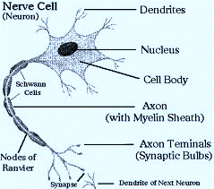
Neurons
The neuron is the building unit of the nervous system which is comprised of:
Cell body:
Nucleus
Dendrites.
Axon:
Myelination
Nodes of Ranvier
Axon terminals (synaptic end bulbs).
Neurotransmitter:
Acetylcholine (ACH)

Slide 7
α-Motor Neuron
Motor unit : is an α-Motor Neuron
Location of α-Motor Neuron : in the anterior horn cell (AHC) and it is responsible for innervating the skeletal muscle fibers and their contraction.
A nerve is made up of a group of neuron axons.
The function of nerve cells : is to transmit electrical messages and signals throughout the body.
Posterior (Dorsal) horn
Anterior (Ventral) horn
Explained in next slide
NOTE : motor unit = motor neurons + their terminal axon + the muscle fiber which will be innervated.

Slide 8
Further Explanation of Neurons (Text: added from external resources based on the doctor’s explanation. Picture: from the doctor’s slides)
Sensory Neurons:
Carry signals from the outer parts of your body (periphery) into the central nervous system.
Motor Neurons (Motoneurons):
Carry Signals from the central nervous system to the outer parts (muscles, skin, glands) of your body.
Interneurons:
Connect various neurons within the brain and spinal cord.

Slide 9
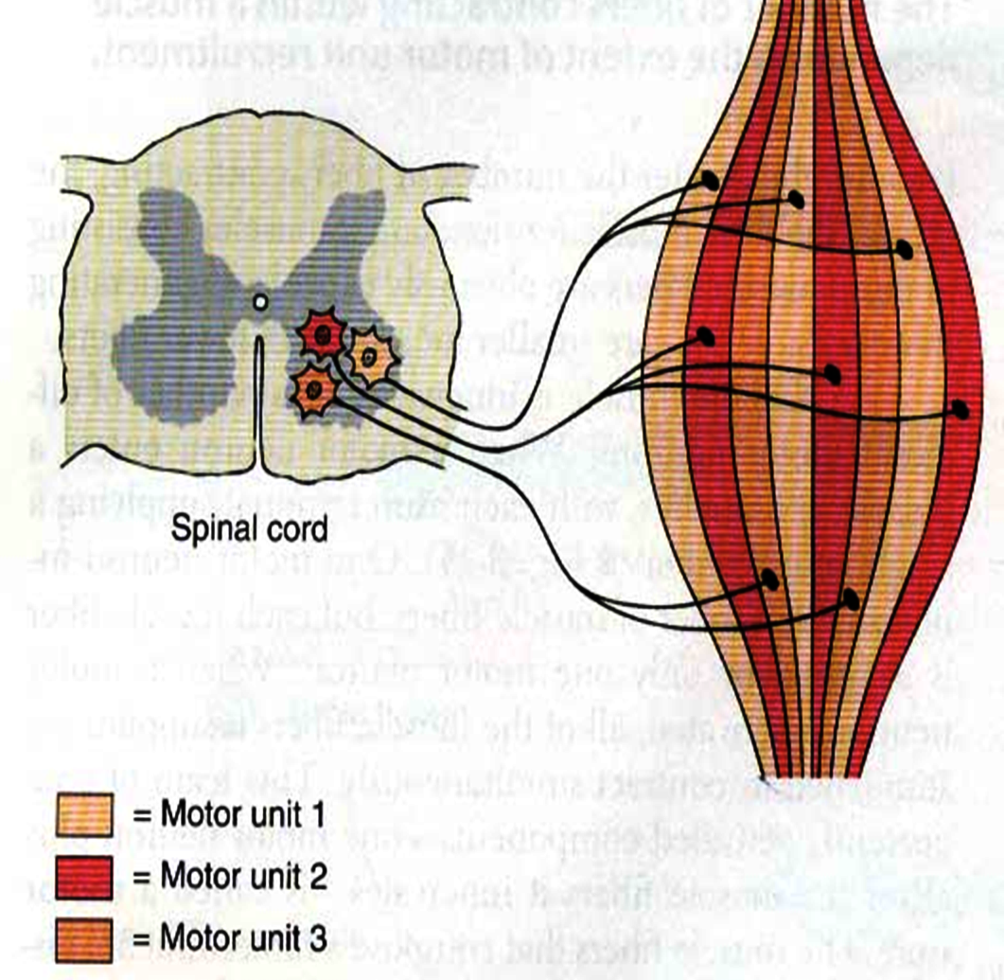
Motor Unit
It is the α-motor neuron in the anterior horn cell AHC and all the muscle fibers it innervates يغذيها
All of these muscle fibers will be of the same type, either fast twitch or slow twitch
Each muscles consist of a number of motor units.(will be explain the next slide )
When a motor neuron is activated, all of the muscle fibers innervated by the motor neuron are stimulated and contract.
There are two types of muscle fibers:
Slow twitch fibers: have low force & high endurance.
Fast twitch fibers: have high force & low endurance.
شرح :
- العضلة الواحدة تحتوي على أكثر من وحدة حركية وكل وحدة حركية تغذي عددًا من الألياف العضلية ويجب أن تكون جميع هذه الألياف العضلية من نفس النوع سواءً السريع أو البطيْ
-عندما تنشط خلية عصبية “جميع” الmuscle fibers ( المرتبطة بهذه الخلية العصبية ) تنقبض ، لكن هذا لا يعني أن “ جميع “ الmuscle fibers في العضلة تنقبض بنفس الوقت، حيث أنها ترتبط بخلايا عصبية أخرى.

Slide 10
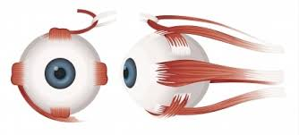
Motor Unit
The number of muscle fibers in a motor unit (innervated by one motor neuron) varies. For example:
Gastrocnemius
2,000 muscle fibers per motor neuron.
Extraocular muscles
Less than 10 muscle fibers per motor neuron.
Ratio of muscle fibers to motor neurons affects the precision(الدقة) of movement:
If the ratio is low the action is specific ( more precise )
If the ration is high the action is less specific ( less precise )
Explanation:
Motor unit X supply 20 muscle fibers / Motor unit Y supply 6 muscle fibers
The movement of Y muscle is more precise than the movement of X muscle.
Extra images
Extraocular
Gastrocnemius

Slide 11
Precision of Movement
More precise movements
Less precise BUT STRONGER movements

Slide 12
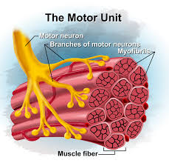
The Precision (الدقة) of Movement
Groups of motor units often work together to help the contractions of a single muscle . “the number of muscle fibers within each motor can vary”
precise movements muscle consist of a large number of motor units and few muscle fibers in each motor unit
e.g. Hand and eye muscles. ( low ratio of muscle fibers to motor neurons )
Less precise movements muscles composed of fewer motor units with many fibers per unit
e.g. Trunk muscles. ( High ratio of muscle fibers to motor neurons )
شرح :
إذا كانت العضلة تحتاج إلى دقة في العمل ( مثل اليد والعين ) يكون لديها عدد عالي من الmotor unit، وكُل motor unit ترتبط بعدد قليل من الmuscle fibers بحيث تستطيع الmotor unit التحكم الدقيق بهذا العدد القليل من ألالياف العصبية

Slide 13
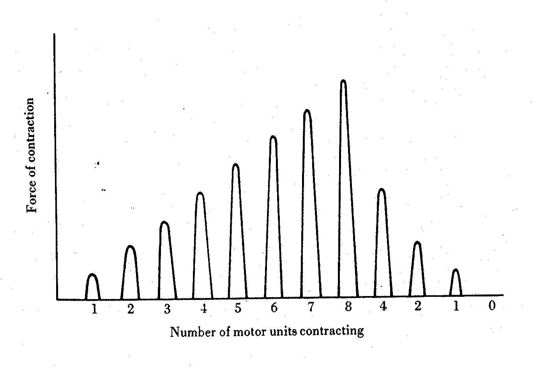
Motor Unit Recruitment(توظيف الوحدات الحركية )
Motor Unit Pool : The group of motor units supplying a single muscle.
The nervous system can increases force production in two ways:
1) Recruitment of new motor units:
It is the progressive activation of a muscle by successive recruitment of contractile units (motor units) to accomplish increasing degrees of contractile strength (force).
If the stimulus is low, the small motor units will be activated. ( small number of muscle fibers will contract )
If the stimulus is higher, the large motor units will be activated ( more muscle fibers will contract )
While if the stimulus is highest, the largest motor unit will be activated( the whole muscle will contract )
شرح:
في الحالات الطبيعية عندما لا نحتاج إنقباض عالي لا تكون جميع الmotor unit تشتغل، لكن مجرد ما نحتاج لجهد إضافي، يزداد عدد الmotor unit الشغالة، فكل motor unit تشغل الmuscle fibers حقاتها، مما يزيد الانقباض.
إذاً بإختصار ال motor unit recruitment راح يزيد عدد ال activated motor unit فبالتالي راح تزداد ال muscle contraction.

Slide 14
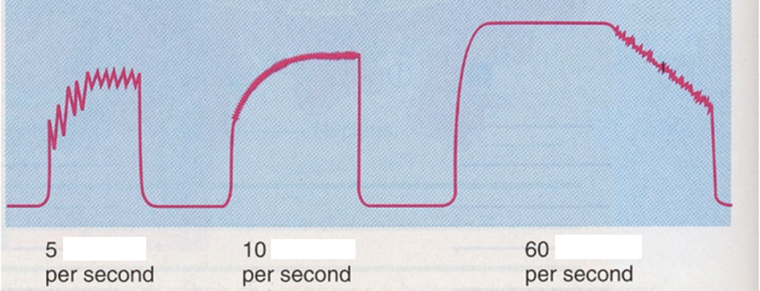
Increasing Stimulation Force
Second way the nervous system can increase force production:
2) Increasing stimulation frequency (rate coding):
Increasing frequency of action potentials (by increasing the impulses) will result in a stronger force of contraction.
شرح:
في البداية كان عدد تكرار ال , stimulus 5 لكل ثانية , في كل مرة يزيد فيها التكرار راح تزيد ال muscle contraction الى ما توصل مرحلة maximum contraction tetany .
If AHCs fire at slow rates → slow MUPs
→ weaker contraction.
If AHCs fire at very fast rates → fast MUPs
stronger contraction.
شرح :
-في الطريقة الأولى كان يزيد عدد الmotor unit، طيب فرضاً اشتغلت كل الmotor unit وما زلنا نحتاج إنقباض أعلى ؟ أو انه اساساً العضلة تحتوي عدد قليل من الmotor unit )مثل العضلات ما بين الاصابع )؟
-> تلقائياً راح تزيد عدد Impulses في الثانية الواحدة مما يزيد الAction potentials فيزداد عندي الانقباض.
لكن هذه الطريقة تجعل العضلة في حاله إجهاد بدون راحة
“ contraction without relaxation” فبيكون فيه نقطة قصوى توقف عندها الImpulses اللي هي (maximum contraction (
(MUPs) : motor unit potentials

Slide 15
Force of a Single Motor Unit
The force produced by a single motor unit is determined by :
The number of muscle fibers in the unit.
( as numbers of muscle fibers increase , the force will be increased )
The frequency with which the muscle fibers are stimulated by their innervating axon.
( as the frequency of stimulus increase, the force will be increased )
Generally, this allows a 2 to 4-fold change in force.

Slide 16
The Size Principle
(moderate)

Slide 17
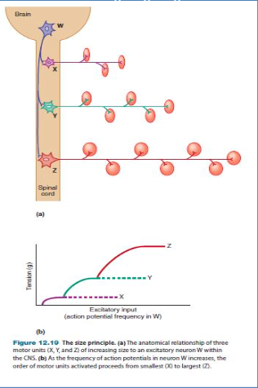
Recruitment and Size Principle
Only in Females’ Slides
Here, X has very low frequency of stimulation.

Slide 18
Rate Coding
Rate coding refers to the motor unit firing rate.
Active motor units can discharge at higher frequencies to generate greater tensions.
Example: 5 times or 10 times per second for the same motor unit
Recruitment VS Rate Coding
Large muscles
Ex: deltoid
Rely more on recruitment
of motor units
Reason: muscle fibers & motor unit are more.
Small muscles
Ex: first dorsal interosseous
Rely more on rate coding (frequency)
Reason: muscle fibers & motor unit are less.

Slide 19
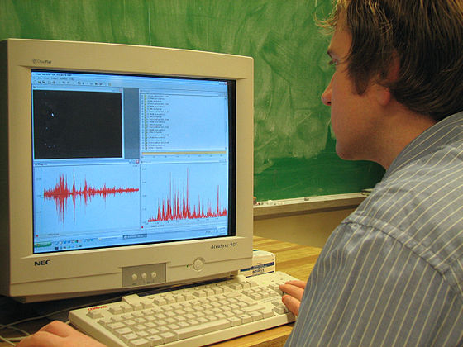
All or None Role
Motor Units Follows “all-or-none” principle – impulse from motor neuron will cause contraction in all muscle fibers it innervates or none.
( اذا صار فيه ,activation of single motor neuron كل الألياف العضلية المرتبطة فيه راح يصير لها contraction , يعني غير ممكن يصير فيه contraction لبعض الألياف والياف ثانية ما يصير لها شي)
In an electrodiagnostic testing (EMG , electromyography) for a patient with weakness, careful analysis of the motor unit action potential (MUAP) size, shape, and recruitment pattern can help in distinguishing a myopathy (problem in muscle) from a neuropathy (problem in nerve)
Extra info:
EMG is a technique for evaluating and recording the electrical activity produced by skeletal muscles. The signals can be analyzed to detect medical abnormalities, activation level, or recruitment order.

Slide 20
Link to Editing File (Please be sure to check this file frequently for any edits or updates on all of our lectures.)
Quiz
https://www.onlineexambuilder.com/physiology-motor-unit/exam-116693
References:
Girls’ and boys’ slides.
Guyton and Hall Textbook of Medical Physiology (Thirteenth Edition.)
Science.howstuffworks.com

Slide 21
Thank you!
اعمل لترسم بسمة، اعمل لتمسح دمعة، اعمل و أنت تعلم أن الله لا يضيع أجر من أحسن عملا.
The Physiology 436 Team:
Rana Barasain
Alaa Alaqeel
Leena alwakeel
Munirah aldofyan
Buthaina Almajed
Wateen Alhamoud
Shoag Al-bugami
Hassan Al Shammari
Faisal Al Fawaz
Muhammad Al-Mutlaq
Team Leaders:
Qaiss Almuhaideb
Lulwah Alshiha
Contact us:
Physiology436@gmail.com
@Physiology436

