Slide 1



Nerve Conduction Study (NCS) and Electromyography ( EMG)
Red: very important.
Green: Doctor’s notes.
Yellow: numbers.
Gray: notes and explanation.
Physiology Team 436 – Musculoskeletal Block Lecture 5
Lecture: If work is intended for initial studying.
Review: If work is intended for revision.

Slide 2
Objectives
Define what is nerve conduction study (NCS) and electromyography (EMG) .
Explain the procedure of NCS using Abductor Pollicis Brevis muscle .
Define the normal conduction velocity in upper limb and lower limb nerves .
Define the motor unit potentials ( MUPs) and how they are changed in muscle and nerve diseases .

Slide 3
Nerve Conduction Study ( NCS)
A nerve conduction study (NCS) : is an electrophysiology test commonly used to evaluate the function of peripheral nerves of the human body.
It could be
Nerve conduction velocity (NCV) is a common measurement made during NCS
Motor Nerve Conduction Study
In this lecture, only motor nerve conduction study will be discussed.
Based on the nature of motor nerve conduction abnormality, two lesions may be identified:
Axonal degeneration and 2. Segmental demyelination.
These tests are considered as an extension of the physical examination in patients with muscular weakness, muscle atrophy, and traumatic or metabolic neuropathy, rather than a simple laboratory procedure.
  Motor NCS
  Sensory NCS
  Mixed NCS
ONLY IN MALES’ SLIDES
Motor nerve conduction velocity of peripheral nerves may be closely correlated to their functional integrity or to their structural abnormalities.

Slide 4
Motor Conduction Studies: Compound Muscle Action Potential (CMAP)
ONLY IN MALES’ SLIDES
Muscle CMAP is the recorded potential in the motor test.
Represents the summation of all underlying muscle fiber action potentials.
It is a biphasic (ثنائية الموجة ) potential with an initial upward deflection from baseline.
For each procedure we measure
  Amplitude
  Latency
  Duration
Conduction Velocity
For each stimulation site: the latency, amplitude, duration, of the CMAP are measured .
A motor conduction velocity can be calculated after two sites of stimulation, one distal and one proximal.

Slide 5
Important Notes:
ONLY IN MALES’ SLIDES
Amplitude
• it is most commonly measured from baseline to the peak (baseline-to-peak) and less commonly from the first upward peak to the next downward peak (peak-to-peak).
CMAP amplitude reflects the number of muscle fibers that depolarize.
• low CMAP amplitudes most often result from loss of axons (as in a typical axonal neuropathy)
• average CMAP amplitude 3 mv
Conduction Velocity
• It’s measurement of the speed of the fastest conducting nerve axons
• It is calculated by dividing the change in distance (between proximal stimulation site & distal stimulation site in mm) by the change in time (proximal latency in milliseconds (ms) minus distal latency in ms)
Latency
The latency is the time from the stimulus to the initial deflection from baseline
Latency measurements usually are made in milliseconds (ms).
Duration
• This is measured from the initial deflection from baseline to the final return
• Duration characteristically increases in conditions that result in slowing of some motor fibers (e.g., in a demyelinating lesion).

Slide 6
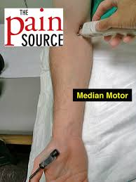

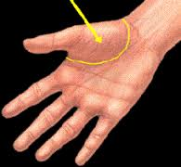
MCS Procedure
An electrical stimulus is applied over a nerve ( e.g., median nerve )
at two sites :
1- a distal site ( wrist ).
2-proximal one ( antecubital fossa , elbow).
An active recording electrode (G1) is place over the belly of the muscle supplied
by that motor nerve (over the motor endplate) . The muscle is the thenar eminence which consist of multiple muscle one of them is the Abductor Pollicis Brevis (the muscle that we use in a routine test ).
Thenar : “palm of the hand” and the Latin word "eminentia : projection” refers to the group of muscles on the palm of the human hand at the base of the thumb)

Slide 7
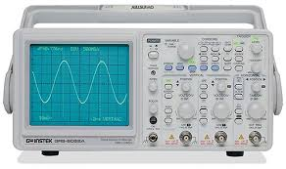
Procedure (cont.)
The reference recording electrode (G2) about 3-4 cm away from G1 .
The stimulator then is placed over the nerve that supplies the muscle.
The oscilloscope ( CRO for cathode-ray oscilloscope) sweep speed is
adjusted to 2 ms/cm.
Oscilloscope : used to observe the change of an electrical signal over time.
The stimulus duration used is 0.2 ms(milliseconds) and stimulus frequency to 1 / sec.
As current slowly increases (from a baseline), more nerve fibers reach stimulation threshold (brought to Action Potential). This will lead to more muscle fiber action potentials.

Slide 8
Procedure (cont.)
Most nerves require a current in the range from 20 to 50 mA to achieve supramaximal stimulation.
When the current reaches the point where CMAP no longer increases, we assume reaching the supramaximal stimulation. The current is increased by 20% to be sure.
1- Apply the stimulus and record the response from stimulation at the wrist.
Store the CMAP ( compound muscle action potential ) in the first channel of the oscilloscope .
2- Change the stimulating site from wrist to antecubital fossa ( elbow ).
Stimulate the nerve & record the CMAP for median nerve stimulation at the elbow.

Slide 9
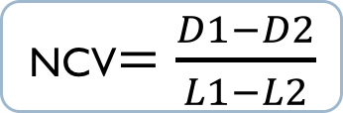
Procedure (cont.)
Measure the distance from elbow to wrist with a measuring tape.
Measure the latency in first CMAP & in the next CMAP.
Latency is a time interval between the stimulus artifact and AP.
Enter the distance between the elbow and wrist (D1)
*D2 : the distance between the median nerve (in wrist) and thenar eminence.
Distance
D1= 284 mm
L1 Latency At wrist
= 3.5 ms
L2 Latency At elbow
= 8.5 ms
NCV$=\frac{D1−D2}{L1−L2}$

Slide 10
Motor Conduction Study: Median nerve
(The procedure in pictures):

Slide 11
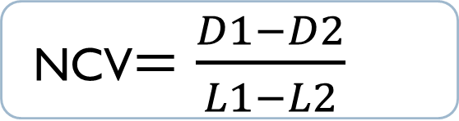
Nerve Conduction Velocity
D2
NCV$=\frac{D1−D2}{L1−L2}$
D1

Slide 12
X axis : for time.
Y axis : for voltage.
L1
-The duration in L1 is less than L2.
-The voltage in both is same.
L2
Amplitude represent the number of muscle fibers that depolarize .
Average CMAP amplitude is 3mV .

Slide 13
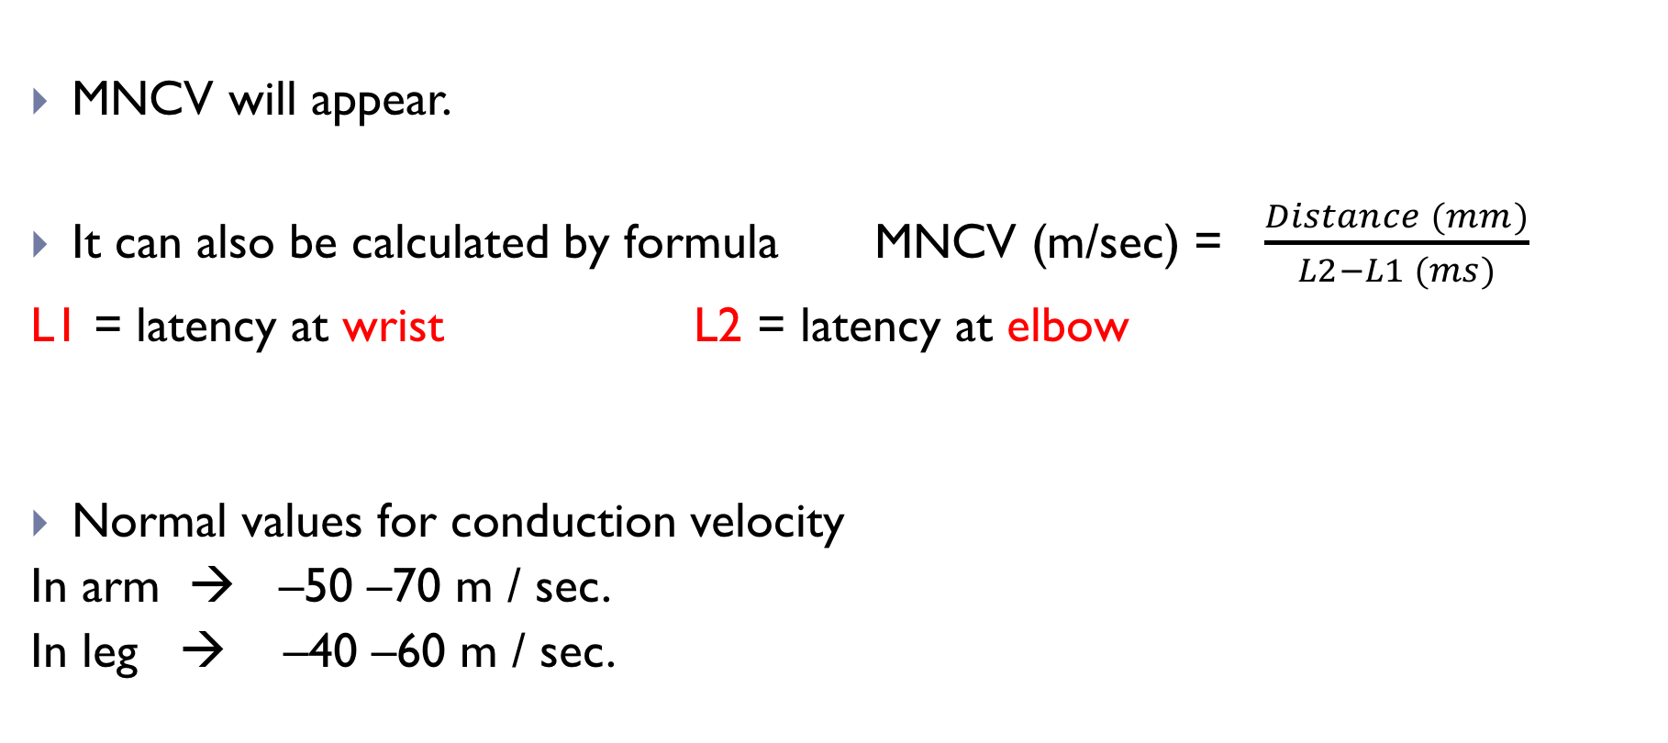
Motor Nerve Conduction Velocity (MNCV)
To help you remember:
Distance over time
Conduction of velocity could be more than the normal which is very good and the patient is not complaining from any thing BUT the abnormal when its become lower than the normal (slower conduction velocity)
(Important)
**Do not forget to convert units when necessary!
(Faster)

Slide 14
Female Doctor’s Notes on Slide 13
1. You might be asked to calculate the conduction velocity and determine whether or not it is within normal range.
2. The Doctor mentioned that:
- Below average: abnormal.
- Above average: still considered normal.

Slide 15
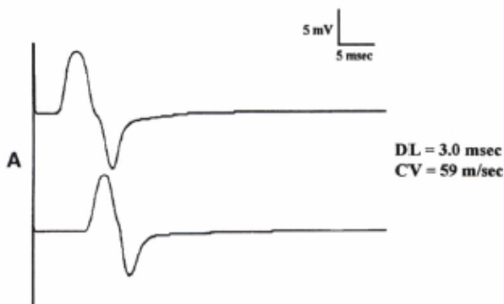
Patterns of Nerve Conduction: Normal Study of Median Nerve
ONLY IN MALES’ SLIDES
Normal median distal latency (DL) 3 ms,
Amplitude >4 m V, and
Conduction velocity (CV) >49 mls.

Slide 16
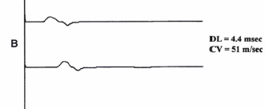
Axonal Loss and Demyelination
ONLY IN MALES’ SLIDES
 | Axonal loss | Demyelination
Amplitude | Decreases | No change
Distal latency | Normal or slightly prolonged | Prolonged ( 130% upper the normal limit)
Morphology of potential between proximal and distal sites | No change | No change
Conduction velocity | Normal or slightly slowed | Markedly slowed (75% lower than normal limit)
Axonal loss
Demyelination
Here: Demyelination is associated with inherited disorders

Slide 17
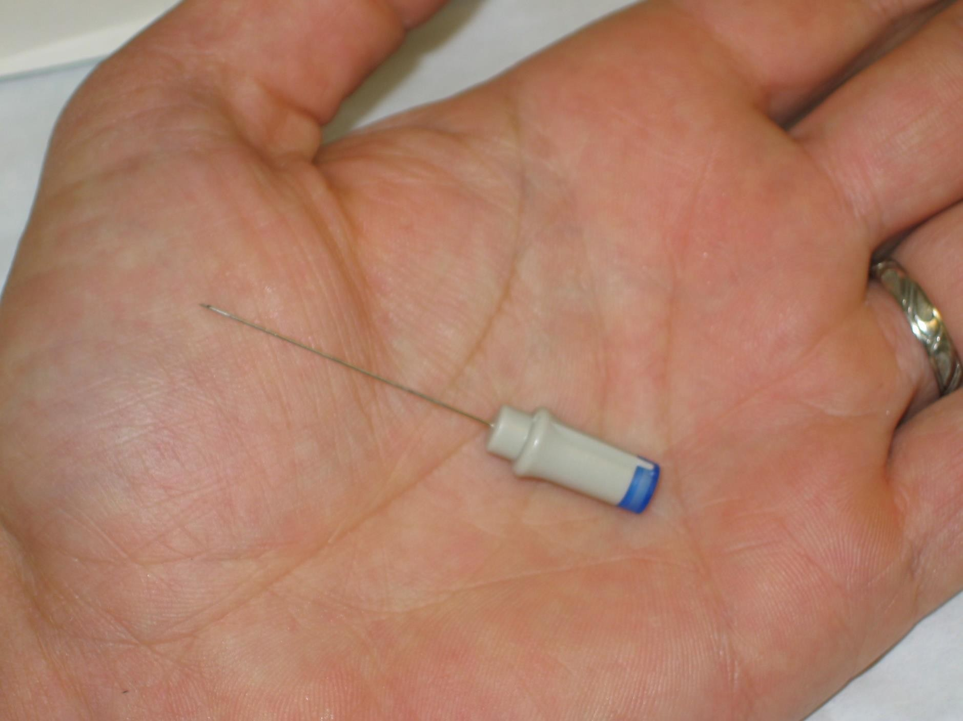
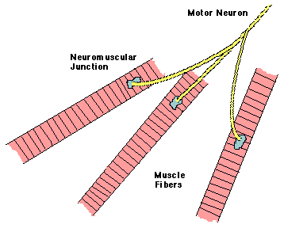
Electromyography ( EMG)
EMG: is a technique for evaluating and recording physiologic properties of muscles at rest and while contracting .
Mechanism: It is a recording of electrical activity of the muscle by inserting needle electrode in the belly of the muscles ( needle EMG ) or by applying the surface electrodes ( surface EMG ).
Recall:
A motor unit: is defined as one motor neuron and all of the muscle fibers it innervates.

Slide 18
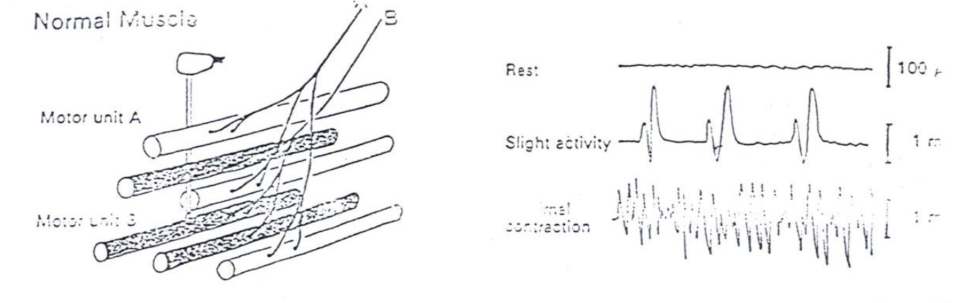
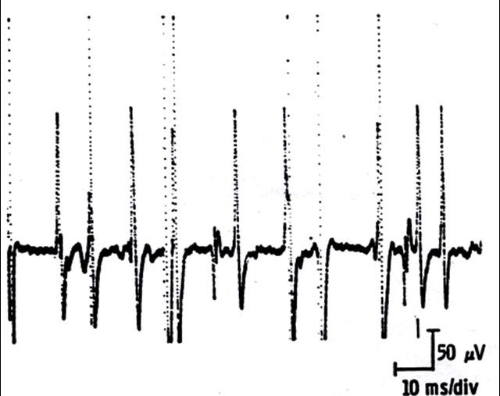
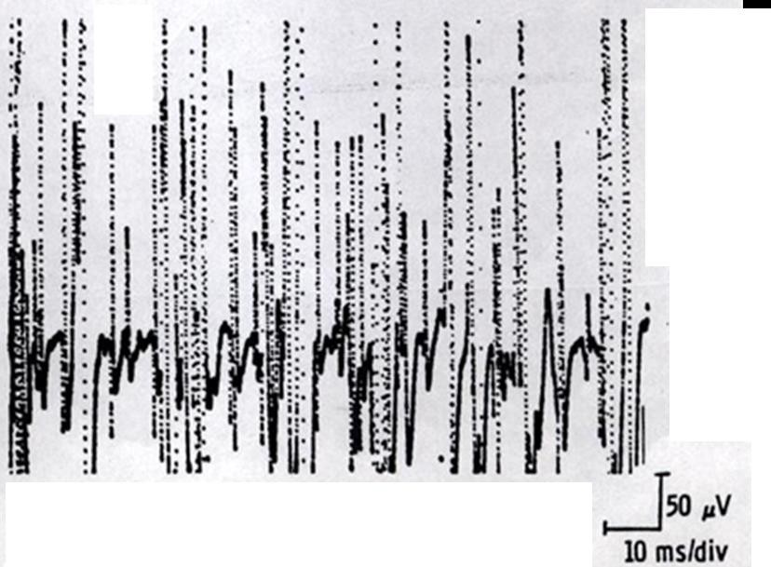
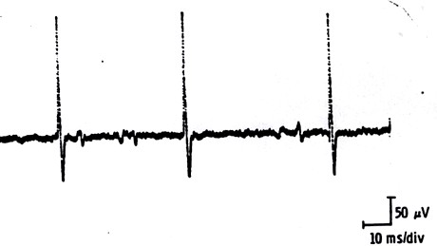
Motor Unit Potentials (MUPs) (Normal MUP)
(MUPs): is the potentials recorded (on volitional effort) in needle EMG are derived from motor units of the muscle.
At Rest: silent
During Mild Effort
During Moderate Effort → note recruitment of additional motoneurons
During Full Voluntary Effort .
There is full recruitment ( you
can not see the baseline )
(MUPs) Abnormalities:
In nerve diseases: Giant MUPs due to re-innervation > 5 mV.
In muscle disease: Small MUPs < 300μV.
Max contraction
Full interference pattern

Slide 19
Analysis
ONLY IN MALES’ SLIDES
Skeletal muscles are silent at rest (spontaneous activity is absent.) يعني في الرسم البياني يكون الخط مستقيم
Normal MUPs
In abnormal MUPs (due to neurogenic lesion or in active myositis) , these spontaneous activities are noted:
  Bi-triphasic
Biphasic = dome shamed = 2 humps
  Duration 3-15mSec
  Amplitude 300μV-5mV
1- Positive sharp wave
Small potential 50-100μV, 5-10mSec duration with abrupt onset and slow outset.
2- Fibrillation potential*
Randomly occurring small amplitude potentials originating from the single muscle fiber of a
de-innervated muscle ( possibly due to denervation hypersensitivity to acetylcholine. )
3- Fasciculation potential
High voltage polyphasic long duration potentials appear spontaneously associated with visible contraction of muscle.

Slide 20
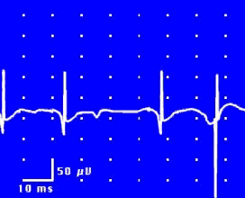
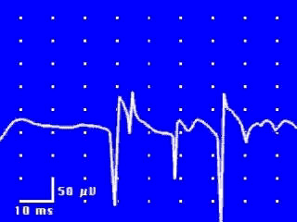
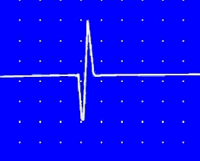
Abnormal MUP
ONLY IN MALES’ SLIDES
Fibrillation Potentials
Positive Sharp Waves
Fasciculation Potential
may appear in runs
(يعني على شكل فترات)
The audio amplifier gives sound. such as; sounds of rain in a tin shade house.
مثل صوت المطر على صفيح
They originate from a large motor unit which is formed due to re-innervation of another motor unit from the neighboring motor unit.

Slide 21
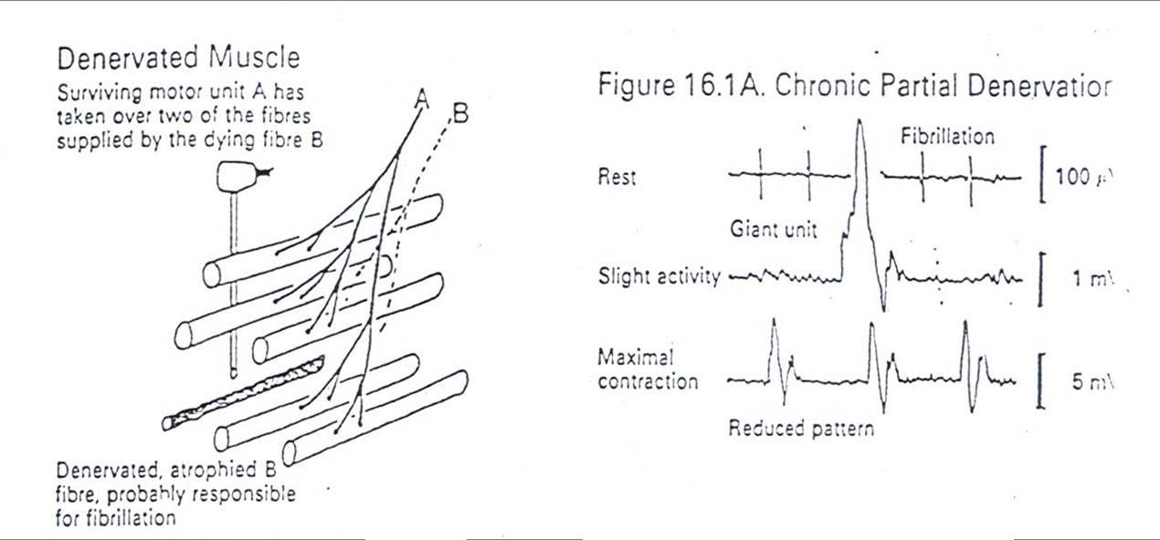
Neuropathic EMG Changes
ONLY IN MALES’ SLIDES
Giant unit is caused by re-innervation
In neuropathy: maximal contraction won’t produce “full interference pattern”; it will produce a “reduced pattern.”

Slide 22
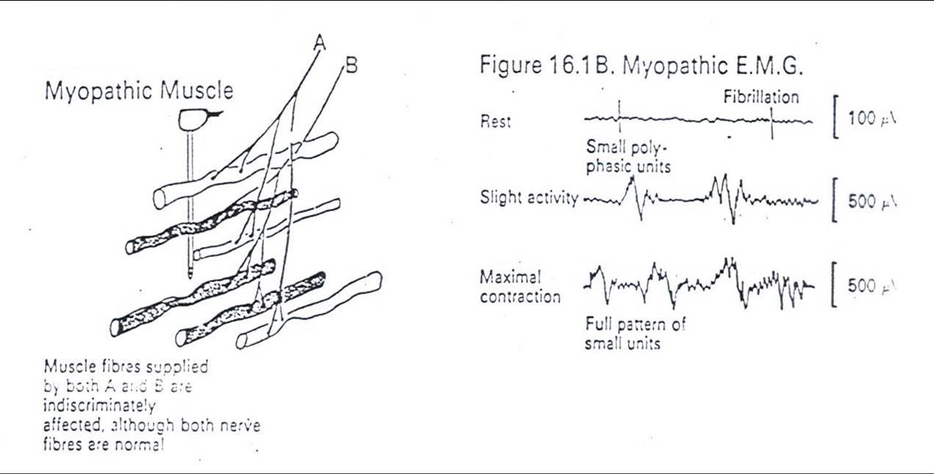
Myopathic EMG Changes
In myopathies: maximal contraction will produce a “full interference pattern”

Slide 23
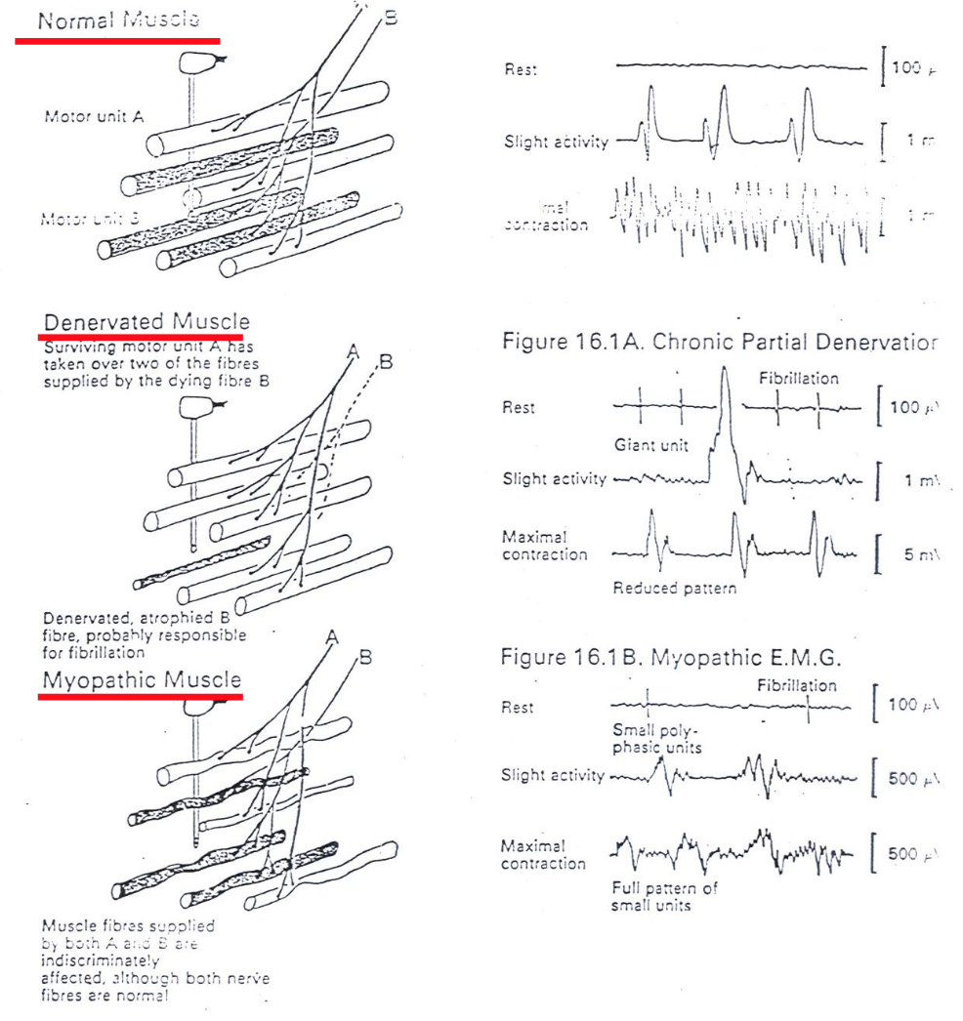
Summary
ONLY IN MALES’ SLIDES

Slide 24
Analysis of a Motor Unit Potential (MUP)
ONLY IN MALES’ SLIDES
MUP | NORMAL | NEUROGENIC | MYOPATHIC
Duration msec. | 3 – 15 msec | longer | Shorter
Amplitude | 300 – 5000 µV | Larger | Smaller
Phases | Biphasic / triphasic | Polyphasic | May be polyphasic
Resting Activity | Absent | Present | Present
Interference Pattern | full | partial | Full

Slide 25
Typical MUP Characteristics in Myopathic, Neuropathic, and Normal Muscle
ONLY IN MALES’ SLIDES
MUP | Myopathy | Normal | Neuropathy
Duration | < 3 msec | 3 – 15 msec | > 15 msec
Amplitude | < 300 µV | 300-5000 µV | > 5 mV
Configuration | Polyphasic | Triphasic | Polyphasic

Slide 26
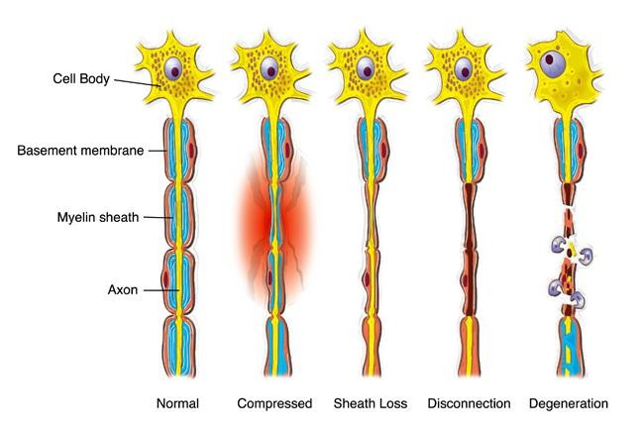
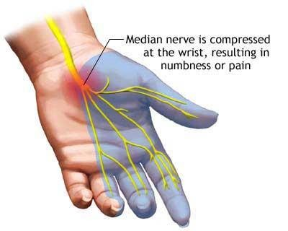
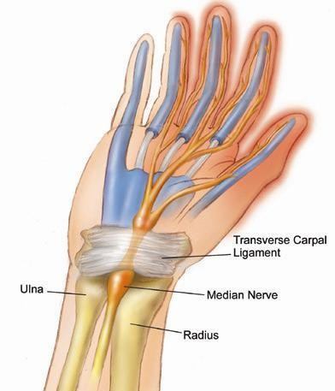
Clinical Application (3 Clinical Applications)
ONLY IN FEMALES’ SLIDES
1- Carpal Tunnel Syndrome
2- Nerve Injury
Extra explanation: carpal tunnel syndrome :Involves thickening of the tunnel in the wrist which the nerve supply to hand muscle passed
3- Myasthenia Gravis (next slide)

Slide 27
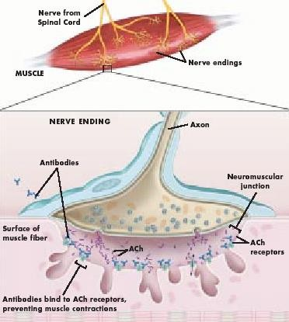
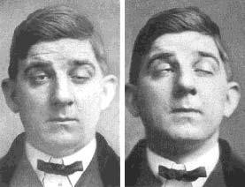
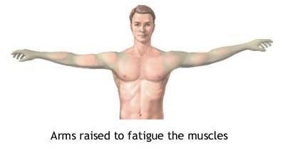
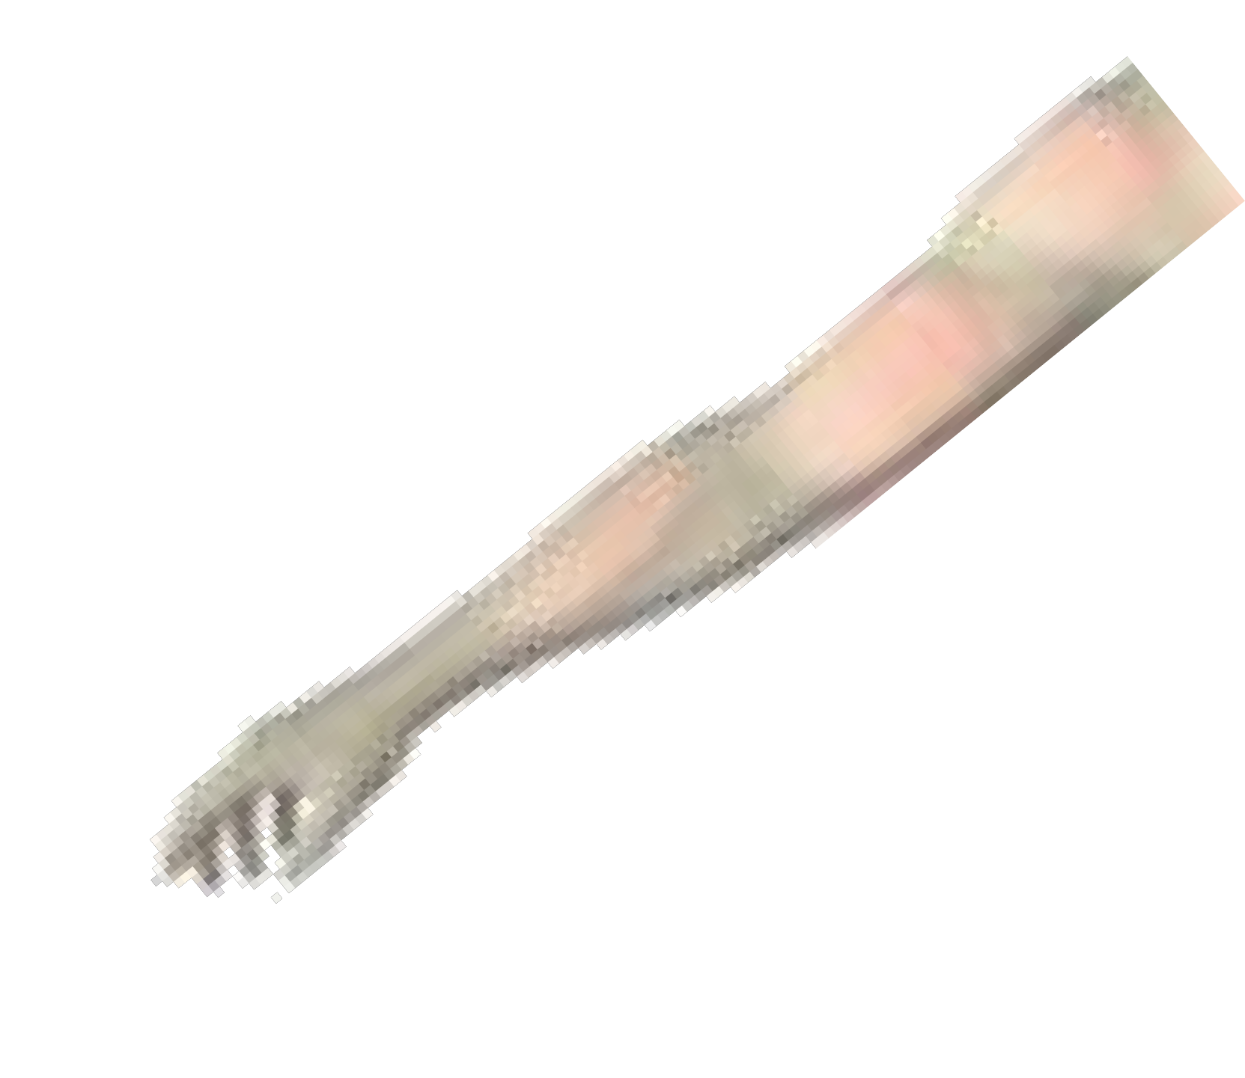
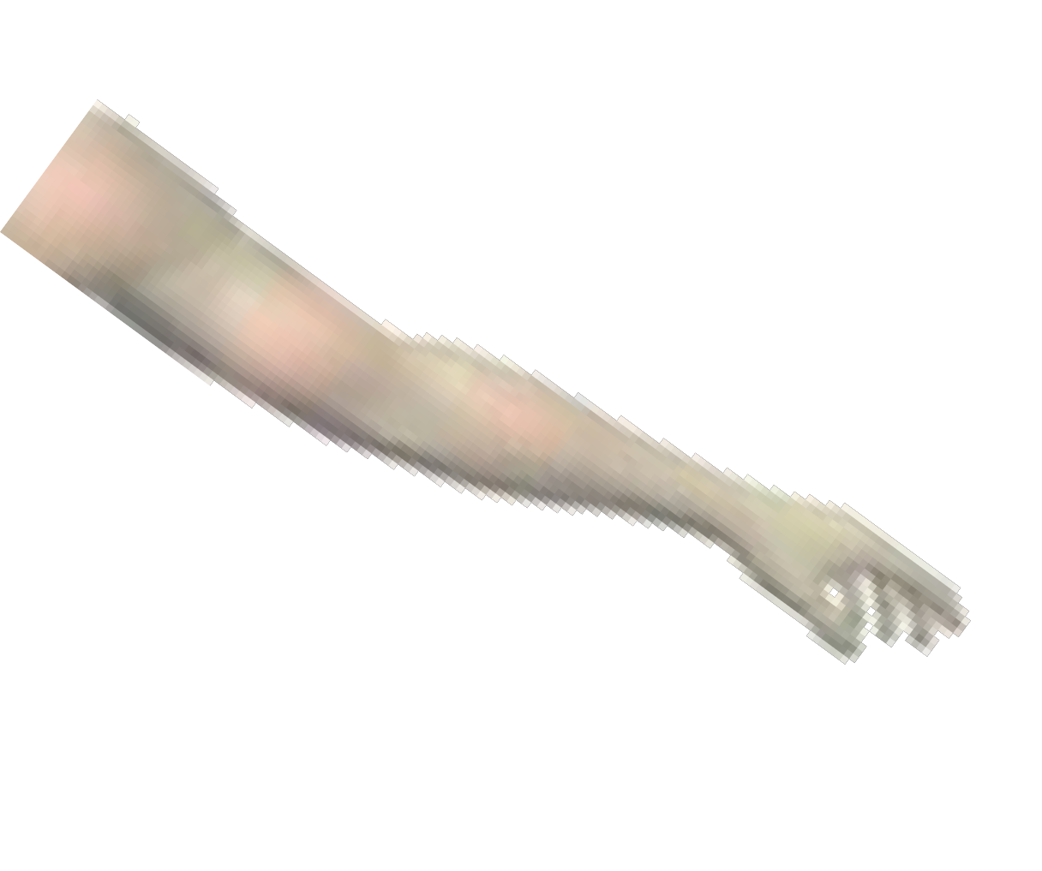
3-Myasthenia Gravis
ONLY IN FEMALES’ SLIDES
Extra explanation :
Myasthenia Gravis: is an autoimmune disease involving the neuromuscular junction, it is characterized by extreme muscular weakness (gravis means severe).
Mechanism: it is an autoimmune condition in which the body produces antibodies against its own (this is why it is an autoimmune disease) motor end-plate Acetylcholine receptor-channels. Thus, not all the released Ach molecules can find a functioning receptor to bind to.

Slide 28
Videos
What are NCS & EMG ?
EMG/NCS testing
Median motor nerve conduction study
Nerve conduction test

Slide 29
Link to Editing File
(Please be sure to check this file frequently for any edits or updates on all of our lectures.)
Quiz
https://www.onlineexambuilder.com/emp-mncv/exam-118896
References:
Girls’ and boys’ slides.
(Lecture contents were not found in our reference textbook and therefore we could not add extra explanation from Guyton and Hall.)

Slide 30
Thank you!
اعمل لترسم بسمة، اعمل لتمسح دمعة، اعمل و أنت تعلم أن الله لا يضيع أجر من أحسن عملا.
The Physiology 436 Team:
Nouf Alaqeel
Leena Alwakeel
Ruba Barnawi
Sondos Alhawamdeh
Heba Alnasser
Ali Al-Subaie
Omar Albabtain
Muhammad Almutlaq
Team Leaders:
Qaiss Almuhaideb
Lulwah Alshiha
Contact us:
Physiology436@gmail.com
@Physiology436

