Slide 1
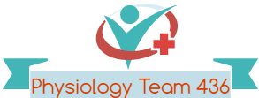
Neuromuscular Junction & Muscle Contraction
Red: very important.
Green: Doctor’s notes.
Yellow: numbers.
Gray: notes and explanation.
Physiology Team 436 – Musculoskeletal Block Lectures 6 & 7
Lecture: If work is intended for initial studying.
Review: If work is intended for revision.

Slide 2
Objectives
Lecture Neuromuscular Junction
- The physiologic anatomy of Neuromuscular Junction (NMJ).
- Motor end plate, synaptic trough/ gutter/ cleft.
Motor End Plate potential and how action potential and excitation-contraction coupling are generated in skeletal muscle.
- Drugs/ diseases affecting the neuromuscular transmission.
Lecture Muscle Contraction
1- The physiologic anatomy of the skeletal muscle. 
2- The general mechanism of skeletal muscle contraction. 
3- The molecular mechanism of skeletal muscle contraction & relaxation. 
4- Sliding filament mechanism.

Slide 3
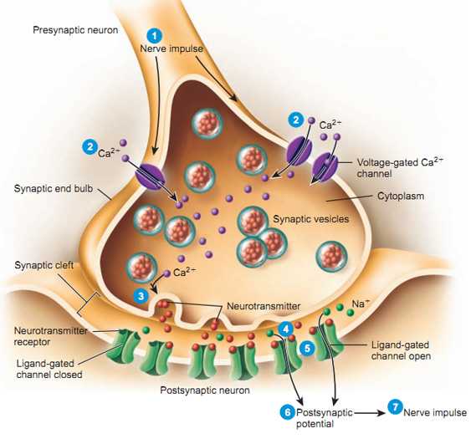
Transmission of Impulses
Transmission of impulses from nerve endings to skeletal muscle fibers occurs via: THE NEUROMUSCULAR JUNCTION (NMJ)
Synapse: is the junction between two neurons where electrical activity of one neuron is transmitted to the other

Slide 4
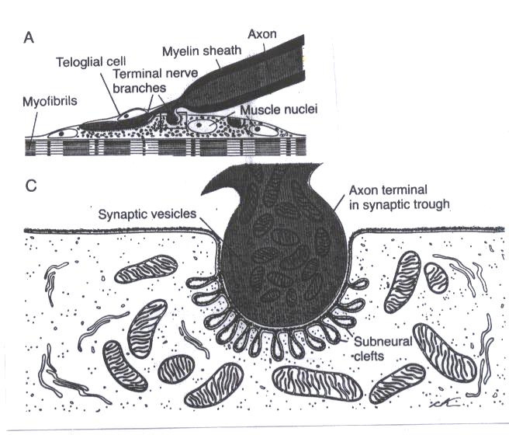
Physiologic Anatomy of Neuromuscular Junction
Motor end plate composed of : (3)
1- Axon terminal (nerve terminal):
Contains around 300,000 synaptic vesicles which contain the neurotransmitter acetylcholine (Ach). Each vesicle has 10,000 Ach molecules.
2- Synaptic Cleft:
20 – 30 nm, the space between the axon terminal & the muscle cell membrane. It contains ECF & Acetylcholinesterase which can destroy Ach. (will talk more about it later)
3- Synaptic Gutter (Synaptic Trough):
The muscle cell membrane which is in contact with the nerve terminal.
It has many folds called Subneural Clefts
Function of Subneural Clefts:
1- Increases surface area.
2 – Allows accommodation of large numbers of Ach receptors which are located here.
Motor End Plate
Motor end plate موجود في العضلة
Presynaptic terminal
Postsynaptic terminal
Presynaptic: nerve Postsynaptic: muscle

Slide 5
Acetylcholine
Synthesized : from active acetate (acetyl coenzyme A) +choline.
Synthesis location: in the cytoplasm of the nerve terminal (axon terminal),
Absorption & Storage: rapidly in synaptic vesicles
Synaptic vesicles synthesis mechanism :
1-synthesized by the Golgi Apparatus in the nerve soma (cell-body),
2- then they are carried by Axoplasmic Transport to the nerve terminal (axon terminal).
Important Vocabulary
Neurotransmitters: Chemicals released by neurons to transmit information to another neuron, gland, or skeletal muscle.
Synaptic knob: the axon terminal which abuts (touches) another neuron, gland cell, skeletal fiber. It is the site of transduction.
Transduction: the conversion of an electrical signal to a chemical signal.

Slide 6
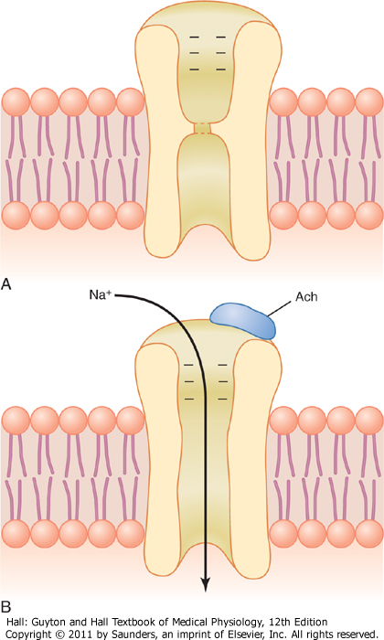
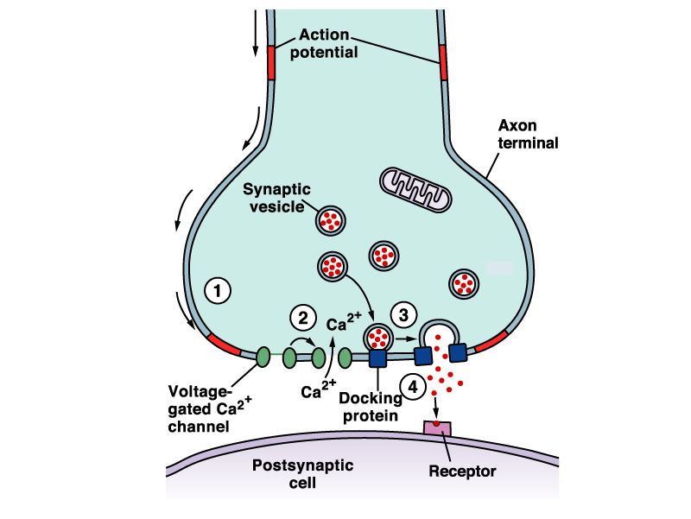
Secretion of Acetylcholine by the Nerve Terminals:
1
Action potential (AP) at the synaptic knob
: A nerve impulse reaches the nerve terminal
Ca+ channel open (voltage-gated Ca+ channels) increase Ca+ permeability
release of neurotransmitter (NT) (Ach) from synaptic knob to synaptic cleft
2 molecule of Ach combines with specific receptor on the subneural cleft
A small amount diffuses out of the synaptic space.
End-plate potential spread & triggers a muscle Action potential to make contraction
Na flow to inside to diffuse into muscle causing local non-propagated potential (End-Plate Potential)
increases electrical potential in the positive direction as much as 50-75 mV and creates a local EPP.
2
Fig. 7.3 Acetylcholine gated channels
A. Closed B. After Ach attaches
Destruction of Ach : by Ach esterase enzyme into:
-Choline : reabsorbed in the nerve terminal to form new Ach - Acetate : goes to blood
Ca dependent exocytosis :
Ca attract vesicles to nerve terminal membrane , they rupture & release Ach to synaptic cleft
Na⁺/Ca⁺/ or K⁺ ions not negative ions such as Cl⁻
The whole mechanism of Ach production, releasing, and destruction takes 5 to 10 minutes.
Important End Note :
One nerve impulse can release 125 Ach vesicles, which is more than enough to produce one End Plate Potential.
Action Potential = Muscle Contract
This opens the Ach gated receptor channels

Slide 7
Extra Information(Team 435)
The action potential reaches the axon terminal, then it will carry a massage to muscles “ Dear muscles, you have to contract now!”
•At the beginning, this massage was electrical then it becomes chemical.
•Action potential > stimulate releasing of chemical substance > that’s why we said “the massage was electrical then it becomes chemical” which called as [Transduction].
•presynaptic cell : an axon terminal ( synaptic knob ) which contains synaptic vesicles.
•postsynaptic cell : a neuron, muscle fiber, or gland cell.
•There are 300,000 vesicle in each axon terminal which contain neurotransmitters such as Acetylcholine.

Slide 8
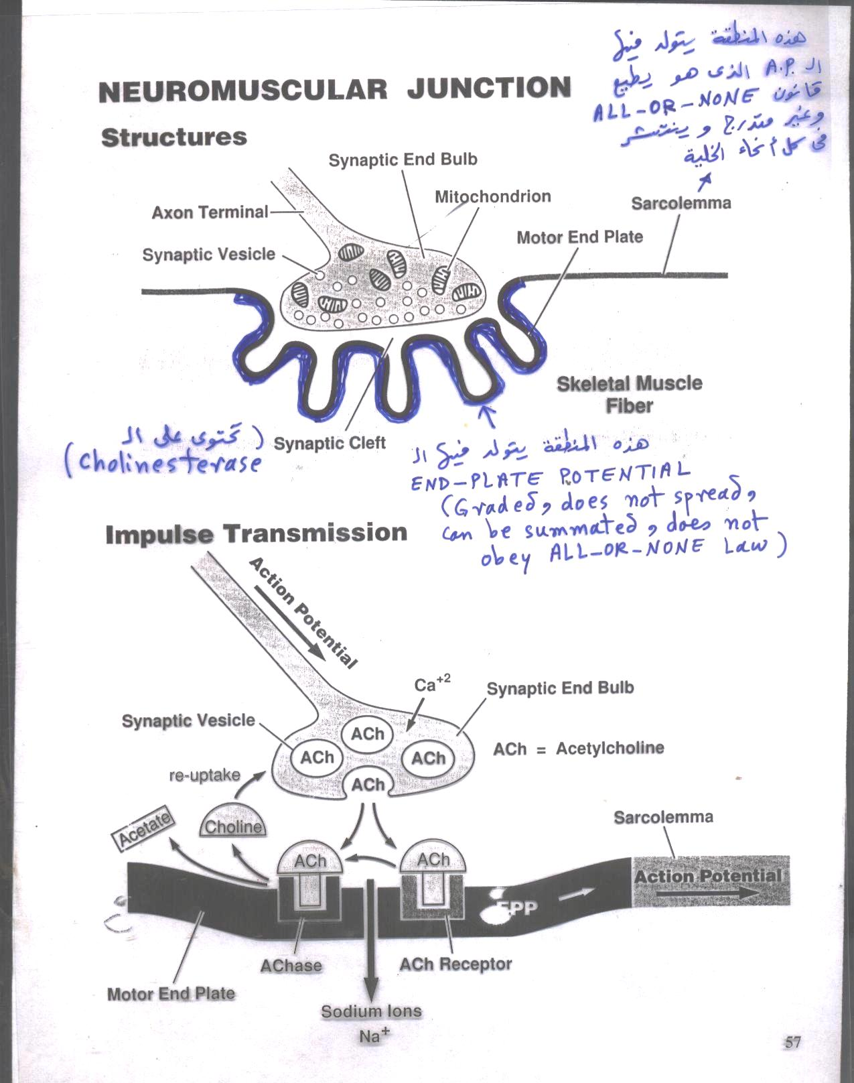

Slide 9
Spread of the Action Potential Via Transverse Tubules
مهمة
System contain :
T-tubules (transverse tubule) are small junction that runs transverse to the myofibrils and extend from one side to the other .(inside each cell & filled with ECF )
The sarcoplasmic reticulum (a place where Ca stored) it is composed of 2 parts:
(1) large chambers called terminal cisternae
(2) long longitudinal tubules
Mechanism :
1- As the AP reaches the T-tubule,
2- the voltage change is sensed by dihydropyridine receptors (DHP)
3- DHP linked to Ryanodine receptors (calcium release channels) which triggers the release of Ca⁺⁺ from Sarcoplasmic reticulum to initiate contraction.
4-This overall process is called excitation-contraction coupling.
Calcium pump : removes calcium ions after contraction occurs.
Calcium binds to calsequestrin.?
Ryanodine receptors is a gate on SR.
DHP is very sensitive to voltage changes.

Slide 10
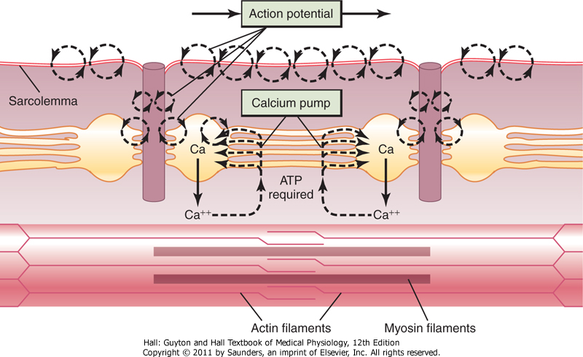
To understand :
ATP is required to pump calcium back to SR
Fig. 7.7 Excitation-contraction coupling in the muscle showing (1) an AP that causes the release of Ca ions from the
sarcoplasmic reticulum and then (2) re-uptake of the calcium ions by the calcium pump.

Slide 11
Safety Factor for Transmission at the Neuromuscular Junction
Fatigue of the Junction:
Each impulse that arrives at the junction causes about
3X as much EPP as required to stimulate the muscle fiber.
Therefore, the normal NMJ is said to have a high safety factor.
Overstimulation diminishes the number of Ach vesicles.
This situation is called fatigue of the NMJ.
Fatigue of the NMJ occurs rarely and only at exhausting levels of muscle activity.

Slide 12
Action Potentials Comparison:الوحدات مهمة
 | Skeletal Muscle | Large Nerves
Resting Membrane Potential | -80 to -90 mV ( Same ) | -80 to -90 mV ( Same )
Duration of the Action Potential | 1-5 milliseconds ( slower ) | 0.2-1.0 milliseconds ( faster )
Conduction Velocity | 3-5 m/sec ( slower ) | 39-65 m/sec ( faster )
Muscle Action Potential:

Slide 13
Drugs that Act on Neuromuscular Junctions
مهم جداً
1- Drugs that stimulate the Muscle Fibers by Ach-Like Action:
2- Drugs that Block Transmission at the NMJ
3- Drugs that Stimulate NMJ by inactivating Ach esterase
1- Methacholine (metha- ميثاء)
2- Carbacol (car – (سيارة
3- Nicotine ( المادة الموجودة (بالسجائر
Metha drink nicotine in the car
They act for minutes or hours.
- They are not destructed by Ach esterase enzyme (cholinesterase).
1- Curare & Curariform
(C) See (U) you Rare
- Competitive inhibition to Ach at its receptors. (Blocking the action of Ach on its receptor)
Can not cause Depolarization (Action potential)
2- Botulinum Toxin
Botul ( بتول (in um toxin's house
Bacterial poison that decrease the quantity of Ach release by the nerve terminals
1- Neostigmine, Prostigmine, Physostigmine:
- Inactivates Ach esterase enzyme temporarily 4 hours.
2- Di-isopropyl-florophosphate: (nerve gas poison)
Inactivates Ach esterase enzyme for days & weeks.
Causes death because of respiratory muscle spasm.
(When we only have a few Ach and we want to use them very well)
Curare is used for hunting.

Slide 14
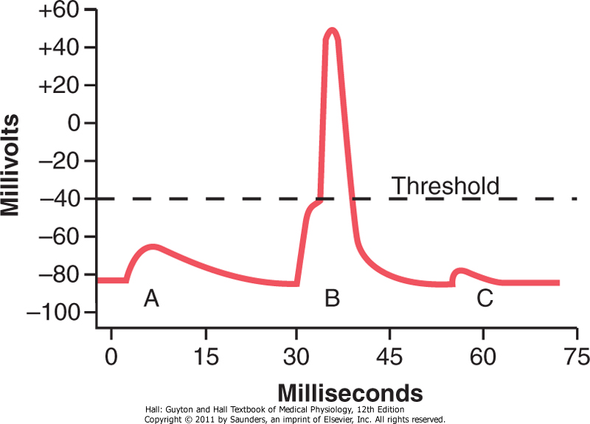
EPP and Excitation of the Skeletal Muscle Fiber
ONLY IN MALES’ SLIDES
Three separate EPP:
End plate potentials A ( Curare “drug”)
End plate potentials B ( NORMAL )
End plate potentials C ( Botulinum toxin )
Curare
Botulinum toxin
You should know that the threshold is not achieved when we use these drugs which means that the EPP is so weak under the effect of these drugs, so the muscle cannot elicit Action potential.
Fig. 7.4 End Plate Potentials in mV. A & C: weakened end potential in a muscle too weak to elicit an AP; B: Normal end plate potential eliciting an AP.

Slide 15
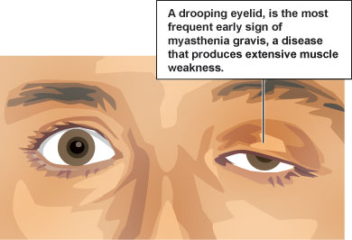
Clinical Application: Myasthenia Gravis
Disease:
Treatment:
Autoimmune disease, Occurs in about 1 in every 20,000 persons.
Cause :
1-The body forms antibodies against Ach receptors which destroy the receptors leaving only about 20%.
Mechanism :
1-inability of the NMJ to transmit enough signals from the nerve fibers to the muscle fibers.
2-EPP is too weak to initiate opening of the voltage-gated sodium channels. The EPP that occur in the muscle fibers is mostly too weak to initiate opening of the voltage-gated sodium channels.
Signs :
1-Disease of adult females affects eyelid, extra ocular bulbar and proximal limb muscles.
2-Presents with ptosis, dysarthria, dysphagia, and proximal limb weakness in hands & feet.
3-Causes muscle weakness
Consequences :
Can lead to paralysis of respiratory muscles which will lead to death. (depending on the severity of the disease)
1- Anti cholinseterase drugs “ Neostigmine”
Mechanism : Inactivate Cholinesterase enzyme to allow more Ach to accumulate on the receptors (allow Ach to accumulate in the synaptic space.)
2- Corticosteroids and Immunosuppressant drugs Mechanism : to inhibit the immune system, limiting antibody production..
Remember: Acetyl Cholinesterase hydrolyzes (breaks, destroys) Ach into choline and acetate.
After treatment :
Good EPP is formed.
Muscle will Contract.

Slide 16
Summary
Muscle AP spreads through T-tubules
it reaches the sarcoplasmic reticulum where → opens its Ca++ channels → calcium diffuses out of the sarcoplasmic reticulum into the cytoplasm → increased Ca++ concentration in the myofibrillar fluid .
Ca++ combines with Troponin , activating it
Troponin pulls away Tropomyosin
This uncovers the active sites in Actin for Myosin
Myosin combines with these sites
This causes cleavage ( breakdown ) of ATP and release of energy
This released energy is used to produce Power Stroke
Myosin and Actin slide upon each other → contraction
A new ATP comes and combines with the Myosin head → this causes detachment ( separation )of Myosin from Actin . Therefore , on order to release the head of Myosin from Actin , a new ATP is needed to come and combine with the head of Myosin .

Slide 17
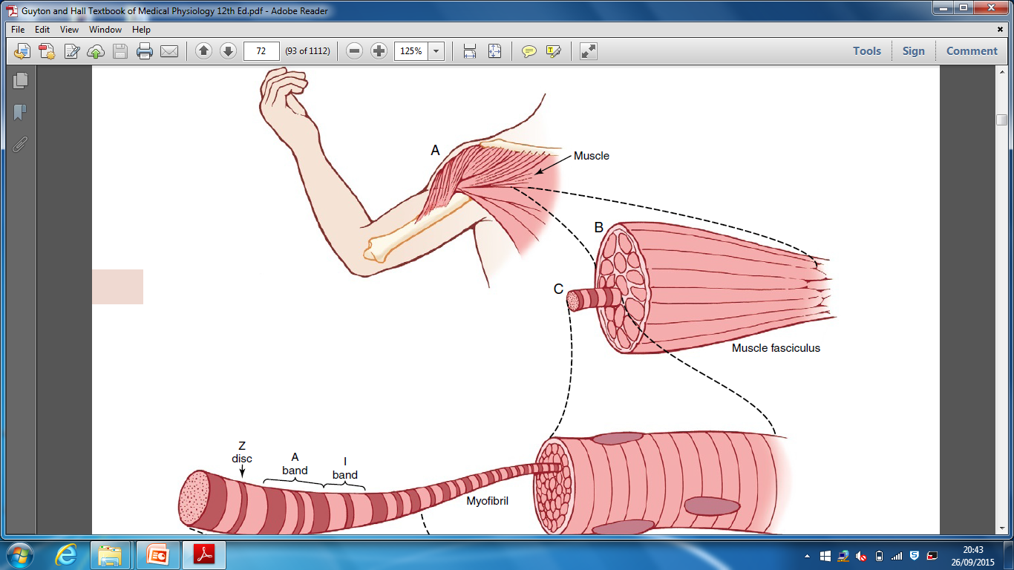
Organization of Skeletal Muscles
Muscle
Fascicle
Muscle fiber (a cell)
Myofibril (each cell contain few hundreds to few thousands )
2 Myofilaments :
Thick: Myosin, Thin: Actin
Function : responsible for the actual muscle contraction
3000 Actin
1500 Myosin
(40% of the body is made out of skeletal muscles)
شرح :
العضلة تركيب دقيق يتكون من عده حزم وهذا ما يعطيها الصلابة، فكل عضلة تتكون من حزم كبيرة تسمى “Fascicle” بداخل هذه الحزمة عدة حزم اخرى صغيرة وهي الخلايا العضلية وتسمى بالMuscle fibers وهي ايضاً بداخلها حزم أصغر تسمى Myofibril وهي بدورها تحتوي على بروتين الأكتين والمايوسين.
-إذاً باختصار كل عضلة تحتوي على 3 حزم بداخل بعضها.

Slide 18
Muscle Fiber Components
Sarcolemma: (plasma membrane) is a thin membrane enclosing a muscle fiber.
Sarcoplasm: Matrix inside muscle fiber in which myofilaments are suspended. It is the ICF between myofibrils.
Sarcoplasmic Reticulum: specialized Endoplasmic reticulum inside sarcoplasm. Function : is to release and store calcium
The functional unit of myofibril is the Sarcomere

Slide 19
Muscle Fiber Components
-Sarcomere: contractile unit of muscle, it is the zone between two Z lines ( discs)
=2 micrometer in length in resting state.
-Z discs: lines extending all way across myofibrils
Myofibril striations Inside each sarcomere there are
I-Band: Light
Formed of actin filament only
A-Band: Dark
Formed of actin and myosin filaments
H-Band:
Formed of myosin filament only
Titins: are filaments that keep the myosin and actin filaments in place.
-IT IS ATTACHED TO THE Z DISK.
Myosin
Actin
M line
* The light and dark bands give skeletal and cardiac muscle their striated appearance.
Myofibril

Slide 20
Molecular Characteristics of the Contractile Filaments
Muscle proteins
Thin filament
Made of round molecules (bead like)
Actin
(the main)
Troponin
( 3circles)
Thick filament
Myosin
(next slide)
Tropomyosin
Composed of double-stranded backbone of F-actin & tropomyosin
string which covers the active site
Troponin T binds with tropomyosin
(stabilizing it),
Troponin I binds with Actin
Troponin C binds with calcium.
الأكتين يشبه في تركيبة الDNA بأنه “Double helix” ولديه binding Site ، يرتبط به مع المايوسن عند عملية الانقباض ، ولكن في الحالة الطبيعية ما نبي هذا الارتباط عشان ما تنقبض العضلة، لذا يوجد تركيب أخر يُغطي هذا الBinding Site يُسمى Tropomyosin، وهو عبارة عن خيط مُلتف حول الأكتين ويغطي الsite.
طيب إذا العضلة بتقبض كيف يروح الTropomyosin؟ عند طريق بروتين أخر “Troponin” مُجرد ما يرتبط الtroponin مع الكالسيوم، علطول يُزيل الtropomyosin فيصير الActive site مفتوح للمايوسين ثم تبدأ عملية الانقباض.
Actin and Myosin: Contractile Proteins
Troponin and Tropomyosin: Regulatory Proteins
Double-Stranded: backbone of the actin filament
Cross-bridges

Slide 21
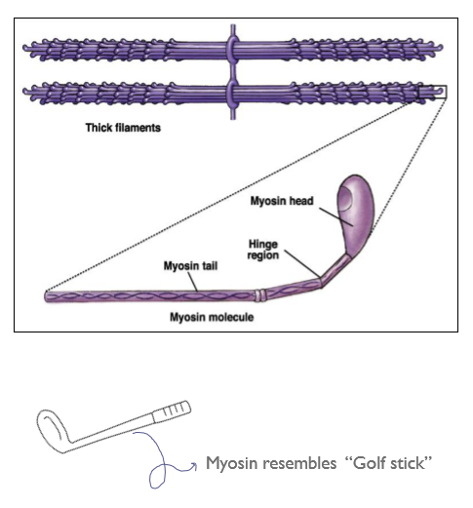
Myosin: Thick Filament
-Each Myosin molecule has:
“شكله يشبه عصا القولف”
-Myosin filaments are composed of multiple myosin molecules.
-Each 200 myosin molecules aggregate to form a myosin filament , from
the sides of which project myosin heads in all directions.
1-Head : has 2 binding sites: (2 ears)
-Actin binding site
-Myosin ATP site
* ATPase” which is responsible of degradation of ATP into (ADP+ phosphate)
2-Tail (body)
3- Arm between tail & head
4-Hinge (joint) منطقة تحت الرأس
Myosin head = cross bridges
نتوءات طالعة من الميوسين
-One for ATP and one for actin. (ATP is broken down because of ATPase enzyme which is always in myosin, so it always has energy.)

Slide 22
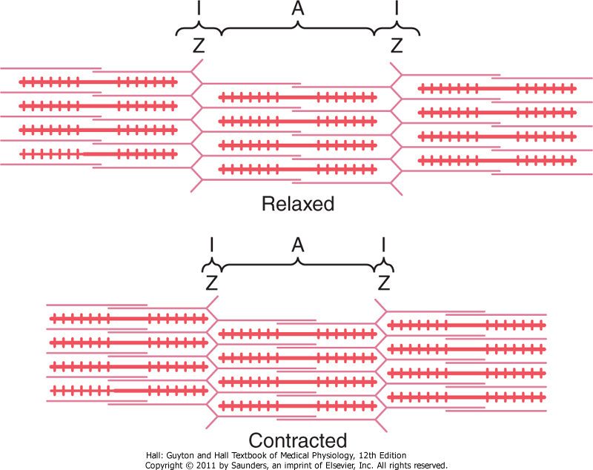
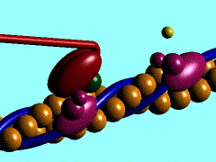
Muscle Fibers during Contraction:
Muscle Contraction Occurs by a Sliding Filament Mechanism which is:
Actin and myosin slide upon each other
The distance between Z discs decreases.
Important NOTES: during contraction :
-H bands: is decreased. (thick)
-I band :is decreased. (thin, light) (may disappear)
-A band: doesn’t change. (dark)
-The length of the fiber itself :doesn’t change
Actin is pulled towards the center of the sarcomere
طول الميوسين ما يتغير؛ الأكتين يصغر بس
Animation of the walk along mechanism:

Slide 23
An action potential travels along a motor nerve to the
motor end plate.
The nerve secretes acetylcholine (Ach).
The Ach binds to sarcolemma and opens gated channels.
Large amounts of Na⁺ enter the cell and initiates and AP.
AP travels along the sarcolemma the same as in a nerve cell.
AP causes depolarization and triggers release of Ca⁺⁺ from the sarcoplasmic reticulum
Ca⁺⁺ initiates the contraction cycle.
After contraction, Ca⁺⁺ ions are reabsorbed by the sarcoplasmic reticulum.
أول ما يصل الAction potential لنهاية الخلية العصبية راح يُحرر الAch المخزن بالvesicles
-وبعد ما يتحرر Ach راح يشغل Nicotinic receptorالموجود بالعضلة
-مما يؤدي إلى دخول الNa بالداخل مؤدياً لزيادة الشحنة الموجبة إي انه بيقلDepolarization “حيث أن الشحنة الموجبة بدخول الصوديوم تعادل الشحنة السالبة داخل الخلية مما يقلل القطبية”
وايضاً بيتحفز الكالسيوم مؤدياً لانقباض العضلة .
“ التفاصيل في المحاضرة الثانية☺ “
General Mechanism of Skeletal Muscle Contraction:
“الحكاية منذ البداية ☺”

Slide 24
Mechanism of Skeletal Muscle Contraction in Actin & Myosin filaments:
- إكمالاً لأحداث عملية الانقباض ، بعد ما صار depolarization وتحفز الكالسيوم بيرتبط ببروتين الtroponin ويحدث ما شُرح ببداية المحاضرة:
once the calcium binds to troponin conformational change takes place
(tropomyosin moves away from myosin active site on actin )
myosin will come and bind with the actin since the active site of actin is exposed now and form a
CROSS BRIDGE
- مجرد ما يرتبط المايوسين والأكتين تبدأ “عملية الانقباض بالحدوث وليس الانقباض بحد ذاته”
Right after myosin bind with actin, the myosin will use the energy that’s stored inside it by change it from chemical to mechanical and break ATP to (ADP+P) by ATPase (they kept in head ).
When (ADP+P) are released (dropped) ,the head of myosin will bend > this movement is called:
[ power stroke ].
To detachment the actin from the myosin we need a new ATP
- مع كُل عملية انقباض نحتاج ATP جديد لفصل الأكتين عن الميوسين ثم يرتبط الميوسين مع أكتين أخر.
-في حال استنفاذ الATP لن ينفصل الأكتين عن الميوسين مما يؤدي إلى جعل العضلة منقبضة
In this stage the myosin become active again so it bind to another actin and “cycle repeated”
Detachment is an active process

Slide 25
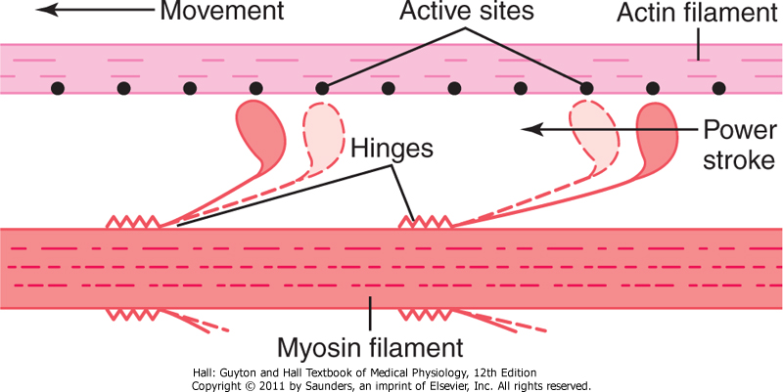
“Walk-along” Mechanism for Muscle Contraction
ONLY IN MALES’ SLIDES
The heads of the cross-bridges bend back and forth
step by step walk along the actin filament
pulling the ends of two successive actin filaments toward the center of the myosin filament.
شرح :
مثل ما قلنا لما الميوسين يستخدم الatp الhead حقه راح يتحرك حركة وحدة “ power stroke”.
الpower strokeتحدث عند التقاء الاكتين مع الميوسين ويحدث بينهمcross-bridges
مع كل power stroke يتحرك رأس الميوسين قدام و وراً مؤدي إلى تحريك الأكتين للCenter بينما الميوسين نفسه ثابت في مكانه.
-But what causes the actin filaments to slide inward among the myosin filaments?
Forces generated by interaction of the cross-bridges from the myosin filaments with the actin filaments.

Slide 26
Muscle Relaxation:
When Ca is pumped back into sarcoplasmic reticulum
Ca detached from troponin
tropomyosin return to its original position
covering active site on actin
prevent formation of cross bridge
Relaxation
NOTES :
-When Ca is released from sarcoplasmic reticulum into the cytoplasm > it does not require energy لأنه زي ما نعرف الساركوبلازم
ريتكليوم هي المخزن فمنطقياً يكون تركيز الكالسيوم اعلى فيها ، بالتالي من التركيز العالي للمنخفض لا يحتاج طاقة .
-But When ca is pumped back into sarcoplasmic reticulum > it requires energy
بالعكس تماماً عندما ننتقل من تركيز منخفض إلى عالي ( المخزن ) نحتاج طاقة

Slide 27
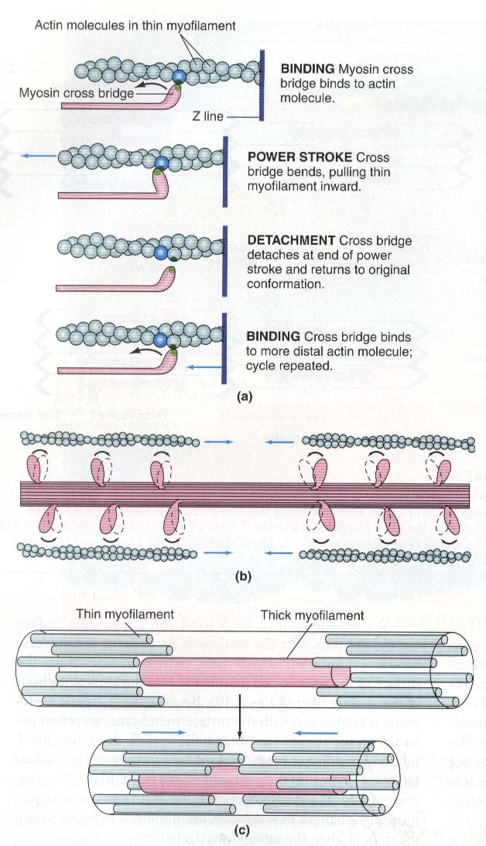
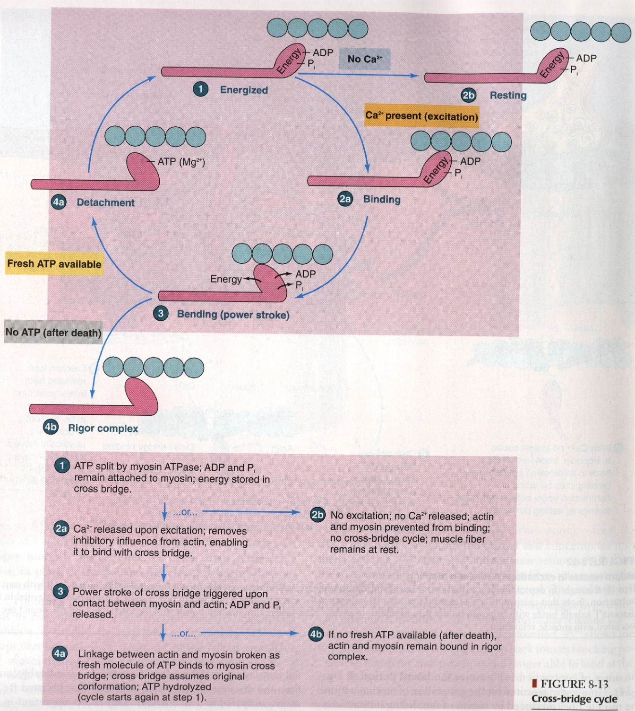
ONLY IN FEMALES’ SLIDES

Slide 28
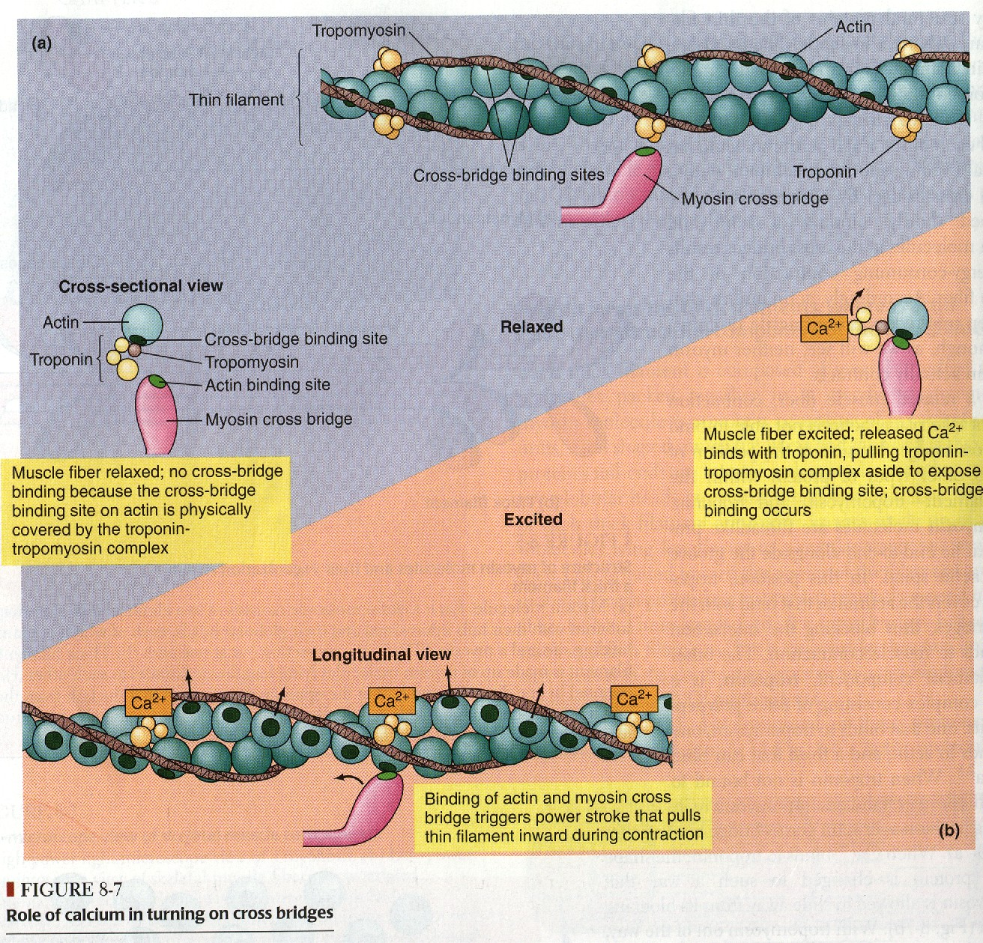
If We Have Calcium: We Have Binding
ONLY IN FEMALES’ SLIDES
بعدم وجود الكالسيوم لا يتحد الـ
مع الـ
myosin
actin

Slide 29
Important Points!
ATP is needed for
3 things :
Power stroke
Pumping Ca++ back into the Sarcoplasmic reticulum
Detachment of myosin from actin active sites
435’s team work:
*Is muscle relaxation a passive or active process ?
-it is active; Why ? Because it needs ATP through pumping of Ca+2back into SR.
*Ca++ is needed in nerve & muscle : when and where ?
•In nerve = needed for exocytosis and release of Ach.
•In Muscle = needed for contraction.

Slide 30
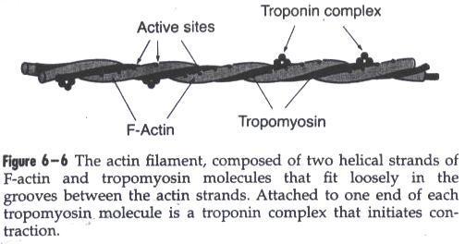
The Diagram of Guyton
Rigor Mortis
After several hours after death, all muscles of the body do into a state of contracture called “rigor mortis”
Means : the muscles become contract and rigid.
Rigidity results : from loss of all ATP which is required to cause separation of the cross-bridges from the actin filaments during the relaxation process.
- مثل ما نعرف عشان العضلة يصير لها relaxation تحتاج ATP فعندما يموت الشخص بيوقف الجسم عن انتاج الATP في لحظات، وفي لحظتها تكون ممكن تكون العضلة منقبضه قبل ما يوصلهاATP لهذا السبب يموت بعض الاشخاص مبتسمين .

Slide 31
Summary :
Muscle AP spreads through T-tubules
2. it reaches the sarcoplasmic reticulum where opens its Ca++ channels calcium diffuses out of the sarcoplasmic reticulum into the cytoplasm increased Ca++ concentration in the myofibrillar fluid.
3. Ca++ combines with Troponin , activating it .
4. Troponin pulls away Tropomyosin
5. This uncovers the active sites in Actin for Myosin
6. Myosin combines with these sites.
7. This causes cleavage (breakdown)of ATP and release of energy
8. This released energy that used to produce Power Stroke
9. Myosin and Actin slide upon each other contraction
10. A new ATP comes and combines with the Myosin head this causes detachment ( separation )of Myosin from Actin .
11. Therefore , on order to release the head of Myosin from Actin , a new ATP is needed to come and combine with the head of Myosin .

Slide 32
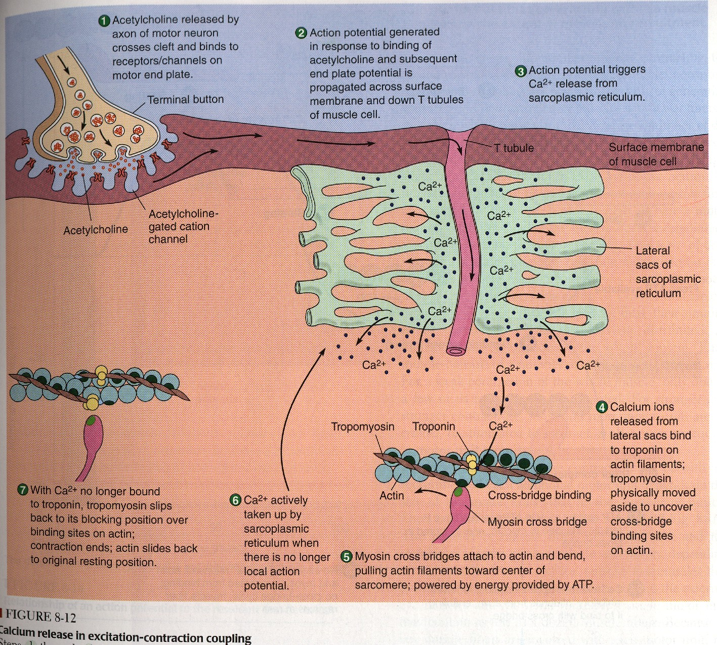
Revision of all stages:
ONLY IN FEMALES’ SLIDES

Slide 33
Questions:
Q1: What is Rigor Mortis ? مات وهو مبتسم مثال:
A: When a new ATP occupies the vacant site on the myosin head, this triggers detachment of myosin from actin (if not, it is called Rigor mortis)
Q2: ATP is needed for 3 things : what are they ?
(1) Power stroke .
(2) Detachment of myosin from actin active sites
(3) Pumping C++ back into the Sarcoplasmic reticulum .
Q3: Is muscle relaxation a passive or active process ? And why?
A : it is active ; Because it needs ATP .
Q4: What happens to A-band and I-band during contraction ?
A: A band do not change while I band changes and shorten
Q5: Ca++ is needed in nerve & muscle : when and where ?
A : In nerve → needed for exocytosis ( & release of Ach)
In Muscle → needed for contraction .

Slide 34
Link to Editing File (Please be sure to check this file frequently for any edits or updates on all of our lectures.)
Editing File
References:
Girls’ and boys’ slides.
Guyton and Hall Textbook of Medical Physiology (Thirteenth Edition.)

Slide 35
Thank you!
اعمل لترسم بسمة، اعمل لتمسح دمعة، اعمل و أنت تعلم أن الله لا يضيع أجر من أحسن عملا.
The Physiology 436 Team:
Rana Barasain
Alaa Alaqeel
Laila Mathkour
Buthaina Almajed
Leena alwakeel
Munirah aldofyan
Wateen Alhamoud
Shouq Albogami
Fouad Bahgat
Mohammed Alayed
Team Leaders:
Qaiss Almuhaideb
Lulwah Alshiha
Contact us:
Physiology436@gmail.com
@Physiology436

