Slide 1
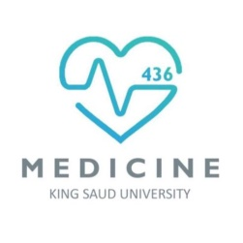
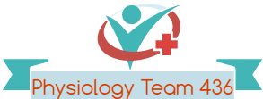
Physical and Physiological Factors Affecting Sport Performance
Red: very important.
Green: Doctor’s notes.
Yellow: numbers.
Gray: notes and explanation.
Physiology Team 436 – Musculoskeletal Block Lecture 8
Lecture: If work is intended for initial studying.
Review: If work is intended for revision.

Slide 2
Objectives
1.Identify the muscle metabolic systems and the nutrients used in exercise
Adenosine triphosphate
Phosphocreatine-creatine system
Glycogen-lactic acid & aerobic system
2. Explain the recovery of the muscle metabolic systems after exercise and the phenomena of oxygen debt
3.Discus the effects of smoking on pulmonary ventilation in exercise.
4.Correlate between heart diseases and the athletic performance in old age.
5.Analyze the changes in body fluids and salts in exercise.
6.Interpret the effects of drugs on athletes.

Slide 3
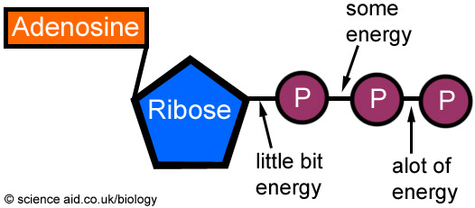
Metabolic Pathways in Skeletal Muscle
Adenosine triphosphate (ATP) is the only energy source used directly by muscles for contractile activities.
The demand and the mechanism of ATP production vary according to the type of work done
At rest, a muscle cell contains a small store of ATP, but it cannot rely on this ATP once it begins contracting (enough for 3 seconds) -> (It will finish quickly so we need to regenerate it)
Muscle cell must get ready for ATP production to keep pace with* the increased rate of utilization.
* To keep pace with : لمواكبة

Slide 4
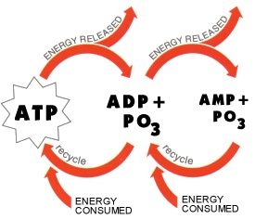
Energy for Muscle Contraction
Mitochondria in the muscle converts glucose, fatty acids, and amino acids into ATP:
(ATP = Adenosine Tri-Phosphate = Adenosine-PO3 ~ PO3 ~ PO3)
Each of the last 2 high energy phosphate bonds in ATP stores 7300 calories per mole of ATP.
All ATP stored in the muscle is sufficient for only 3 seconds (the number will vary) of muscle power. (Enough for one half of a 50-meter dash)
So resting muscles must have energy stored in other ways:
1. Creatine Phosphate (CP) 2. Glycogen 3. Fat & amino acids.

Slide 5
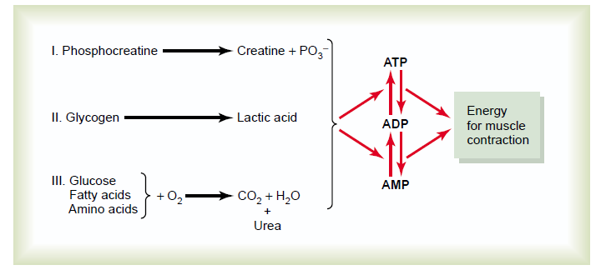
Muscle Metabolic System in Exercise
There are 3 metabolic systems exceedingly (extremely, very) important in understanding the limits of physical activity, those are:-
Phosphocreatine-creatine system
Glycogen-lactic acid system
Aerobic system

Slide 6
ATP Regeneration
As we begin to exercise, we almost immediately use our stored ATP within a few seconds
ATP is regenerated from ADP by:
1) Direct phosphorylation of ADP by creatine phosphate (CP) (take the phosphate and turn ADP to ATP)
2) Anaerobic pathway (glycolysis → lactic acid)
3) Aerobic respiration of fatty acids in the mitochondria (slow, little intensity)
Fast and limited

Slide 7
Interaction of Energy Systems
Immediate
Short-term
Long-term

Slide 8
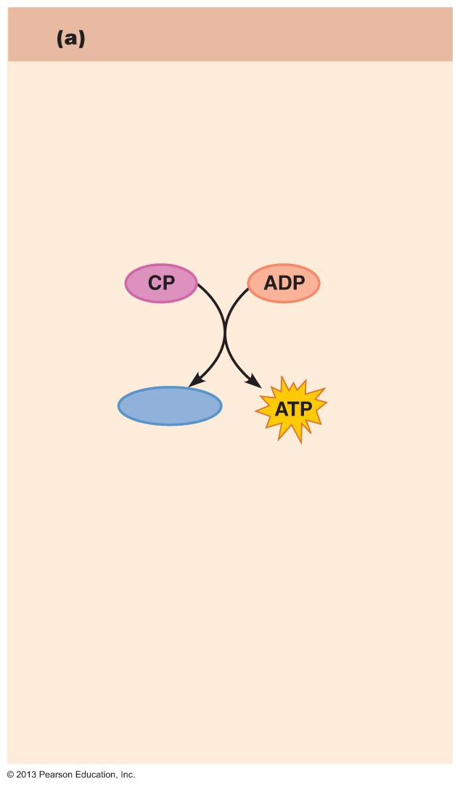
1-Phosphocreatine-creatine System (Creatine Po3):
CP: Contain high energy phosphate bond has 10,300 calories/mole
Most muscle cells have 2-4 times as much CP as ATP
Energy transfer from CP to ATP occurs within a small fraction of a second.
Energy of muscle CP is immediately available for contraction just as stored energy of ATP.
Product: 1 ATP
Direct phosphorylation
Coupled reaction of creatine
Phosphate (CP) and ADP
Energy source: CP
Creatine kinase
Creatine
Oxygen use: None
Products: 1 ATP per CP, creatine
Duration of energy provided:
15 seconds

Slide 9
Phosphagen Energy System:
Formed of combined amounts of cell ATP + CP
Together provide maximal muscle power for 8-10 seconds
(enough for 100 meter run)
Energy of phosphagen system is useful for maximal short bursts of muscle power ( 8-10 seconds).
(Severe exercise for short duration)

Slide 10
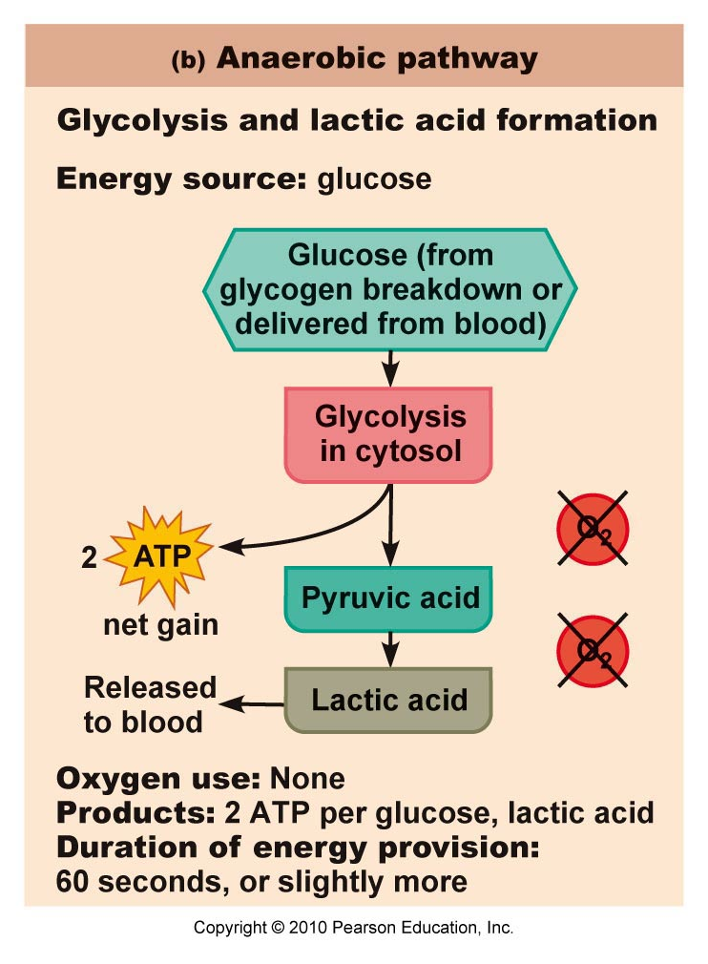
2- Anaerobic Glycolysis (Glycogen-Lactic Acid System) Without Oxygen:
Is the primary energy source for peak (severe) muscular activity. It provides 1.3-1.6 minutes of maximal muscle activity
The process of anaerobic metabolism can maintain ATP supply for about 45-60s.
Source of energy:
Carbohydrate (glycolysis)
Products: 2 ATP & Lactate
Produces 2 ATP molecules per molecule of glucose + 2 NADH
Glycogen → Glucose → 2 pyruvic acid
Lactic acid diffuses out of muscles→blood→ taken by the liver → Glucose (by gluconeogenesis) →blood → taken by the muscle again
2 Pyruvic acid → 2 lactic acid (2 NAD⁺)

Slide 11
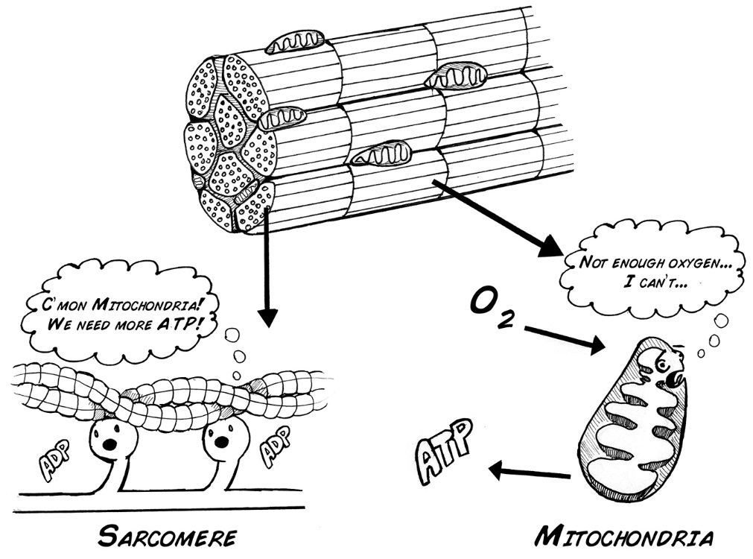
Anaerobic Glycolysis (Glycogen-Lactic Acid System)
Anaerobic metabolism is inefficient ((غير فعال… Why? 1- Large amounts of glucose are used for very small ATP returns. 2- Lactic acid is produced whose presence contributes to muscle fatigue.
Which type of sports use anaerobic metabolism? -Sports that require bursts of speed and activity like:
1- basketball. 2- tennis.

Slide 12
3- Aerobic Metabolism (With Oxygen):
Primary energy source of resting muscles:
- to convert glucose into glycogen
- to create energy storage compounds as CP. نعيد تكوينه
during rest and light to moderate (average) exercise aerobic metabolism contributes 95% of the necessary ATP.
It breaks down fatty acids, pyruvic acid (made via glycolysis), and amino acids
Produces 34 ATP molecules per glucose molecule.
CO₂, H₂O & ATP
Source of Energy:
1-Fatty acids (mainly)
2-Carbohydrates
3- Amino acids

Slide 13
Comparing the Energy Supply of the 1. Phosphagen, 2. Anaerobic, and 3. Aerobic Systems
لاحظ ان مولات النظام القصير اعلى نظام لأن لديه طاقة انفجارية تنتهي بسرعه.(مثل القفز بشكل مفاجئ).
الطاقة متوسطة
الطاقة الاقل ولكنها مستمرة.

Slide 14
Comparison of Energy Sources Used During Short-Duration Exercise and Prolonged-Duration Exercise
6 seconds
10 seconds
30–40 seconds
End of exercise
Hours
ATP is generated by breakdown
of several nutrient energy fuels by
aerobic pathway.
ATP stored in
muscles is
used first.
ATP is formed from
creatine phosphate
and ADP (direct
phosphorylation).
Glycogen stored in muscles is broken down to glucose, which is oxidized to generate ATP (anaerobic pathway).

Slide 15
Extra From Team435

Slide 16
Recovery of Muscle Metabolic Systems After Exercise
Energy
from CP reconstitutes ATP.
from glycogen-lactic acid system reconstitutes the phosphagen system (CP+ATP).
from oxidative metabolism of aerobic system reconstitutes(يعيد تكوين) all other systems:
glycogen-lactic acid system + CP+ ATP.
Both
oxidative metabolism
بإختصار: يعاد تخزينه في العضلات من ومن وراح ترجع مره ثانية.
Glycogen lactic
ATPs
Both
كل واحد يرجع اللي قبله.
Lactic acid causes fatigue so it should be removed by:
1-portion (small amount ) converted into pyruvic acid that is oxidized by all body tissues.
2-The remaining is changed into glucose in the liver to replenish glycogen stores of muscles.
) lactic acid is an energy source ).
مهم تعرفون الجسم اي سستم يستعمل خلال رياضة معينة و التفرقة بينهم لكن عدد الامتار بس مروا عليها مو لازم تحفظوها

Slide 17
Recovery of Aerobic System After Exercise (Oxygen Debt)
It is the amount of extra O₂ that must be taken after exercise to restore the muscles to the resting conditions.
When a person stops exercising, the rate of oxygen uptake does not immediately return to pre-exercise (Normal) levels, it returns slowly. (the person continues to breathe heavily –hyper ventilating- for some time afterward).
This extra oxygen is used to repay the oxygen debt incurred during exercise.
Oxygen Debt :
كمية الأوكسجين اللازمة عشان يرجع الجسم لحالته الطبيعية بعد النشاط البدني
اذا كان الشخص رياضي رح تتم العلمية بسرعة ويسترجع الاكسجين اسرع والعكس
توضيح:
لما الشخص يسوي نشاط بدني عالي , راح يستهلك كمية كبيرة من الأوكسجين الموجودة بالجسم. ولما يوقف هذا النشاط البدني , راح يزيد معدل التنفس بكمية أكبر ويزيد عشان يعوض الأوكسجين اللي أستهلك, ويرجع العضلات لحالتها الطبيعية (recovery).

Slide 18
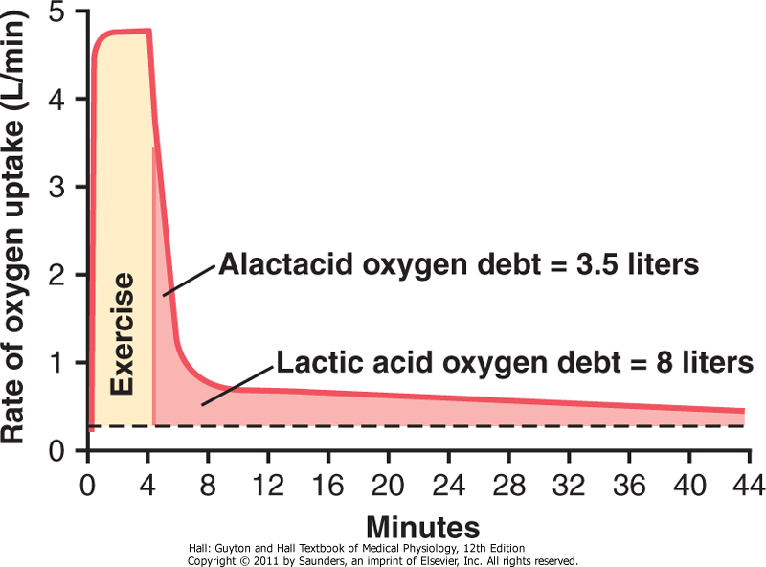
Oxygen Debt
The body normally contains about 2 liters of stored oxygen that can be used for aerobic metabolism.
These 2 liters consist of (0.5 L in lungs + 0.25 L dissolved in body fluids + 1.0 L combined with Hb + 0.3 L stored in muscle myoglobin).
These 2 liters are used within a minute of heavy exercise or for aerobic metabolism.
When a person stops exercising, oxygen debt is about 11.5 L of oxygen.
In addition to 2 L, more O2 (9 L) are needed to reconstitute the phosphagen & glycogen-lactic acid systems.
4 minutes to replenish
مهم
Oxygen debt is only with aerobic system
توضيح:
أثناء النشاط البدني , ال 2 لتر أوكسجين راح تستخدم , بالإضافة لل phosphagen& Glycogen , وعشان يرجعهم الجسم لحالتهم الطبيعية , راح يحتاج ل 11 L من الأكسجين .

Slide 19
Oxygen Debt
During the first 4 minutes, O2 uptake is high & fast to refill stored O2 & phosphagen system. It is called (alactacid O2 debt = 3.5 L)
After the first 4 minutes, O2 debt takes 40 minutes for lactic acid removal. Breathing level will be slower.
It is called (lactic acid O2 debt =8 L)
توضيح:
في اول 4 دقايق بعد النشاط البدني , راح يكون معدل التنفس سريع لتعويض الأوكسجين و phosphagen system, بعدها راح ياخذ الجسم 40 دقيقة عشان lactic acid removal

Slide 20
Recovery of Muscle Glycogen
Reduction of glycogen stores by heavy exercise needs days to be replenished.
On high CHO (Carbohydrates) diet, recovery occurs in 2 days.
On high fat, high protein or on no food all show very little recovery.
Therefore, athletes should:
Have high CHO diet before exercise for ideal recovery. (to have glycogen storage)
Not to participate in exhausting exercise during 48 hours preceding the event.

Slide 21
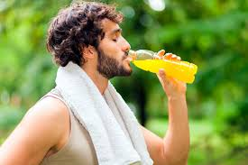
Nutrients Used During Muscle Activity
During early stages of exercise body use CHO of muscle and liver glycogen.
Also in intense muscle activity the body uses fats as F.A & very little amino acids.
1. If endurance athletic events last longer than 4-5 hours & 2. During exhaustion. Then muscle glycogen is depleted (because it finishes after 1 minute) & muscle depend on fats.
Glucose solution given to athletes to drink during athletic event supplies 30-40% of energy required during prolonged events such as a marathon race.

Slide 22
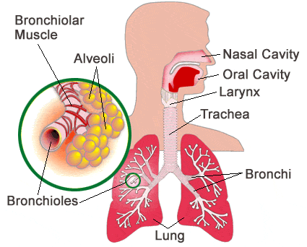
Effects of Smoking on Pulmonary Ventilation in Exercise
Smoking (Nicotine) causes irritation to the bronchioles:
By increasing fluid secretion into the bronchial tree and swelling of epithelial layer. Which will constrict the terminal bronchioles and therefore increases resistance of airflow into and out of the lungs.
Also , Nicotine paralyzes the cilia of the respiratory epithelial cell surface.
All lead to fluid and waste accumulation and reduced level of performance.
Chronic smokers may develop emphysema =
(obstruction of bronchioles + chronic bronchitis + destruction of alveoli)
- so slight exercise causes respiratory distress (pain).

Slide 23
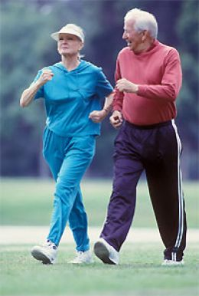
Effects of Heart Disease and Old Age on Athletic Performance
Cardiac diseases that reduce cardiac output (C.O.P) will reduce muscle power.
Patient with congestive heart failure has little muscle power to even walk on the floor.
Recall muscle power : is the amount of work that the muscle perform in a period of time (kg-m/min) .
N.B the muscle power is inverse proportional with the time.
There is 50% decrease in C.O.P between age 18-80 years.
There is a decrease in maximal breathing capacity
Decrease in muscle mass.
Therefore there is decrease in muscle power with age.

Slide 24
Effect of Body Fluids and Salts in Exercise
Exercising for 1 hour during endurance athletic events causes 5-10 pounds of weight loss in hot humid atmosphere due to sweat loss.
Recall: muscle endurance: is the ability of muscles to sustain repeated contractions against a resistance for a period of time.
Loss of enough sweat reduces performance -5-10% may lead to cramps, nausea & serious effects, so this water lost due to sweat should be replaced.
Sodium tablets or supplemental fluids which contain potassium in the form of fruit juice are required for athletes.
Also Acclimatization to exercise by gradual increase over 1-2 weeks instead of maximal exposure is needed.
-Acclimatization: is the process in which an individual organism adjusts to a gradual change in its environment, to maintain performance across a range of environmental conditions. (التاقلم)

Slide 25
Drugs and Athletes
Caffeine increases athletes’ performance.
Male sex hormone (Androgens) & other anabolic steroids:
When women use Androgens , They develop:
Develop facial hair,
Stoppage of menses “menstruation”
Ruddy “reddish” skin and bass “the lowest adult male singing voice.” voice
Increases athletes’ performance
Increasea the risk of heart attacks due to hypertension,
Increase LDL (low-density lipoprotein cholesterol) increasing LDL increase the risk of CVD
and decrease HDL. (high-density lipoprotein cholesterol) N.B: LDL also called ("bad" cholesterol) , HDL also called ("good" cholesterol)
Decrease testicular functions
Decrease natural testosterone secretion in males
Amphetamine & cocaine improve performance
BUT overuse reduces performance, they are psychic stimuli. *Have a “psychological effect”
The action of these drugs in addition to epinephrine and norepinephrine (hormones of adrenal medulla ) secreted during exercise lead to death by ventricular fibrillation.
epinephrene A hormone secreted by the adrenal medulla that is released into the bloodstream in response to physical or mental stress,

Slide 26
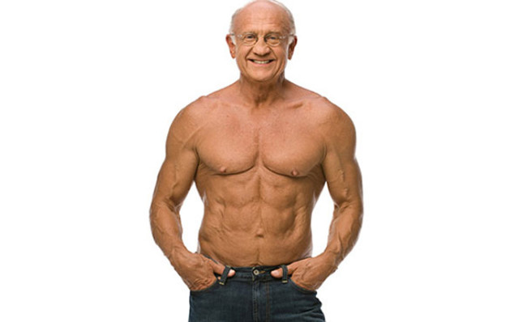
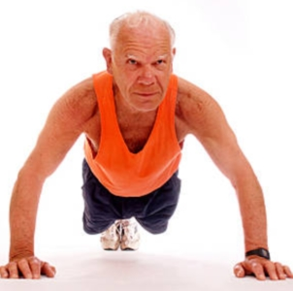
Body Fitness Prolongs Life
Studies show that body fitness, exercise & weight control prolong life (between 50-70 yrs)
Reasons:- 1- Reduce CVD (cardiovascular diseases), heart attacks, brain stroke and kidney disease due to low blood pressure, low blood cholesterol, low LDL, and high HDL.
2- Reduces insulin resistance and type 2 diabetes.
3- Reduces the risk of breast, prostate, and colon cancers and reduces obesity.

Slide 27
Link to Editing File (Please be sure to check this file frequently for any edits or updates on all of our lectures.)
Quiz
https://www.onlineexambuilder.com/physical-and-psycological-factors-affecting-sport-performance/exam-120808
References:
Girls’ and boys’ slides.
Guyton and Hall Textbook of Medical Physiology (Thirteenth Edition.)

Slide 28
Thank you!
اعمل لترسم بسمة، اعمل لتمسح دمعة، اعمل و أنت تعلم أن الله لا يضيع أجر من أحسن عملا.
The Physiology 436 Team:
Rana Barasain
Nouf Aloqaili
Ruba Barnawi
Lama Alfawzan
Heba Alnasser
Fahad Al Fayez
Hassan Al Shammari
Ali Al Subaei
Omar Al Babteen
Fouad Bahgat
Faisal Al Fawaz
Muhammad Al Aayed
Muhammad Al Mutlaq
Waleed Al Asqah
Team Leaders:
Qaiss Almuhaideb
Lulwah Alshiha
Contact us:
Physiology436@gmail.com
@Physiology436

