Slide 1
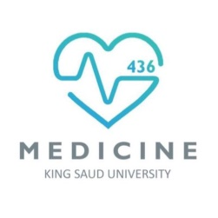
Muscle Adaption to Exercise
Red: very important.
Green: Doctor’s notes.
Yellow: numbers.
Gray: notes and explanation.
Physiology Team 436 – Musculoskeletal Block Lecture 9
Lecture: If work is intended for initial studying.
Review: If work is intended for revision.

Slide 2
Objectives
Define strength, power, and endurance of muscles.
Analyze the effect of athletic training on muscle structure and muscle performance.
Discuss the mechanism of muscle hypertrophy.
Contrast Fast-twitch and slow-twitch muscle fibers.
Explain the respiratory changes in exercise (Oxygen consumption, pulmonary ventilation and VO2 max).
Identify the cardiovascular changes in exercise (Work output, oxygen consumption, and cardiac output , heart hypertrophy).
Interpret the role of stroke volume and heart rate in increasing the cardiac output.
Explain the body heat in exercise & the heatstroke.

Slide 3
Strength & Power
Muscle Strength: The amount of force a muscle can produce.
Also known as the maximal overload of this muscle.
Size of muscles: Influences the maximal contractile force (increased muscle diameter -> increased muscle strength ) Normally 3 - 4 kg/cm²
Example : a cross-sectional area 150 cm² cause maximal contractile strength of 525
(150 cm² x 3.5 = 525)
*3.5 is the average of size
Mechanical work of muscle = W= F x D
force applied by the muscle X distance
Muscles Power: amount of work that the muscle performs in period of time
(kg-m/min)
Strength refers to FORCE
Work refers to FORCE & DISTANCE
Power refers to WORK ( force & distance) & TIME
مهمة جدا
The maximal Power achieved by all the muscles working together of a highly trained athlete:
Can’t do it twice
Anabolic pathway
Physics recall: Work= Force x Distance - Power= Work (FD) x Time

Slide 4
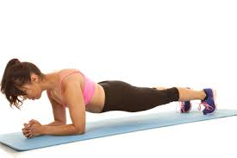
Endurance of Muscles
مهمة جدا
The difference between Endurance and strength
Muscles Endurance: Ability of muscles to sustain repeated contractions against a resistance (e.g. gravity) for a period of time.
It depends on glycogen stored in the muscle.
Dynamic Endurance: is defined as a muscle’s ability to contract and relax repeatedly.
Static Endurance: is a muscle’s ability to remain contracted for a long period.
Endurance | Strength
increased repetition | decreased repetition
decreased resistance | increased resistance
increase in cardiovascular fitness | increase in muscle mass
قدرة تحمل العضلة هي القدرة على تحمل الانقباضات المتكررة ضد المقاومة لوقت محدد وتعتمد على كمية الجلايكوجين في العضلة.
اللي يسوون تمارين مقاومة عارفين هالكلام زين ☺

Slide 5
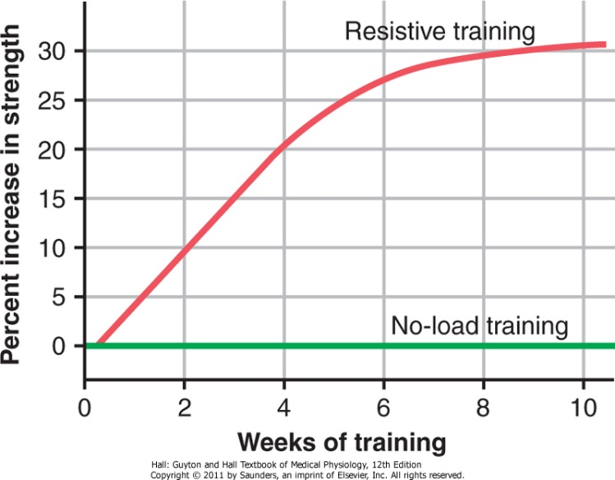
Effects of Exercise on The Body
مثل تمارين المقاومة "استخدام أثقال" تزيد
من قوة تحمل العضلة اعتماداً على كمية
الجلايكوجين أما التمارين الهوائية "مثل
الجري" لا تتطلب مقاومة بالتالي
لا تعمل على تقوية العضلات بالمقدار الكافي
مثل تمارين المقاومة.
Muscle Performance
Body
Heat
Cardiovascular System
Respiratory
System
Cardiovascular System
Maximal Resistance Training
6 Maximal muscle contraction sets against a load X 3 days a week = great increase in muscle strength, No muscle fatigue.
Muscles that function under no load, even if they are exercised for hours on end, increase little in strength
10 weeks training against load increases muscle’s strength up to 30%
Notes:
From 434 Team

Slide 6
Muscle Hypertrophy
Exercise Hypertrophy: is due to an increase in contractile protein
(number of actin &myosin filaments in each muscle fiber = muscle cell)
Hypertrophy results primarily from the growth of each muscle cell, rather than an increase in the number of cells.
With training, muscles are hypertrophied by 30 - 60 %
Increase in number of contractile proteins
Myofibrils split within each muscle fiber to form new myofibrils.
GREAT increase in the number of additional myofibrils
Hypertrophy
Changes in Hypertrophied Muscle:
Increased myofibrils
Increased 120 % in mitochondrial enzymes( tricarboxylic acid)
Increased ATP and phosphocreatine
Increased 50 % in stored glycogen
Increased 75 -100 % in stored triglyceride
Increased oxidative metabolic system rate by 45 %
Increased capability of aerobic and anaerobic metabolic systems

Slide 7
Fast Twitch and Slow Twitch Muscles Fibers
الفيديو بطل ويختصر عليكم
Muscles in the human body are usually composed of two types of Fibers:
Fast-twitch fibers | Slow-twitch fibers
For forceful and rapid contraction | For prolonged muscle activity
e.g. Gastrocnemius muscle used for jumping. | e.g. Soleus muscle in the lower leg muscles for standing.
Achieves maximal power: in very short periods of time (few seconds to a minute). | Prolonged strength of contraction (minutes to hours)
- | Organized for (provides) endurance
Organized for Anaerobic energy | For Aerobic energy
In summary, fast-twitch fibers can deliver extreme amounts of power for a few seconds to a minute or so.
Conversely, slow-twitch fibers provide endurance, delivering prolonged strength of contraction over many minutes to hours.

Slide 8
Fast Twitch and Slow Twitch (Extra.)
مب موجود في السلايدات بس الدكتور عاد أكثر من مره انه نقراه ومطلوب مننا بالباثولوجي
These are the differences between fast and slow twitch fibers found in Guyton & Hall Textbook of Medical Physiology 12E Unit XV chapter 84 page 1036.
1. Fast-twitch fibers are about twice as large in diameter than Slow-twitch fibers.
2. The enzymes that promote rapid release of energy from the phosphagen and glycogen-lactic acid energy systems are two to three times as active in fast-twitch fibers as in slow-twitch fibers, thus making the maximal power that can be achieved for very short periods of time by fast-twitch fibers about twice as great as that of slow-twitch fibers.
3. Slow-twitch fibers are mainly organized for endurance, especially for generation of aerobic energy. They have far more mitochondria than the fast-twitch fibers. In addition, they contain considerably more myoglobin, a hemoglobin-like protein that combines with oxygen within the muscle fiber; the extra myoglobin increases the rate of diffusion of oxygen throughout the fiber by shuttling oxygen from one molecule of myoglobin to the next. In addition, the enzymes of the aerobic metabolic system are considerably more active in slow-twitch fibers than in fast-twitch fibers.
4. The number of capillaries is greater in the vicinity of slow-twitch fibers than in the vicinity of fast-twitch fibers.

Slide 9
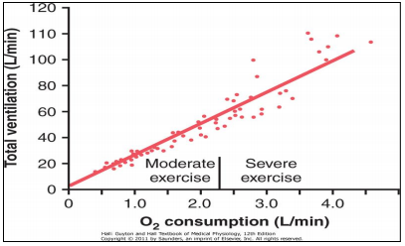
Respiration In Exercise
تنبيه: الفيديو يحتوي على موسيقى
Oxygen consumption (VO2) at rest is about 250 ml/min.
However, at maximal efforts, this can be increased to the following levels:
Oxygen Consumption (VO2) and Pulmonary Ventilation (VE) in Exercise
Untrained average male
3600 ml/min
Athletically trained average male
4000 ml/min
Male marathon runner
5100 ml/min
Both Oxygen Consumption (VO2) and Pulmonary Ventilation (VE) increase about 20 folds between resting state and maximal intensity as shown in the graph.
لازم الاثنين يزيدون مع بعض –علاقة طردية-
O2 consumption : The amount of oxygen needed to meet the metabolic needs of the tissues.
Pulmonary ventilation refers to the total exchange of air between the lungs and the ambient air

Slide 10
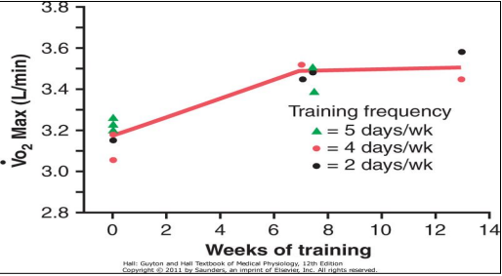
Effect of Training on VO2 Max (Max Oxygen consumption)
In the study below, VO2 Max increased only about 10 percent by training. Depending on number of factors:
Chest sizes in relation to body size.
Increase respiratory muscles’ strength.
شرح الرسمة:
الرسمة تقارن بين استهلاك الاكسجين وعدد أسابيع التمرين لثلاث أشخاص: واحد يتمرن ٥ أيام بالأسبوع وواحد ٤ وواحد ٢.
من الرسمة نقدر نشوف انه الي تمرن مرتين بالأسبوع هو أكثر واحد زاد عنده استهلاك الاكسجين.
(مب شرط انه الي يتمرن اكثر أحسن)
الرياضة ما تزود VO2 كثير.
Pulmonary Ventilation = VE / Oxygen Consumption = VO2
كلهم يزيدون مع قوة نشاط العضلات

Slide 11
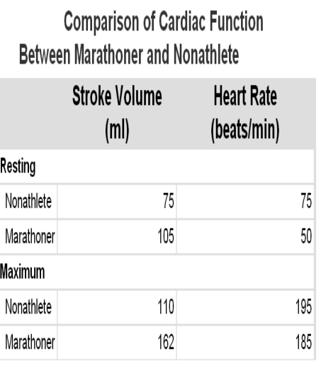
Cardiovascular System In Exercise
Work Output , Oxygen Consumption , and Cardiac Output During Exercise:
All are directly related to one another by :
So, heart chambers (Heart size) of marathoners enlarge about 40% in contrast to non-trained individuals.
Muscle work output (training)
dilates the muscle blood vessels
increasing venous activity
increases oxygen consumption
increasing cardiac output C.O. P (about 40%)
السيمباثاتك اقل عندهم فلذلك يقل ال HR – يكونون مروقين

Slide 13
Cont.

Slide 14
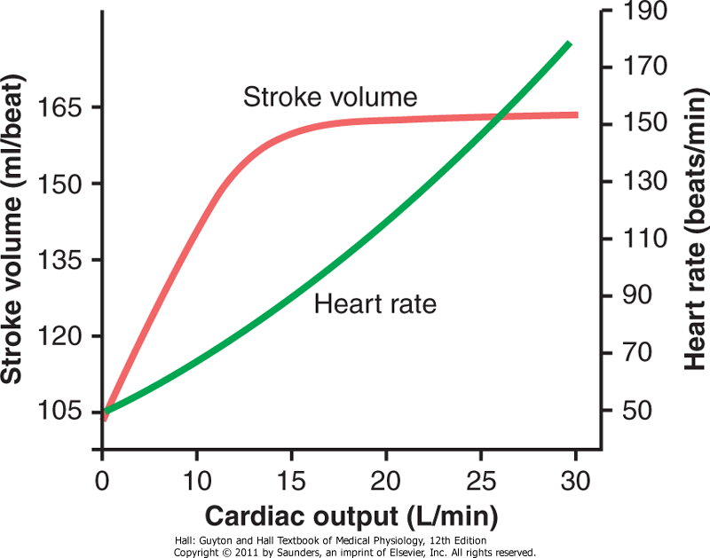
Cardiovascular System in Exercise
شرح
The cardiac output increases from its resting level of about 5.5 L/min to 30 L/min
The stroke volume increases from 105 to 162 milliliters, an increase of about 50%
The heart rate increases from 50 to 185 beats/min, an increase of about 270%
The heart rate increase is a greater proportion of the increase in cardiac output than the increase in stroke volume (Why?????)
Cardiac output = heart rate x stroke volume
Stroke Volume= volume of blood pumped (ml per beat.)
اذا زاد الجهد تزيد نبضات القلب ويزيد الستروك فوليوم. في مرحلة معينة تستمر نبضات القلب بالزيادة ولكن الستروك فوليوم ما يزيد .(steady state stroke volume) ليش؟
Because Stroke Volume depends on venous return(عودة الدم الى القلب) .
When Venous return reaches its max, Stroke volume does not increase
Girls’ doctor: Because Stroke volume is restricted by the size of the heart
At the beginning the increase in cardiac output is due to heart rate and stroke volume but later it is due to heart rate only.
* Again: The increase in heart rate holds a greater proportion of the increase in cardiac output than the increase in stroke volume does
Approximate stroke volume output and heart rate at different levels of cardiac output in a marathon athlete.

Slide 15
Body Heat in Exercise
Almost all the energy released by the body's metabolism is converted into body heat.
Working muscle uses only 20-25% of that energy
The rest is converted into heat as a result of:
During endurance training body temperature rises from 98.6° to 102° or 103°F (37° to 40°C) with very high heat and humidity body temperatures could easily rise to 106° to 108°F (41° to 42°C)
High temperature is destructive
(-ve) to tissue cells mainly (brain cells)
Resistance to the movement of the muscles and joints.
Friction of the blood flowing through the blood vessels
Muscle contractile converted into heat
If sweating mechanism cannot eliminate the heat, Heatstroke will occur.

Slide 16
Symptoms and Treatment of Heatstroke
Symptoms
Body weakness
Headache
Exhaustion
Uncontrolled gait
Dizziness
Unconsciousness or collapsing
nausea (disgust)
Sweating
Death
(in Extreme conditions)
Treatment
If body temperature reaches 41 > damage of brain cells > highly fragile cells > زيادة
الحرارة تسبب تلف في
البروتينات وبما أنها خلايا
ضعيفة إذاً تتلف البروتينات
داخلها
Remove all clothing
Maintain a spray of cool water on all surfaces of the body
Blow air over the body with a fan
Physicians prefer total immersion of the body in water containing a mush of crushed ice if available.

Slide 17
Heatstroke Cont.

Slide 18
Link to Editing File (Please be sure to check this file frequently for any edits or updates on all of our lectures.)
You are done! Good luck!
References:
Girls’ and boys’ slides.
Guyton and Hall Textbook of Medical Physiology (Thirteenth Edition.)

Slide 19
Thank you!
اعمل لترسم بسمة، اعمل لتمسح دمعة، اعمل و أنت تعلم أن الله لا يضيع أجر من أحسن عملا.
The Physiology 436 Team:
Munirah Aldofyan
Rana Barasain
Leena alwakeel
Laila Mathkour
Buthaina Almajed
Wateen Alhamoud
Shoag Albogami
Mohammad Almutlaq
Faisal Alfawaz
Ali Al-Subaie
Team Leaders:
Qaiss Almuhaideb
Lulwah Alshiha
Contact us:
Physiology436@gmail.com
@Physiology436

