Slide 1
PNEUMONIA
RESPIRATORY BLOCK
Dr. Maha Arafah & Prof. Ammar Rikabi
Department of Pathology
KSU, Riyadh
2017

Slide 2
Pulmonary infections
Pneumonia /pulmonary infection can be very broadly defined as any infection in the lung
Respiratory tract infections are more frequent than infections of any other organ. Why?
The epithelium of the lung is exposed to liters of contaminated air
Nasopharyngeal flora are aspirated during sleep
Underlying lung diseases render the lung parenchyma vulnerable to virulent organism

Slide 3
Pulmonary infections: Predisposing factors
Other causes:
Loss or suppression of the cough reflex: as a result of coma, anesthesia, neuromuscular disorders, drugs, or chest pain.
Injury to the mucociliary apparatus: by either impairment of ciliary function or destruction of ciliated epithelium e.g. cigarette smoke, inhalation of hot or corrosive gases, viral diseases, chronic diseases or genetic disturbances
Decreased function of alveolar macrophages: by alcohol, tobacco smoke, anoxia, or oxygen intoxication
Pulmonary congestion and edema
Retention and accumulation of secretions: e.g. cystic fibrosis and bronchial obstruction
Immunologic deficiencies, treatment with immunosuppressive agents, leukopenia
chronic diseases

Slide 4
Pathogenesis of pneumonia
Portal of entry for most pneumonias is
Inhalation of air droplets
Aspiration of infected secretions or objects
Hematogenous spread from one organ to other organs can occur.
Pneumonia can be acute or chronic

Slide 5
Anatomic classification of pneumonia
Classification of pneumonia can be made according to causative agent or gross anatomic distribution of the disease.
1. Alveolar
- Bronchopneumonia: (Streptococcus pneumoniae, Haemophilus influenza, Staphylococcus aureus) Represent an extension from preexisting bronchitis or bronchiolitis. Extremely common tends to occur in two extremes of life.
- Lobar pneumonia: (Streptococcus pneumoniae) Acute bacterial infection of a large portion of a lobe or entire lobe.Classic lobar pneumonia is now infrequent.
Note: Overlap of the two patterns often occur
2. Interstitial: Influenza virus (children), Mycoplasma pneumoniae

Slide 6
The clinical types of pneumonia
Community-Acquired Acute Pneumonia
Community-Acquired Atypical Pneumonia
Nosocomial Pneumonia
Aspiration Pneumonia
Chronic Pneumonia
Opportunistic pneumonias/Pneumonia in the Immunocompromised Host

Slide 7
Community-Acquired Acute Pneumonia
Usually Bacterial
Can follow URT infection
It can be lobar or bronchopneumonia
Clinical features: Sudden onset of high fever, chills, pleuritic chest pain and productive cough, may be with hemoptysis
Reduced air entry and dullness by percussion
Cause:
The most common cause of Community-Acquired Acute Pneumonia is Streptococcus pneumoniae
Other common causes: Haemophilus influenzae, Moraxella catarrhalis, Staphylococcus aureus, Legionella pneumophila, Klebsiella pneumoniae and Pseudomonas aeruginosa spp.
In intraveinous drug abuser: Staphylococcus aureus
It is more common in:
Underlying chronic disease e.g. DM, COPD, and congestive heart failure
Congenital or acquired immune deficiency
Decreased or absent splenic function

Slide 8
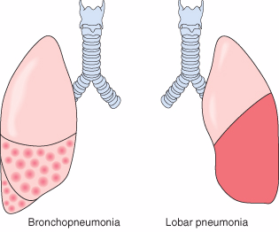
Anatomic classification of pneumonia
Community-Acquired Acute Pneumonia

Slide 9
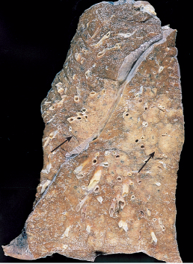
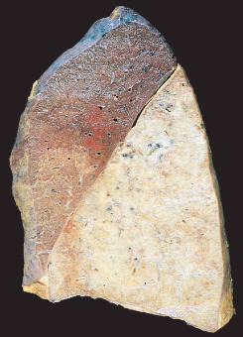
Community-Acquired Acute Pneumonia
Bronchopneumonia
– most common agents are:
Streptococcus pneumoniae,
Haemophilus Influenza, in COPD
Pseudomonas Aeroginosa in CF
coliform bacteria.
staphylococci
Lobar pneumonia
- 90-95% are caused by pneumococci(Streptococcus pneumoniae)
(type 1,3,7 & 2)
- Rare agents: K. pneumoniae
staphylococci - streptococci
H. influenzae - Pseudomonas and Proteus

Slide 10
Lobar pneumonia
Community-Acquired Acute Pneumonia
It is widespread involvement of a large area and even an entire lobe of lung (widespread fibrinosuppurative consolidation).
There are 4 stages:
Stage I: Congestion: lung is heavy, boggy and red. The intra-alveolar space is filled with fluid, few scattered neutrophils and numerous bacteria.
Stage II: Red hepatization ( solidification): alveolar spaces are filled with neutrophils, red cells (congestion) and fibrin. Grossly the lung is firm/solid red and liver-like.
Stage III: Gray hepatization: here the red cells are reduced but neutrophils and fibrin(fibrinopurulent/suppurative exudate) are still present. Grossly the lung is still firm/solid and liver-like but grey.
Stage IV: Resolution: exudates within the alveoli are being enzymatically digested, resorbed, ingested by macrophages or coughed up.

Slide 11
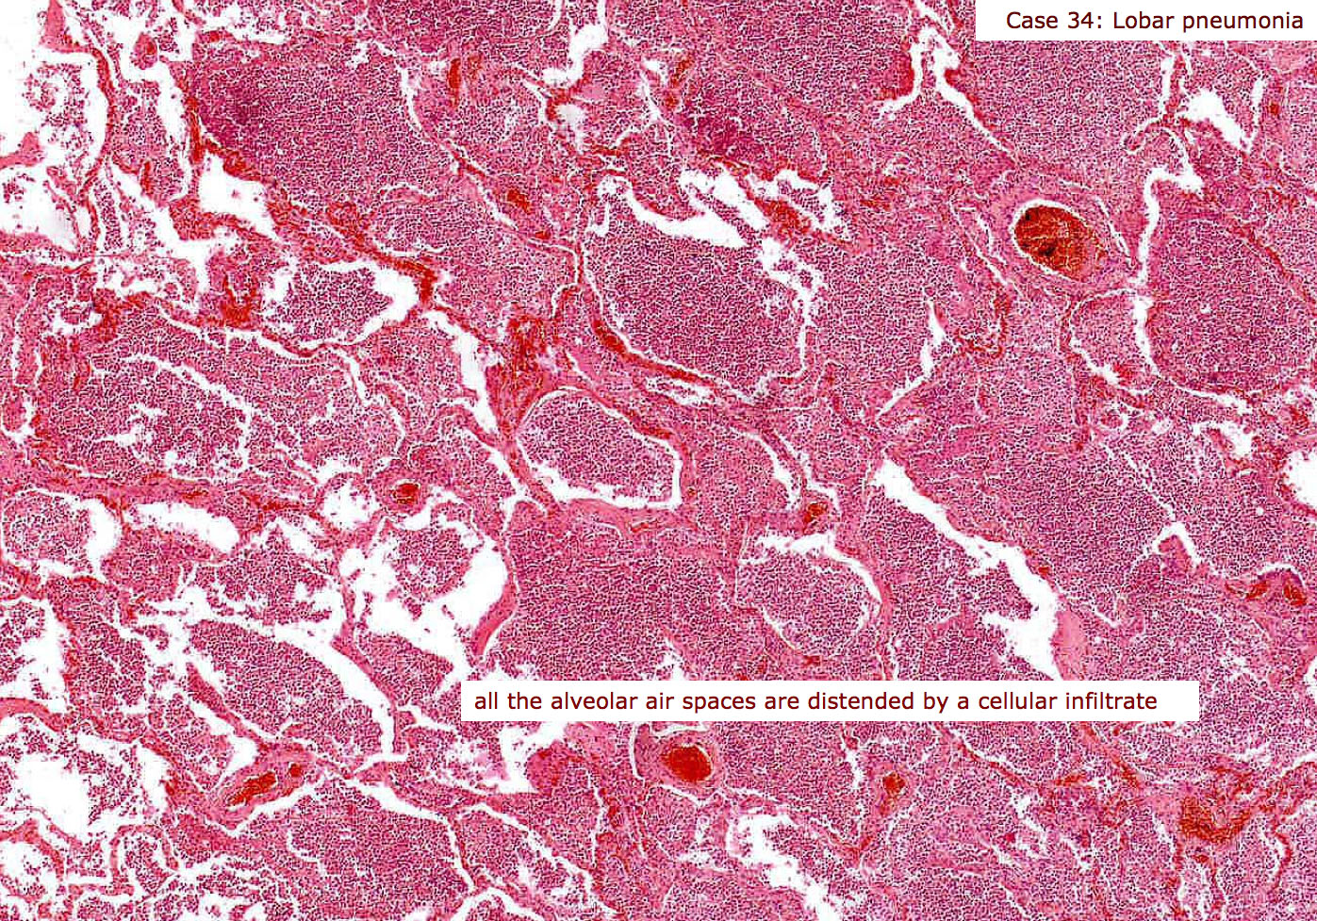
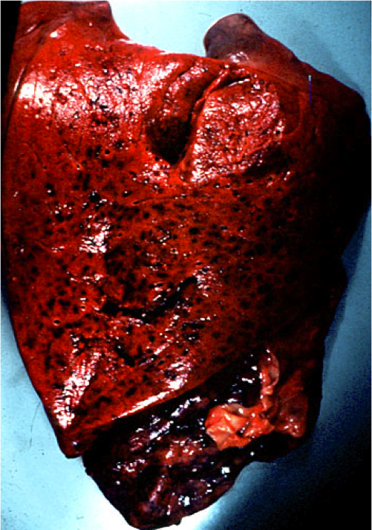
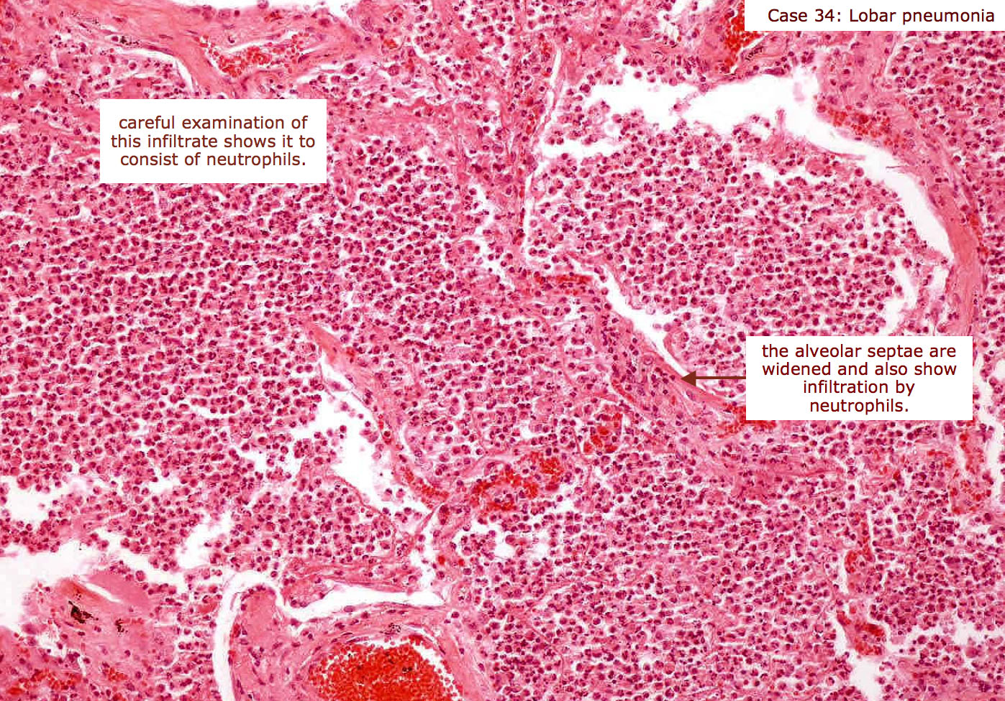
Red hepatization
Community-Acquired Acute Pneumonia
Alveoli are filled with fibrin, RBC’s and neutrophils

Slide 12
Bronchopneumonia
Community-Acquired Acute Pneumonia
Are focal/patchy areas of consolidated acute suppurative inflammation in one or more lobes.
Usually it involves lower lobes (basal) bilaterally because there is a tendency of the secretions to gravitate into the lower lobes.
Well developed lesions are 3 to 4 cm dry grey red ill defined nodules.
Microscopy: neutrophil rich exudate filling the bronchi, bronchioles and adjacent alveolar spaces.

Slide 13
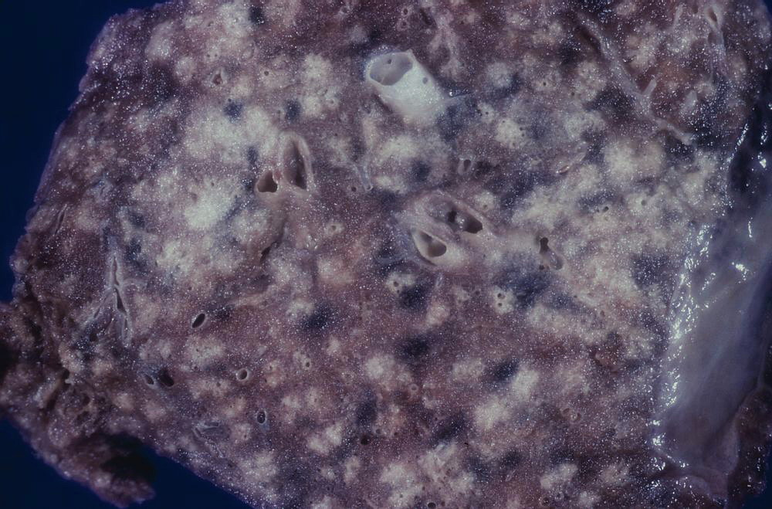
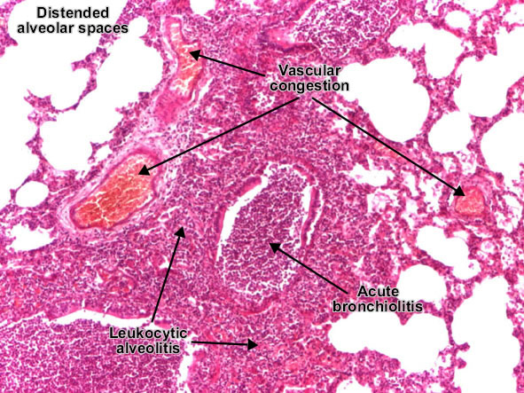
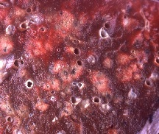
Bronchopneumonia
Community-Acquired Acute Pneumonia

Slide 14
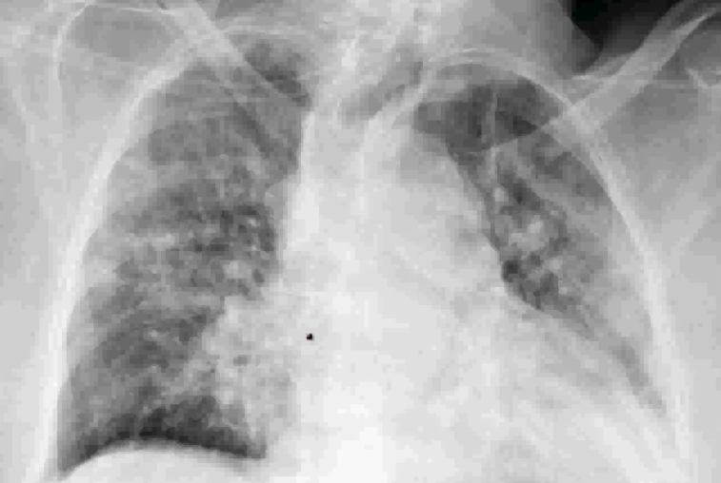
Bronchopneumonia
Community-Acquired Acute Pneumonia
multiple small opacities (consolidation)

Slide 15
Community-Acquired Acute Pneumonia
Clinical features
Abrupt onset of
high fever
shaking chills
cough productive of mucopurulent sputum occasional patients may have hemoptysis.
When fibrinosuppurative pleuritis is present, it is accompanied by pleuritic pain and pleural friction rub
Radiology:
in lobar pneumonia there is a radio opaque (consolidation) well circumscribed lobe
in bronchopneumonia there are multiple small opacities usually basal and bilateral.

Slide 16
Community-Acquired Acute Pneumonia
Complications
Tissue destruction and necrosis (abscess).
Spread of infection to the pleura leading to empyema.
Organization of the exudate which converts the lung into solid tissue.
Bacteremic dissemination to heart valves (infective endocarditis), pericardium, brain (meningitis), kidneys, spleen or joints (arthritis)

Slide 17
2) Community Acquired Atypical Pneumonia/ Primary atypical pneumonia/interstitial pnemonitis
Characterized by patchy inflammation in the lungs confined to the alveolar septae and pulmonary interstitium and therefore it is called interstitial pnemonitis.
It is also called atypical pneumonia because it not the typical pneumonia in which the inflammation is primarily in the alveolar spaces.
It is caused by many organisms
the most common is Mycoplasma pneumonia
Others include:
Viruses e.g. respiratory syncytial virus, influenza virus (children), influenza A and B (adults); adenovirus and SARS virus
Chlamydia spp. (C. pneumonia etc.) and Coxiella burnetti (Q fever). Chlamydia is transmitted by inhalation of dried excreta of infected birds and causes ornithosis/psittacosis.
Predisposing factors: malnutrition, alcoholism and any underlying debilitating disease

Slide 18
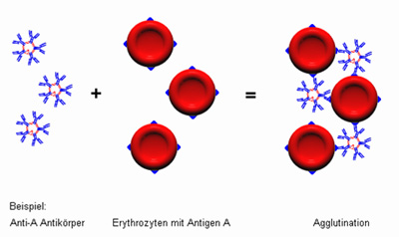
2) Community Acquired Atypical Pneumonia
Test for Mycoplasma pneumonea:
serological assays, and polymerase chain reaction (PCR) are used for diagnosis

Slide 19
Primary atypical pneumonia/interstitial pnemonitis
2) Community Acquired Atypical Pneumonia
Clinical course:
Extremely variable course. Patient usually present with flulike symptoms which may progress to life-threatening situations.
Identification of the organism is difficult.
Prognosis in uncomplicated pt. is good
Gross:
Pneumonic involvement may be patchy, or involve whole lobes bilaterally or unilaterally.
Affected areas are red-blue congested.

Slide 20
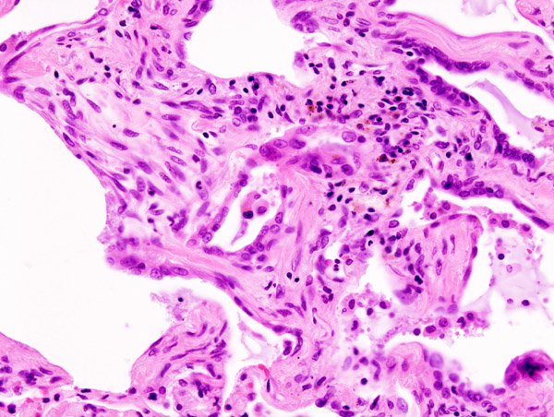
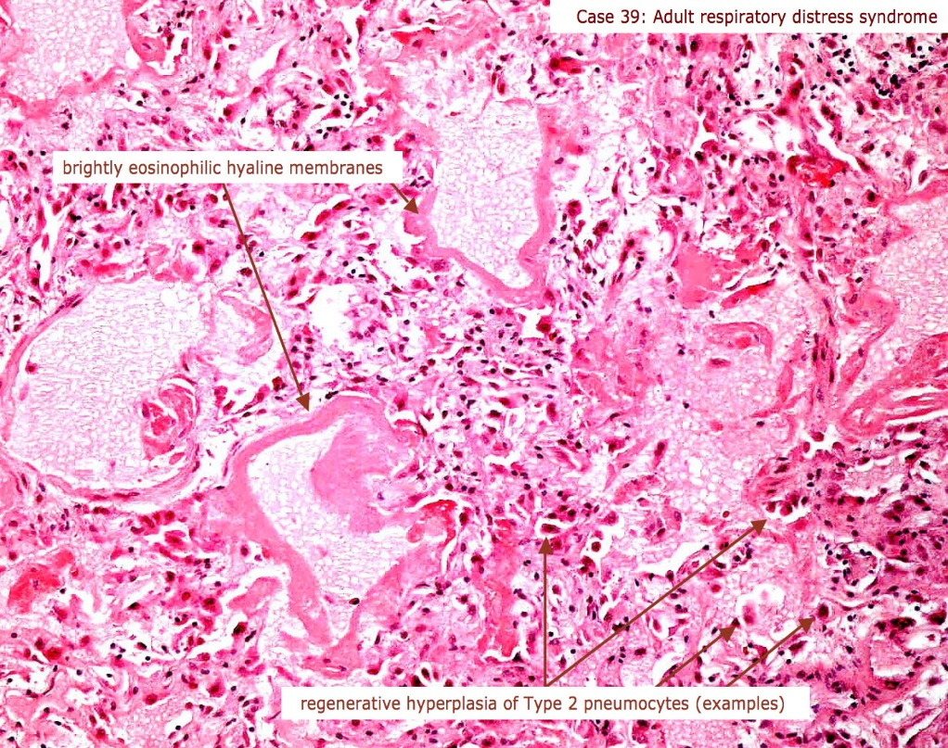
Primary atypical pneumonia/interstitial pnemonitis
2) Community Acquired Atypical Pneumonia
Micro:
Predominantly there is inflammation in the interstitium/alveolar wall.
Alveolar septa are widened and edematous with mononuclear inflammatory infiltrate (and neutrophils in acute cases only)
Sever cases: Intra-alveolar proteinaceous material with pink hyaline membrane lining the alveolar walls (diffuse alveolar damage)

Slide 21
3) Nosocomial Pneumonia:
Hospital acquired Pneumonia.
Acquire terminal pneumonias while hospitalized (nosocomial infection)
Predisposing factor: sever underlying conditions e.g. immunosuppression, prolonged antibiotic therapy, intravascular catheter and pt. with mechanical ventilator
Cause: Gram-negative organisms like Klebsiella, Pseudomonas aeruginosa and E. coli have been implicated.

Slide 22
4) Aspiration pneumonia
Occur in debilitated patients, comatose, alcoholic, or those who aspirated gastric contents
Chemical injury due gastric acid and bacterial infection (anaerobic bacteria admixed with aerobic bacteria, e.g. Bacteroides, Fusobacterium and Peptococcus)
A necrotizing pneumonia with fulminant clinical course, common complication (abscess) and frequent cause of death.

Slide 23
5) Chronic pneumonia
is most often a localized lesion in an immunocompetent person, with or without regional lymph node involvement.
There is typically granulomatous inflammation,
Which may be due to bacteria (e.g., M. tuberculosis) or
fungi (Histoplasma capsulatum, Coccidioides immitis, Blastomyces )
In the immunocompromised, there is usually systemic dissemination of the causative organism, accompanied by widespread disease.
Tuberculosis is by far the most important entity within the spectrum of chronic pneumonias.

Slide 24
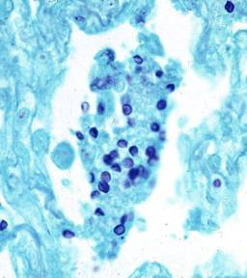
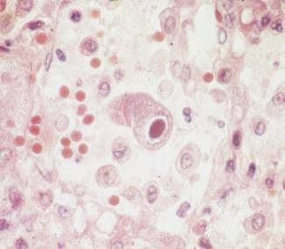
6) Opportunistic pneumonias
Infections that affect immunosuppressed patients (AIDS, cancer patients and transplant recipients)
Causative organisms:
Cytomegalovirus
Pneumocystis jiroveci
Mycobacterium avium-intracellulare
Invasive aspergillosis
Invasive candidiasis
"Usual" bacterial, viral, and fungal organisms
Aspergillus
Pneumocystis carinii
Cytomegalovirus

Slide 25
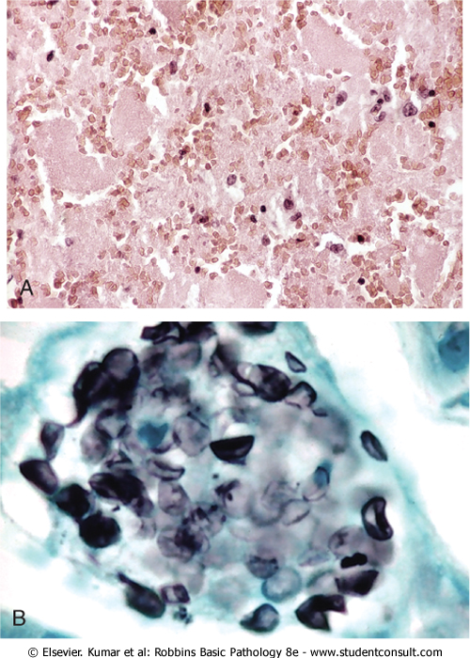
Pneumocystis Pneumonia
6) Opportunistic pneumonias
P. jiroveci (formerly P. carinii) is an opportunistic infectious agent considered as a fungus.
Seen in immunocompromised individuals especially AIDS.
Effective methods of diagnosis are:
identify the organism in bronchoalveolar lavage fluids or in a transbronchial biopsy specimen.
immunofluorescence antibody kits and PCR-based assays.
Microscopically:
characteristic intra-alveolar foamy, pink-staining exudate on H&E stains (A).
organism is trapped in the foamy material and can be seen on silver stain as oval cup shaped structures (B)

Slide 26
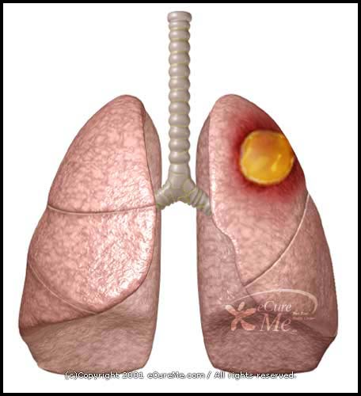
Lung abscess

Slide 27
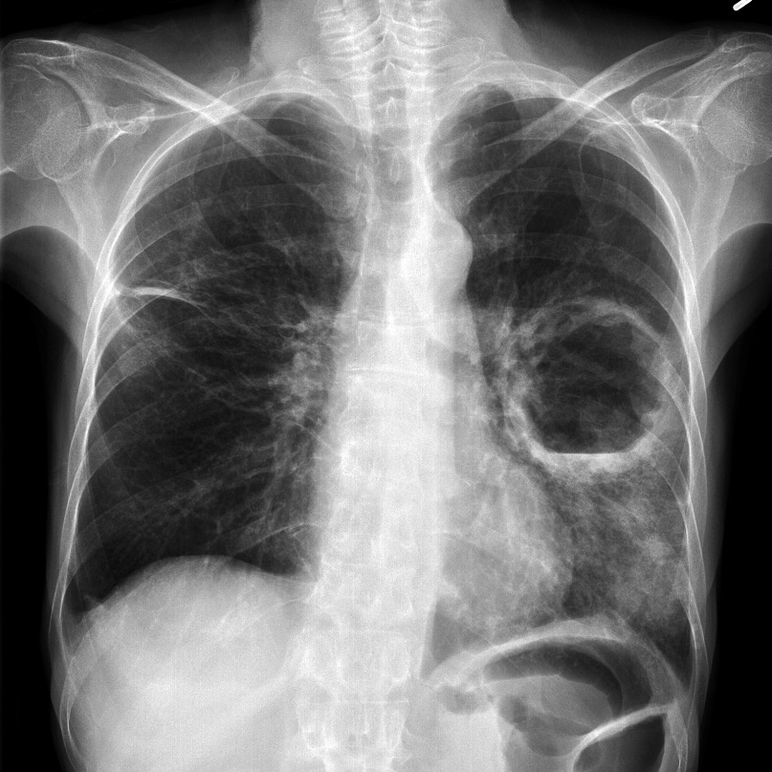
Lung abscess
Is localized suppurative necrotic process within the pulmonary parenchyma
Features: tissue necrosis and marked acute inflammation. Abscess is filled with necrotic suppurative debris
Organisms:
Staphylococci
Streptococci
Gram-negative organisms
Anaerobes
Pathogenesis:
Can follow aspiration
As a complication of pneumonia
Septic emboli
Tumors
Direct infection

Slide 28
Lung abscess
Clinical features
Prominent cough producing copious amount of foul smelling and bad-tasting purulent sputum
Change in position evoke paroxysm of cough
Fever malaise and clubbing of fingers
Radiology shows fluid filled cavity

Slide 29
Lung abscess
Complications
Bronchopleural fistula and pleural involvement resulting in empyema
Massive hemoptysis, spontaneous rupture into uninvolved lung segments
Non-resolution of abscess cavity
Bacteremia could result in brain abscess and meningitis
Prognosis:
with antibiotic therapy 75% of abscess resolve

