Slide 1
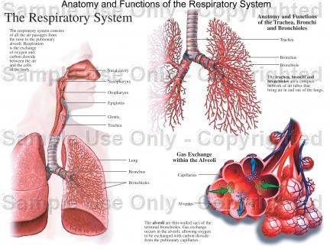
Respiratory Physiology
Dr. Aida Korish
Associate Prof. Physiology KSU
Dr.Aida Korish ( akorish@ksu.edu.sa)

Slide 2
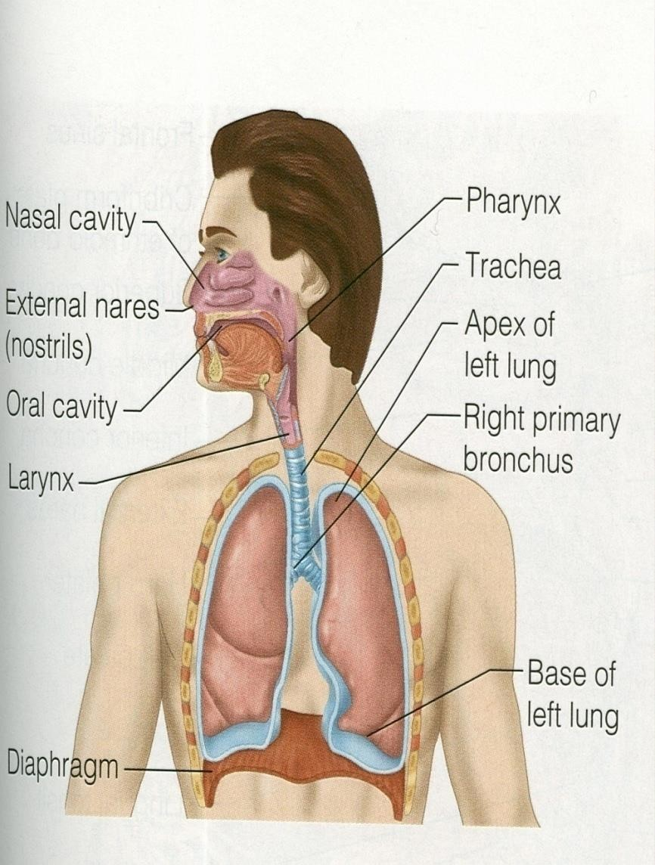
The main goal of respiration is to
Provide oxygen to tissues
Remove CO2
Respiratory system consists of:
passages (airways)
muscles
centers
Dr.Aida Korish ( akorish@ksu.edu.sa)

Slide 3
Functions and organization of
the respiratory system
Dr.Aida Korish ( akorish@ksu.edu.sa)

Slide 4
Learning Objectives
By the end of this lecture you will be able to:-
1-Describe
the structures and functions
of the
conductive and respiratory zones of airways.
2-Distinguish the difference between
internal and
external respiration.
3-Discuss the functions of the respiratory
system,
including non-respiratory functions, like clearance mechanism by mucus and cilia, production of surfactant and its physiological significance.
Dr.Aida Korish ( akorish@ksu.edu.sa)

Slide 5
Functions of the respiratory system include
Gas exchange (respiratory function).
Phonation: is the production of sounds by the
movement of air through the vocal cords.
Pulmonary defense:
Immunoglobulin A (Ig A),
Alpha-1 antitrypsin,
The pulmonary macrophages in the alveoli: engulf smaller particles which pass through the muco- cilliary barrier filter.

Slide 6
Cont..non respiratory functions of lung
Angiotensin I is converted to angiotensin II with the help of angiotensin converting enzyme formed by the lungs.
Regulating the acid- base status of the body by washing out extra carbon dioxide from the blood.
Secretion of important substances like surfactant.

Slide 7
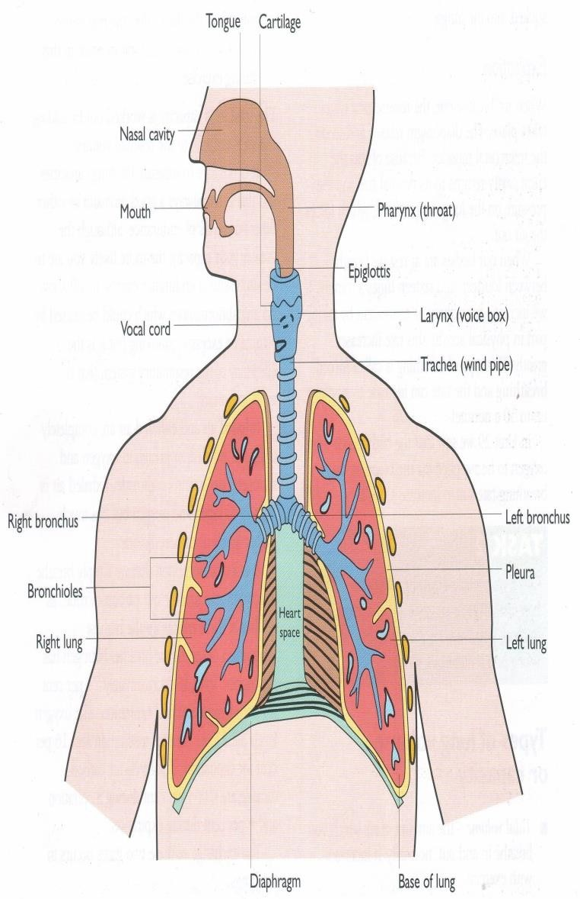
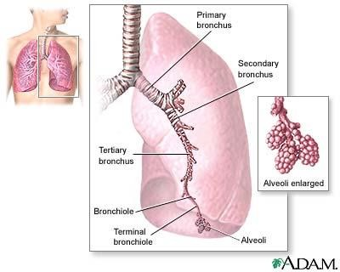
Respiratory passages (airways)

Slide 8
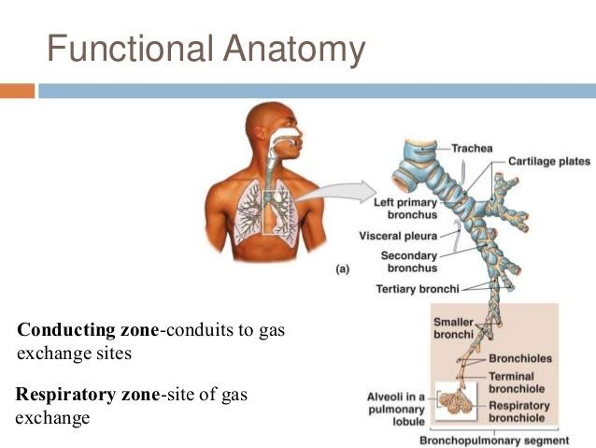
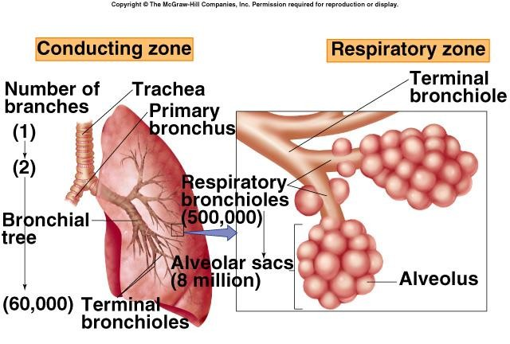
Respiratory passages airways can be divided into

Slide 10
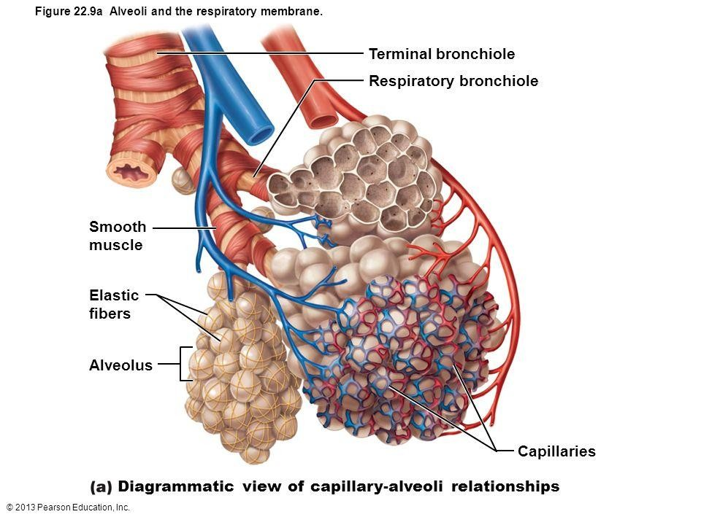
II- Respiratory Zone
(Respiratory unit)
I- Conductive Zone
•Starts from nose to the end of •
terminal bronchioles.
•Help warming, humidification, filtration of inspired air.
Includes:
Respiratory bronchioles, alveolar ducts, alveolar sacs, alveoli
Function in gas exchange.
▪Contains
the olfactory
receptors for smell sensation.
Conducts the sound during speech.
Protective function by cough
and sneezing reflexes.

Slide 11
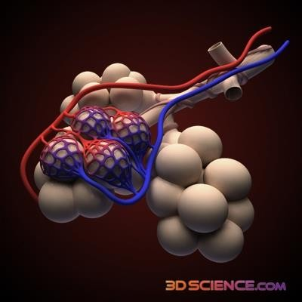
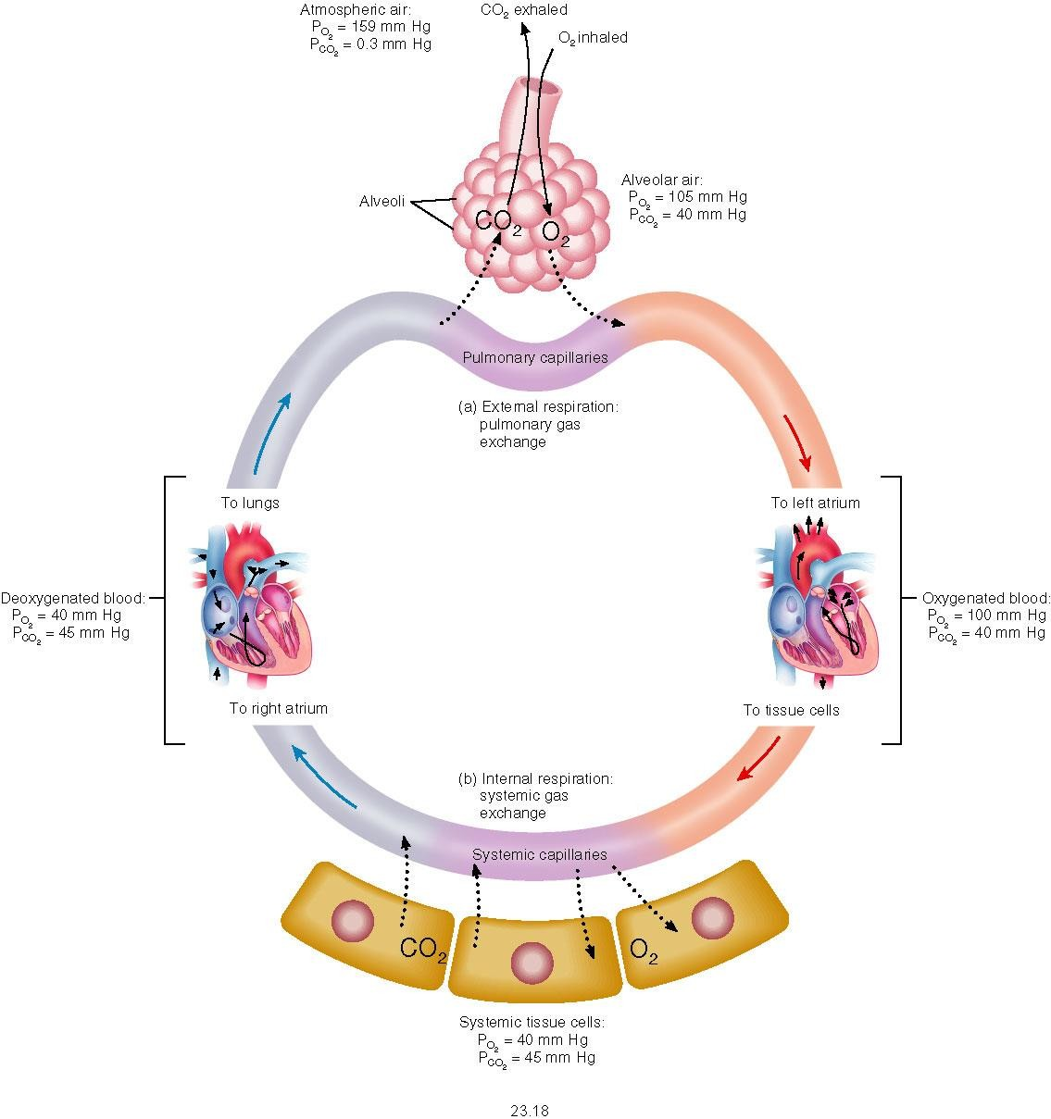
External & Internal Respiration

Slide 12
External respiration
3 major functional events occurs during it:
Pulmonary ventilation: inward and outward movement
of air between lung and atmosphere.
Diffusion of oxygen and CO2 between the alveoli and
the pulmonary capillary blood
Transport of O2 & Co2 in the blood and body fluids to and from the cells
Respiration could be either:
Resting: normal breathing during resting conditions.
Forced (maximal): during exercise, in patients with
asthma, allergy,…

Slide 13
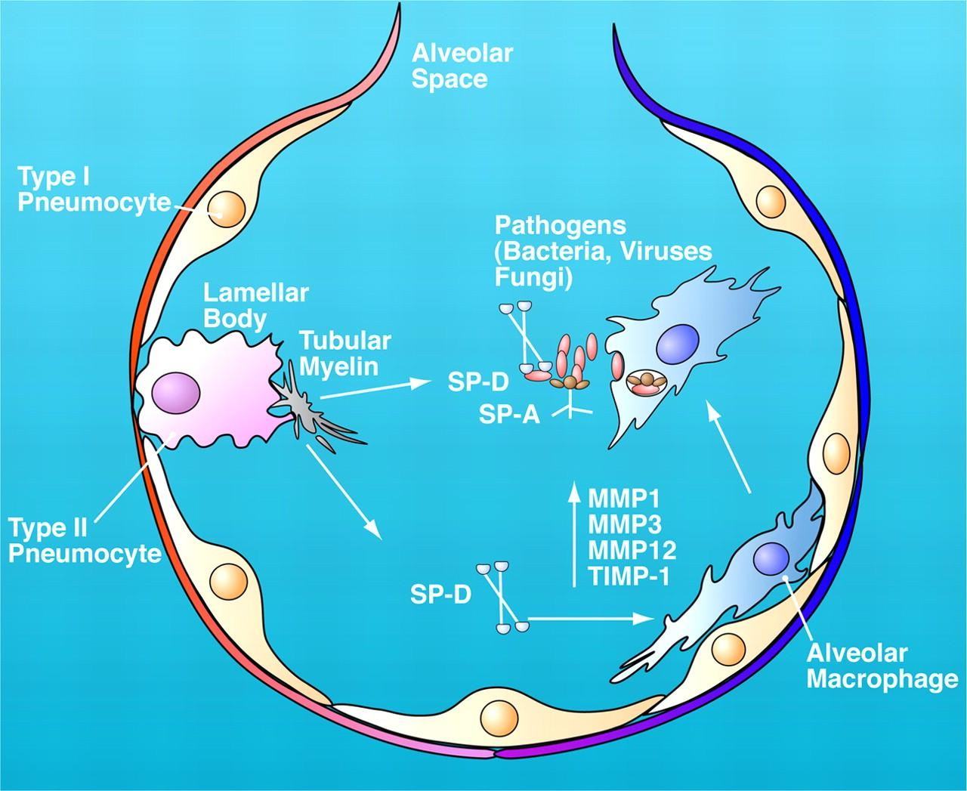
Lining cells of the alveoli
Type I alveolar cells ( type I pneumocytes)
Participate in the respiratory membrane.
Type II alveolar cells ( type II pneumocytes) (Secrete surfactant)
Alveolar macrophages Engulf the foreign bodies that reach the alveoli.

Slide 14
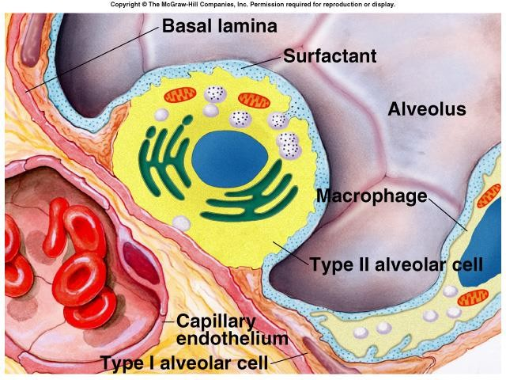
Surface Tension
H₂O molecules at the surface are attracted to each other by attractive forces that resist distension called surface tension.
Surface tension tends to oppose alveoli expansion.
Pulmonary surfactant reduces surface tension.

Slide 15
Surfactant
Surfactant is a complex substance containing phospholipids and a number of apoproteins.
Secreted by the Type II alveolar cells. The earliest detection from fetal alveoli begins between 6-7th month but this could be delayed in others to wk 35 of intrauterine life.
Surfactant reduces surface tension throughout the lung, prevents alveolar collapse, decreases airway resistance and the decreases work of breathing.

Slide 16
Cont…surfactant
Deficiency in premature babies causes respiratory distress syndrome of the new born (RDS) (hyaline membrane disease).
Smoking in adults, hypoxia or hypoxemia (low oxygen in the arterial blood) or both, decrease the secretion of surfactant and cause adult respiratory distress syndrome.

Slide 17

Innervations of lungs and bronchi
Is by autonomic nerves.
Sympathetic stimulation causes dilatation of the
bronchi
Parasympathetic stimulation causes constriction of
the bronchi.
Locally secreted factors :histamine, slow reacting substances of anaphylaxis (SRSA) by mast cells, due to allergy (as in patients with asthma) often cause bronchiolar constriction and increased airway resistance.

Slide 18
Mechanics of pulmonary
ventilation

Slide 19
Learning Objectives
By the end of this lecture you will be able to:
1- List the muscles of respiration and describe their roles during
inspiration and expiration.
2- Identify the importance of the following pressures in
and
respiration: atmospheric, intralveolar, intrapleural,
transpulmonary.
Explain why intrapleural pressure is always subatmospheric under normal conditions, and the significance of the thin layer of the intrapleural fluid surrounding the lung.
Define lung compliance and list the determinants of
compliance.

Slide 20
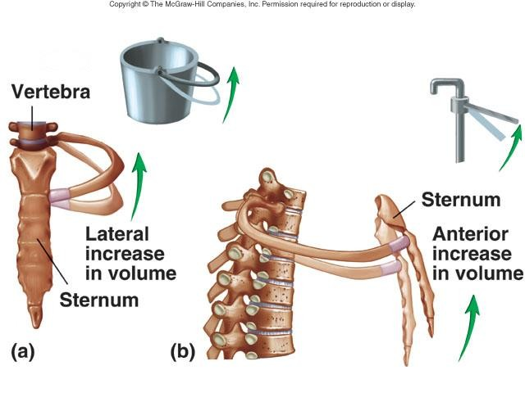

Slide 21
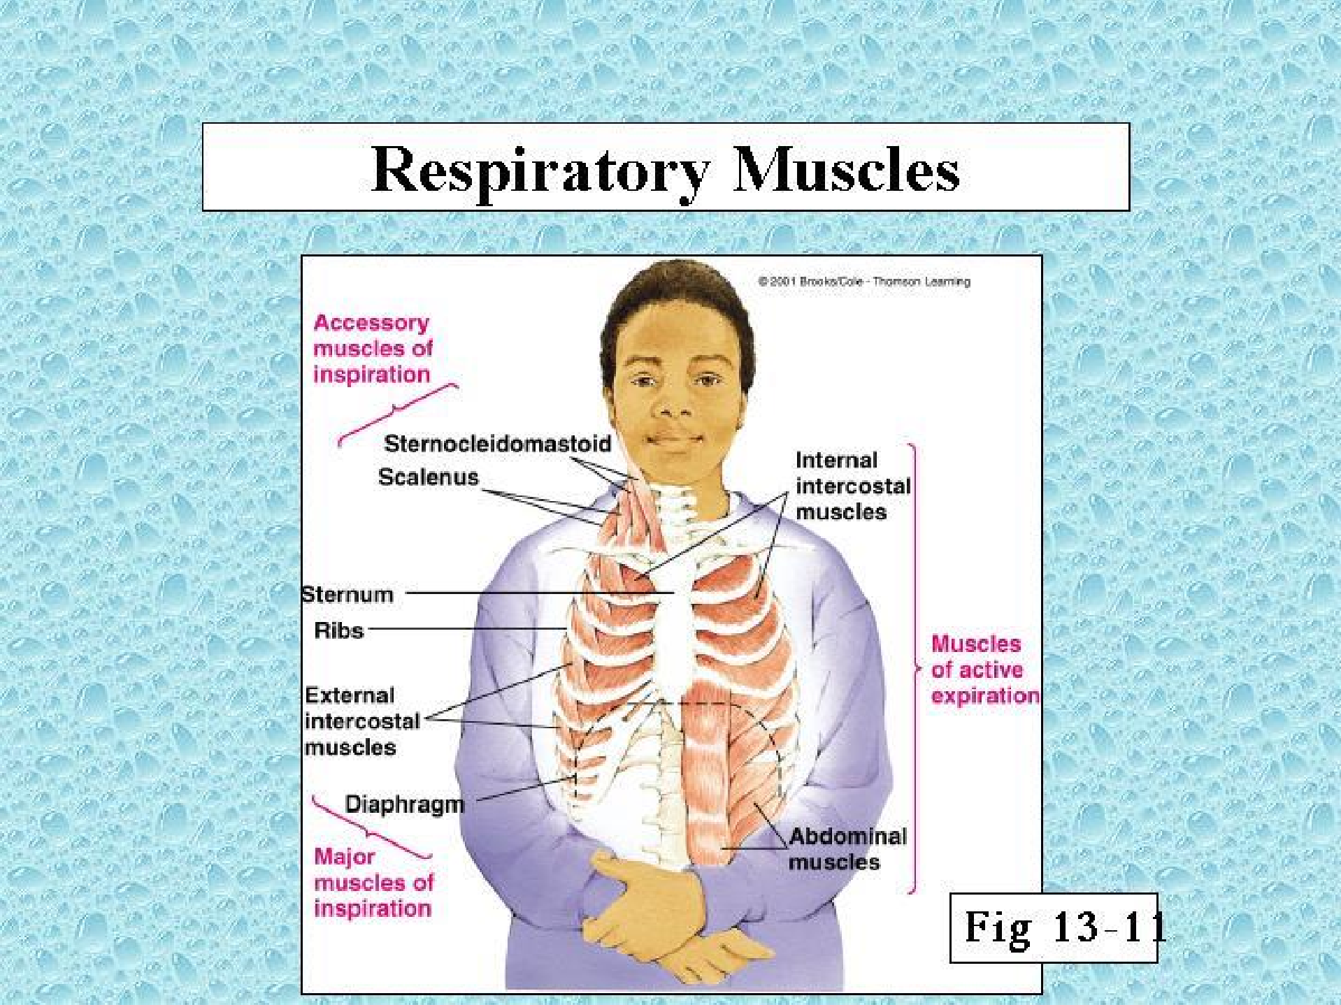
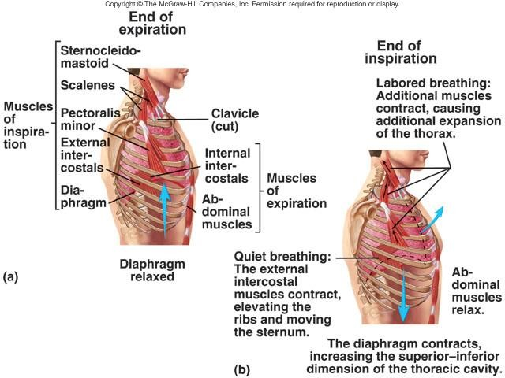
Respiratory muscles

Slide 22
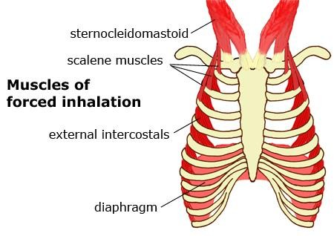
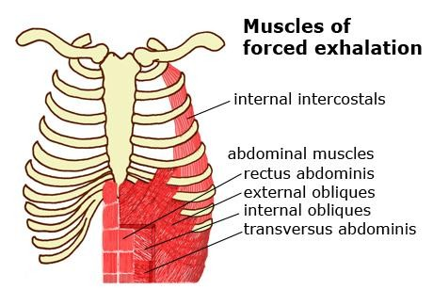
Cont…respiratory muscles
Inspiratory muscles
- During resting inspiration are the diaphragm, external intercostals.
- Accessory muscles of inspiration: the
sternomastoid, anterior serratus
,scalene muscles contract during forced inspiration in addition to ms. of resting inspiration).
Expiratory muscles:(work only during forced expiration)
1-Abdominal muscles . 2-internal intercostals.
N.B: Resting expiration is a passive process that depends on the recoil tendency of the lung.

Slide 23
Deep Forceful Breathing
Deep Inspiration
  During deep forceful inhalation accessory muscles of
inspiration participate to increase size of the thoracic cavity
    Sternocleidomastoid – elevate sternum
    Scalene – elevate first two ribs
    Pectoralis minor – elevate 3rd–5th ribs
Deep Expiration
  Expiration during forceful breathing is active process.
  Muscles of exhalation increase pressure in abdomen and thorax
    Abdominal muscles.
    Internal intercostals.
Dr.Aida Korish ( akorish@ksu.edu.sa)

Slide 24
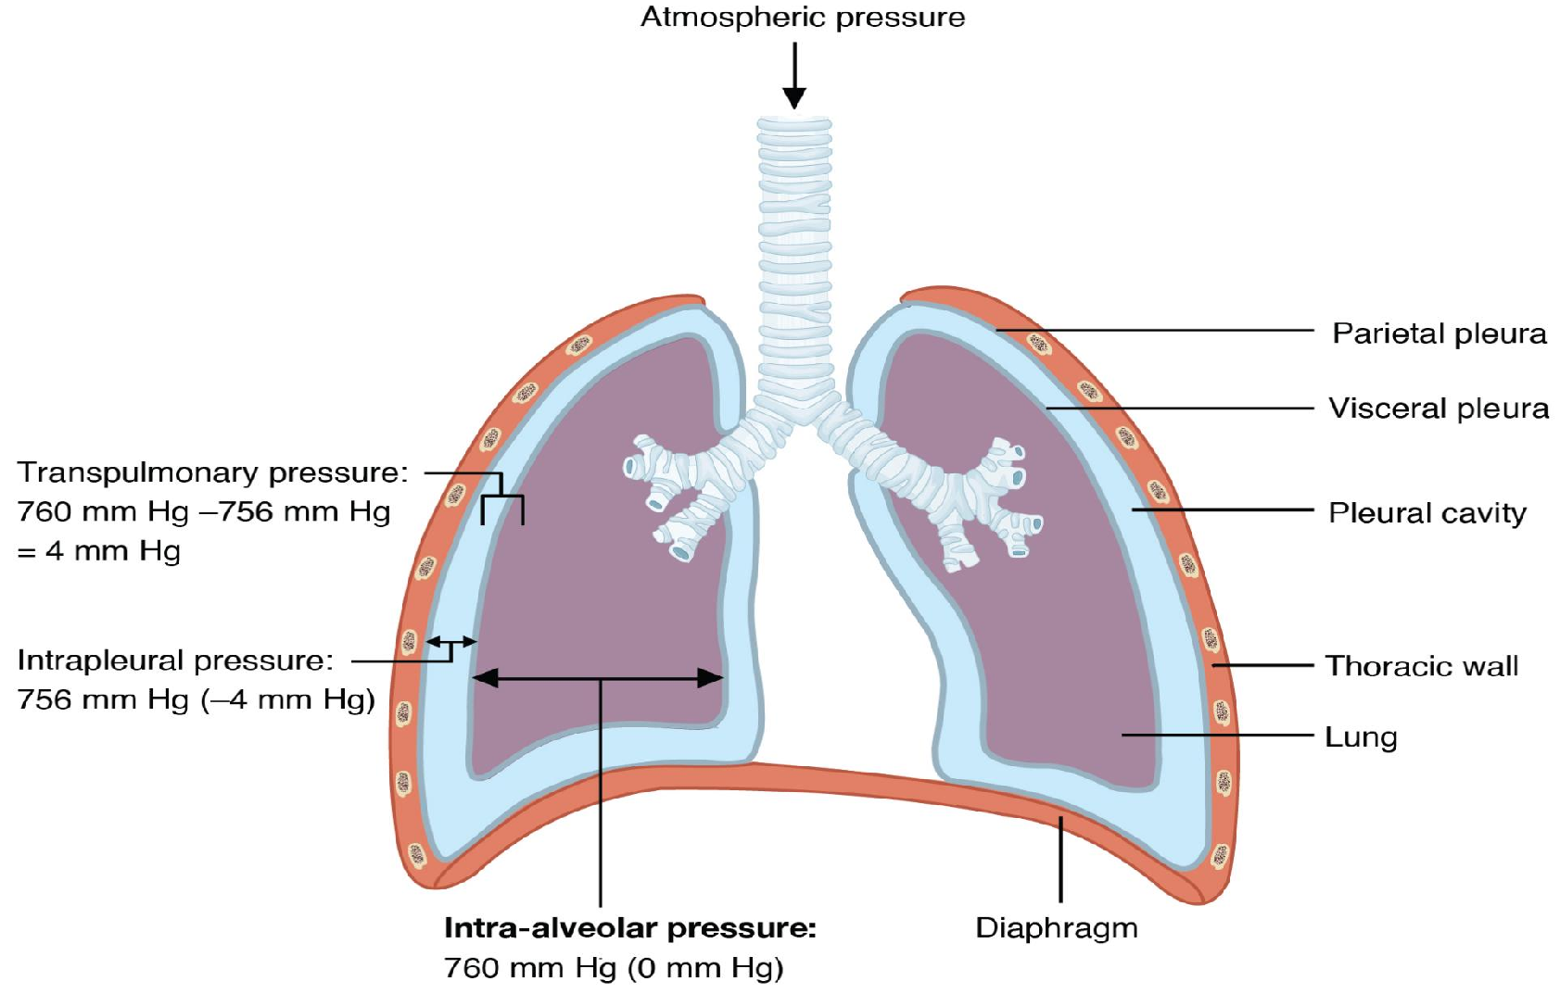
Pressures in the lungs

Slide 25
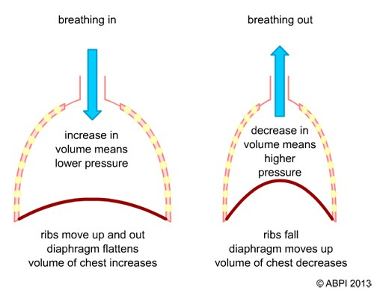
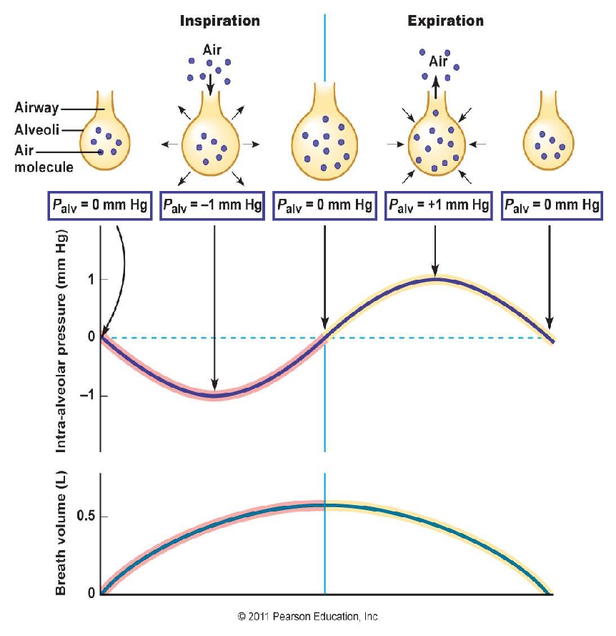
Intra-alveolar pressure
Air will flow from a region of high pressure to one of low
pressure-- the bigger the difference, the faster the flow

Slide 26
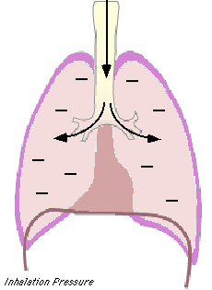
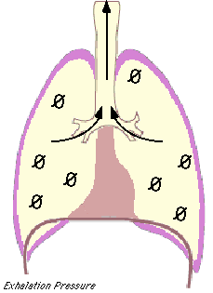
Pressure changes in the lungs during breathing
1-Intra-alveolar (intrapulmonary
pressure
Between breathes = zero pressure
During inspiration = (-1 mmHg) and air (tidal volume) flows from outside to inside the lungs).
At the end of inspiration = zero and
air flow stops.
During expiration = (+1 mmHg) and
air flows out of the Lungs
Dr.Aida Korish ( akorish@ksu.edu.sa)

Slide 27
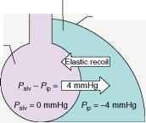
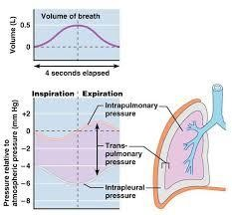
Intrapleural pressure

Slide 28
2-Intrapleural pressure (IPP):
Pressure in the pleural space
is negative with respect to atmospheric pressure at the
end of normal expiration( -5cmH2O).
Why negative??:
  The lung's elastic tissue causes it to recoil, while that of the chest wall causes it to expand. Because of these 2 opposing forces the pressure in the pleural cavity becomes negative.
  The pleural space is a potential space, empty due to
continuous suction of fluids by lymphatic vessels.
Dr.Aida Korish ( akorish@ksu.edu.sa)

Slide 29
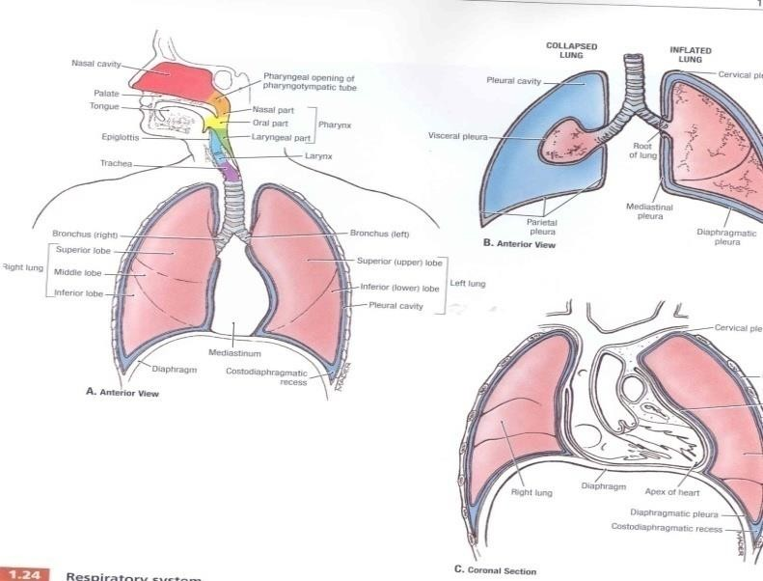
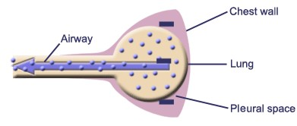
Values of IPP
(-5) cm H2O during resting position between breathes, and it becomes more –ve (-7.5) cm H2O during resting inspiration.
Forced ventilation
Insp. :-20 to - 40 cm H2O
Exp. : + 30 cm H2O
Dr.Aida Korish ( akorish@ksu.edu.sa)

Slide 30
3-Transpulmonary pressure (TPp) (Extending Pressure)
The difference between the alveolar pressure (Palv)
and the pleural pressure(Ppl).
TPp = Palv-Ppl
It is a measure of the elastic forces in the lungs that
tend to collapse the lungs (the recoil pressure).
  It prevents lung collapse.
The bigger the volume of the lung the higher will be its
tendency to recoil.
Dr.Aida Korish ( akorish@ksu.edu.sa)

Slide 31
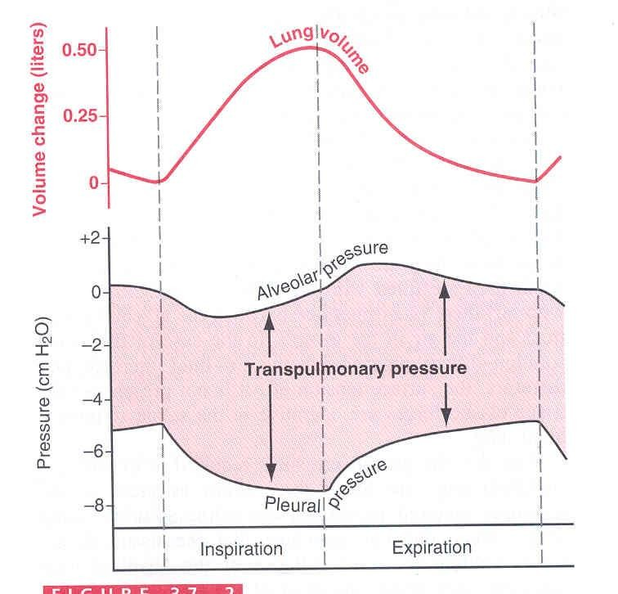
(Compliance of the lung) in a single respiratory cycle
Dr.Aida Korish ( akorish@ksu.edu.sa)

Slide 32
Is defined as, the ratio of the change in the lung volume produced per unit change in the distending pressure.
The extent to which the lungs expand for each unit increase in the transpulmonary pressure.
CL= Volume change (∆ V) Transpulmonary pressure change (∆ P)
• CL = (∆ V)
(∆ P)
Dr.Aida Korish ( akorish@ksu.edu.sa)

Slide 33
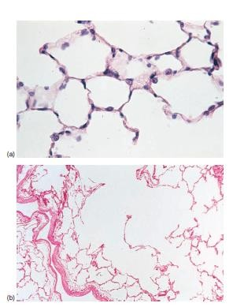
Cont…compliance of lung
For both lungs in adult = 200 ml of air /cm H20.
For lungs and thorax together = 110 ml/cm H20.
Is reduced in pulmonary fibrosis , pulmonary edema, diseases of the chest wall ( kyphosis, scoliosis)
Emphysema increases the compliance of the lungs because it destroys the alveolar septal tissue rich with elastic fibers that normally opposes lung expansion.
Dr.Aida Korish ( akorish@ksu.edu.sa)

