Slide 1
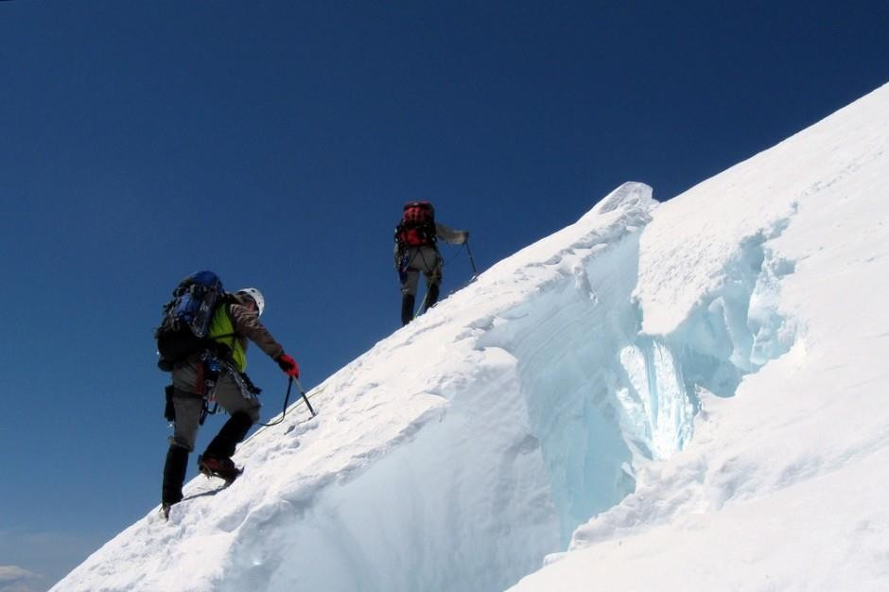
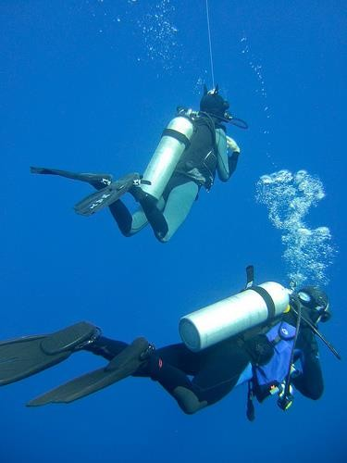
Effects of low and high gas pressure on the
body
Dr.Aida Korish Assoc.Prof.Physiology KSU
iaidakorish@yahoo.com

Slide 2
Objectives
By the end of this lecture you should be able to:
Describe the effects of exposure to low and high barometric pressures on the body.
Describe the body acclimatization to low barometric
pressure.
Define decompression sickness and explain how it can
be avoided.
Understand the effects of high nitrogen pressure, and nitrogen narcosis.

Slide 3
Effect of increased barometric pressure
(Deep sea diving)
When human descend below the sea, the pressure around them increased.
To prevent the lungs from collapse , air must be supplied also under high pressure.
This exposes the blood in the lungs to extremely high alveolar gas pressure (hyperbarism).
Under certain
limits
these
high
pressures cause tremendous alterations in the physiology of the body.

Slide 4
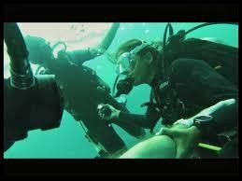
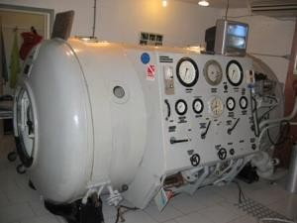
Cont..
The surrounding pressure increases by 1 atmosphere for every 10 meter (33 feet) of depth in sea water.
Therefore at a depth of 31 meter (100 feet) in the ocean the diver is exposed to a pressure of 4 atmospheres.
These SCUBA
under
problems (self water
confront contained breathing
apparatus.

Slide 5
Effect of depth on the volume of the gases:
is compression of gases to smaller and smaller volumes.
1L (sea level )→1/2 L at 33 feet and so on
Effect of depth on density of gases
increase in density of gas and hence increased work of
breathing.
Nitrogen effect at high nitrogen pressure
has 2 principle effects:
* Nitrogen narcosis (anesthetic effect)
* Decompression thickness.

Slide 6
Nitrogen narcosis
Nitrogen like most other anesthetic gases, dissolve freely in the fats of the body including the membranes and other lipid structures of the neurons.
This leads to alteration of the electrical conductance of the membranes, reduces their excitability and subsequent narcosis develops.
At 120 feet: the diver loses many of his
cares.
At 150 feet: there is a feeling of euphoria
and drowsiness and impaired performance.
At higher pressure: loss of coordination and finally coma might develop.

Slide 7
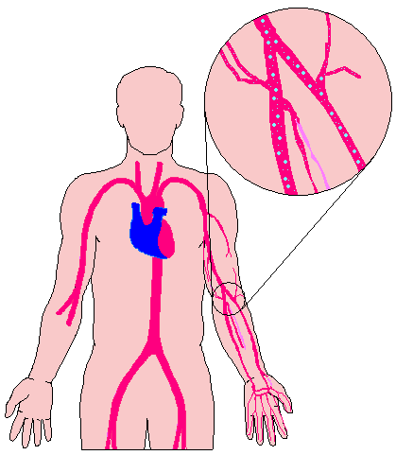
Decompression sickness (Cassion’s disease)
It is a syndrome caused by a decrease in the ambient pressure which occur in animal and men when the tissues of the body contain an excess of physically inert gas.
During descent, the high partial pressure of nitrogen (encountered when breathing compressed air at depth) forces this gas into solution in body tissue particularly in fat (it has a high N2 solubility).
On ascending, this inert gas comes out of physical solution forming a gaseous phase (bubbles), leading to symptoms and signs.

Slide 8
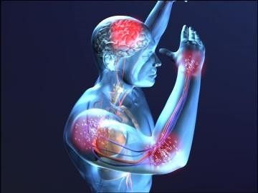
Cont.. Decompression sickness
During slow ascent N2 is slowly removed from the tissues since the partial pressure there is higher than that in the arterial blood and alveolar gas.
If decompression is rapid
bubbles of gaseous nitrogen are
released, in tissues and blood, causing the
symptoms of sickness (the
decompression
bends or caisson disease).

Slide 9
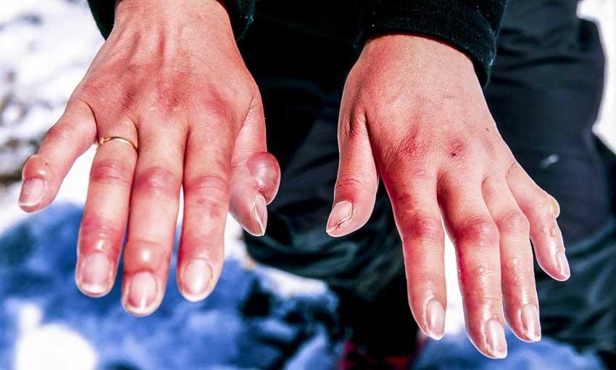
Symptoms & signs of decompression sickness (DS)
The mildest form of DS is fatigue or drowsiness after decompression.
Locally there is skin itch other sever symptoms may occur e.g.:
bubbles in the tissues cause sever pains particularly around the joints.
Neurological symptoms include paresthesia, itching, paralysis, and inner ear disturbances.

Slide 10
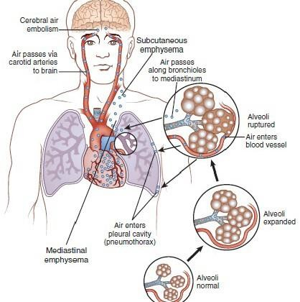
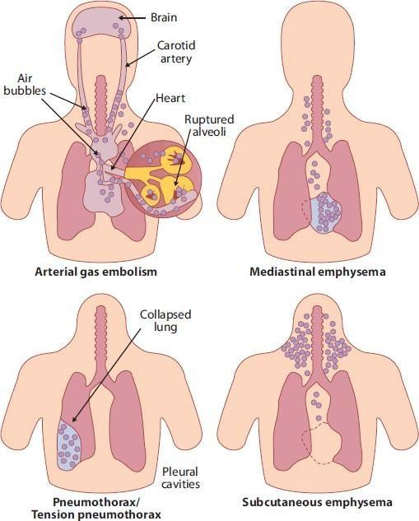
Cont.. DS
Thoracic substernal and cough.
pains:
pain,
dyspnea,
cyanosis,
Bubbles in the
coronary
cause
arteries may
myocardial damage. Decompression
sickness
shock, capillaries become permeable to plasma and hypovolemia rapidly develop.
Edema may be prominent and shock is also usually complicated by pulmonary edema.

Slide 11
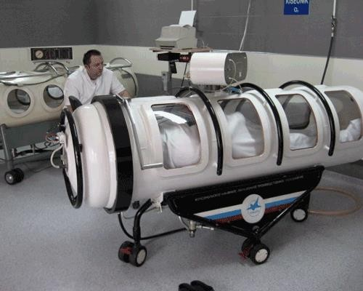
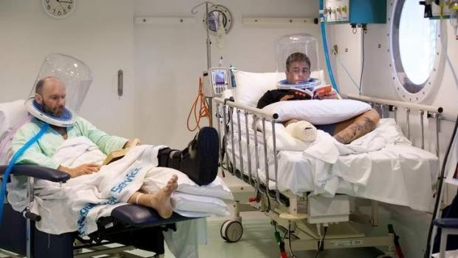
Treatment of decompression symptoms
Rapid recompression in a pressure chamber followed by slower decompression.
This reduces the volume of the bubbles and forces them back into solution.
In a very deep dives, the risk of decompression sickness can be reduced if a helium- O2 mixture is breathed during the dive..

Slide 12
Cont.. Treatment of DS
Helium is more desirable than nitrogen in deep dives because it has:
¼-1/5 the narcotic effect of nitrogen on CNS.
1/7 the molecular weight of nitrogen.
low
density leading to decreased air way
resistance of diver.
High diffusion through tissues.
Helium is about 1/2 as soluble as nitrogen in body fluids. This reduces the quantity of bubbles that can form in tissues when the diver is decompressed after diving

Slide 13
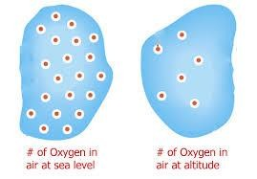
Effects of low oxygen pressure on the body
( Aviation-ascend to high altitude)
At the sea level the barometric pressure is 760 mmHg.
At 10,000 feet is 523 mmHg
At 50,000 feet 87 mmHg.
This decrease in barometric pressure is the basic cause of all the hypoxia problems in high altitude in physiology.

Slide 14
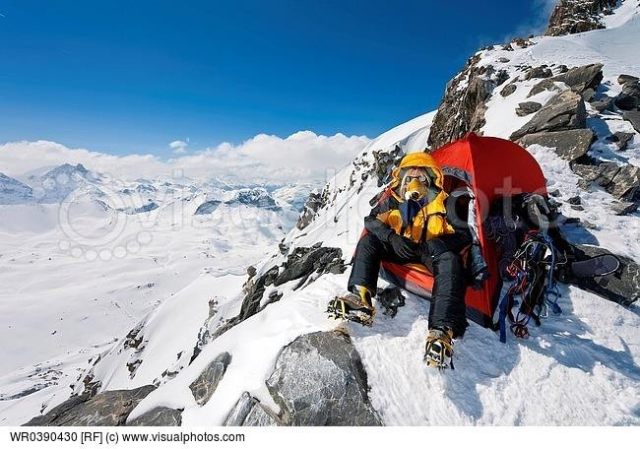

Slide 15
Alveolar PO2 at different altitudes
As the barometric pressure decreases, the oxygen partial pressure decreases proportionally, remaining less than 21 % of the total barometric pressure.
At sea level PO2= 159 mmHg.
At 20,000 feet PO2= 40 mmHg.
At 50,000 feet PO2= only 18 mmHg.

Slide 16
Cont…
Even
at high altitude CO2 is
continuously
excreted from the pulmonary blood into the alveoli. Also, water vaporizes into the inspired air from the respiratory surfaces.
Therefore, these two gases dilute the oxygen in the alveoli, thus reducing the oxygen concentration and therefore hypoxia develops.

Slide 17
Effects of acute hypoxia
Some of the important acute effects of hypoxia beginning at an altitude of approximately 12,000 feet, are:
Drowsiness, lassitude, mental and muscle fatigue, sometimes headache, occasionally nausea and sometimes euphoria.
All these progress to a stage of twitching or convulsions above 18,000.
Above 23,000 feet the un acclimatized person can enter into coma.

Slide 18
Acclimatization to low PO2
A person remaining at high altitudes for days , weeks or years becomes more and more acclimatized to low PO2.
So that it causes fewer deleterious effects on the body and it becomes possible for the person to work harder without hypoxic effects or to ascend to still higher altitude.

Slide 19
Principle means of acclimatization
Increase in pulmonary ventilation.
Increased red blood cells.
Increased diffusing capacity of the lungs.
Increased vascularity of the tissues.
Increased ability of the cells to utilize oxygen
despite the low PO2.

Slide 20
