Slide 1
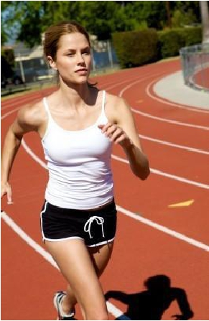
Effects of exercise on the respiratory
system.
Dr. Aida Korish
Assoc. Prof Physiology
KSU
Dr.Aida Korish ( iaidakorish@yahoo.com)
1

Slide 2
Dr.Aida Korish ( iaidakorish@yahoo.com)
2

Slide 3
Objectives
By the end of this lecture the students should be able to: -
1-Describe the effects of moderate and severe
exercise
on
oxygen
consumption,
and
ventilation volumes.
2- Interpret the effects of exercise on arterial PO2,
PCO2 and H+ions.
3-Define the diffusing capacity of the respiratory
membrane, and its typical values at rest, and
explain its changes in exercise.
4-Explain causes of hyperventilation in exercise.
Dr.Aida Korish ( iaidakorish@yahoo.com)
3

Slide 4
Dr.Aida Korish ( iaidakorish@yahoo.com)
4

Slide 5
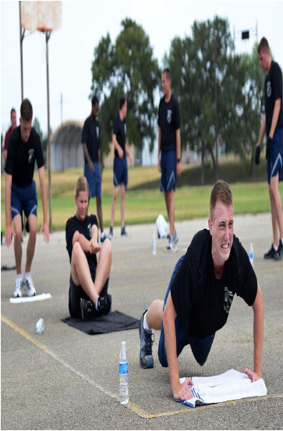
Effect of Exercise on the respiratory system
• The blood gases do not always
have to become abnormal for
respiration to be stimulated in
exercise.
• Instead, respiration is
stimulated mainly by
neurogenic mechanisms
during exercise.
Dr.Aida Korish ( iaidakorish@yahoo.com)
5

Slide 6
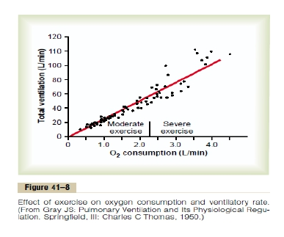
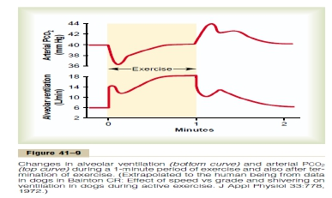
Regulation of respiration during exercise.
In strenuous exercise O2
consumption and CO2
formation may increase 20
folds but alveolar ventilation
increases almost exactly in
step with the increased
levels of metabolism.
Therefore the arterial PO2,
PCO2, PH all remain almost
exactly normal.
Dr.Aida Korish ( iaidakorish@yahoo.com)
6

Slide 7
What causes intense ventilation during
exercise?
• The brain, on transmitting motor impulses to the exercising
muscles, transmits at the same time collateral impulses into
the brain stem to excite the respiratory center.
• A large share of the total increase in ventilation begins
immediately on initiation of the exercise, before any blood
chemicals have had time to change.
• It is likely that most of the increase in respiration results from
neurogenic signals transmitted directly into the brain stem
respiratory center at the same time that signals go to the
body muscles to cause muscle contraction.
Dr.Aida Korish ( iaidakorish@yahoo.com)
7

Slide 8
Dr.Aida Korish ( iaidakorish@yahoo.com)
8

Slide 9
What cause intense ventilation during exercise?
• Neural signals from the motor areas of the
brain to the respiratory center.
• The joint proprioceptors
• Body temperature (hypothalamus).
• Possibility that the neurogenic factor for
control of ventilation during exercise is a
learned response.
Dr.Aida Korish ( iaidakorish@yahoo.com)
9

Slide 10
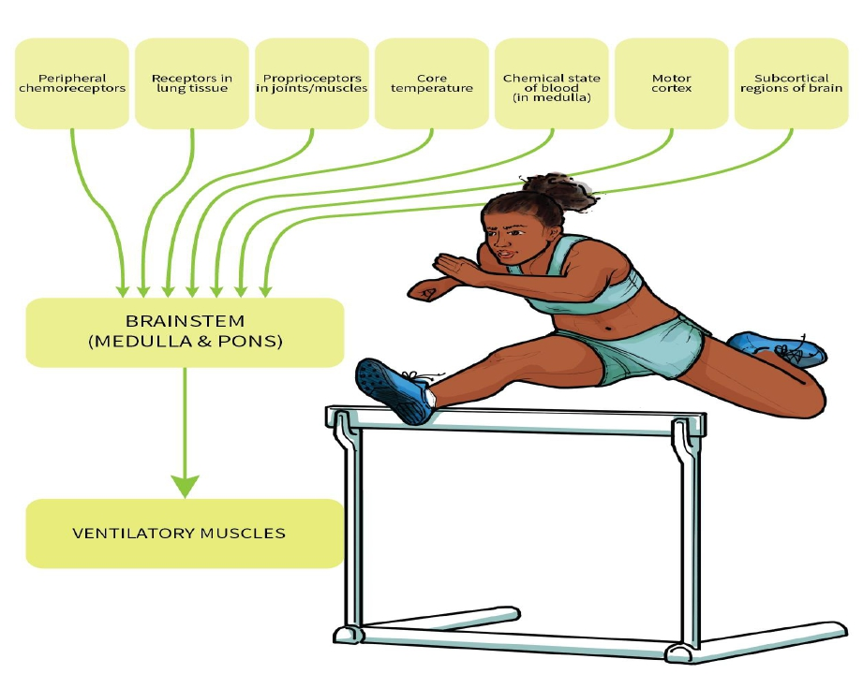
Dr.Aida Korish ( iaidakorish@yahoo.com)
10

Slide 11
Interrelation Between Chemical Factors and Nervous Factors
in the Control of Respiration During Exercise.
• Direct nervons signal stimulate the respiratory center almost
the proper amount to supply the extra oxygen required for
exercise and to blow off extra carbon dioxide.
•
Occasionally, the nervous respiratory control signals are
either too strong or too weak.
• Then chemical factors play a significant role in bringing about
the final adjustment of respiration required to keep the O2,
Co2, and H+ ion concentrations of the body fluids as nearly
normal as possible.
Dr.Aida Korish ( iaidakorish@yahoo.com)
11

Slide 12
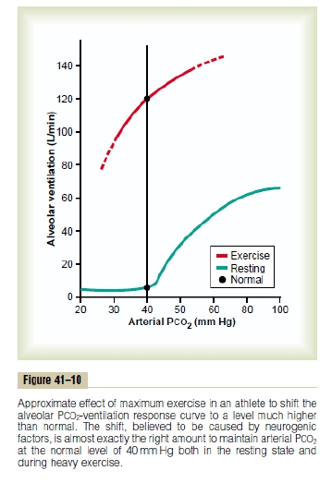
The Neurogenic Factor for Control of Ventilation
During Exercise Is a Learned Response.
▪ The ventilatory response during
exercise, is at least partly a learned
response.
▪ That is, with repeated periods of
exercise, the brain becomes
progressively more able to provide
the proper signals required to keep
the blood PCO2 at its normal level.
▪ The cerebral cortex is involved in
this learning, because experiments
that block only the cortex also
block the learned response.
Dr.Aida Korish ( iaidakorish@yahoo.com)
12

Slide 13
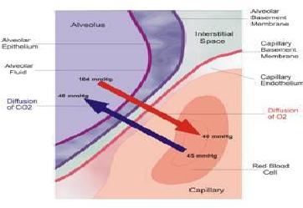
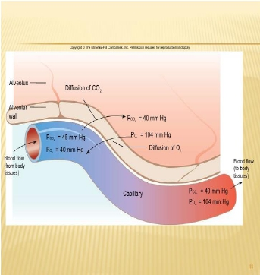
Diffusion capacity of the respiratory membrane
➢ Is the volume of gas that diffuses
through the membrane each minute
for a pressure difference of 1mmHg.
➢ Diffusing capacity for oxygen at rest
21ml/min/mmHg
➢ Even if the oxygen pressure difference
across the respiratory membrane is
11mmHg----------11x21= 230ml oxygen
diffusing through the membrane each
minute.
➢ During rest tissues consume 250 ml O2
/min
Dr.Aida Korish ( iaidakorish@yahoo.com)
13

Slide 14
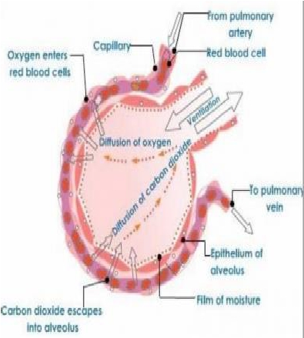
Changes in the oxygen- diffusing capacity during
exercise
• 65ml/min/mmHg
• This is due to increased
number of open pulmonary
capillaries which was
dormant, thereby increasing
the surface area for gas
exchange.
• In addition to increased
alveolar ventilation.
Dr.Aida Korish ( iaidakorish@yahoo.com)
14

Slide 15
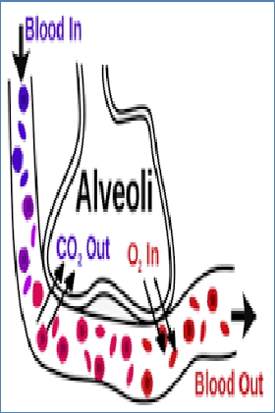
Diffusing capacity for carbon dioxide
• It diffuses 20 times greater than
oxygen due to greater diffusion
coefficient which is 20 times that
for oxygen.
• Diffusion capacity for carbon
dioxide 400ml/min/mmHg.
• During exercise 1200 to
1300ml/min/mmHg.
Dr.Aida Korish ( iaidakorish@yahoo.com)
15

Slide 16
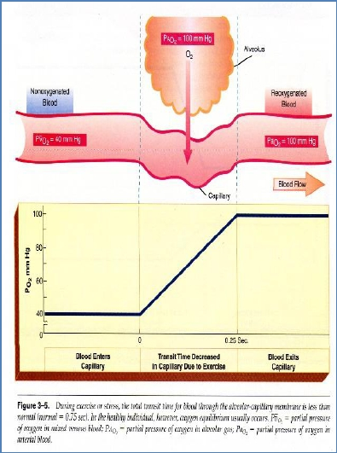
• During exercise the oxygen
requirement increased 20
times, and cardiac output
increased and so the time
blood remained in the
pulmonary capillaries
becomes less than half normal
despite the fact that additional
capillaries open up.
• But the blood is almost
completely
saturated
with
oxygen when it leaves the
pulmonary capillaries.
Dr.Aida Korish ( iaidakorish@yahoo.com)
16

Slide 17
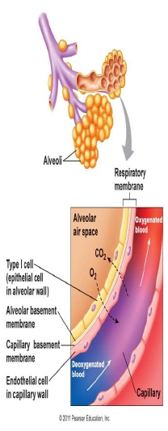
Reasons for this are as follow:
1- The diffusing capacity for oxygen increases
almost three fold during exercise, this
results mainly from increasing numbers
of capillaries participating in the
diffusion, and a more even V/Q ratio all
over the lung.
2- At rest the blood normally stays in the lung
capillaries about three times as long as
necessary to cause full oxygenation.
Therefore, even with shortened time of
exposure in exercise, the blood is still
fully oxygenated or nearly so.
Dr.Aida Korish ( iaidakorish@yahoo.com)
17

Slide 18
Oxygen Consumption and Pulmonary
Ventilation in Exercise.
Normal oxygen consumption for a young man at
rest is about 250 ml/min.
However, under maximal conditions,
this can be increased to approximately the
following average levels:
·
ml/min
Untrained average male --------------3600
Athletically trained average male ---4000
Male marathon runner----------------- 5100
Dr.Aida Korish ( iaidakorish@yahoo.com)
18

Slide 19
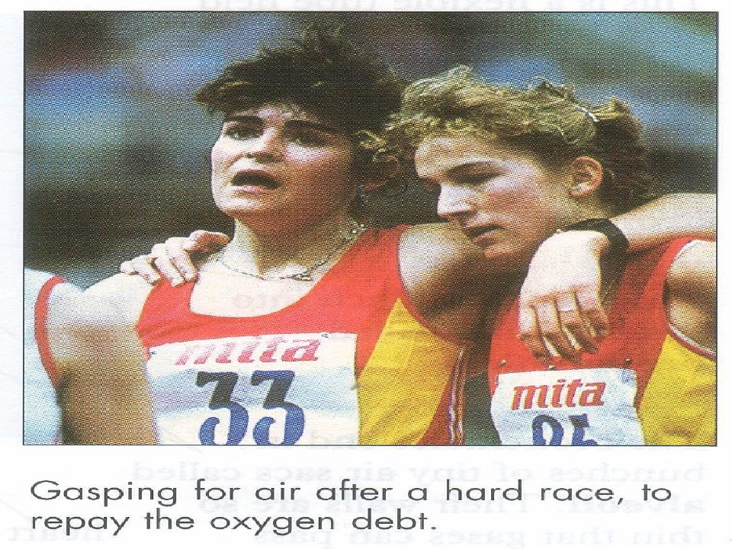
Dr.Aida Korish ( iaidakorish@yahoo.com)
19

Slide 20
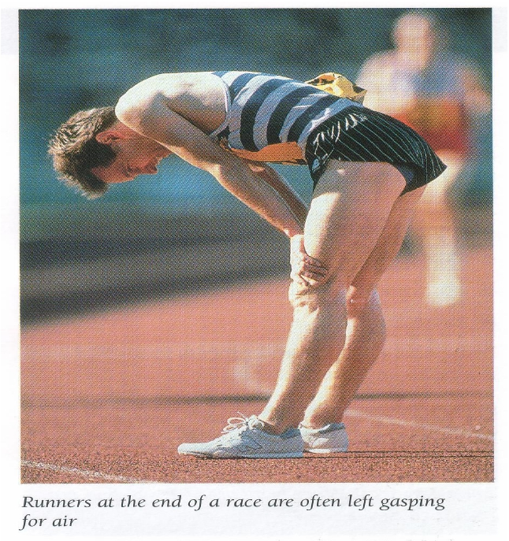
Dr.Aida Korish ( iaidakorish@yahoo.com)
20

