Slide 1
Gas Transfer (Diffusion of O2 and CO2)
Laila Al-Dokhi

Slide 2
objectives:
1-Define partial pressure of a gas.
2- Understand that the pressure exerted by each gas in a mixture of gases is dependent on the pressure exerted by the other gases (Dalton's Law)
3- Understand that gases in a liquid diffuse from higher partial pressure to lower partial pressure (Henry’s Law)
4- Describe the factors that determine the concentration of a gas in a liquid.
5- Describe the components of the alveolar-capillary membrane (i.e., what does a molecule of gas pass through).
6- Knew the various factors determining gas transfer: -
Surface area, thickness, partial pressure difference, and diffusion coefficient of gas
7- State the partial pressures of oxygen and carbon dioxide in the atmosphere, alveolar gas, at the end of the pulmonary capillary, in systemic capillaries, and at the beginning of a pulmonary capillary.

Slide 3
Gas exchange through the respiratory membrane

Slide 4
Partial pressure of gases (in a mixture)
The pressure of gas is caused by the constant kinetic movement of gas molecules against the surface.
In respiratory physiology, there is a mixture of gases mainly of O₂, N₂, and CO₂.
The rate of diffusion of each of these gases is directly proportional with the partial pressure of the gas.
Pressure of gases dissolved in water and tissue:
The pressure of gases dissolved in fluid is similar to their pressure in the gaseous phase and they exert their own individual partial pressure.

Slide 5
2-Dalton's Law of Partial Pressures
It states that the total pressure exerted by a mixture of gases is the sum of partial pressure of each individual gas present.
P_{total} = P₁ + P₂ + P₃ + . .

Slide 6
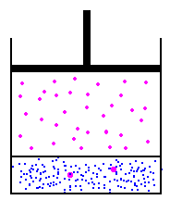
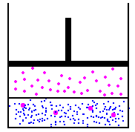
3-Henry's Law
Gas solubility is proportional to the gas partial pressure. If the temperature stays constant increasing the pressure will increase the amount of dissolved gas.
Low pressure equilibrium
Low concentration
Double the pressure equilibrium
Double the concentration

Slide 7
4-Factors that affect the rate of gas diffusion through the respiratory membrane
D α ΔP x A x S
d x √MW
D: diffusion rate
P: Partial pressure differences
A: Surface area for gas exchange
S: Solubility of gas
d: Diffusion distance
MW: Molecular weight

Slide 8
4-Factors that affect the rate of gas diffusion through the respiratory membrane
The diffusion rate of the specific gas:
Diffusion coefficient for the transfer of each gas through the respiratory membrane depends on:
Directly on its solubility (S) through the membrane
Inversely on the square root of its molecular weight (MW).
CO₂ diffuses 20 times as rapidly as O₂.

Slide 9
4-Factors that affect the rate of gas diffusion through the respiratory membrane
P: Partial pressure differences
The pressure difference between the two sides of the membrane (between the alveoli and the blood).
When the pressure of the gas in the alveoli is greater than the pressure of the gas in the blood as for O₂, net diffusion from the alveoli into the blood occurs.
When the pressure of the gas in the blood is greater than the pressure in the alveoli as for CO₂, net diffusion from the blood into the alveoli occurs.

Slide 10
4-Factors that affect the rate of gas diffusion through the respiratory membrane
Surface area of the membrane (A).
Removal of an entire lung decreases the surface area to half normal.
In emphysema with dissolution of the alveolar wall → ↓ S.A. to 5-folds because of loss of the alveolar walls.
The thickness of the respiratory membrane (d:Diffusion distance)
↑ thickness of the respiratory membrane e.g., edema → ↓ rate of diffusion.
The thickness of the respiratory membrane is inversely proportional to the rate of diffusion through the membrane.

Slide 11
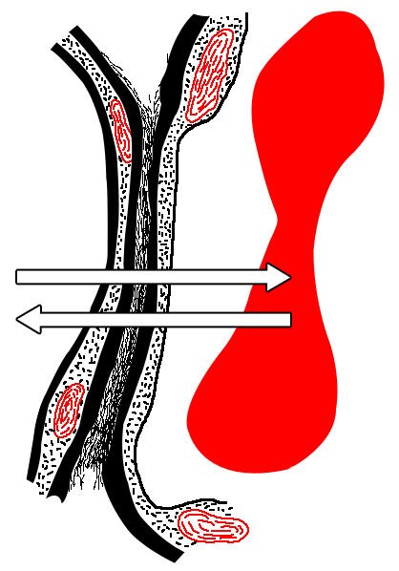
Epithelial basement membrane
Capillary basement membrane
Interstitial space
Capillary endothelium
Alveolar epithelium
Fluid and surfactant layer
Red blood cell
Alveolus
Capillary
Diffusion
O2
Diffusion
CO2

Slide 12
Composition of alveolar air and its relation to atmospheric air:
Alveolar air is partially replaced by atmospheric air with each breath.
O₂ is constantly absorbed from the alveolar air.
CO₂ constantly diffuses from the pulmonary blood into the alveoli.
The dry atmospheric air enters the respiratory passage is humidified before it reaches the alveoli.

Slide 13
Partial pressures of respiratory gases as they enter and leave the lungs (at sea level)
N₂
O₂
CO₂
H₂O
Atmospheric Air*
(mmHg)
Humidified Air
(mmHg)
Alveolar Air
(mmHg)
Expired Air
(mmHg)
597.0 (78.62%)
563.4 (74.09%)
569.0 (74.9%)
566.0 (74.5%)
159.0 (20.84%)
149.3 (19.67%)
104.0 (13.6%)
120.0 (15.7%)
0.3 (0.04%)
0.3 (0.04%)
40.0 (5.3%)
27.0 (3.6%)
3.7 (0.50%)
47.0 (6.20%)
47.0 (6.2%)
47.0 (6.2%)

Slide 14
Partial Pressure of O2 and CO2
Oxygen concentration in the atmosphere is 21%
So PO2 in atmosphere =760mmHg x 21%=160 mmHg.
This mixes with “old” air already present in alveolus to arrive at PO2 of 104 mmHg in alveoli.
Carbon dioxide concentration in the atmosphere is 0.04%
So PCO2 in atmosphere =760 mmHg x 0.04% = 0.3 mm Hg
This mixes with high CO2 levels from residual volume in the alveoli to arrive at PCO2 of 40 mmHg in the alveoli.

Slide 16
PO2 and PCO2 in air, lung and tissues

Slide 17
PO2 and PCO2 in various potions of normal expired air

Slide 18
O2 concentration in the alveoli
At resting condition 250 ml of oxygen enter the pulmonary capillaries/min at ventilatory rate of 4.2 L/min.
During exercise 1000 ml of oxygen is absorbed by the pulmonary capillaries per minute, the rate of alveolar ventilation must increase 4 times to maintain the alveolar PO2 at the normal value of 104 mmHg.

Slide 19
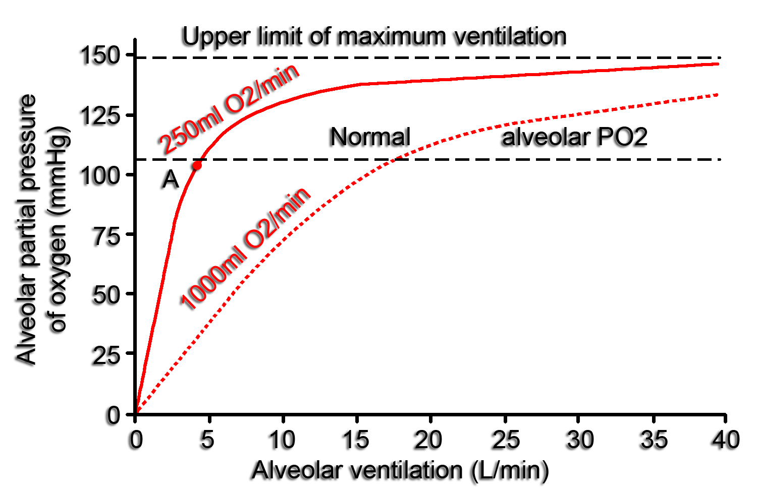

Slide 20
CO2 concentration in the alveoli
The solid curve represents the normal rate of CO₂ excretion of 200ml/min at normal ventilation of 4.2 liters/min,
The operating point for alveolar PCO₂ is at point A at 40mmHg.
Alveolar PCO₂ increases directly in proportion to the rate of CO₂ excretion, as represented by the dotted curve for 800ml CO₂ excretion/min.
Alveolar PCO₂ decreases in inverse proportion to alveolar ventilation

Slide 21
